Slide 1
WiFiMon InfoShare
William Kibirango <wkibirango@renu.ac.ug>
21 March 2024

Slide 2
Monitoring Metro eduroam user experience with WiFiMon
Background
Objectives
Testbed
Observations
Challenges
Next steps
Outline

Slide 3
Background and Objectives
Monitoring user experience
Monitoring access point availability and location
Troubleshoot connectivity issues
Notes:
COVID-19 and working from home (outside campus) -> RENU’s reponse, Metro eduroam
No infrastructure, Service providers owned infra we could use
Monitoring user experience and enabling Service provider SLA
2023/2024, RENUMesh -> own infrastructure

Slide 4
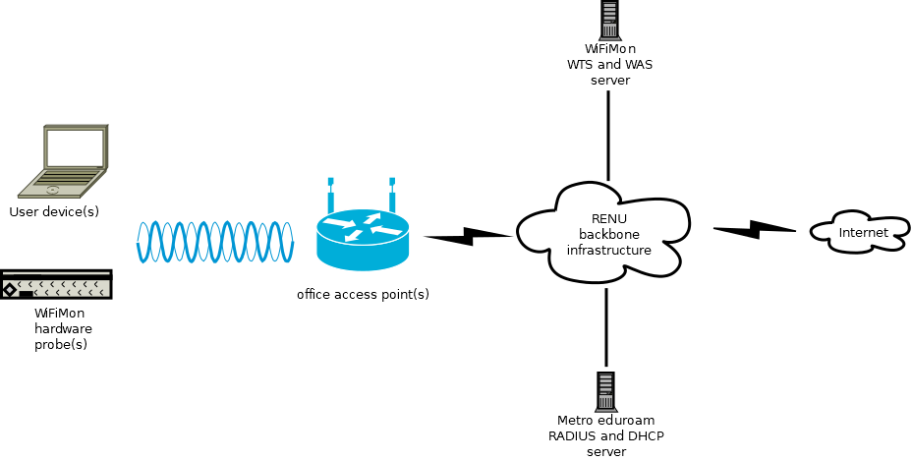
Testbed

Slide 5
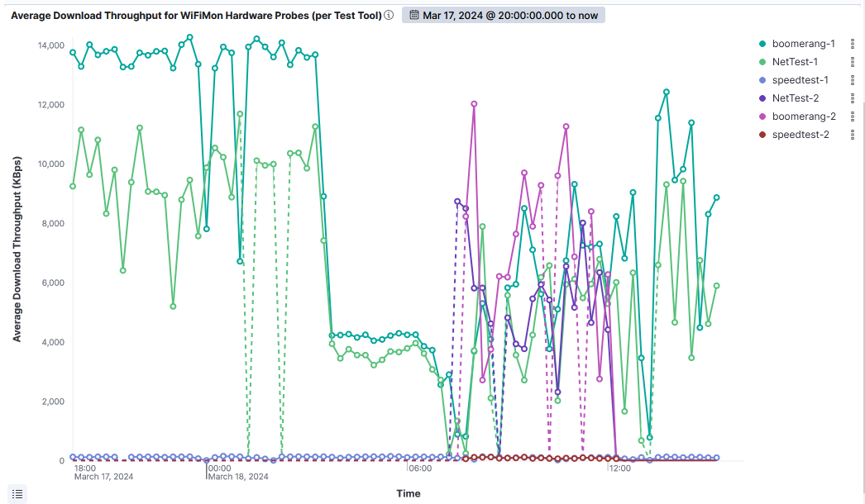
Observations – HW Probes

Slide 6
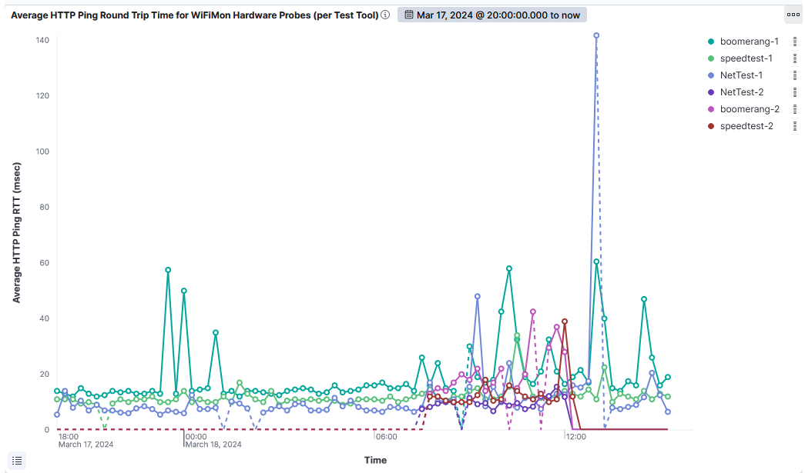
Observations – HW Probes

Slide 7
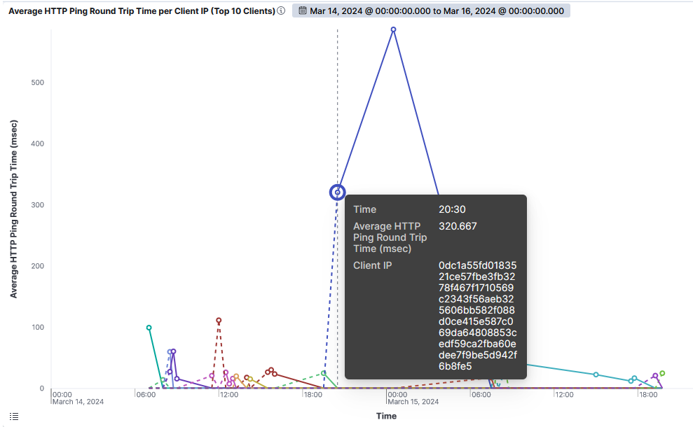
Observations – Crowd-sourced

Slide 8
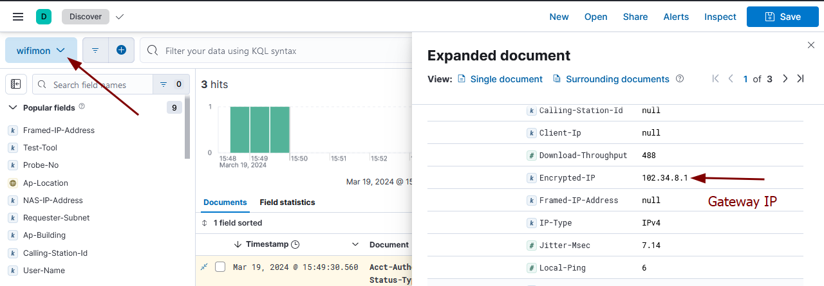
Challenges
WiFiMon RADIUS/DHCP logs correlation: NAT

Slide 9
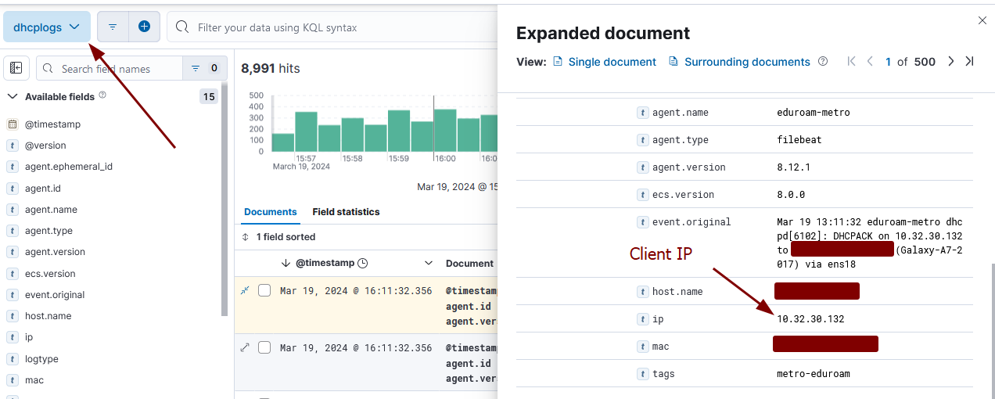
Challenges
WiFiMon RADIUS/DHCP logs correlation: NAT

Slide 10
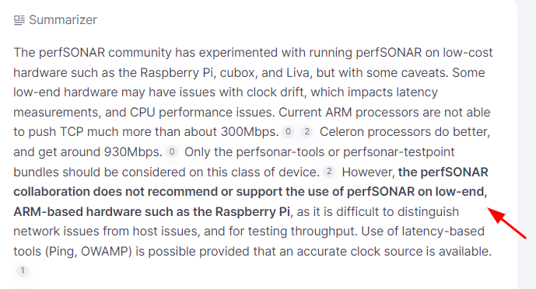
Challenges
Reliance of hardware probes (budget)
TWAMP tools (perfSONAR) vs WPA2-Enterprise (eduroam): Raspbian image (Debian12)
WPA2-Enterprise connections (eduroam) manually configured: deployment scalability
Cronjob too frequent, RPi overloaded

Slide 11
Next steps
Finalise HW probe testing
Fix TWAMP, WPA2-Enterprise auto-config, cronjob reliability
Deploying HW probes in metropolitan areas
Monitor Metro eduroam and HW probe behaviour

Slide 12
THE END
Thank you for your time

