Slide 1


Sustaining the Role of e-Infrastructures in EOSC and Beyond – a GÉANT Contribution
The Coordination of EU Funding Streams
Cathrin Stöver
CCO, Géant
E-IRG Workshop - Brussels
5 June 2024
Public
Notes:
Dear Cathrin,
On behalf of the e-IRG Chair Stefan Hanslik and e-IRG co-Chair Chris de Loof and the PC for the e-IRG Workshop under the Belgian Presidency of the Council of the Union, with an overarching theme “Sustainable e-Infrastructures for research results valorisation”, we would like to cordially invite you to:
Session 2: Sustaining the role of e-Infrastructures in EOSC and beyond, Wednesday, 5 June 2024, 16:00 - 18:00 CEST
The e-IRG Workshop will take place at the Royal Library of Belgium (KBR) in Brussels as a hybrid event, attached to the Research Infrastructures Conference | Calendar of Belspo meetings | Belgian presidency of the Council of the European Union | Belspo
Session 2 description
The second session of the e-IRG Workshop under Belgian EU Presidency aims to continue the discussions from the Valencia e-IRG Workshop and reflect on the future orientation of Research Infrastructures and its next Work Programme, which includes the topic of sustainability of RIs, and refers to the federation and uptake of e-Infrastructures. The landscape becomes more complex with multiple other funding streams besides the Framework Programmes for Research (currently Horizon Europe), such as the Connecting Europe Facility (CEF Digital), the Digital Europe Programme (DEP), and other national/regional funding instruments, such as the Recovery and Resilience Facility (RRF) fund and the traditional European Structural and Investment Funds. The session will also touch upon the concept of federation and role of e-Infrastructures in the new EOSC node-based ecosystem, especially as e-Infrastructures are not formally part of the nodes' ecosystem nor the EOSC procurement projects. The sustainability topic of RIs and e-Infrastructures is also relevant to the new ERA policy agenda for 2025-2027.
We would like to invite you to contribute to session 2 and to provide a 15-minute presentation about the above-mentioned topics from the perspective of GÉANT and in particular on the coordination of the EU funding streams relevant to e-Infrastructures (exact title to be defined).
The session currently has the following layout:
[Session 2 layout – Titles to be updated]
Future Orientation of the Research Infrastructures Work Programme, (EC and ESFRI-EOSC Task Force), Javier Lopez-Albacete, EC/DG RTD
Coordination of EU funding streams, Cathrin Stoever, GÉANT
The role of e-Infrastructures in the EOSC nodes ecosystemand beyond
NRENs as EOSC nodes and beyond – The Belnet paradigm, Dirk Haex, Belnet
The e-IRG policy document on e-InfrastructuresSustainability,Recommendations on European e-Infrastructures for Research and Education (zenodo.org)
The e-Infrastructure Assembly view(EGI, EUDAT, GÉANT, OpenAIRE, PRACE) – Speaker to be identified
The role of thematic Research Infrastructures in the EOSC nodes ecosystem (Andy Goetz, ESFRI-EOSC TF/EOSC-A)
Panel discussion
Further information about the e-IRG Workshop under the BelgianPresidency of the Council of the Union can be found at: e-IRG Workshop under Belgian EU Presidency (5 June 2024): Overview
We are looking forward hearing from you and seeing you in Brussels.
All the best,

Slide 2


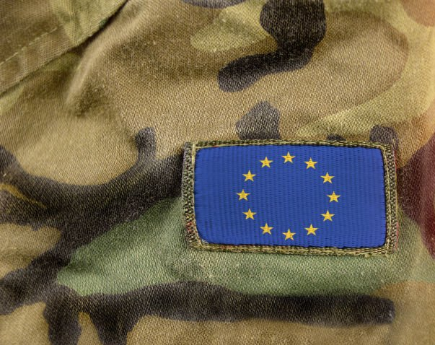
The Twin Transitions:
Digital Transformation and
Positive Climate Action
Defence R&D and Dual-Use?

Slide 3


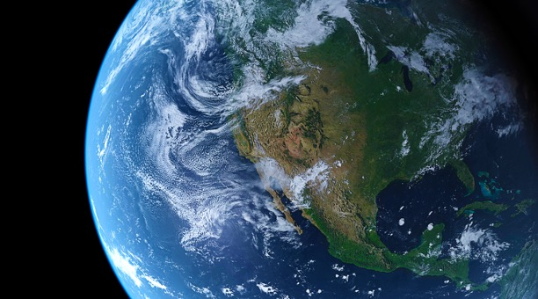

Digital Europe Programme
EuroHPC JU
EuroHPC JU
Connecting Europe Facility
EuroQCI
Horizon
Europe
NDICI and IPA3
Common European Data Spaces
Research Missions?
RRF
. . . and many more examples
3 |

Slide 4
Digital Europe Programme
EuroHPC JU
Connecting Europe Facility
EuroQCI
Horizon
Europe
NDICI and IPA3
Common European Data Spaces
Research Missions?
RRF
. . . and what about the security clause?
4 |
Notes:
Fragmented Funding Programmes

Slide 5
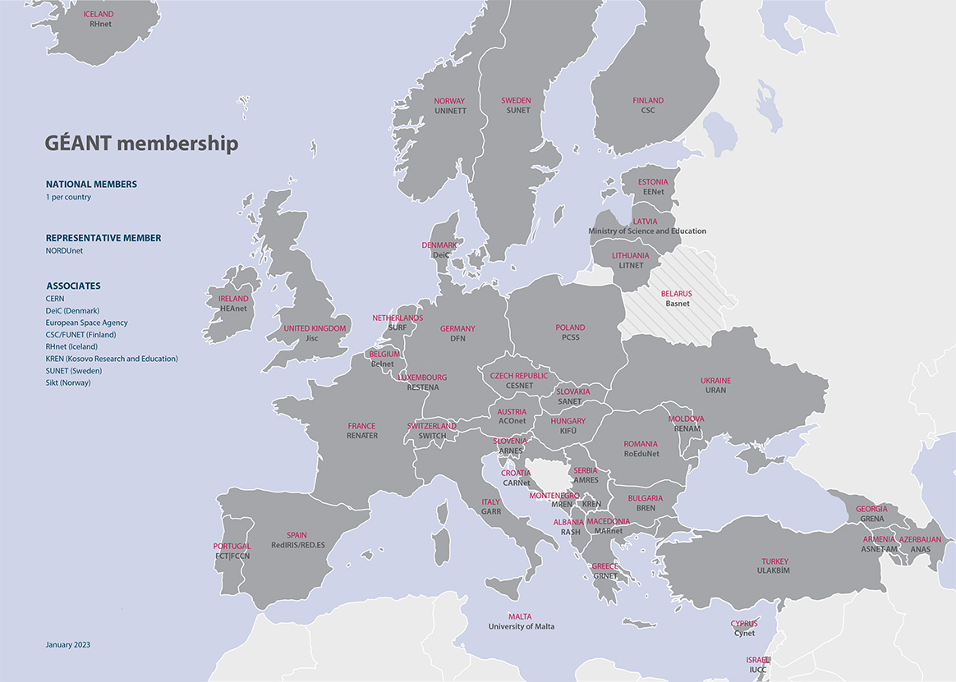
EU-27
EEA
Accession candidates
Neighbourhood
Third countries and KREN
Association to HE
*CH currently only under ERC calls
Association to CEF
Association to DEP
Updated: 24.05.2024

Slide 6



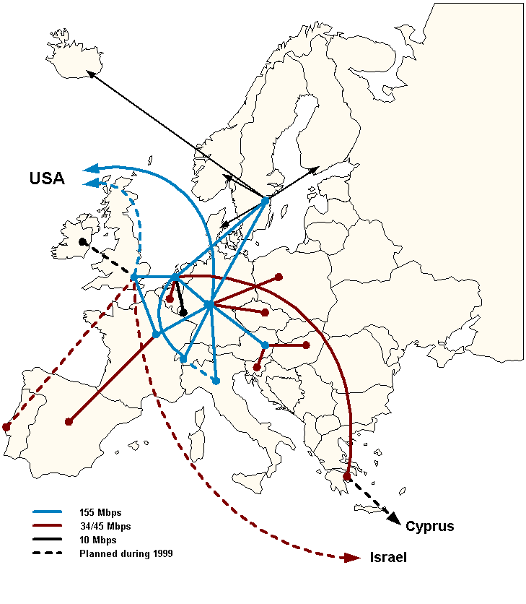
April 1999 Topology
In the 90s and 2000s digital was about connectivity

Slide 7
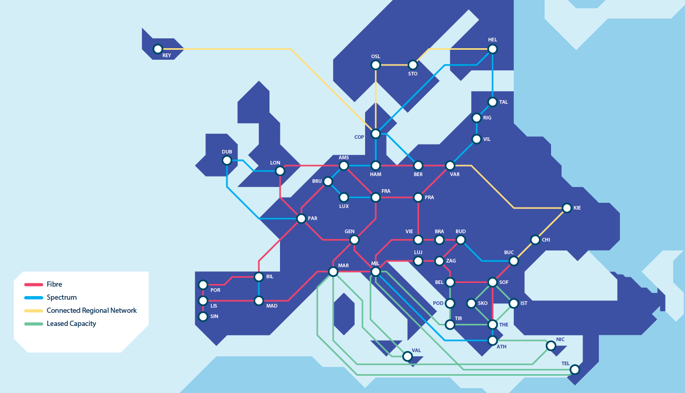

Slide 8
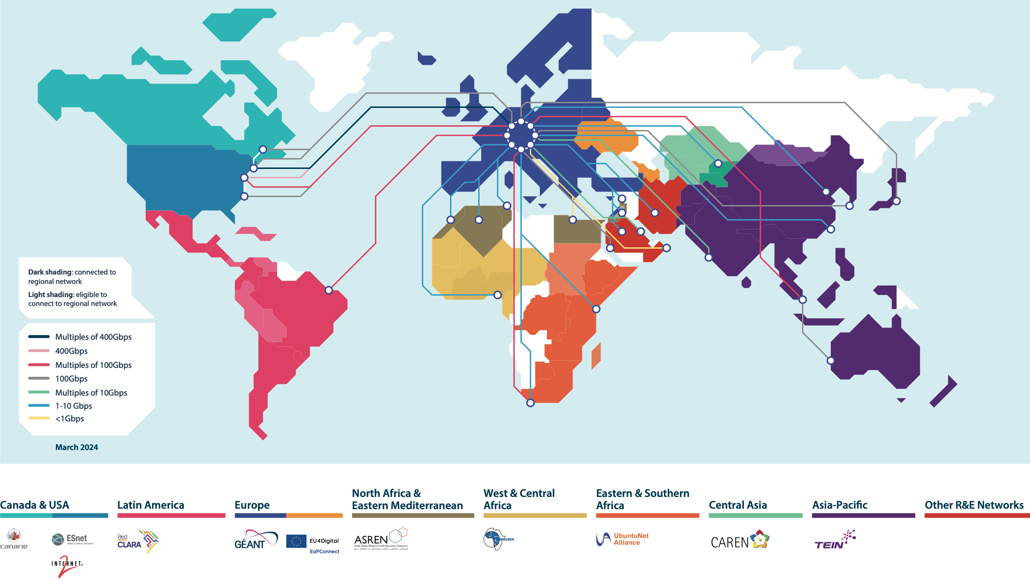
Europe’s Global Reach
The GÉANT network interconnects research, education and innovation communities worldwide, with secure, high-capacity networks.

Slide 9
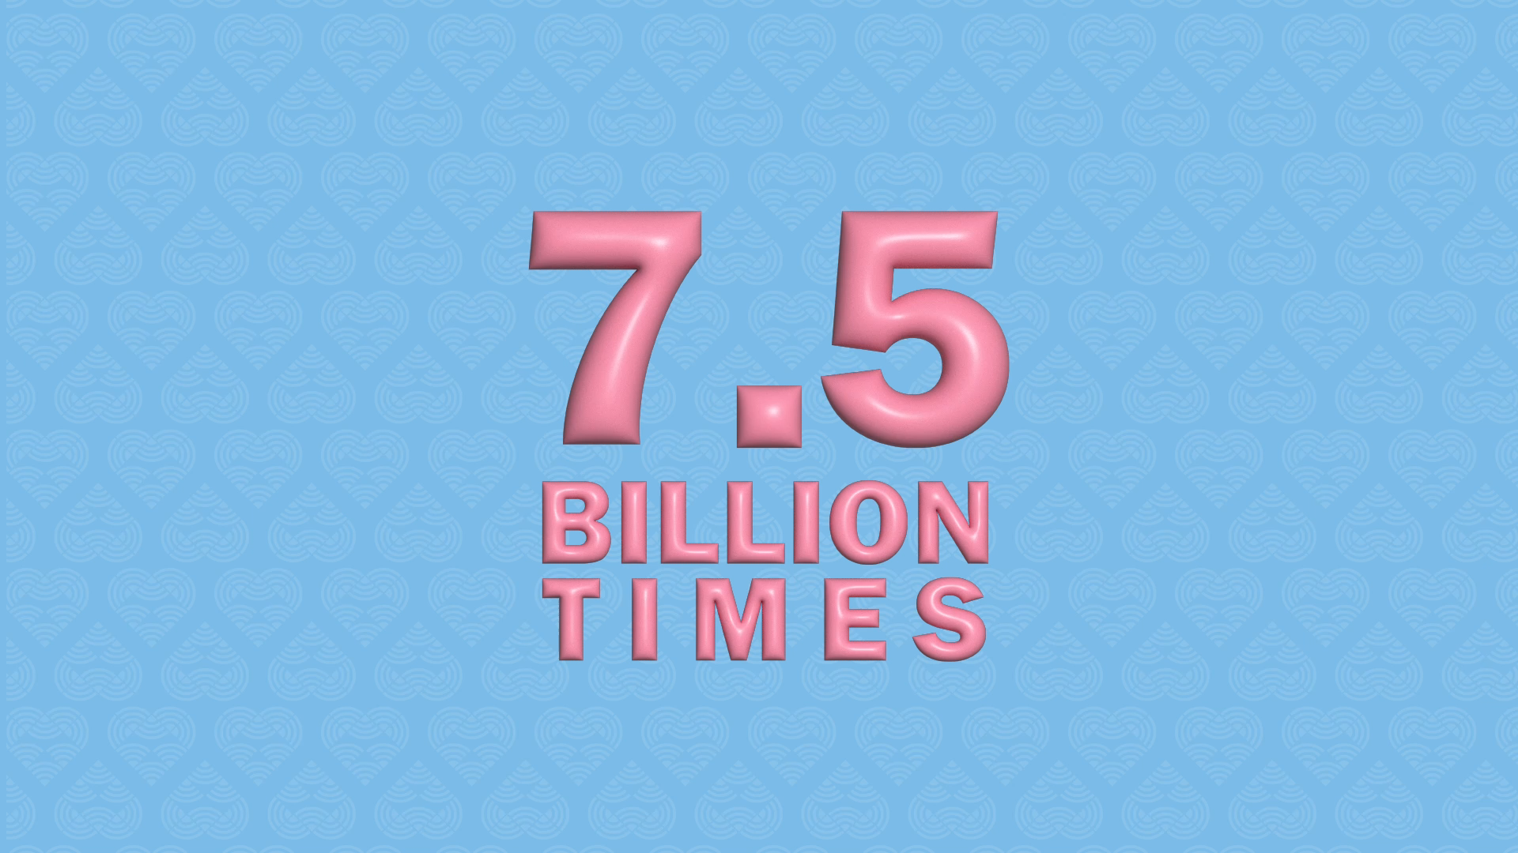

Slide 10

Bottom Up – Top Down
EuroHPC JU, EOSC EPA, ERICs, EDICs, Art.185s
GÉANT, PRACE, EGI, EUDAT, OpenAIRE,
NRENs across the Globe
The funding envelopes are getting bigger
Operational and Financial Maturity?
With great power, comes great responsibility

Slide 11
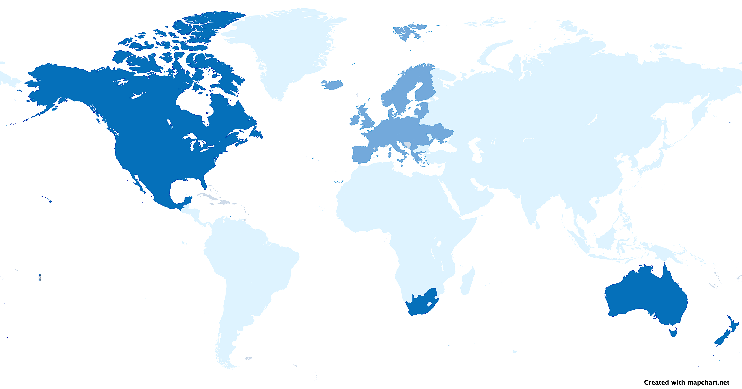
EU, national and international investments into dedicated R&E connectivity
EU Framework Programme funding (in Euro)
European NREN national budgets
SURVEY ON INTERNATIONAL INVESTMENT
2020 Financial information collected from
  55 global RENs participated (of approximately 130)
Reported annual investment: US$1,104,783,363
GN1 (2001) | 80M
GN2 | 93M
GN3 | 93M
GN3 Plus | 42M
GN4-1 | 25M
GN4-2 | 59M
GN4-3 | 77.5M
GN4-3N | 50.5M
GN5-1/ic1 (2024) | 70M
€ 590M EU funding for European focused GÉANT projects between 2001 and 2024 – this is multiplied by yearly NREN contributions to GÉANT, as well as national investments into national infrastructure.

Slide 12

Thank you!
Any questions?
cathrin.stover@geant.org
www.geant.org
© GÉANT Association
As part of the GÉANT 2020 Framework Partnership Agreement (FPA), the project receives funding from the European Union's Horizon 2020 research and innovation programme under Grant Agreement No. 856726 (GN4-3).

