Slide 1
Recommendations on European e-Infrastructures for Research and Education
Malin Sandström, VR Sweden, malin.sandstrom@vr.se
Jan Meijer, Sikt Norway, jan.meijer@sikt.no
Alexander van den Hill, SURF Netherlands, alexander.vandenhil@surf.nl
Ron Augustus, SURF Netherlands, ron.augustus@surf.nl
Co-authors: Panos Argyrakis, Arūnas Stašionis, Ignacio Blanquer

Slide 2
SURF cooperative
University Medical Centers
Universities of Applied Science
Vocational Institutions
Universities
Research Institutions
NREN Netherlands
~ 700 FTE
~ 115 members
Notes:
Kort – we zijn cooperatie van oa de relevante research instellingen in NL

Slide 3
Three roles of SURF for education and research
Service Provider
Association
Innovation Factory
Notes:
We verbinden, leveren diensten en ontwikkelen nieuwe dingen, zoals concepten voor open science

Slide 4
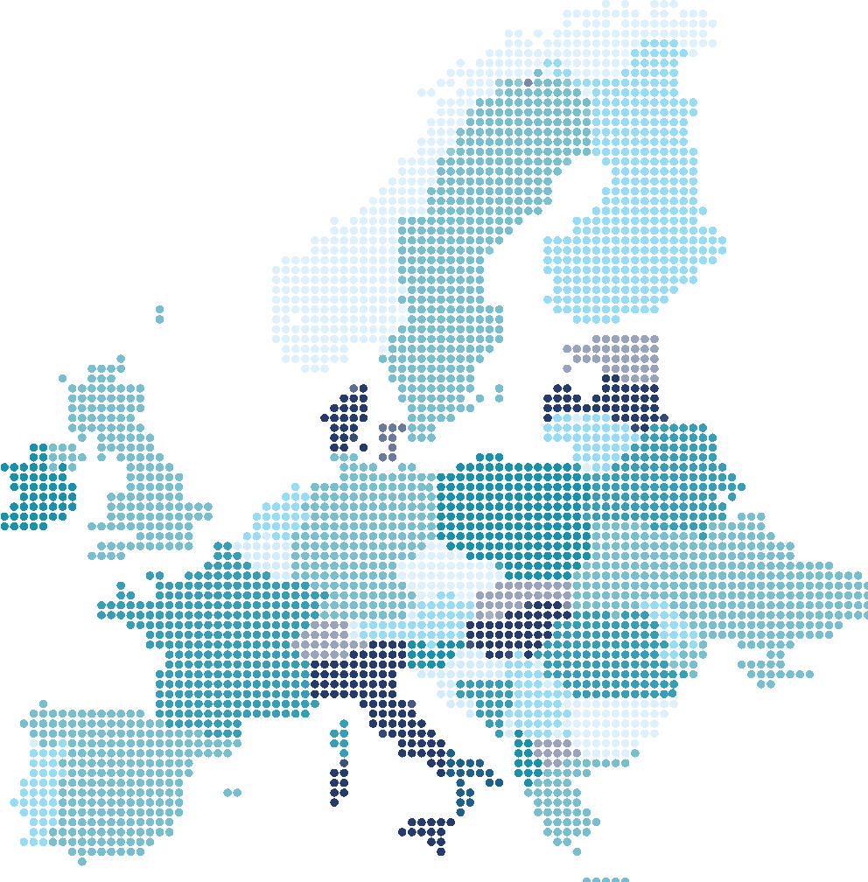
Essential Collaborations in Europe
Notes:
At SURF we are tasked with managing the national IT infrastructures and support staff dedicated to advancing research and education performed at institutional level. We have a deep understanding of our national contexts, and we are adhering to local regulations and responding to the specific needs and priorities of the Dutch research and educational users.
To increase impact in education, science and innovation on European and even global scale it’s clear for SURF and it’s members that we need to harmonize in Europee. We have numerous partnershops and memberships in place.

Slide 5
Innovative solutions and tailored support
Everywhere
Always
Everyone
National Research depending on facilities and instruments deployed all over Europe.
Infrastructure needs to be accessible, compatible and available.
To lower barriers, we collaborate on delivering pan-European facilities.
In the federated way we work, we offer more than the sum of all parts.
Images generated with AI technology
Notes:
Europe needs bodies dedicated to accommodating a digital ecosystem that supports the success of European students, educators, and researchers through innovative solutions and tailored support.
We need coordination at pan-European level to provide a coordinated response to the most demanding needs of European communities with the ultimate goal of boosting excellence within the European knowledge and science economy.

Slide 6
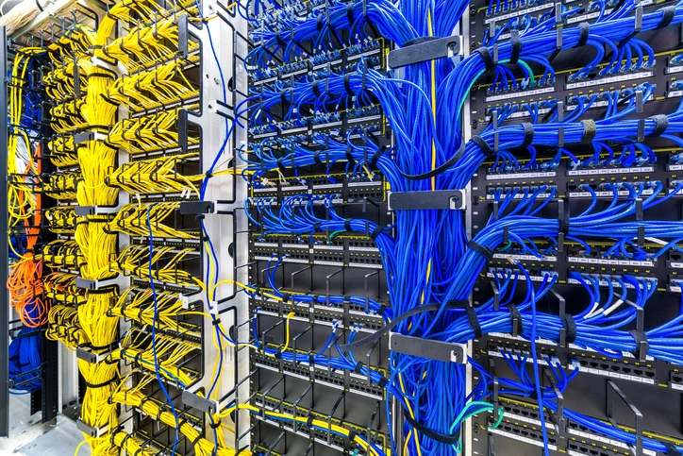
E-infra’s: The public foundation serving Research and Education
European e-infrastructures are:
GÉANT : European NRENs
EGI: European federated distributed compute
PRACE: Association of HPC centers
EUDAT: Data infrastructure
OpenAire: research results discovery
The collective of e-Infrastructures forms a ‘public foundation’ for solutions tailored to the research sector's needs.
This is achieved through a combination of federated infrastructures, a rich set of digital skills and consensus on standards.

Slide 7
E-infra’s: The challenges
The European Commission's approach of procurement tenders for elements similar to existing e-Infrastructures.
e-Infrastructures, naturally playing on the demand-side market, are now in competition with commercial entities prioritizing profit.
The European Commission does not always speak with a unified voice, which contributes to the ambiguity surrounding the roles of DG-CNECT/DG-RTD in managing e-Infrastructures.

Slide 8
eIRG recommendation:
The e-Infrastructure Reflection Group (e-IRG) advises the member states, the associated countries and the EC:
To direct R&E initiatives towards utilizing established e-Infrastructures rather than acquiring separate components
to devise financing strategies that support the sustainability of public foundations integral to these e-Infrastructures.

