Slide 1
Dirk Haex – General Director

Slide 2
The role of Belnet and NRENs
towards EOSC nodes and beyond

Slide 3
30

Slide 4
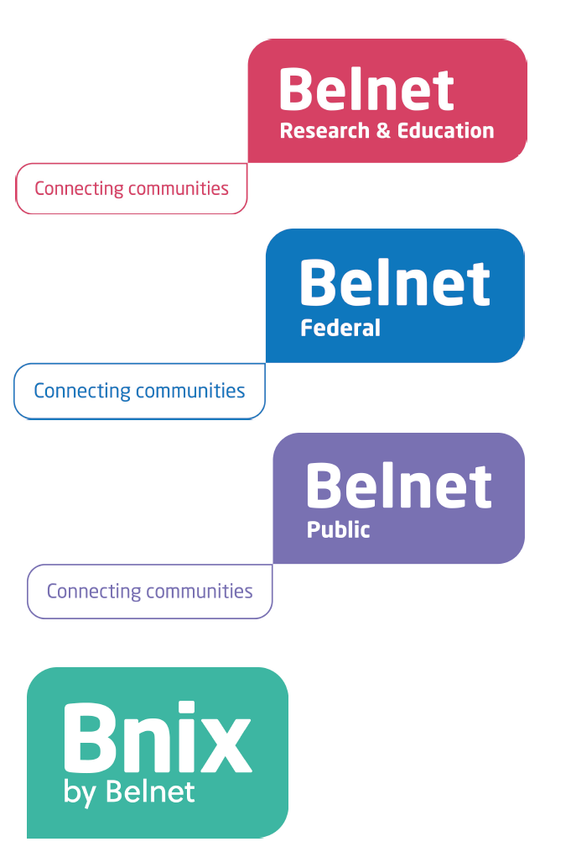
From infrastructure and connectivity towards dedicated and sustainable services

Slide 5
Connectivity & Internet
Trust & Security
Identity, Mobility & Federation
Cloud
Community Support

Slide 6
Connectivity & Internet
Trust & Security
Identity, Mobility & Federation
Cloud
Community Support

Slide 7
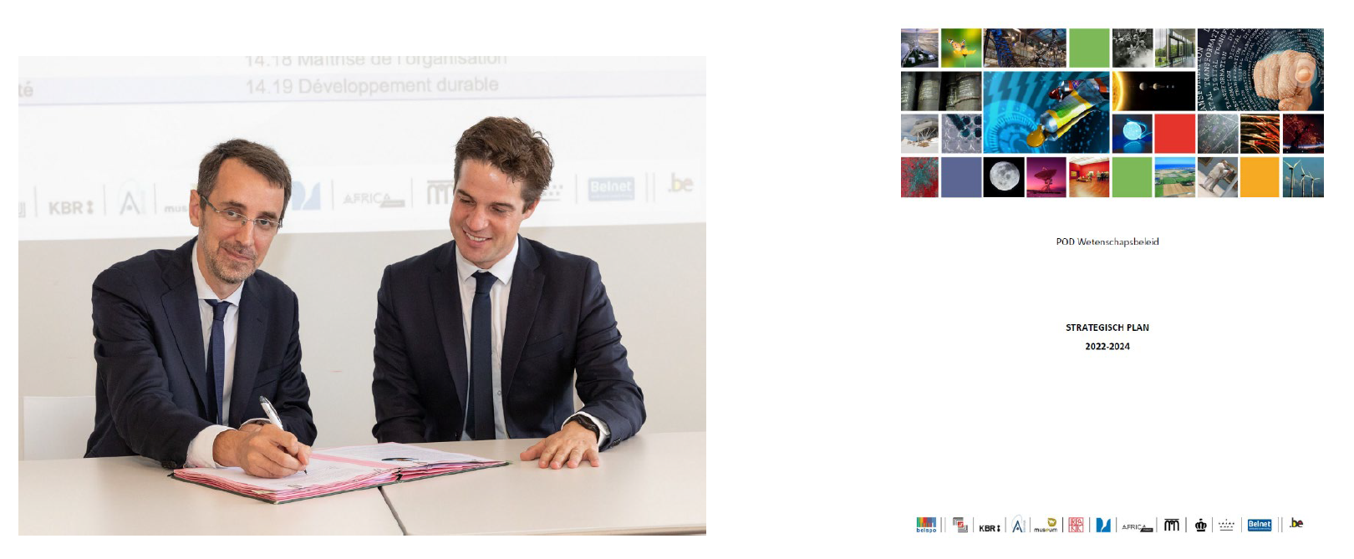

Slide 8
EOSC, a consistent axis within Belnet
Since 2020, the Mandated Organisation in Belgium for EOSC-A
“Belnet represents the organisations that are not represented directly in the EOSC-A”
“Belnet facilitates the needed discussions and translates the mission of EOSC on national level”
Strongly involved in the EOSC Focus Project
Active partnership within the GÉANT community
Ambassador and program lead for the implementation of EOSC building blocks within the Federal scientific community (FedOSC)

Slide 9
…

Slide 11
Conclusions & take aways
NRENs are part of a foundation for the entire EOSC and Open Science framework
e-infrastructures are essential and provide sustainability
e-infrastructures provide the technical framework and services that enable researchers to collaborate, share and innovate in an open and efficient manner.
Belnet, as th Belgian NREN, is eager to listen to the specific Belgian Research community needs and to take up a prominent role in the collaborative ecosystem.

