Slide 1
Introduction to the Data Spaces Support Centre (DSSC) Blueprint and links to EOSC Clara Pezuela, FIWARE Foundation eIRG, Brussels, 5 June 2024
The Data Spaces Support Centre receives funding from the European Union Digital Europe Programme under grant agreement n° 101083412.
Notes:
Following up to EC Federico Milani’s policy perspective.
“Members of our expert group would appreciate an exchange of views with you on the role and activities of the Data Spaces Support Centre. The idea would be to devote about one hour in total to an agenda point on European data spaces where we would also invite our colleagues from DG CNECT to give an update on progress with the establishment of data spaces. Thus, you would be welcome to give a 10-15 minute presentation, followed by an exchange of views.”

Slide 2
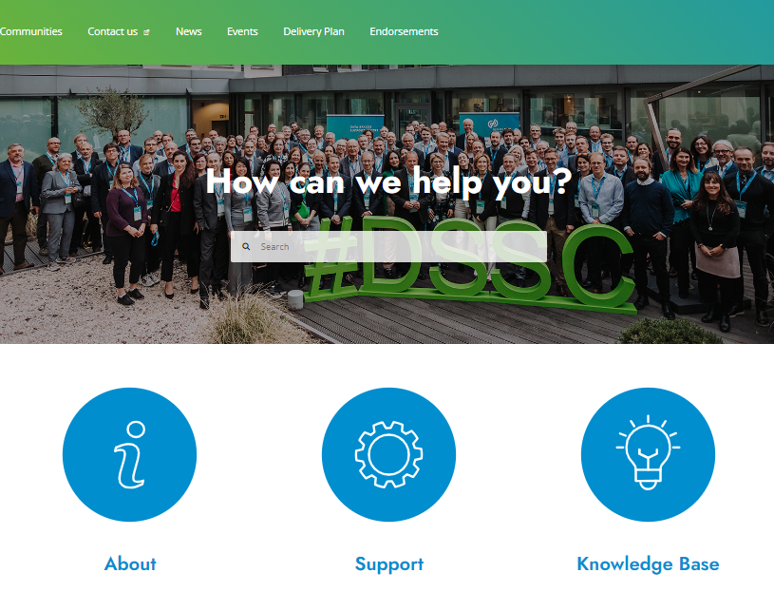
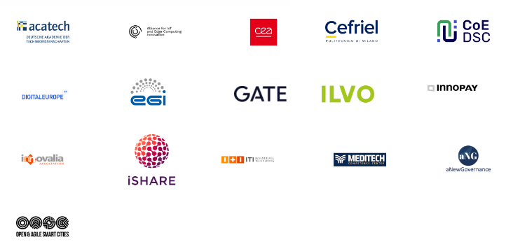
DSSC.EU
Data Spaces Support Centre
The virtual organization and EU-funded project which supports the deployment of common European data spaces and promotes the reuse of data across sectors
Partners
Associated partners

Slide 3
DSSC mission
Facilitate interoperable data sharing across sectors while respecting the EU values
Co-create, develop and evolve guidance through assets and services such as the data spaces “Blueprint”, together with stakeholders and experts
Support the EU Data Strategy
Coordinate the development of a data space blueprint
Support the European Commission
Support community of stakeholders
Assist the European Data Innovation Board in setting guidelines for common European data spaces
Promote adoption through support activities, a knowledge-sharing platform, and engagement with stakeholders

Slide 4
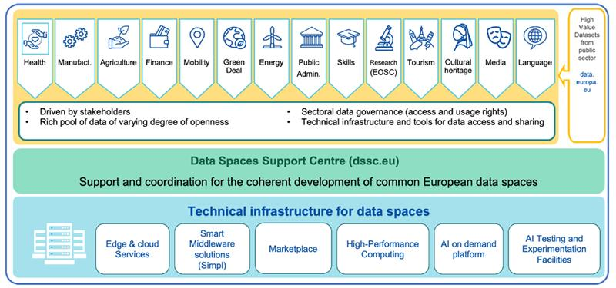
Positioning of the DSSC within the EU Data Strategy implementation actions
Common European Data Spaces

Slide 5
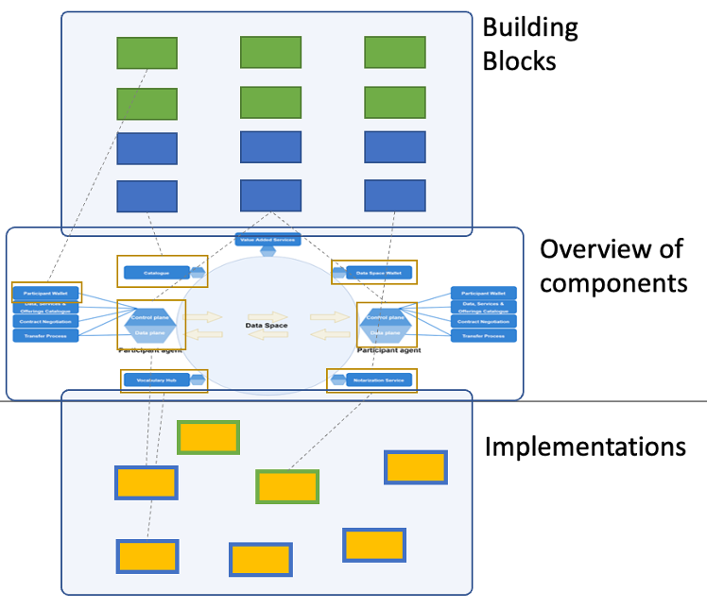
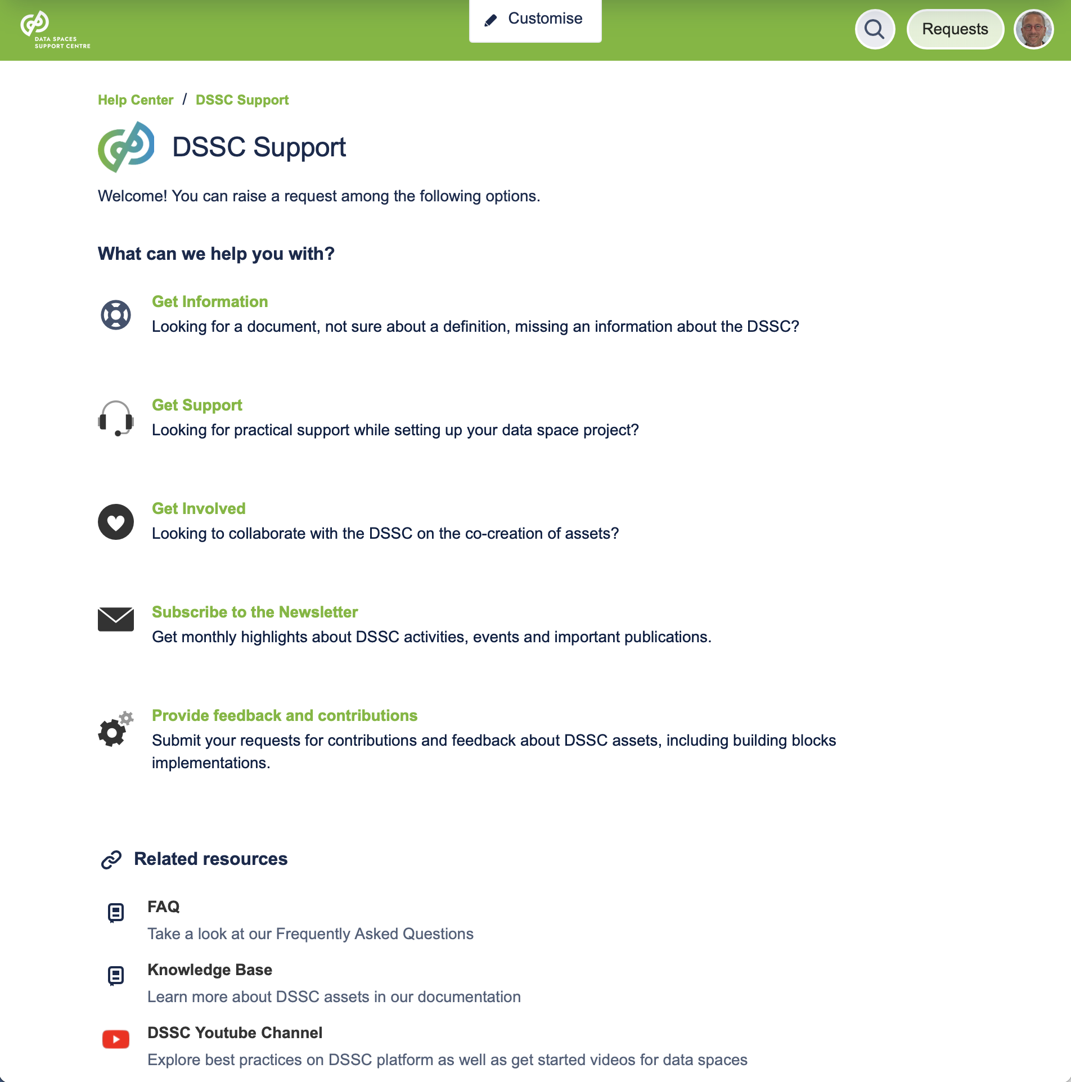
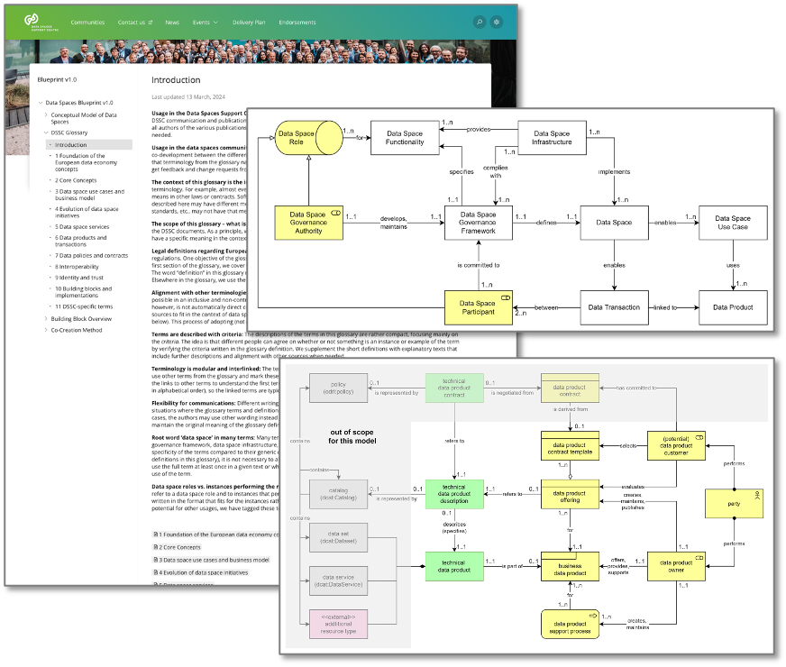
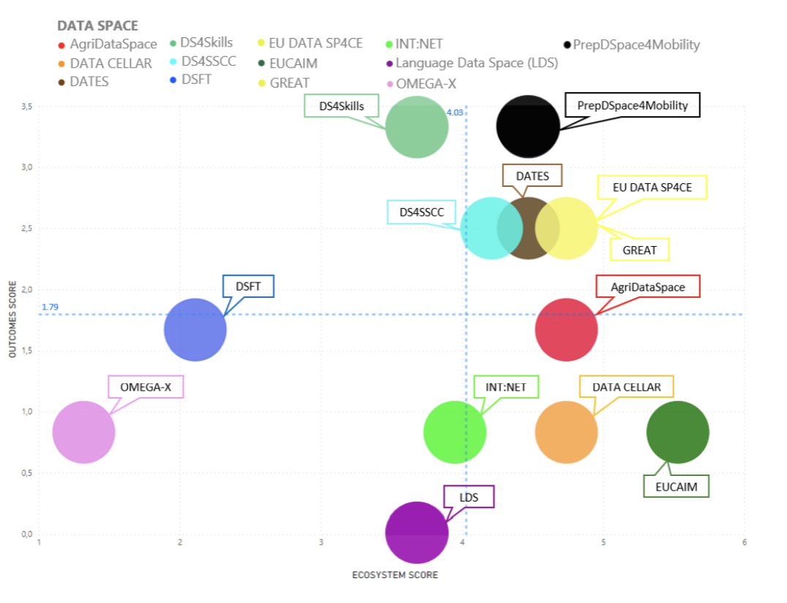
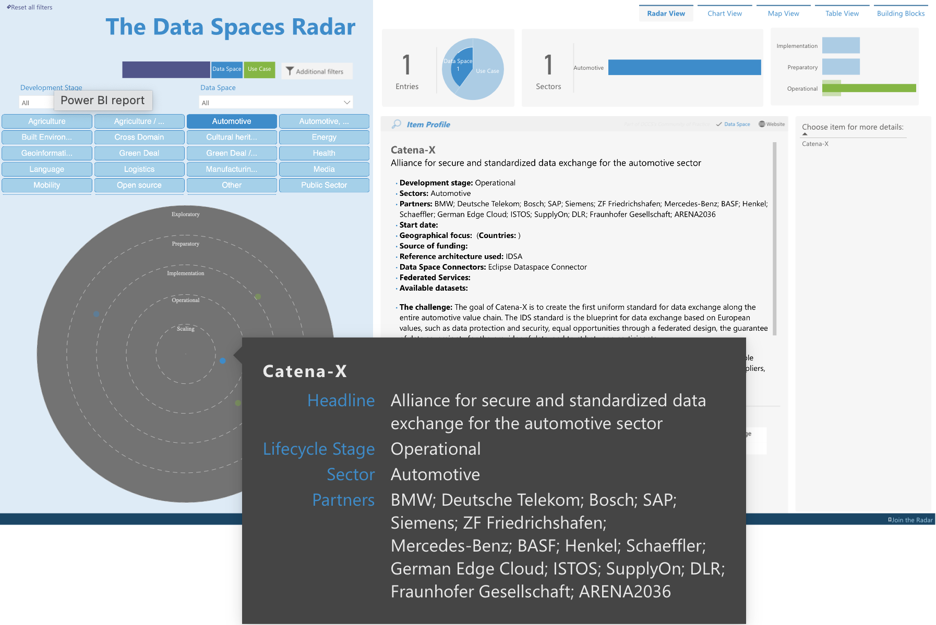
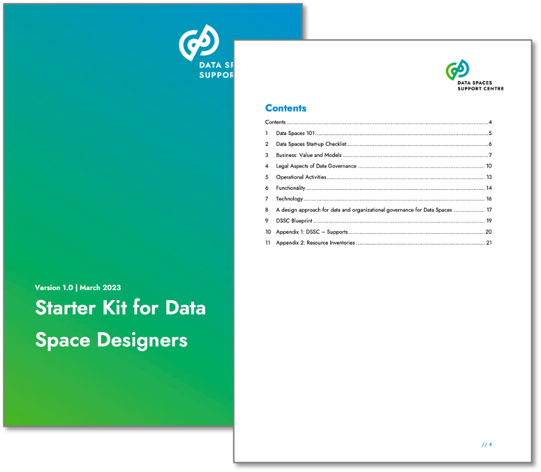
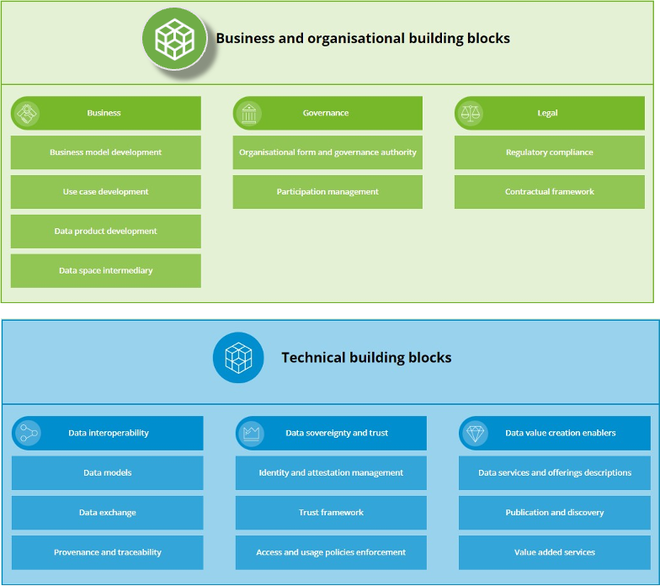
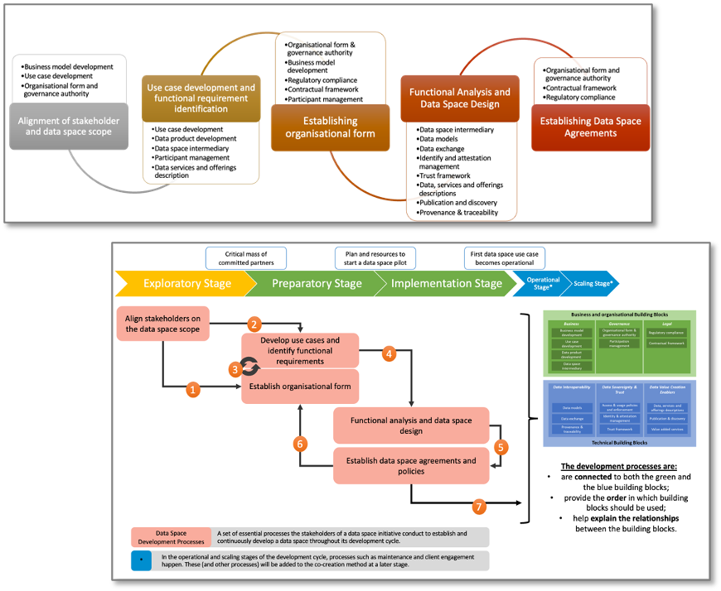
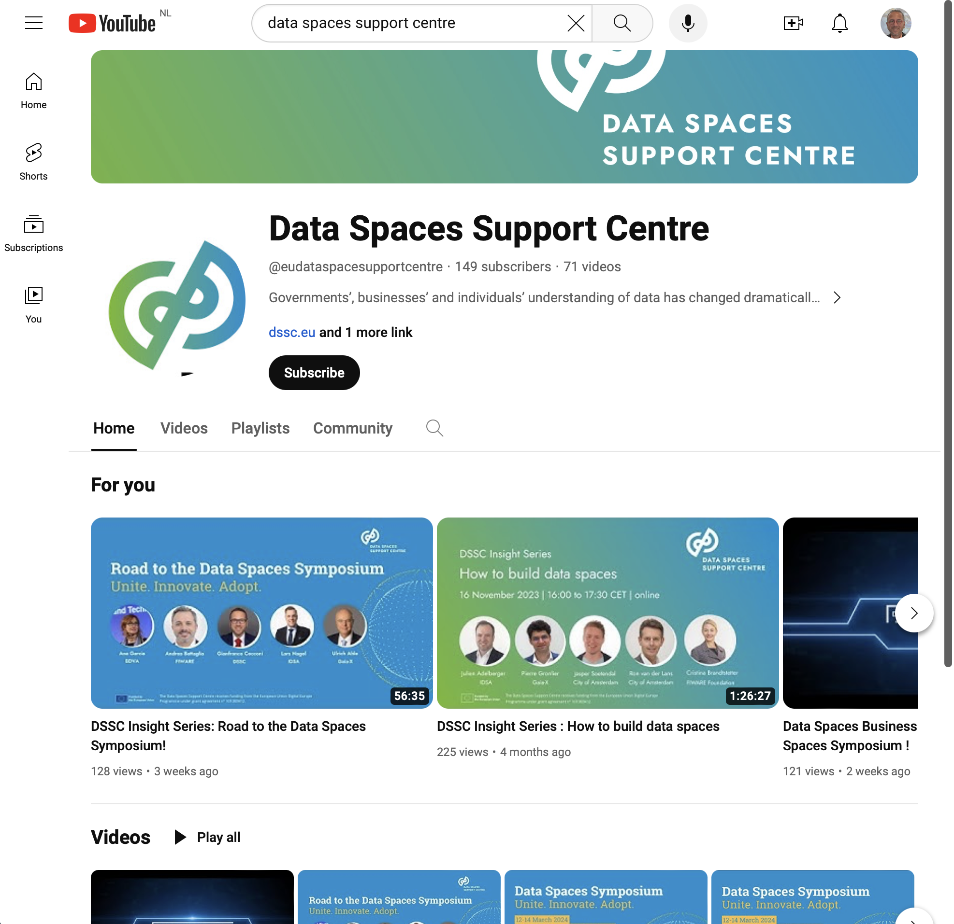
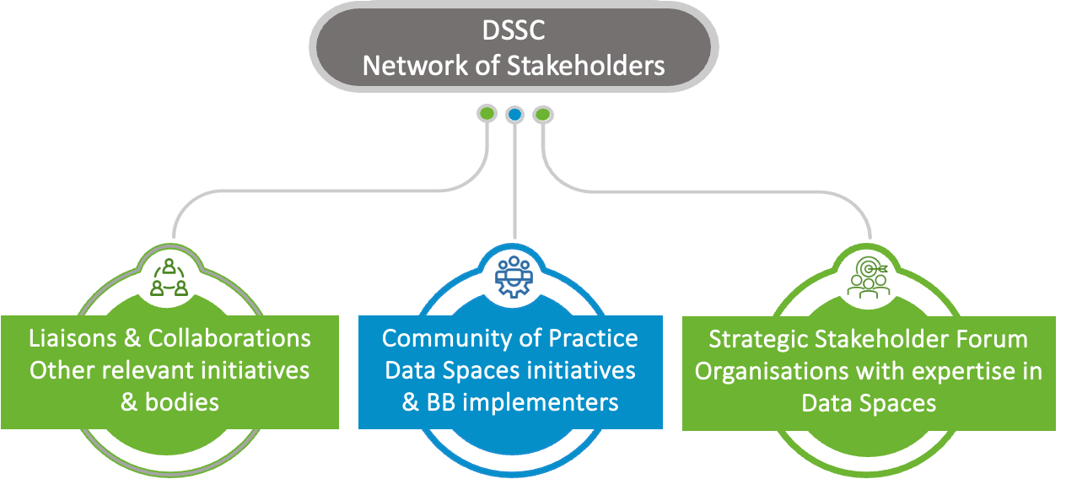
DSSC offerings
The Network of Stakeholders
The Glossary and the Conceptual Model
The Starter Kit
The Collection of Standards
The Blueprint
The Co-Creation Method
The Toolbox
The Radar
Impact monitoring and evaluation
Support
Communications

Slide 6
DSSC Network of Stakeholders (NoS)
DSSC Network of Stakeholders
Initiatives and bodies DS need to collaborate with for alignment and/or holistic picture
Bring requirements, knowledge, influence, alignment
Set up, run or provide technology for Data Spaces
Hands-on community
Learn from each other, align, contribute
Enablers, influencers and users of
Data Spaces
Have expertise on the matter
They have committed resources
Advice, give direction and contribute
Collaborations and liaisons
Relevant initiatives and bodies
Community of Practice (CoP)
Strategic Stakeholder Forum (SSF)
Organisations with expertise in Data Spaces
Data Space Initiatives
Simpl
Building Blocks implementers
SDOs
EDIB
EOSC
EOSC
Data Spaces Support Centre
SUPPORT
ASSETS
Thematic groups (Technical, Business, Governance)
Relationship Managers

Slide 7
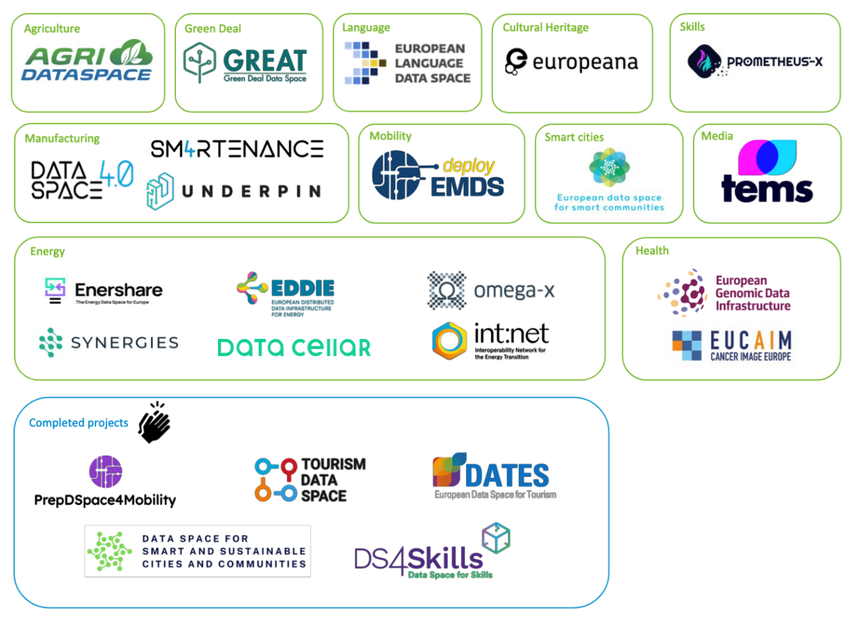
DSSC Community of Practice (as per March 2024)
Relationship Manager
Regular group discussions
Thematic Groups
Expert groups
Regular communications
Insights and visibility
Events
Community
Support
Collaboration with SIMPL started
‹#›

Slide 8
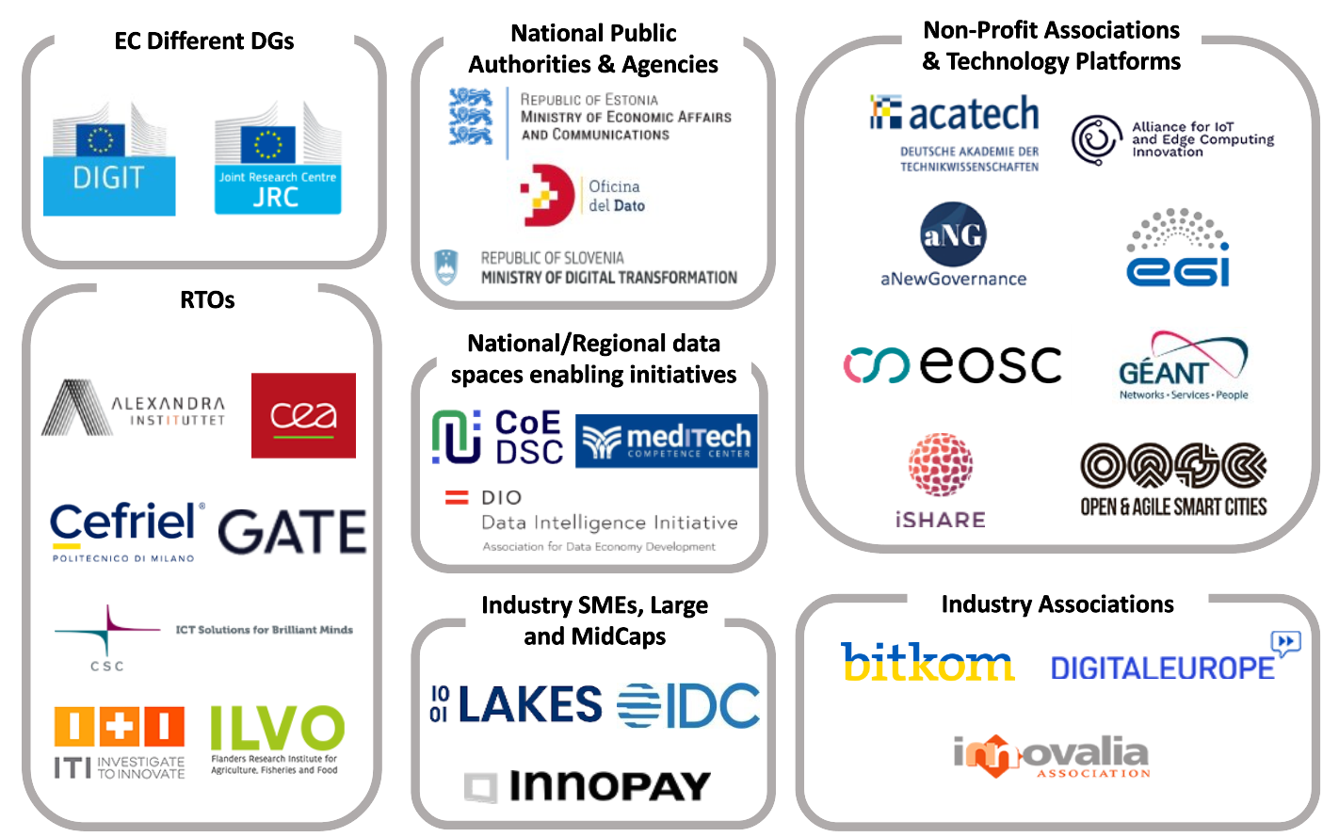
DSSC Strategic Stakeholder Forum
The SSF is a group of key organisations very active in the Data Space landscape in Europe (sectoral and cross-sectoral). It has an active advisory and strategic role for DSSC
The SSF includes 29 members from 12 EU countries (but also members with European & international focus)

Slide 9
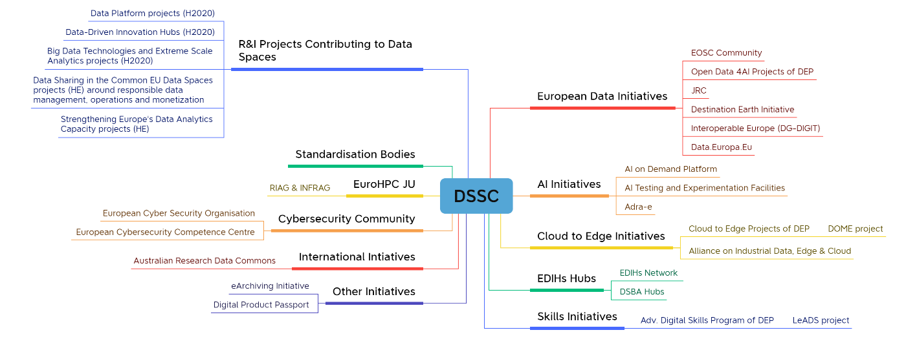
Collaborations and liaisons (March 2024)
EOSC Focus
EOSC Future
WorldFAIR
FAIR-Impact
FAIRCORE4EOSC
Coordination of synergies and matchmaking with CoP
‹#›

Slide 10
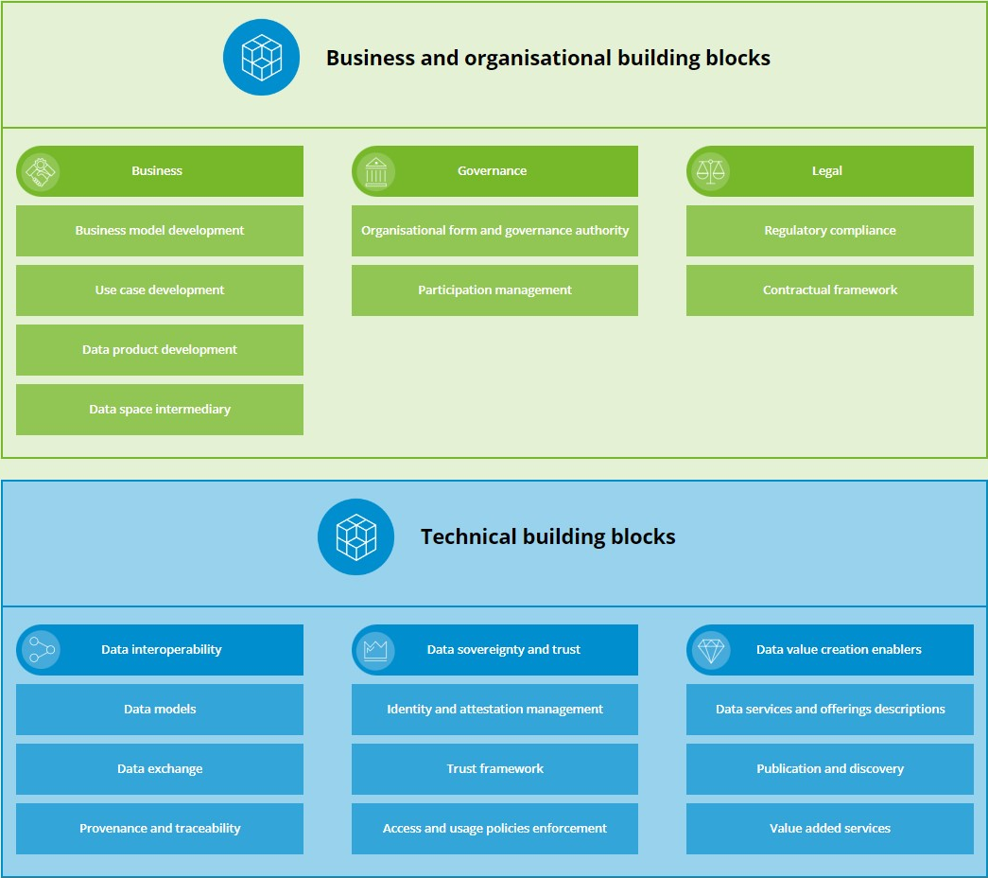
The Blueprint
The collection of building blocks and components that make most typical data spaces.
Functional description and related recommended standards.
Supporting the choices you face in designing a data space or performing gap analysis vs pre-existing systems.
Required capabilities
Core design decisions
Specifications & common standards
Further reading

Slide 11
The Blueprint: in the focus of EOSC
Financial sustainability
Health use cases
Participation compliance
Semantic interoperability
Metadata
Technical interoperability
Catalogue
Data Quality
Federated services (Marketplace)
Identities registry

Slide 12
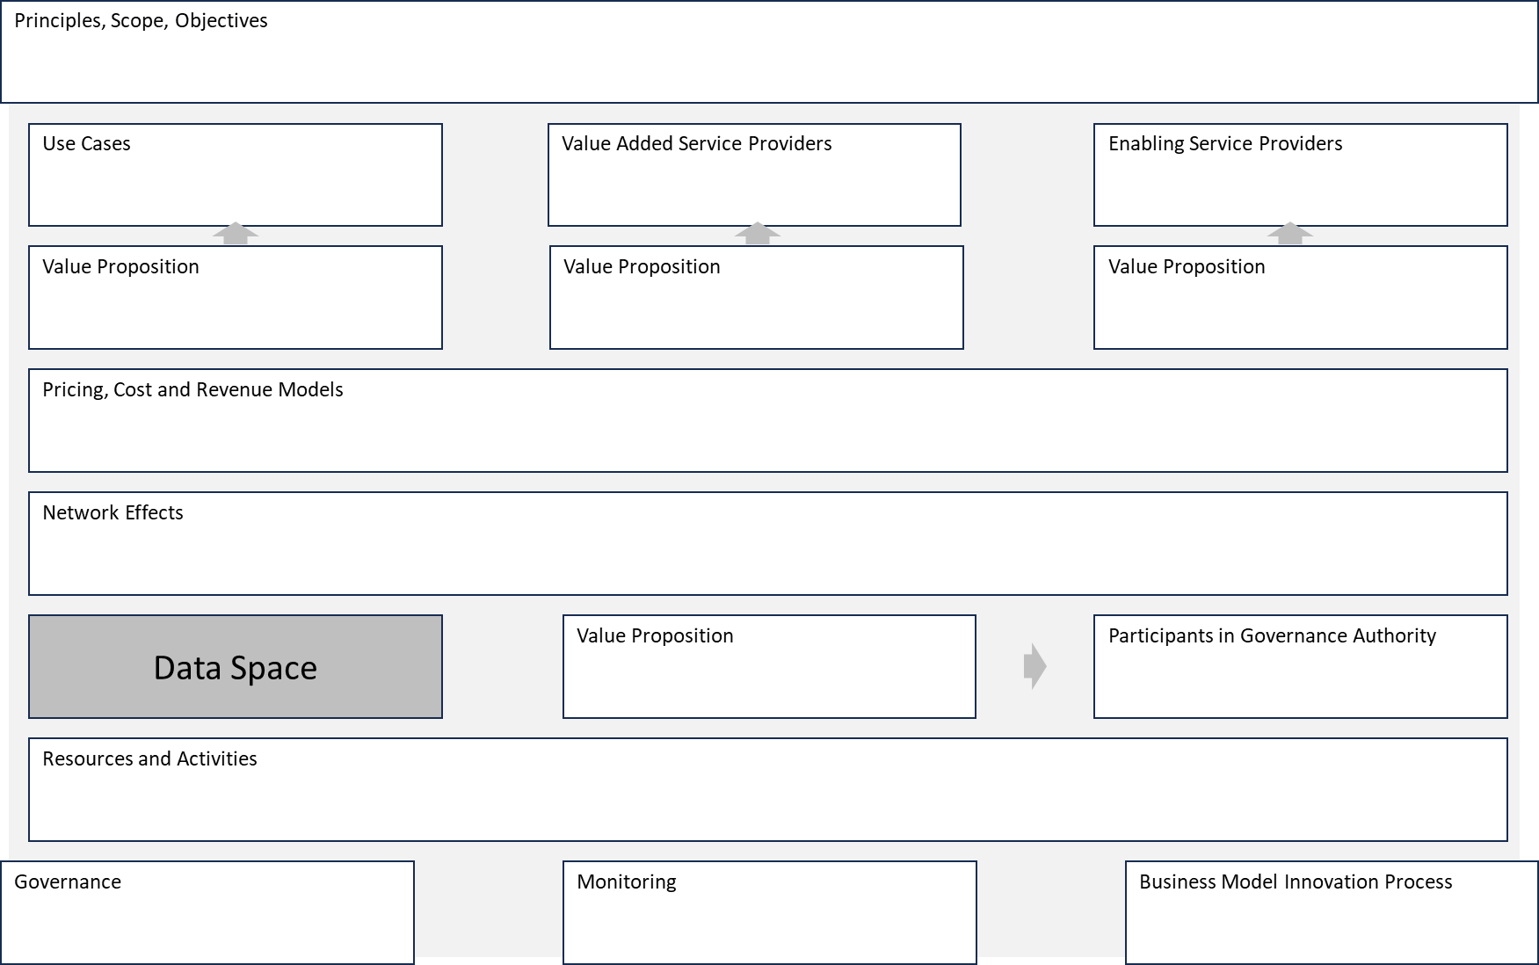
Business
Example: Key elements of a data space business model
Business model development
Develop a business model based on
Guidelines to the customer journey
Revenue and cost models
Use case development
Explore, develop and onboard use cases based on
Templates, scenarios, ensuring synergies
Data product development
Create data product strategy based on
Guidance to create data products
Governance rules and principles (e.g., data quality and security)
Data space intermediary
Decide on the use of data space intermediaries that offer enabling services (e.g., identity management) based on
Four generic models and guidelines
Notes:
Heidi

Slide 13
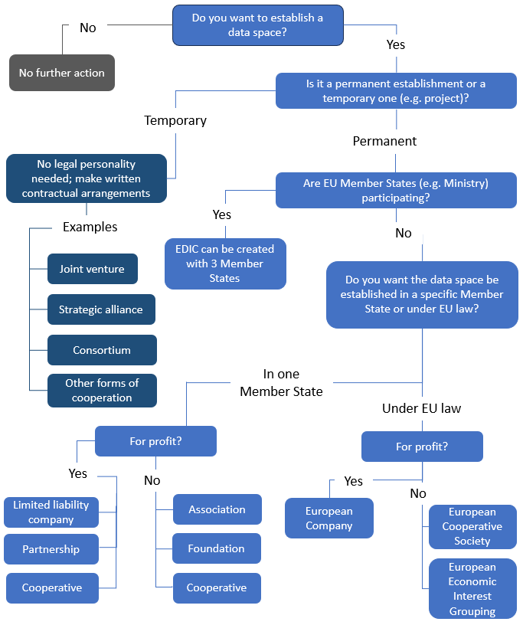
Governance
Example: Decision tree on organising and establishing a data space
Organisational form and governance authority
Develop the organisational form and governance authority (GA) based on
Guidelines on the impact on the GA
Participation management
Defining the participants and enabling their onboarding and offboarding based on
Clear criteria for admission and continued participation and specification of roles
Notes:
Heidi

Slide 14
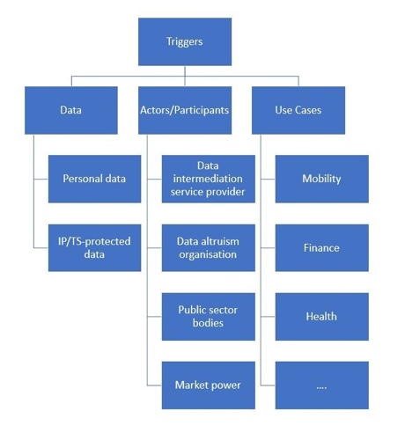
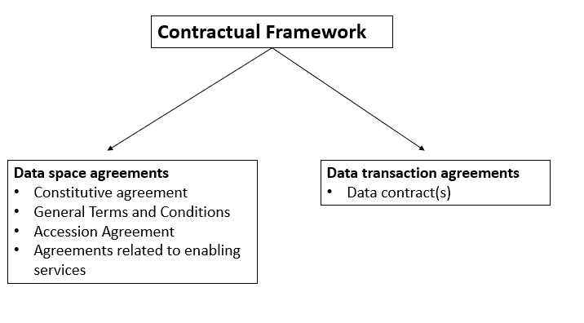
Legal
Example: Overview of data space triggers that link to EU legislation
Regulatory compliance
Becoming legally compliant by guiding
On relevant EU legislation
On roles and responsibilities
Contractual framework
Develop legally enforceable agreements
Data space agreements
Transaction agreements
Example: Data space agreements and transaction agreements
Examples of related legislation;
Data:
Personal data: GDPR, e-Privacy Directive
IP/TS protected data : Copyright law, Trade secret protection
Actors/Participants:
Data intermediation service provider: DGA
Data Altruism org: DGA, GDPR
Public sector bodies: Open Data Directive
Market Power: 101 TFEU, 102 TFEU.
Notes:
Heidi

Slide 15
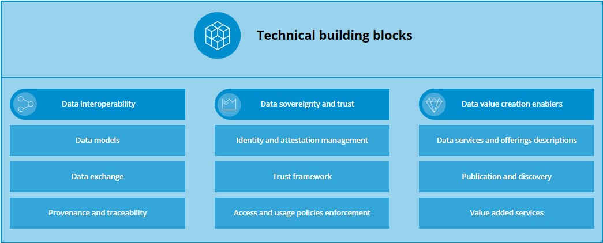
Technical Building Blocks

Slide 16
Technical Building Blocks
Vocabulary Hub for common data models
Data Exchange APIs characteristics
Approaches for provenance & traceability
Attestation & Identity Management based on W3C Verifiable Credentials (SSI)
Role of Trust Frameworks
Access and usage policies based on W3C ODRL
Usage of DCAT for specifying data products & services
Cataloguing features for Publication and Discovery of data and services
Role of Value Added Services in a data space

Slide 17
Blueprint Publication (v1.0)
Rationale: having at a glance all the DSSC offers for all users' type
For Building Blocks makers:
Implementers of BBs
Data Space deployment projects
Contributors to BBs specifications
Data Space services developers
For Data Space makers:
Data Space initiatives at every stage
For business users:
Data Spaces landscape
Market analysis
Support and services
Provide feedback &
Get support
….at any time
Notes:
Clara P.

Slide 18
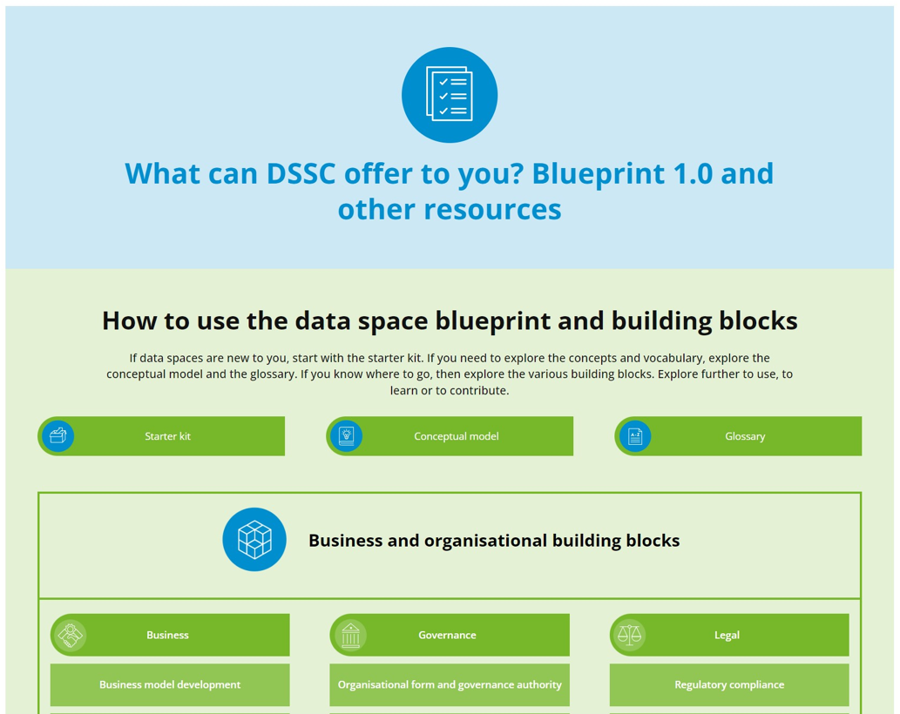
Our message to the community
Connect, use and contribute
Use the DSSC Blueprint to develop or enhance the rulebook of your own dataspace
“Comply or explain” + Contribute!

Slide 19
Other assets

Slide 20
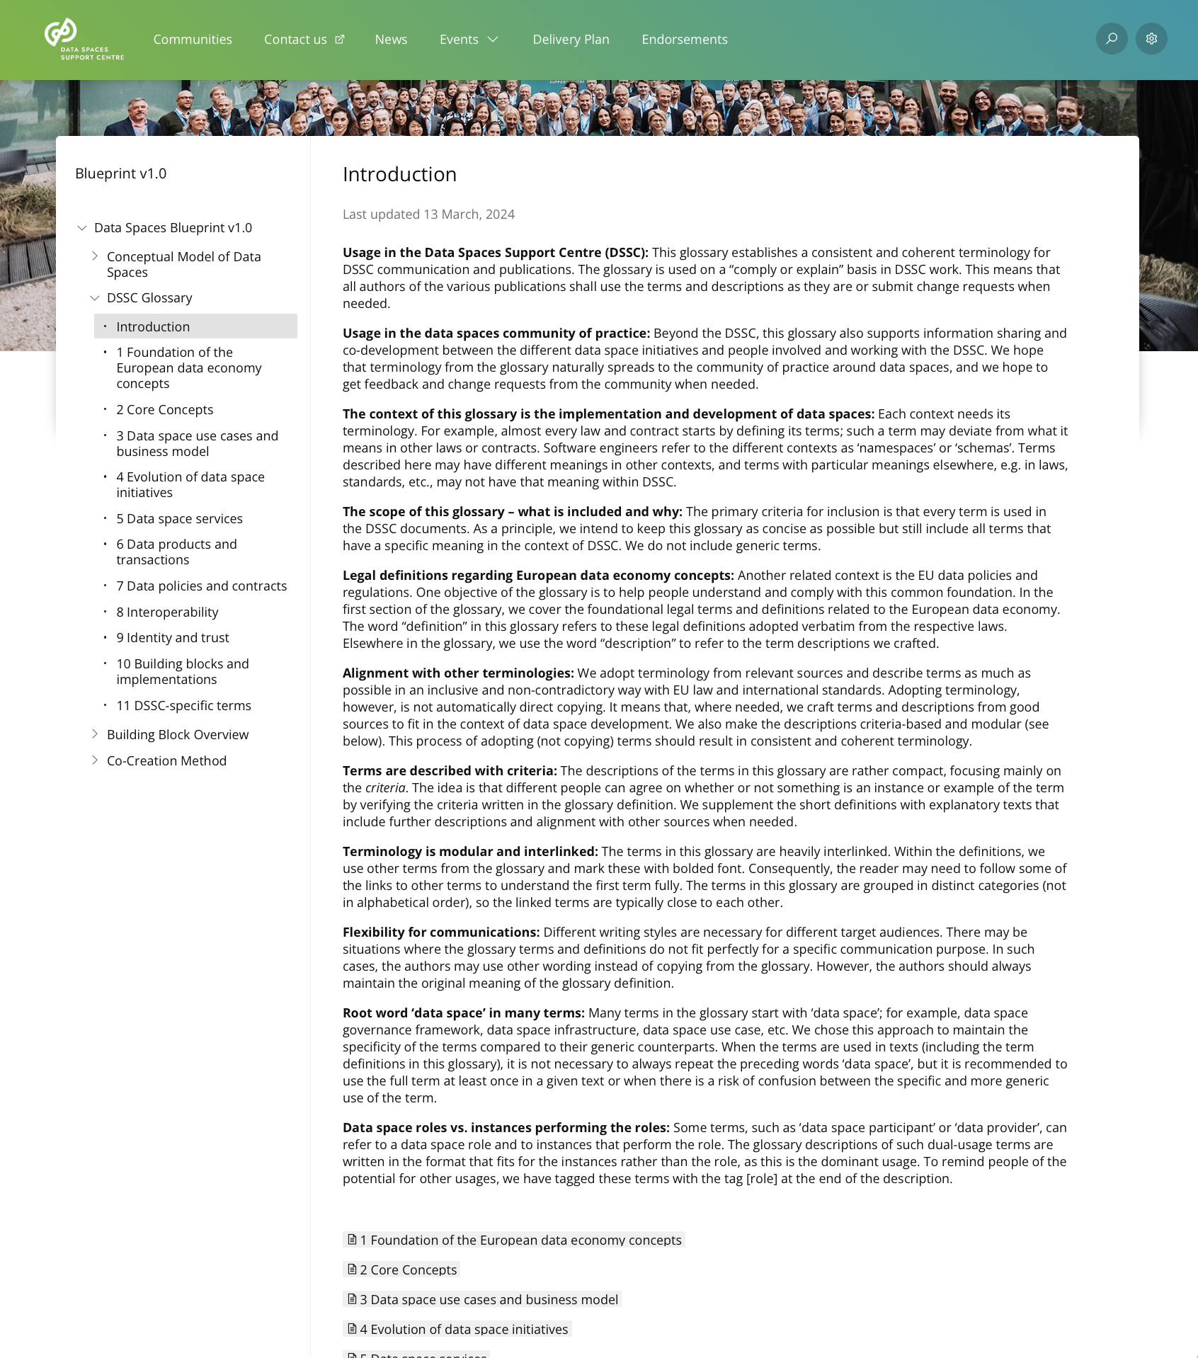
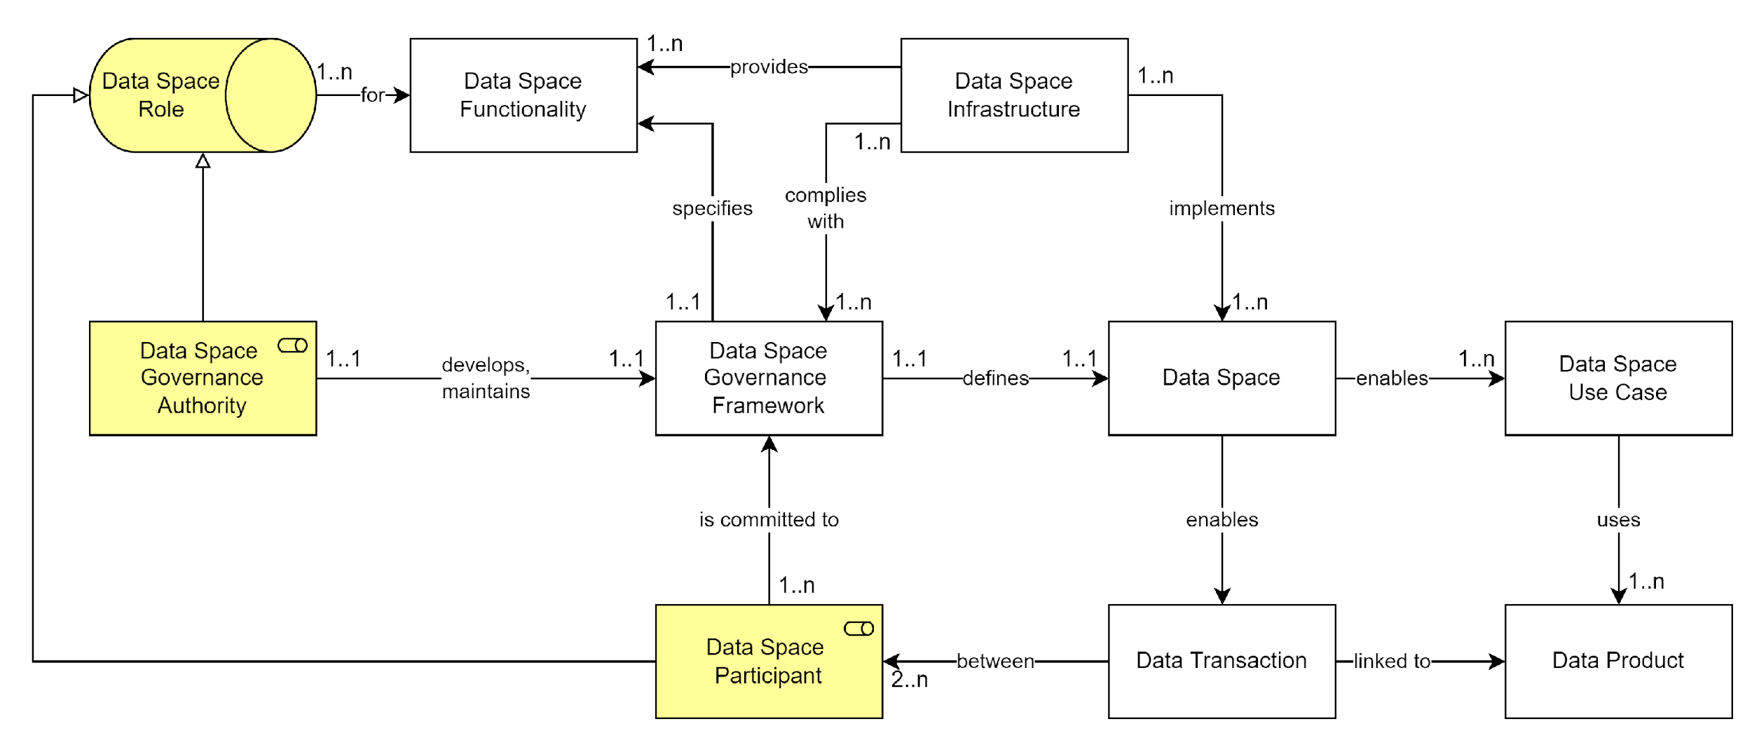
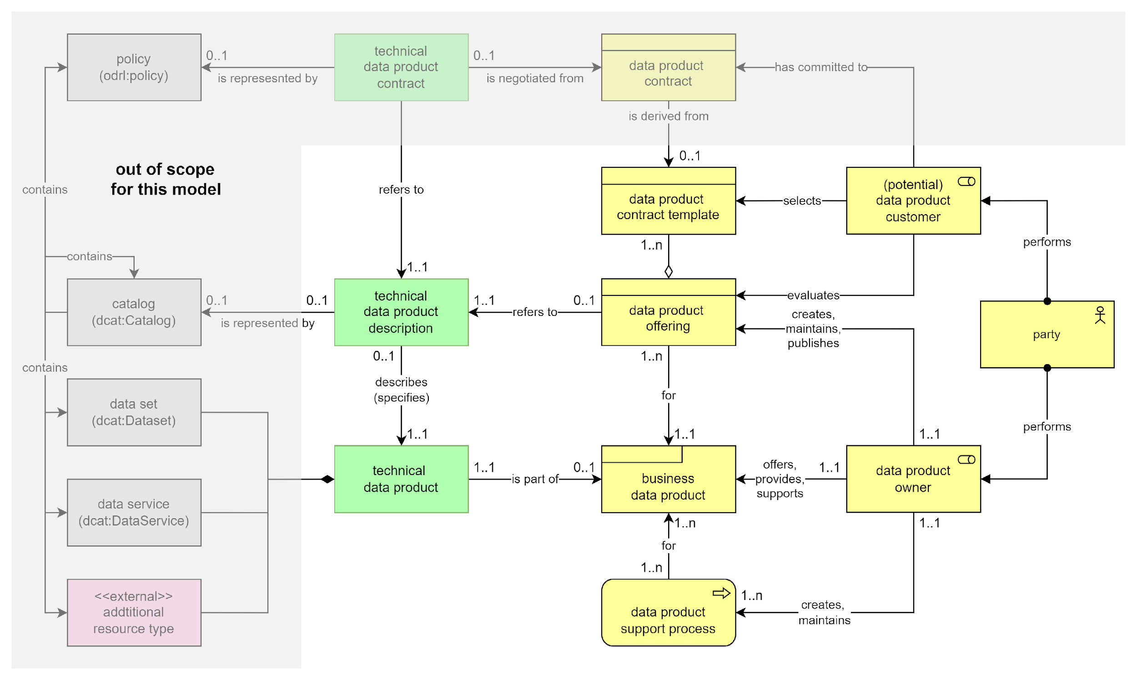
The Glossary and the Conceptual Model
Data Spaces is an innovative domain
Among practitioners, concepts and terminology can be ambiguous or subject to different interpretation.
Converging on language is necessary for clarity and collaboration

Slide 21
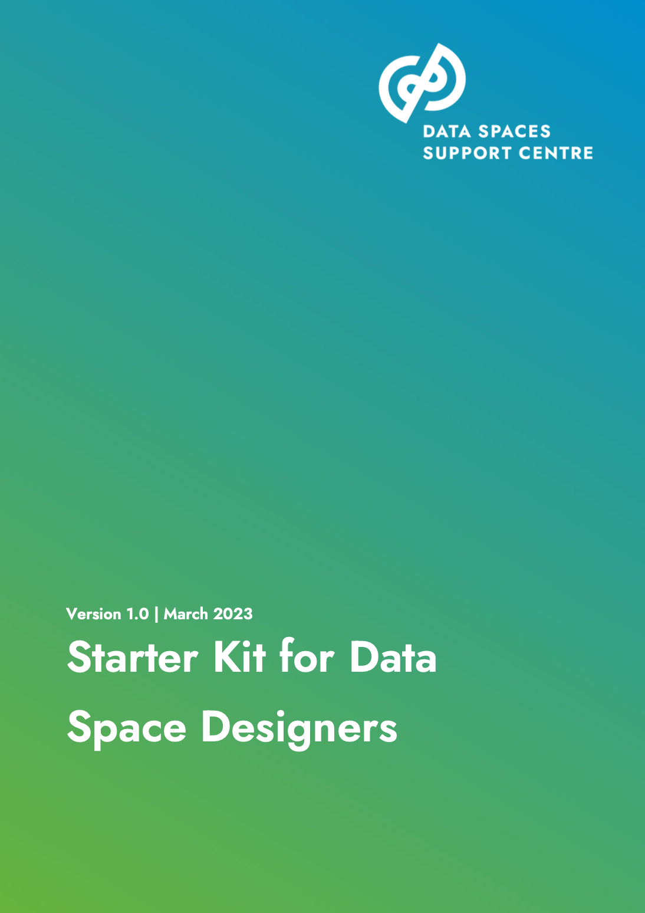
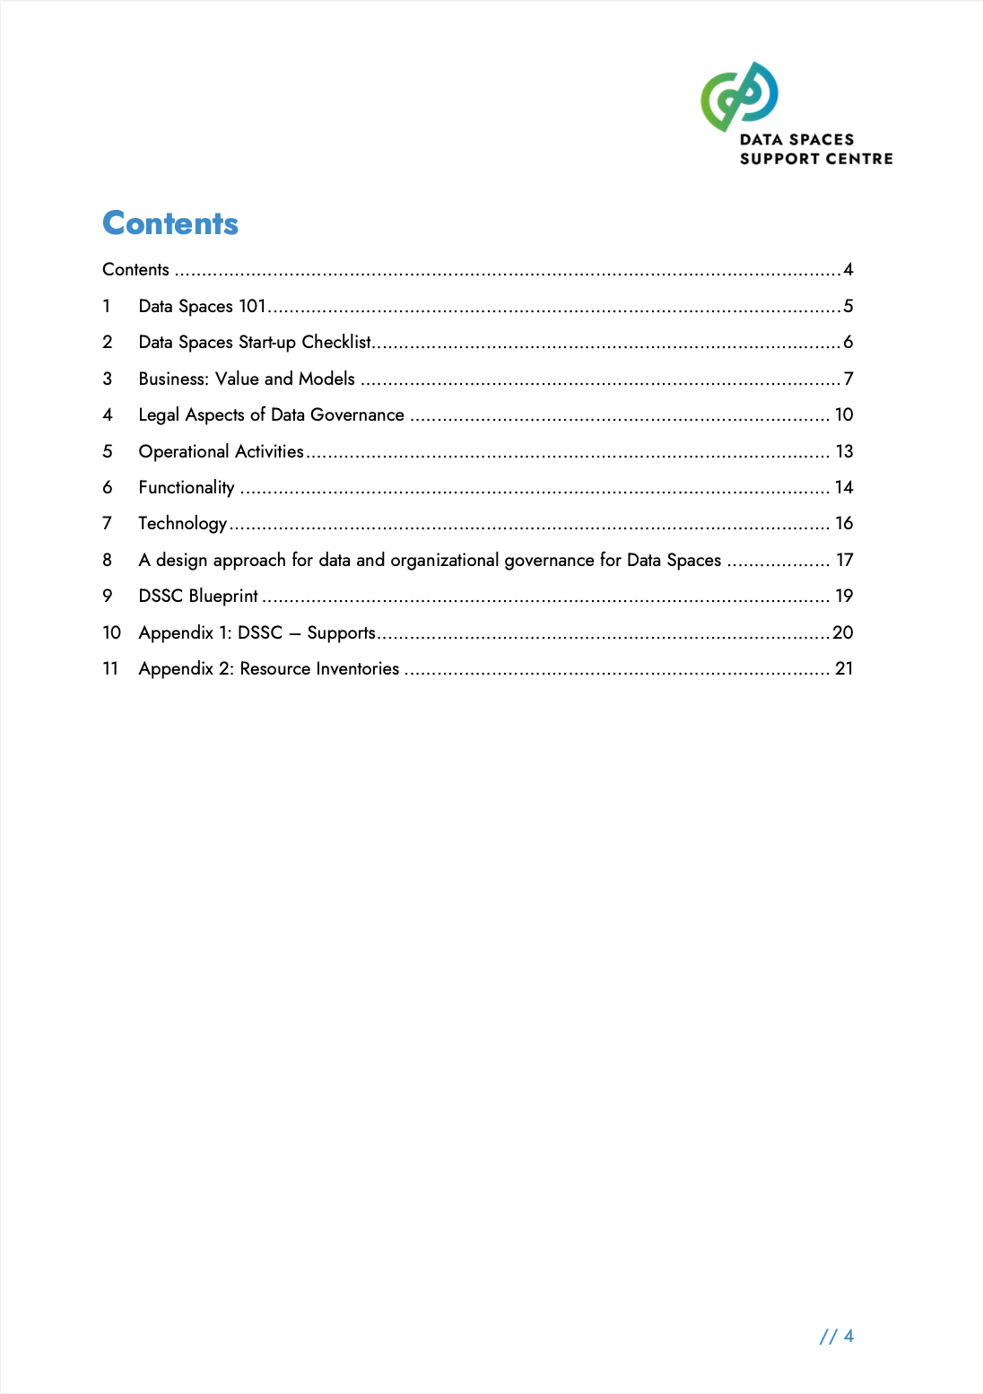
The Starter Kit
An easy introduction to data spaces and Data Spaces Support Centre
For data space designers, data producers, data consumers, providers of intermediary services, or services and business applications.
To be updated later in 2024

Slide 22
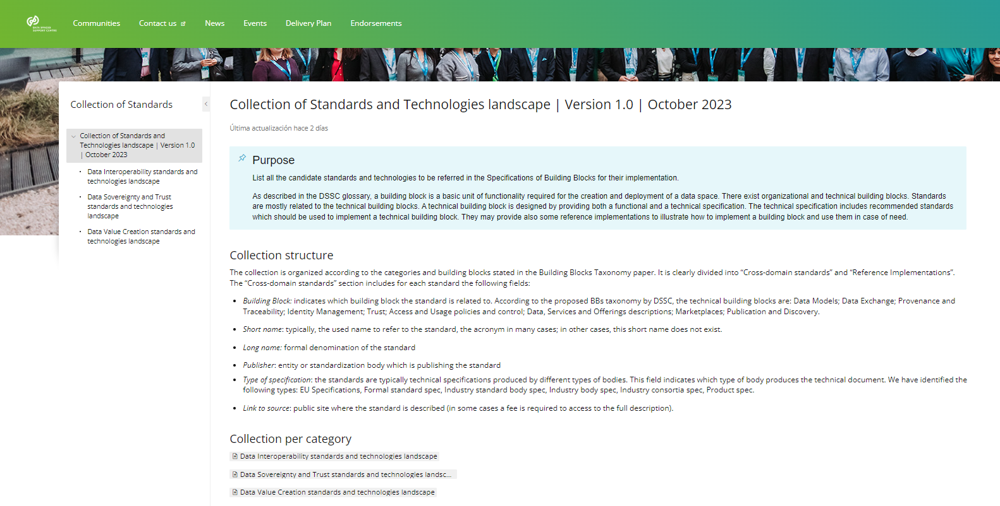
Collection of standards
A map of existing de-facto/de-jure standards and reference implementations candidates for the technical descriptions of the Building Blocks
In co-creation with the data spaces initatives and stakeholders
130 collected standards (Sep 2023)
Available through DSSC web site
Open for contributions (feedback form)

Slide 23
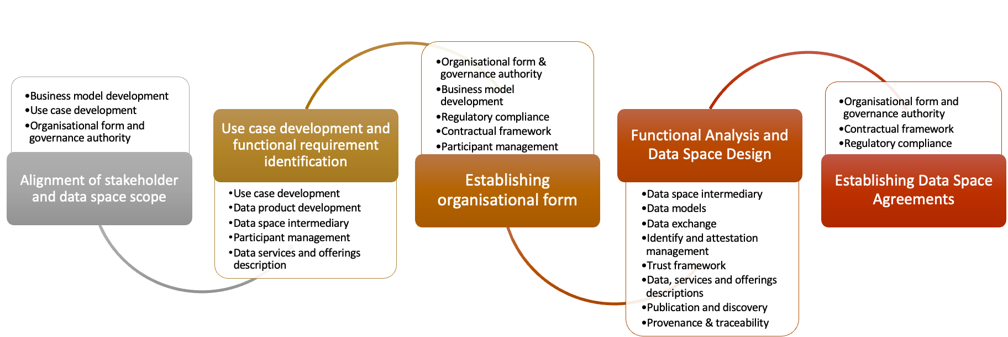
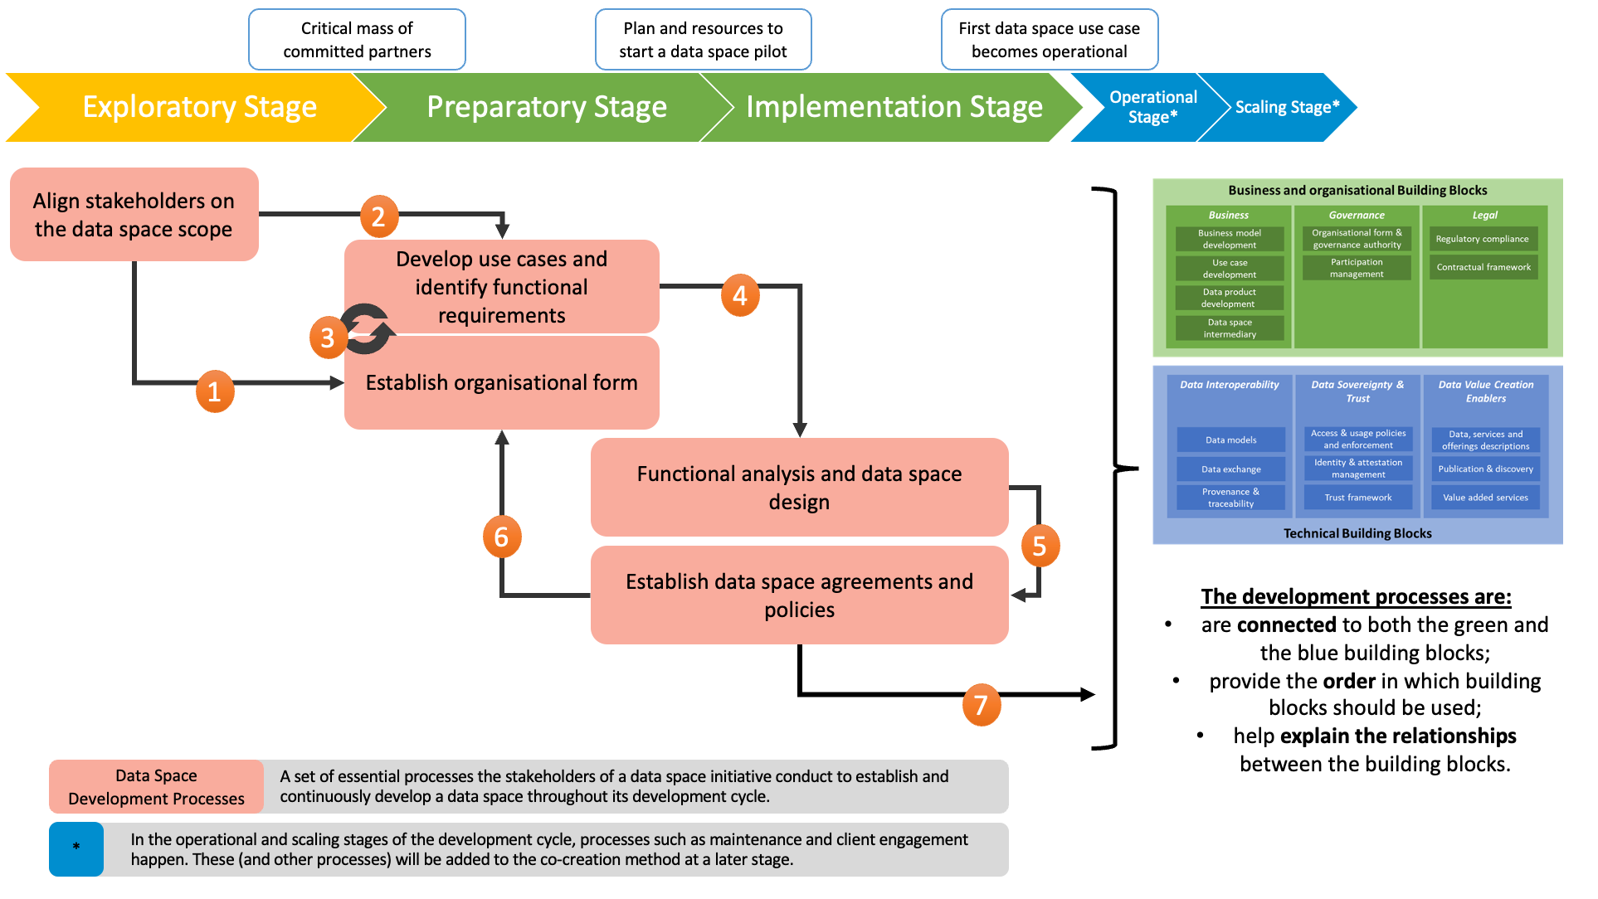
The Co-Creation Method
A guide to select which building blocks and components are typically used to address your use case.
Aligned to the maturity level of your data space.
Enabling you to be agile in your implementation.

Slide 24
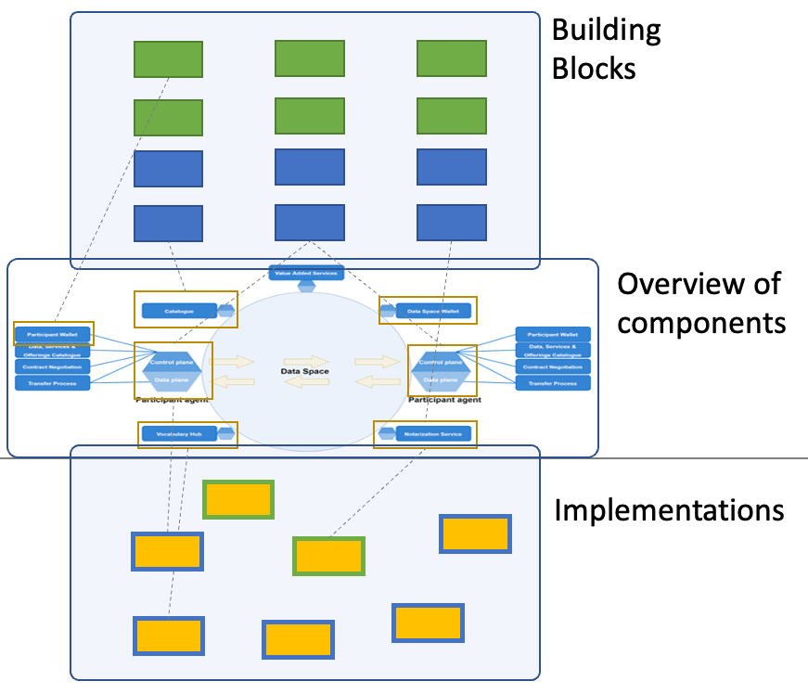
The Toolbox (coming late 2024)
Translating the functional specification of building blocks and components into actual implementations available “in the wild”
Not just technology implementations but also business and organisational

Slide 25
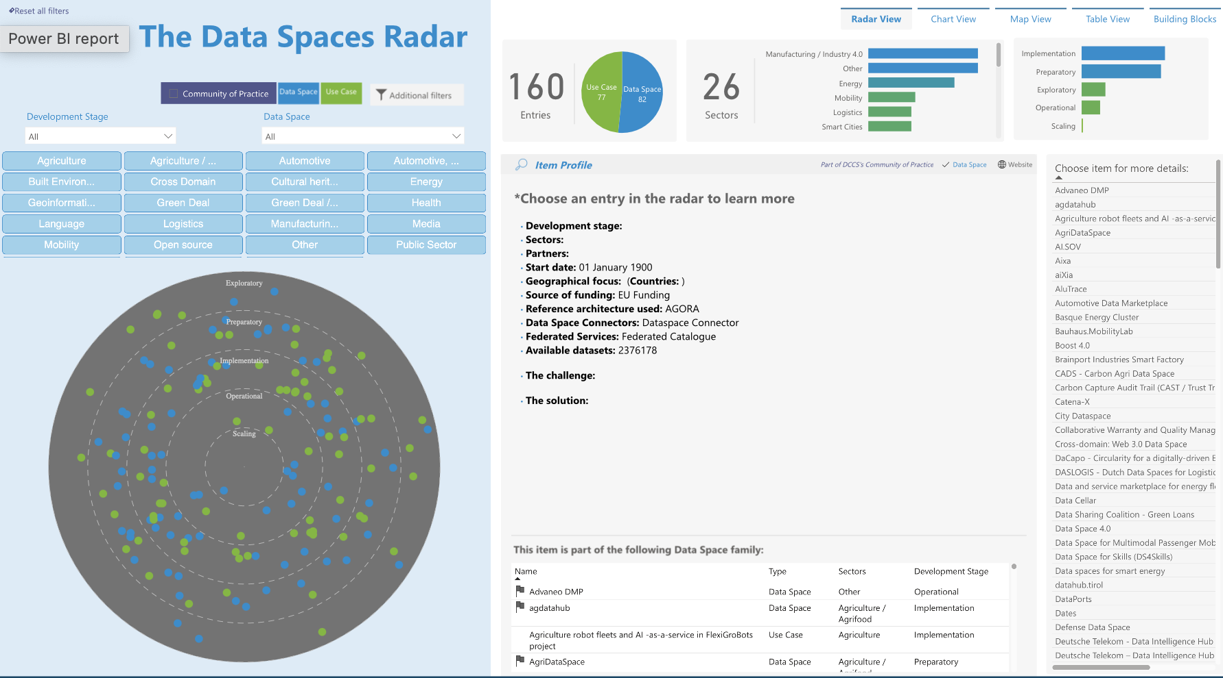
The Radar
A tool to collect and offer information back about data spaces and use cases, whether EU-funded or commercial
>150 initiatives and use cases listed across 23 sectors

Slide 26
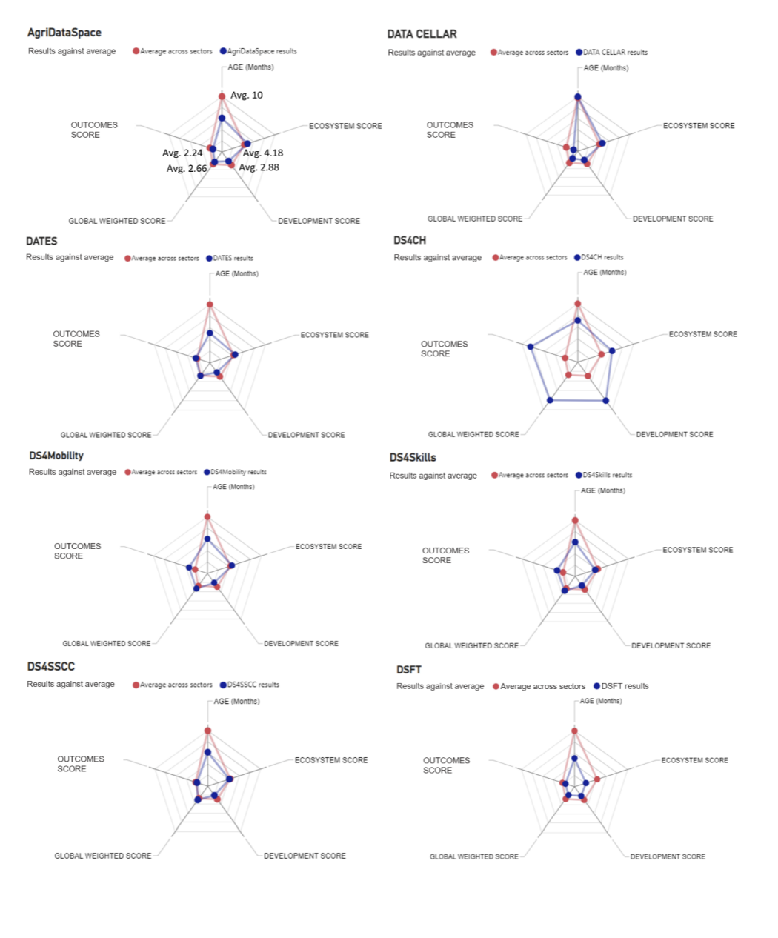
Impact monitoring and evaluation
The first ”maturity model” offering a benchmark and a shared reference to evaluate our efforts designing and operating data spaces.
To learn from the experience and challenges of others.

Slide 27
Support platform
To get in touch with the experts in the team and get opinion and advice.
>1200 requests addressed in ~1,5 years.

Slide 28
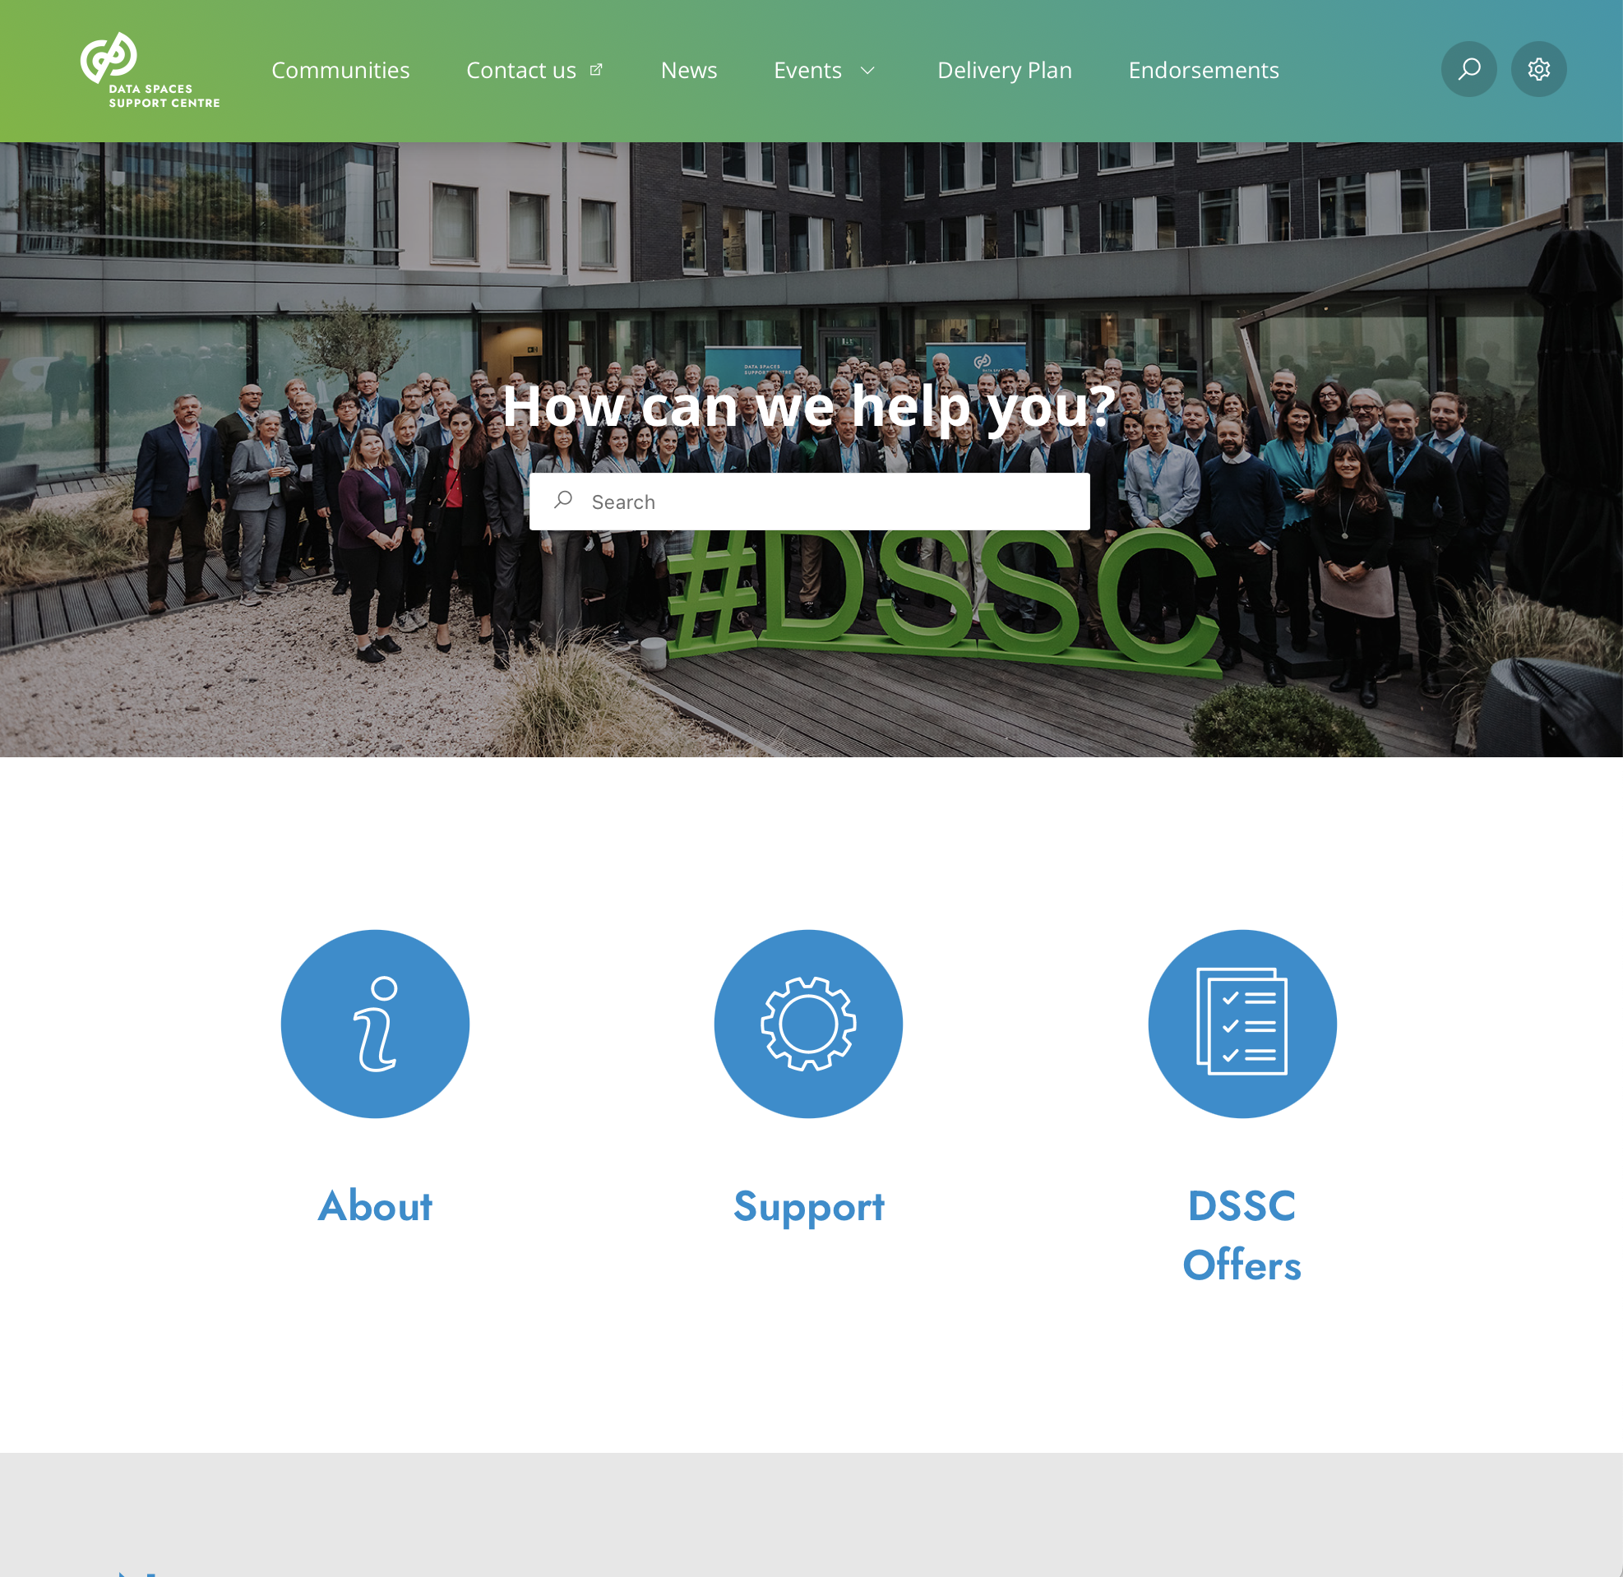
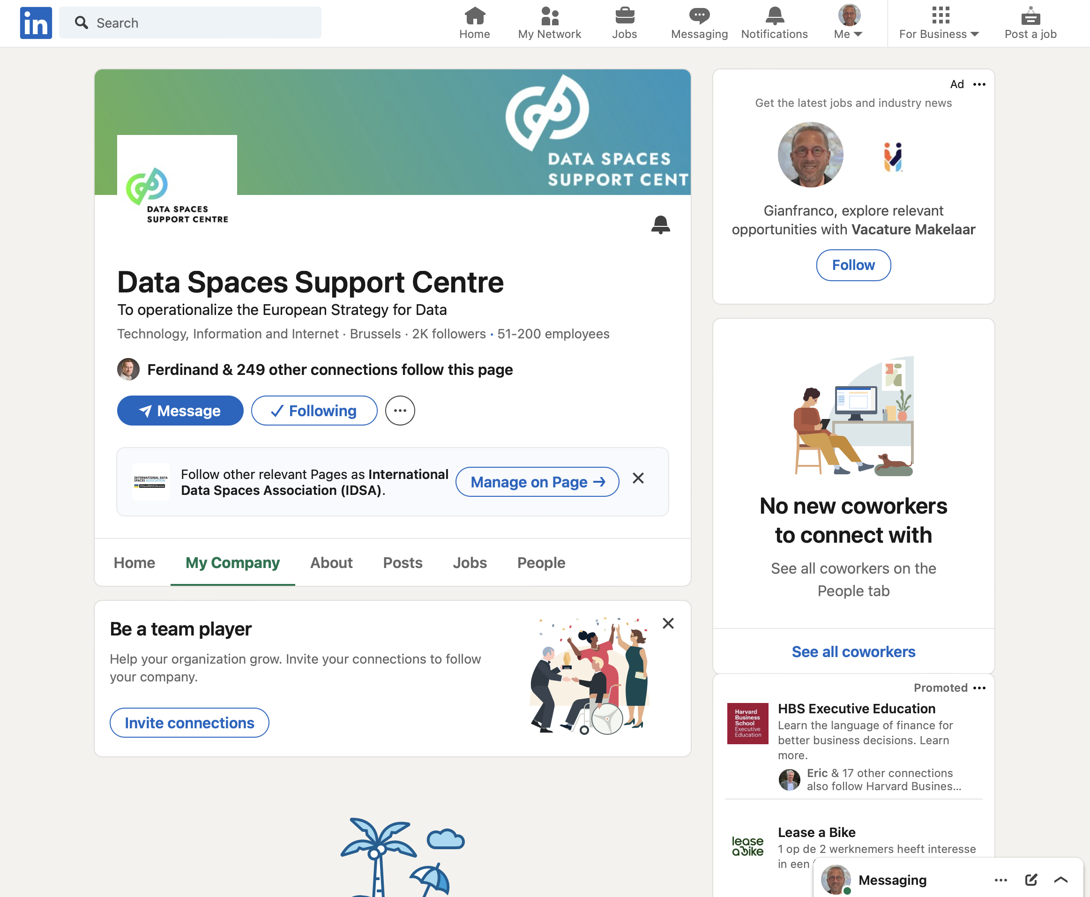
Communications
Keeping you connected and informed.
Subscribe to our newsletter! Engage with us!

Slide 29
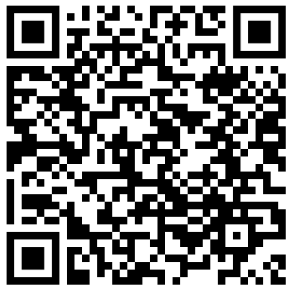
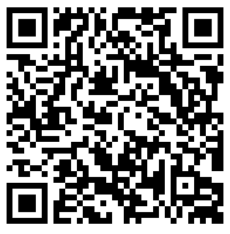
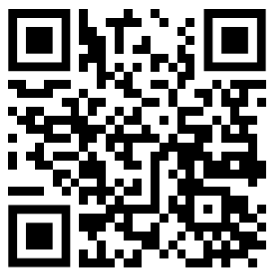
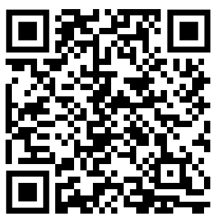
Where to find out more
Sign up for the Data Spaces Support Centre newsletter using the QR-code or at tinyurl.com/dssc-newsletter …….
Join our community at tinyurl.com/dssc-get-involved ……………………………
Use our resources at tinyurl.com/dssc-knowledge-base ………………………………………………………
Get support at tinyurl.com/dssc-support ……………………………………..

