Slide 1
The thematic Research Infrastructures view on research results valorisation
Anca Hienola
-OSCARS-
Finnish Meteorological Institute

Slide 2
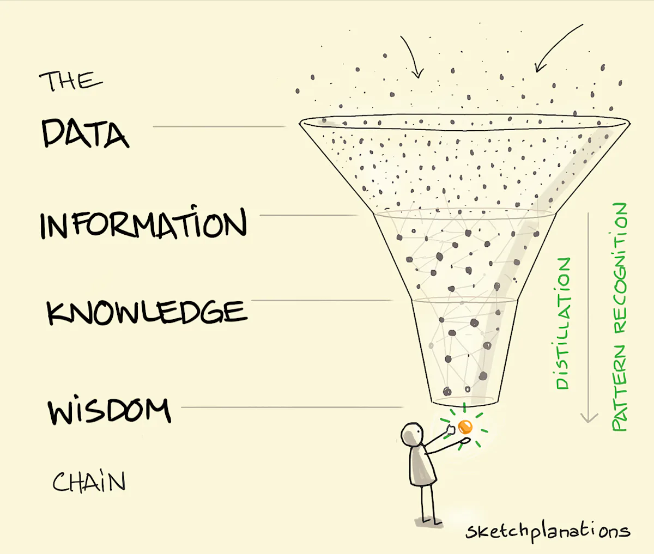
RESEARCH RESULTS VALORISATION DEFINITION
The process of generating value from KNOWLEDGE by connecting various fields and sectors.
It converts DATA and research findings into sustainable products and SOLUTIONS that benefit society,
enhancing economic prosperity, environmental sustainability, social progress, and informed policy-making.
Notes:
I started to conceptualize this presentation from the definition of research results valorisation. While knowledge itself is good, it’s even better when it’s applied to help solve the big challenges facing our societies.
Many components must come together to ensure research has a lasting impact on society.
Three words attracted my attention: DATA, Knowledge and solutions

Slide 3
RESEARCH RESULTS VALORISATION DEFINITION
The process of generating value from KNOWLEDGE by connecting various fields and sectors.
It converts DATA and research findings into sustainable products and SOLUTIONS that benefit society,
enhancing economic prosperity, environmental sustainability, social progress, and informed policy-making.
Notes:
Which reminded me of the well known DIKW framework.

Slide 4
Project Management Infographics
Uncovers patterns, trends
and relatioships
DECISION
Ah, well….
KNOWLEDGE
WISDOM
Understanding, integrated, actionable
INFORMATION
Organized, structured, contextualized
DATA
Signals, raw, unprocessed data
Notes:
Data: It is the foundation of science providing the empirical evidence needed to test hypotheses, validate theories, and build a cumulative foundation of knowledge.but holds limited value in isolation. Data, given context, becomes information.

Slide 5
Project Management Infographics
Uncovers patterns, trends
and relatioships
DECISION
Ah, well….
KNOWLEDGE
WISDOM
Understanding, integrated, actionable
INFORMATION
Organized, structured, contextualized
DATA
Signals, raw, unprocessed data
Notes:
Information:useful answering basic questions: what when where, how was it measued . Information given meaning becomes knowledge.

Slide 6
Project Management Infographics
DECISION
Ah, well….
WISDOM
Understanding, integrated, actionable
KNOWLEDGE
Uncovers patterns, trends
and relatioships
INFORMATION
Organized, structured, contextualized
DATA
Signals, raw, unprocessed data
Notes:
Knowledge is the result of analyzing and interpreting information to uncover patterns, trends, and relationships. It provides an understanding of "how" and "why" certain phenomena occur. Given insight, becomes wisdom.

Slide 7
Project Management Infographics
DECISION
Ah, well….
WISDOM
Understanding, integrated, actionable
KNOWLEDGE
Uncovers patterns, trends
and relatioships
INFORMATION
Organized, structured, contextualized
DATA
Signals, raw, unprocessed data
Notes:
Wisdom: reveals principles, reveals direction. Unlike the other levels, wisdom operates in the future, enabling us to anticipate and prepare for upcoming challenges. The data-driven approach not only answers to “what?” and “why?”, but suggests “what’s next” and “how to do it right”. Given purpose, becomes decision.

Slide 8
Project Management Infographics
DECISION
Ah, well….
WISDOM
Understanding, integrated, actionable
KNOWLEDGE
Uncovers patterns, trends
and relatioships
INFORMATION
Organized, structured, contextualized
DATA
Signals, raw, unprocessed data
Notes:
Decision: well, in an ideal world, the decision making would be based on the wisdom provided by scientists. But we know this is not always the case.
This diagram shows well at least part of the research results valorisation, where Ris, thematic clusters have very evident roles.

Slide 9
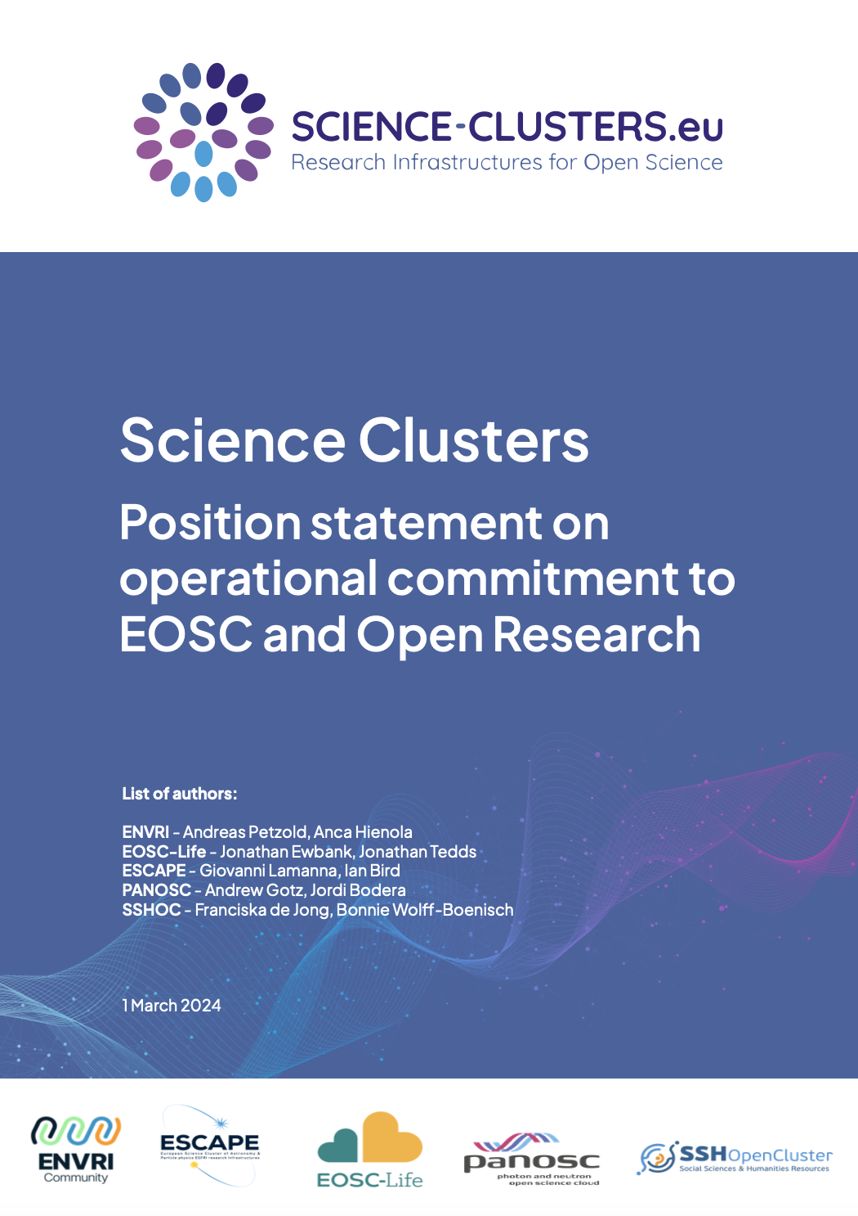
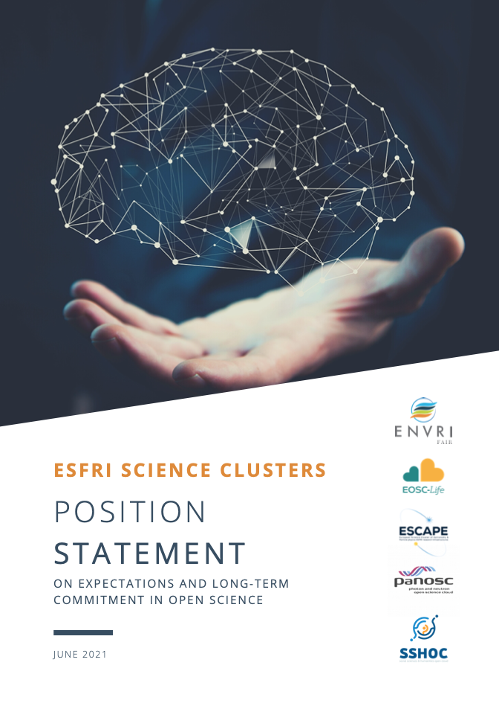
ESFRI SCIENCE CLUSTERS
The Science Cluster concept was aimed at supporting “Open-science data-intensive research” in order to “raise productivity of researchers and to lead to new insights and innovation” and has enabled broader synergies and shared visions
https://zenodo.org/record/3675081 - .X2R2PJNLhTY
https://zenodo.org/record/4889503
https://indico.in2p3.fr/event/24327/
https://doi.org/10.5281/zenodo.10732049
Notes:
I would like to remind you that The Science Cluster concept was designed to support open-science data-intensive research with the goal of enhancing researchers' productivity and fostering new insights and innovation. Simply the definition of the concept leads us back to the idea of valorisation.

Slide 10
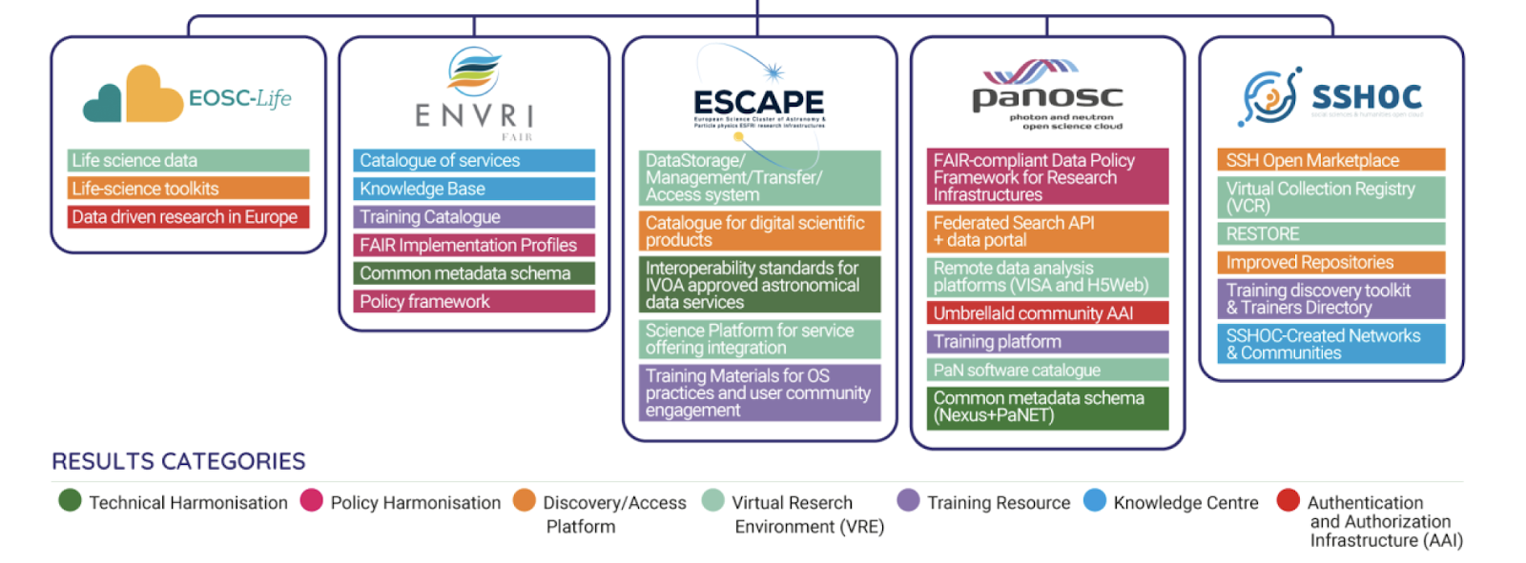
Project Management Infographics
Notes:
The closer we are to the base of the pyramid, the larger the impact of the Ris, thematic clusters.
The individual RIS, the Thematic clusters projects (you see the 5 of them on the slide) play important roles in neasly all of the layers of the pyramid by bringing to the table massive amount of high quality data, by fostering collaboration, standardization, and accessibility within specific scientific domains and also cross domains. This collaborative approach enables comprehensive and multidimensional analysis, promoting a deeper understanding of complex scientific phenomena. All these lead to the ability to guide informed decision making and innovative solutions to complex societal challenges. As for the peak of the pyramid, well, science can illuminate the path towards informed decisions but cannot impose the final choice. The ultimate decision making authority remains with the stakeholders.

Slide 11
Notes:
All these data efforts are commendable, but is it enough? The real revolution and valorisation comes from seeking beyond our cluster bubble, through cooperation with other projects and e-infrastructures.
The five ESFRI cluster projects had extensive collaboration that culminated with the OSCARS project. They devised a little different perspective on the European Open Science Cloud (EOSC), emphasizing the consolidated e-infrastructures, open science principles, and the content and user engagement within scientific communities. These projects propose an "alternative" interpretation of the EOSC acronym, focusing on these three building layers. You see, we thought of the e-infrastructures as part of the family.
I was hoping to have at least one presentation where I do not mention the word EOSC. I failed. Nevertheless, all these things can exist also without EOSC.

Slide 12
VISION SLIDE
Make a big impact with our professional slides and charts
The Science Clusters and e-infrastructures have
synergistically crafted an advanced a white paper on SRIA.
Science Clusters and the e-infrastructures developed
cutting-edge project proposals.
(ENVRI-hub NEXT, OSTrails)
The Clusters and the European e-Infrastructures are dedicated to collaborating and actively playing a role in ensuring the success of the European Open Science Cloud (EOSC).
Notes:
The science clusters and e-infrastructures bring value to eachother by cooperating, supporting and working together. For example, A joint statement on the EOSC Strategic Research and Innovation Agenda (SRIA) was released by the ESFRI Science Clusters and the four main European e-infrastructures underscore the importance of orienting services around diverse community needs, thereby driving data valorization by ensuring that research outputs are effectively utilized to foster societal and economic benefits.
As such, understanding this, the science clusters and e-infras developed project proposals aimed at advancing their collective efforts within the European Open Science Cloud (EOSC).
This showcases theourir proactive approach to fostering collaboration and pushing the boundaries of innovation not only within the European Open Science Cloud (EOSC), but also beyond.

Slide 13
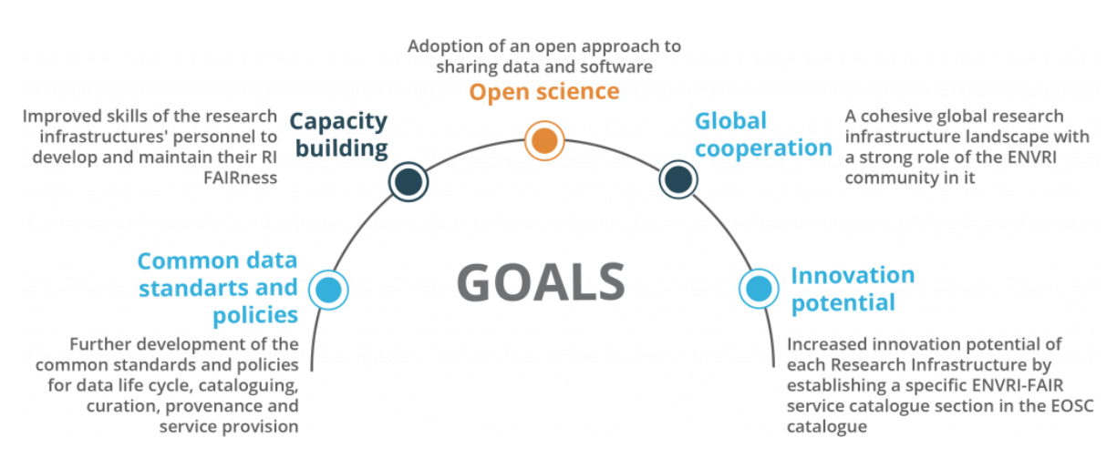
The goal of the Clusters is to advance the FAIRness of
the data and services offered by each Cluster research
infrastructures (and to connect them to the EOSC)
Notes:
Open science is at the core of what both the clusters and e-infras do.
The primary objective of the clusters is to enhance the FAIRness of data and services provided by the research infrastructures and to provide an open access platforms for interdisciplinary research
In order to achieve this, several goals have been established from the beginning.

Slide 14
The Clusters are producers and providers of research data.
WHY? Societal Grand Challenges
CLIMATE CHANGE CRISIS, FOOD Security,
URBANIZATION, HEALTH etc
Need for Open, FAIR, trustworthy data
E-infrastructures provide the technological backbone
Notes:
The RI are the most comprehensive producers and providers of research data in Europe collected from the in-situ and space-based observing systems, etcxperiments, surveys e. .There is an underlying, strong scientific reason behind what the RIs do both separatelly and collectively: the the societal grand challenges such as the climate change crisis.
. Fighting climate change requires easy and fast access to open FAIR,trustworthy, high quality, well-documented observations that capture the complexity of the Earth system and the interactions between the atmosphere, the land and the ocean;
E-infrastructures play a crucial role in this process by providing the technological backbone needed for managing, sharing, and utilizing vast amounts of research data.
In support of my words, I’ll give you some examples:

Slide 15
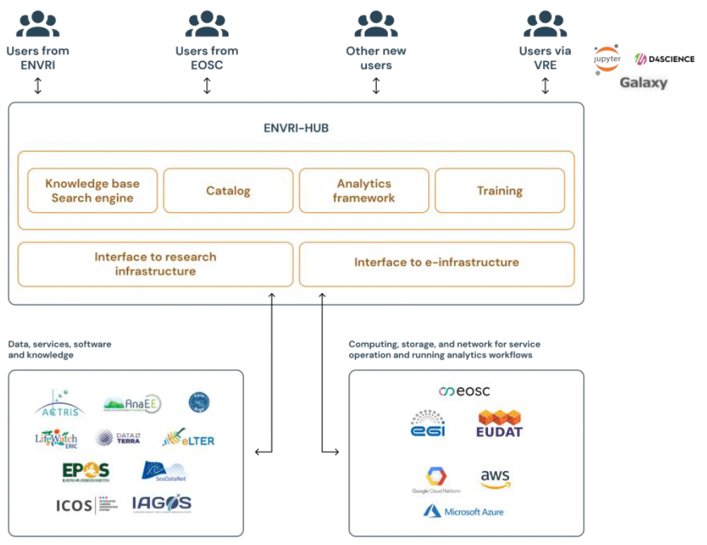
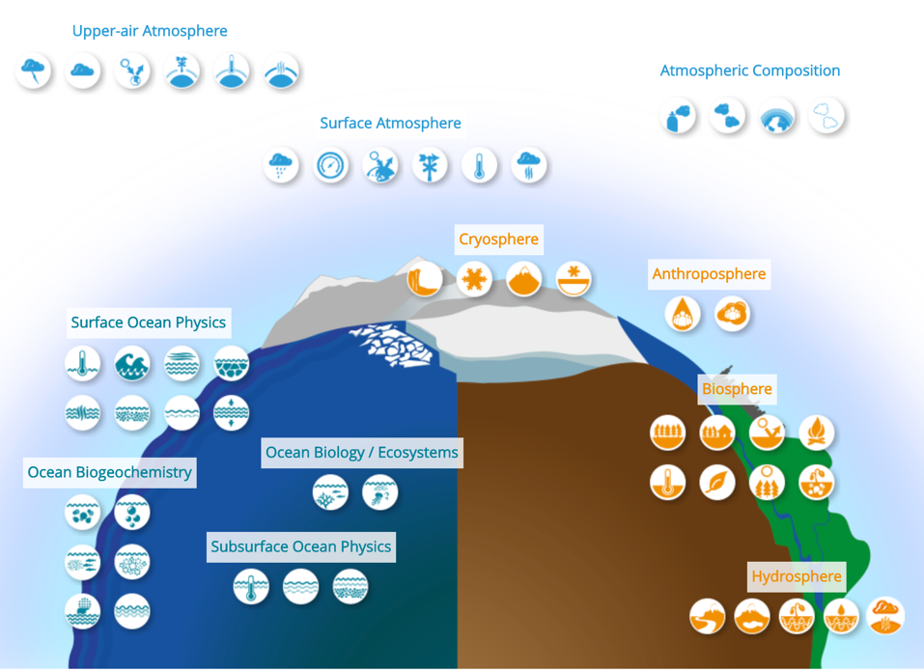
ENVironmental Research Infrastructures delivering an open access Hub and NEXT-level interdisciplinary research framework providing services for advancing science and society
TECHNOLOGY
Cloud Computing Resources
Technical Expertise
Support Services
SCIENCE
Delivers data and services
Leverages Essential Climate Variables
Support for Climate Strategies
Notes:
The first one is envri hub next, which is a cooperation between ENVRI community and EGI. Actually, EGI is coordinationg the project.
ENVRI-Hub is a central gateway to environmental data and services provided by European environmental research infrastructures. It aims to integrate and enhance the accessibility and interoperability of diverse environmental datasets, tools, and services. These services aid in the development of mitigation and adaptation strategies, as well as the assessment of climate risks. This is the science

Slide 16
ENVironmental Research Infrastructures delivering an open access Hub and NEXT-level interdisciplinary research framework providing services for advancing science and society
SCIENCE
Delivers data and services
Leverages Essential Climate Variables
Support for Climate Strategies
TECHNOLOGY
Cloud Computing Resources
Technical Expertise
Support Services
Notes:
In this context EGI provides the technological development. EGI provides cloud-based computing resources for storing, processing, and analyzing large-scale environmental data, along with expertise in data integration and interoperability.

Slide 17
ENVironmental Research Infrastructures delivering an open access Hub and NEXT-level interdisciplinary research framework providing services for advancing science and society
SCIENCE
Delivers data and services
Leverages Essential Climate Variables
Support for Climate Strategies
TECHNOLOGY
Cloud Computing Resources
Technical Expertise
Support Services
Notes:
This is a combination of science and technology..this project is a very good example of a way to engage e-infrastructures towards the scientific endeavours, but strictly led by the scientific community needs. This is fundamental in order to develop, deploy and operate what is really needed for the scientific objectives as well as for leveraging the ENV. data for society, politics and industry.

Slide 18
Virtual Research Environments (VREs)
Competence Centers
Common and New Services
Software Quality and Standards of Coding
Innovative Software Solutions
EU Virtual Institute for Research Software Excellence
Notes:
The Science Cluster's collective actions through OSCARS and EVERSE (where OPENAIRE participates) focus on developing services and frameworks to establish EOSC as the premier Scientific Research Data Space. Virtual Research Environments (VREs), Competence centers and standardized services lead to interdisc collab, innovation, higher research quality. On the other hand, in EVERSE they will deal will. High software standards improve research reliability, while innovative software tools enhance data analysis and discovery. The EU Virtual Institute coordinates efforts across infrastructures, to maximize research impact.
All this participate in opening up further opportunity for societal and economic "valorisation".

Slide 19
Notes:
COPERNICUS CONTINUOUSLY MONITORS THE HEALTH OF OUR PLANET. Every year, Copernicus disseminates a whopping 40 petabytes of data. Coping with this amount of data and high volume of users requires a robust, hard-working infrastructure.
That is why the European Space Agency has an agreement with GÉANT to distribute Copernicus data across the GÉANT and DFN networks.
This right here saves lives, thanks to faster responses to natural disasters, improved border surveillance, protection against respiratory system diseases and skin damage etc

Slide 20
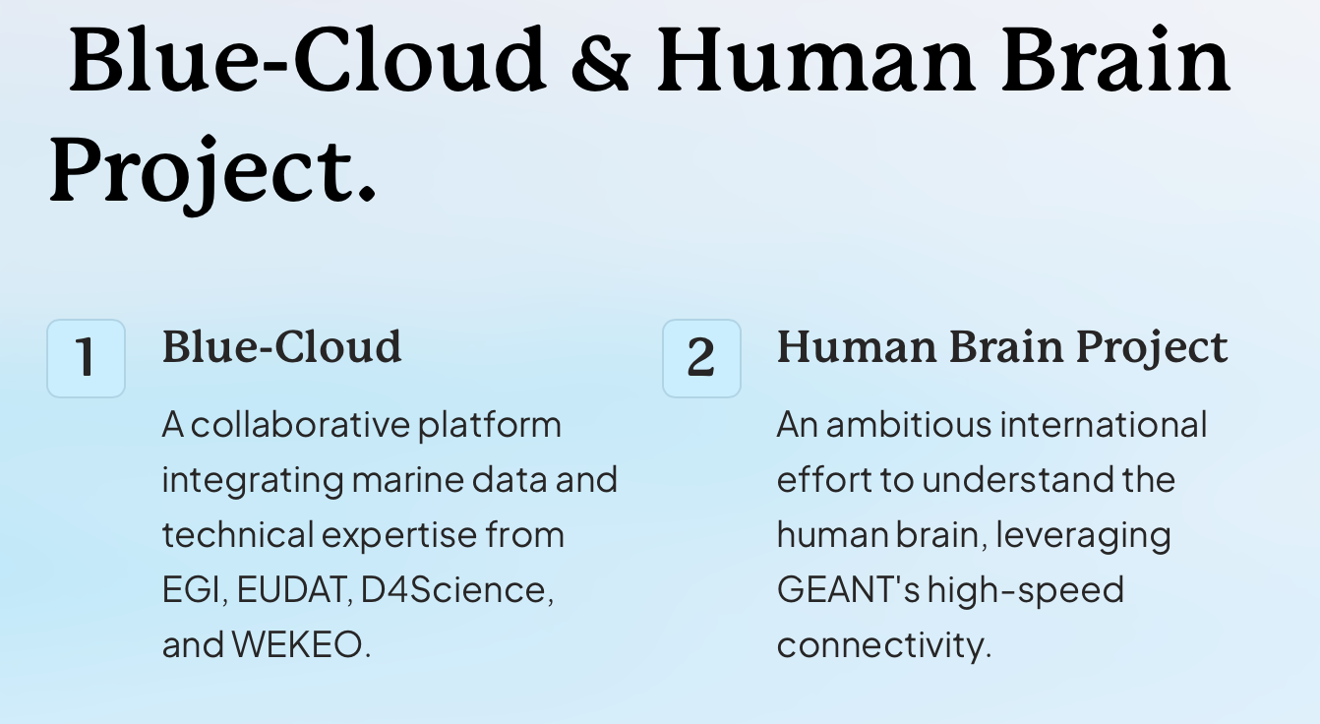
Notes:
Blue cloud is a platform that combines data from various marine research infrastructures which are actually part of ENVRI and the expertise from e-infrastructures. They address issues related to climate change, food, biodiversity conservation, sustainable ocean economy, pollution and natural hazards.
HBP project that evolved into a research infrastructure called eBRAINS pioneered digital brain research. It contributed to a deeper understanding of the complex structure and function of the human brain with a unique interdisciplinary approach at the interface of neuroscience and technology.
Among many success stories there is one that stands out as not being one. OMG, I’m gonna be executed for this.

Slide 21
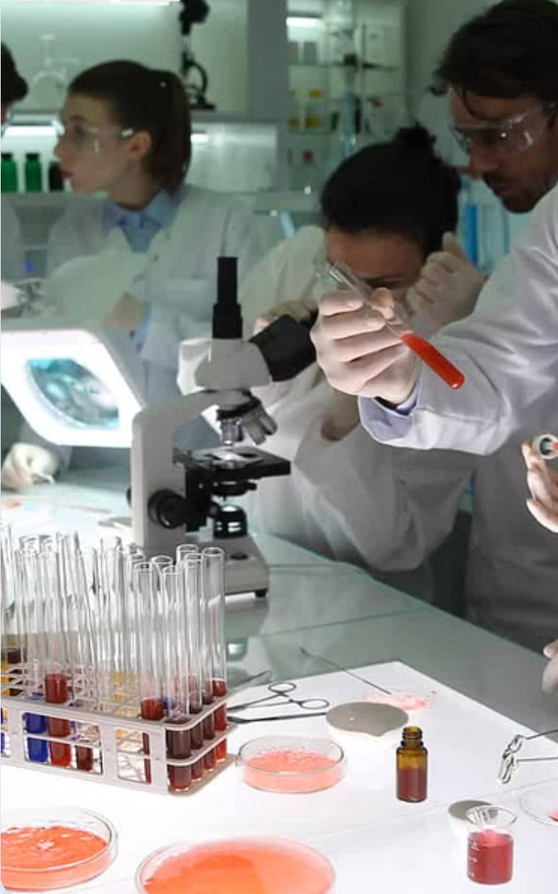
The most impactful scientific breakthroughs with benefits for society often result from synergies between research projects, RIs and e-infrastructures.
The e-infras layer is crucial when it
supports of the science objectives
of a specific scientific initiatives.
Notes:
.
All the success stories with actual benefits to society involve cooperation between projects or RIs and e-infrastructures. With one condition:
The e-infras layer is essential and its impact is maximized when
is deployed as support of the science
objectives of a specific initiatives.

Slide 22
Waiting for my execution…

