Slide 1
Natalia Manola, OpenAIRE CEO
Unlocking Value:
How Open Scholarly Communication Infrastructure Transforms Research Outcomes

Slide 2
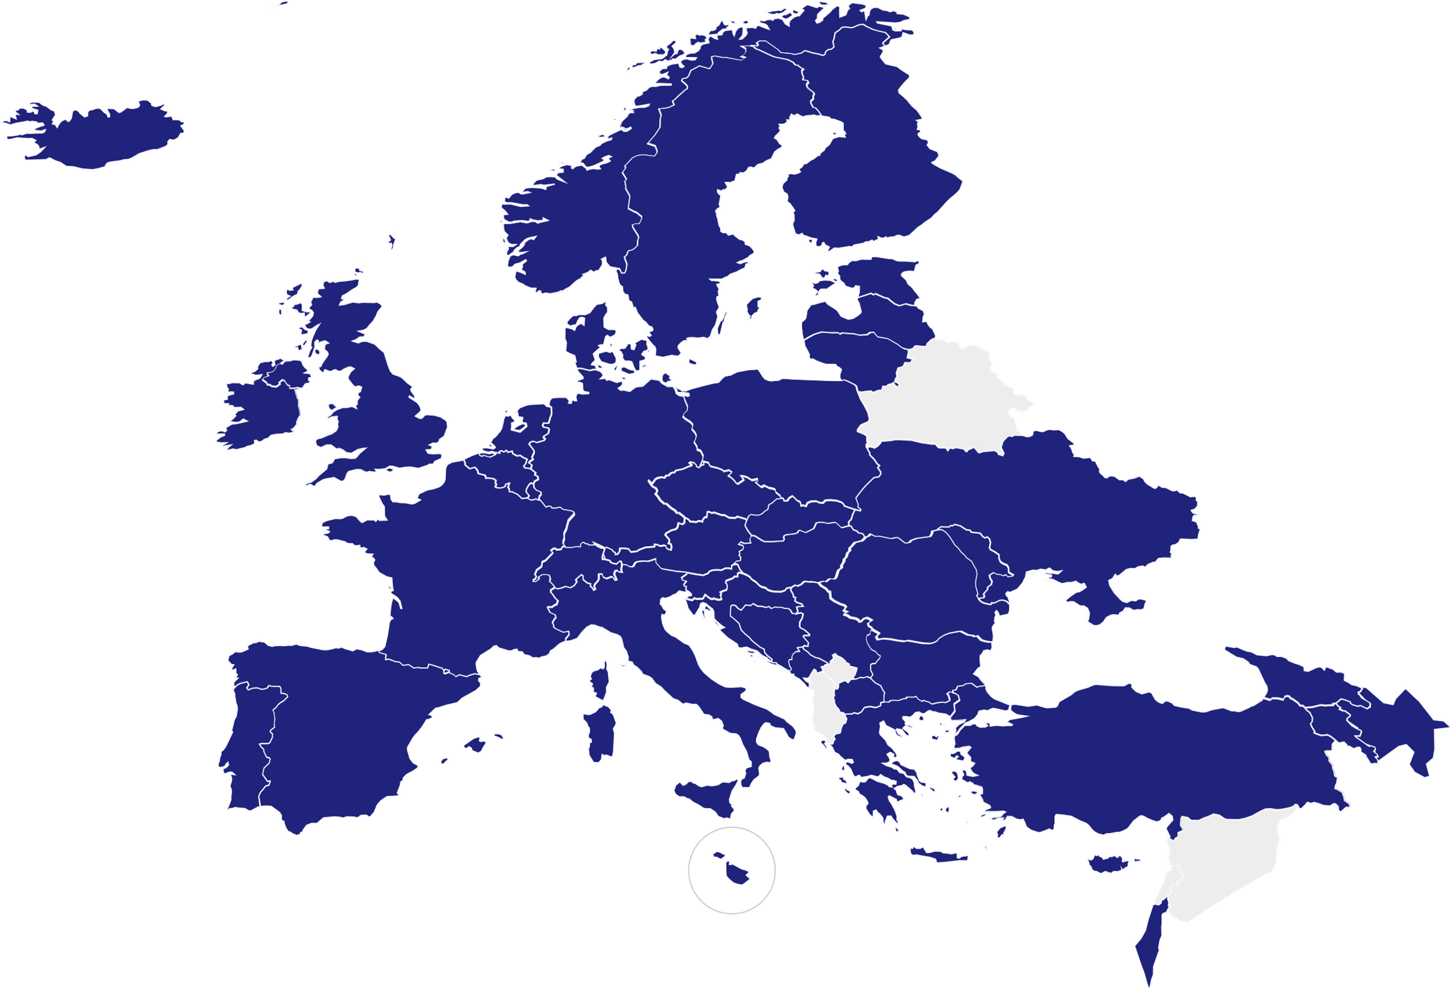
OpenAIRE AMKE
53
members
36
countries
Non-profit organisation, established Oct 2018
Mission: Shift scholarly communication towards openness and transparency and facilitate innovative ways to communicate and monitor research
A Scholarly Communication e-Infrastructure that brings together human capital and advanced ICT services
A network of experts from major national organisations (National Open Access Desks) in operation since 2009
Open Membership!
Join us
Global Collaborations: Latin America, US, Canada, Japan, Korea, …

Slide 3
Strategy 2023-25 Our commitment to facilitate Open Science
https://www.openaire.eu/strategy-2023-25
+AI

Slide 4
Infrastructure & Services

Slide 5
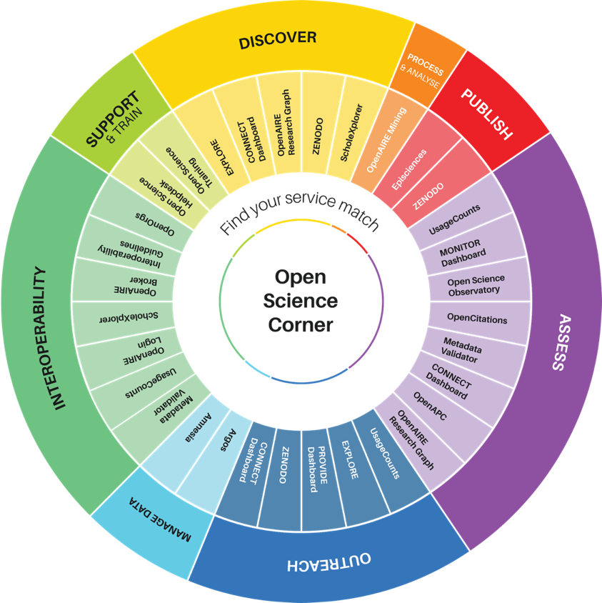
Services in our core
http://catalogue.openaire.eu
Researchers – discover, plan, anonymize, publish
Providers – interoperate, enrich metadata
Research & Funding Performing organizations – track, assess, monitor research & open science
Policy makers & public agencies – assess R&I investments
Building Infrastructure to CONNECT and FEDERATE

Slide 6
1. Focus on Interoperability
OpenAIRE Guidelines
for DATA Repositories
OpenAIRE Guidelines
for LITERATURE Repositories v4.0
OpenAIRE Guidelines
for SOFTWARE Repositories
Guidelines for content providers A common metadata framework and best practices
OpenAIRE Guidelines
for OTHER research products
OpenAIRE Guidelines
for CRIS
OpenAIRE Guidelines
for USAGE statistics
https://guidelines.openaire.eu
Adopted around the world
FAIR BY DESIGN

Slide 7
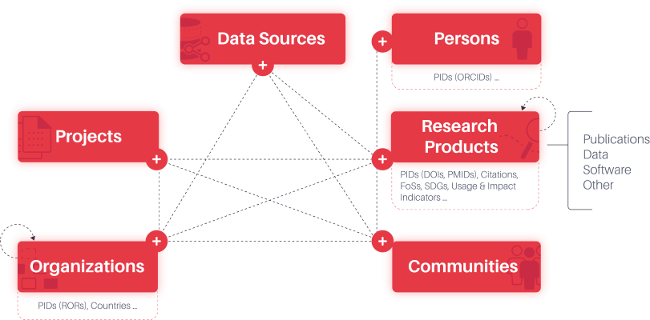
2. The OpenAIRE Graph
https://graph.openaire.eu
176mi publications (+35 mi pdfs)
60 mi data items
374 K software
3 mi grants from 180 funders
FOS Classifications
Citations
SDGs
250 mi API request / year
Used by 3 key Library Commercial services
Replacing Scopus / WoS as Open Infrastructure for bibliometrics
… more in the pipeline
Methods
Facilities
Services

Slide 8
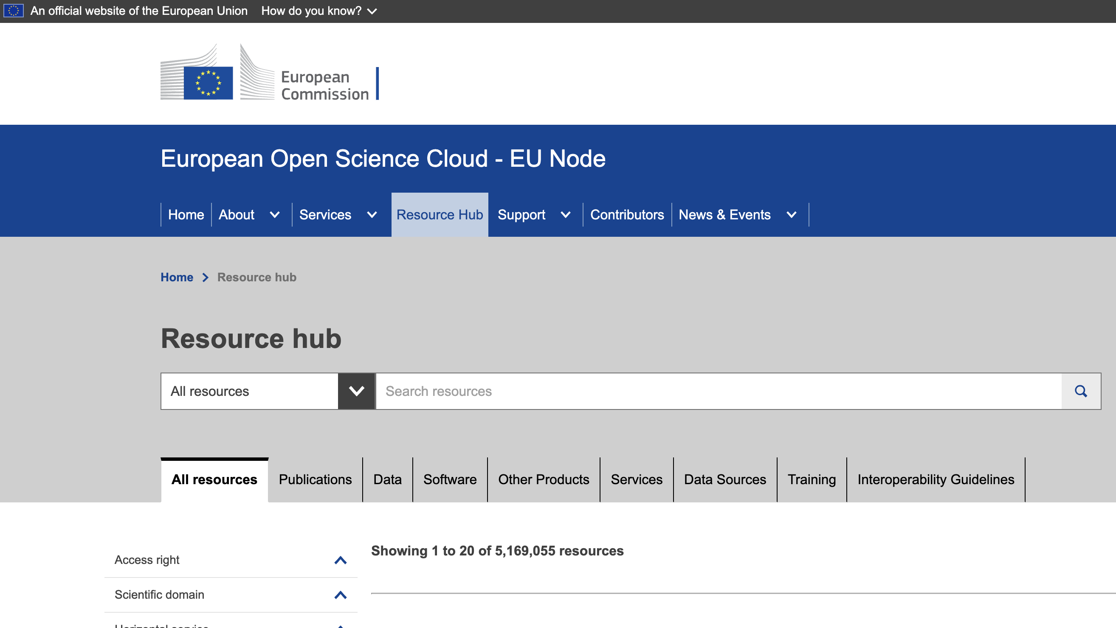
A key asset for Europe & the world
EOSC EU Node
EOSC Federated Nodes
Research Communities
Next Step: LLMs
Ongoing: Country Monitors
Ongoing : APIs

Slide 9
3. Supporting the creation of Scientific Knowledge Graphs
Enhancing metadata through text & data mining
Domain Specific Machine Translation
Data Science Tool for Heterogeneous Network Mining
Discovering Dependencies, Enriching Knowledge
Enriching resource description
High-performance graph analytics
01
02
03
04
05
06
COMMUNITIES
Transport, Cancer, Energy, EBRAINS, PanOSC, LifeWatch, ECRIN, …, CompSci, NFDI, …
Citation Analysis
Impact Propagation
Fields of Classification
Scientific Topic Evolution
Artifact Extraction
11
07
08
09
10

Slide 10
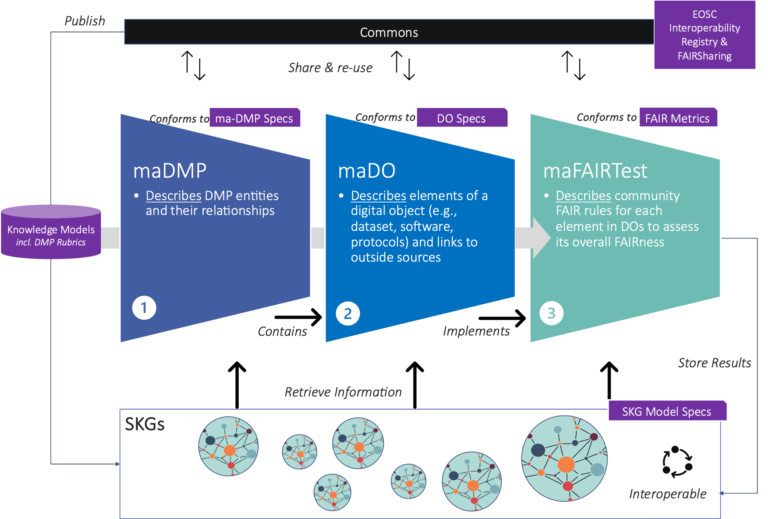
3. Interconnecting Plan-Track-Assess research

Slide 11
Responsible Research Assessment

Slide 12
Open Infrastructure that is relevant to emerging trends
https://graspos.eu/
Next Generation Research Assessment to Promote Open Science
Working Group on Open Infrastructures for Responsible Research Assessment
EOSC - Building a Research Assessment Data Space data & tools on OpenAIRE, Operas, OpenCitation, CRIS, …

Slide 13
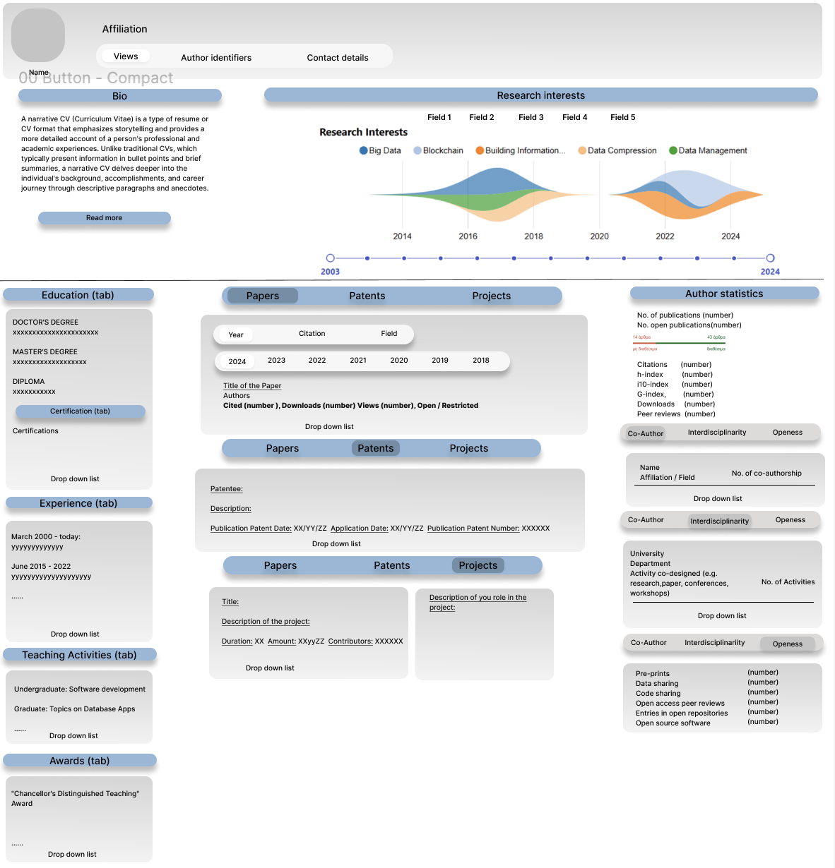
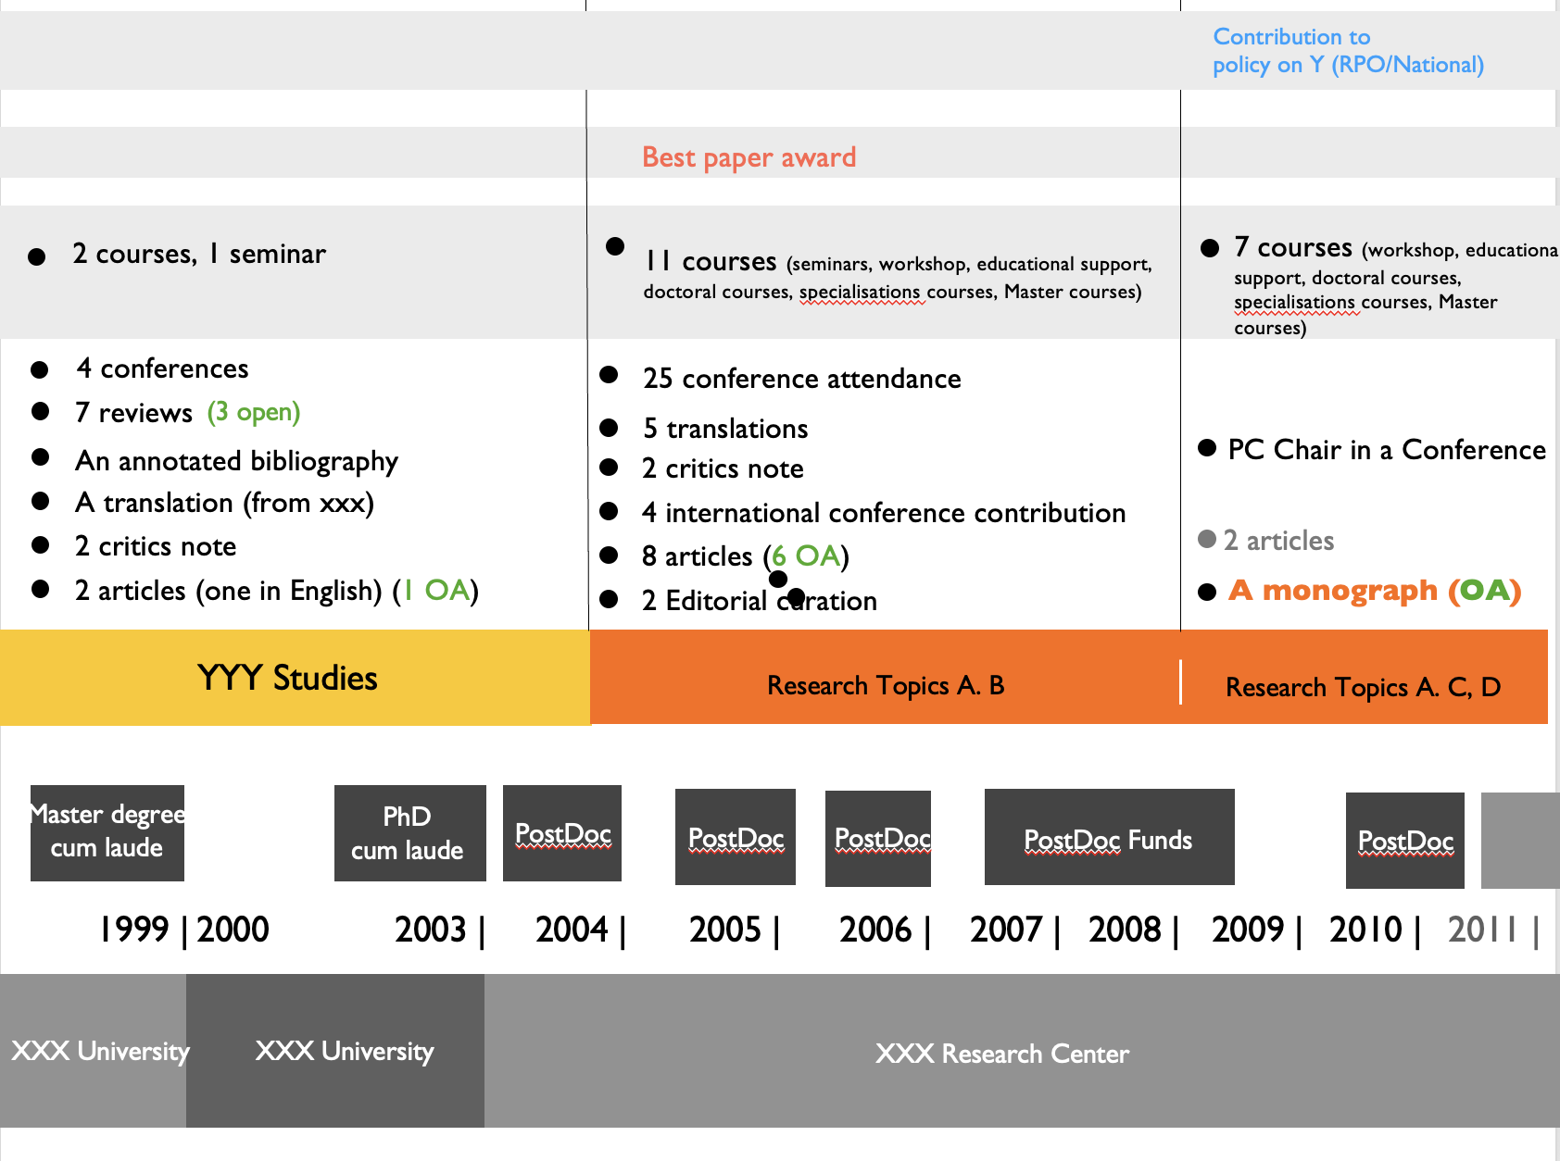
Researcher Profile – As-a-Service

Slide 14
Monitoring Open Science

Slide 15
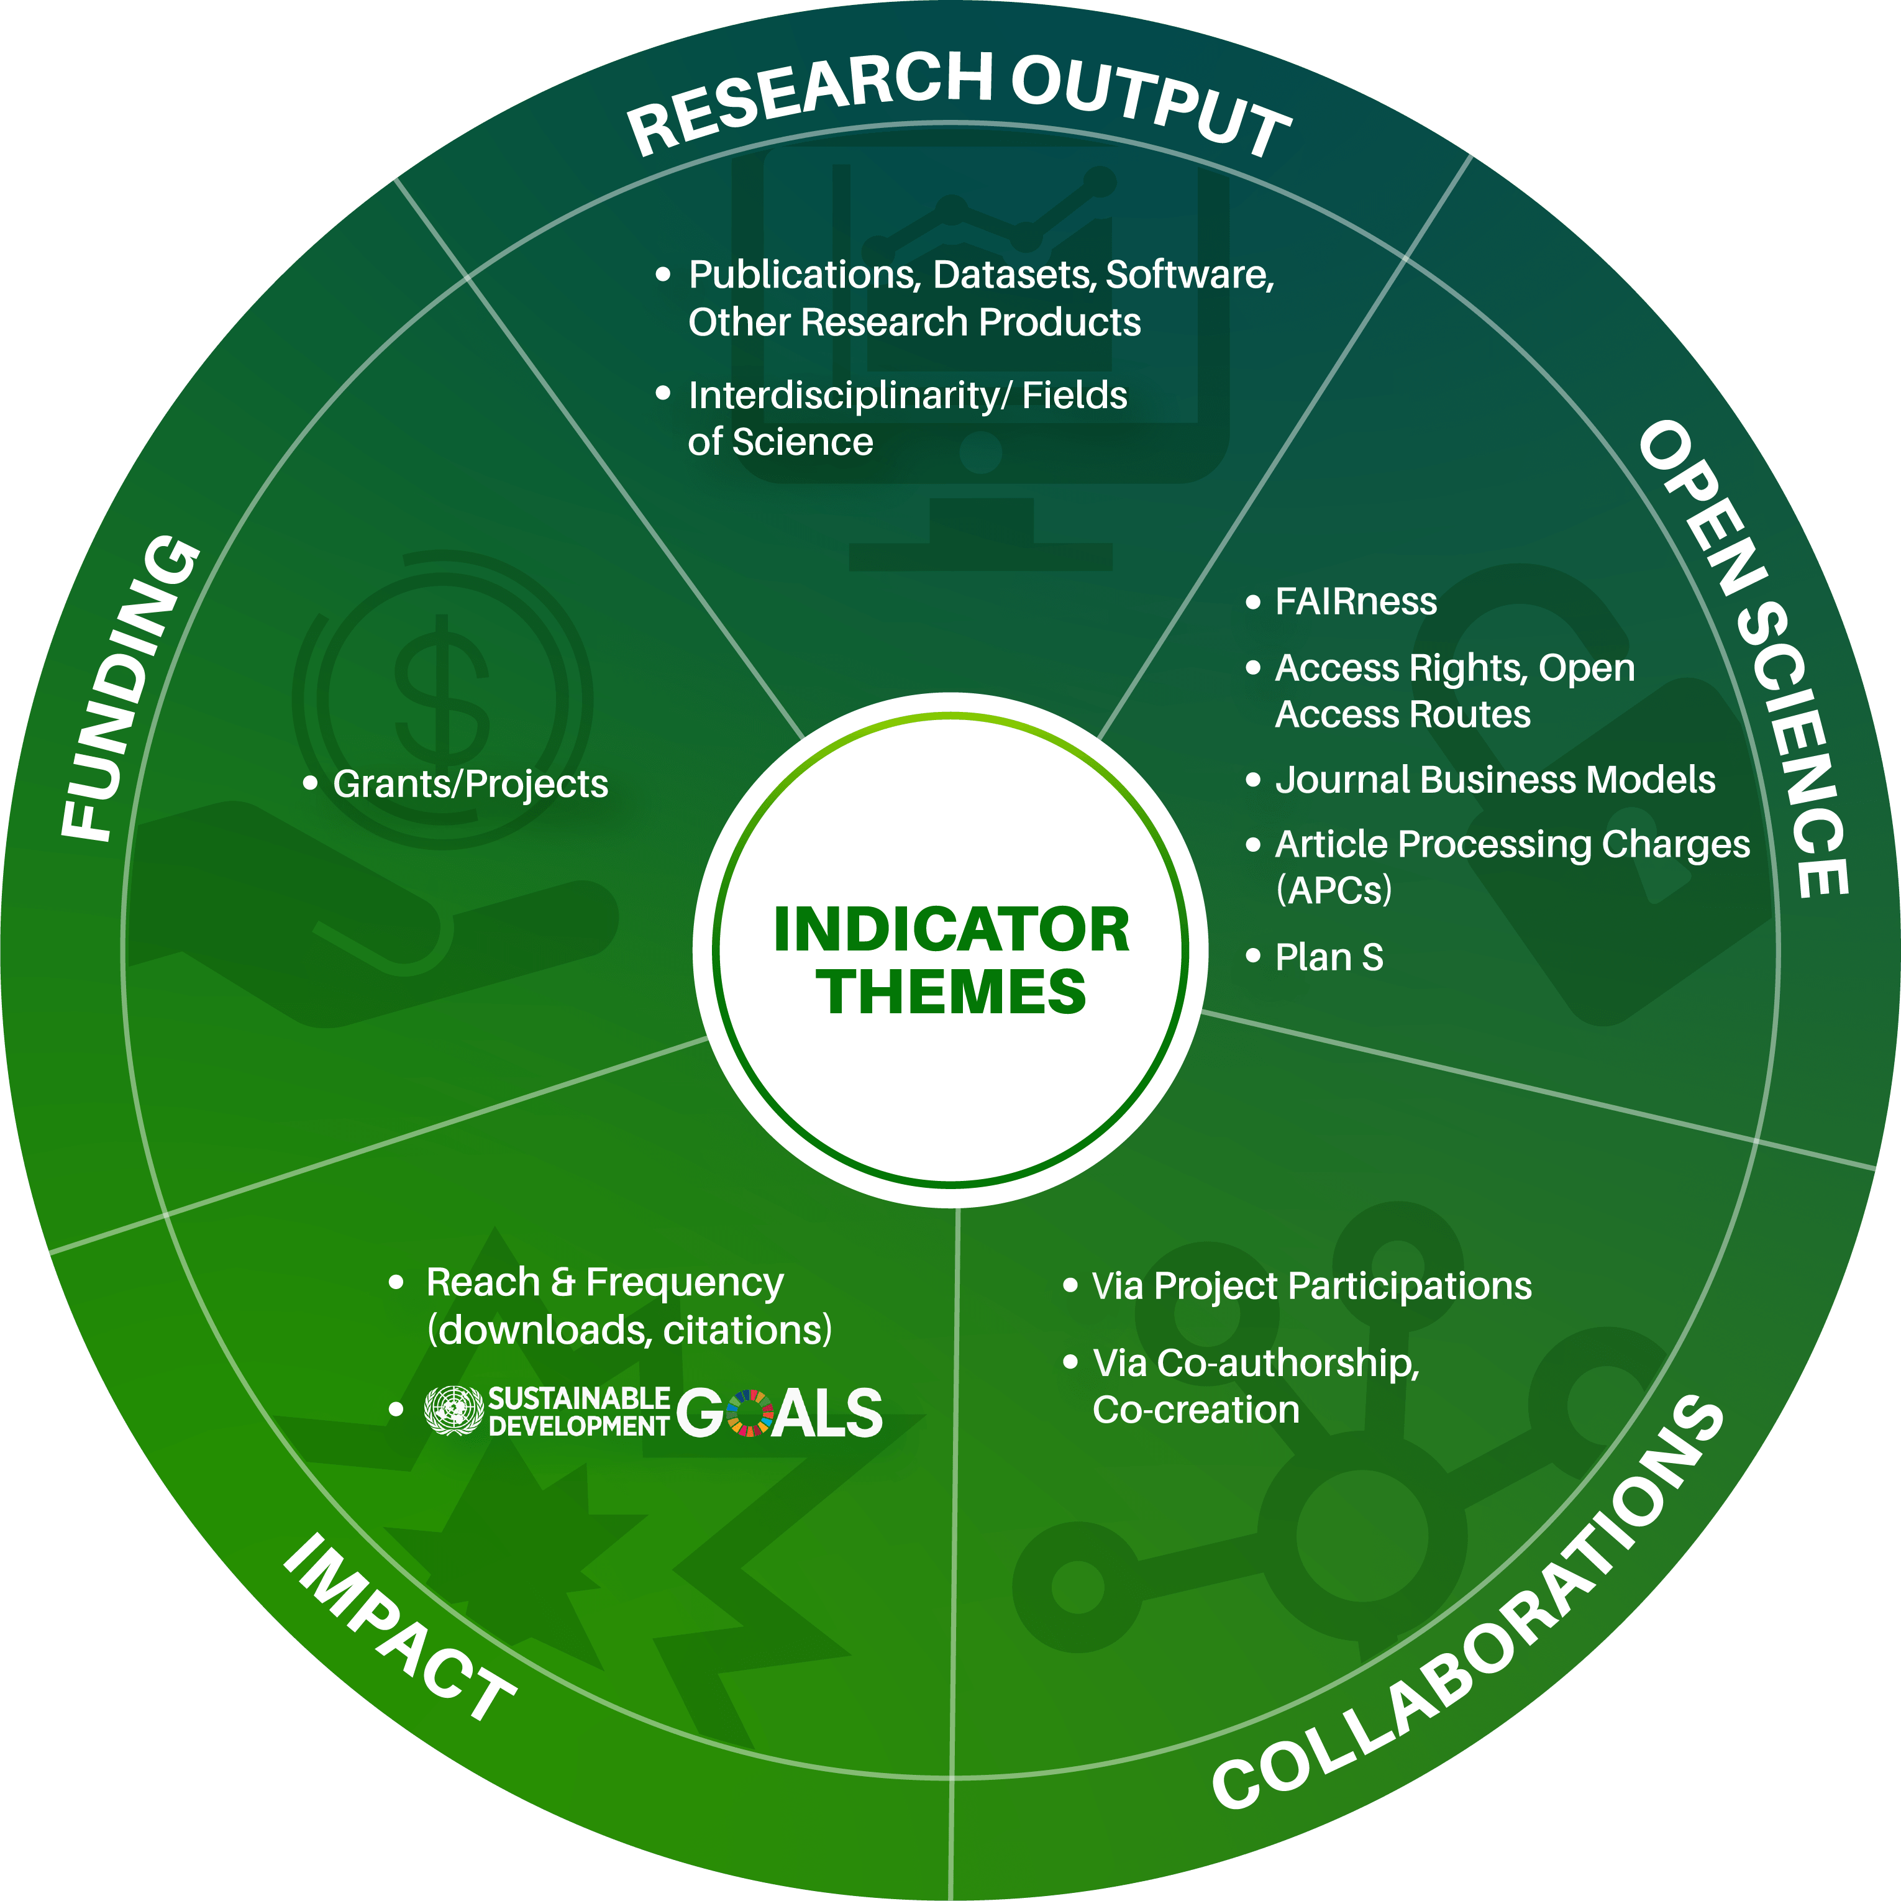
Indicators for (Open) Science

Slide 16
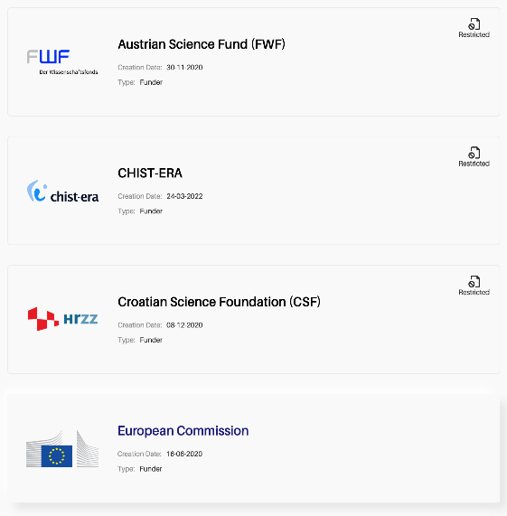
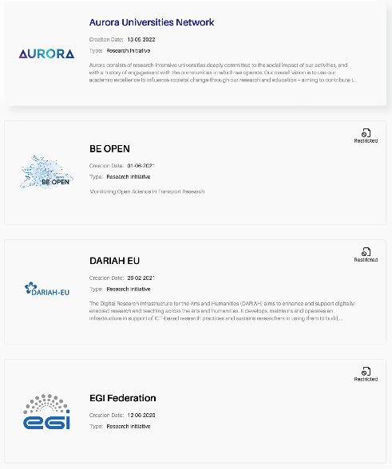
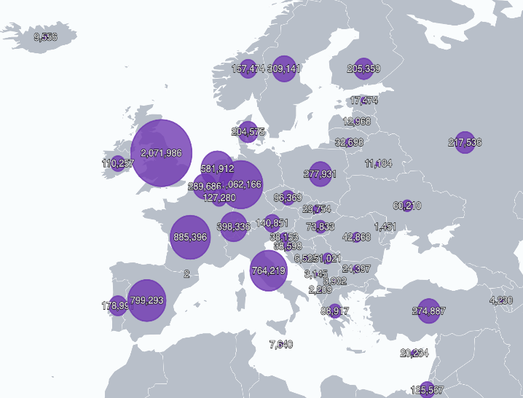
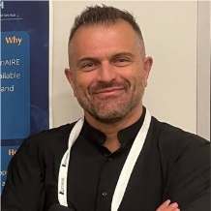
Customizable Dashboards-on-Demand
OBSERVATIONAL DASHBOARD
https://monitor.openaire.eu
https://osobservatory.openaire.eu
Institutions
Funders
Research Initiatives
Countries
OpenAIRE expert
Leonidas Pispiringas
OpenAIRE expert
Harry Dimitropoulos
OpenAIRE expert
Alessia Bardi
OpenAIRE expert
Ioanna Grypari

Slide 17
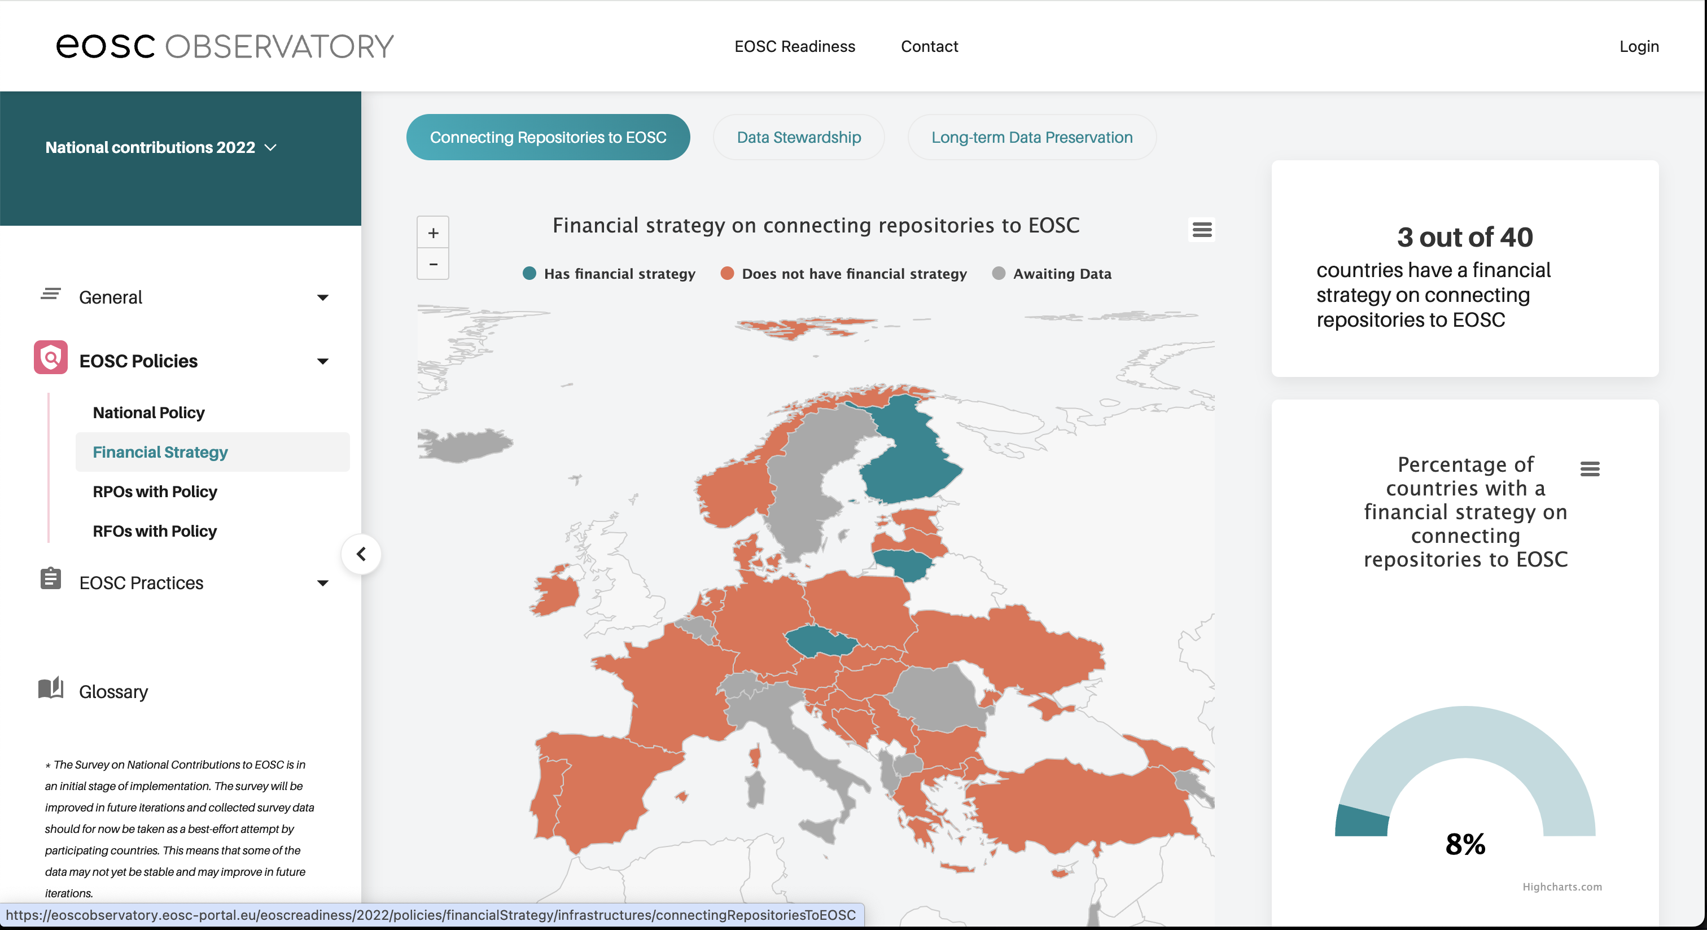
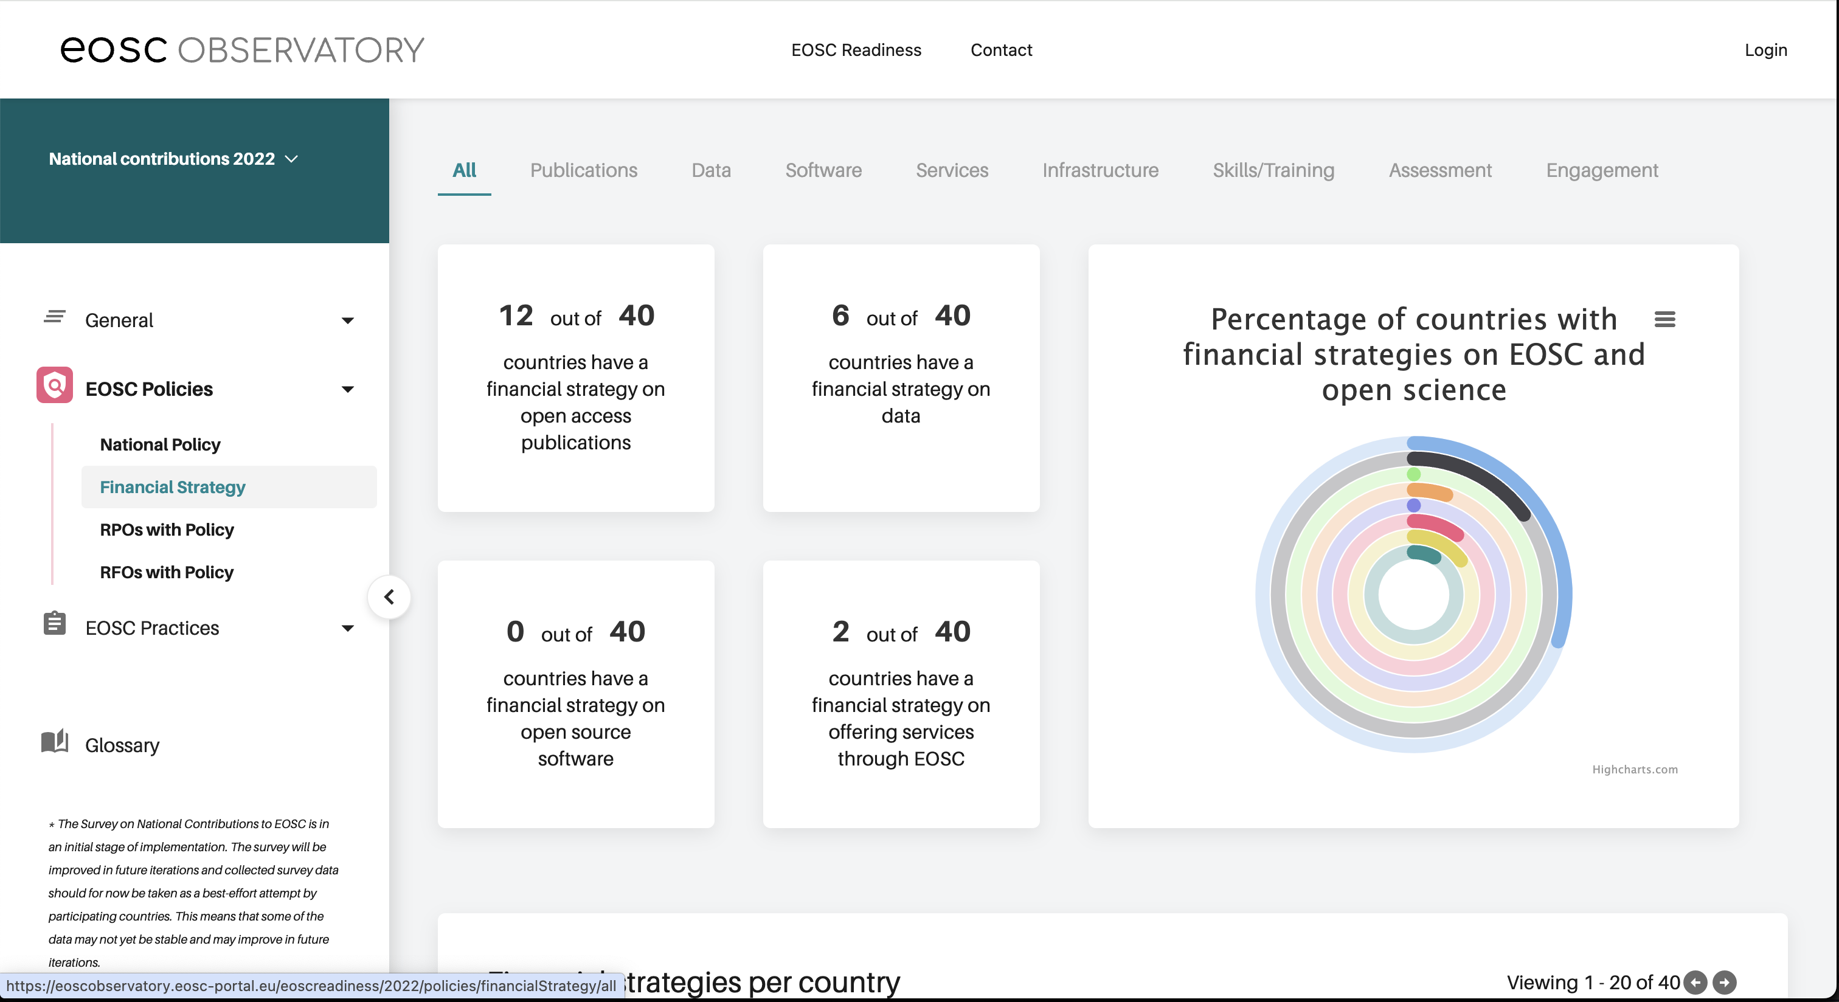
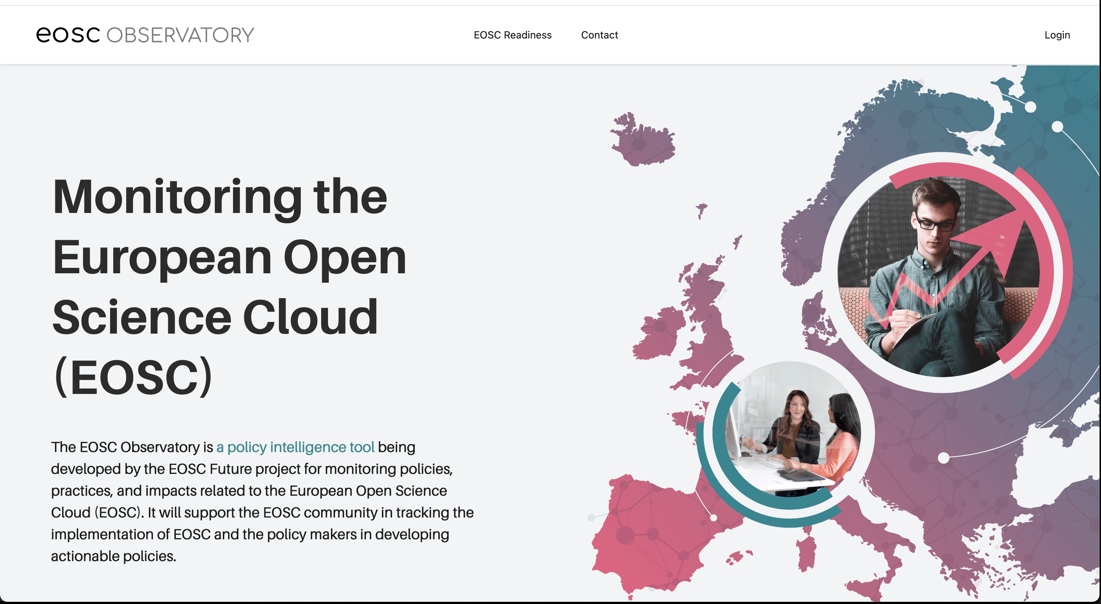
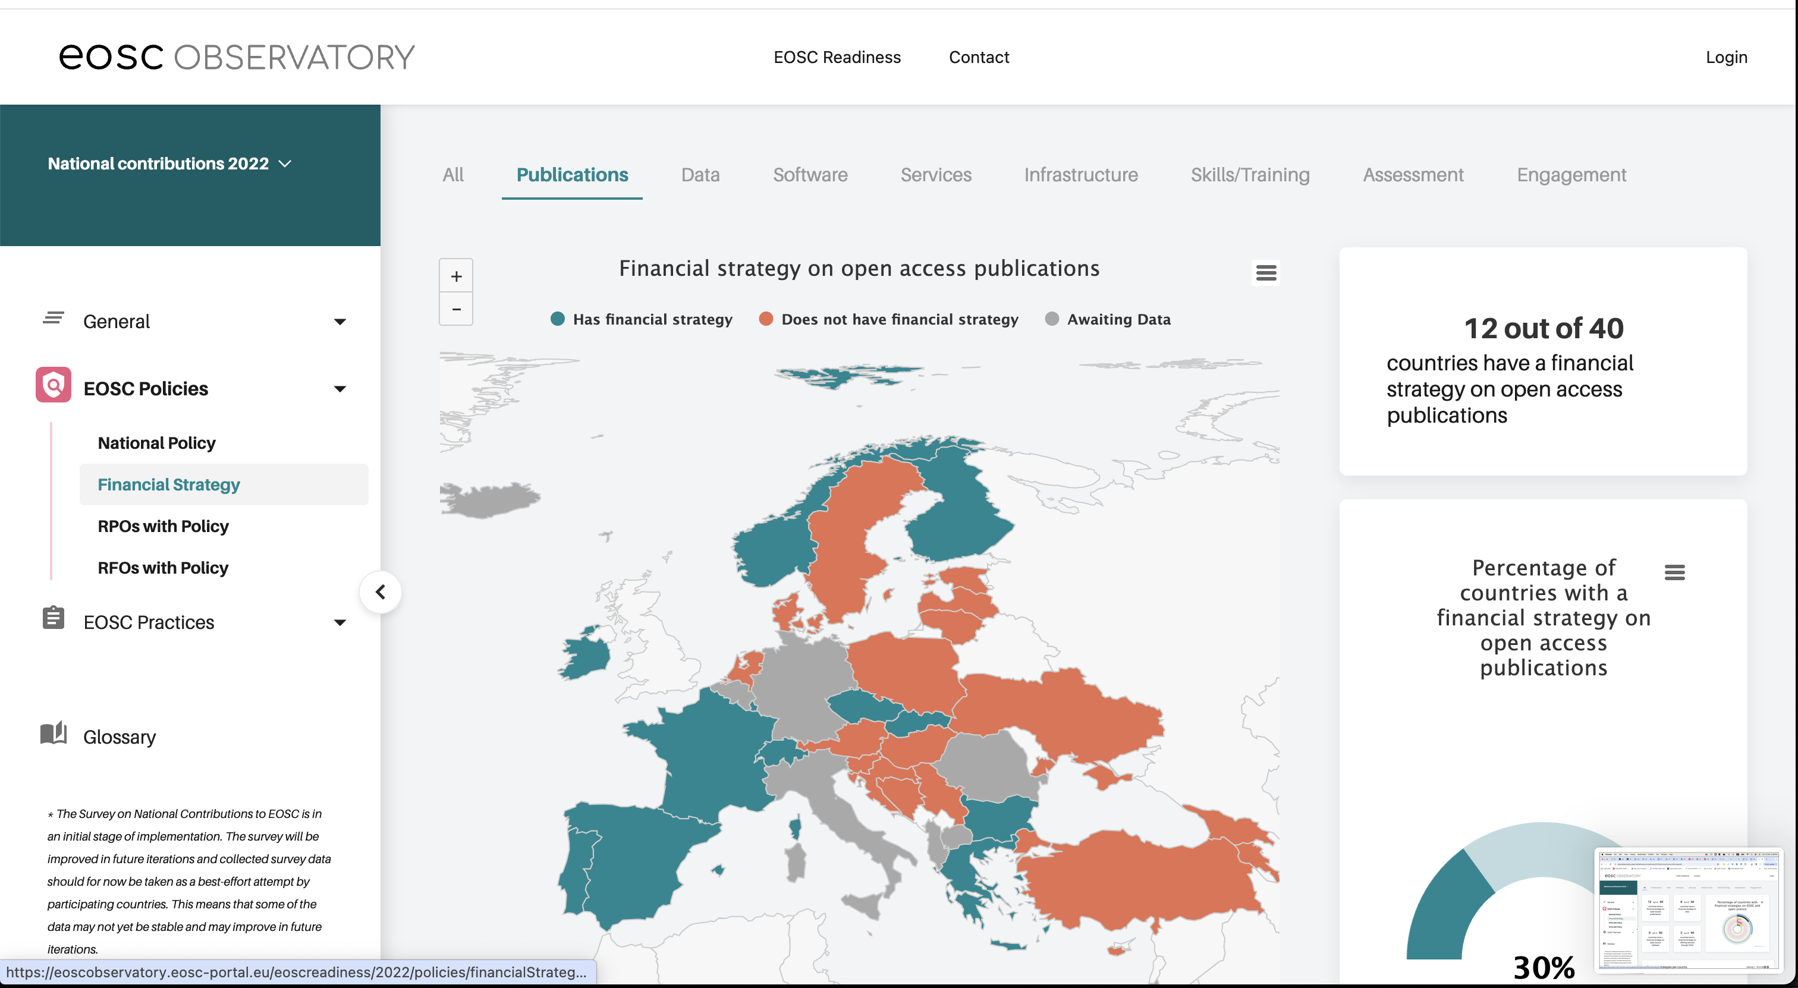
EOSC Observatory

Slide 18
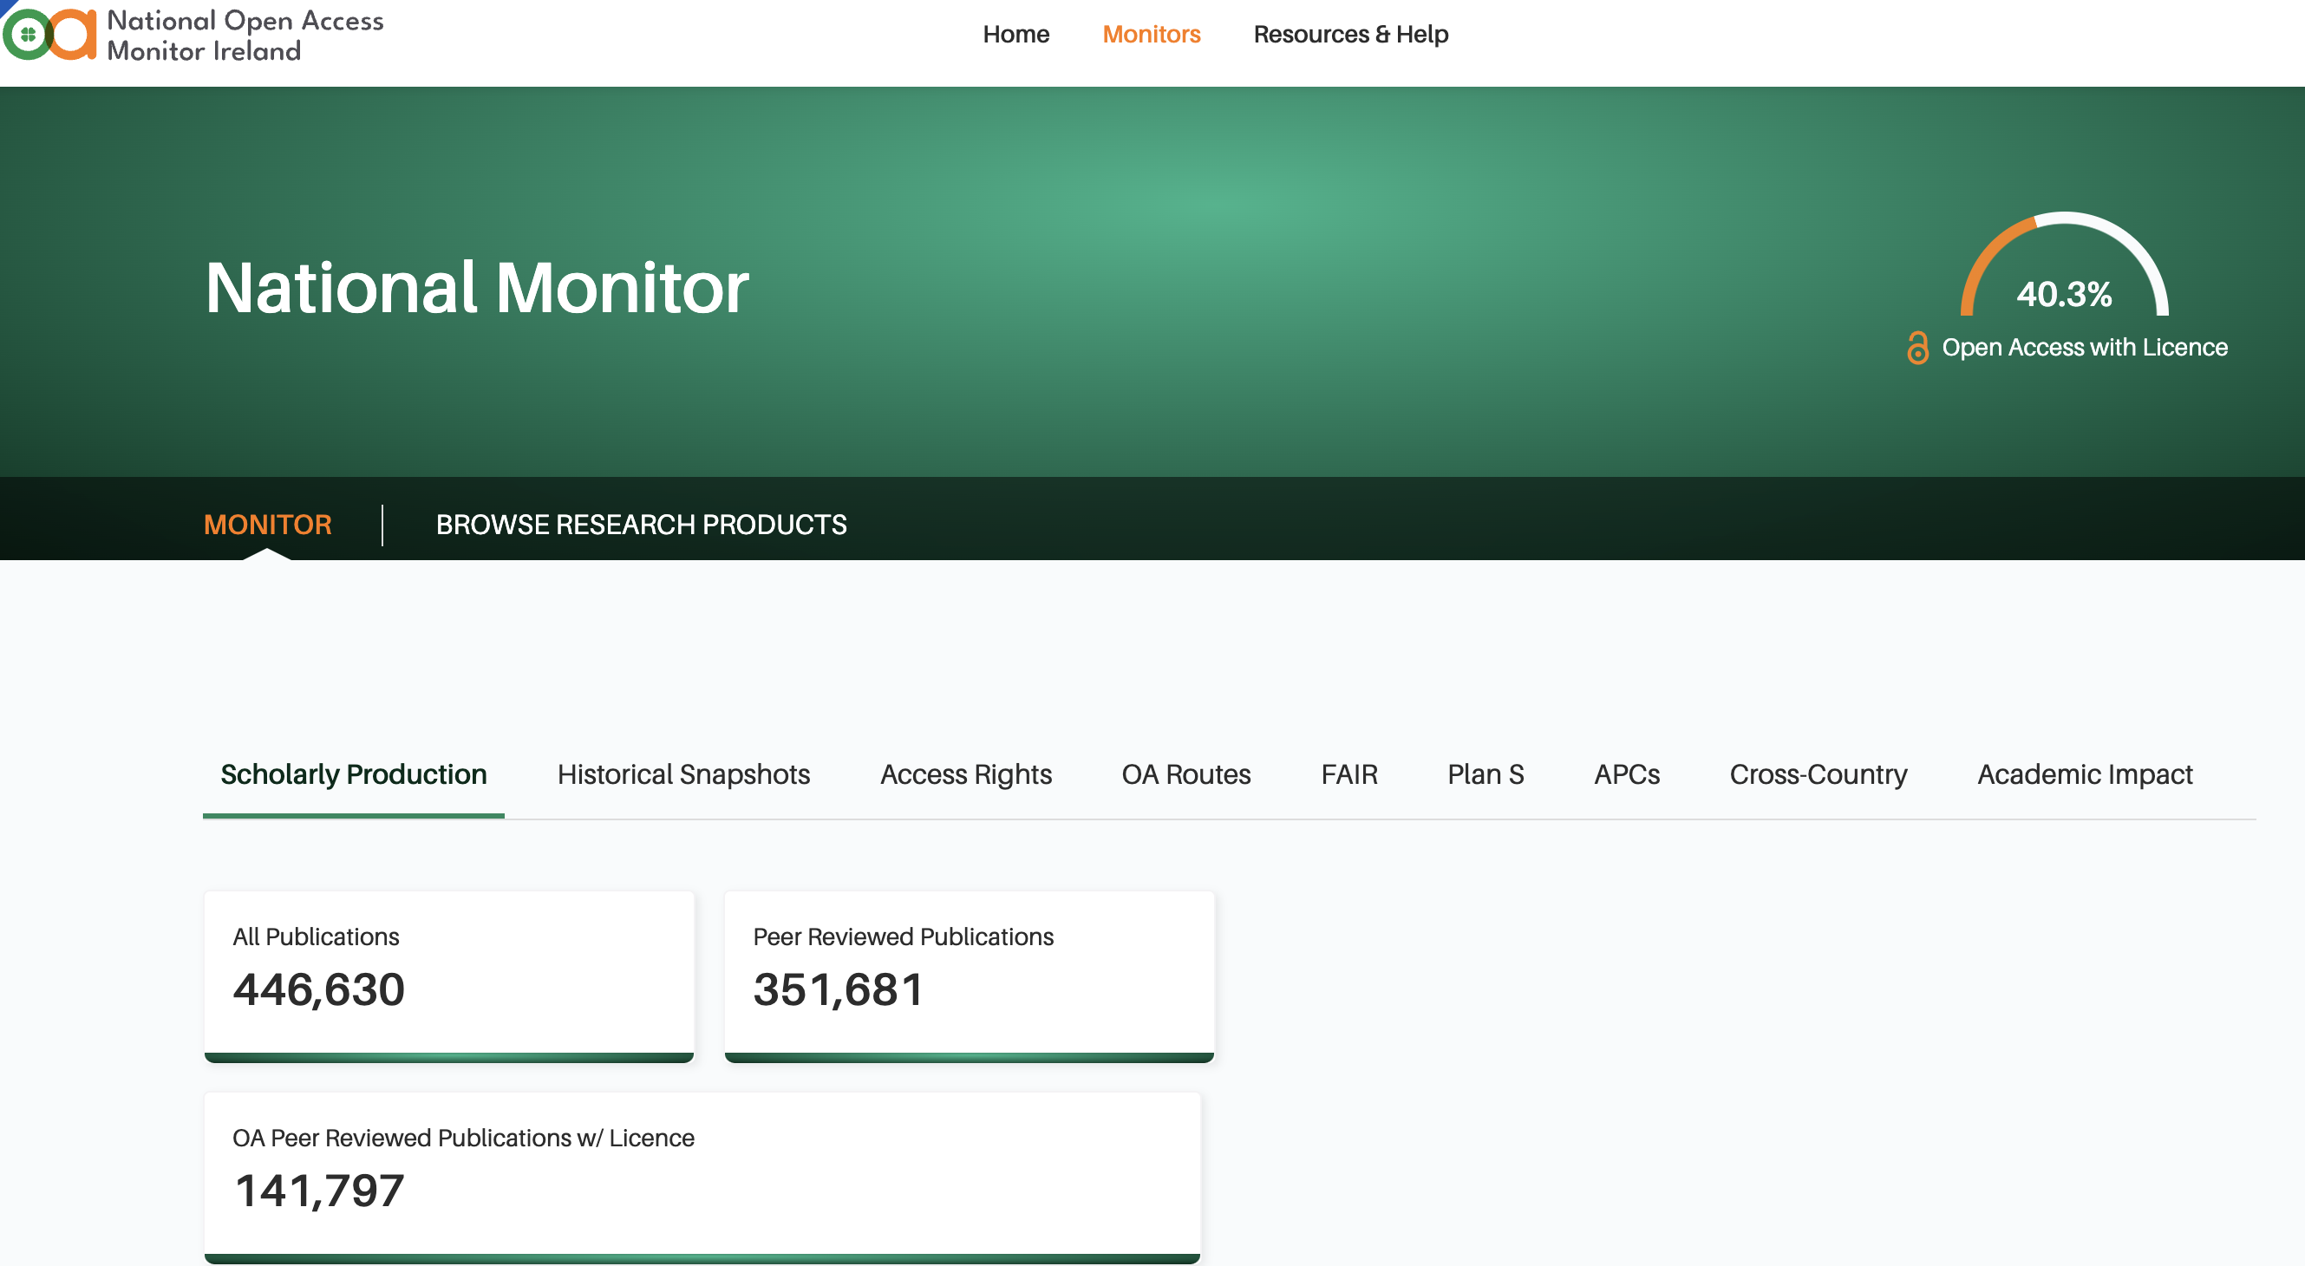
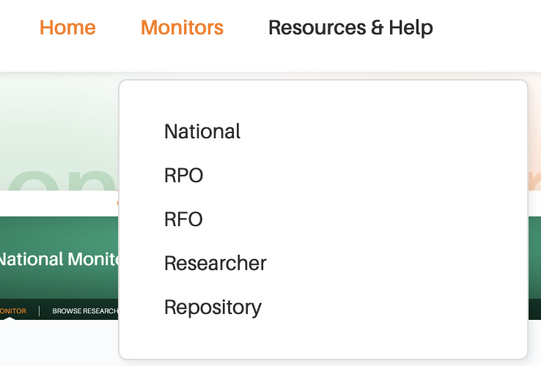
Irish OA Monitor
https://oamonitor.ireland.openaire.eu/

Slide 19
Key take away messages

Slide 20
Scholarly Communication (SC)
SC is an integral and large part of operations in any Research Performing Organization
A pan-European horizontal endeavor
Europe has a proven record to be a world leader in SC
Data & Technology sovereignty are not just empty words
Existing investments of 15+ years
EOSC / EOSC Federation cannot exist without embedding SC infrastructure
EOSC for all, not the few
Robust operations are crucial - local, national, regional, European
New business models, new culture
Evolution is not something in the future, it is here. Now
AI and LLMs are already being used
OpenAIRE has to stay relevant

Slide 21
Thank you!
Natalia Manola
natalia.manola@openaire.eu
Images licence
https://www.istockphoto.com/legal/license-agreement

