Slide 1
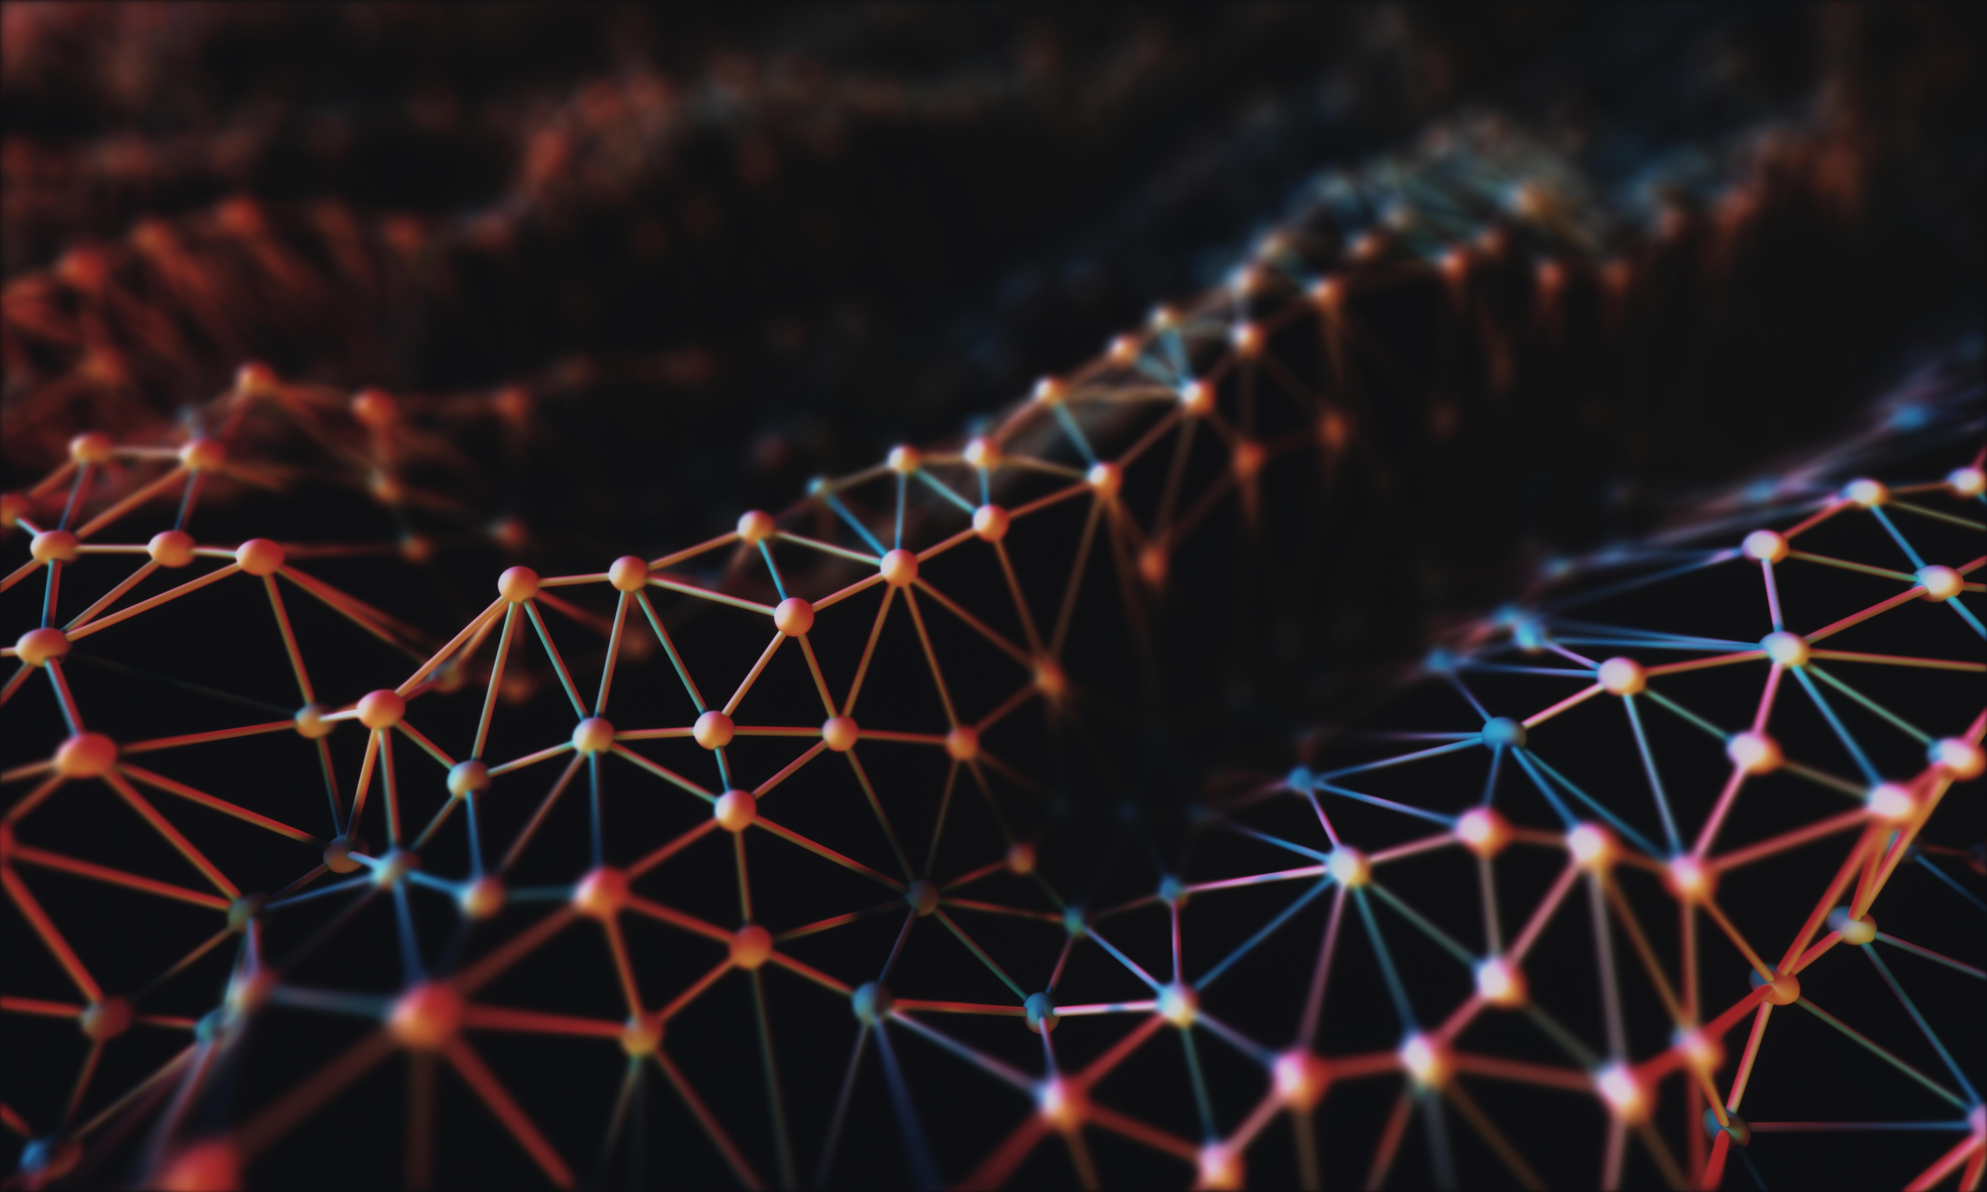



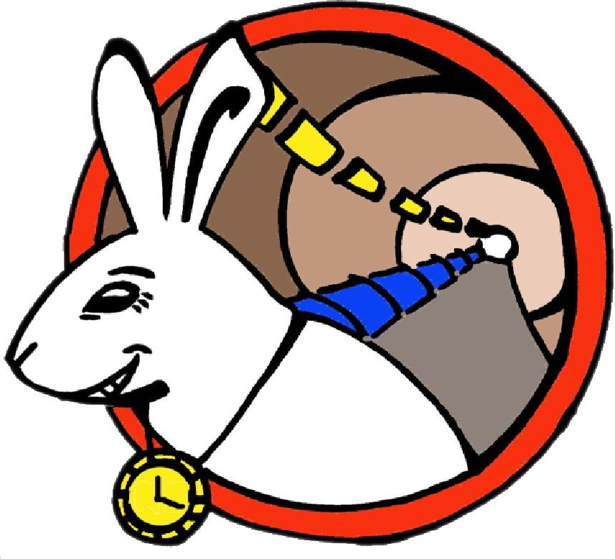
What time is it SURF?
SURF Time & Frequency pilot service
Sander Klemann
Productmanager Networkservices (SURF)
Notes:
Version 3.5

Slide 2
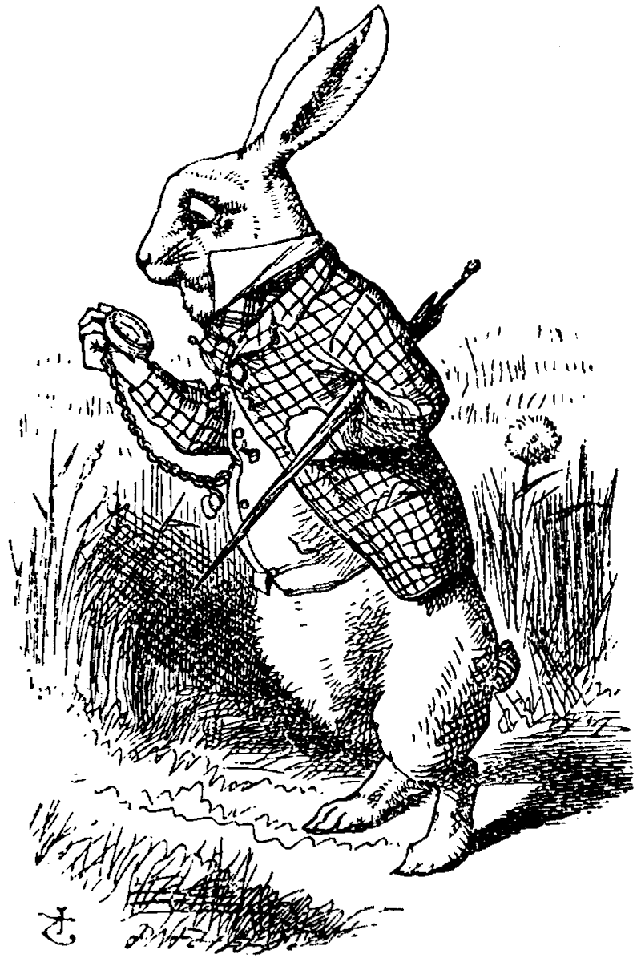
Program
What is SURF Time & Frequency?
SURF members Science Use Cases

Slide 3
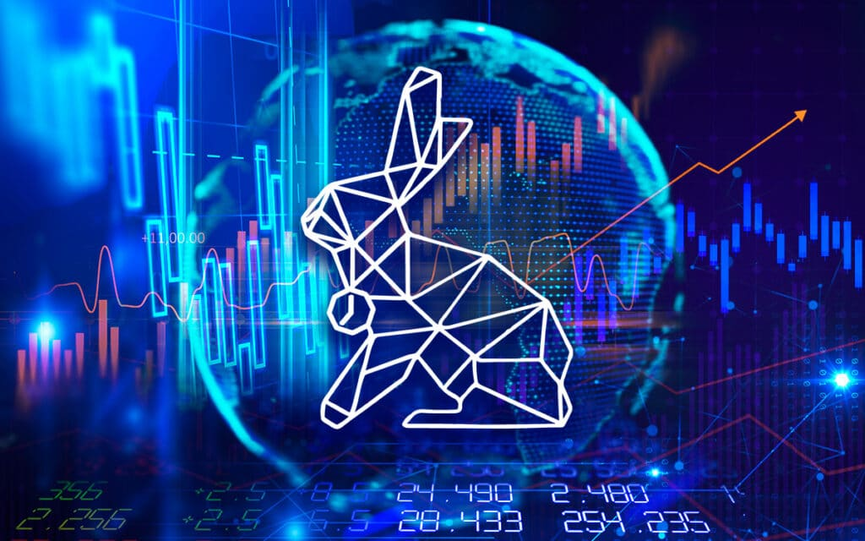
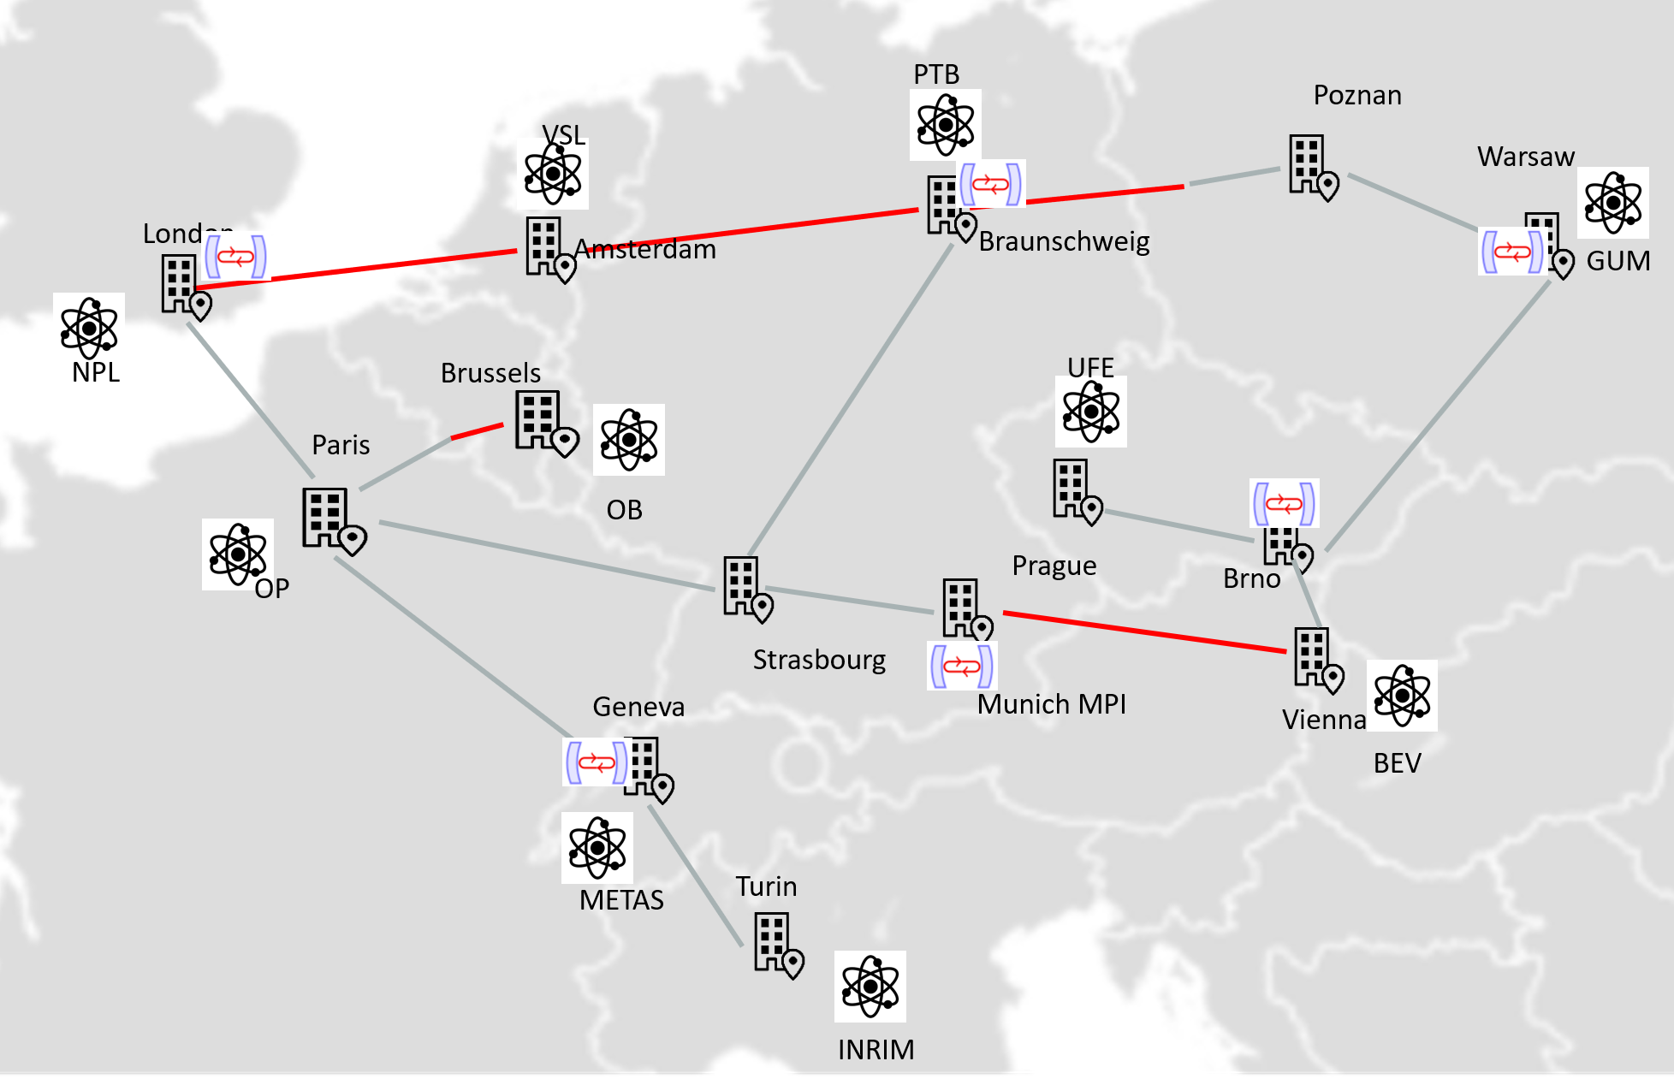
SURF Time&Frequency
A reliable and highly accurate time and frequency signal over the fiber optic network of SURF.
Decription
SURF Time & Frequency provides institutions with a reliable and highly accurate time (under 1 nanosecond) and frequency signal over SURF's fiber optic network. It is a new application utilizing the existing SURF network.
Institutions use this Time and Frequency (TFT) signal as a reference for fundamental scientific research, synchronizing (measurement) equipment, as an alternative to GPS, or as a traceable source of time.
Goals and ambition
Enabling the synchronization of geographically dispersed research instruments.
Systems and devices on the network perfectly synchronized independently of GPS.
As a pioneer in European network innovation, SURF aligns TFT projects with the broader European ambition.
Source: GEANT Time-Frequency Incubator Project 2024
Notes:
Wat het is?
Waarom ? Hoe wordt het gebruikt?
Hoe werkt het?
Voor wie
Elk land heeft een metrologisch instituut wat de UTC tijd bepaald voor dat land. In Nederland is dit VSL in Delft
Momenteel als je wilt weten hoe laat het is?
Gaat dit over network via NTP dan Miliseconden
Via GPS onder preciesier ongeveer 10 tot 1 microseconde
Via SURF TFT 1 nano seconde

Slide 4
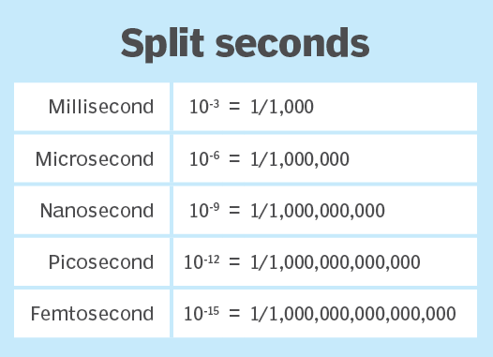
What is SURF Time & Frequency?
TFT is short for Time Frequency Transfer. Meaning: Transporting a highly accurate and stable time and frequency signal (< 1 nanoseconds) over fibre.
White Rabbit is a time transfer protocol.
  It’s Initiated by CERN and developed in a consortium of several research institutes such as Nikhef en GSI.
  There are other high precision TFT techniques but White Rabbit is currently the most scalable.
GPS = 10 nanoseconds ~ 10-20m
Stability and accuracy performance of at least three orders of magnitude better than the current best commercial services.
NTP
PTP
GPS
WR
Notes:
to, for example, security concerns such as GPS spoofing attacks or reception issues if they are located in an underground laboratory.

Slide 5
High-Level Design SURF Time & Frequency pilot - Phase 1 End state
Groningen
ASTRON
ESA
34km/ 8.2db +
66km/ 14.3db
VSL
Amsterdam 66
Nikhef
Dwingeloo
Leiden
Amsterdam 1b
30km/ 9.5db +
32km/ 8.0db
Leiden 5
60km/ 14.0db
UVA
Zwolle
Zwolle 10
ASTRON
Amsterdam 3
Lelystad
VU
10km/ 3.0db
73km/ 20.0db
77km/ 22.0db
Amsterdam 2
65km/ 18.0db
Enschede
ASTRON
34km/ 10.0db
SURF
TUDelft
46km/ 12.0db
Delft 1b
Delft 10
Utrecht
4km/ 3.0db
15km/ 5.0db + 78km/ 17.0db
19km/ 6.0db +
km/ 17.0db
Delft 14
Den Bosch
Amplifier
Optical Only
T+F
Source
VSL
50km/ 13.0db +
2 km/ 1.0db
Eindhoven
TU/e
New WR Node
Science Case

Slide 6
High-Level Design SURF Time & Frequency pilot - Phase 1 End state
Groningen
ASTRON
ESA
34km/ 8.2db +
66km/ 14.3db
VSL
Amsterdam 66
Nikhef
Dwingeloo
Leiden
Amsterdam 1b
30km/ 9.5db +
32km/ 8.0db
Leiden 5
60km/ 14.0db
UVA
Zwolle
Zwolle 10
ASTRON
Amsterdam 3
Lelystad
VU
10km/ 3.0db
73km/ 20.0db
77km/ 22.0db
Amsterdam 2
65km/ 18.0db
Enschede
ASTRON
34km/ 10.0db
SURF
TUDelft
46km/ 12.0db
Delft 1b
Delft 10
Utrecht
4km/ 3.0db
15km/ 5.0db + 78km/ 17.0db
19km/ 6.0db +
km/ 17.0db
Delft 14
Den Bosch
Amplifier
Optical Only
T+F
Source
VSL
50km/ 13.0db +
2 km/ 1.0db
Eindhoven
TU/e
New WR Node
Science Case

Slide 7
Program
What is SURF time&frequency high level?
SURF members Science Use Cases

Slide 8
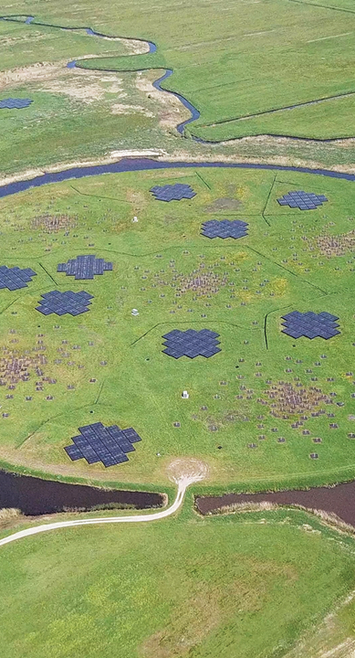
ASTRON’s White Rabbit in LOFAR2.0

Slide 9
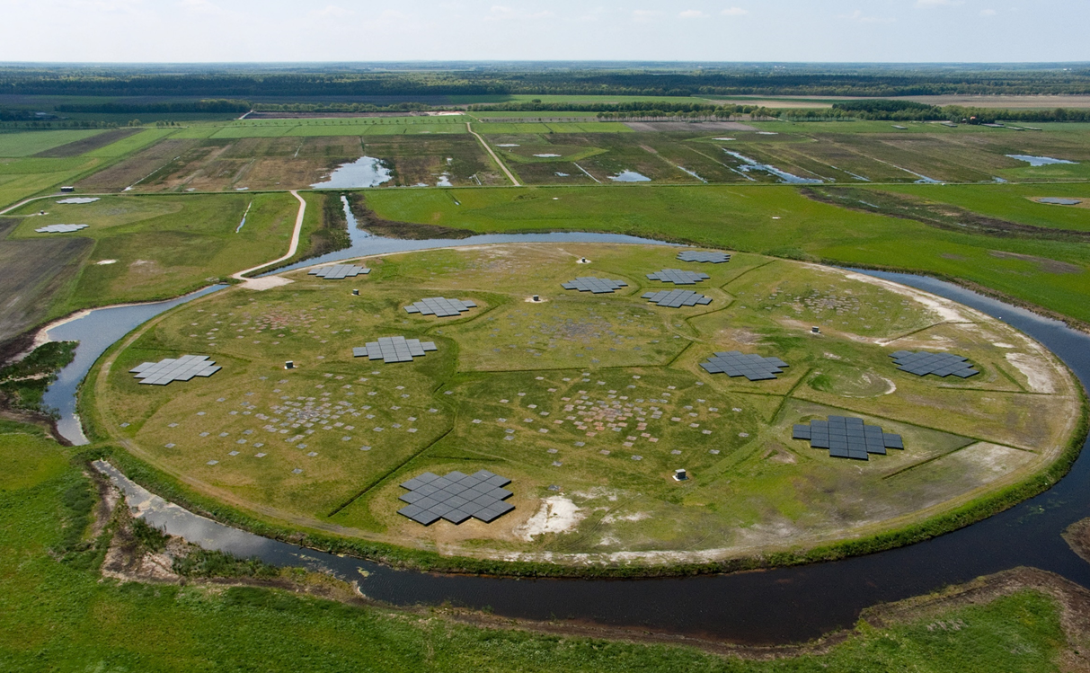
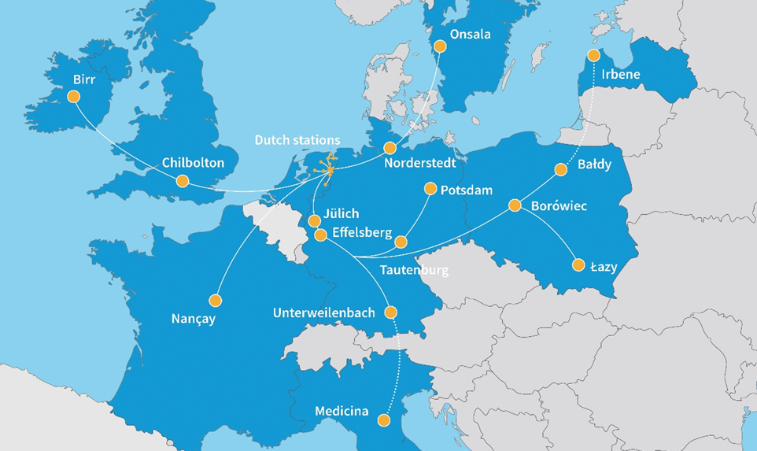

Slide 11
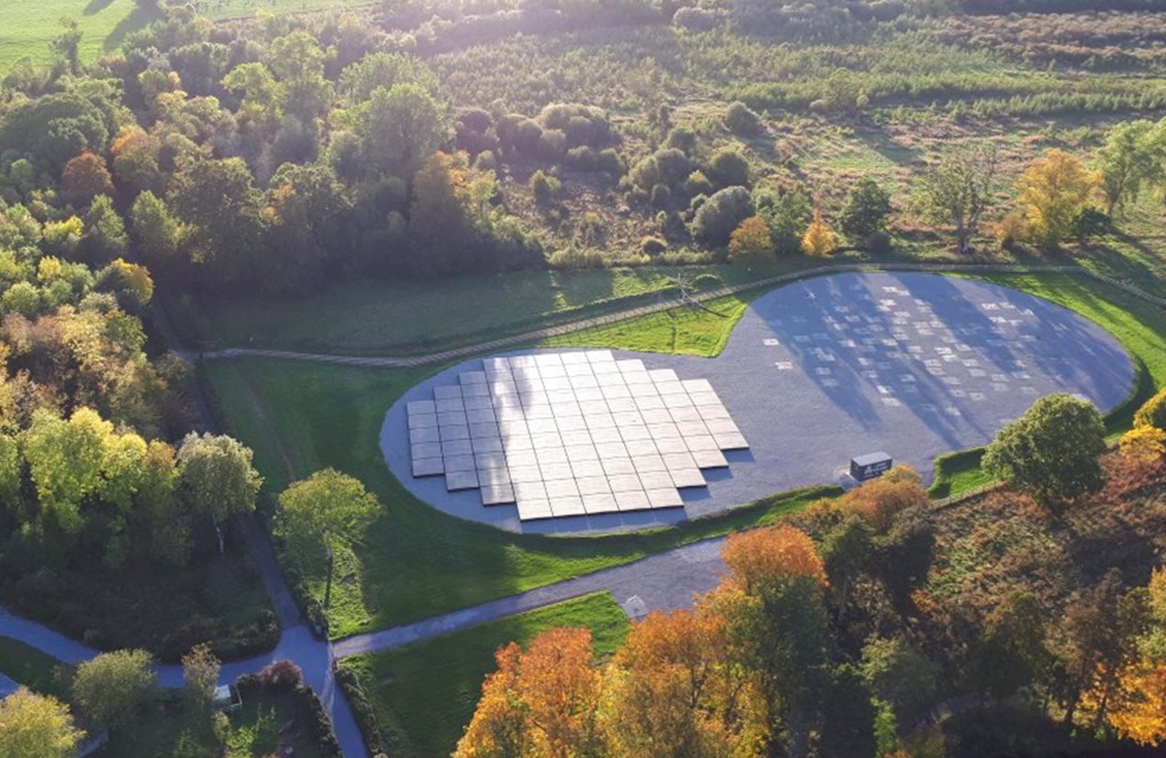

Slide 12
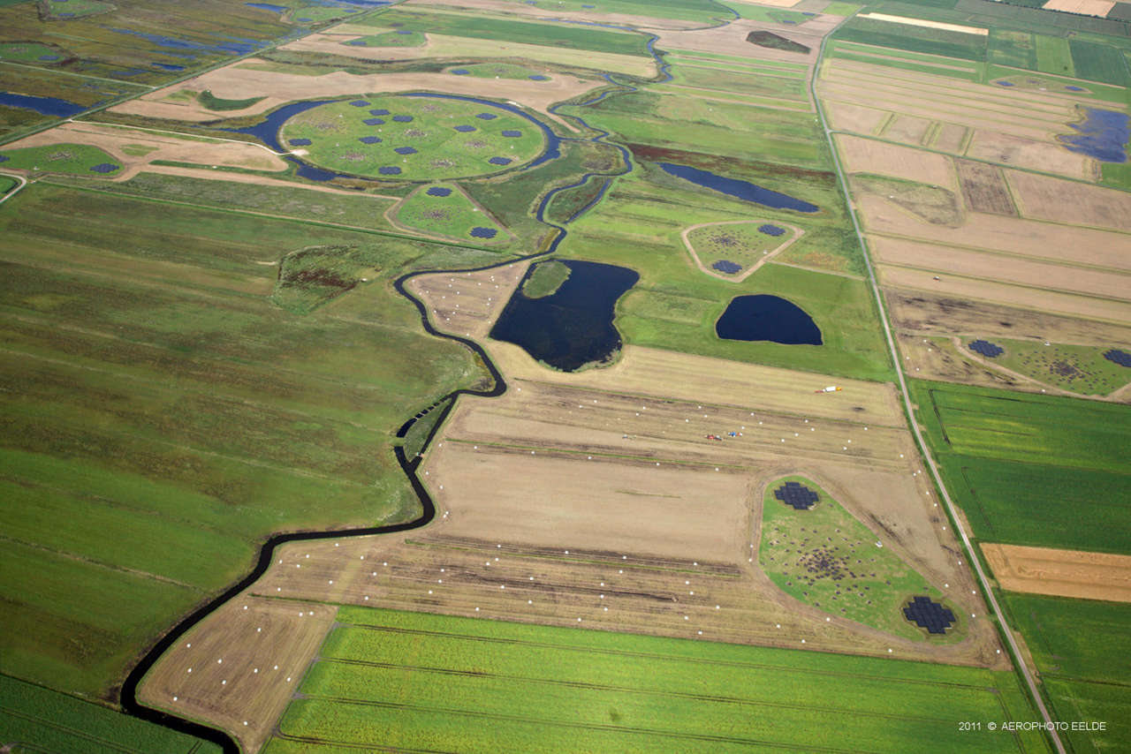

Slide 13
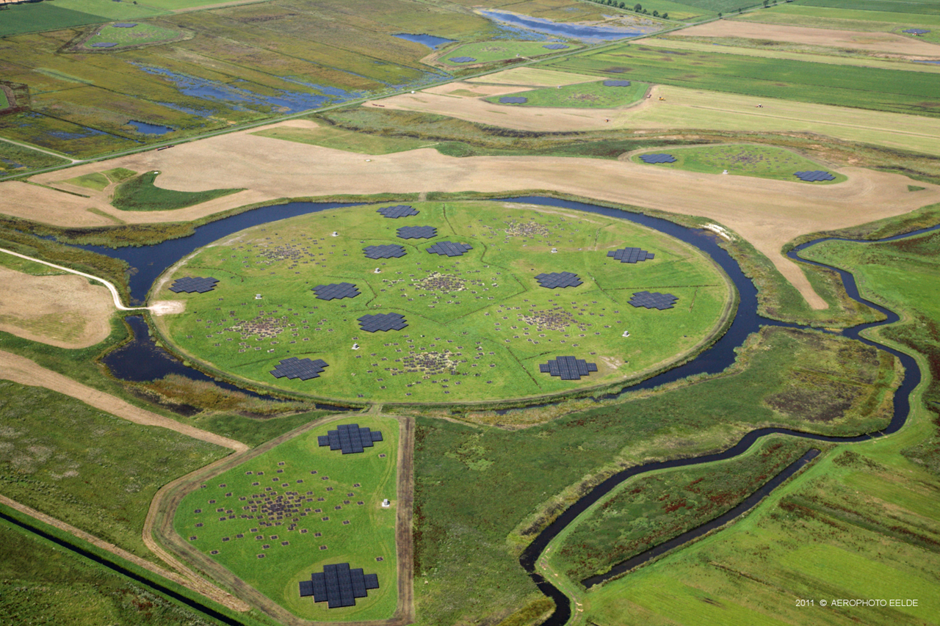

Slide 14
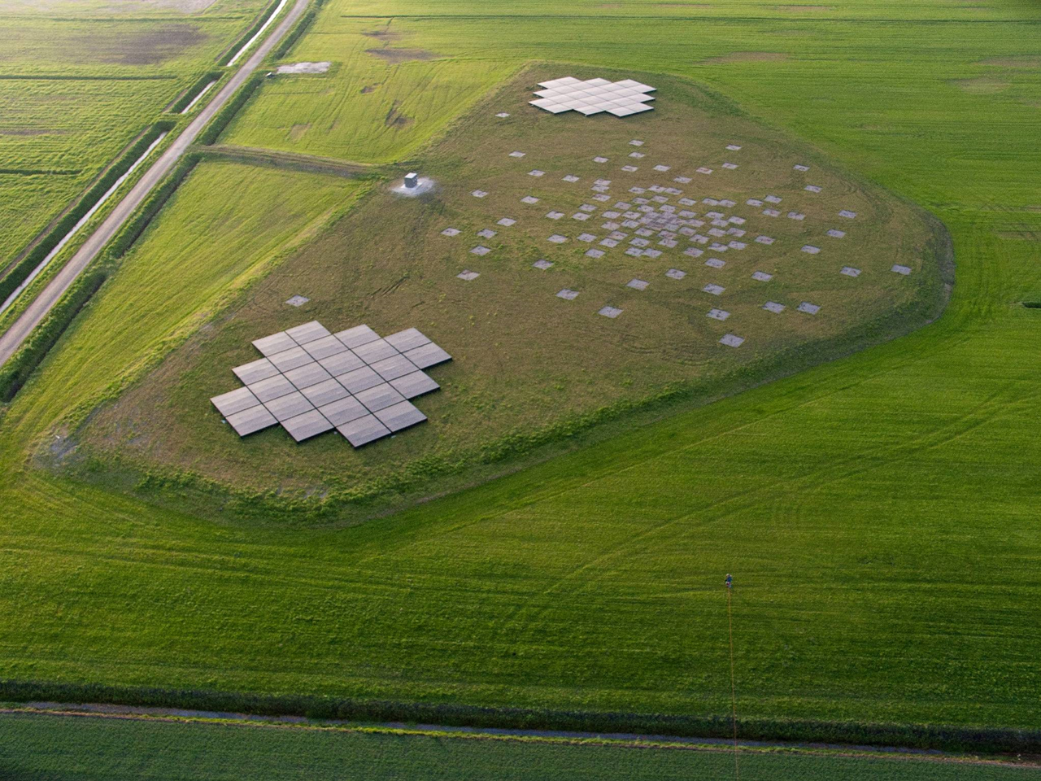

Slide 15
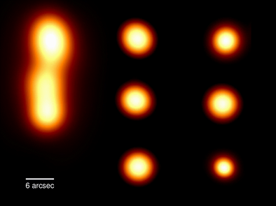

Slide 16
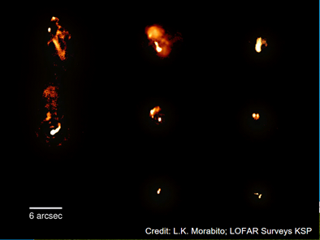

Slide 17
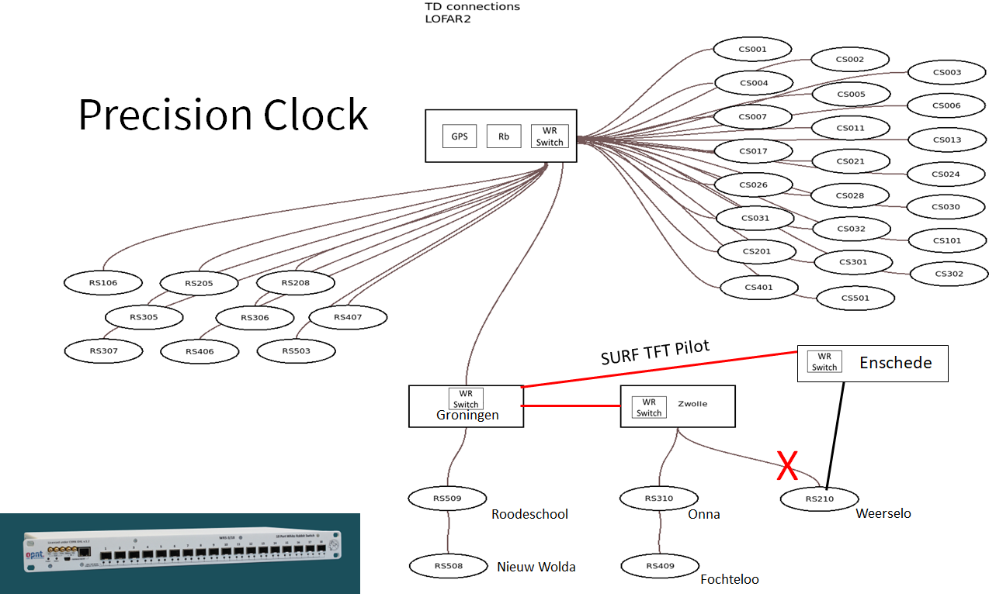

Slide 18
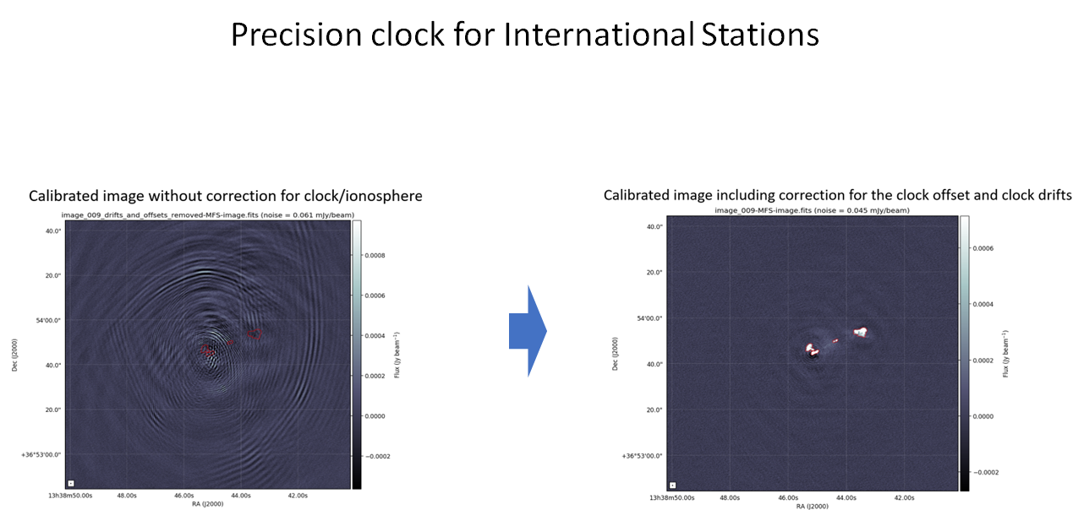

Slide 19
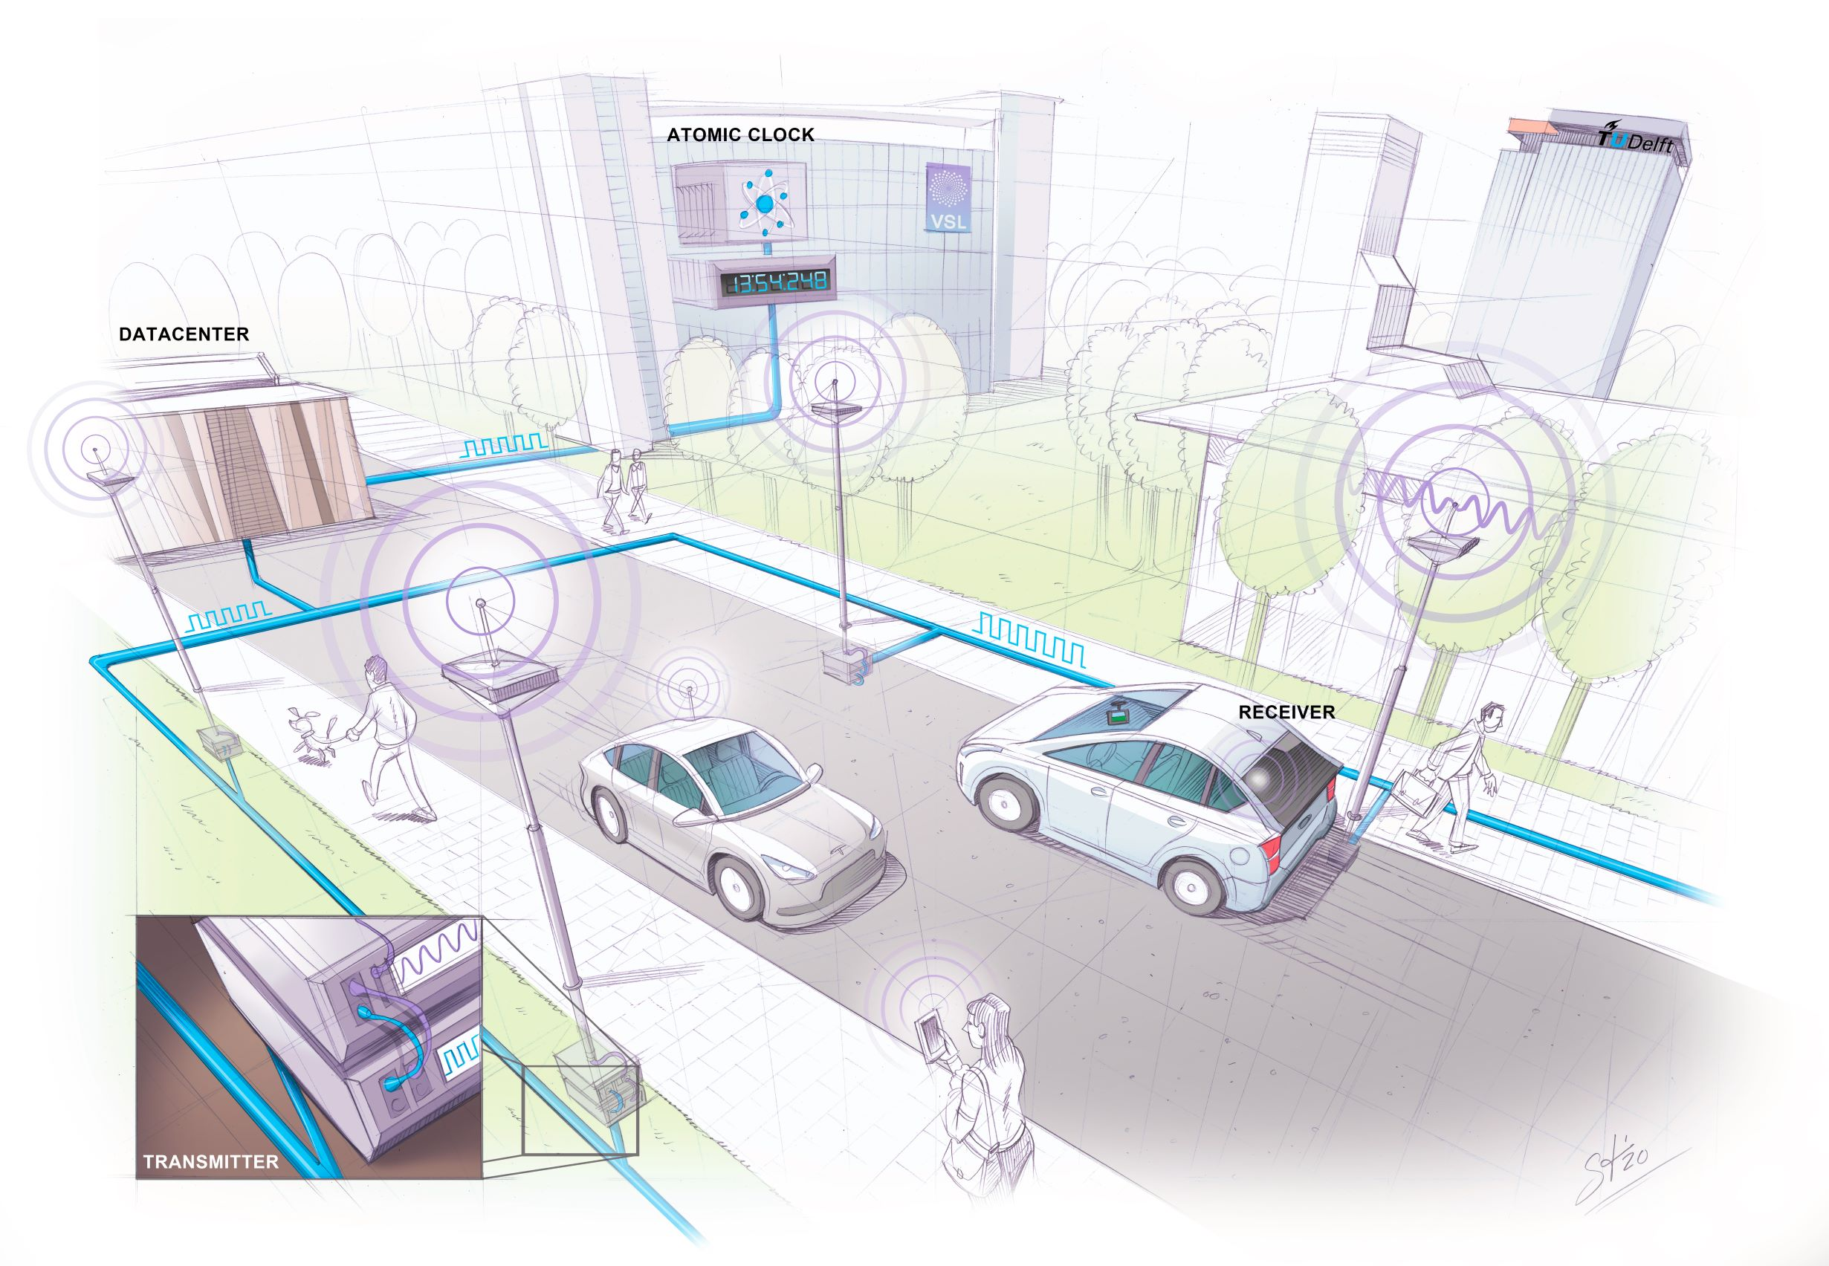
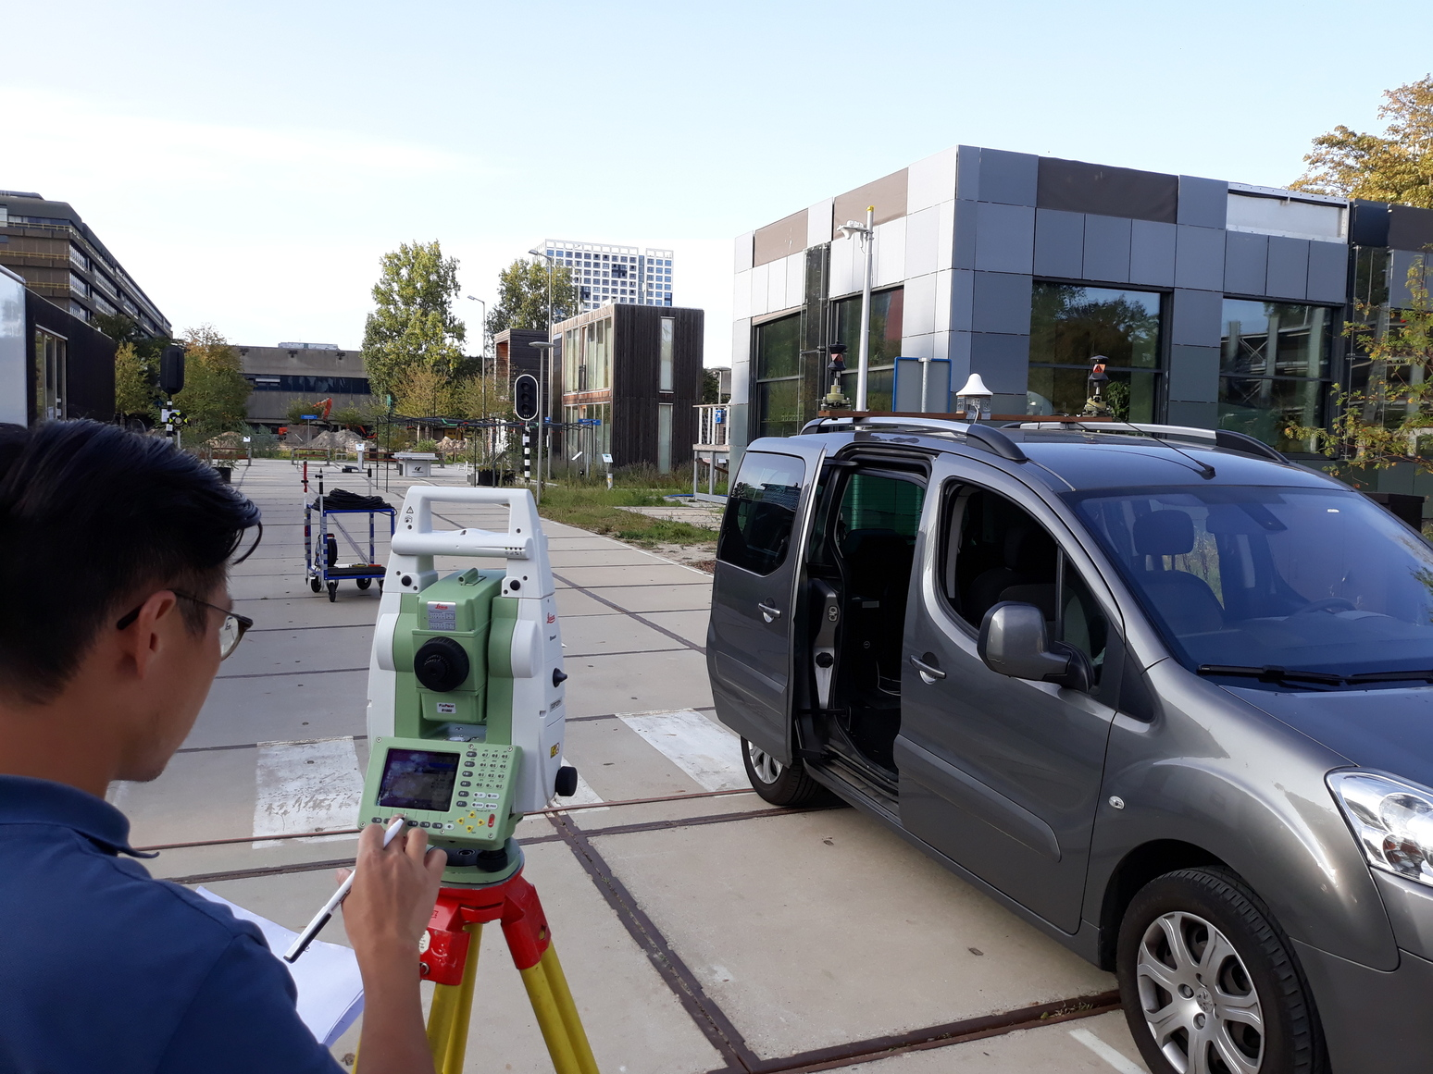
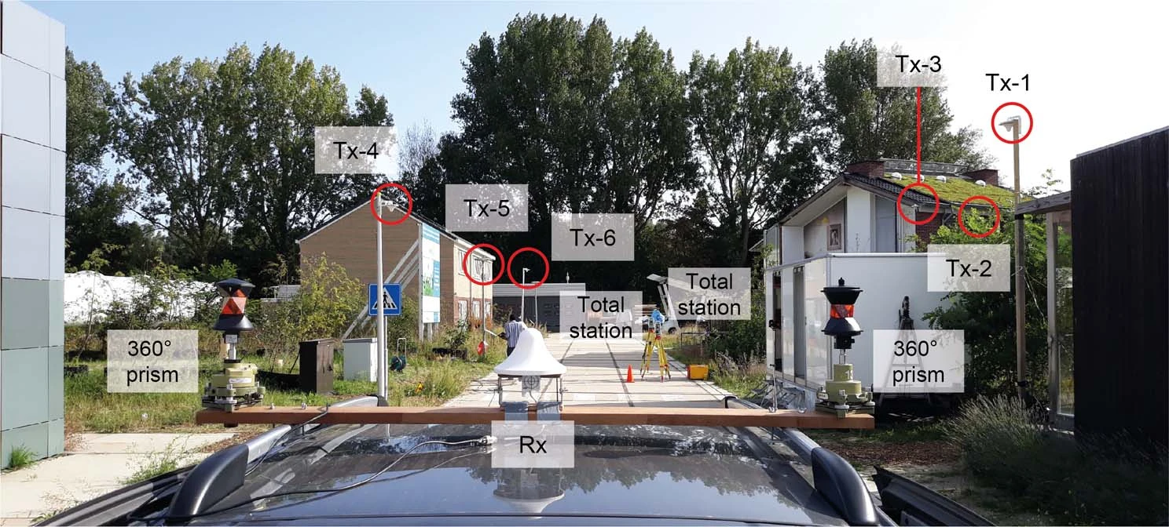
“Super-GPS” An urban navigation system with 10-centimeter accuracy
Colaboration between TUdelft, VU University, VSL and SURF
Use Mobile Telecommunication Network to distribute Atomic Clock time
More precise time is better accuracy
Publication in Nature in 2022
  Koelemeij, J.C.J., Dun, H., Diouf, C.E.V. et al. A hybrid optical–wireless network
  for decimetre-level terrestrial positioning. Nature 611, 473–478 (2022)
Notes:
3 meter per nano seconde
https://www.tudelft.nl/en/2022/tu-delft/a-navigation-system-with-10-centimeter-accuracy
Koelemeij, J.C.J., Dun, H., Diouf, C.E.V. et al. A hybrid optical–wireless network for decimetre-level terrestrial positioning. Nature 611, 473–478 (2022). https://doi.org/10.1038/s41586-022-05315-7

Slide 20
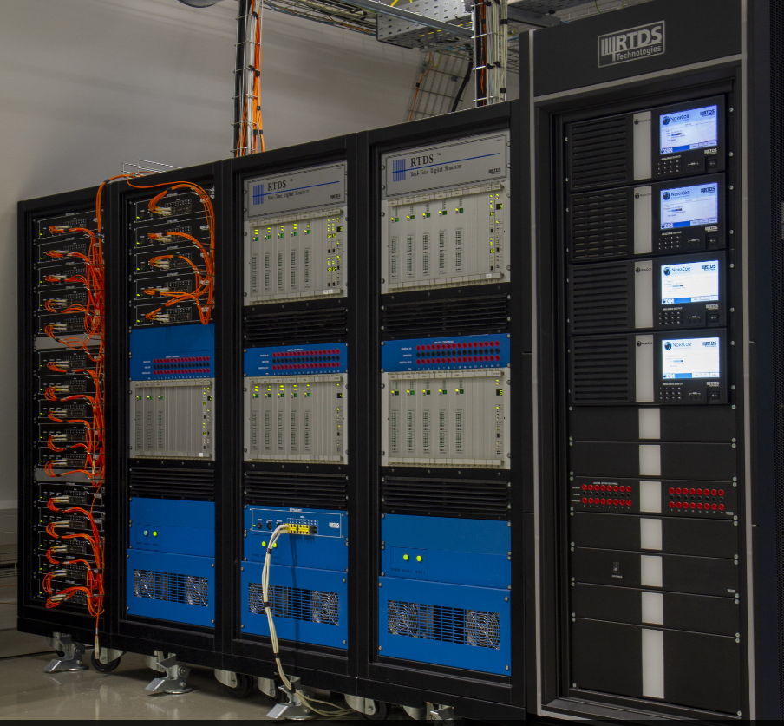
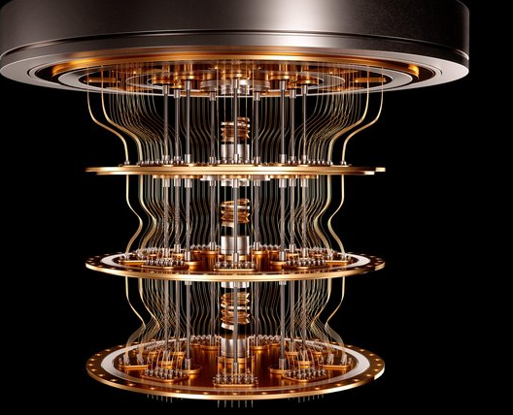
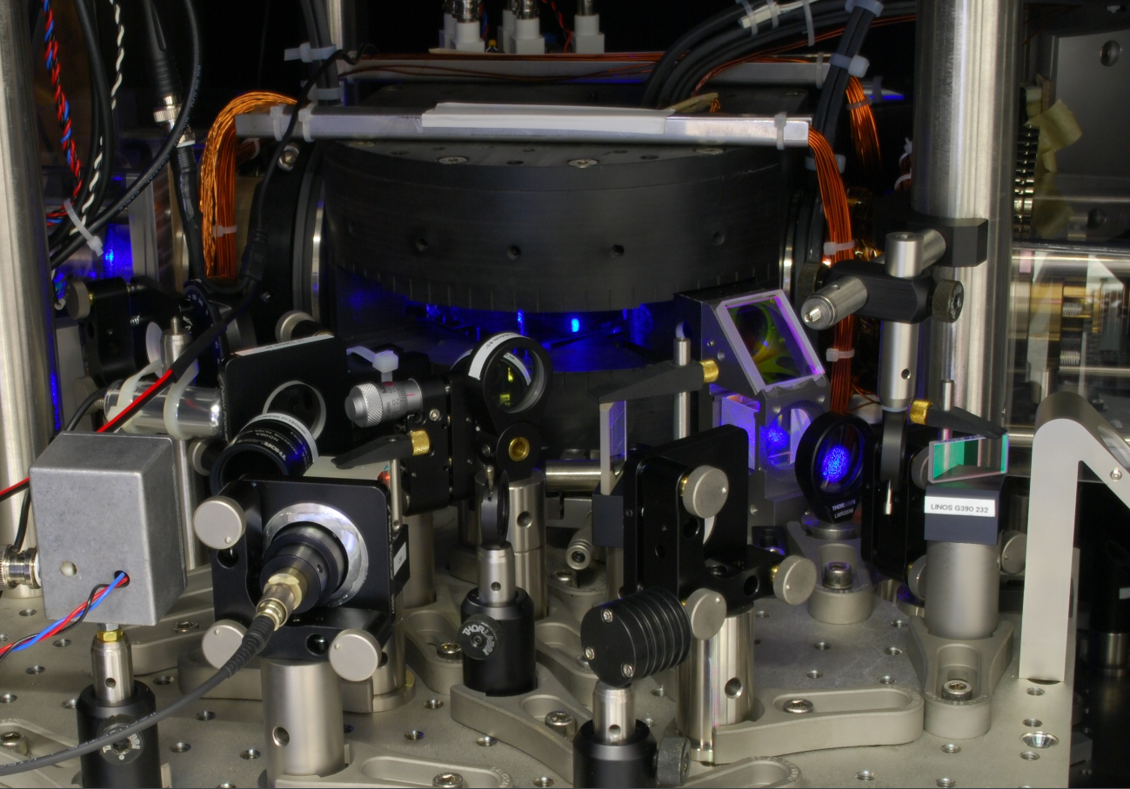
Other Use Cases in The Netherlands
TU Delft: Extra High Voltage Power Cable Research TU Delft
Real Time Digital Simulator laboratory (RTDS)Lab within a Faraday Cage, No access to GPS, needed for precise on off switching.
Eindhoven University of Technology: Hybrid Quantum Computer
Synchronisation of support devices.
University of Amsterdam: Stable Frequency for building next generation Optical Clocks
iqClock - Integrated Quantum Clock
Notes:
3 meter per nano seconde
https://www.tudelft.nl/en/2022/tu-delft/a-navigation-system-with-10-centimeter-accuracy
Koelemeij, J.C.J., Dun, H., Diouf, C.E.V. et al. A hybrid optical–wireless network for decimetre-level terrestrial positioning. Nature 611, 473–478 (2022). https://doi.org/10.1038/s41586-022-05315-7

Slide 21
Looking for new Use Cases & Interested Parties
Do you know of researchers or institutions who might be interested in the (Dutch) TFT service?
We are looking for international collaborations in the coming years.
Please contact me at: Sander.Klemann@surf.nl

Slide 22
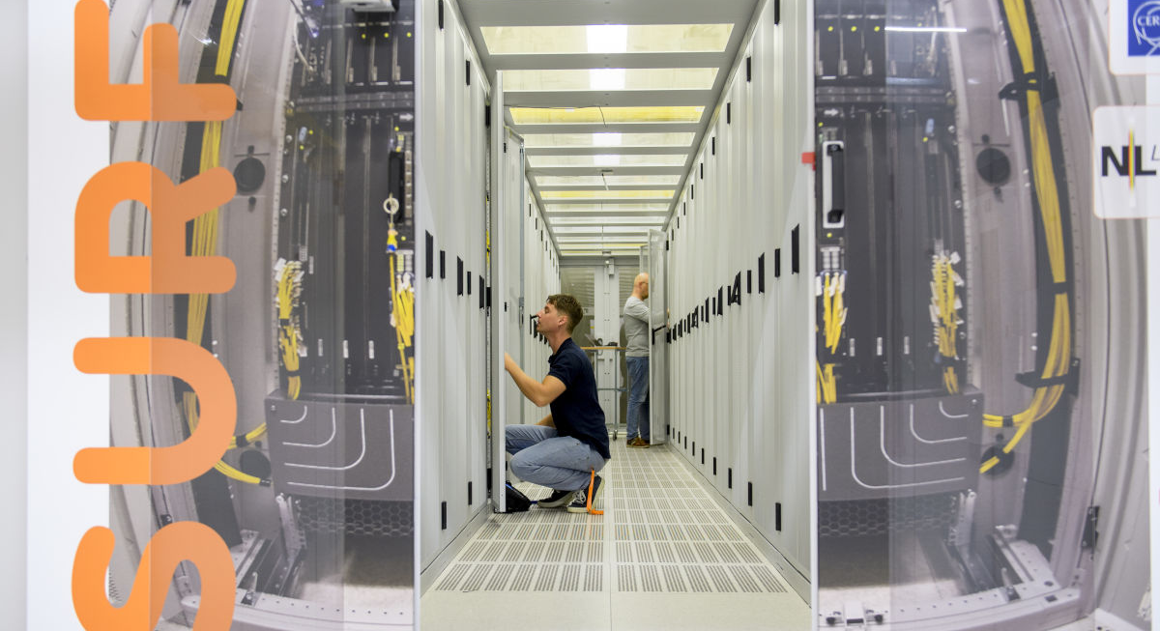
Thank you for your attention
Sander Klemann - Productmanager
E-mail: Sander.Klemann@surf.nl
www.surf.nl
Driving innovation together

Slide 23
Driving innovation together

Slide 24
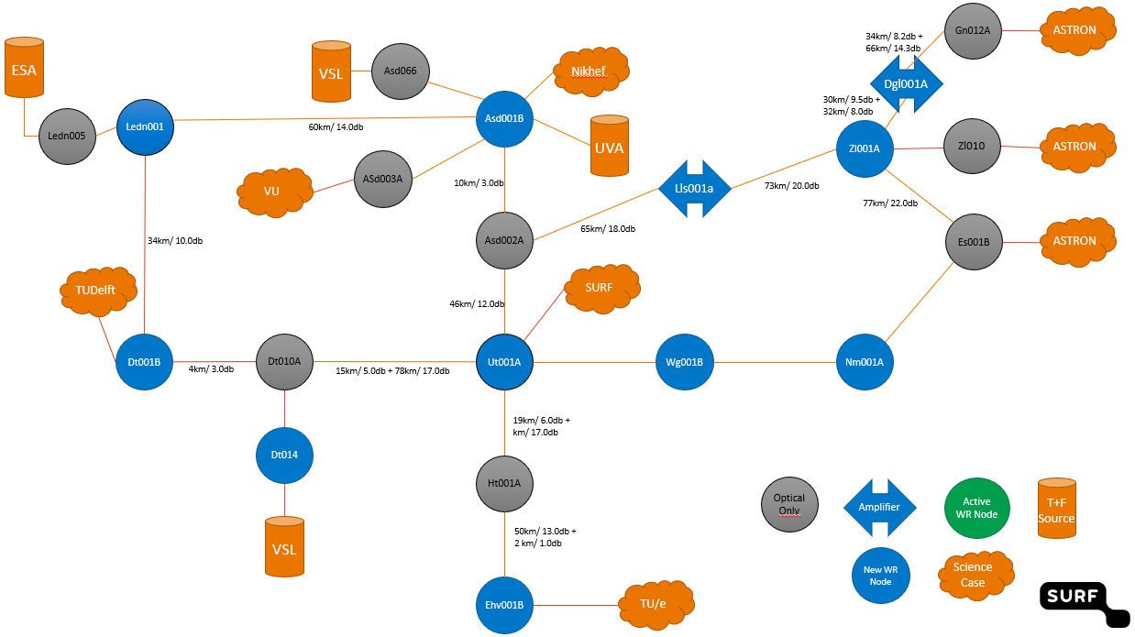
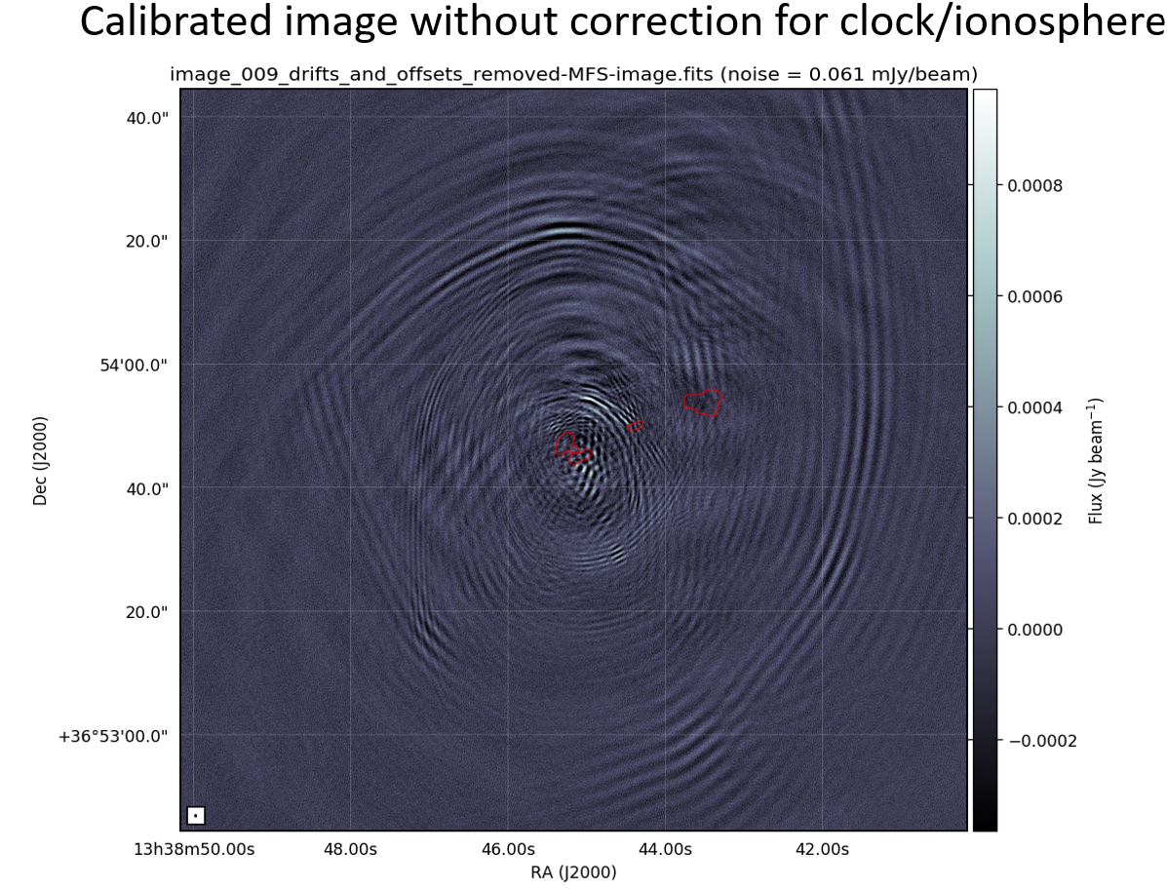
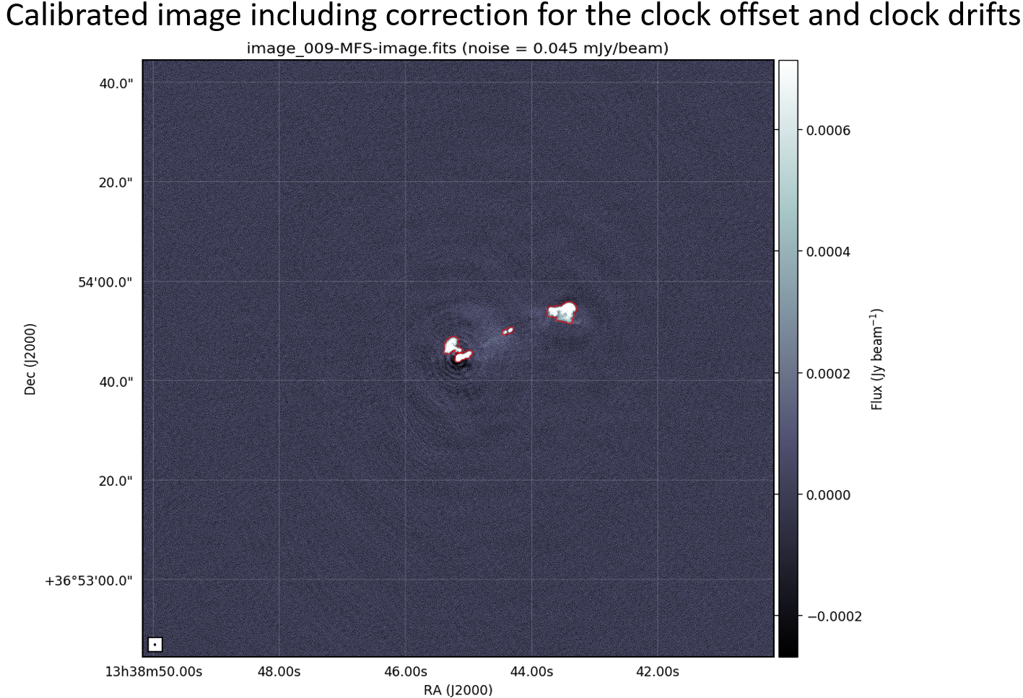
SURF Time & Frequency – Pilot Summery
SURF TFT Pilot Proposition Fase 1
White Rabbit TFT Signal in 4 city’s, 6 locations.
  VSL TAI Time Signal
  10 MHz Frequency
  Time pulse (1PPS)
Collaboration with OPNT as supplier.
No SLS determined yet.
Current Dutch TFT Science Use Cases:
TU/e: Quantum Computer Synchronisation
VU: Time & Frequency Transfer Research.
Nikhef: WR Protocol Development, TFT research
UvA: Development of Quantum Clock, iqClock.
ESTEC: Time synchronisation and determining UTC-NL.
TU Delft: SuperGPS Research¹
ASTRON: LOFAR 2.0 Radio telescope Image Correction² due to high precision clock synchronisation ↓
Demarcation Model – User is responsible for connection to SURF boundary clock.
Phase 1
Notes:
1. Koelemeij, J.C.J., Dun, H., Diouf, C.E.V. et al. A hybrid optical–wireless network for decimetre-level terrestrial positioning. Nature 611, 473–478 (2022). https://doi.org/10.1038/s41586-022-05315-7
2.Toelichting bij ASTRON Science Case:
We zien hier twee afbeelden één voor en een na de correctie. De golven in de eerste afbeelden zijn artefacten in de kaart welke ontstaan door storing van de ionosfeer en door inaccurate in de klokken. Deze twee effecten worden tegelijk gecorrigeerd.
De witte vormen zijn het gewenste signaal uit een Astronomische Bron. Dit kunnen sterren zijn maar ook sterrenstelsels of Pulsars. De Clock offset is constant maar de Clock Drift wordt langzaam erger naar mate de tijd voortduurt.
De X en Y as vormen het J2000 coördinaten stelsel. Het geeft aan het stukje uit de hemel waar de telescoop op gericht is.
Nu kan er al gecorrigeerd worden (we zien ten slotte deze afbeeldingen) maar dit gebeurt achteraf en is tijdrovend. Door de klokken bij de meting al synchroon te laten lopen hoeft deze niet achteraf nog gecorrigeerd te worden.
Hoeveel beter het beeld gaat worden is nu nog niet te voorspellen. Tegelijker tijd moet er een afweging gemaakt worden tussen de kosten van TFT en wat deze correctie gaat opleveren.
Voor het corrigeren van de ionosfeer wordt gebruik gemaakt van een bekend object als kalibratie bron om zo de correctie te kunnen meten.

Slide 25
Attachement 1: Accuracy vs Stability

Slide 26
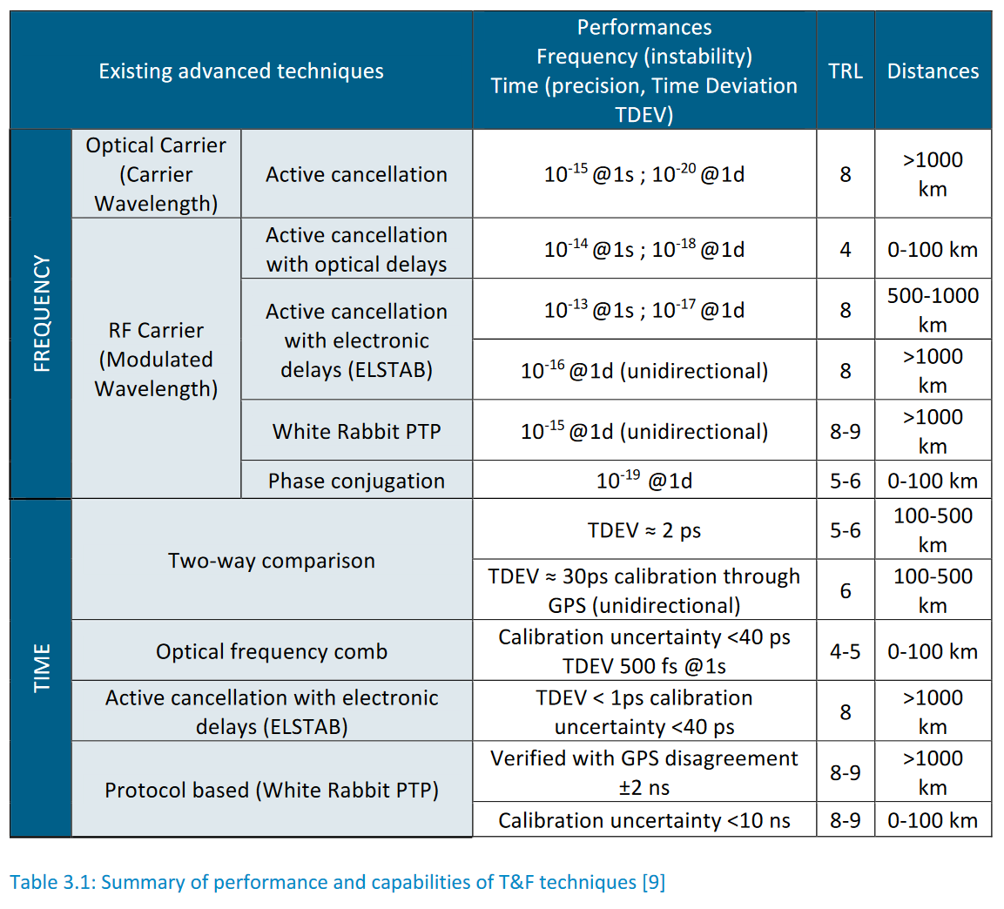
Attachement 2: Accuracy TFT signals
Source Geant White Paper: Distributing New Performant Time and Frequency Services over NREN Networks (2020)

Slide 27
Attachment 3 Want to know more about TFT? Reading material:
White Rabbit: An Accurate Time and Frequency Transfer over Ethernet Network" - presentation for Time Application Project of Open Compute Project, online event (6 May 2021): presentation, recording
(Slides about White Rabbit in this powerpoint were copied from Maciej Lipinski’s presentation)
GEANT White Paper: Distributing New Performant Time and Frequency Services over NREN Networks Grant 2020
  https://resources.geant.org/wp-content/uploads/2022/02/GN4-3_White-Paper_Time_and_Frequency.pdf
GEANT White Paper: Management and Monitoring of Time and Frequency Services 2022
  https://resources.geant.org/wp-content/uploads/2022/11/GN4-3_White-Paper_Management-and-Monitoring-of-TF-Services.pdf
Clonets-DS: Clock network services Requirements of the Scientific Community Requirements and Definitions
  https://clonets-ds .eu/wp-content/uploads/2022/07/Deliverable-1.2-Requirements-and-Definitions.pdf
White Rabbit Open Hardware Repository WIKI
  https://ohwr.org/project/white-rabbit/wikis/home

Slide 28
Attachment 4: English description TFT
In the past few years, National Metrology Institutes (NMIs) have successfully developed and tested new T&F techniques using optical fibres which have shown a stability performance of at least three orders of magnitude better than the current best commercial services. Moreover, such techniques offer an alternative to Global Navigation Satellite System (GNSS) for end-users who cannot rely on broadcast signals due to, for example, security concerns such as GPS spoofing attacks or reception issues if they are located in an underground laboratory. Further, new T&F services have the potential to respond effectively to the challenges of tomorrow. These new services generated by NMIs and based on optical fibre transfer (often referred to as metrological T&F services) have emerged in response to a worldwide challenge driven mainly by research institutes that wanted to improve their physical experiments using metrological signals.
Source Geant White Paper: Distributing New Performant Time and Frequency Services over NREN Networks (2020)

Slide 29
Attachment 5: References
Super GPS project and publication in Nature:
  https://www.tudelft.nl/en/2022/tu-delft/a-navigation-system-with-10-centimeter-accuracy
  https://vu.nl/en/news/2022/a-navigation-system-with-10-centimeter-accuracy
  Koelemeij, J.C.J., Dun, H., Diouf, C.E.V. et al. A hybrid optical–wireless network for decimetre-level terrestrial positioning. Nature 611, 473–478 (2022). https://doi.org/10.1038/s41586-022-05315-7
LOFAR 2.0 Radiotelescope project by Astron
  https://www.astron.nl/telescopes/lofar/

Slide 30
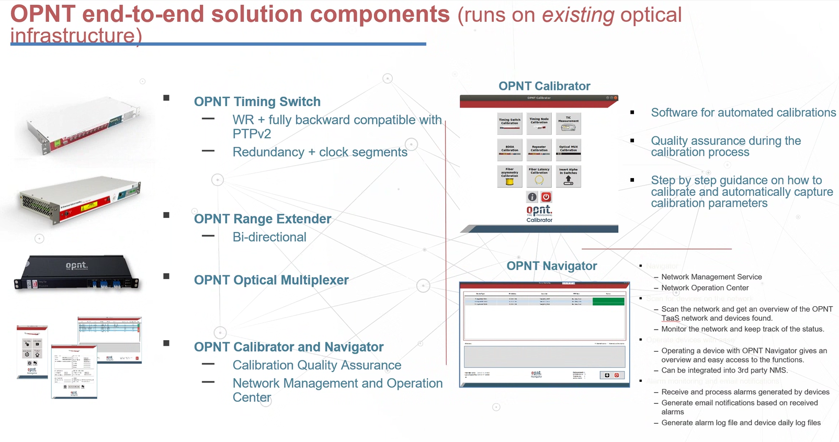
Attachment 6: OPNT Hardware

Slide 31
Attachment 7: What is SURF Time & Frequency? The short version
TFT is short for Time Frequency Transfer. Meaning: Transporting a highly accurate and stable time and frequency signal (< 1 nanoseconds) over fibre.
White Rabbit is a time transfer protocol. It’s Initiated by CERN and developed in a consortium of several research institutes such as Nikhef en GSI. There are other high precision TFT techniques but White Rabbit is currently the most scalable.
Users of SURF Time & Frequency can pick up the White Rabbit signal on a SURF pop location. We will use OPNT adapted White Rabbit Switches to distribute the UTC(VSL) time signal. This is generated by the Dutch Metrology Institute VSL which is one of the best in the world in UTC accuracy.
The signal contains three components:
  An accurate 10 Mhz frequency
  Timestamps 1 pulse per second (1PPS)
  Timestamps in the international atomic time (TAI) UTC (NL-VSL)
Possible use cases are: Synchronizing and calibrating measuring devices, traceable time signal for documentation. Other possible uses are in development such as “Super-GPS”

