Slide 1


Medusa Submarine Cable System
An overview of the GÉANT build
Karel van Klink
Network Engineer (Network Evolution)
14th SIG-NGN, Catania IT
08-04-2024
Public

Slide 2
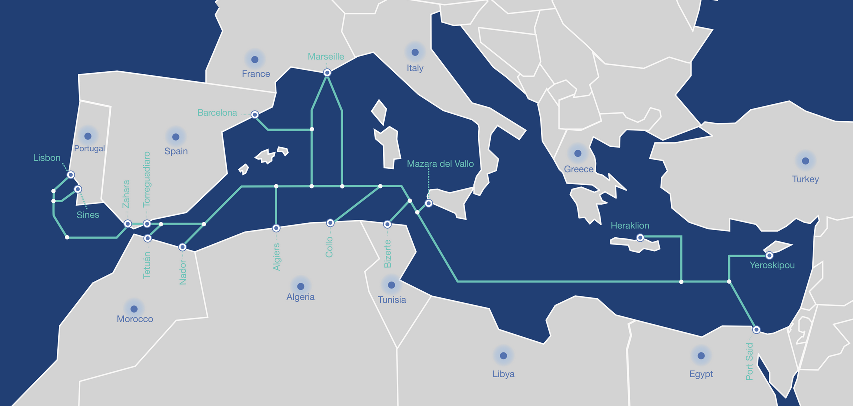
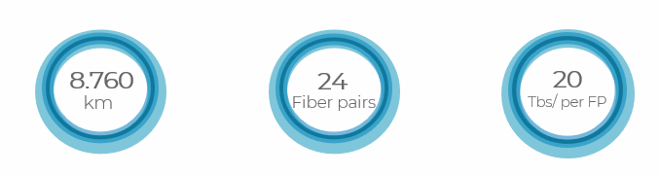
The Medusa system
South European countries:
Portugal
Spain
France
Italy
Greece
Cyprus
North African countries:
Morocco
Algeria
Tunisia
Egypt
MEDUSA is built by AFR-IX
https://medusascs.com/
Notes:
Highlighted countries are were we have connections in our existing network.

Slide 3
The Medusa system
GÉANT as final beneficiary
First 10y of OPEX funded by DG-NEAR
Access to 50% of a fibre pair for its entire lifetime (25+ years)
10+ Terabit capacity

Slide 4
The Medusa system
Built in two Phases:
West Mediterranean – Portugal, Spain, France, Morocco, Algeria and Tunisia
East Mediterranean - Italy, Greece, Cyprus and Egypt

Slide 5
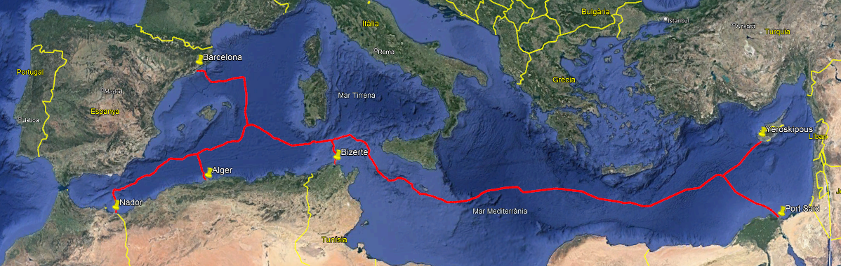
The GÉANT build
The GÉANT build includes 6 countries as:
Spain, Cyprus, Morocco, Algeria, Tunisia and Egypt
The system can also be upgraded to include Libya

Slide 6
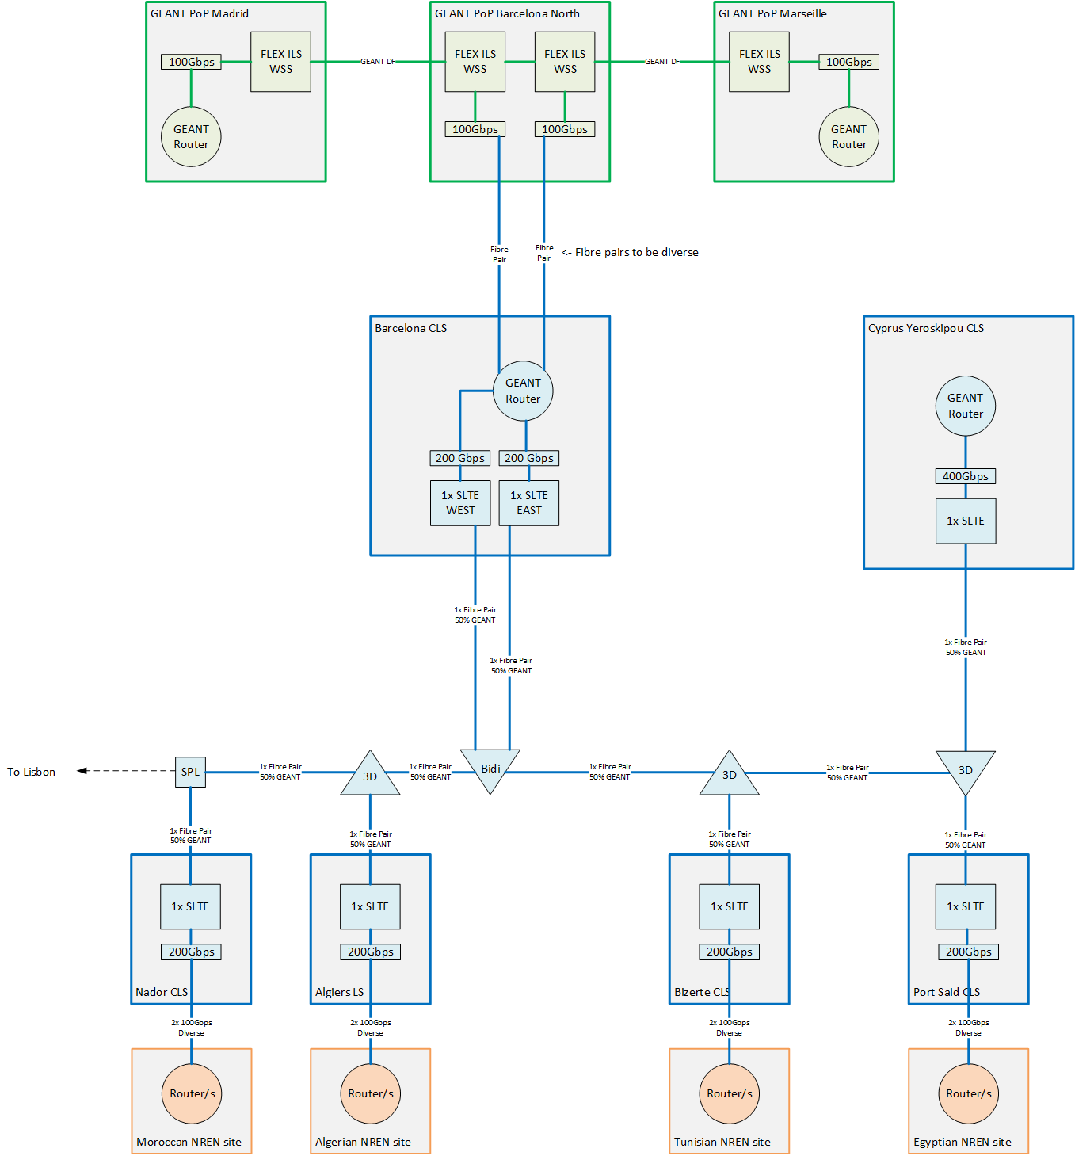
Details
A full fibre is built based on GÉANT requirements/design
  50% (as 2250GHz of Spectrum) for GÉANT – equating to >10Tbps of capacity
Two Southern European and four Northern African countries
  Spain, Cyprus
  Morocco, Algeria, Tunisia and Egypt
  Option to add Libya
Space and Power at Landing stations at all six locations
  2 Racks at Barcelona and Cyprus CLS
  1 Racks at Nador, Algiers, Bizerte and Port Said CLS
Backhaul connectivity included to connect to GÉANT Fibre and four NRENs
  2x 100Gbps CLS to NRENs designated site for Northern African countries
  2x Dark Fibre from Barcelona CLS to GÉANT fibre PoP in Barcelona
  Cyprus PoP will be co-located
  All contracts are on 10 years IRU and include Extension and Upgrade options
Routing kit at Barcelona and Cyprus CLSs
DWDM kit will be managed by MEDUSA on GÉANT behalf
Notes:
Green: GÉANT
Blue: Medusa
Orange: NREN

Slide 7
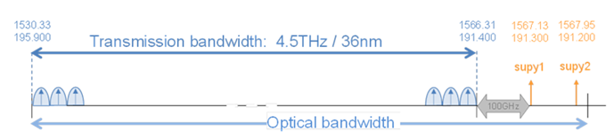
Cable system
4.5THz (4500GHz) of useable frequencies for DWDM signals
>25-year lifetime
Open Cables standard
  G-OSNR measured, and all signals accepted

Slide 8
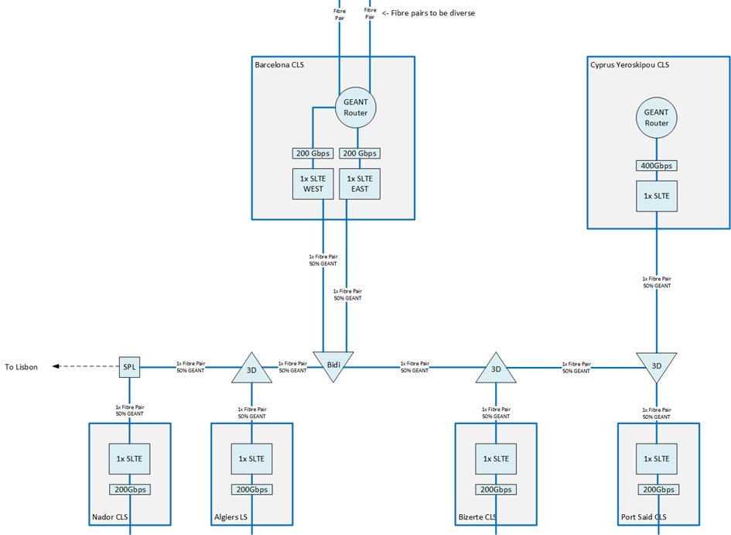
Submarine system
Main elements:
Cable system
  4500GHz Spectrum – 2250GHz for GÉANT
  BCN – PSD 3486Km OSNR 18.4dB
WSS
  Barcelona is bidirectional
  The others are 3D
  Full FlexGrid 12.5GHz tuneability
SLTE
  Nokia 1830 PSI SLTE
  Full FlexGrid 12.5GHz tuneability
Notes:
This is as it is in the budget, but things might change over time

Slide 9
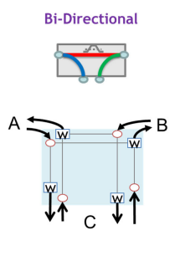
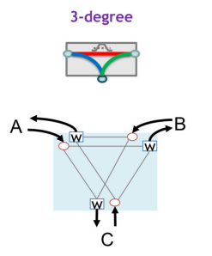
WSS types
Used for Barcelona
Requires 2 fibre pairs per branching unit
Each branch fibre is bound to East or West
More overall capacity available from CLS
Used for all other WSS
Requires single fibre pair per branching unit
Any to Any signal routing
Less overall cost due to single fibre at branching more flexibility, less capacity to CLS

Slide 10
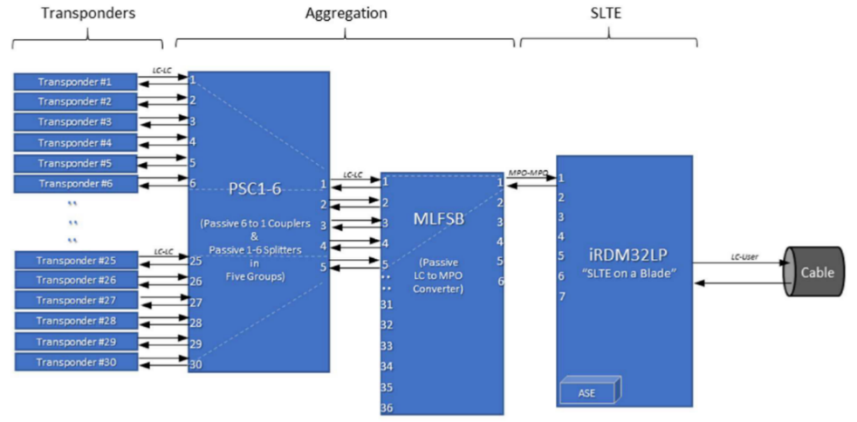
SLTE setup
One SLTE to manage each fibre pair
Will aggregate both GÉANT and MEDUSA signals (50% of fibre pair capacity each)
Accepts signals from any transponders
(inc. non-Nokia)
Flexible Grid allows for compatibility with future technologies
GÉANT specific part
Notes:
Submarine Line Terminal Equipment

Slide 11
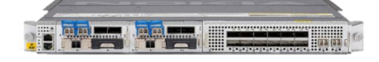
DWDM transponders
Transponders used to light capacity on the fibre
2x 100GE min. available for each Northern African country
Barcelona and Yeroskipou aggregate capacity
Current build based on Nokia 1830 PSI-M
Transponders capacity matrix

Slide 12
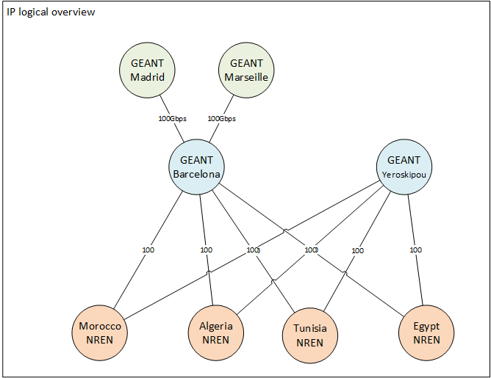
IP layer
MEDUSA will provide 200Gbps of capacity to each Northern African NRENs main PoPs to the GÉANT “Hub” nodes in Barcelona and Cyprus
The GÉANT “Hub” nodes will be connected to the GÉANT Fibre footprint in Barcelona
GÉANT “Hub” nodes can aggregate traffic from other systems – e.g., East Med. for Yeroskipou
To East Med

Slide 13
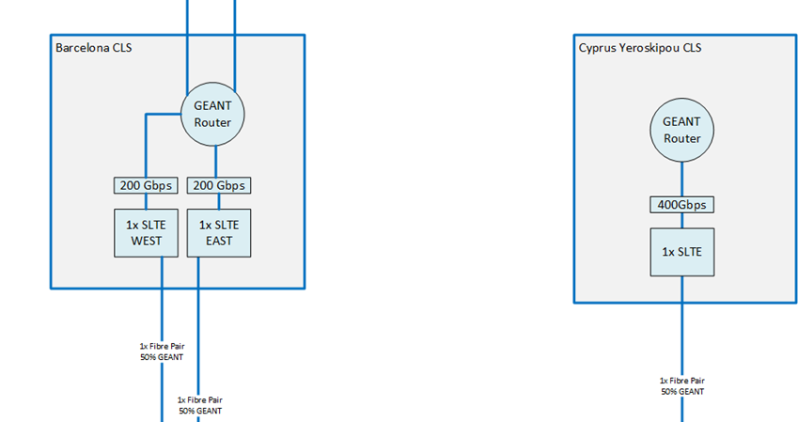
Routing kit
ROUTING KIT SPECS:
2 Routing engines/ supervisor modules
~2Tbps backplane capacity
QSFP based 100G optics 10x available at start, with option to add at least another 10x
Ability to support 10Gbps interfaces
400G support – desirable, likely via dedicated line card not to be necessarily included.
Supports for full internet routing Table and L3VPNs
Two routing sites to be established at Barcelona and Yeroskipou
Routing kit will be acquired via AFR-IX/MEDUSA and managed by GÉANT
200Gbps from each NREN will be terminated at these sites
Routing kit will allow for expansion – i.e. Cyprus toward Eastern Med – by providing 10, 100 and (upon upgrade) 400G interfaces
Actual procurement of Routing Kit will be done at later stage – Budgeted costs and Specs match exactly T3 sites build using Nokia
Routing kit
Notes:
Tier 3 in the GÉANT network packet layer refresh corresponds to a Nokia SR-2se with 2 line cards installed

Slide 14

Terrestrial connectivity Europe
The GÉANT router in Barcelona will be connected to a GÉANT ILA north of Barcelona (Bosc Tancat EXA node)
Barcelona
  CLS will be connected to a GÉANT DWDM PoP in Barcelona via a Dark Fibre ring procured via AFR-IX/MEDUSA
Cyprus
  GÉANT will establish PoP at Yeroskipou
GÉANT PoP co-located with MEDUSA
Fully diverse fibre pairs between CLS and GÉANT DWDM PoP

Slide 15
Terrestrial connectivity NRENs
2x 100Gbps diversely routed leased capacity Ethernet links on 10 years IRUs will be established between the selected NREN site and the country MEDUSA CLS
Contracts will offer extension and upgrade options with price ceiling agreed as part of the initial contract
Various mechanisms such as: price book, external manhole, price ceilings etc.. Used to limit risk of CLS “lock-in” or “golden cross connect”

Slide 16
Timeline and conclusions
Expected System RFS is early 2026 for Phase 1 and late 2026 for Phase 2 (TBC)
Current plan representing a “reference build” for budgeting and planning purposes – low level design and acquisition offers opportunities for further optimization
200Gbps end to end from NREN PoPs to GÉANT aggregation routers with possibility to grow to terabits
Multiple high-capacity connections to GÉANT to provide resiliency and optimize routing toward international destinations
Hub in Cyprus offering a strategic aggregation point toward Eastern Mediterranean
Options for Expansion – Crete, Israel, Turkey, Lebanon being considered (DG NEAR)

Slide 17

Thank You
karel.vanklink@geant.org
www.geant.org

