Slide 1

FAIR data principles, from theory to diagnosis of needs
The SOMMa approach
The ‘Severo Ochoa’ Centres and ‘María de Maeztu’ Units of Excellence Alliance
Núria Benítez Monforte
València – Nov 2023

Slide 2

SO·MM PROGRAMME’S PHILOSOPHY & OBJECTIVES
The Severo Ochoa and Maria de Maeztu are the most prestigious accreditation of excellence awarded by the Spanish Government to recognize, reward and promote outstanding scientific research in Spanish centres.
1
2
3
4
ORGANIZATION
TALENT ATTRACTION & RECRUITMENT
OUTREACH
PARTNERSHIPS
To improve the capacity of high-level research centres to organize and carry out their investigations
Improve their ability to attract, recruit, train and retain talent
Disseminate research results to the general public
Encourage their relationship with other reference centres

Slide 3

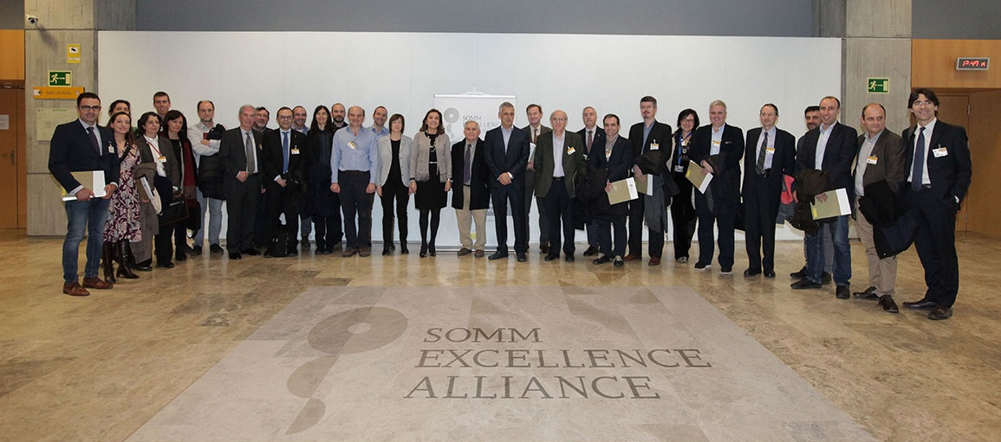
What is SOMMa?
SOMMa is the alliance of the ‘Severo Ochoa’ centres and ‘María de Maeztu’ units, to promote Spanish Excellence in research and to enhance its social impact at national and international levels.
The alliance was constituted in October 2017 with the support of the Secretary of State of Research, Development and Innovation.
SOMMa’s mission is to internationally promote, strengthen and maximise the value of the ground-breaking research produced by the Spanish ‘Severo Ochoa’ Centres and ‘María de Maeztu’ Units of Excellence and the scientific, social and economic impact it generates.
SOMMa institutions cover a wide breadth of scientific disciplines, from life sciences and medicine, mathematics, chemistry, physics, engineering, to humanities, economics and social sciences, and are distributed over the Spanish geography.

Slide 4






















































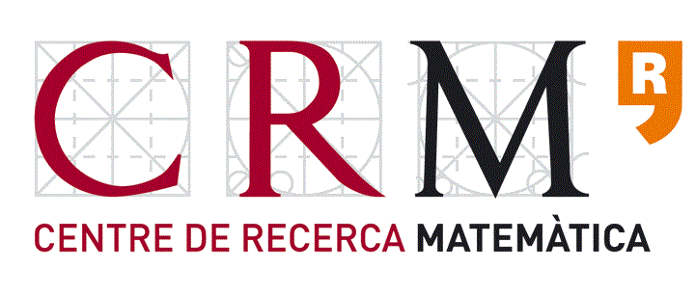

SOMMa members 2023 (62)
Notes:
Ordenar formato

Slide 5
SOMMa members 2023: Geographic distribution
b

Slide 6
SOMMa Open Science Working Group
SOMMa created an Open Science working group in 2018 to be able to follow its members Open Science principles application.
The SOMMa Open Science working group has participated in the interministerial technical Open Science Commission from its creation, contributing to the National Open Science Strategy (ENCA) for the benefit of the Spanish Research system as a whole.
Open Science is a global challenge, collective initiatives ensure results impacting in the system, beyond specific actors.

Slide 7
EOSC Survey Results
As requested by EOSC Spanish representative, SOMMa ran a survey to its members.
The survey was answered by 54 of its members (83% of the members at that moment)
From them:
33 (61%) had a data management policy
30 (56%) referred to this policy as including open data
30 (56%) referred to this policy as including the principles of FAIR data
29 (25%) had a policy for long preservation
20 (37%) had a policy for open software
31 (57%) had an Open Science training policy
29 (54%) recognises open access to results in their evaluation and recognition policy

Slide 8
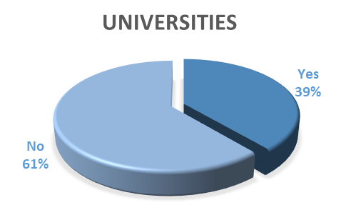
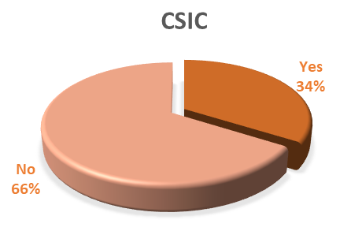
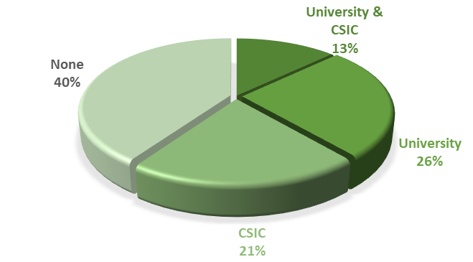
Access to resources
40% of SOMMa members (25) are not under the umbrella of a University nor the CSIC
25 out of 62 SOMMa members do not have access to:
transformative agreements for publications
direct right to use public repositories

Slide 9
Looking to EOSC
What can SOMMa look for at EOSC?
Map of existing infrastructures for research data management
Infrastructure for the selection of data related professionals
Data management training for researchers and research support professionals

Slide 10
thanks
many thanks
www.somma.es
nuria.benitez@icn2.cat
mbenitez@bcamath.org

