Slide 1
Open science training and education in EOSC
The story so far

Slide 2
The skills gap
In 2016 the report Realising the European Open Science Cloud identified 10 challenges and general observations, three of which highlighted a need for relevant skills:
“There is an alarming shortage of data experts both globally and in the European Union.
This is partly based on an archaic reward and funding system for science and innovation, sustaining the article culture and preventing effective data publishing and re-use.
A lack of core intermediary expertise has created a chasm between e-infrastructure providers and scientific domain specialists.”
Realising the European Open Science Cloud (2016) https://ec.europa.eu/research/openscience/pdf/realising_ the_european_open_science_cloud_2016.pdf

Slide 3
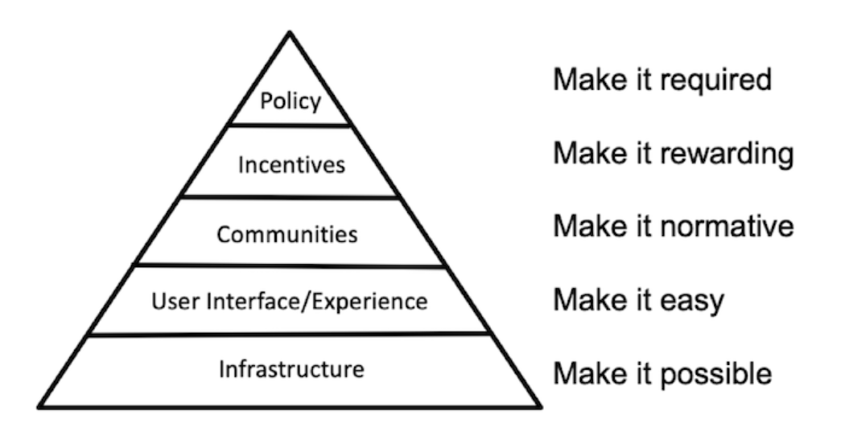
Centre for Open Science Model of Culture Change
Brian Nosek, https://www.cos.io/blog/strategy-for-culture-change

Slide 4
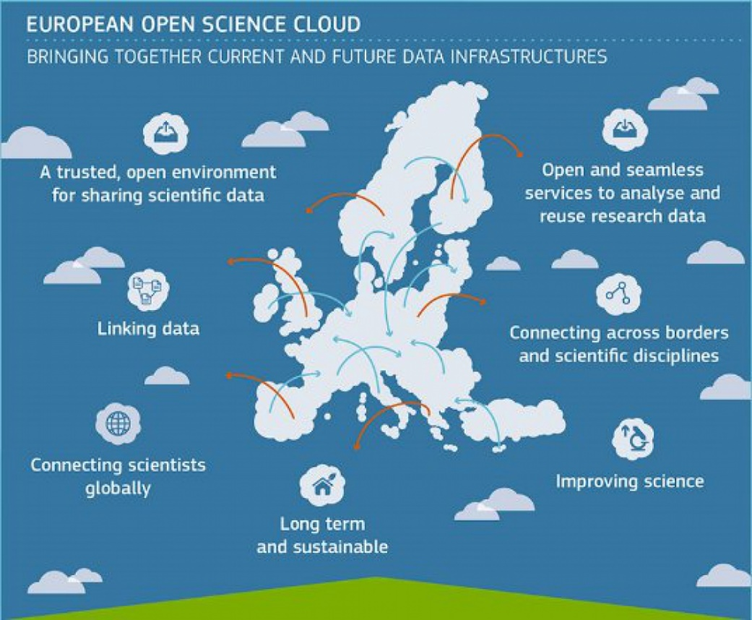
EOSC - The European Open Science Cloud
Enabling the digital transformation of research: towards more of data-intensive, collaborative and cross-disciplinary science
“A web of FAIR data and services”
“A process not a project”
ec.europa.eu/research/openscience/index.cfm?pg=open-science-cloud

Slide 5
EOSC Strategic Research and Innovation Agenda
Three overarching objectives:
Ensure that Open Science practices and skills are rewarded and taught, becoming the ‘new normal’
Enable the definition of standards, and the development of tools and services, to allow researchers to find, access, reuse and combine results
Establish a sustainable and federated infrastructure enabling open sharing of scientific results

Slide 6
SRIA priorities for skills and training
Priority 1: Developing the next generation of Open Science and data professionals
Priority 2: Bridging the education gap: coordinating and aligning curricula for students and researchers
Priority 3: Building a trusted and long-lasting knowledge hub of learning materials and related tools
Priority 4: Influencing national Open Science policy for skills by supporting strategic leaders
Supported by detailed Multi-Annual Roadmap (MAR) https://eosc.eu/sria-mar/

Slide 7
EOSC Association Task Forces 2021-2023
Addressing key areas of implementation https://eosc.eu/eosc-task-forces/
AG Sustaining EOSC
TF Financial Sustainability
TF Rules of Participation Compliance Monitoring
AG Research Careers and Curricula
TF Data Stewardship, curricula and career paths
TF Research Careers, Recognition and Credit
TF Upskilling countries to engage in EOSC
TF Researcher Engagement & Adoption
Technical Challenges
TF AAI
TF Infrastructures for quality research software
TF Technical Interoperbility of Data and Services
TF Long-term Data Preservation
AG Metadata and data quality
TF FAIR metrics and data quality
TF Semantic Interoperbility
TF PIDs

Slide 8
Task Force Chairs
Upskilling chairs
Jessica Lindvall (SE, NBIS/ELIXIR-SE) Sabina Anderberg (SE, Stockholm University)
Helen Clare (UK, JISC) Zisis Kozlakidis (FR, BBMRI)
Data stewardship chairs
Ilire Hasani-Mavriqi (AT, TU GRAZ)
Celia van Gelder (NL, DTL/ELIXIR-NL)
(Vera Matser, UK, EMBL-EBI)
Research careers, credit & recognition chairs
Francesca Di Donato (IT, CNR)
Gustav Nilsonne (SE, Karolinska Institutet)
Researcher engagement & adoption
Sverker Holmgren (SE, Chalmers University)
Franciska de Jong (NL, CLARIN-ERIC)

Slide 9
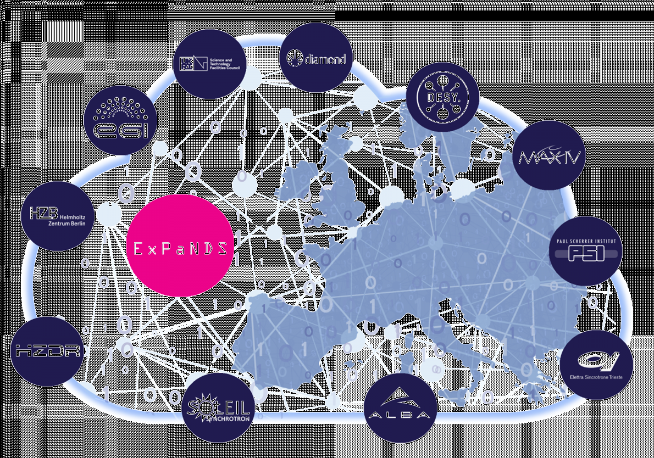
A timeline of training in EOSC
2017
2018
2019
2020
2021
2022
2023
Regional projects
Cluster projects
Timeline CC-BY Helen Clare

Slide 10
Areas of training activity in EOSC*
Frameworks & curricula
Upskilling & sharing
Resources & Metadata
Platform(s) & tools
* Not exhaustive!

Slide 11
Upskilling Countries to Engage in EOSC
Activities
Regular monthly sharing presentations
Blog posts
Widening participation activities
Aligning and supporting existing EOSC initiatives on a national/domain basis
Promoting the exchange of approaches across the member states and regions, organisations and groups
Leveraging information from EOSC Task Forces, projects and initiatives to help nations to identify and implement paths to improvement or “upskilling”
Key findings
Context matters
Flexibility and adaptability are needed
Collaboration is key
Knowledge exchange accelerates progress
Recommendations for widening countries
Next steps
Final report
Joint paper on engagement strategies
EOSC Winter School
Continued activities under EOSC umbrella
Notes:
Thanks to Bernd!!
Aligning and supporting existing EOSC initiatives on a national/domain basis
Promoting the exchange of approaches across the member states and regions, organisations and groups
Leveraging information from EOSC Task Forces, projects and initiatives to help nations to identify and implement paths to improvement or “upskilling”
25 members, representing 16 countries
Regular presentations about OS and EOSC in countries and/or domains

Slide 12
Researcher Engagement and Adoption
Activities
Three subgroups:
Institutional Perspectives
National Perspectives
Perspectives of Thematic Communities at the International/European level
To formulate and communicate a solid EOSC’s value proposition for EOSC.
To capture and understand the needs and expectations of researchers with respect to EOSC.
To create the conditions to enable them to increase their engagement of EOSC as users and service/data providers.
To involve them in a participative process to further improve EOSC services and value proposition, and act as champions for new communities.
To provide recommendations on how to speed up the EOSC engagement and adoption for national / EU / institutions
Key findings
Very broad area covered
While also crucial for future success of EOSC, there is a need to focus limited resources
Focus area: Research Performing Organisations
Next steps
The need to focus on engagement of RPOs has been noted by EOSC-A Board
Workshop planned for Spring 2024 to inform future engagement

Slide 13
Research Careers, Recognition and Credit
Activities
Review of landscape and identifying gaps for TF to address
Development of recommendations
To address incentives and rewards for researchers to manage and share their data, code and other research outputs, activities, and processes
These incentives and rewards will be based on making criteria of Open Science and FAIR principles an integral part of academic career progression and grant assessment processes
The Task Force will identify various research stakeholders groups and their specific roles and responsibilities in support of embedding incentives and rewards for researchers in assessment processes
Key findings
Research assessment a very active and fast-moving space
Recommendations to EOSC Board and to the EOSC Association via position paper
Next steps
Defining role for EOSC in supporting CoARA activities
Joint paper on engagement strategies

Slide 14
Data Stewardship, curricula and career paths
Activities
Actively engage with stakeholders and build on previous work: build, connect & consolidate
Ensure a co-creation process between theoretical development and implementation examples
Focus on the Data Steward role and their core activities
Work on data stewardship job roles and curricula to ensure these are recognised and aligned across Europe
Develop recommendations for potential career paths taking into account appropriate recognition and rewards for data management activities
Key findings
Recommendations for Data Stewardship Skills, Training and Curricula with Implementation Examples from European Countries and Universities
Data Stewardship Career Paths: State-of-the-Art Report and Recommendations
Next steps
Working with RDA special interest group on Professionalising Data Stewardship
Skills4EOSC producing a curriculum for data stewards

Slide 15
EOSC projects
Notes:
Skills4EOSC
Competence centres – mapping data, AI and HPC
Data stewardship curricula
FAIR by design training methodologies
Registry of data management training
FAIR-IMPACT
the FAIR-IMPACT project supports the implementation of FAIR-enabling practices, tools and services across scientific communities at a European, national and institutional level
FAIR tools, impact stories, use cases, FAIR champions, training, community
GraspOS
OS-aware RRA approaches landscape report
Open Science Assessment Framework including Openness Profile templates and the Open Science Assessment Registry (OSAR)
Tools and services landscape report
Federated Open Metrics Infrastructure
Pilots, community engagement

Slide 16
EOSC Winter School , Jan 2024
Team Building - One EOSC
Speed-dating for Projects and TF
Building Unity and Alignment in EOSC
6 Opportunity Areas (OA)
Task Forces and Projects’ Results and mutual learning
Discussing and Analyzing projects’ Reports and Results
Discussing and Analyzing TF’ Reports and Results (Deliverables)
1. PIDs
2. Metadata, ontologies & interoperability
6. Scholarly Communication
3. FAIR metrics & certification
4. User & resource environments
5. Skills, training, rewards, recognition and upscaling
Outreach and Communication
Engagement Strategies and Methods
Impact and Importance of Effective Communication
Role of EOSC-A in Facilitating Communication
Supporting and enabling a user-centric EOSC
OA support
EOSC Impact and sustainability
Overall Impact of EOSC
SRIA 2.0

Slide 17
Concluding remarks
EOSC is supporting the development of skills, reward, recognition and upscaling
Guided by the SRIA and MAR
Aim to complement existing activities not duplicate
Many partners from e-infrastructures are involved and play an integral role

Slide 18
Thank you!
Helen Clare, Jisc
helen.clare@jisc.ac.uk
0000-0002-6656-3012
LinkedIn: www.linkedin.com/in/helenclare

