Slide 1
A closer look at research data practices in Europe’s universities
European university association
Vinciane Gaillard Deputy Director for Research & Innovation
30 November 2023

Slide 2
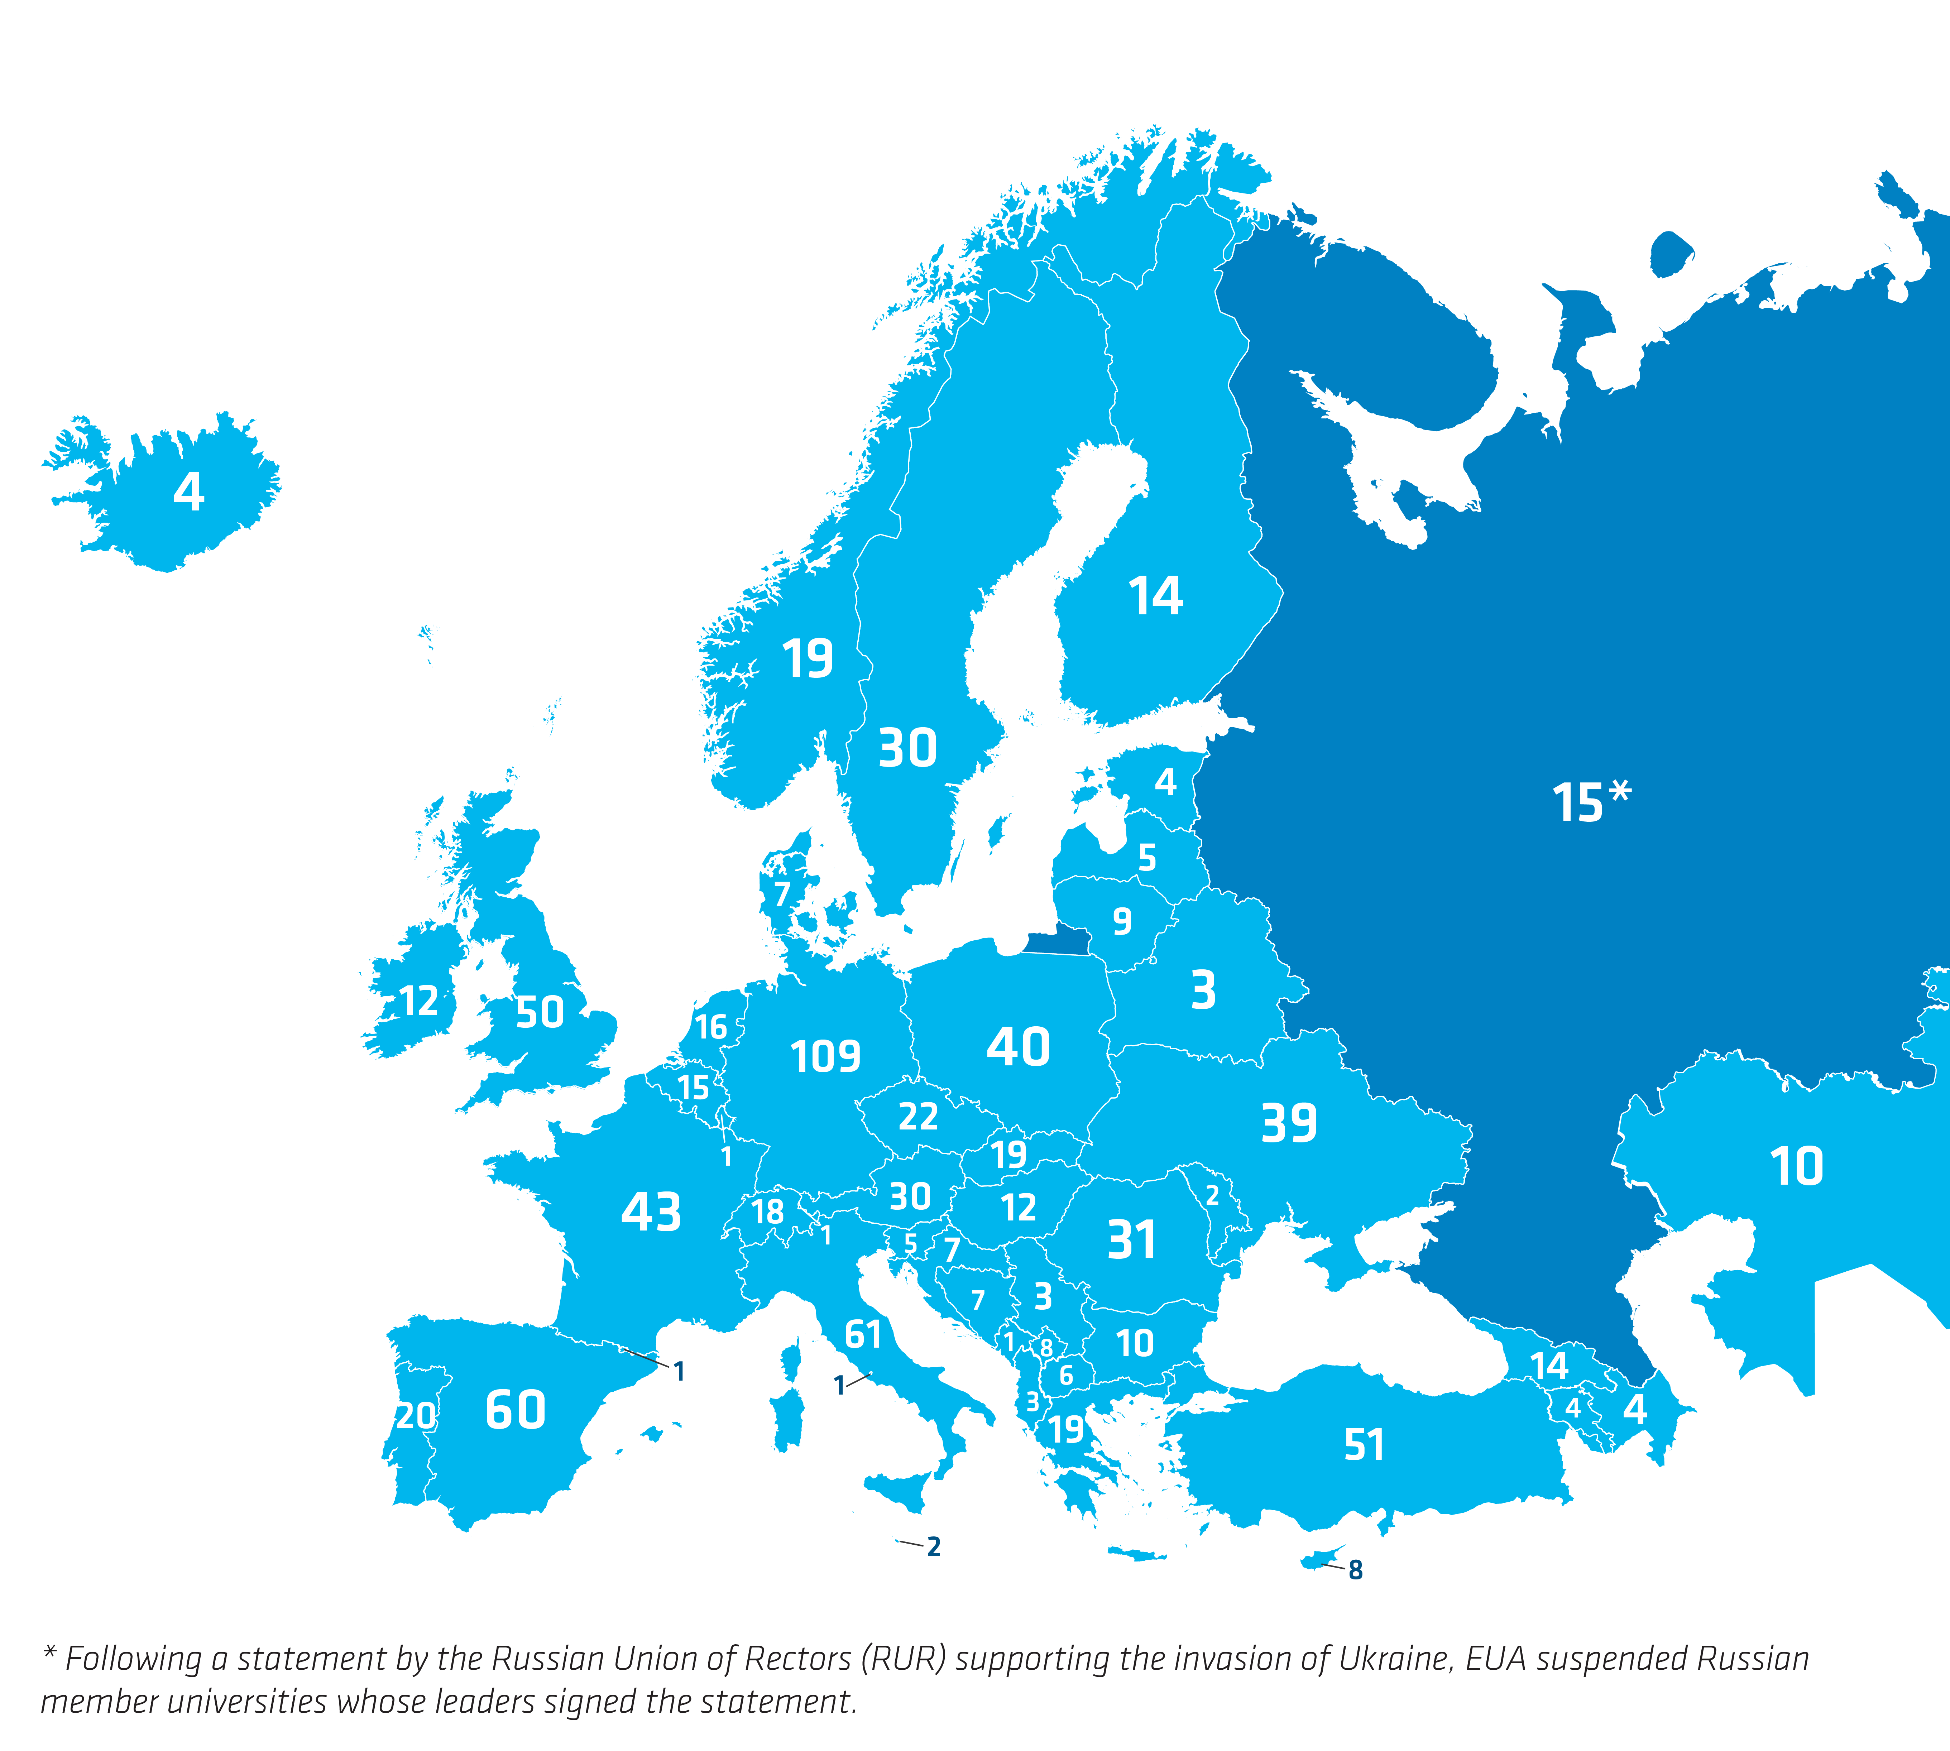
EUA has 866 members
based in 51 countries
(as of 1 April 2023)

Slide 3
EUA and Open Science
Since 2014, EUA has been actively supporting universities in the transition to Open Science, through evidence-based policy making and regular consultations with its members.
EUA takes a holistic approach to Open Science in line with the UNESCO Recommendation on Open Science.
As laid out in the EUA Open Science Agenda 2025, the Association has three key priority areas in Open Science:
Universal and perpetual Open Access to scholarly outputs, in a just scholarly publishing ecosystem.
Findable, Accessible, Interoperable and Reusable (FAIR) research data.
Institutional approaches to research assessment.
Notes:
- When we talk about research data management at EUA we of course talk about Open Science
- Since 2014, EUA has been very active in the field of OS and in particular in supporting universities’ transition to Open Science, through evidence-based policy making and regular consultations with our members (OS surveys)
- Holistic approach to OS → An inclusive construct that combines various movements and practices aiming to make multilingual scientific knowledge openly available
- EUA OS Agenda 2025 + priorities

Slide 4
Priority area #2 FAIR research data
By 2025, Europe’s universities will be part of a scholarly ecosystem characterised by:
Notes:
- RDM is part of our second key priority area on FAIR research data
- Reaching these objectives will indeed mean addressing a set of challenges we identified, which include
- Lack of skills and upskilling opportunities for researchers and research support staff
- Gap of implementation of FAIR RDM practices
- Lack of professional profiles and career paths for the new data-related careers
- Need for a broader engagement of universities with EOSC

Slide 5
Highlights from the EUA follow-up report on research data
Notes:
We will now look more into those challenges by exploring some of the highlights from the follow-up report on research data, which provided much evidence-based information which allowed us to formulate the scope and objective of the key priority area of FAIR research data.

Slide 6
Background
Part of a series of three follow-up reports to the main EUA 2020-2021 Open Science survey report.
272 valid responses from institutions in 36 European countries.
Focus on research data practices and not just FAIR data management.
Research data is defined as a set of information, knowledge and results generated by, and which at the same time support, research projects in different scientific fields.
4 recommendations for universities to foster the implementation of research data practices at institutional level.
Source: https://eua.eu/resources/publications/1016:a-closer-look-at-research-data-practices-in-european-universities.html

Slide 7
Recommendation #1
Universities should develop measures to support the implementation of research data practices at institutional level.
Support measures should ensure that the university community can comply with institutional policy objectives, by providing the right infrastructure and skills to practice research data management.
Due consideration should be given to the recognition of research data-related activities in university approaches to academic assessment.

Slide 8
Gap between strategic importance and implementation
Notes:
- Explain graph: RDM 71% respondents see RDM as (very) important but only 26% mention (very) high levels of implementation / FAIR data: 60% vs 13% / Data sharing: 56% vs 16%
- Support measures need to be developed in order to ensure that the university community can comply with the ambitions of institutional Open Science strategies.
- In particular, researchers and their support staff need to be equipped with the right tools (infrastructure) and training (research data management and FAIR data skills).
- Importance of research assessment
- Researchers still tend to perceive data management recommendations and requirements as an extra burden, rather than as a practice that helps promote the integrity and visibility of their work.
- Efforts are needed to ensure the creation of a more responsible and sustainable assessment system that includes incentives and rewards for researchers and therefore provides a framework that supports and fosters the implementation of research data-related practices and other areas of Open Science at institutional level.

Slide 9
Recommendation #2
Universities should continue to invest in research data infrastructure and explore opportunities to engage with EOSC.
Infrastructure is key to the implementation of research data practices, and universities should invest in securing the presence of infrastructures that address the needs of the different disciplines.
National and European support will also be needed to facilitate university engagement with EOSC.

Slide 10
Types of research data infrastructure
Notes:
- Most of the surveyed institutions currently have some type of research data infrastructure (over 70% of respondents, more when it comes to data storage)
The landscape presented in this report is quite diverse: universities appear to rely less on purely internal infrastructure in favour of external and shared infrastructure, or a combination of all three.
Developing new and/or enhancing current infrastructure also ranks highly among institutional actions to support the transition to Open Science.
More attention should also be placed on fostering university engagement with the European Open Science Cloud (EOSC).
- As knowledge-provider institutions and research performing organisations, universities are both key enablers and major beneficiaries of the EOSC roll-out. While universities are largely aware of these benefits, they are still deciding whether to link their infrastructure to the EOSC ecosystem.
- National/European support needed to address universities needs and concerns

Slide 11
Recommendation #3
Universities should create dedicated research data support services and hire specific data support roles.
FAIR research data management should not be considered an additional research task, but an ad hoc responsibility.
Providing dedicated support and staff is essential to fostering the implementation of research data practices and a research data culture at institutional level.

Slide 12
Dedicated research data support services
Notes:
- Comment graph: dedicated at institutional level: services that are predominantly focused on providing support and guidance for research data-related activities.
43% don’t have dedicated services but we will see that these institutions do provide researchers with some kind of support to help them manage, store and curate their data.
The availability of staff with the right technical expertise is crucial to supporting the implementation of research data management practices.
Results presented in the report show that universities are progressively creating dedicated research data support services and hiring specific support staff. However, significant disparities still exist between countries and institutions.

Slide 13
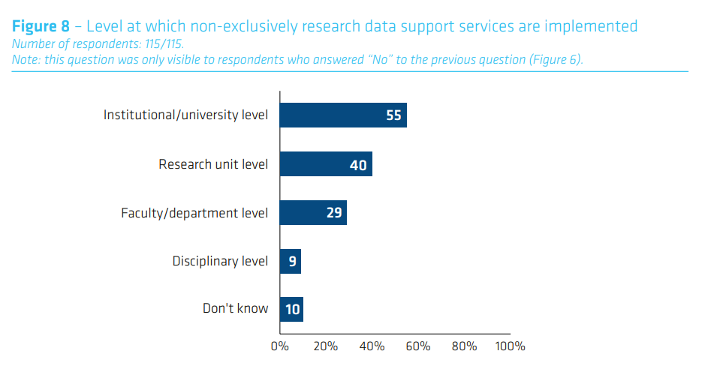
Dedicated VS non-exclusively research data support services
Notes:
- institutional level is where dedicated data support services are implemented.
The 43% of universities without dedicated services → research data management responsibilities still fall largely to existing members of staff, also at institutional level but also more at the research unit level.
These people are generally librarians, IT experts and research administrators and, in the absence of adequate upskilling and reskilling opportunities, they may not be able to offer researchers the right support and guidance.
In many cases, specific technical skills are needed but only partially available.

Slide 14
Dedicated research data support staff
Recently hired profiles include:
Data Stewards, Research Data Officers/Managers, Data Administrators, Open Science Coordinators and Open Science Policy Officers.
Notes:
- Universities will increasingly be asked to invest in research data expertise. Yet, the absence of a shared recognition and definition of data professional profiles represents a major challenge.
- Additional support will be needed to create a new framework for research data careers, including the identification of key skills, clear career paths and defined accreditation mechanisms.
Recent developments: ERA Actions 3, 4 and 17

Slide 15
Recommendation #4
Universities should look for sustainable funding sources to cover the costs related to research data management.
This should include national support, as national bodies increasingly require universities to practice FAIR research data management.

Slide 16
Sources of funding
Notes:
- When it comes to covering the costs of research data infrastructure and services, the results presented in this report reveal a diverse landscape.
- While most universities benefit from multiple funding sources, sustainability remains an issue.
- This is especially true at institutions which cannot rely on funding streams that are entirely dedicated to research data.
- The creation of sustainable sources of funding to cover research data-related costs is a responsibility that needs to be shared.
- National Open Science strategies are trying to encourage the uptake of research data practices and national funders are increasingly mandating FAIR data management as a boundary condition for funding.
- National support should therefore be provided in order to ensure universities have the necessary tools and skills to comply with such national driven ambitions.
- Yet, Europe is still home to significant national differences in terms of the availability of ad hoc national funding streams to advance research data practices and infrastructure and, even when these do exist, not all universities appear to be aware or benefit from them.

