Slide 1
1+MG/GDI - European Genomic Data Infrastructure
e-IRG Workshop under Spanish EU Presidency.
Salvador Capella-Gutierrez (BSC) / Juan Arenas Márquez (ELIXIR Hub)
29th November 2023
Valencia

Slide 2
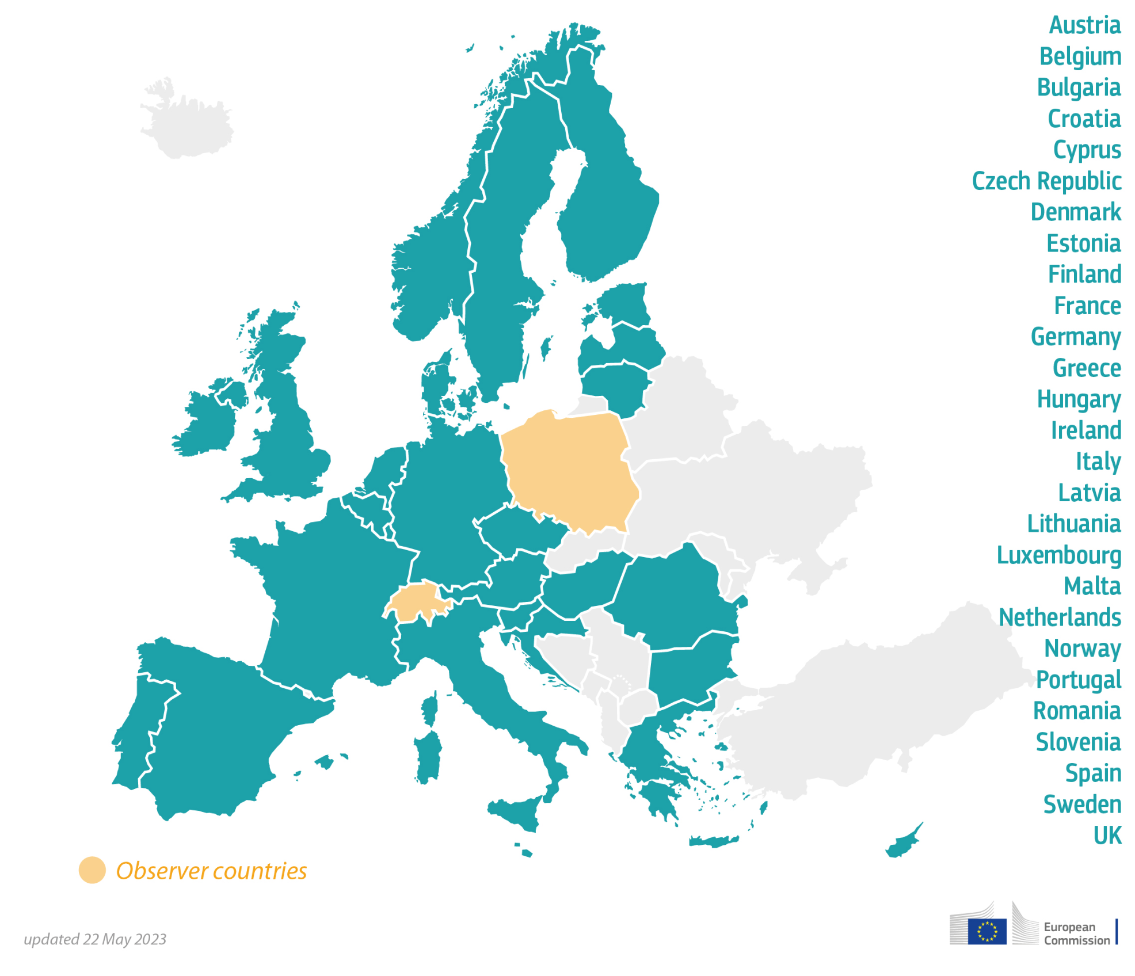
1+MG initiative
Cross-border access to genomic data, implementation of genomics-based health. Supported by 27 countries to date
Ambition: Enable secure access to high-quality genomics and the corresponding clinical data across Europe for better research, personalised healthcare and health policy making

Slide 3




Realising the promise of genomics
Genomics integrated into national healthcare systems
Data infrastructure is required
Data will soon be generated more frequently in healthcare.
Solutions are required to ensure research findings (if appropriate) can be incorporated into healthcare
Make a reality of personalised prevention, diagnostic and treatments
Innovation
Evidence
GENOMICS TO BENEFIT ALL
Diagnostics, treatments, personalised medicine approaches, prevention
Evidence
Data
Research

Slide 4


1+MG Implementation projects
Cross-border access to genomic data, implementation of genomics-based health. Supported by 27 countries to date
2018
2020
2022
2023
2026
2027
Design & Testing
Scale-up & Sustainability
Population Genomics
Genome of Europe
Notes:
Add H2020 logo left, right the DE programme logo - visualise change from funding schemes from one to the other - research to DE (deployment and establishment)

Slide 5
GDI in numbers
€40M
45
6
7
58
20
2
(50% co-funded)
Project Beneficiaries
Affiliated Entities
Associated Partners
Total Project Partners
European countries
At least 6 countries technically operational by 2024
At least 15 countries technically operational by 2026
International Organisations*
*ELIXIR & BBMRI-ERIC
Cyprus, Hungary, Malta and Romania joining GDI soon
Notes:
4 countries joining so will soon total 24 - will be mentioned later

Slide 6
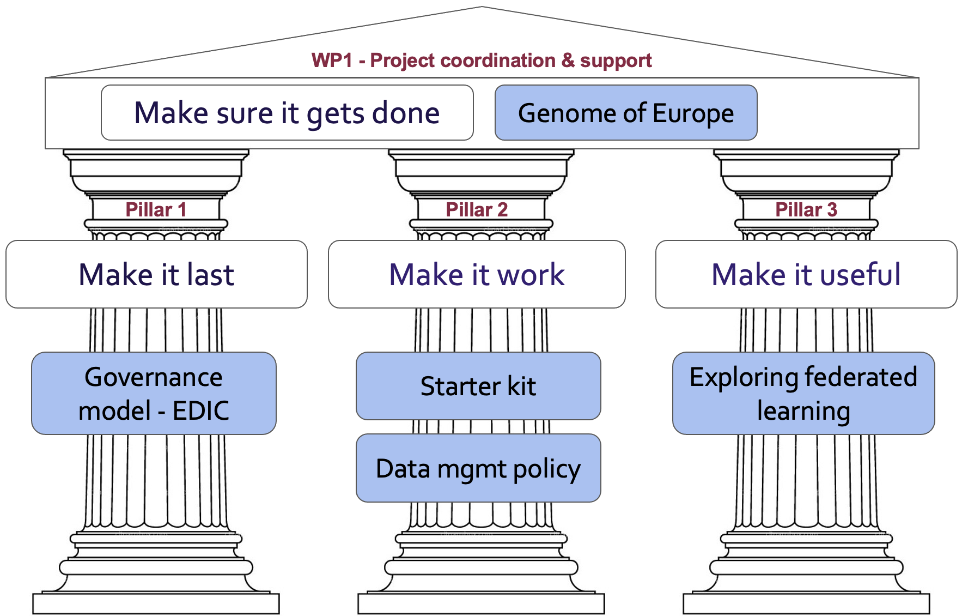
GDI Project overview

Slide 7
Why an EDIC for 1+MG
Beyond research
  1+MG will be a data infrastructure for secondary use beyond research (ERIC instruments) as it includes also reuse in healthcare and policy development
Governance of a genome data space
  The 1+MG Declaration aims at a joint harmonised governance
  Enable participation of EU member states, EC, private sector and other institutions as agreed by EDIC members: ESFRIs, eInfras, EOSC,...
  By definition members are expected to contribute in-kind or in cash
Legal framework for a genomic data space
  Systematic data sharing for secondary use needs (new) legislation
  EDIC as a new legal instrument may have weaknesses for 1 +MG purpose→ exploration needed

Slide 8
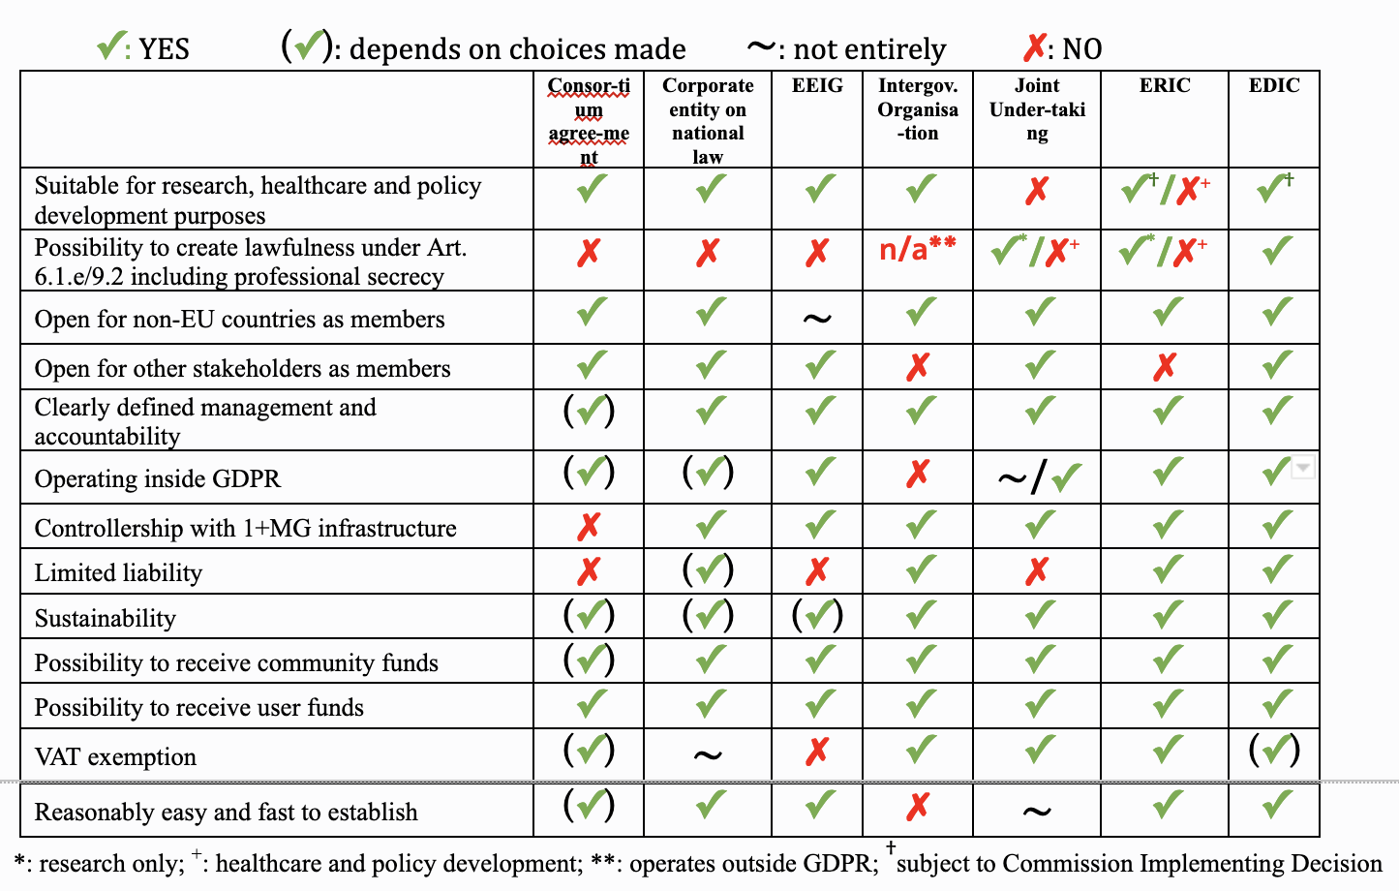
Legal framework – potential instruments
Evaluation of potential legal instruments
  Identification of main criteria, e.g. possibility
  to allow a mission beyond research;
  liability; ease to set up etc.
  Evaluation identified “European Digital
  Infrastructure Consortium” (EDIC) as most
  promising
EDIC characteristics
  Modelled on ERIC of research infrastructures
  Any mission to support digital agenda
  Differences with respect to members and
  role as international organisation

Slide 9
Journey so far
Pursuit on an EDIC
  EDIC selected as most promising solution to be pursued by the 1+MG initiative
Subsequent activities around the EDIC
  Submission of “Expression of Interest” on creating an EDIC for the genomic infrastructure to the Digital Decade Board by 19 countries
  Pre-notification of willingness to create an EDIC with indication of first financial contributions (9 countries + ELIXIR)
Included recommendation to maximise utilisation of current EU capacity as well as EC and MS investment when applicable ( ESFRIs, EuroHPC, EOSC, eInfras,... could be invited to participate by the MS forming the EDIC)
Impact of EDIC EoI / pre-notification
  Creation of the 1+MG EDIC Working Group supported by GDI pillar I and MCP Accelerator

Slide 10
1+MG & EHDS
a path for EDICs participation in EU Data Spaces?

Slide 11
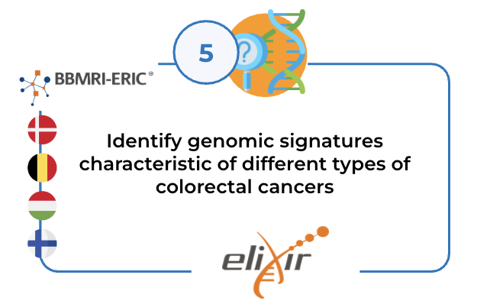
1+MG/GDI and EHDS
1+MG CRC use cases included in Healthdata@EU pilot project
  Accessing EHDS participants data
    BE, DK,HU,NO Health data body
    BBMRI-ERIC Data sharing infrastructure
  WGS, Phenotypic and, socioeconomic data
Demonstrate use of 1+MG/GDI standard to manage genomic and health data within the Healthdata@EU

Slide 12


HealthData@EU: vision and reference architecture
Slide developed by the European Commission
(updated on 01/01/23)
EMA
Data Sharing Infrastructures
ECDC
Data Sharing Infrastructures
New infrastructure for secondary uses of health data
Connecting health data access bodies and data sharing infrastructures
Several health data access bodies are established, or in the process, across Member States
Core
Services
Data Authorisation Body
< Data Users >
Researcher
Health Professional
Public Health Authority
Regulator
Innovator
Data Authorisation Body
Health Data Access Body
Health Data Access Bodies
SPE
SPE
CORE Services
provided by EC
< Data Holders >
Electronic Health Records
Health Data Registries
Administrative Data
Claims Data
Genomics
GENERIC Services
provided by authorised participants
Secure Processing Environments
SPE
LOCAL Services
provided by/to local partners
Notes:
https://ec.europa.eu/info/strategy/priorities-2019-2024/europe-fit-digital-age/european-data-strategy_en
cf. aussi https://eur-lex.europa.eu/legal-content/FR/TXT/HTML/?uri=CELEX:52020DC0066&from=EN
It is widely acknowledged that safe, efficient and sustainable healthcare systems are highly dependent on data (Delvaux et al 2019, OECD 2019). Data may support clinical decision making, may allow for healthcare system planning, supervision and improvement and may provide information to empower patients to engage actively in their healthcare and wellness management.
EHS: The first point of note is that all Member States reported to have created some form of mechanism for researchers to gain access to at least some types of data previously collected for other purposes, although in some cases this may be to only a limited category of data.
almost all the Member States use some form of Research Ethics Committee (REC) either at national or regional level, and in some cases the RECs also provide the necessary approval for data to be made available through a centralised data governance and access body. The notes provided by correspondents indicate that usually the DPA and REC processes happens in tandem
Once REC and DPA approval has been received the research and data access can begin.
exchange of health data for both care and research was made more complex in their views by the fact that a wide range of governance models exist across the Member States, and they generally felt that neither the legislation in the Member States nor at EU did much to facilitate data exchange between Member States

Slide 13
EHDS and GDI
1+MG use case on colorectal cancer leveraging data infrastructure participation in EHDS (ELIXIR & BBMRI)
Common interests on crucial issues such as data discovery, data access, etc.
GDI and Healthdata@EU pilot projects are complementary and synergetic projects for secondary use of health data. Close collaboration a key success factor for both projects.

Slide 14
1+MG/GDI
By delivering GDI we are also contributing to deliver EHDS
GDI infrastructure/products can provide services under different governance models:
  National infrastructures
  1+MG
  EUCAIM
  EHDS
  FEGA
  EOSC
  Others
It is an implementation decision.

Slide 15
salvador.capella@bsc.es / juan.arenas@elixir-europe.org
gdi-coordination@elixir-europe.org

