Slide 1
EUROPEAN CANCER IMAGING INITIATIVE in the context of the EDIC application
Presenter: Mario Aznar
EUCAIM’s Sustainability / EDIC Application coordinator

Slide 2
European Cancer Imaging Initiative Presentation for MS
THE CANCER IMAGING INITIATIVE
THE EDIC
APPLICATION

Slide 3
Problem / Opportunity
100 million medical images are populated in the EU every year...
(i.e. from clinical practise, studies and research projects, cancer screening programmes…)
Distributed into thousands of Hospitals and repositories, resulting in scattered, heterogenous and non-standardized data
But they are…

Slide 4
Problem / Opportunity
AI can revolutionise cancer diagnosis and treatment as long as quality datasets are available for training
Running Cancer Screening programmes or Observational studies implies intense resources in terms of time, effort and coordination between the different clinical centers involved in the studies.
National/EU R&D funded projects could have a greater and lasting impact if, once finished, their scientific community and results (tools and high-quality Research data for secondary use) obtained remain operative and accesible for further research.

Slide 5
Value Proposition
A pan-European federated infrastructure, linking and making research cancer imaging data from EU-level and national hospital networks and research repositories accesible, ready & usable .
An accelerator for medical research and industry to better understand, diagnose and fight cancer.

Slide 6
Target Groups
DATA HOLDERS
DATA USERS
They provide access to the cancer imaging and related data to be shared through EUCAIM
They use the EUCAIM infrastructure to easy or enrich their achievement of research results
Clinical sites
Existing cancer image repositories
Research infrastructures
Cancer screening programmes
Others (e.g. data altruism organisations, etc.)
Researchers & innovators in data science & AI
Researchers & innovators in new therapies
Medicines regulatory agencies
Others (e.g. policymakers, etc.)

Slide 7
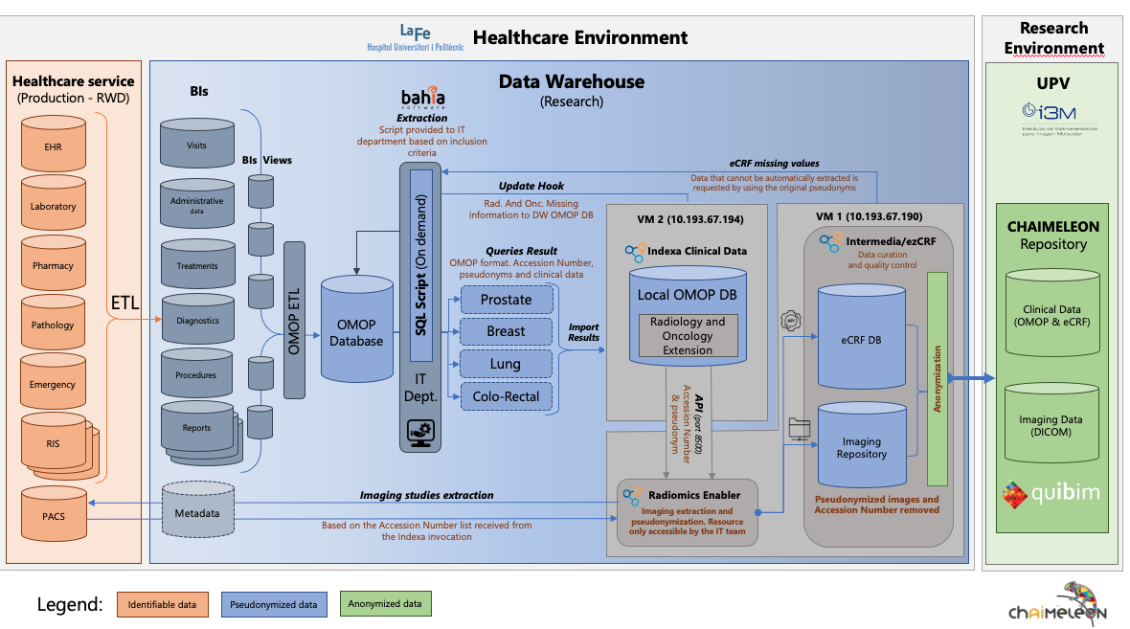
Value Proposition Federated Infrastructure with a Central Node Atlas of Cancer Images
Observational RWD Studies
(new data)
Experimental AI Image Optimization
(existing data)
Open Challenge
Central HUB Platform
Data Warehouses
Observational RWD Studies
Central Storage
Anonymized
Governance
& Access
Cancer Screening Programs and Grants
Biobanks
Data Altruism
Integrated / Standardized
Accessible High-Quality Data
into a Secure Processing Environment

Slide 8
Value Proposition
Two main Value Axis:
1. Accessible Quality Data
2. Secure Processing Environment
EUCAIM Atlas of Cancer Images
Provides data users with existing collections of cancer medical images
Meets data holders needs / interest to make their existing collections accessible for secondary use.
EUCAIM Observational Studies + Screening: New multicentric data collections in response to specific research purposes.
For Data Holders
Maximises guarantees of safety and compliance with technical, ethical and legal requirements, thanks to the EUCAIM technology, governance and sharing models (the "EUCAIM Standard").
Minimise the effort, time and cost related to the preparation of datasets thanks to tools and services provided by EUCAIM.
For Data Users
Maximises the usefulness of the data for specific research purposes.
EUCAIM Services: data-based/intelligence services (i.e.: validator of medical devices and AI algorithms, statistics, regulatory agencies partner

Slide 9
SUSTAINABILITY OF OPERATIONS Operational Model
Maintain the operation of the Central Hub beyond the project’s end in full compliance with legal and ethical requirements.
EUCAIM: Hub Central + Federated Network of Data H.
Member States
Central national node(s)
National nodes with federated structure
Other structure (i.e AI4HI projects)

Slide 10
SUSTAINABILITY OF OPERATIONS Operational Model
Cost structure and definition of operating procedures
Cost and management of HR (Secretary General, administrative staff, technical staff...)
Cost and management of operating, maintaining and updating infrastructure (cloud storage, processing power, equipment, etc).
Cost and management of operating, training, and upgrading technical teams (Project management, federation and node management, relationship with hospitals, helpdesk, etc...)
Cost and management of related activities (travel, dissemination, legal services, participation in forums, organization of events, etc.).
Others...

Slide 11
EUCAIM – The future
How could we maintain and improve EUCAIM’s infrastructure and services in the future?

Slide 12
European Cancer Imaging Initiative Presentation for MS
THE CANCER IMAGING INITIATIVE
THE EDIC
APPLICATION

Slide 13
The Project: overview
Research infrastructure developed by the EU-funded EUCAIM project
Coordinated by EIBIR
Scientific Director Luis Martí-Bonmatí (HULAFE, Valencia/ES)
Consortium: 76 partners from 14 countries
Runtime: January 2023 - December 2026
Investment: €35.5 million total (50% EU Grant)
Flagship activity of the European Cancer Imaging Initiative

Slide 14
The Project: main challenges
Infrastructure challenges
Overall architecture (completed)
Connecting different components
Data-related challenges
Finding and connecting data (repositories, warehouses)
Making data interoperable
Sustainability challenges
Business model definition (Financial, Operational and Legal pillars)
Gathering interest and support from EUCAIM’s stakeholders (MS, industry, academy) and society in general.
How are we addressing them
Regular internal meetings
Developing guidelines and requirement documents
Developing a common data model and hyperontology
Project Coordination (WP1) + Sustainability Unit (WP8) working together in Sust. planning + EDIC application. Intensive Desktop + Networking + Customized communication actions.

Slide 15
General Roadmap
2023
2025
2027
Design completed
Requirements analysis
Design
Collaboration mechanisms
Early release of the data federation framework
Final release of platform
Federated learning
Final version of tools and services
Federation of new cancer images databases through open calls
Implementation of clinical use cases
Expansion
First version of platform
Platform validated and populated for external production
Data providers connected
Prototype for federated learning
Benchmarking platform
Full operation of federated repository
Integration with other data infrastructures
Piloting of the business model
Legal and operation model finalised
2024
2026

Slide 16
European Digital Infrastructure Consortia - EDIC
EDIC
(European Digital Infrastructure Consortium)
The achievement of European digital objectives will be facilitated through large-scale multi-country projects (MCPs) by pooling EU, national and private funds and resources.
These multi-country projects will have to be selected and implemented in a coordinated manner (Commission and Member States).
‘Common European data infrastructures and services' are included in the list of eligible areas of activity.
The EDICs are meant to be a mechanism for implementing these multinational projects. European digital objectives will be achieved

Slide 17
EDIC Application progress
Digital Decade Board (DDB)
WG EUCAIM EDIC
WG EDIC to be 1
WG EDIC to be 2
WG EDIC to be N….
MCP Accelerator

Slide 18
EDIC Application progress
Actions accomplished during 2023
Letter of Interest (LOI) from 3 MS: During the first quarter of 2023, we managed to gather the support of 3 MS: Spain, Sweden and Italy.
Additional Support from other MS (updated November ‘23): In addition, the interest of MS in supporting the EUCAIM EDIC application increased in the following months, adding to the list France, Belgium, Greece and Latvia.
EUCAIM EDIC Working Group (WG): The EC has given its approval to the constitution of the official working group for the EUCAIM EDIC application.
Coordinating Country: Spain has confirmed its commitment to act as Coordinating/Host Country for the future EDIC and for acting as Coordinator in the WG.
Biweekly meetings with the Coordinating Country representative: every two weeks, a meeting with the representatives of the Spanish Ministry of Economy in support of the EUCAIM EDIC Application is held, providing updated information and sharing documentation for planning upcoming activities.
Individual interviews: individual interviews with each of the MS already interested in EUCAIM have been programmed for the last quarter of 2023. These interviews are intended to share information with each MS representative on EUCAIM’s goals and, at the same time, understand the main expectations and interests of the MS.

Slide 19
EDIC Application progress
Countries supporting the initiative:
(Updated Nov’23. Note the project started just 01/01/2023)
Spain
Sweden
Italy
Greece
France
Belgium
Latvia
…Short-term goal: 10+ MS Q4’23 / Q1’24 (talks with Portugal, Estonia, Lithuana, C. Rep, Finland, Norway in progress)

Slide 20
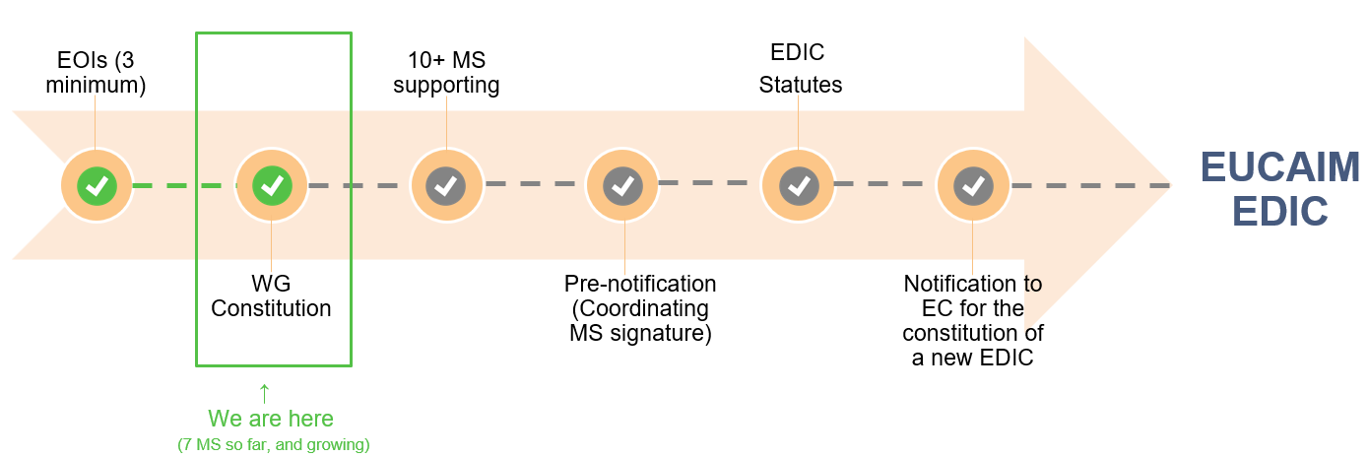
EDIC Application progress
EDIC application:
Current actions:
a) Individual interviews with each Member State
b) Communication actions to invite more Member States to the EUCAIM EDIC Working Group
c) Organization of the WG Kick-off meeting (foreseen by Q1’24. After ind. Interviews)
2023
2024-2025
2025-2026
2027

Slide 21
EDIC Main challenge so far: MS Rep. identification
The main challenge faced by the EUCAIM’s EDIC application has been (and still is) the identification of the proper contacts in each MS.
There is no process established to identify the MS representatives able to support the EDIC application under the Digital Europe programme.
Mitigation measures:
asking support from the EC MCP Accelerator team to identify Digital Europe Board members;
mobilising all the consortium members to ask within their governments and ministries
contacting out of the blue potential MS representatives
sharing documentation and presentations on EUCAIM to scientific leaders within our consortium and beyond to engage with potential MS representatives in events and congresses.
digging on the Internet to find names of potential representatives in national administrations.

Slide 22
visit cancerimage.eu for a first preview of the platform

Slide 23
Thank you
Mario Aznar
EUCAIM’s Sustainability Coordinator
m.aznar@matical.com

