Slide 1
Towards the Common European agriculture data space through EDIC mechanism ?
Sébastien Picardat
CEO
Agdatahub
#Agdatahub #AgriDataSpace

Slide 2
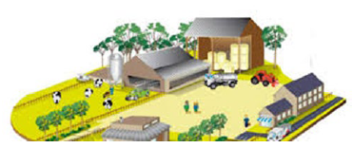
10 EU millions farms to interconnect with 500 000 partners
Data maturity of this sector
A very large amount of heterogeneous, competing, non-interconnected and sometimes inaccessible data, scattered among the partners of the farms
Coop / private companies
Agro supplier
Food industry
Agricultural machinery
Wholesale
Chamber of agriculture
GMS / Retailers
Research and technical institutes
Bank / insurance
Commun Agricutural Policy
- Provide food to EU consumers and third countries in quantity and quality
- Minimize the impacts of agricultural practices
State / Community
Social security
Start-up / IOT
#Agdatahub #AgriDataSpace

Slide 3
Agdatahub’ technological modules are Gaia-X compliant
Candidate to be an EU-recognized data intermediation services provider
SOVEREIGN
NEUTRAL
COMPLIANT
RECOGNIZED
ADAPTED
French solution guaranteeing data security and confidentiality, subject to European and national regulations
Supported by some thirty representative agricultural players, Agdatahub is not directly involved in data processing, and will operate under the regulation of ARCEP.
Technological platform in line with the rules of the single data market defined by the new European regulations (DGA, DA)
Agdatahub is the coordinator of the AgriDataSpace Consortium and a Gaia-X day-One member
Solution based on proven partner technologies, adapted for agricultural and agri-food markets.
#Agdatahub #AgriDataSpace

Slide 4
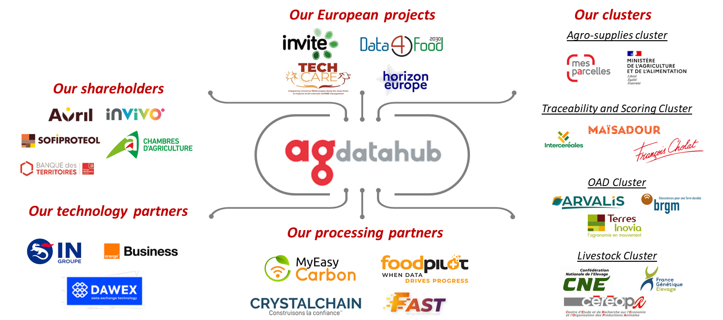
Agdatahub succeeds in federating the agritech ecosystem
#Agdatahub #AgriDataSpace

Slide 5
Towards the Common European agriculture data space
Commun European Agriculture Data Space ?
Data Exchange Platform
Data Intermediation Platform
Gaia-X Digital Clearing House
Data Exchange Platform
Data Exchange Platform
Notary
Compliance
Credential Event Service
Data Exchange Platform
Other National
Data Exchange Platforms
#Agdatahub #AgriDataSpace

Slide 6
Thank you!
Sébastien Picardat – sebastien.picardat@agdatahub.eu
#Agdatahub #AgriDataSpace

