Slide 1
ERIC Forum experiences with a setup of a series of ERICs for Ris/e-Infrastructures Jens K. Habermann Coordinator ERIC Forum 2 Project jens.habermann@bbmri-eric.eu
29th November 2023, e-IRG Workshop

Slide 2
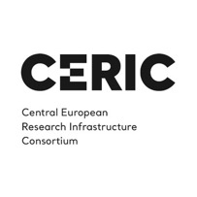
ERIC Forum: who are we?
A bottom-up collaboration of 25 European Research Infrastructure Consortia (ERIC)

Slide 3
ERIC Forum: how are we organized?
5 topic-specific clusters:
Environment
Health and Food
Energy
Physical sciences and engineering
Social and cultural innovation
Icons source: Flaticon.com

Slide 4
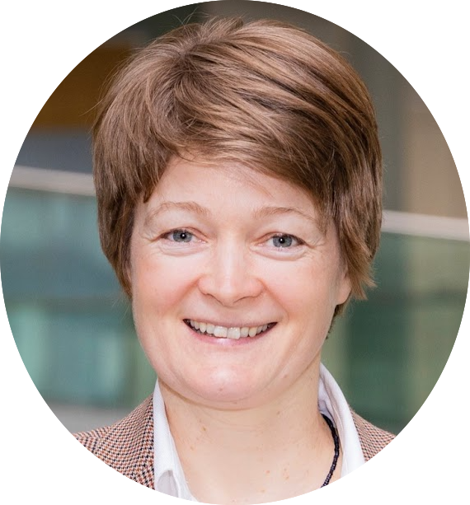
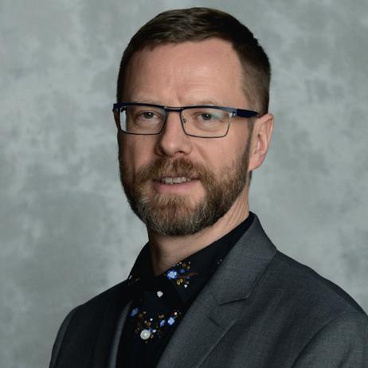
ERIC Forum: Executive Board
Chairs
ExBo Members
Antje Keppler Chair
Life Sciences cluster
Toma Tasovac Social Sciences and Humanities cluster
Emmanuel Salmon
Environment & Earth Sciences cluster
Allen Weeks Vice-Chair
Physical & engineering, energy clusters
Nicolas Pade Life Sciences cluster

Slide 5
Strengths of ERICs I.
A well tested legal model across EU countries and in H2020 associated countries
Decision-makers in national ministries and EU Commission well acquainted with the processes and requirements towards establishment of an ERIC
A broad community of ERICs which can help and advise in case of questions
Recent legal reports (e.g. EGERIC Report) provide additional know-how on the model

Slide 6
Strengths of ERICs II.
Country-level participation which provides for sustainability
Well functioning governance model that is embedded in the Statutes
Support from the EC – on expert level, but also with funding
ERICs have become well versed in combining their primary missions with addressing the big challenges and serving as implementors of the EU Missions (e.g. canSERV project)

Slide 7
Strengths of ERICs III.
Vibrant cooperation between all ERICs through:
ERIC Forum I and II projects
ExBo meetings
Individual pillar meetings
On-going dialogue with other key stakeholders: EC, EOSC, EIROForum, ERIC Committee, ESFRI
Cooperation with ERICs-to-be

Slide 8
Persisting challenges across ERICs:
National institutions still struggling to be eligible for national funding for ERICs
Critical resource limitations and understaffing endanger ERICs in living up to their actual capacities, as well as diverse employment conditions make it difficult for ERICs to become and remain attractive employers for highly skilled staff
Strengthen ERICs to become part of a globally integrated RI ecosystem
User access programs are still fragmented, under-resourced & complex at national and EU level => Scientists cannot yet fully benefit from ERICs and their service portfolios

Slide 9
ERIC Forum 2 project
ERIC Forum Project 2.0 addresses key topics for ERIC implementation and operation, such as
ERIC Regulation implementation
ERICs and European Science Policy & Research Strategy
Internationalisation and engagement with 3rd countries
Personnel-related challenges
Cooperation with ERICs-to-be
ERIC Forum provides regularly key information “from the ground” on the status of ERIC implementation to the EC in their meetings. => 3rd EC Report on the ERIC implementation

Slide 10
ERIC Forum position papers in 2023
ERIC Forum position paper regarding the
“Public consultation on the past, present and future of the European Research & Innovation Framework programmes 2014-2027”
2. Contribution from ERIC Forum to the ESFRI Landscape Analysis about the functioning of the current ecosystem of RIs and its future development

Slide 11
Future: Consolidation vs Fragmentation?
ERIC Forum and ERICs will continue close cooperation and further consolidate their outreach to the scientific communities
A danger of further fragmentation of the RIs landscape: besides ERIC and e-IR, EDIC has emerged as a new legal model
Need for even closer involvement of all stakeholders on the political level to avoid further fragmentation of legal structures, doubling of already-made investments, red tape for researchers, as well as dispersal of EU and national funding

Slide 12
​ ​ ​ ​ ​ ​ Providing cutting edge cancer research services across Europe
Prof. Jens K. Habermann, BBMRI-ERIC, canSERV Coordinator

Slide 13
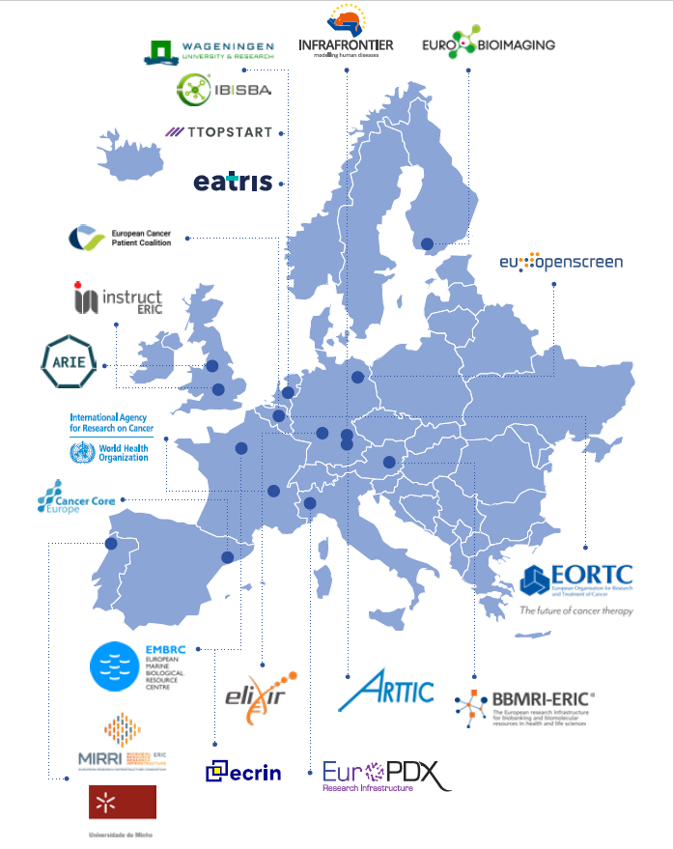
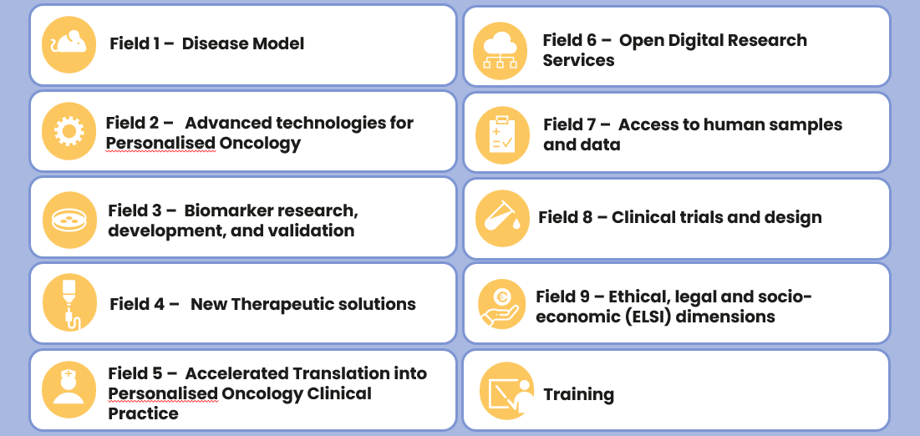
canSERV in a nutshell
One-stop shop for cancer research services –
Browse our catalogues and find the right service(s) for your cancer research
13 Research Infrastructures 150+ associated service provider
1 application platform
+400 services in 10 Research Fields
CAMS –
Common Access Management System
Want to accelerate your research with free access to scientific services? www.canserv.eu/calls

Slide 14
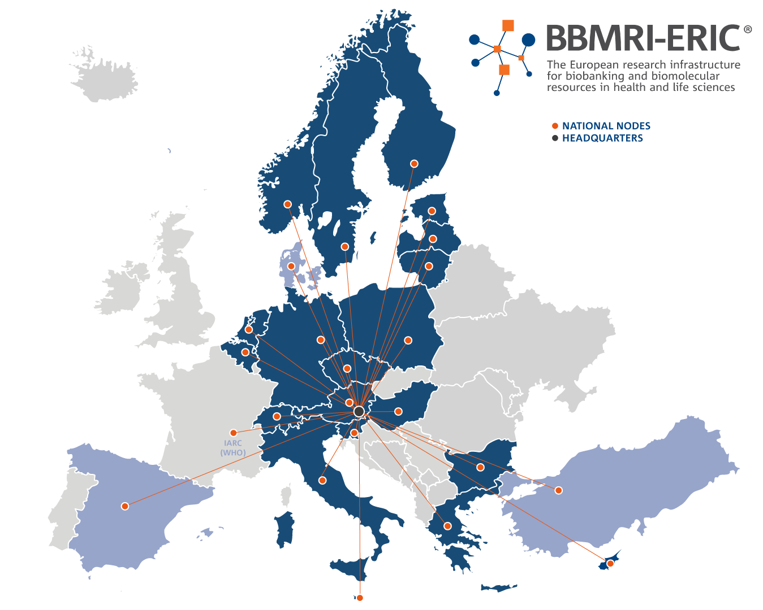
Health & Life Sciences Research
Infrastructure build upon federation:
20 Member States
5 Observers
Austria
Belgium
Bulgaria
Cyprus
Czech Republic
Estonia
Finland
Germany
Greece
Hungary
Italy
Latvia
Lithuania
Malta
Netherlands
Norway
Poland
Slovenia
Sweden
Switzerland
Denmark
IARC/WHO
Qatar
Spain
Turkey
Comprising
24 National Nodes + IARC/WHO
~ 400 biobanks
+ affiliated partners
3 Expert Centres
1 Headquarter
… and growing interest

Slide 15
BBMRI-ERIC IT domains & services
Discovery of data and biospecimen
Access to data and biospecimen Data deposition, pooling, analyses Interoperability
Data protection and access control
Quality controlling & reusability Support
IT Infrastructure

Slide 16
BBMRI-ERIC IT ECOSYSTEME
(e.g., Hospital, University)

Slide 17
DATA ACCESS TO > 400 BIOBANKS/INSTITUTES* for >5.1 Mio. patients (+ 54 Mio. samples) accross 32 countries
Available types of data:
7,834 distinct OMOP variables of clinical phenotype data (incl. biochemical measurements)
> 10PB whole slide imaging data or radiology imaging data
OMICs data (genomics incl. >200K genomes, proteomics, metabolomics, etc.)
possibly other types of data (surveys, genealogy, …)
Connection to national registries (e.g., survival data, harmonized data on specific diseases)
Patient-provided data (part of patient empowerment)
Query & Access through BBMRI‘s DIRECTORY, Federated Platform and/or NEGOTIATOR
*MIABIS: Minimum Information ABoutBIobanking data Sharing

Slide 18
Organization of IT Services
Operations and development of core services
Research and development of additional services
Interfacing to others
Projects
EJP RD
Standardization bodies:
ISO, GA4GH, …
EOSC-Life EOSC-Future ERIC Forum
Other projects
Other European RI and e-Infrastructures
BBMRI-ERIC Common Service IT:
Discovery
Access facilitation
Authentication & authorization
Interoperability
Supporting services: helpdesk, UX, infra
canSERV EOSC4Cancer
European Open Science
EHDS2Pilot HealthyCloud
Cloud (EOSC)
BY-COVID, ISIDORe
European Health Data Spaces (EHDS)
Mission Cancer and other strategic activities

Slide 19
Thank you for your attention! Contact: Jens K. Habermann Coordinator, ERIC Forum 2 Project jens.habermann@bbmri-eric.eu
29th November 2023, e-IRG Workshop

Slide 20
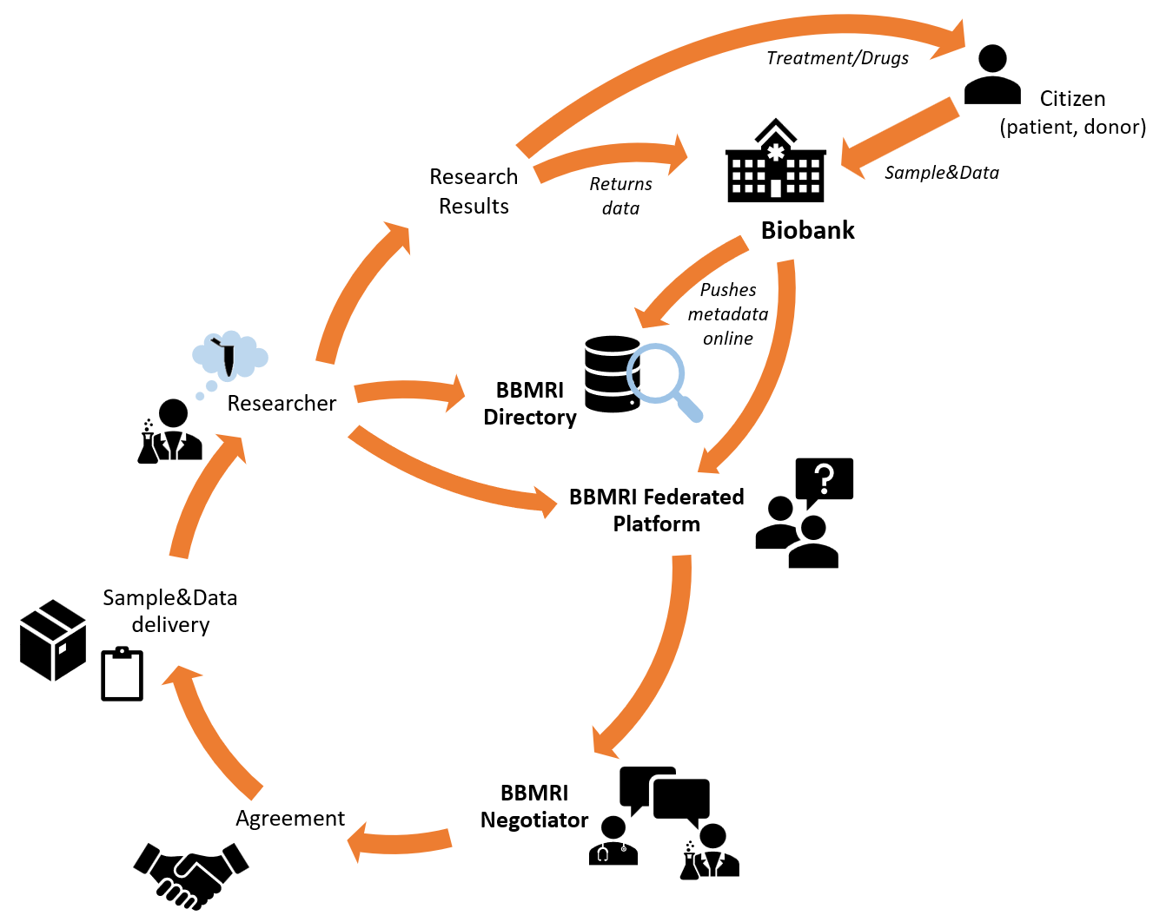
BBMRI-ERIC ACCESS PIPELINE
Simplified schema
Academia, Industry,
& BBMRI
Directory is open for any biobank to visualize COVID or Rare Disease samples & data for use!
Image thanks to Zdenka Dudova and Petr Holub

