Slide 1
Security awareness in the GÉANT community: 5 main findings of our awareness survey
Davina Luyten, Belnet
Subtask lead Awareness, WP8, GN5-1

Slide 2
Awareness survey: what, why, how, who
(Online) questionnaire combined with in-depth interviews
Based on SANS' Security Awareness Maturity Model
To measure the maturity of the NRENs
Focusing on internal and external awareness programmes
24 NRENS + GÉANT

Slide 3
Main findings
Overall NRENs are striving to build a strong security culture in their organisations.

Slide 5
Main findings
Overall NRENs are striving to build a strong security culture in their organisations.
Awareness programmes are risk-based and getting more mature with a targeted approach

Slide 8
Main findings
Overall NRENs are striving to build a strong security culture in their organisations.
Awareness programmes are risk-based and getting more mature with a targeted approach
Different formats are used to involve employees

Slide 10
Main findings
Overall NRENs are striving to build a strong security culture in their organisations.
Awareness programmes are risk-based and getting more mature with a targeted approach
Different formats are used to involve employees
Internal security awareness is usually the task of the Security / CERT team

Slide 13
Main findings
Overall NRENs are striving to build a strong security culture in their organisations.
Awareness programmes are risk-based and getting more mature with a targeted approach
Different formats are used to involve employees
Internal security awareness is usually the task of the Security / CERT team
Most NRENS run external awareness activities, focusing on their constituents

Slide 15
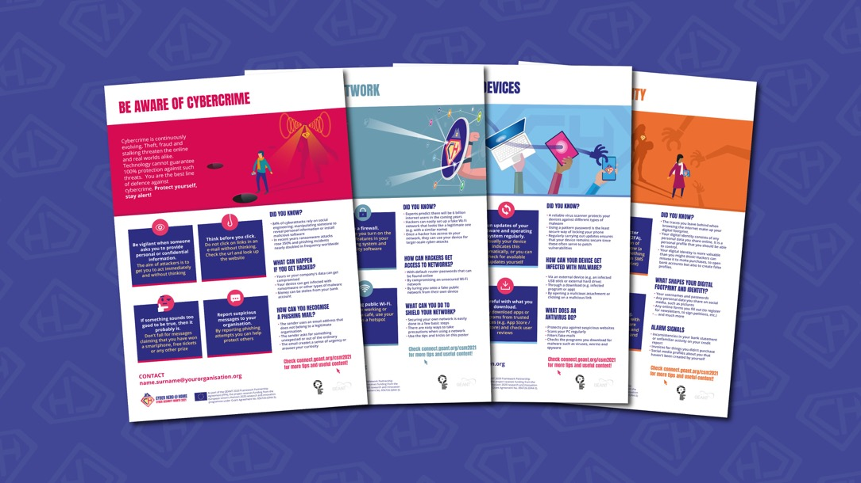
Needs
Our community is most interested in sharing best practices and experiences with other NRENs (84%) and in receiving ready-to-use awareness materials (76%).
The topics / risks that NRENs consider most relevant to include in their awareness programme are password security, data protection and privacy and phishing/vishing/smishing.
Notes:
Did you know that you can use PowerPoint stock images? Go to Insert / Pictures.

Slide 16
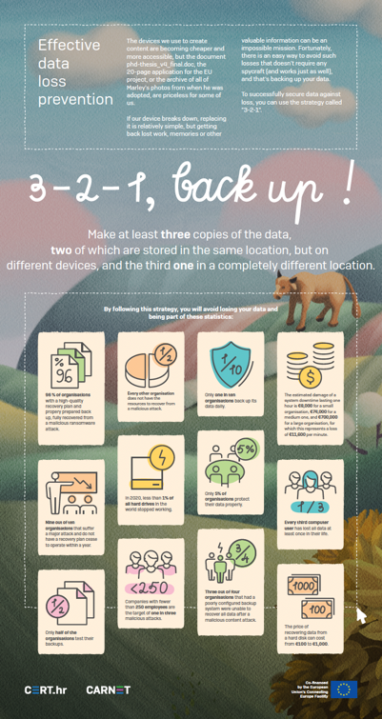
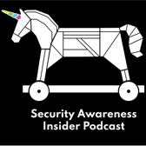
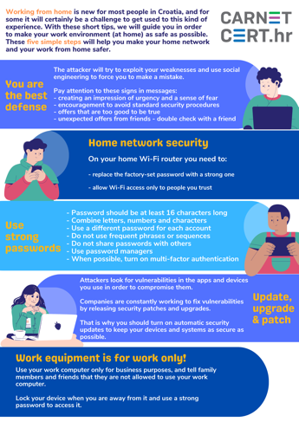
Next steps
Build an active community for awareness officers and develop training or workshops for NRENs to take their programmes to the next stage
> JOIN US FOR THE AWARENESS SIDE MEETING ON THURSDAY AFTERNOON
Further build on our awareness knowledge base
Continue to raise awareness for the human factor in security among the community
Notes:
Did you know that you can use PowerPoint stock images? Go to Insert / Pictures.

Slide 17
Questions? Ideas? Remarks?
Contact the team: csm@geant.org
Rosanna Norman, GÉANT
Leonardo Marino, GÉANT
Cornelia Puhze, SWITCH
Mark Tysom, Jisc
Marina Dimić Vugec, CARNET
Simona Venuti, GARR
Charlie van Genuchten, SURF
Laetitia Lagneau, Belnet
Davina Luyten, Belnet
Notes:
If you decide to use this slide, please note that PowerPoint will crop the images you choose as per the suggested design.

Slide 18
Any questions?

