Slide 1
Security Awareness at Switch
Fabio Greiner Géant Security Days 11 April 2024

Slide 2
About Switch
Swiss NREN
Registry
for .ch/.li ccTLDs
About 170 employees

Slide 3
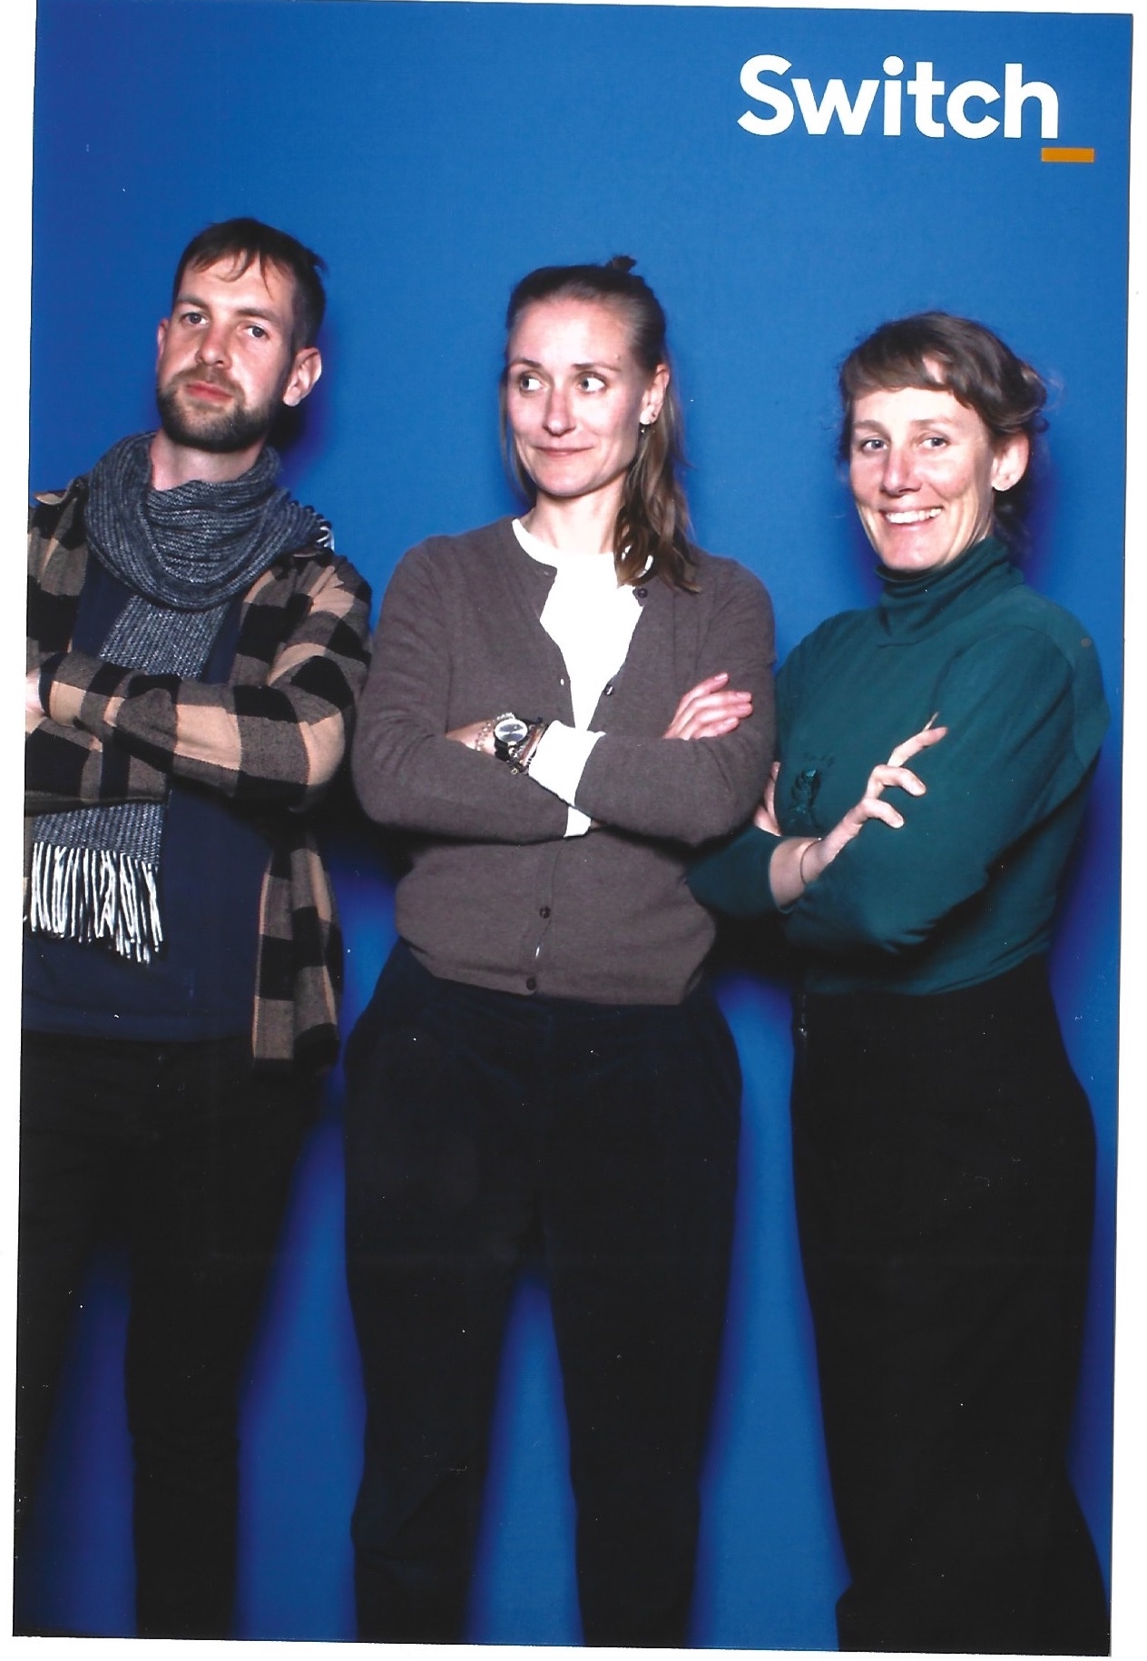
Security Awareness Competence Center
Fabio Greiner | Katja Dörlemann | Cornelia Puhze
awareness@switch.ch

Slide 4
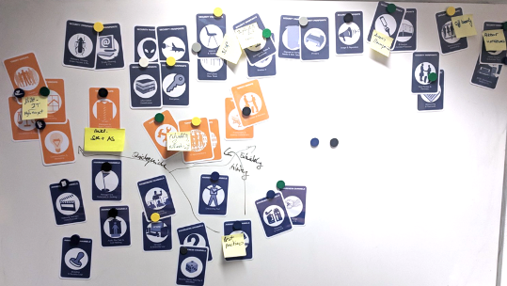
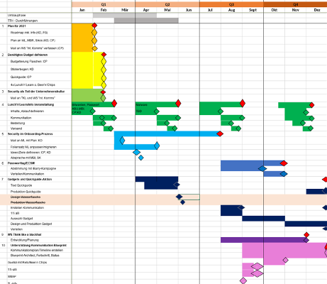
Beginnings
2019: Goal → ISO 27001 Certification
Workshop «Action Plan»
Support from internal communications
Kick-off interrupted by Covid
Home Office rules post card
Remote Working Guide
Remote L&Ls

Slide 5
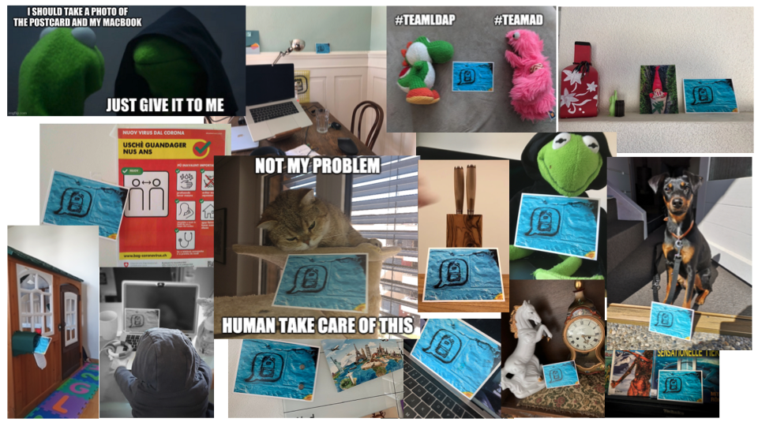
Home Office Rules Foto Share

Slide 6
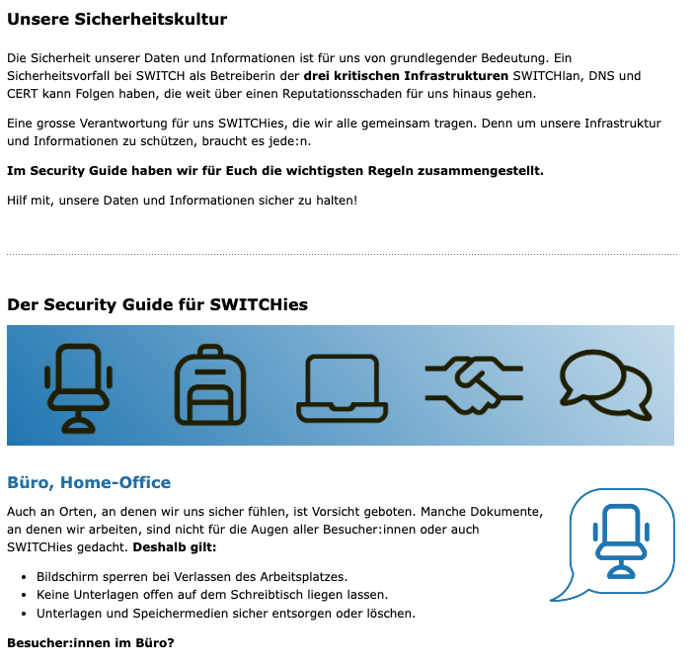
Setup
Onboarding
Security Awareness Adventures
Lunch&Learns
Intranet
Town hall meetings
Soon: E-Learning, Phishing reporting button
Phishing Simulations as training for the reporting button
Notes:
Same programme for all employees

Slide 7
Lunch&Learns

Slide 8
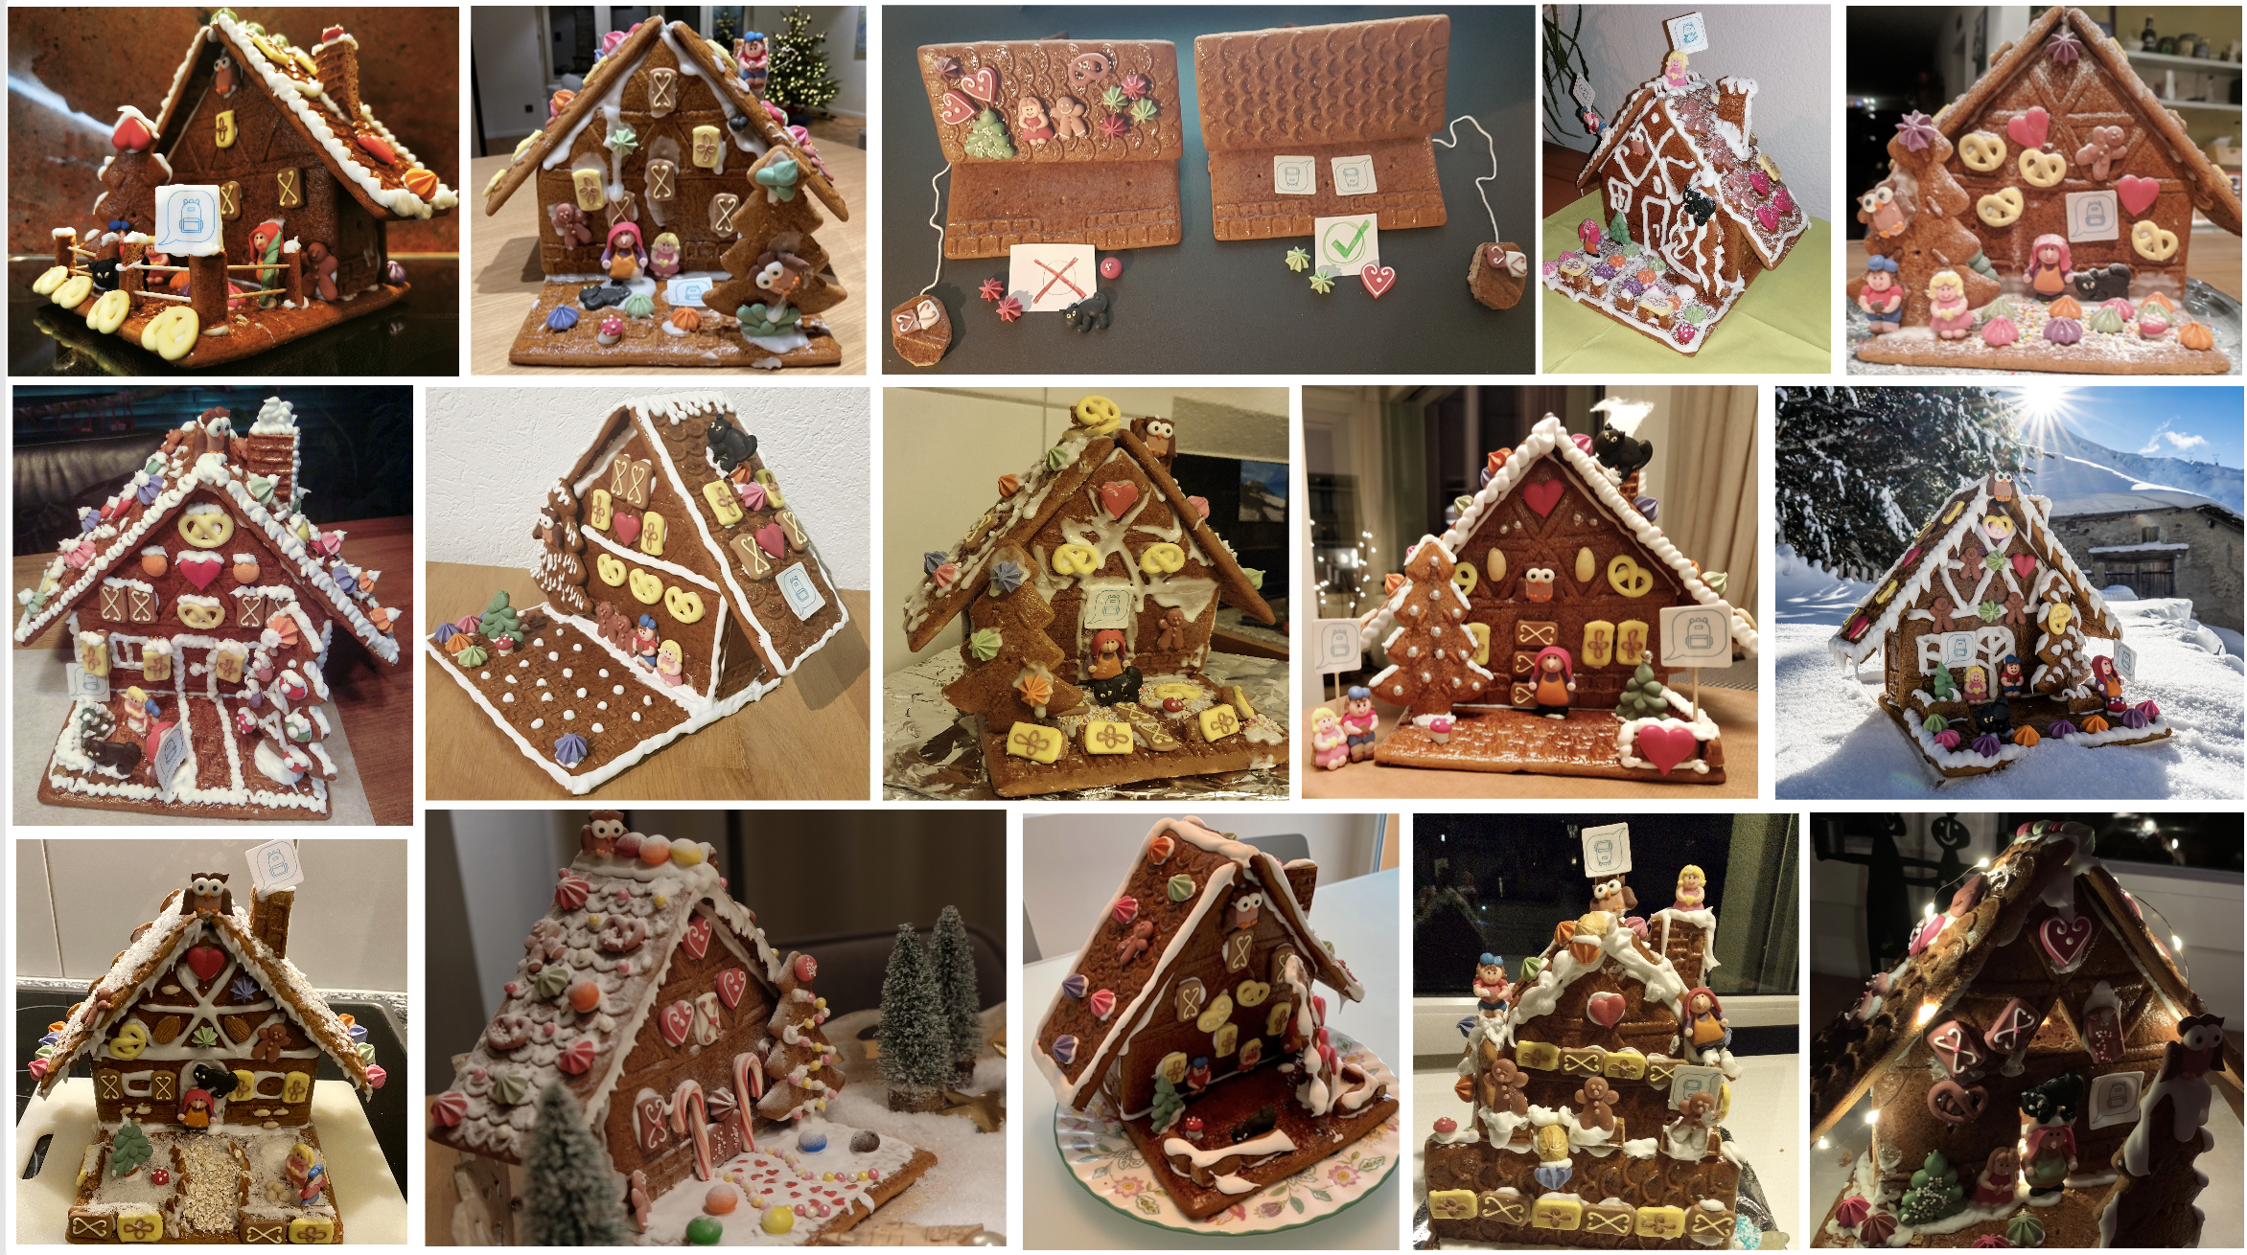
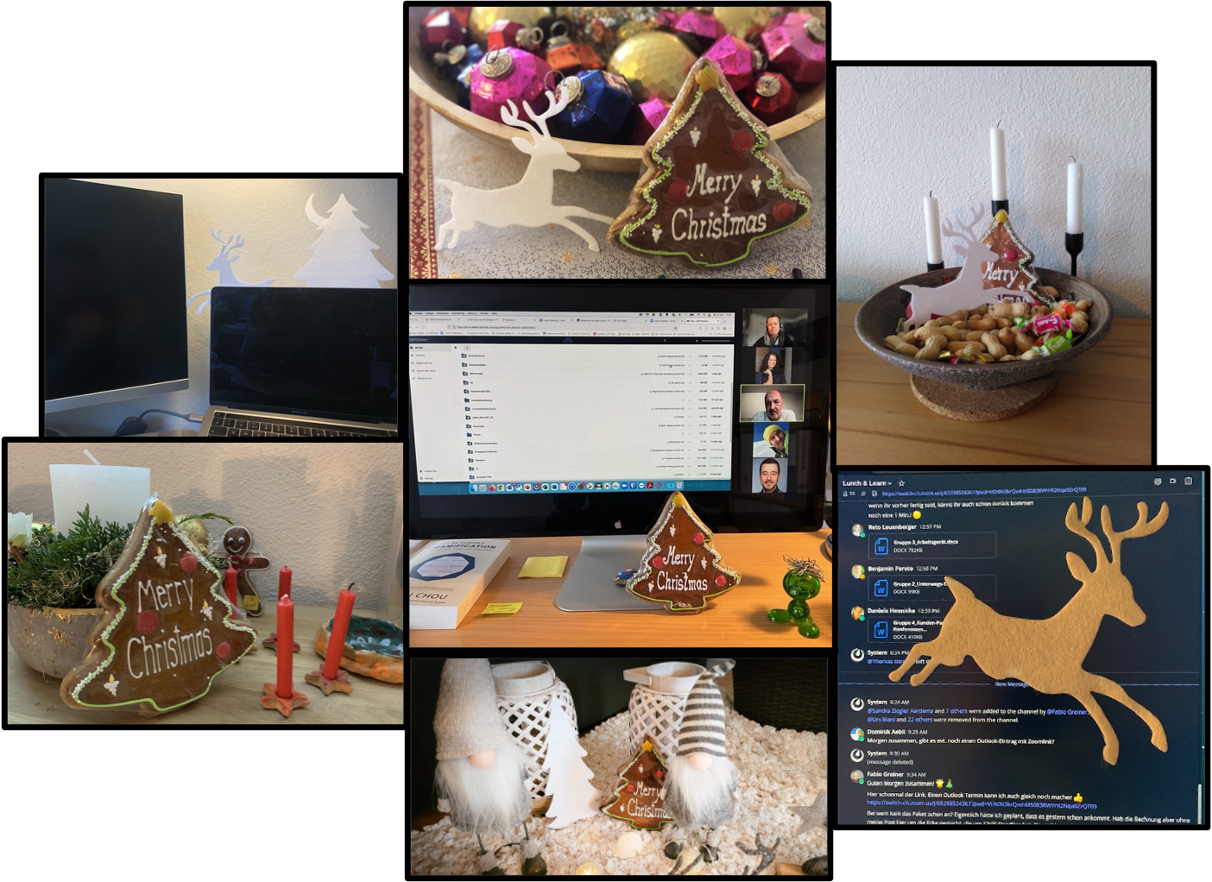
Lunch&Learns

Slide 9
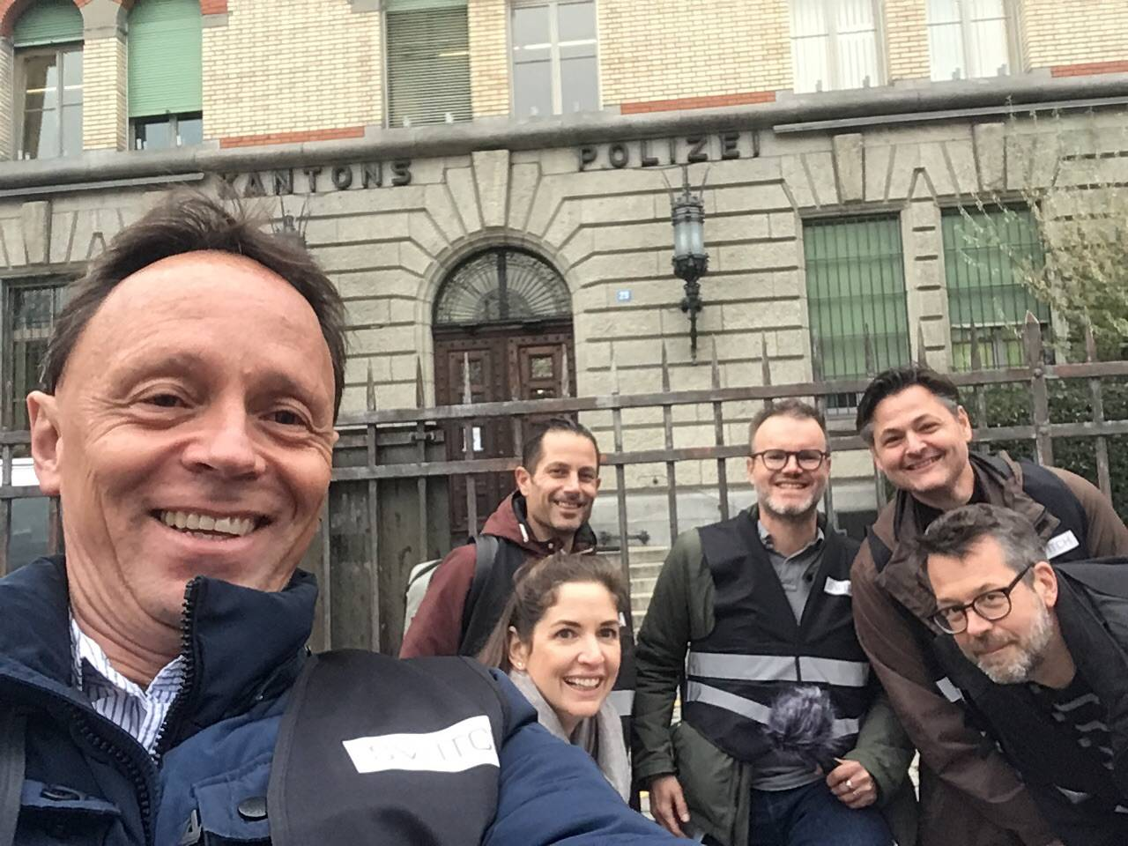
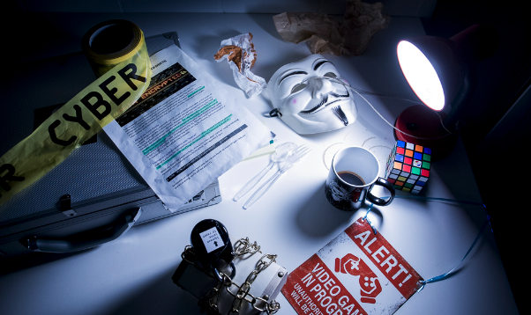
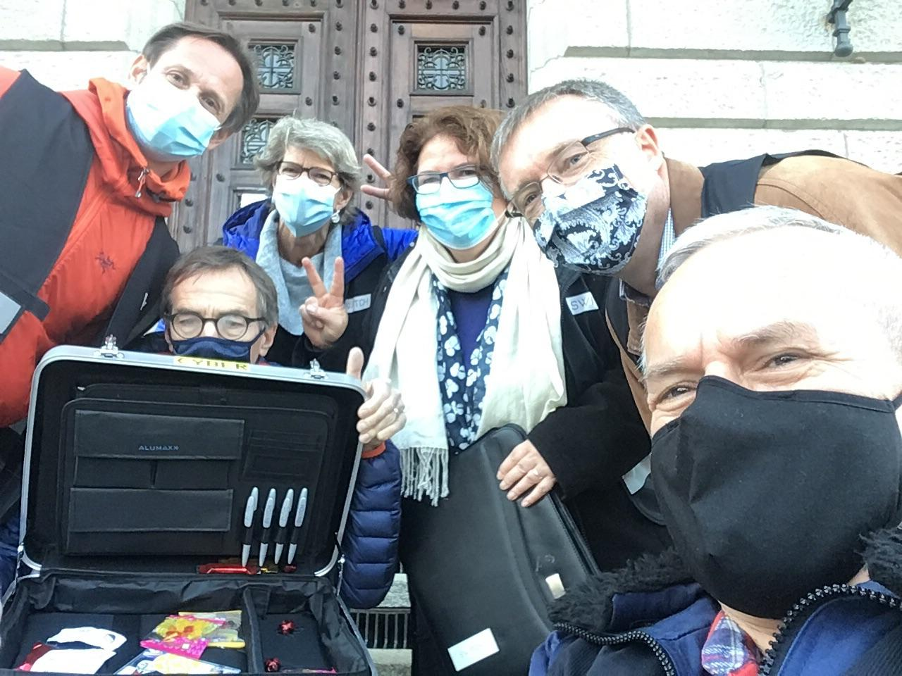
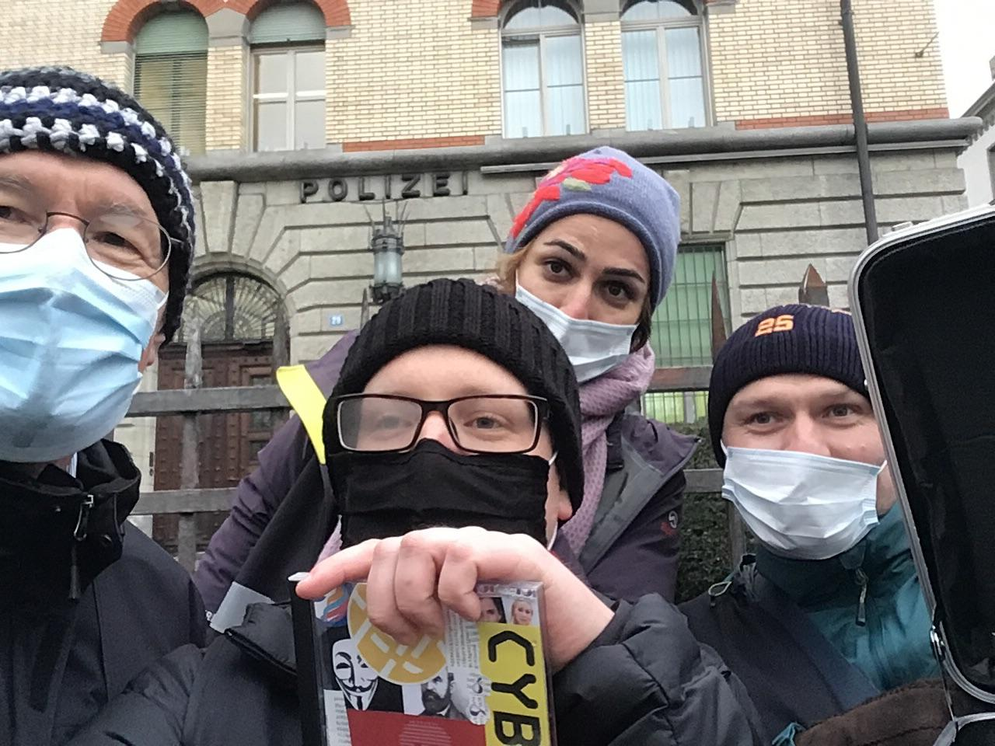
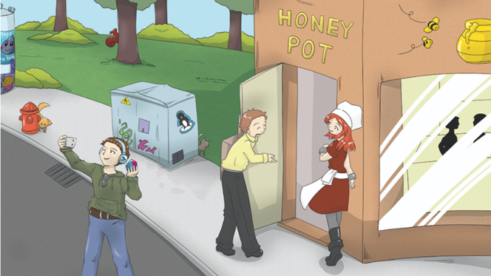
Security Awareness Adventures
Hack
The
Hacker
The Escape Room

Slide 10
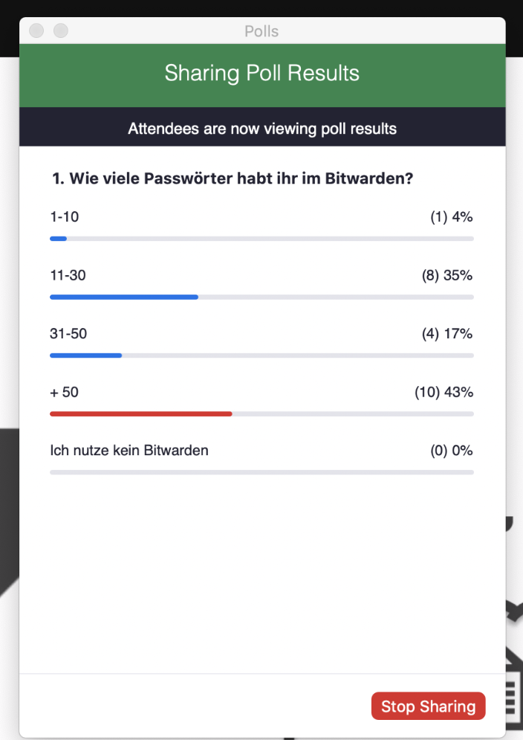
Monitoring and Evaluation
Evaluation of polls and attendances of in-person events and trainings
In the future: Monitoring of e-learning and reporting button
Security Awareness Survey 2023

Slide 11
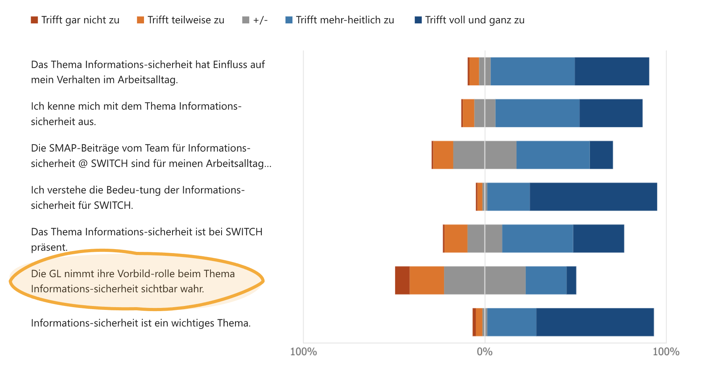
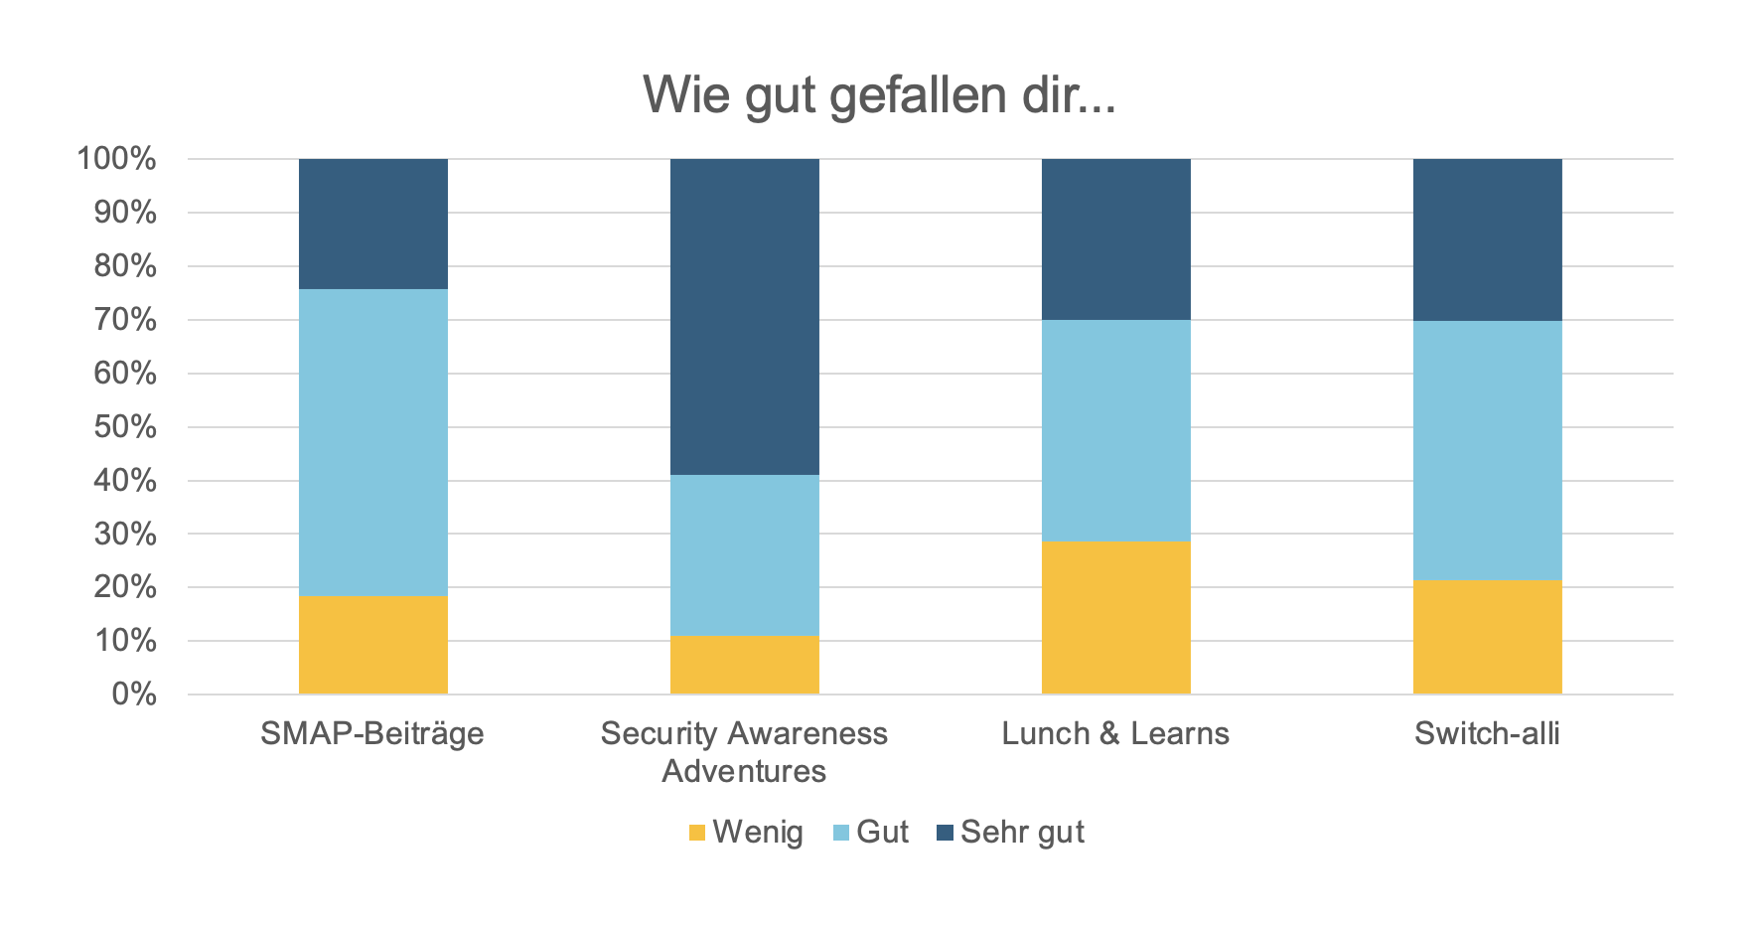
Security Awareness Survey
Employees
like our Security Awareness programme
feel secure
underestimate that they are a target of attack
Management isn’t perceived as a role model
Less then 50% use the official password manager for all their passwords

Slide 12
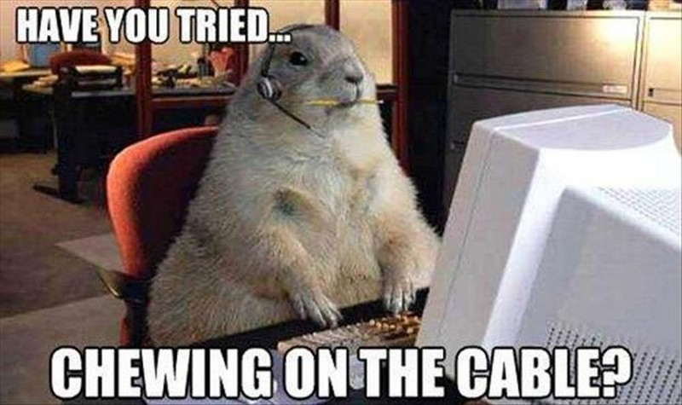
Challenges
More employees
Resources
Missing tools and processes

Slide 13
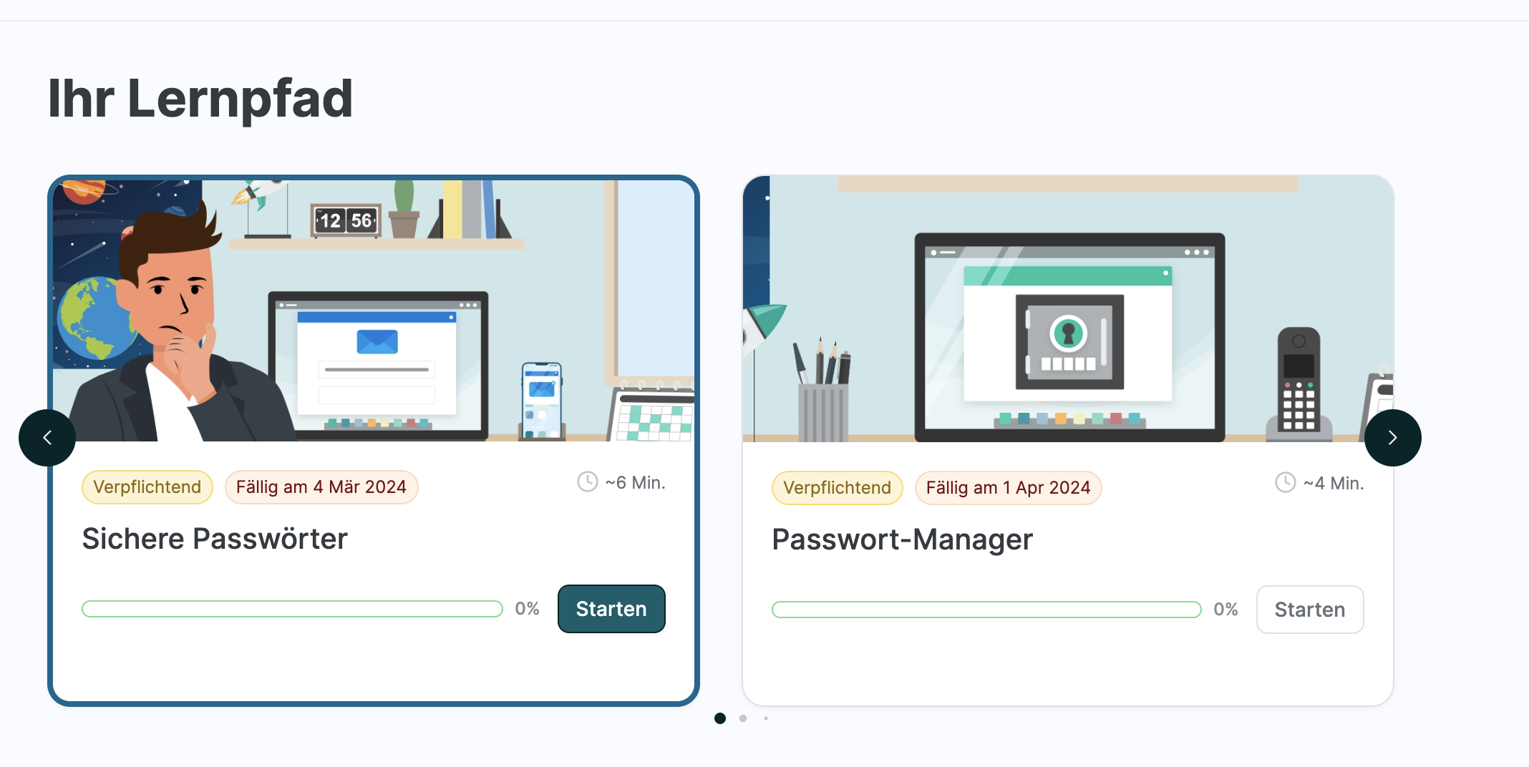
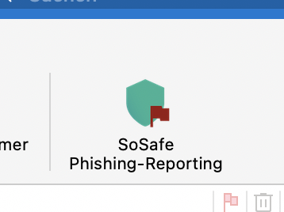
Next steps
Roll out e-learning
Rethink and standardise and appearance of Security
Security skills trainings for employees with technical background

