Slide 1
Information security awareness training at Jisc
Dr John Chapman Director information security, policy and governance
Notes:
Image generated by Adobe Firefly AI

Slide 2
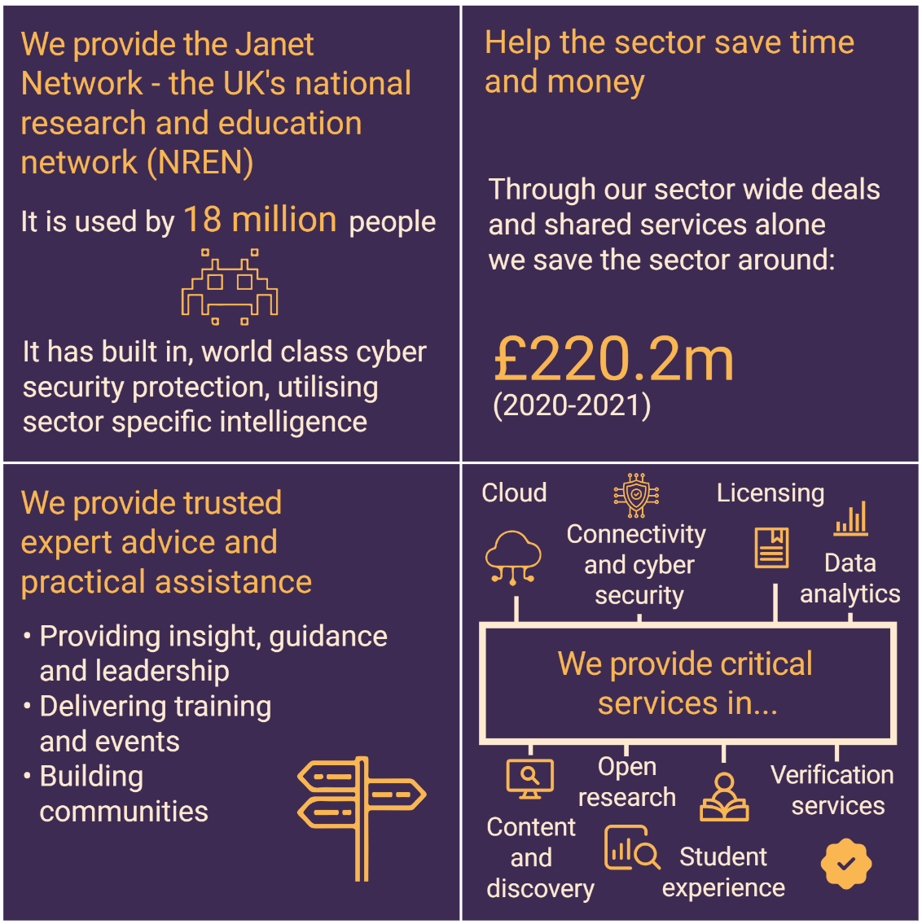
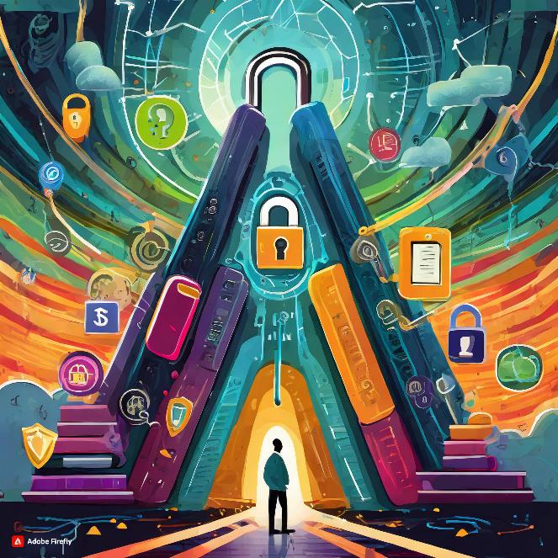
About Jisc
Notes:
Jisc – one of the largest NRENs with more than 1300 staff, delivering more than just connectivity and security – more than 130 different services. Massive range of skills and information security awareness
Image generated by Adobe Firefly AI

Slide 3
Mandatory training
Training is built internally through Articulate Storyline​
Enabling customisation to Jisc​
Underpinned by our related policies and processes​
Repeated on annual basis​
Questions are interjected throughout the training​
Final test to complete the training (80%)
Supported by comms and awareness sessions and complemented by phishing simulation training
Notes:
Image generated by Adobe Firefly AI

Slide 4
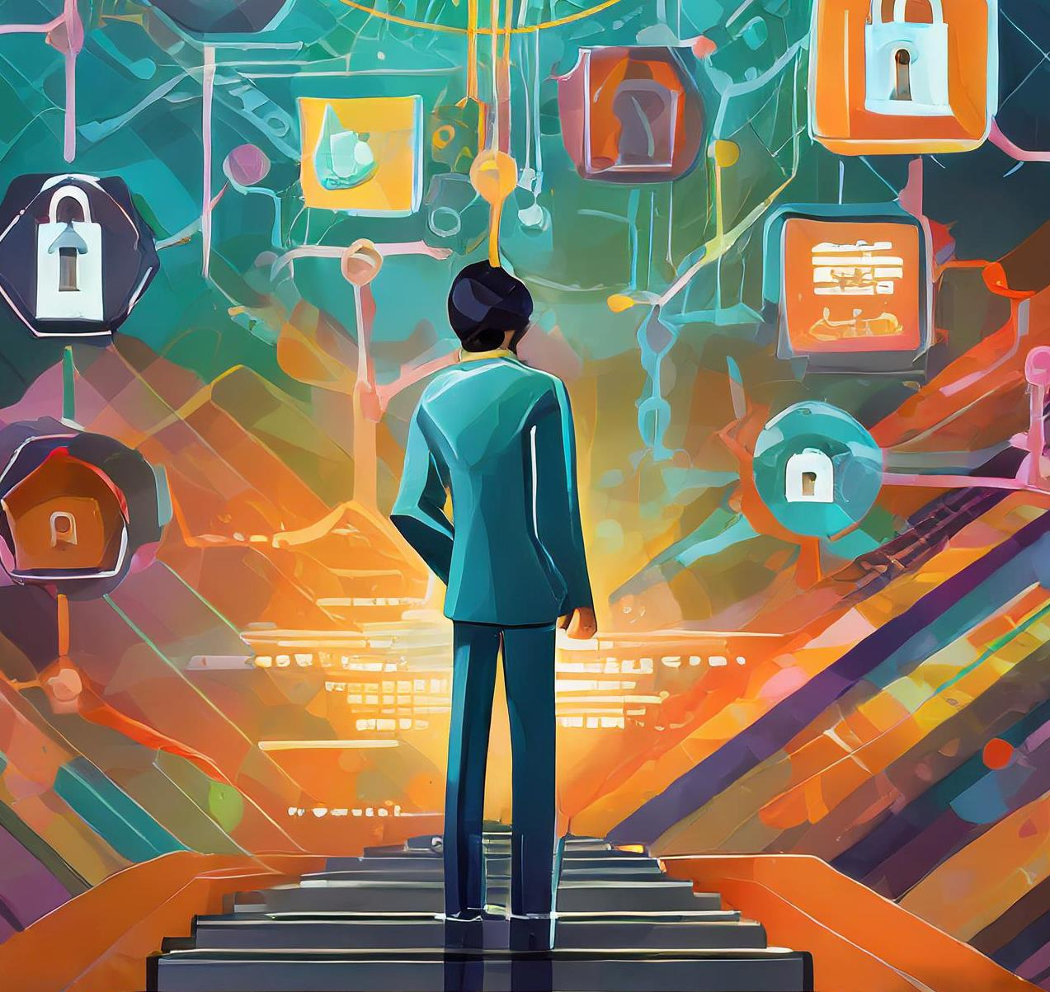
Training topics
What information means at Jisc
Social engineering
Phishing
Work and personal devices
Working in and out of our offices
Information classification and handling
Information security incidents and reporting
Transferring information
Line management responsibilities
Business continuity communication platform
Key information security related policies, processes
Notes:
Started more than 10 years ago
Became more formalised in line with us starting ISO27001 and ISO 9001 in 2014
Image generated by Adobe Firefly AI

Slide 5
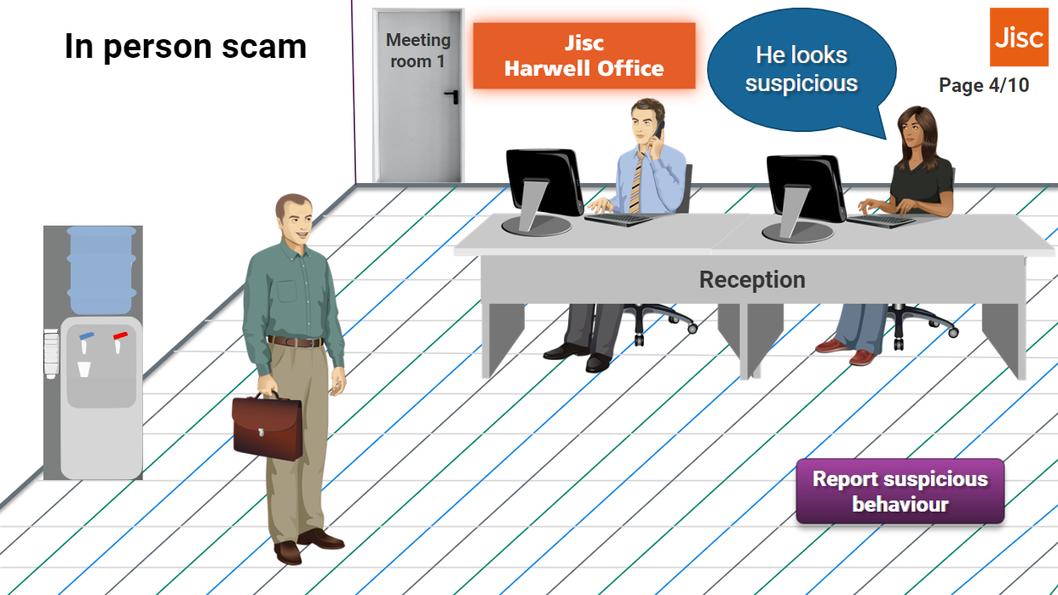
Snippet of training
Notes:
A short anecdote demonstrating someone trying to gain unauthorised access to one of our Jisc offices, what to look out for and the action that should be taken, reinforced with an action that colleagues need to take while they’re doing the training (click the button).

Slide 6
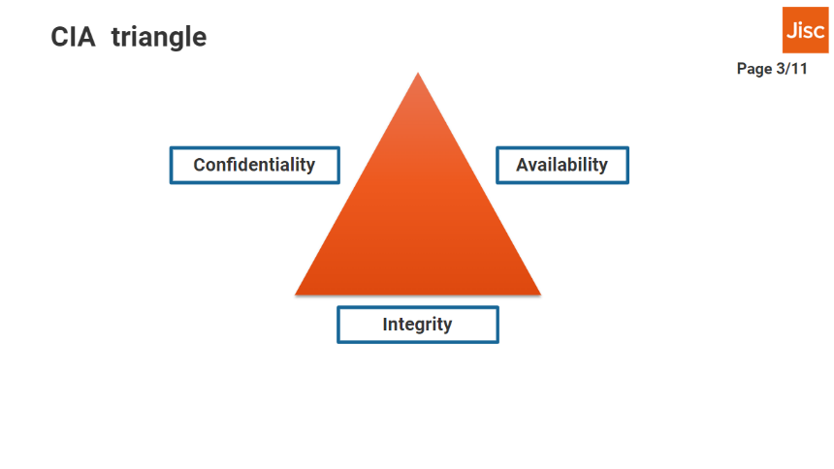
Snippet of training 2
Notes:
Trying to make it memorable with familiar associations for information security terminology

Slide 7
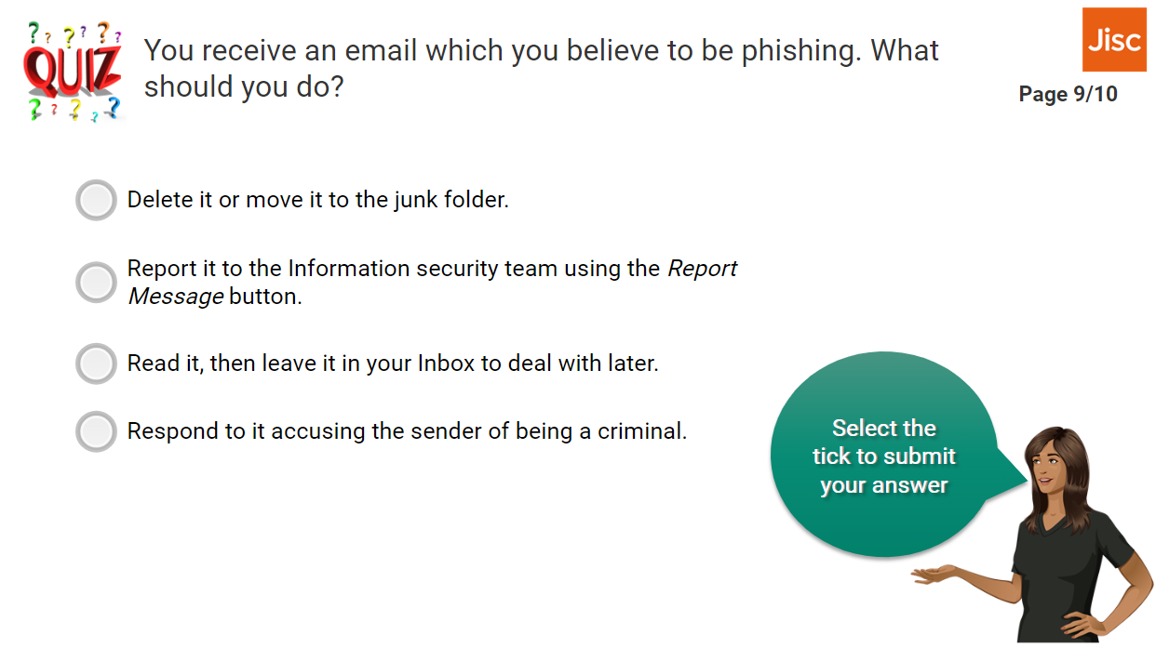
Snippet of training 3

Slide 8
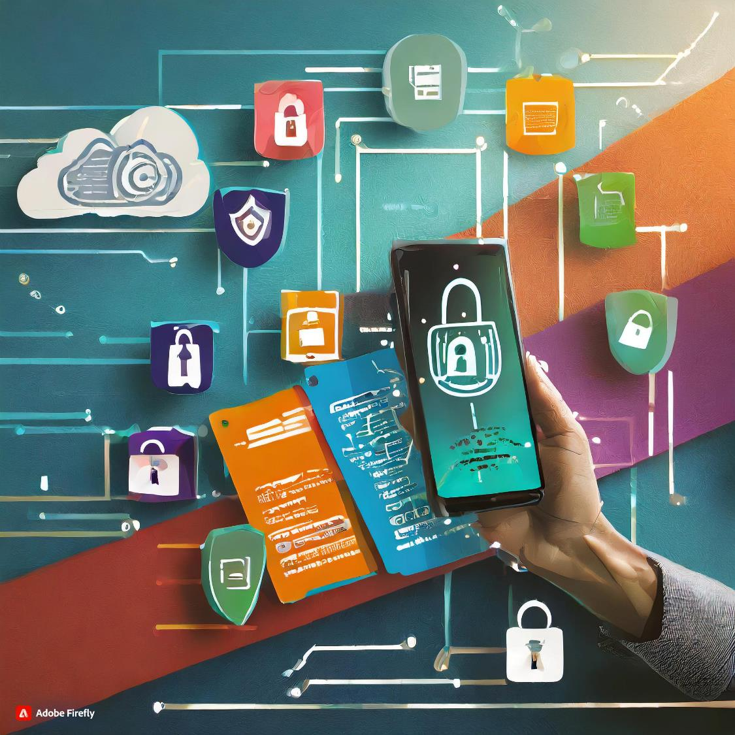
Regular awareness
Fortnightly staff update
Regular intranet articles – themed to calendar events or recent incidents
All-hands meetings and team meetings

Slide 9
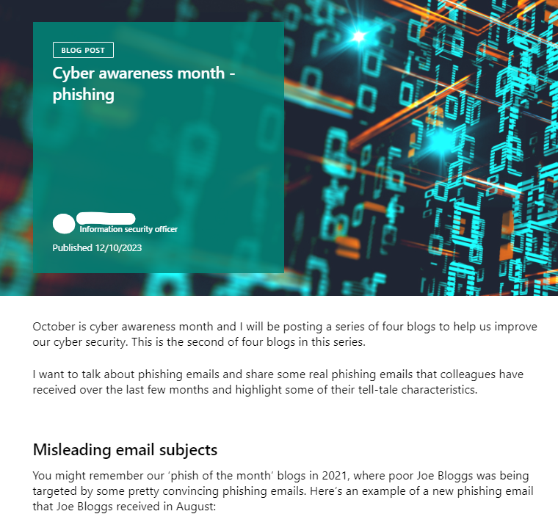
Snippet of comms

Slide 10
Simulated phishing
Co-ordinated through Microsoft Defender
Run on a quarterly basis
Varying:
senders (‘internal’ and external)
premises for content
indicators of phishing included
sent at different times of week/day
Analysis is performed on the reporting and follow up awareness sessions as required.
Notes:
Image generated by Microsoft Copilot’s AI

Slide 11
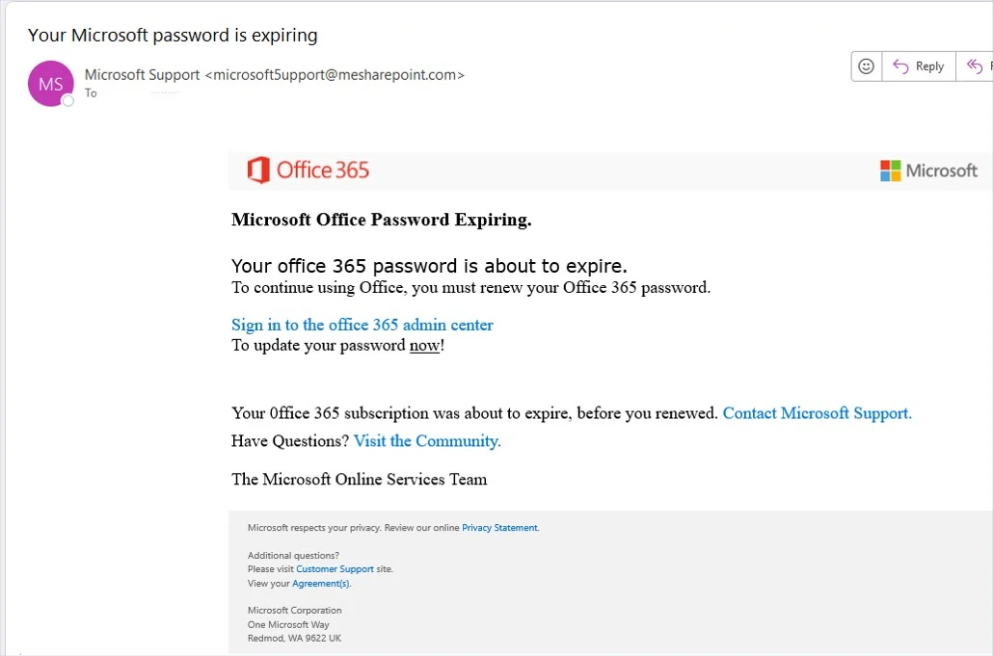
MS office password expiry email
Notes:
Image generated by Microsoft Copilot’s AI

Slide 12
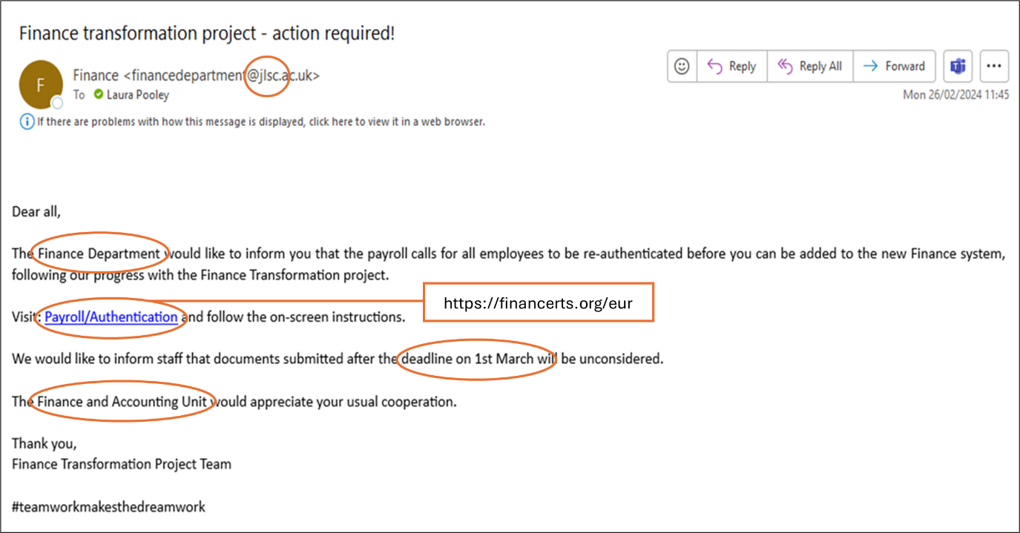
Finance phishing email
Notes:
Image generated by Microsoft Copilot’s AI

Slide 13
Click through graph
Notes:
Image generated by Microsoft Copilot’s AI

Slide 14
Improvements
Using a computer-generated voice to enable faster amendments to the course
Shortening up content for refresher training
Live follow up sessions (rather than computer training) for phishing simulations to promote interaction with information security
Any ideas I can steal today…
Notes:
Image generated by Microsoft Copilot’s AI

