Slide 1
Awareness at the NREN, how does SURF do it?
Helma de Boer, SURF

Slide 2
About SURF
Around:
500 staff
60 IT services
100+ members/institutes
Amsterdam
100+ Members:
Vocational and adult education
Higher education
Universities/scientific education
University medical centres
Research institutes
Utrecht

Slide 3
The start
The programme was already running ☺
Reasons: vulnerability, regulations/requirements (ISO 27001), sectoral alignment
Best practises and experience in the field of information security points to the necessity of an awareness programme (it just makes sense)

Slide 4
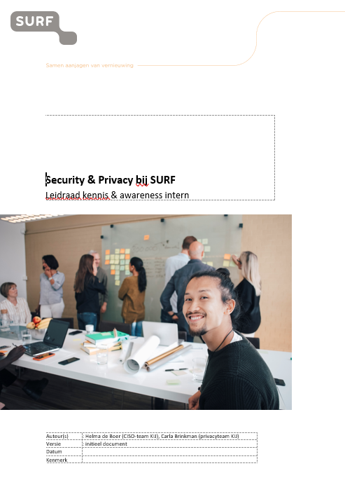
Guideline Security & Privacy
Umbrella approach, clarity, synergy
Separate annual programme → customisation by topic → clear activities per month
The CISO-team runs the (internal) show: ISO with focus on awareness
security
privacy
Notes:
Overarching guideline for both security & privacy → same approach, synergy

Slide 5
Approach
Maturity model with focus on People, Process, Technology
5 target groups within the workforce
Translation of knowledge and skills required per target group
Annual monitoring via SURF Security & Privacy Awareness Measurement (from CSY)
Finetuning
Notes:
In the programme, we use the following principles:
Repetition is important: activities are consistent, there is a steady flow of blogs, workshops, training sessions and other activities throughout the year.
Inform and motivate employees, systematically and regularly, starting at onboarding
Variety: information is conveyed in different ways and there are structurally several contact moments with the different target groups
Reuse information: we build on material already present and developed for members (and vice versa), in cooperation with the Trust & Security Awareness department Positive approach: communicating risks as well as highlighting positive stories: we celebrate successes.
Active: employees are actively informed, know where to find information and take the information proactively.
Transparent: SURF will communicate transparently (where possible) about incidents to its employees and, if necessary, institutions, without downplaying the seriousness of the situation. SURF does not engage in naming and shaming; those involved are informed and counselled;
Responsibility: Managers bear and take responsibility for informing their employees and raising awareness.

Slide 6
5 target groups & approach
All employees → general information sessions
Product managers, project leads, TPM’s → themed sessions
Technical specialists → specialist expertise training
Privacy Coordinators → specialist knowledge training
Management → training according to need
Notes:
In the programme, we use the following principles:
Repetition is important: activities are consistent, there is a steady flow of blogs, workshops, training sessions and other activities throughout the year.
Inform and motivate employees, systematically and regularly, starting at onboarding
Variety: information is conveyed in different ways and there are structurally several contact moments with the different target groups
Reuse information: we build on material already present and developed for members (and vice versa), in cooperation with the Trust & Security Awareness department Positive approach: communicating risks as well as highlighting positive stories: we celebrate successes.
Active: employees are actively informed, know where to find information and take the information proactively.
Transparent: SURF will communicate transparently (where possible) about incidents to its employees and, if necessary, institutions, without downplaying the seriousness of the situation. SURF does not engage in naming and shaming; those involved are informed and counselled;
Responsibility: Managers bear and take responsibility for informing their employees and raising awareness.

Slide 7
Building blocks
No phishing simulations
Onboarding
Sessions with collegues who explain
External guest speakers
Knowledge & skills trainings
Basic training consisting of micro modules
Tear-off calendar and other material
Narrow casting
Ezine 2-monthly
Intranet Space & blogposts

Slide 8
Main challenges: it is a lot!
Around 60 services for members
Internal business operations
Quirky, Npuls, new requirements

Slide 9
Future
Intranet space perfection
SURF Academy = Fundamentals
A consistent toolbox with a variaty of specific learning options
Timely approved annual programme
Co-creation

Slide 10
Questions?
helma.deboer@surf.nl

