Slide 1
Security Training and Awareness at GÉANT
Nicole Harris
Senior Trust and Security Manager
Security Days, Prague
12th April 2024
Public

Slide 2
Staff
159 FTE
NON-TECHNICAL
TECHNICAL
48%
52%

Slide 3
Training and Awareness Principles
Security training at GÉANT should be engaging and interactive
Training should be differentiated for groups depending on need
Training should not be seen as a tick-box exercise
Training should be bespoke and discuss the GÉANT environment
Security training at GÉANT will not be punitive in its approach (no phishing)

Slide 4
Timeline
Started Using the Security Baseline
New Plan and “Security Tips”
First Modules into Moodle
2021
2023
2020
GÉANT Security Restructure
2022
2024
Started Planning for ISO 27001

Slide 5
Security Teams
c
CISO Office
DPO, CISO and Risk
D
Digital Services
S
Security Products
Core Security for GÉANT Org
External security services
T
Trust and Security
N
NOC / SOC
Training, Awareness, Crisis Management
NOC and SOC functions

Slide 6
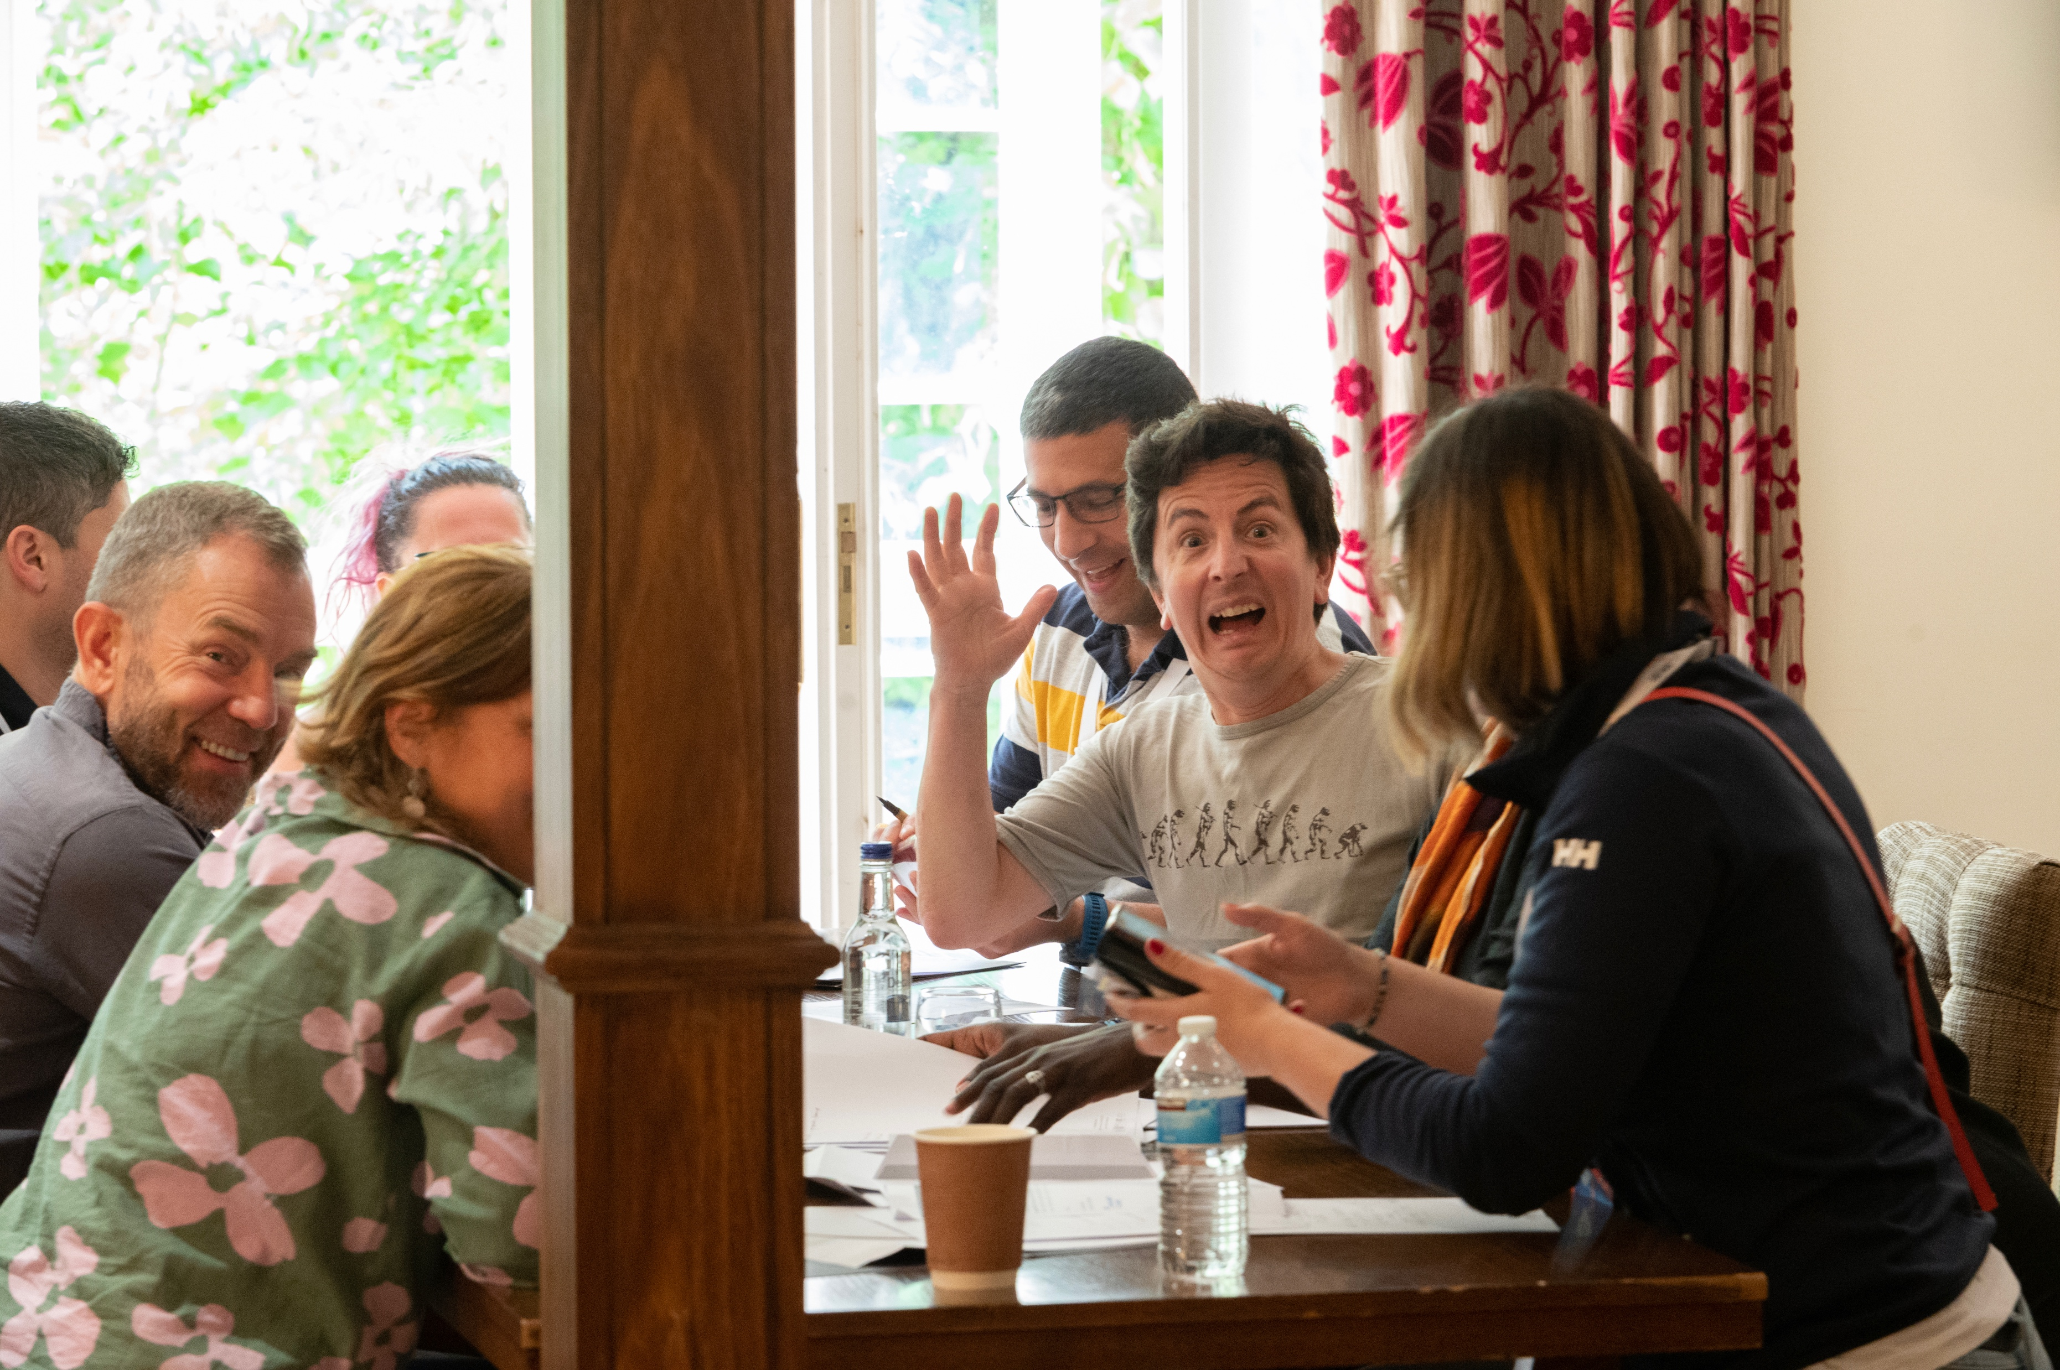
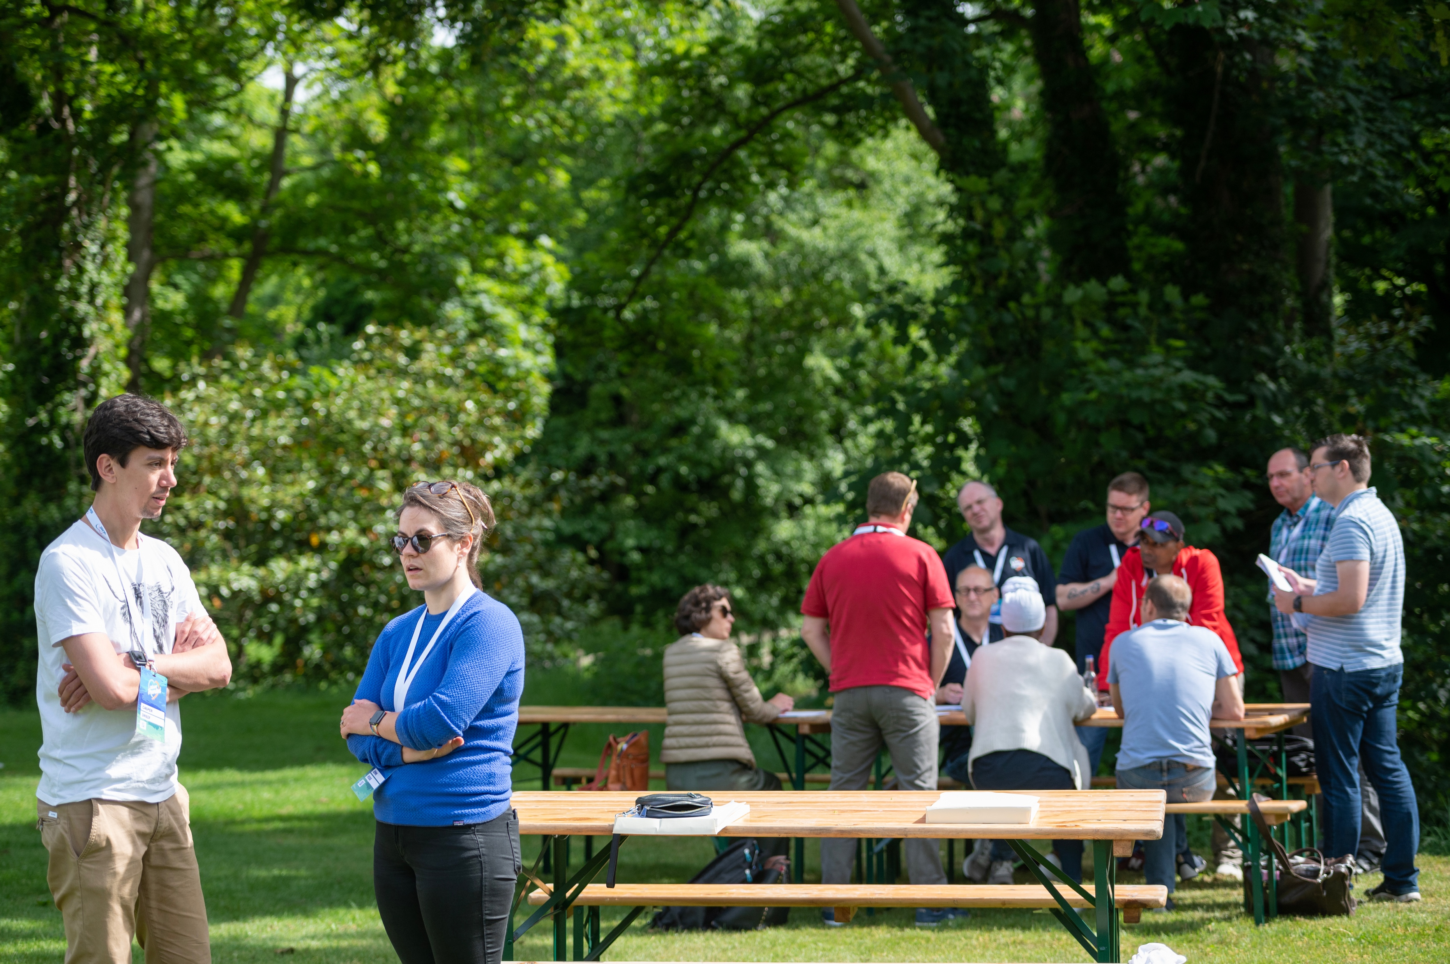
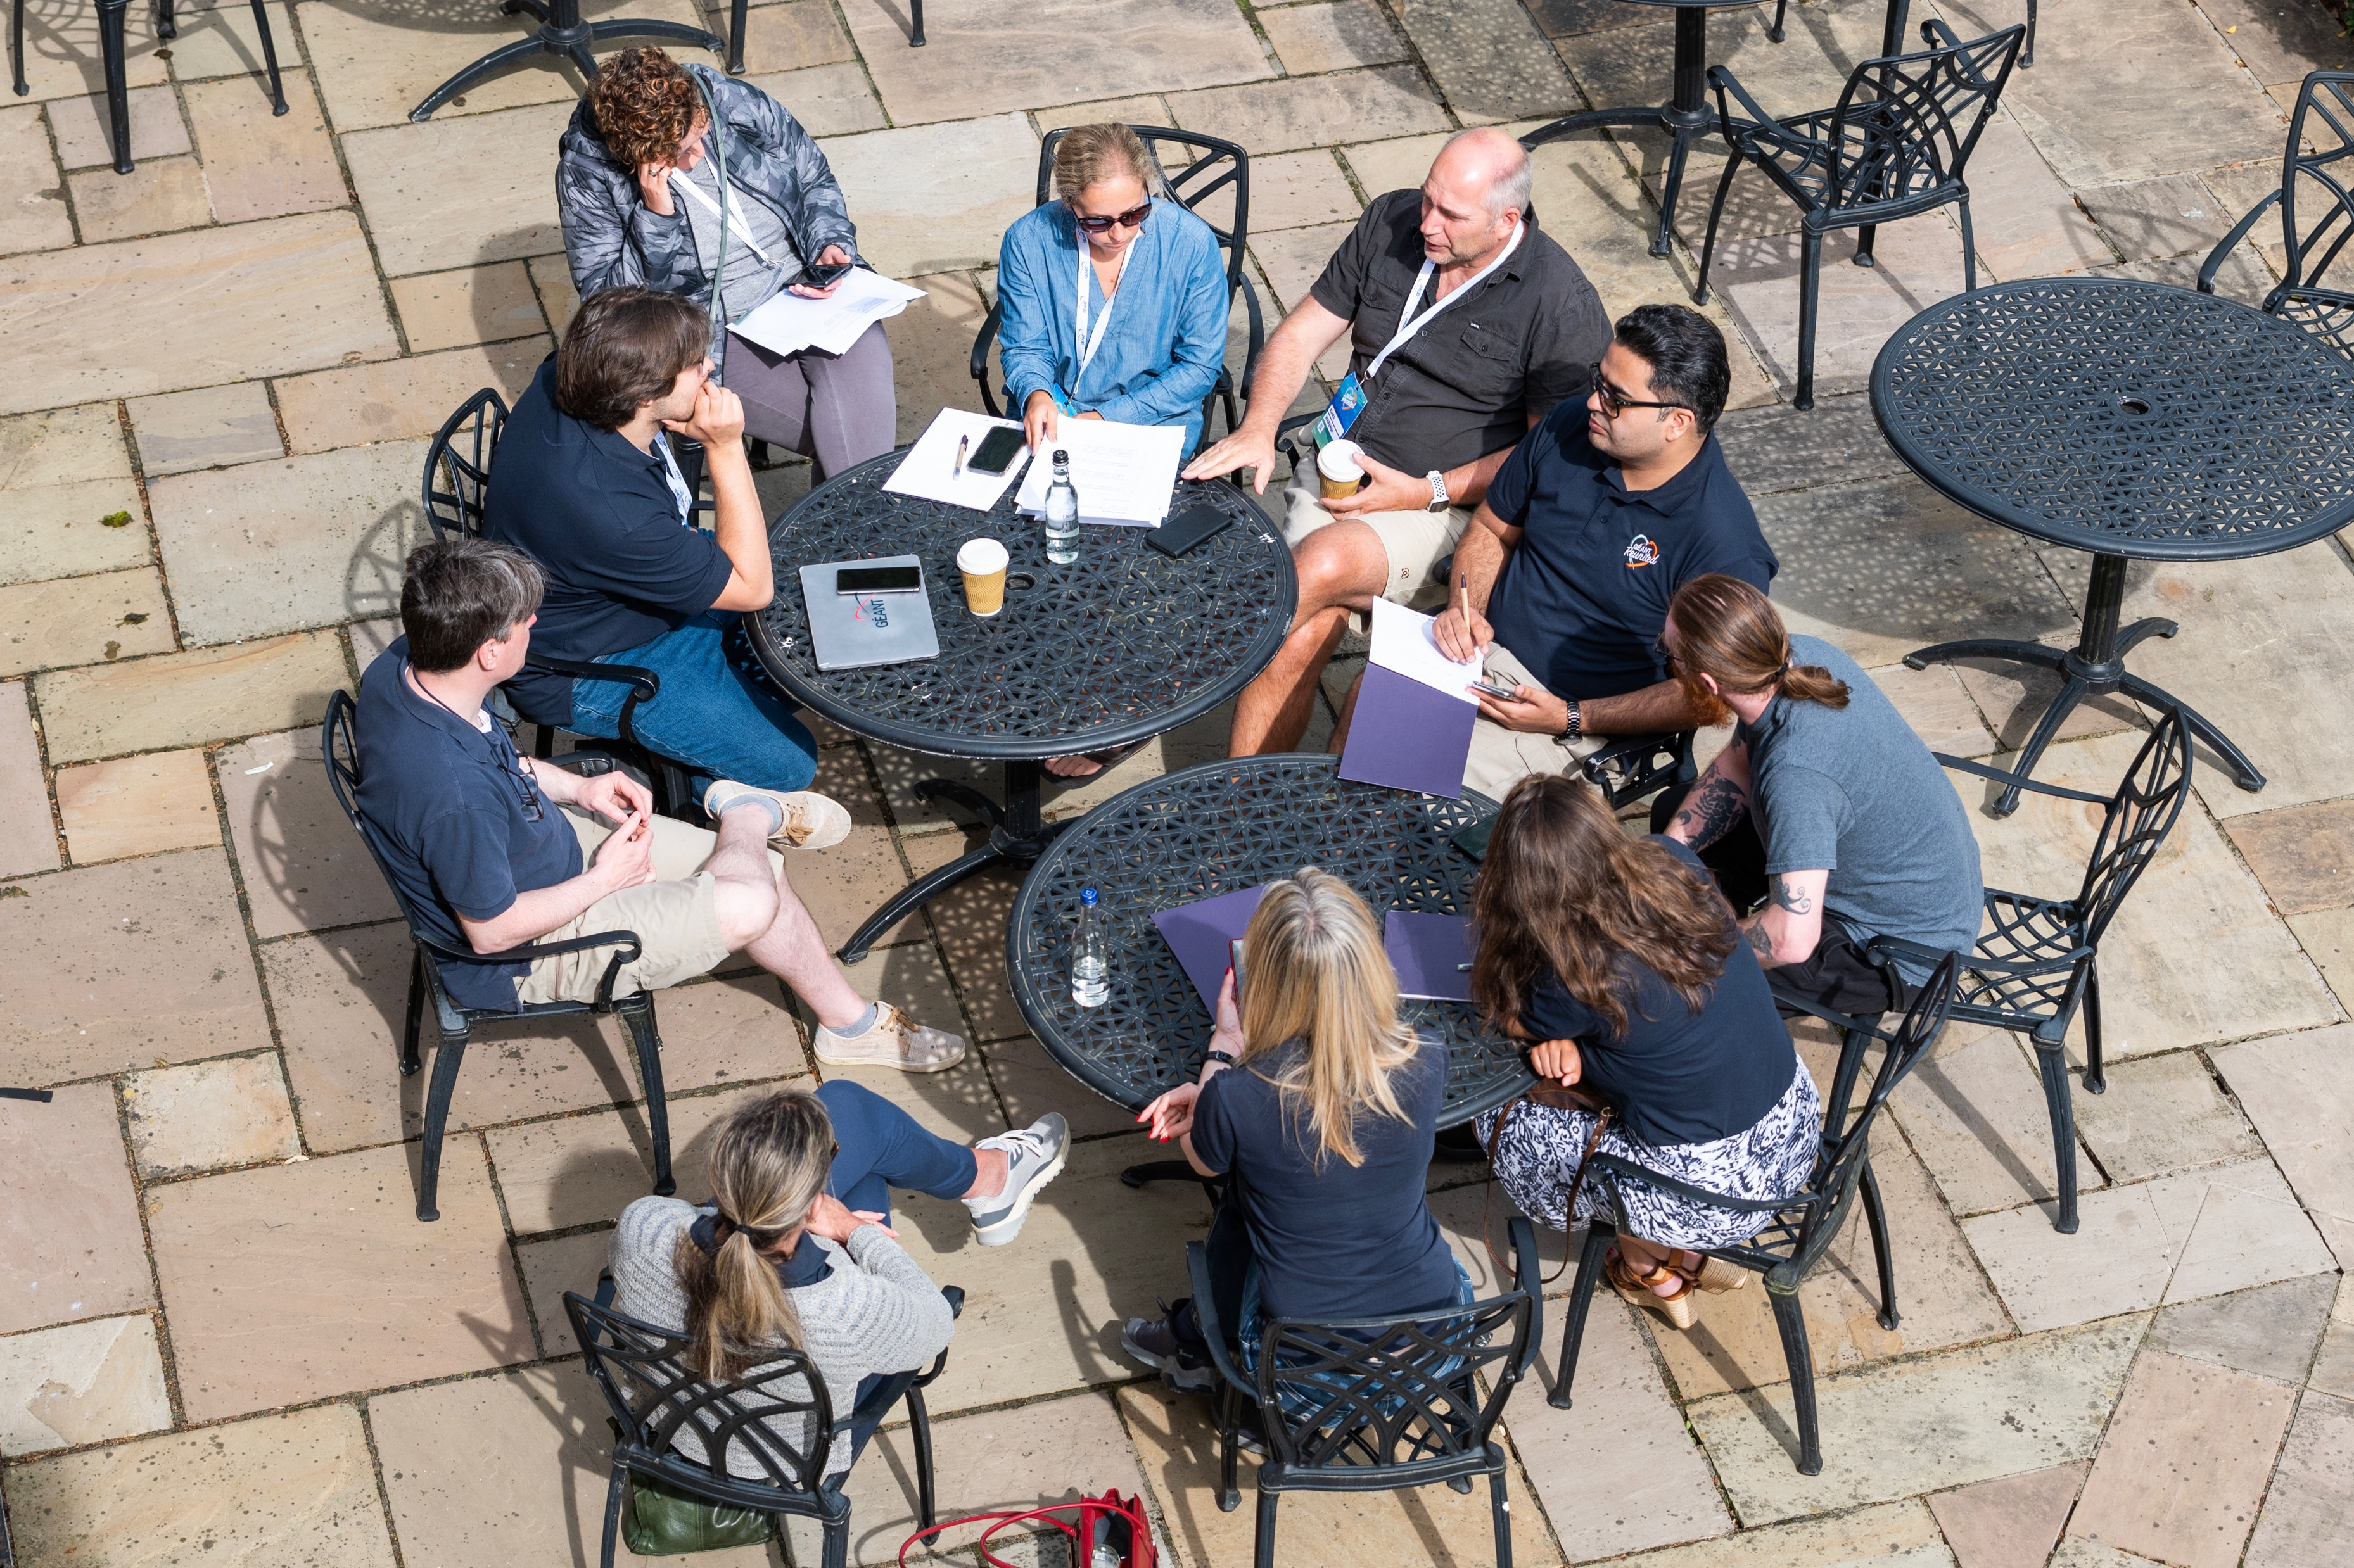
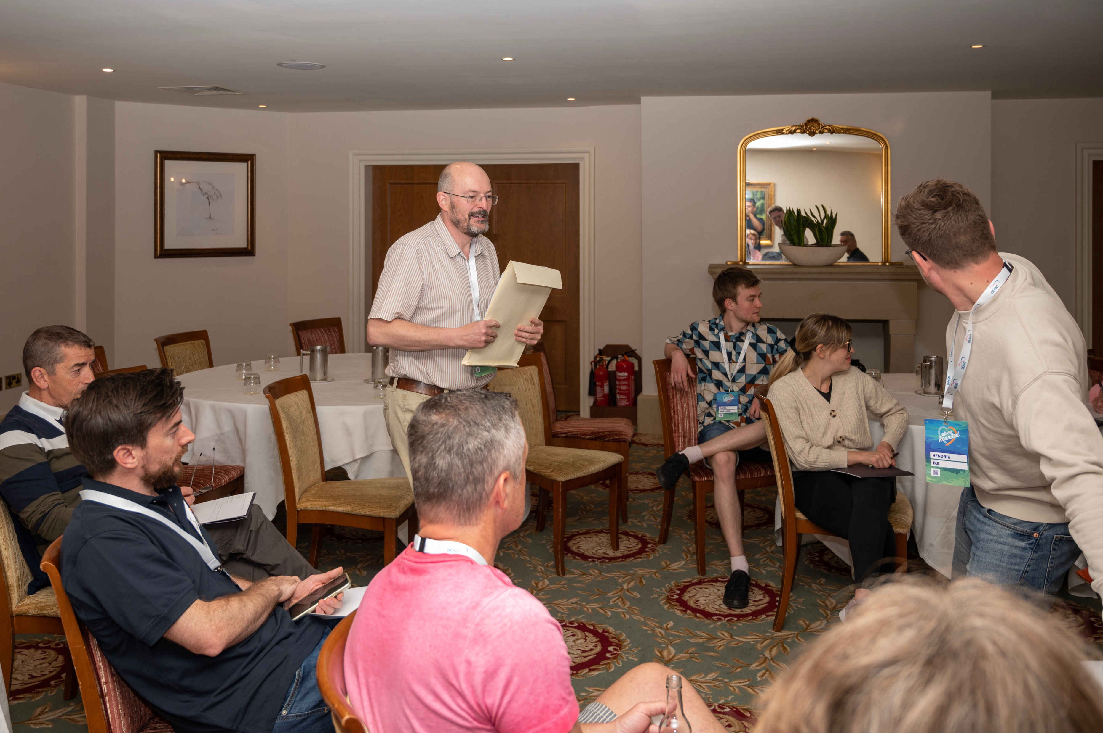
All Staff Crisis Management Exercise (PAW)
Security Pub Quiz
What band name is commonly used as a password in order to meet arbitrary password criteria?

Slide 7
Example – Security Tips Campaign

Slide 8
Security Tips Campaign
Topics
Themes per week: passwords, tools, security fails, advanced topics
1
2
Security Tips!
One tip per-day sent out for the whole of Cybersecurity Month
3
Approach
Shared on a created slack channel, all staff added, conversation encouraged

Slide 9
Behavioural Models (warning!)
Pseudoscience?
Like to be in fours
There are many different opinions on the applicability
This can be reductive; we are not boxes but humans
Very Subjective
Can be a useful framing
Results can differ depending on mood / situation
CAN be a useful tool to remind people of different personalities / learning types
Notes:
DISC, Surrounded by Idiots, Myers Brigg, Happiness Project
Keep in mind introverts vs extroverts, different reactions and different needs

Slide 10
Happiness Project
UPHOLDERS
QUESTIONERS
What MUST I do to comply / pass
WHY are we doing this, what is the purpose?
OBLIGERS
REBELS
I am ON IT
Need freedom, need to make their own choices
Notes:
Upholders and Obligers happy to meet external expectations, questioners and rebels likely to resist

Slide 11
Security Tips Bingo Card
Someone leaves channel
Mansplaining
Advice deemed wrong
Passive/Aggressive fight breaks out
Staff share helpful tips
People mute channel
Great training ideas suggested
Tips adopted by staff
Existing problems fixed
Planned tips shared by others
This information is too frequent
Everyone appreciates the effort
Notes:
What was ”wrong”: MFA doesn’t work if you lose your device
Useful tips: bitwarden, protonmail.
Hacking google docuseries

Slide 12
Outcomes
7% of staff left the channel. Mostly technical staff. All “alpha male” types.
Actions were taken by staff – increased use of LastPass, passwords reset etc
Staff Left Channel
1
Set the expectations better, introduce earlier.
Action Taken
5
2
Expectations Unclear
Energy was lost by week 4 – 2 weeks could have been enough.
4
3
Lots of great advice for home setup (e.g. bitwarden, protonmail).
Energy Flagged
Home Setup Advice

Slide 13
Questions for Evaluation
Did we give a clear justification for the campaign?
Did we give people freedom?
Did people understand accountability?
Were our expectations clear?
Notes:
For our questioners
For our rebels
For our obligers
For our upholders

Slide 14
Next Steps

Slide 15
Future Training and Awareness
Moodle it Up
Induction Gifts
Creating our first bespoke courses in Moodle
Top 10 tips on a mouse mat
Toolset Security
Make it Fun!
Refresher on how to use tools like listserv, wiki, indico securely
Looking at escape room options for October 2024

Slide 16
Thank You
Any questions?
www.geant.org

