Slide 1

New Security Challenges for NRENS
Jan Kolouch
CESNET
11th april 2024
GÉANT Security Days

Slide 2
Secure approach to professors and wizards of Unseen University

Slide 3



Or?

Slide 4
Spoiler
Almost no cyber attacks
Sir Terry Pratchett
Librarian and Wizzards
„Fairy Tales“

Slide 5
So many challenges, so little time…

Slide 6


Slide 7
Prague!

Slide 8
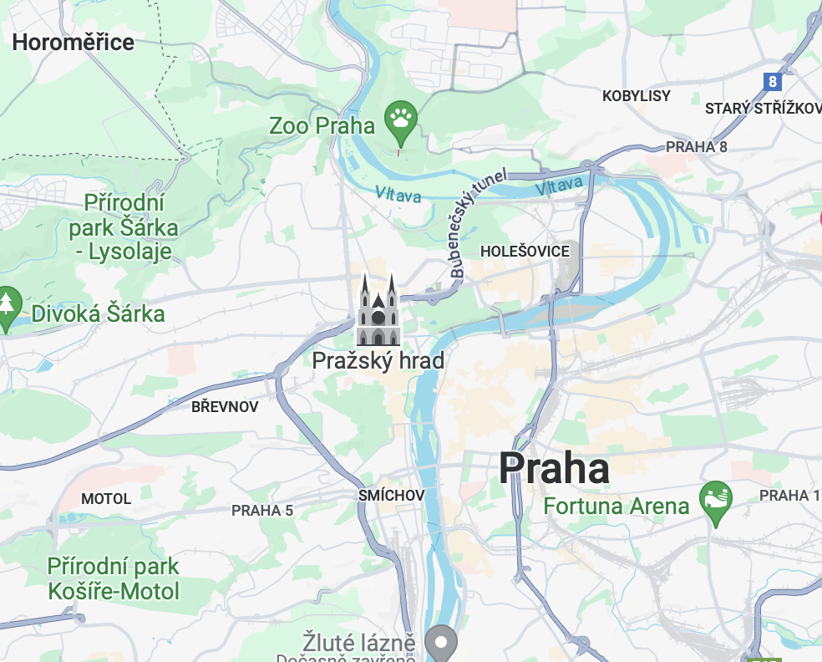
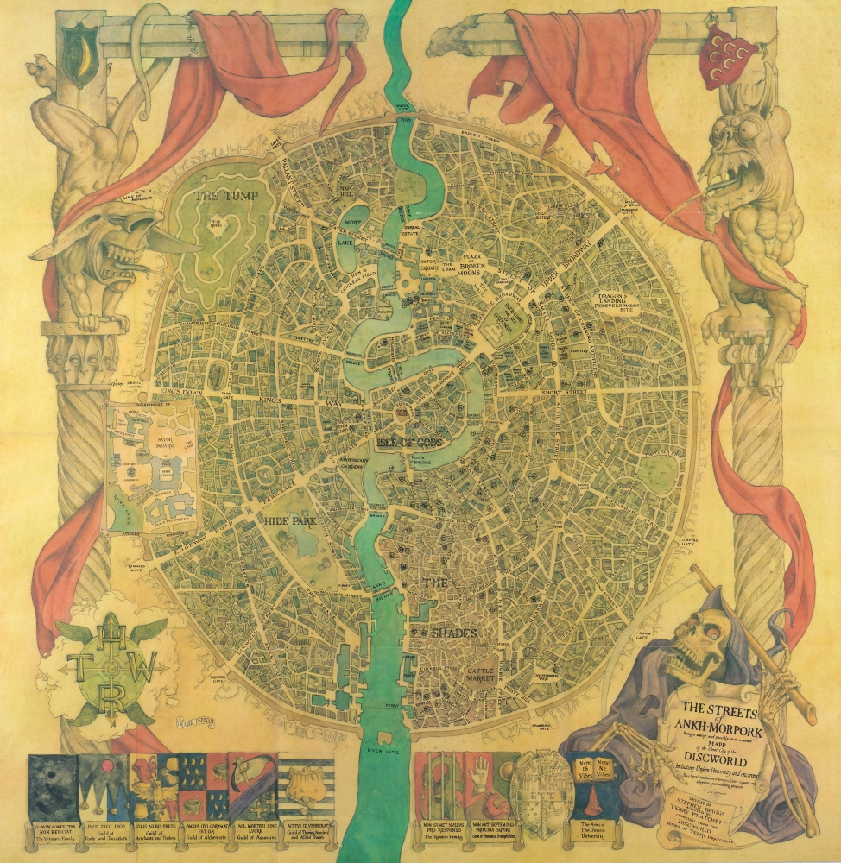
Ankh-Morpork

Slide 9
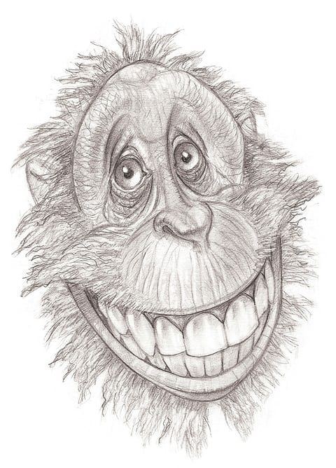
Librarian
librarian by paul kidby

Slide 10
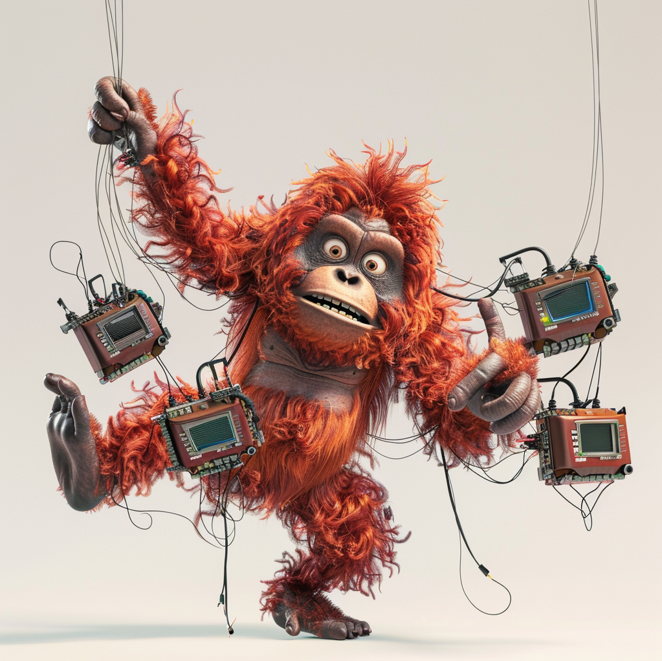
/imagine prompt
crazy cartoon orangutan ballancing on one leg, holding 100 strings connected to small computers with one hand and trying to grab one more string with second hand

Slide 11
CESNET - NREN

Slide 12

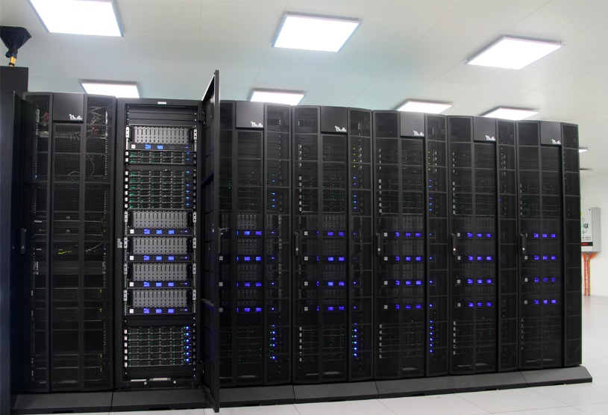


#Together for Sience
  Backbone network
400 Gb/s
  Data repositories
103 PB
  Computing power
37 628 CPU

Slide 13
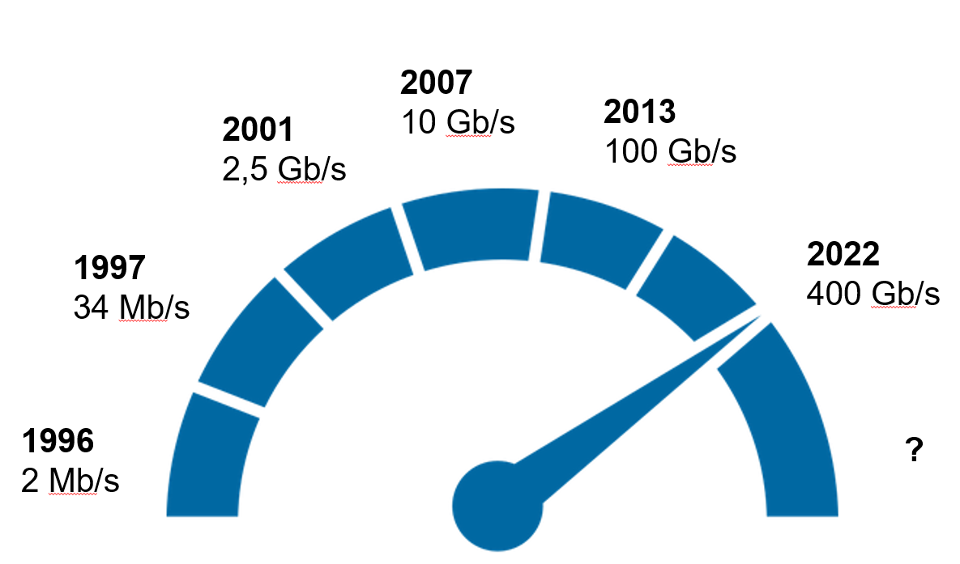
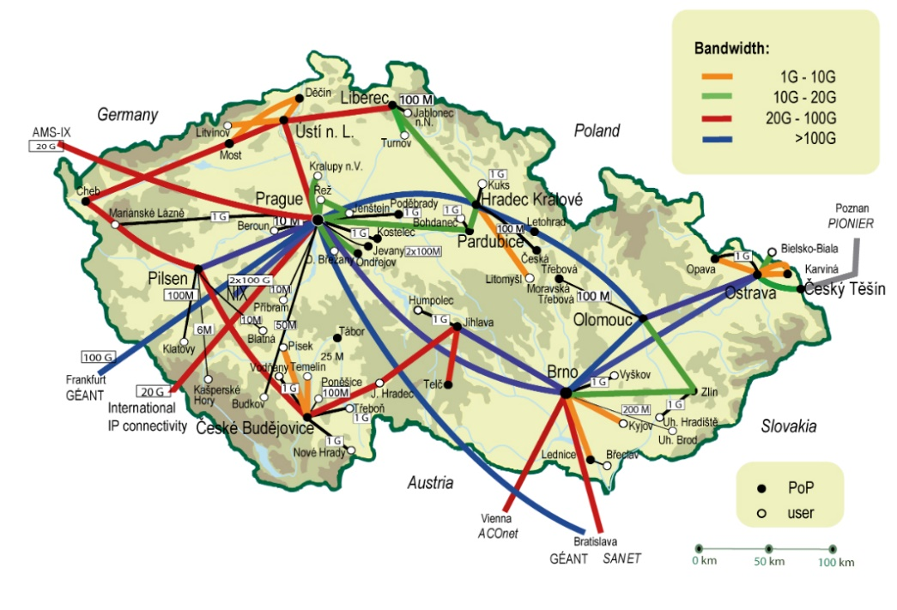
From 2 Mb/s to 400 Gb/s

Slide 14
1996
1 service
2000
14 services
2005
24 services
2010
27 services
2015
38 services
Network
Identity
Computing power
Data repositories
Security
Multimedia
2023
60+ services
2020
57 services
Security
Identity
Computing power
Data repositories
Network
Multimedia

Slide 15


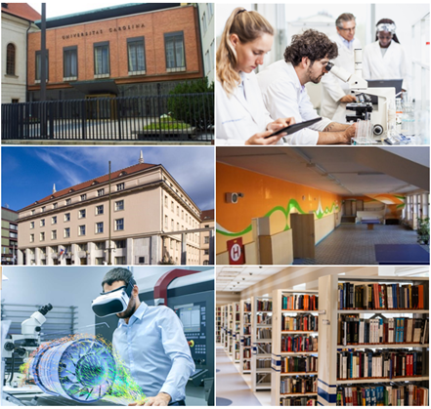
Users
500.000 users/day
300 connected institutions
Research organisations and hospitals
Universities
Public administration and local government
Schools
Libraries, museums and galleries
Institutes of the Academy of Sciences

Slide 16





Research and development
14 patents in the Czech Republic
8 patents in the USA
4 patents in the EU
3 spin-offs
National and international research projects

Slide 17


Slide 18
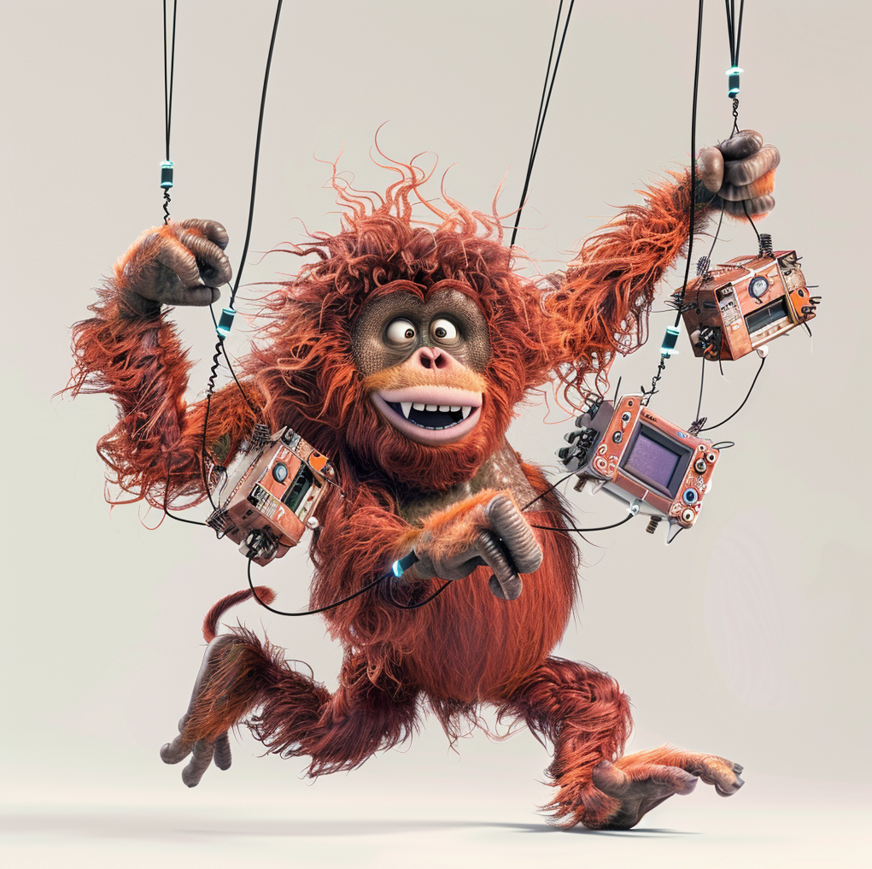
Evolved Orang huntan
/imagine prompt
crazy cartoon orangutan ballancing on one leg, holding 100 strings connected to small computers with one hand and trying to grab one more string with second hand

Slide 19
More challenges?

Slide 20
Scientists, professors and wizzards…

Slide 21
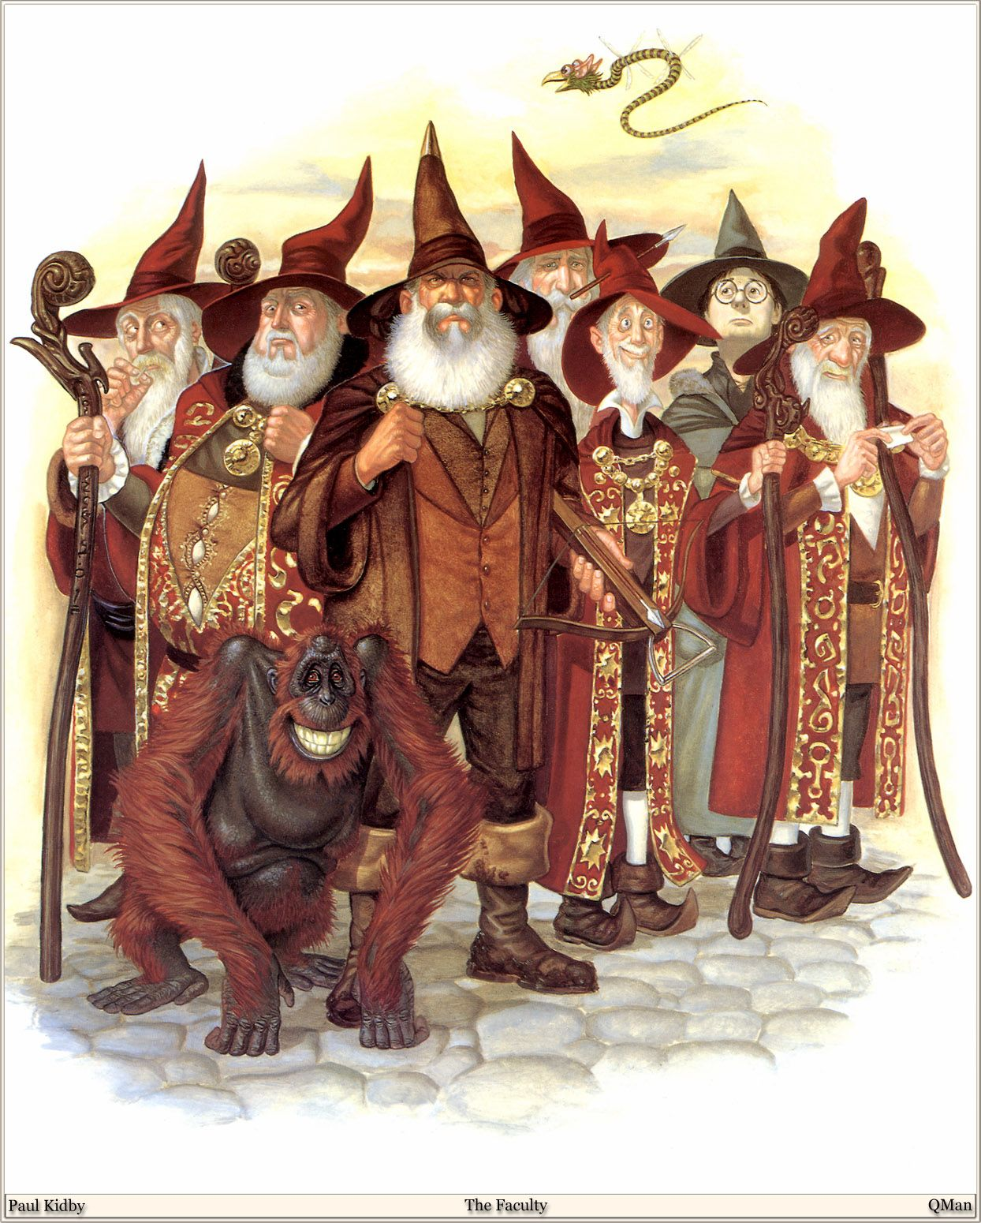
Unseen University

Slide 22
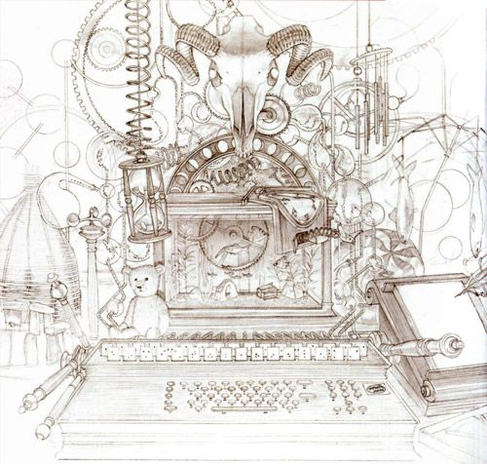
HEX

Slide 23
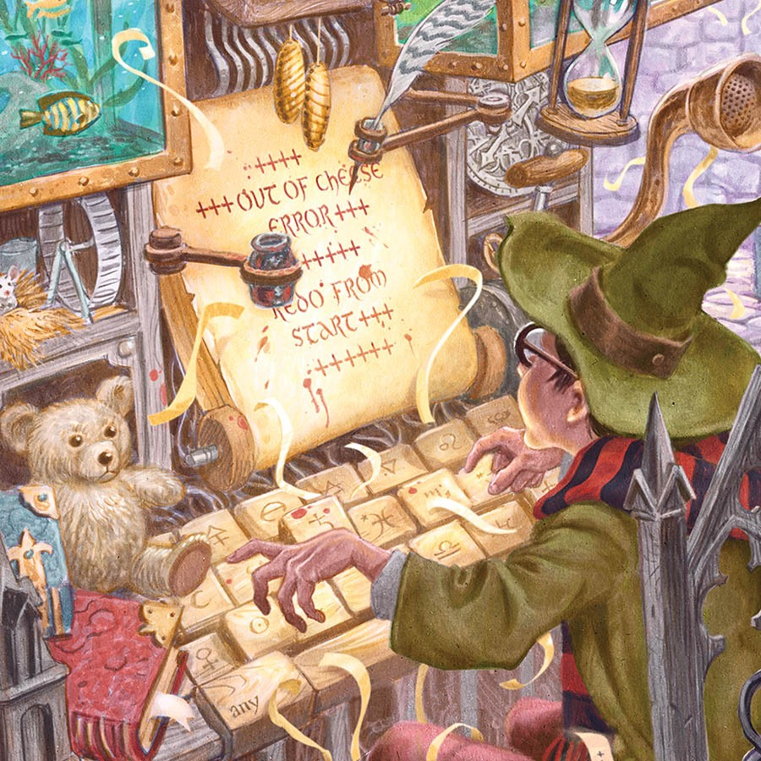
HEX

Slide 24
Fairy Tale?

Slide 25
Use case No. 1

Slide 26
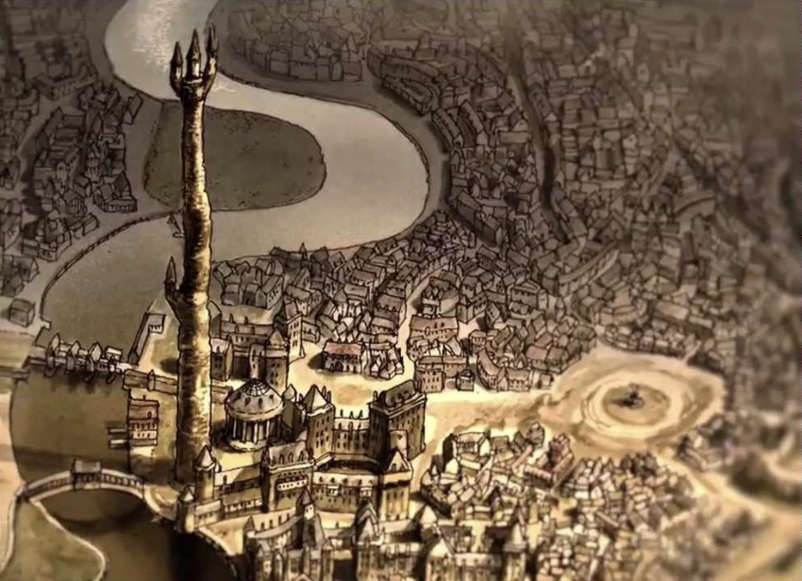
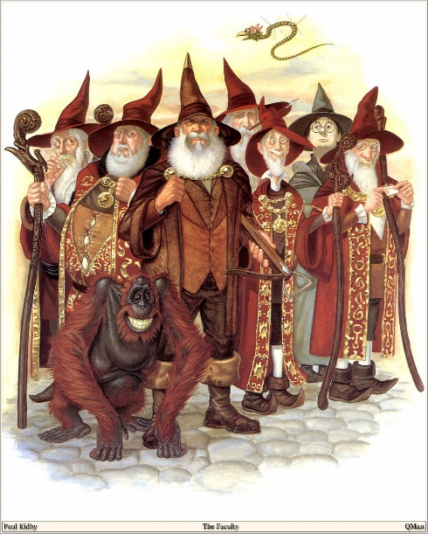
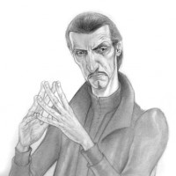

Slide 27
Cyber security - SD3
Design
Default
Deployment
PDCA cycle
Processes
Compliance
Technologies
People

Slide 28
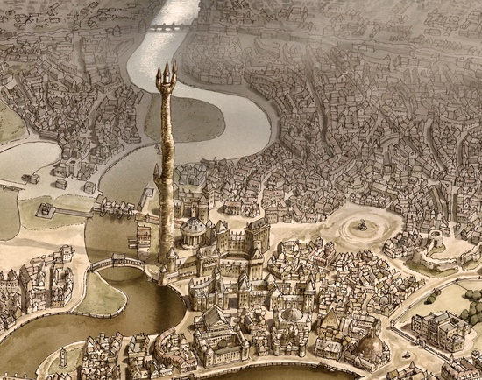

Slide 29

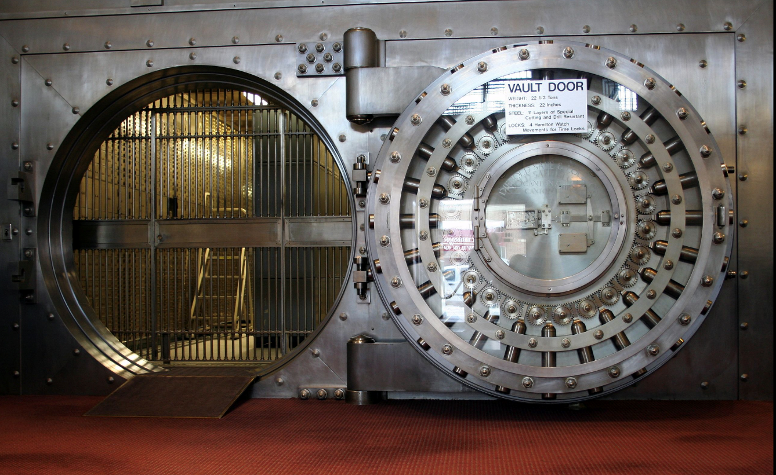
Expectations and wishes

Slide 30
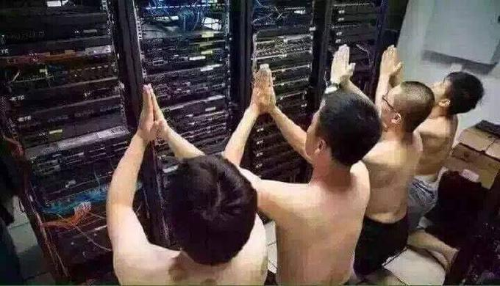
Reality

Slide 31
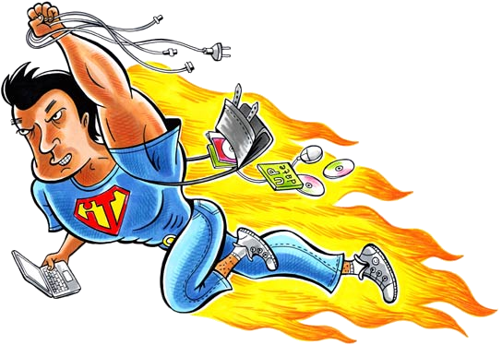
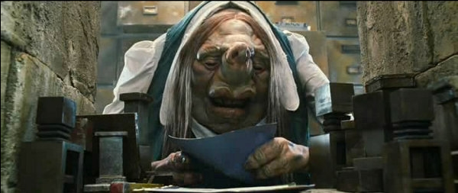
The near future
vs.
+
Security
+
Compliance

Slide 32
Quiz?

Slide 33
Use case No. 2

Slide 34
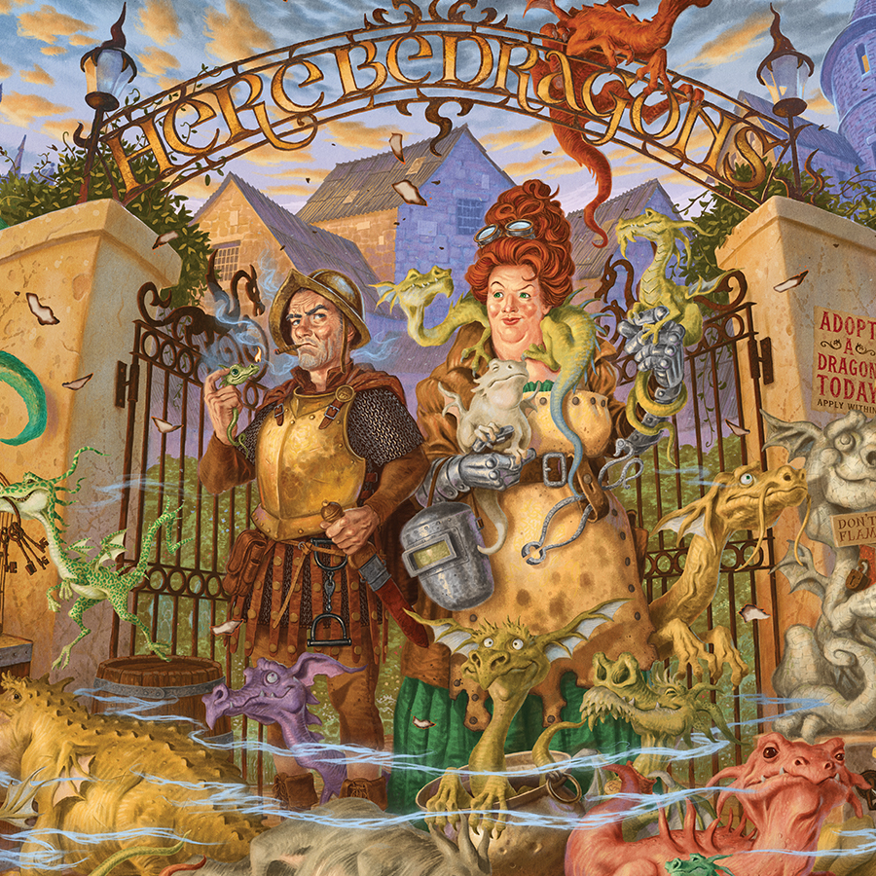
Sunshine sanctuary for sick…
https://www.discworldemporium.com/product/the-sunshine-sanctuary-for-sick-dragons-print/

Slide 35

Artificial Intelligence (AI)

Slide 36
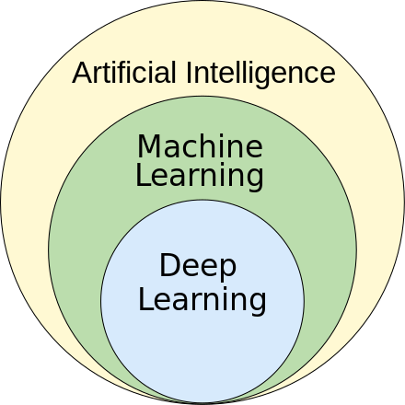
Machine learning models
1959 – Arthur Samuel (IBM)
Sindhu V, Nivedha S, Prakash M (February 2020). "An Empirical Science Research on Bioinformatics in Machine Learning". Journal of Mechanics of Continua and Mathematical Sciences (7). doi:10.26782/jmcms.spl.7/2020.02.00006

Slide 37

„11/2022 - AI“

Slide 38
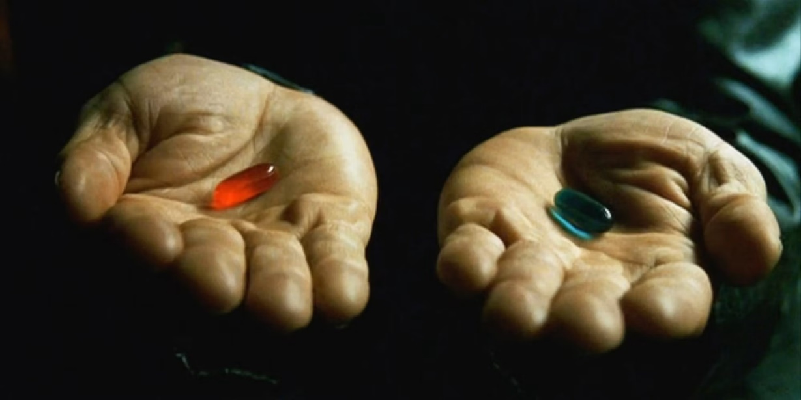
The Matrix (1999)
“You take the blue pill, the story ends. You wake up in your bed and believe whatever you want to believe. You take the red pill, you stay in Wonderland, and I show you how deep the rabbit hole goes.”
Morpheus

Slide 39
LLM
Response formatting - results
Notes:
Extrakce strukturovaných dat z elektronické zdravotní dokumentace pomocí velkých jazykových modelů
MUDr. Martin Černý; pplk. MUDr. Martin Májovský, Ph.D., FEBNS; prof. MUDr. David Netuka, Ph.D.
Konference: Moderní postupy v distanční péči a rehabilitačním lékařství

Slide 40
Data extraction accuracy
Llama2?

Slide 41


Slide 42
AI & Cyber Security?

Slide 43


Slide 44
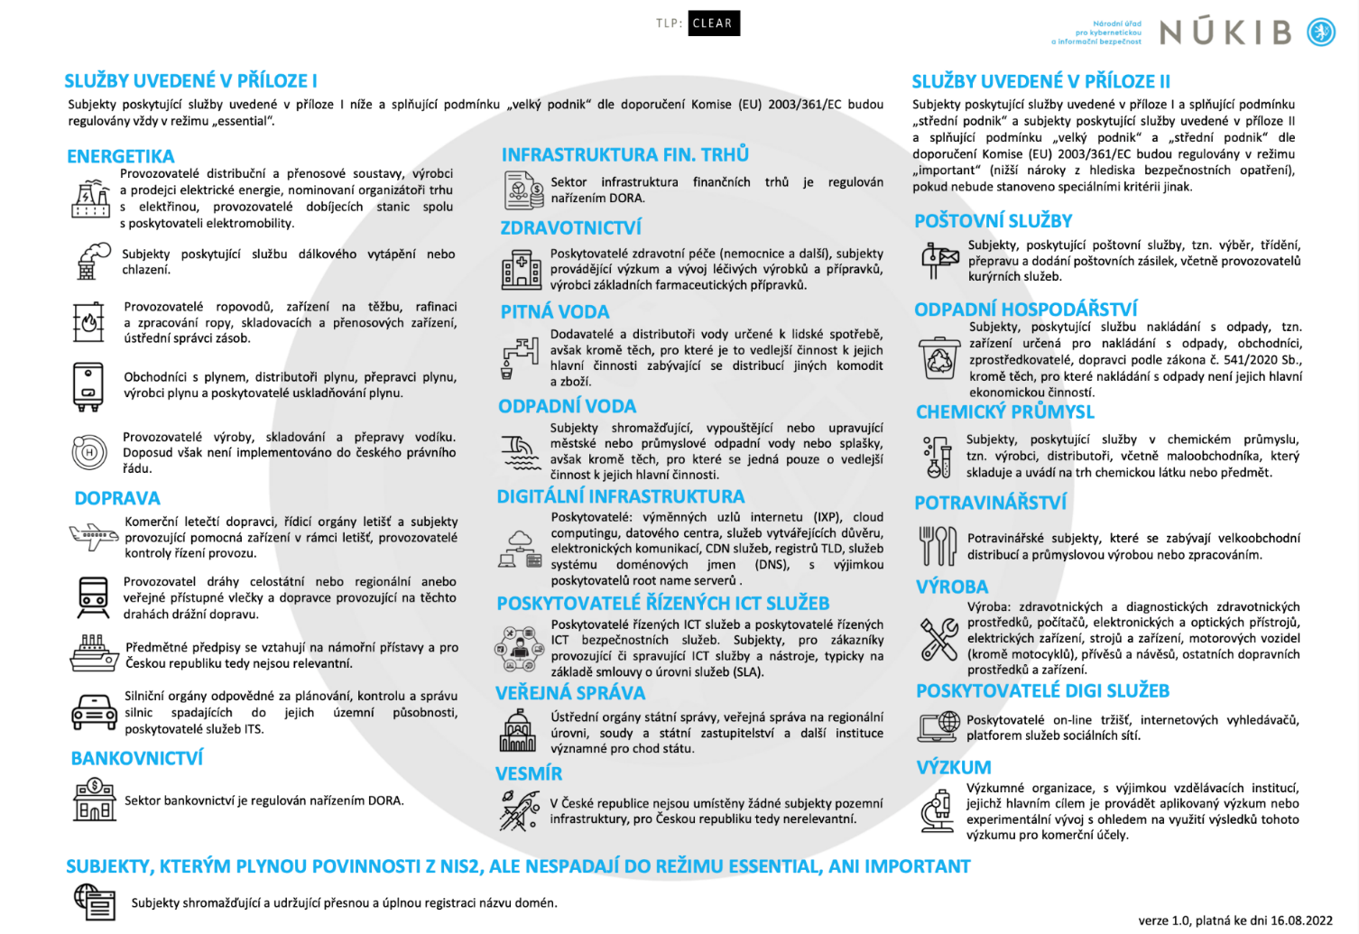
NIS2
https://osveta.nukib.cz/pluginfile.php/58365/mod_page/content/323/Priloha-1_Graficke-znazorneni-bez-nazvu_logo_v1.0.pdf

Slide 45
Participants of project
Unseen University
Unknown Faculty hospital
Essential entities
Important entities

Slide 46
AI ACT
Proposal for a
REGULATION OF THE EUROPEAN PARLIAMENT AND OF THE COUNCIL LAYING DOWN HARMONISED RULES ON ARTIFICIAL INTELLIGENCE (ARTIFICIAL INTELLIGENCE ACT) AND AMENDING CERTAIN UNION LEGISLATIVE ACTS
COM/2021/206 final
https://eur-lex.europa.eu/legal-content/CS/TXT/?uri=CELEX:52021PC0206

Slide 47
AI ACT – R 30
As regards AI systems that are safety components of products, or which are themselves products, falling within the scope of certain Union harmonisation legislation, it is appropriate to classify them as high-risk under this Regulation if the product in question undergoes the conformity assessment procedure with a third-party conformity assessment body pursuant to that relevant Union harmonisation legislation. In particular, such products are machinery, toys, lifts, equipment and protective systems intended for use in potentially explosive atmospheres, radio equipment, pressure equipment, recreational craft equipment, cableway installations, appliances burning gaseous fuels, medical devices, and in vitro diagnostic medical devices.

Slide 48
Risk Analysis?

Slide 49
Vendor?

Slide 50
Solution No. 1

Slide 51
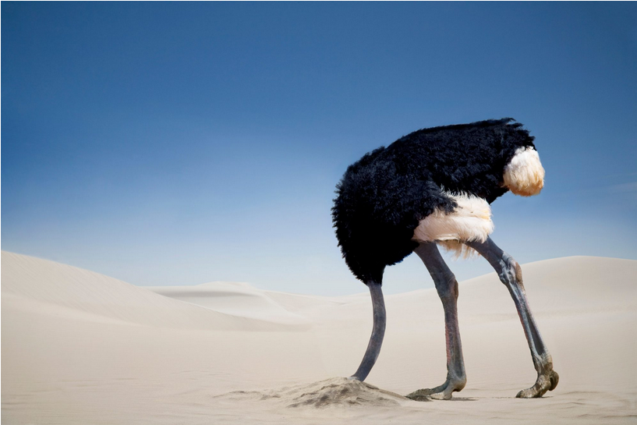
https://practicalhealthpsychology.com/cz/2020/05/stop-being-an-ostrich-the-benefits-of-helping-people-to-monitor-their-progress/

Slide 52


Slide 53
Solution No. 2

Slide 54


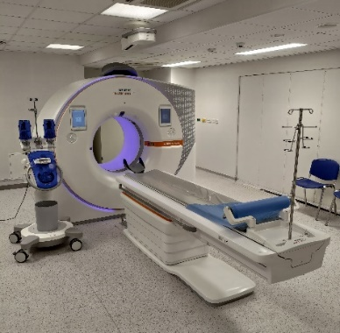


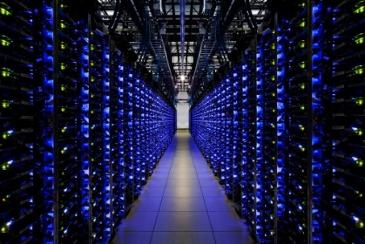
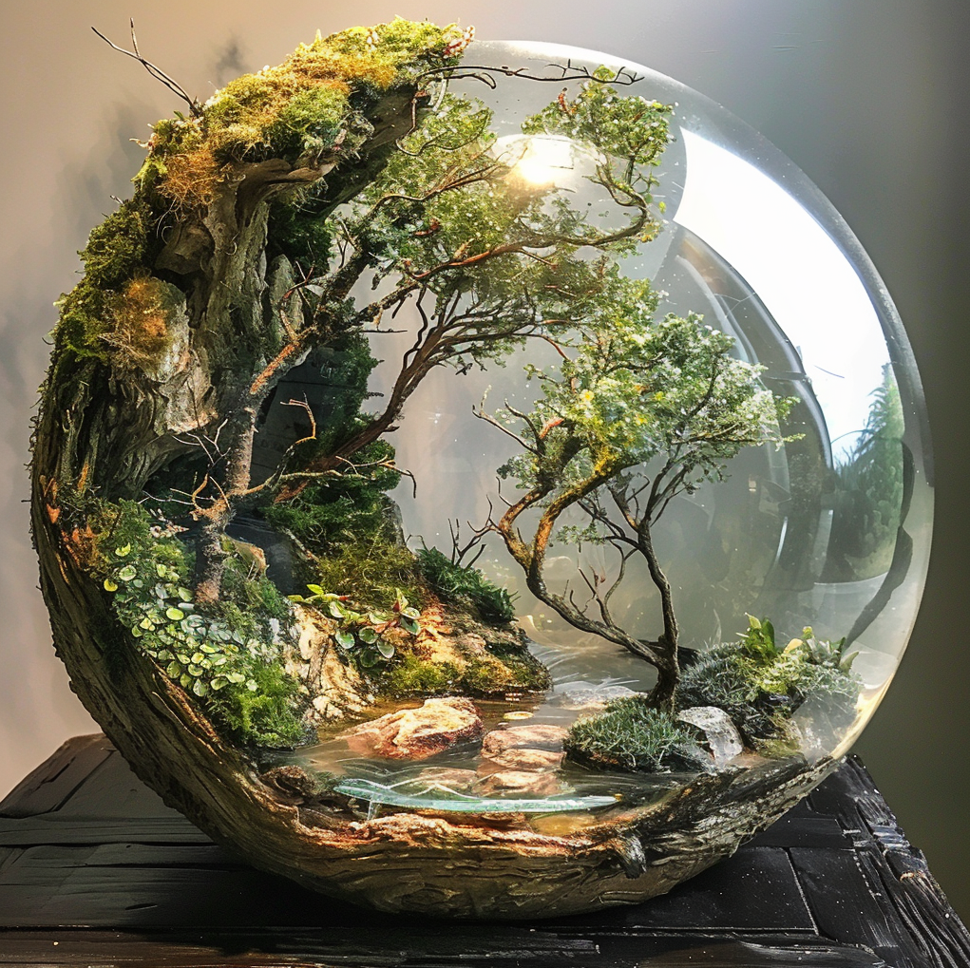

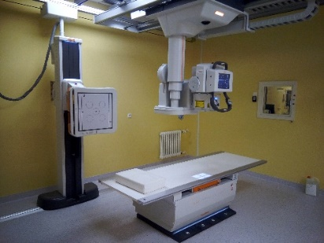

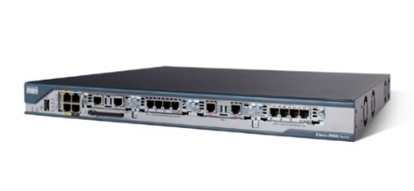
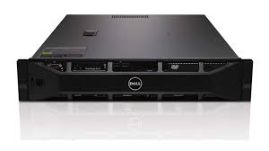

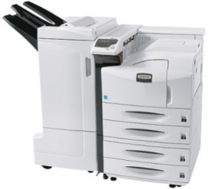
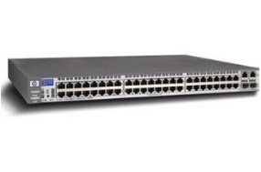


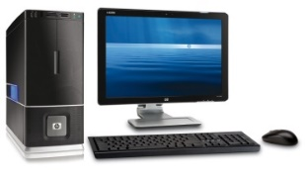


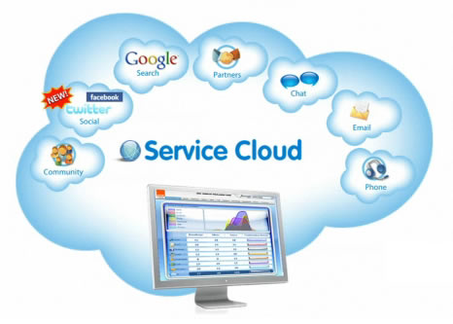





https://www.agilus.ai/difference-between-vendor-and-supplier/
HIS
https://www.irozhlas.cz/zpravy-domov/konci-moznost-rychle-zmeny-zdravotni-pojistovny_201111301143_mkopp

Slide 55
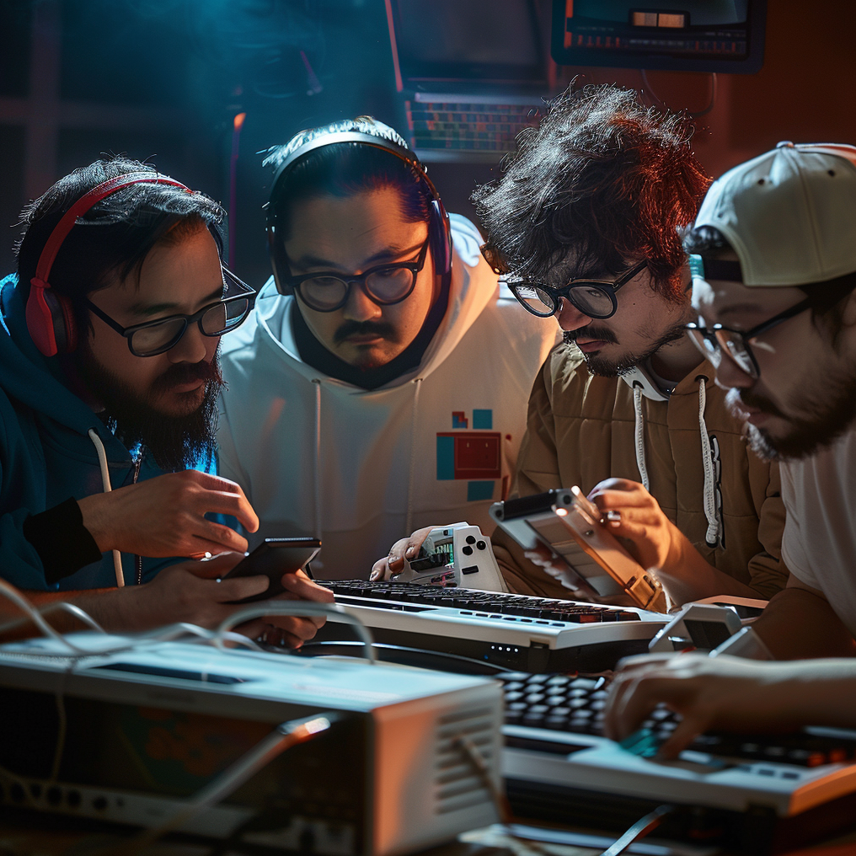
Who's gonna do it?

Slide 56


Slide 57
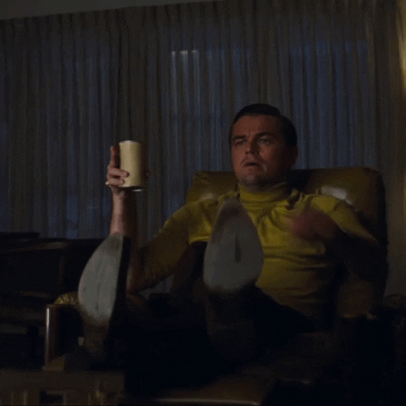
It will bring savings!
It will be ours, and safe!

Slide 58
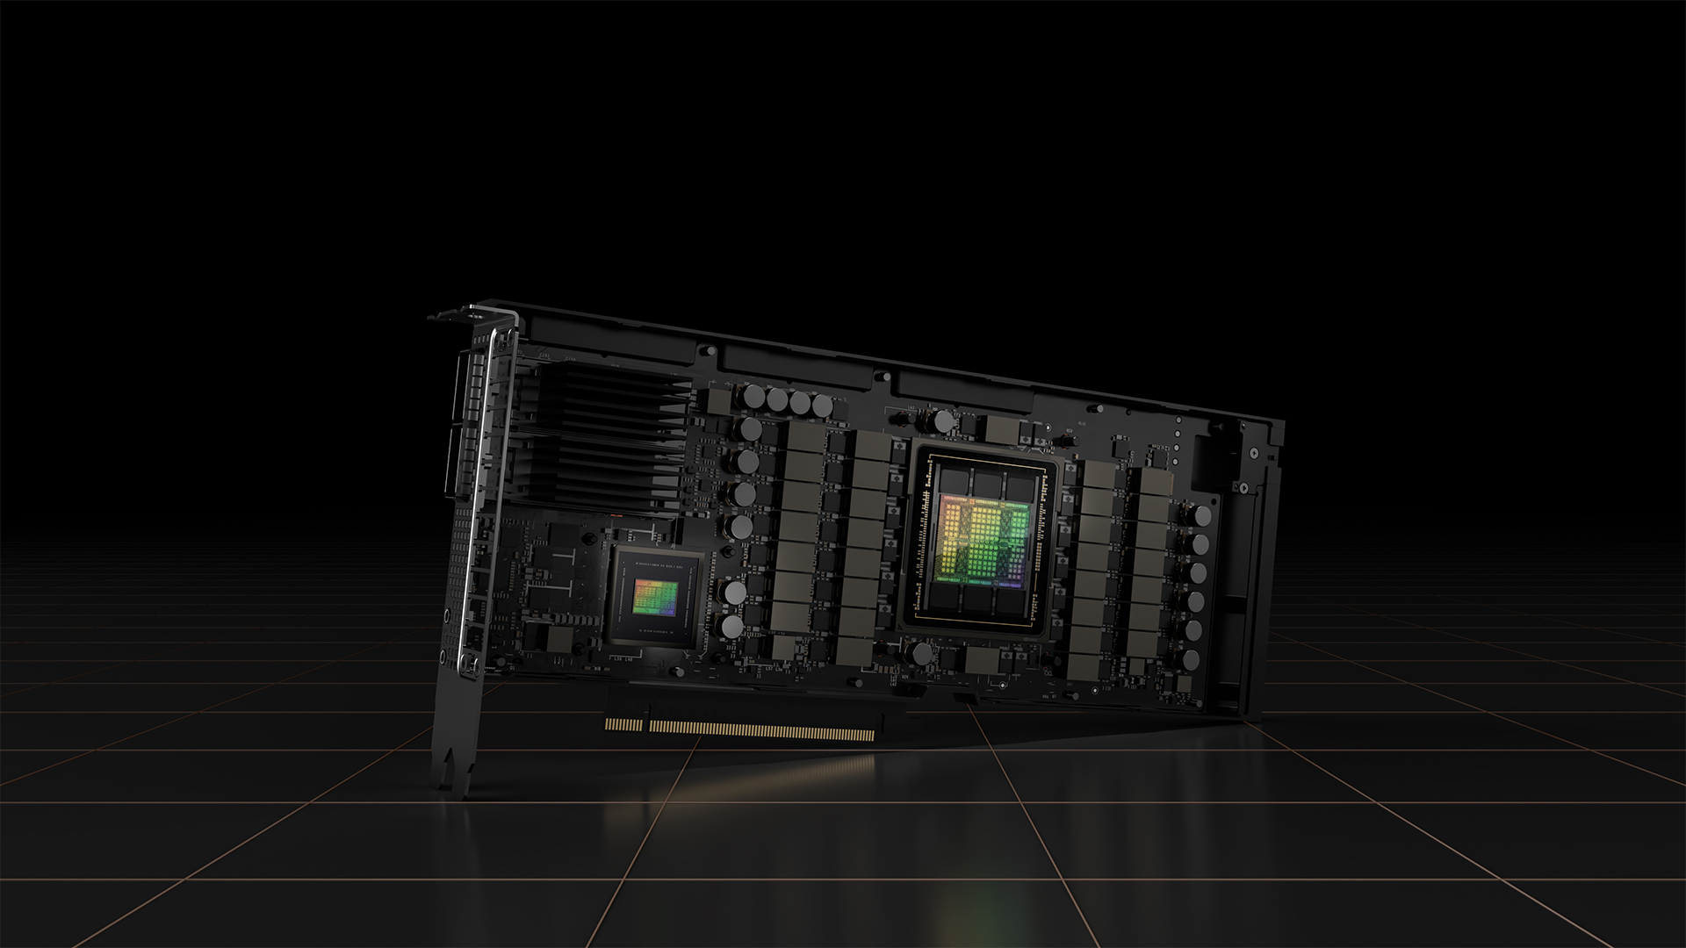
nVIDIA h100

Slide 60
Vendor?
Where the data will go?

Slide 61

Lawyers!

Slide 62
Cloud?

Slide 63


Slide 64
SLA?

Slide 65


Slide 66
AAI?

Slide 67
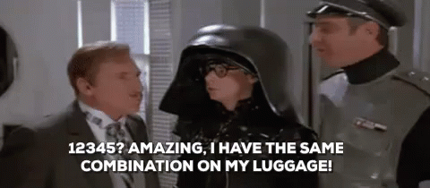

Slide 68
Security?

Slide 69


Slide 70

Professor/Wizzard

Slide 71
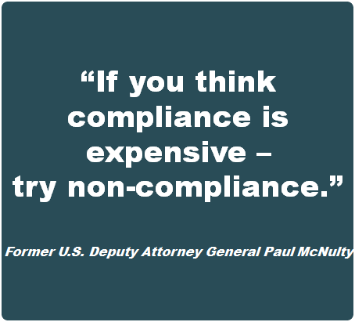

Slide 72
I'm not suicidal…

Slide 73
Challenges?

Slide 74

Legislation
NIS directive
  decrees to Cybersecurity Act (4)
GDPR
  Act No. 110/2019 Coll., Act on the Processing of Personal Data
NIS 2 directive
  decrees to New Cybersecurity Act (7)
CER
DSA
AI ACT

Slide 76



cybersecurity across different organisations
Essential entities
Important entities
CESNET
Universities?
Scientists?
Other entities?
Projects
  National
  International
Our rules / obligations?

Slide 77
Real Challenges?

Slide 78
Not to succumb to the illusion that buying technology will solve everything
  Bottom up approach
  We need to know how it works, to be able to fix it
  We need develop skills and build capacities
Not having a single, unified solution
  „Knowledge base“
  Let's agree on the interface, but not on the tools
  Diversification brings resilience and mutual growth
Law…
  Ballance between the fulfilment of formal requirements and reality

Slide 79

Capacity building

Slide 80
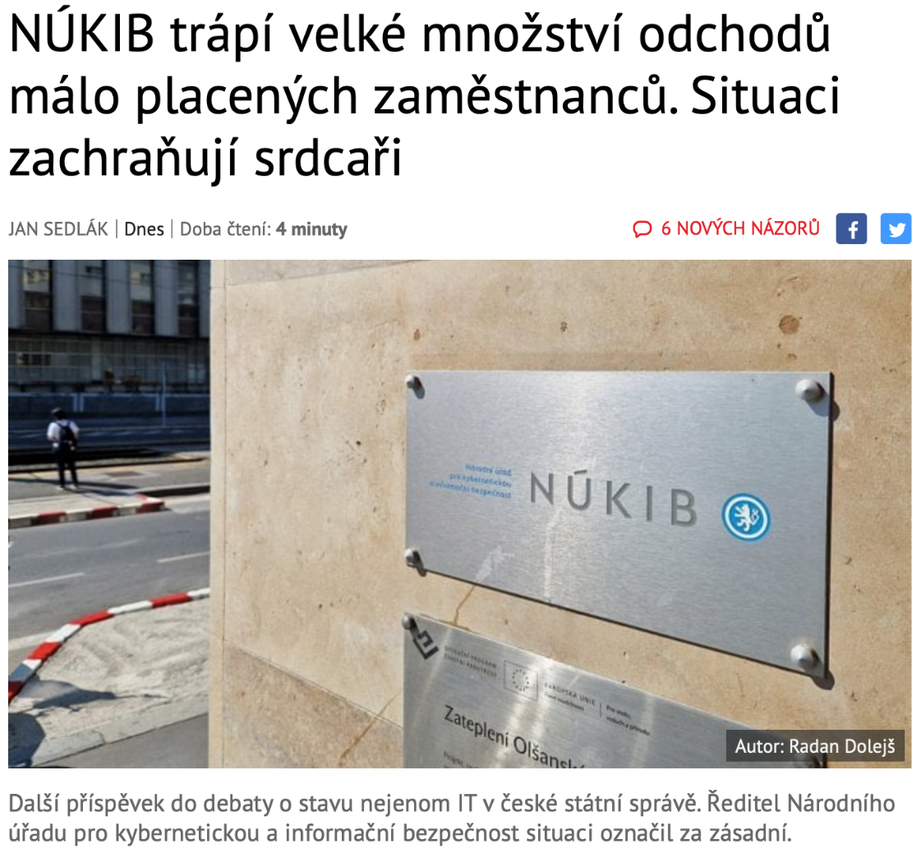
We are not alone!
https://www.lupa.cz/clanky/nukib-trapi-velke-mnozstvi-odchodu-malo-placenych-zamestnancu-situaci-zachranuji-srdcari/

Slide 81
Cooperation and communication

Slide 82
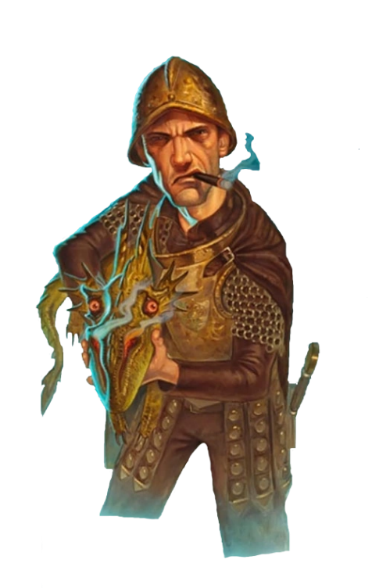
Thank you for the attention
Assoc. Prof. Dr. Jan Kolouch
jan.kolouch@cesnet.cz

