Slide 1
Project Overview and Roadmap
Panayiota Smyrli
Cyber Security Analyst at CYNET-CSIRT
GEANT Security Days 04/10/2024

Slide 2
AGENDA
Background, basic information
Project objectives
Overall Framework, conceptual architecture
Demonstration Scenarios, Evaluation Strategies
Work Plan and Milestones

Slide 3
CYBERUNITY Info
Acronym: CYBERUNITY
Title: Community for Integrating and Opening Cyber Range Infrastructures that Build an Interoperable Cross-Domain and Cross-Sector Cyber Range Federation
Call: DIGITAL-ECCC-2022-CYBER-03-CYBER-RESILIENCE
Budget: 3,594,528.04 €
Duration: 36 months (1/2024-12/2026)
Coordinator: NTNU
Consortium: 10 partners
Total effort: 487 PMs

Slide 4
Project Goals
Build an interoperable community of Cyber Ranges in Europe
Provide the first interoperable cyber range infrastructure
Realize the concept of “Cyber-Range-as-a-Service” (CRaaS)
Develop Knowledge Repository for cyber ranges
Develop a secure framework that enables cross-organisation and cross-border trustworthy and privacy-compliant integrated cyber range services
Train a new generation of cyber defenders who will be able to effectively exploit the tools and the methods required for their work
Provide software solutions, technical resources, and operational guidance for the establishment of new cyber ranges across Europe
Give access to cyber range facilities to a larger number of stakeholders

Slide 5
CYBERUNITY Implementation

Slide 6
WP Structure
1
Project Management
2
Requirements & Specification
3
CYBERUNITY Building Blocks
4
CYBERUNITY Integration
5
Testing, Demonstration & Validation
6
Dissemination, Standardization & Exploitation

Slide 8
OUR
TEAM
Notes:
8

Slide 9
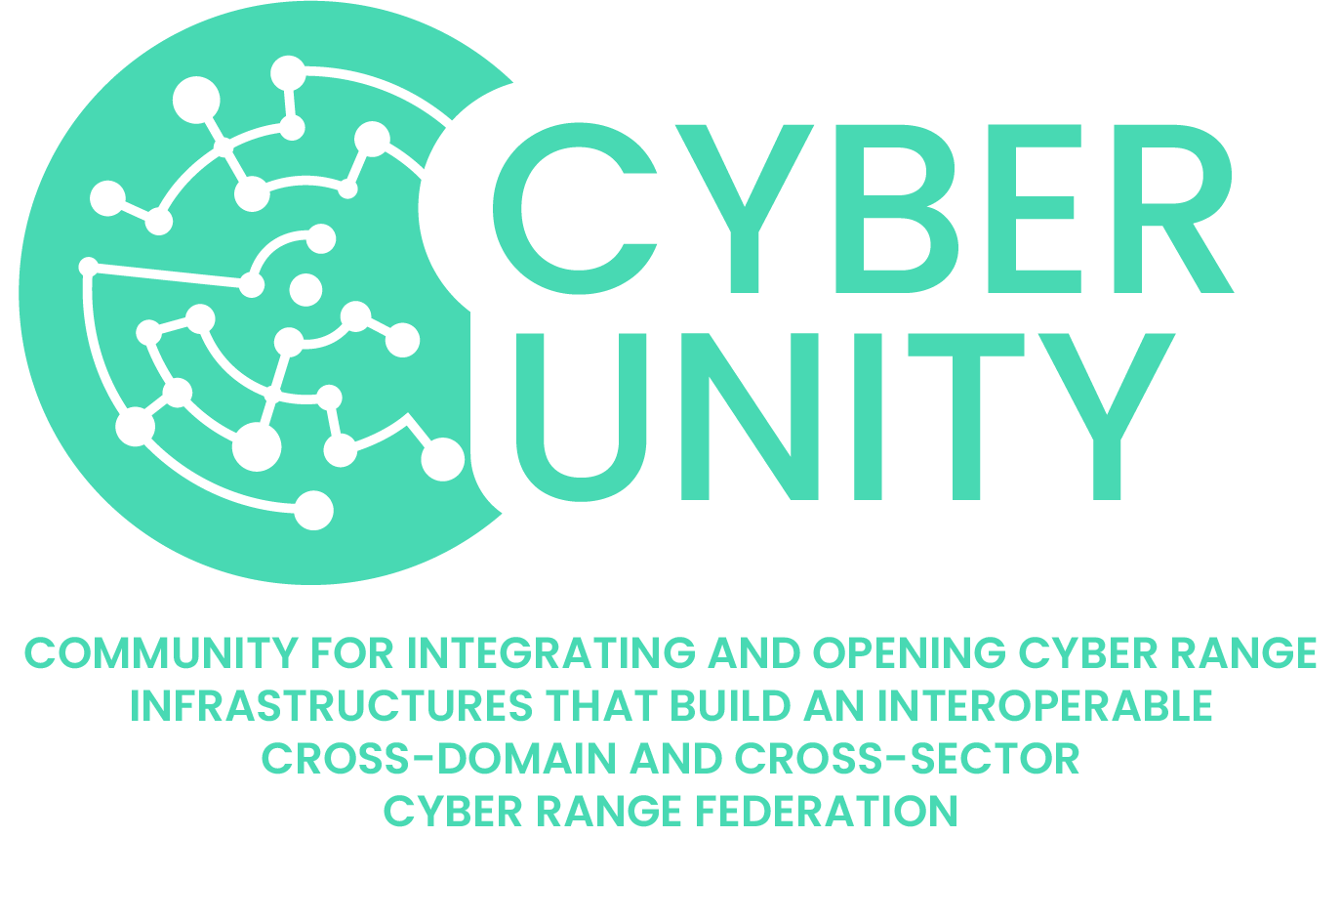
ANY
QUESTIONS?
THANK YOU

