Slide 1
CISO WANNA BE
Ana Alves - Chief Information Security Officer (CISO)
GÉANT ASSOCIATION
Notes:
You must be tired of seeing me here but believe it’s not my fault this time. The programme committee though that I would have something interesting to say ☹ and that talking about this CISO position could be interesting. Not sure about that.

Slide 2
CISO WANNA BE
Internal Auditor
Lead Auditor
Project Manager
Cybersecurity and privacy degree
Data Protection Officer
CISO at GÉANT Association
2011
Notes:
Explain a bit of my progress as CISO and at GEANT

Slide 3
CISO, why do you need one?
Digital Transformation
Cyber Threats
Risks and Financial Impact
Notes:
As digital transformation accelerates, the frequency and sophistication of cyber threats increase exponentially.
This makes it critical to have a strategic and leadership-oriented approach to managing cybersecurity risks within your NREN
Modern threats require coordinated multi-layer strategies and responses, sometimes involving multiple organisations and stakeholders.
The world is changing, the role of the CISO has become absolutely necessary in organizations.
the CISO plays a critical role in protecting against breaches, attacks, and other online threats by driving a culture of security awareness and implementing strategic cybersecurity measures throughout your NREN
I got the idea for this session because we had the CISO meetings during the summer and heard that some NRENs don’t have a CISO appointed

Slide 4
Let’s focus on NRENs
No black and white requirements
Small teams
Lack of C-Level Commitment and engagement
Huge consequences and impact
Notes:
No black or white requirements – ambiguity in legislation interpretation (like applicability of NIS2)
Guidelines and recommendations – mapping , adjusting and implementing requirements internally
Huge Consequences and financial impact (like losing funding) if not meeting the requirements

Slide 5
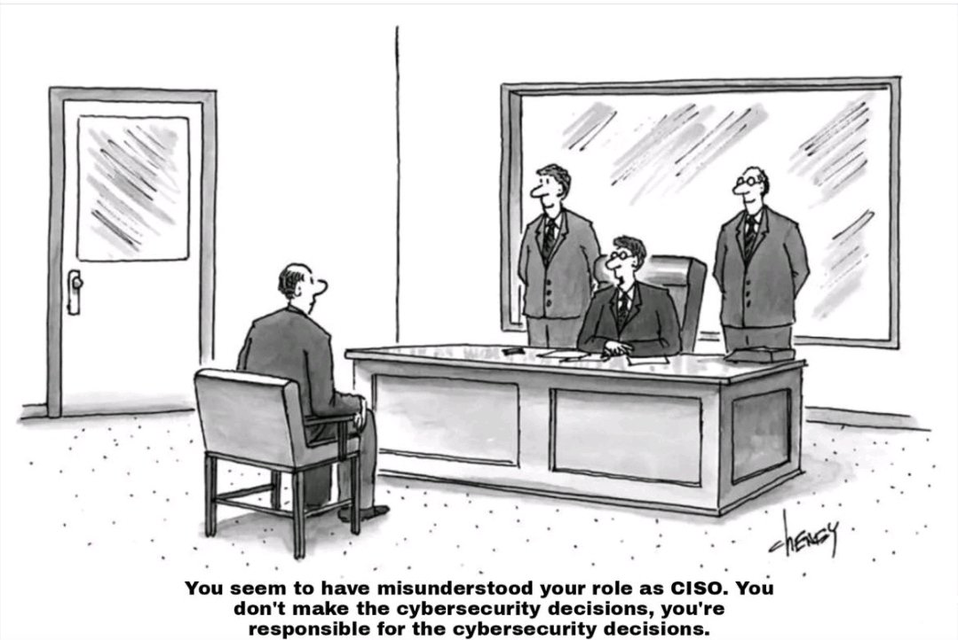
What is a CISO role?
Notes:
T & A – Training and Awareness

Slide 6
Responsibilities?
CISOs are leaders in charge of keeping the Organization's assets safe
Responsible for …
Strategy
Safeguard Data
Networks
Objectives
Systems
Security Incident Management
Planning
Reporting
Policies
Communication
Training
Coordination and alignment
Monitoring and Auditing
Risk Management
Notes:
And have a life
And somehow they are expecting to have normal people applying to this job

Slide 7
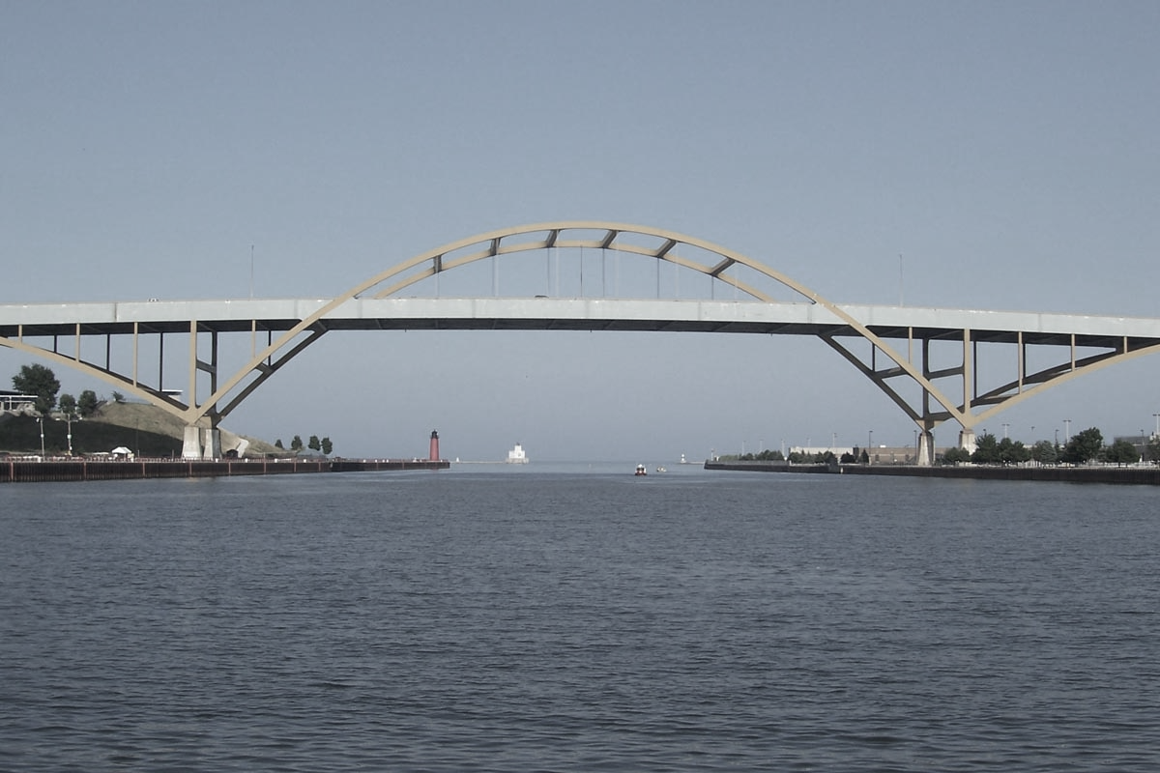
How does it work internally?
CISO
Executive
Staff
Reporting
Training
Support
Support
Strategy
Commitment
Commitment
Trust
Structure
Trust
Objectives
Planning
Notes:
CISO is the bridge between EXECUTIVE LEVEL and Staff
We provide training and of course also guidelines

Slide 8
CISO = GLUE
Compliance Orgs.
Board
CISO
Security for P&S
DST Internal Security
T&I
CERT + SOC
Security Comm.
Partner Relations Sec.
Suppliers
NCSC
NRENs
Risk Committee
Notes:
Broader perspective of CISO position. CISO is the Glue/ connection between internal and expternal, aligning perspectives and making sure :Strategy and Objectives achievement
Suppliers – External Auditors
IT Systems
NCSC - The National Cyber Security Centre
CISO IS WHAT MAKES POSSIBLE COMMUN LANGUAGE AND UNDERSTANDING OF SECURITY

Slide 9
CISO Skills and Profile
Notes:
We need a multitasking person ? That can do all in one ?
Responsible for monitoring, auditing and ensure process quality
Provide training and awareness
Be aware of the global changes and threats
Incident Management

Slide 10
CISO Skills and Profile
Strategic Thinking
Communication and Influence
Mediation & Diplomatic
Business Facilitator
Leadership
Cross-functional Collaboration
Ethical Leadership
Adaptability
Risk Oriented
Notes:
Strategic Thinking: The ability to think strategically and see the big picture, understanding how cybersecurity fits into the broader goals and objectives of the organization. Ability to establish strategic partnerships with industry peers, government agencies, and cybersecurity organizations to share threat intelligence, best practices, and collaborate on cybersecurity initiatives.
Communication and Influence: Strong communication and interpersonal skills to effectively communicate cybersecurity risks and strategies to executive leadership, board members, and other stakeholders, influencing decision-making processes.
Mediator and Diplomatic. Knowing that everything needs to be escalated, finding solutions and not fights. We are not always right, so we have to have some flexibility to adapt to the business we operate.
Business Facilitator Alignment: Skill in aligning cybersecurity initiatives with the overall business strategy and objectives, considering the organization's industry, market, and regulatory environment
Leadership – Leading the Organisation to achieve the proposed Objectives
Cross-functional Collaboration: Adeptness in collaborating with teams across various departments, including IT, legal, finance, and human resources, to ensure a holistic approach to cybersecurity.
Ethical Leadership: Commitment to ethical principles and values, promoting transparency, integrity, and accountability in cybersecurity practices.
Adaptability: Flexibility and adaptability to navigate evolving cybersecurity challenges, emerging technologies, and changing business requirements.
Risk Management: Expertise in identifying, assessing, and prioritizing cybersecurity risks, balancing risk mitigation efforts with business priorities and resource constraints
A CISO with a broader perspective integrates cybersecurity into the organization's overall strategy, fosters collaboration across functions, and effectively manages risks in alignment with business priorities and values.

Slide 11
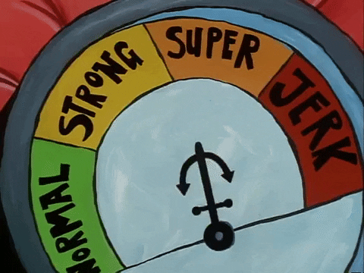
CISO – Don’t be
Don't operate in isolation
Avoid being solely reactive
Not just focused on compliance
Avoid being exclusively technical
Don’t be a gatekeeper
Don’t be a blocker
Don’t be a jerk
Notes:
If you decide to use this slide, please note that PowerPoint will crop the images you choose as per the suggested design.

Slide 12
Any questions?

