Slide 1
Together we are strong!
Floor Jas – Head of Trust & Security
Wim Biemolt - Chair of SURFcert

Slide 2
Security collaboration on different levels
    SURFfirewall
    SURF DNS
    Dienstverlener
    Vereniging
Services
    Dienstverlener
    Vernin
International
    SURFcert
    GEANT
    SURFcert MISP
    Strategical
    Operational
    Innovatiewerkplaats
    SCIRT
Organisation levels
    Tactical

Slide 3







A bit of background: Security Services at SURF
Cybersave Yourself
Prepare your own awareness campaigns
Safe internet everywhere
Protect your e-mail
Cyber crisis
exercises
(N)OZON
Prepare for cyber crises
SURFaudit
How well is my institute doing on Information Security?
A
Secure Access to services with 2-factor authentication
SURFdomains
Better security through DNS
SURFcertificates
Certificates for encrypted connections, code-signing and personal certificates
24/7 support in case of security incidents
24/7 monitoring and sharing of Indicators of Compromise (IoC)

Slide 4






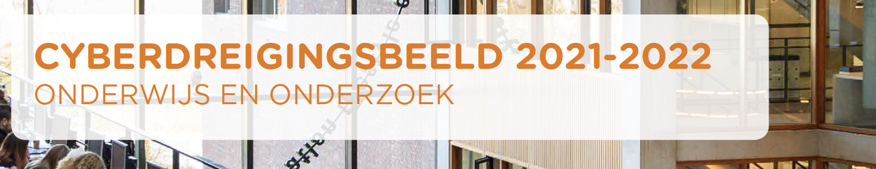


More than services
We share knowlege in our
Security Expertise Center
We collaborate both nationally and internationally
We publish an annual Cyber Threat Overview
We organise courses, workshops and an annual Security & Privacy conference
We host the platform
Safe and Open Higher Education
We facilitatie 2 very active communities:
SCIPR and SCIRT
4

Slide 5
International Collaboration
    SURFcert
    GEANT
    SCIRT

Slide 6



How it started
2023-11-17T10:57:02.220576+0100 alert x.y.z.232 58381 x.y.z.231 53
UDP Traffic TO Dark ip space

Slide 7

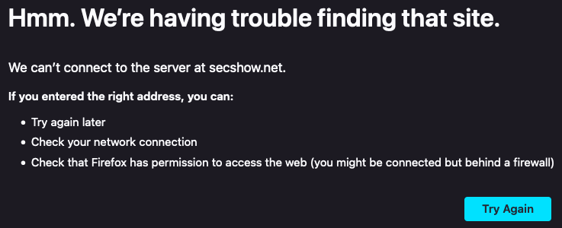
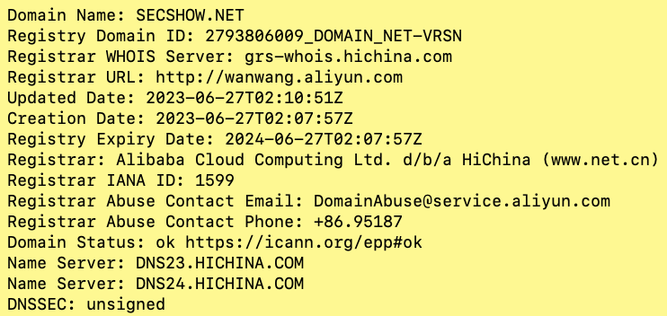

secshow.net …

Slide 8
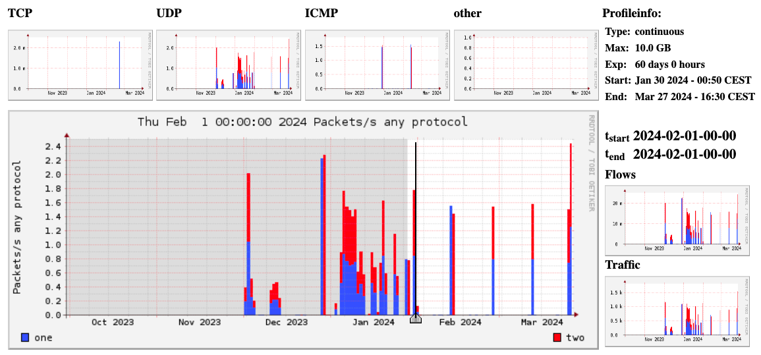
input = 1494

Slide 9
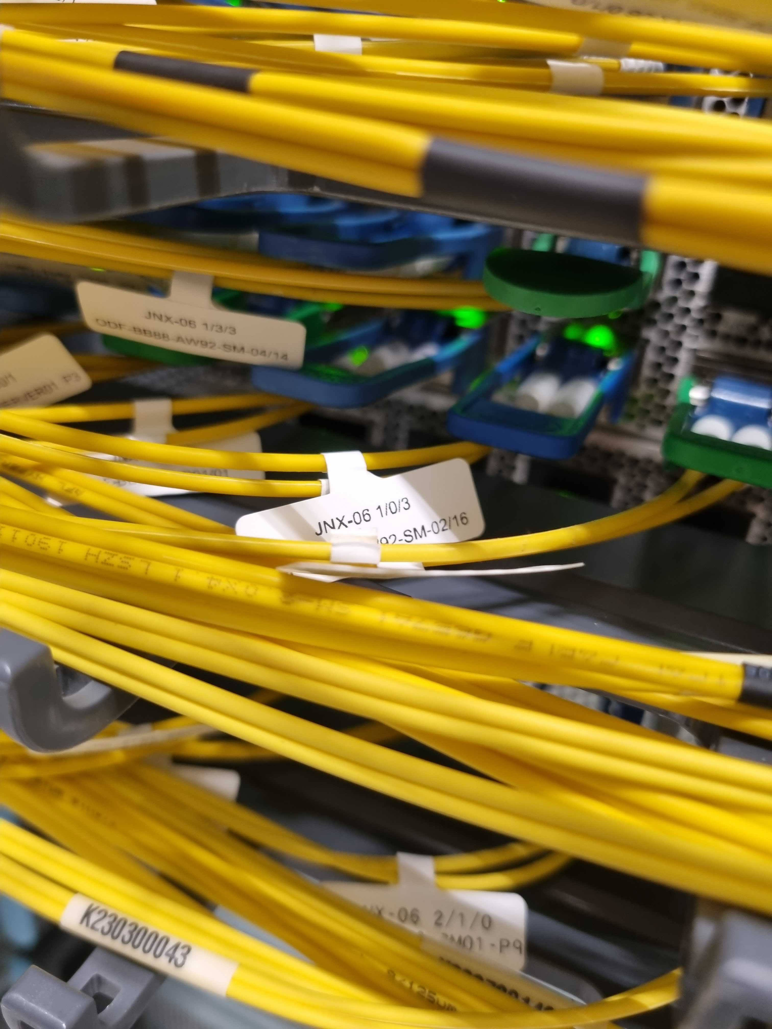
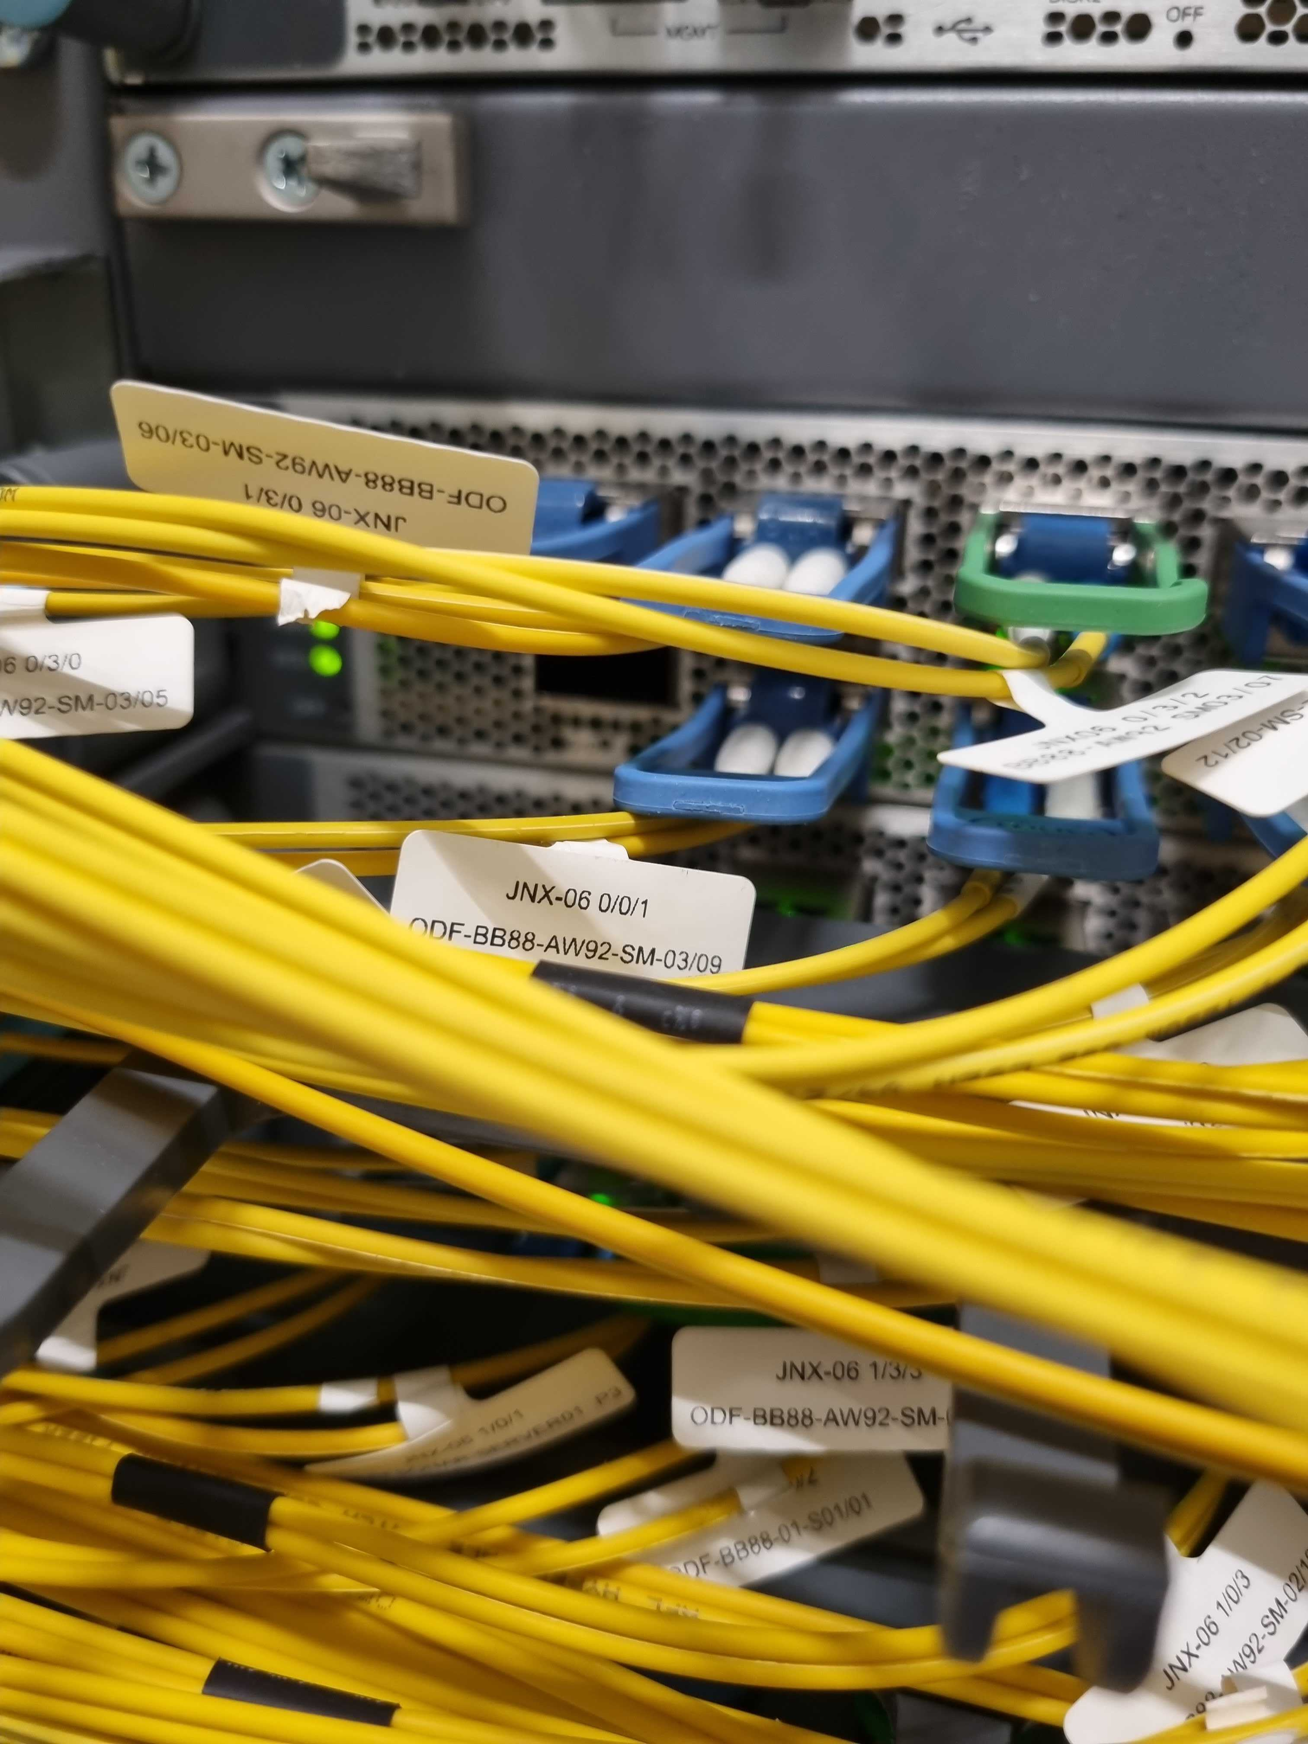
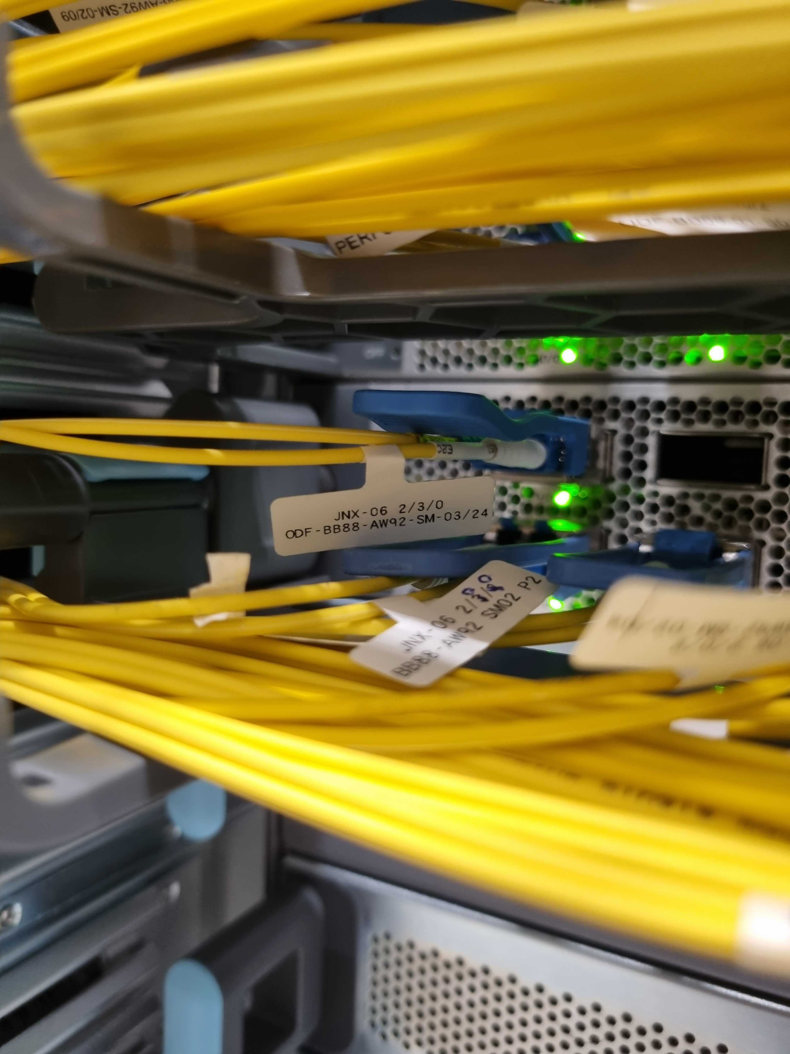
Logical interface ae11.1103 (Index 489) (SNMP ifIndex 1494)

Slide 10
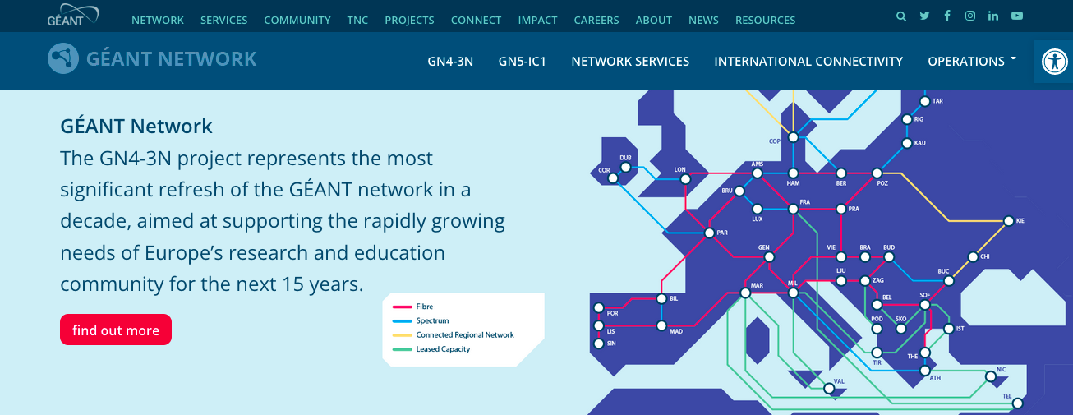
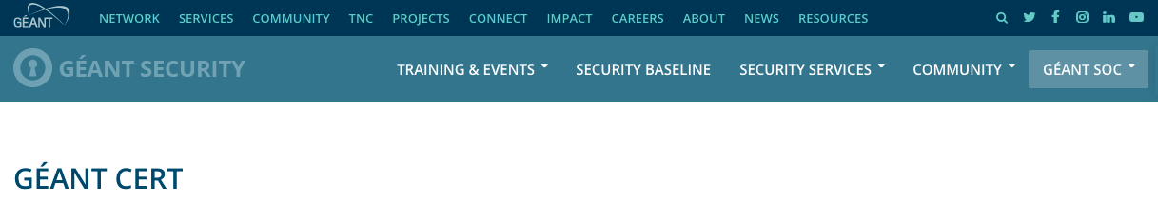
GEANT!

Slide 11
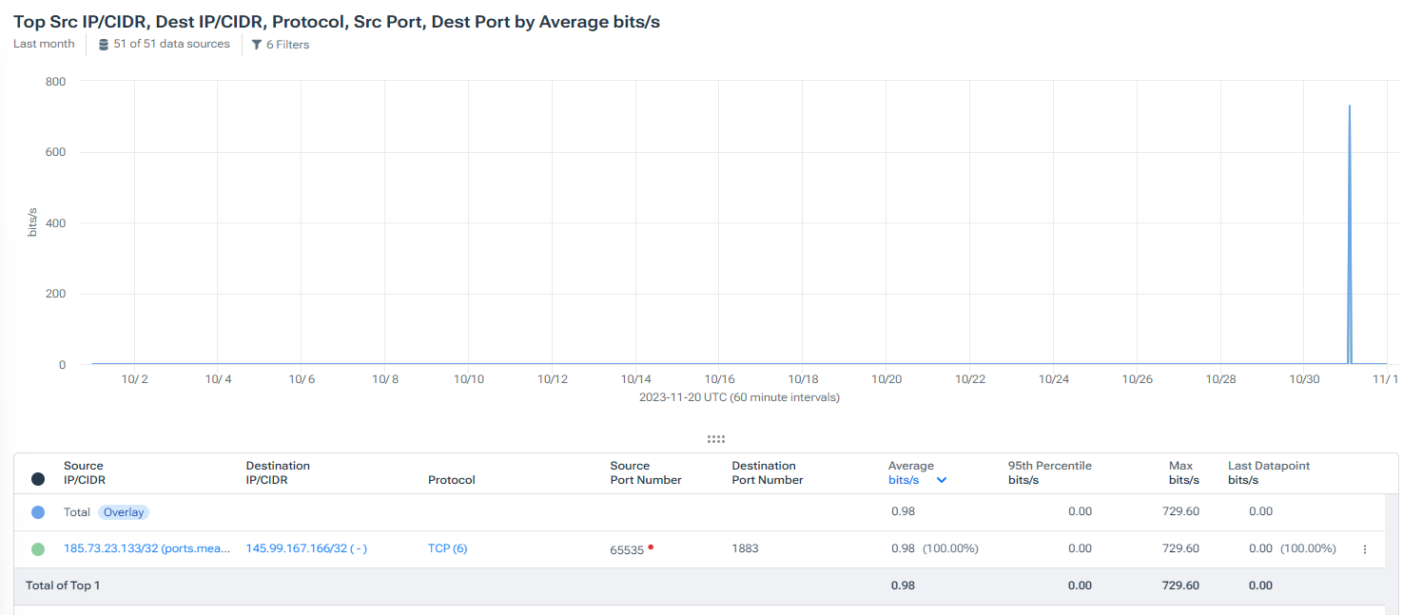
An answer: “all i can see is below”

Slide 12


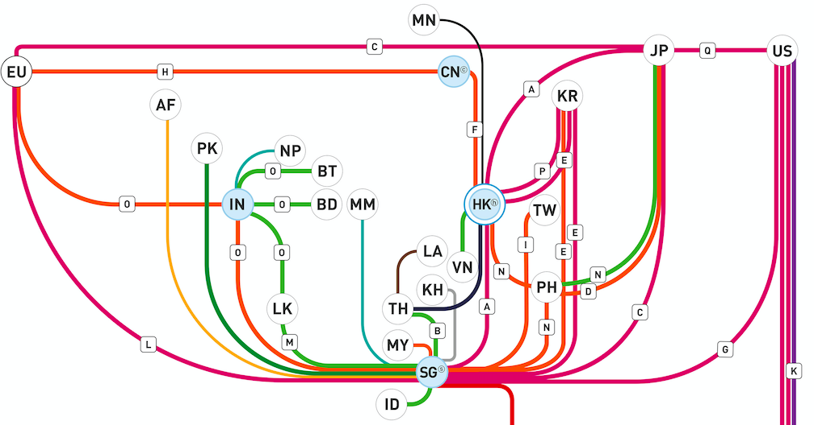
“Upon closer examination, we identified the spoofed traffic”

Slide 13
[SURFcert#114890] spoofed traffic? [TT#2023111834003766]
them
absence of a flow analysis system
anti-spoofing mechanisms like uRPF not recommended
us
thoughtful implementation of filters on inbound interfaces

Slide 14

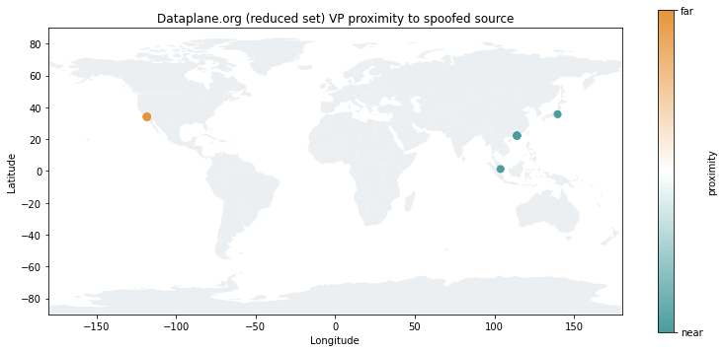
New developments
https://dataplane.substack.com/p/destination-adjacent-source-address

Slide 15
/var/named/log/verbose
16-Nov-2023 21:21:27.902 client @0x21f15d30 192.42.113.61#41640 (c02a713c-202311161.l.secshow.net): query: c02a713c-202311161.l.secshow.net IN A + (192.42.113.60)
19-Nov-2023 11:06:16.382 client @0x21f15d30 192.42.113.61#56993 (c02a713c-202311191.l.secshow.net): query: c02a713c-202311191.l.secshow.net IN A + (192.42.113.60)
……
28-Mar-2024 10:06:00.257 client @0x22b13530 192.42.113.61#54321 (0-c02a713c-202403261-100-query-timeout.l-time.secshow.net): query: 0-c02a713c-202403261-100-query-timeout.l-time.secshow.net IN A + (192.42.113.60)
29-Mar-2024 08:00:44.218 client @0x220b9d30 192.42.113.61#12345 (ahwel.c02a713c.0.d1201.savme.xyz): query: ahwel.c02a713c.0.d1201.savme.xyz IN A + (192.42.113.60)

Slide 16
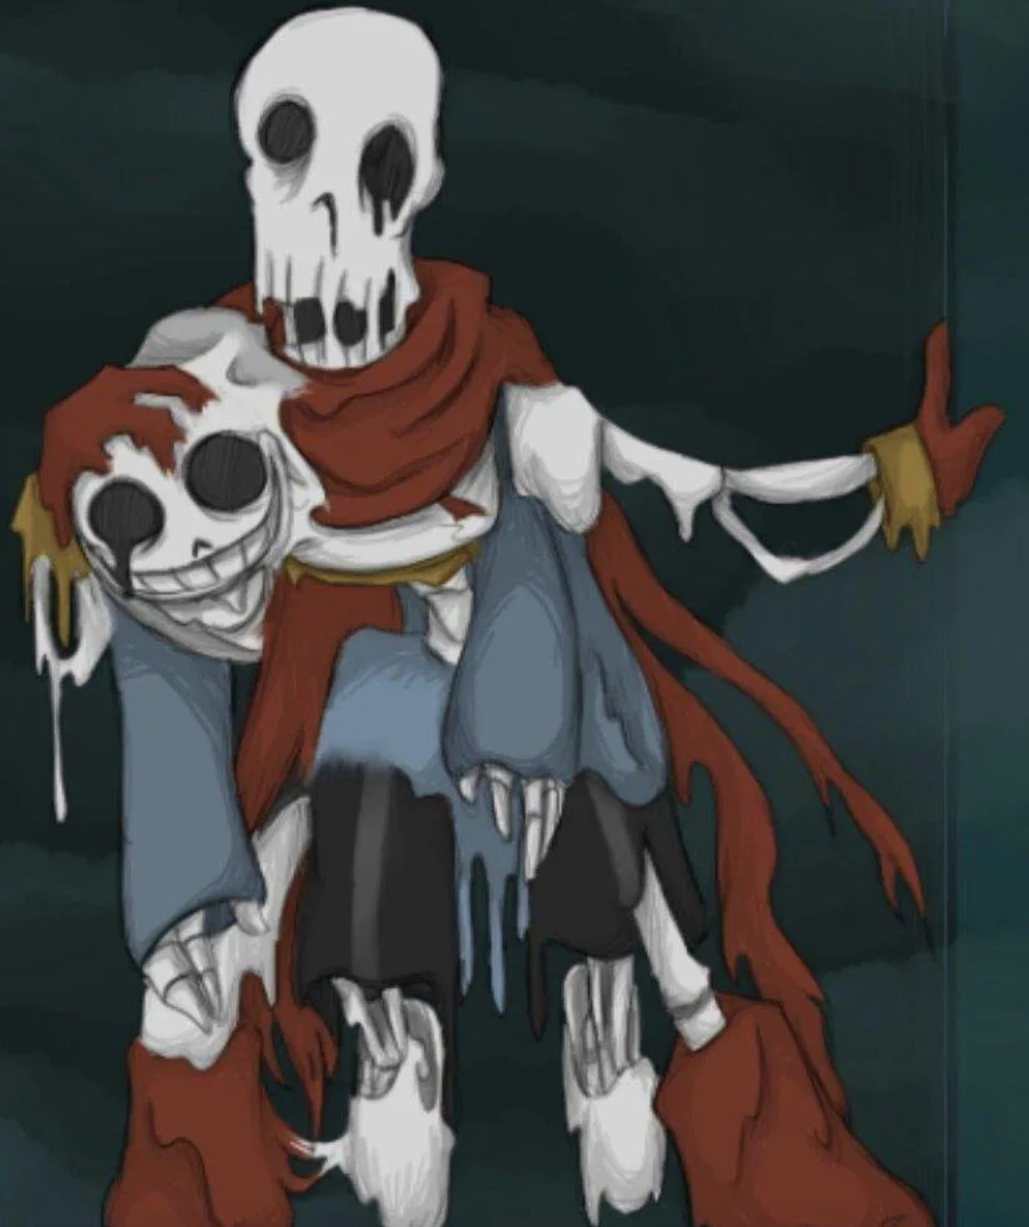
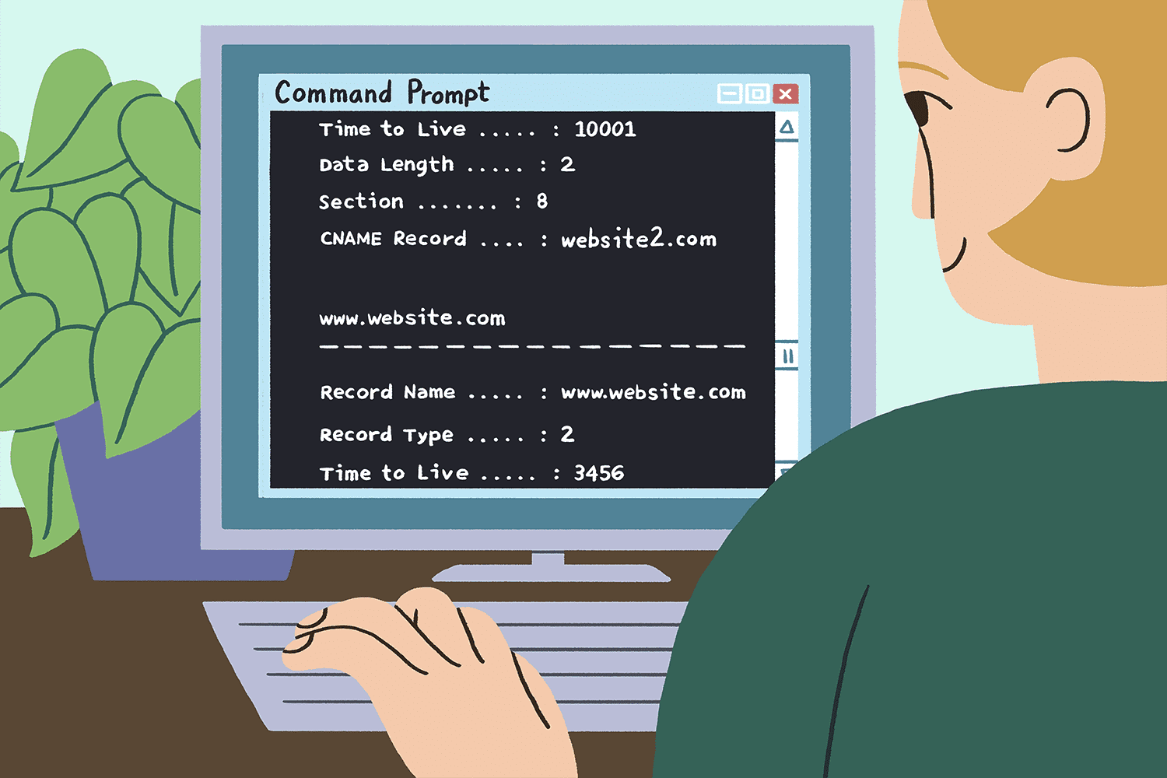

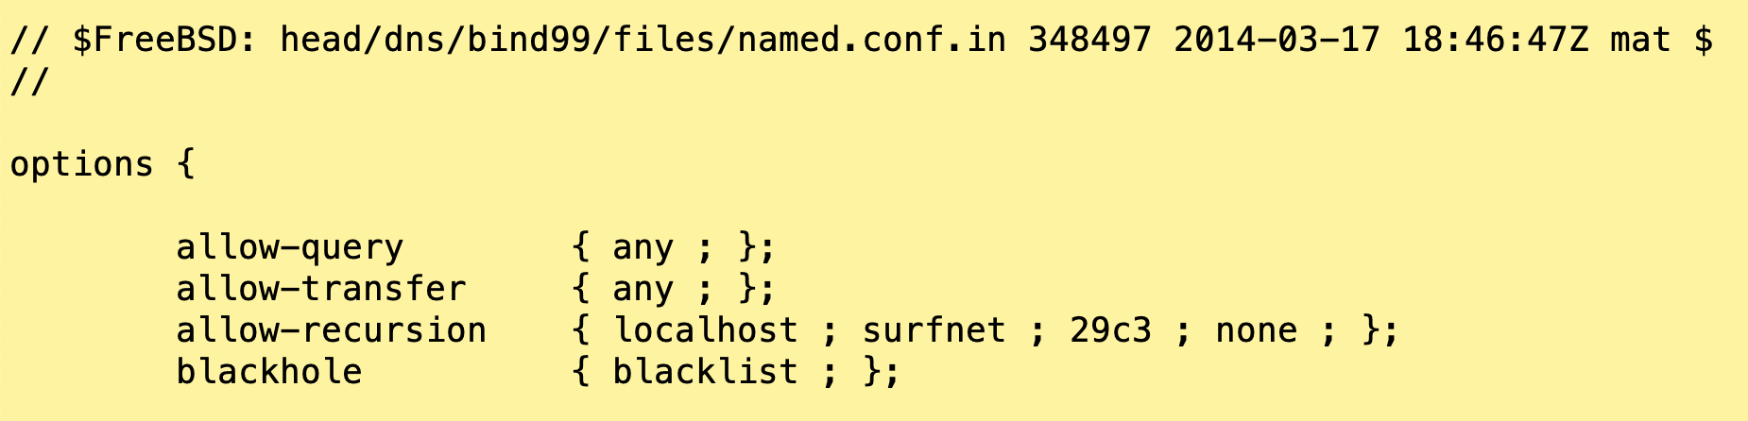


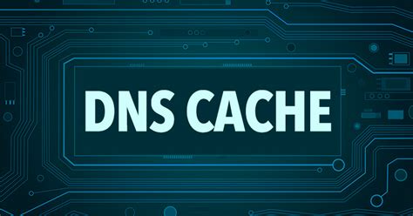


CTI?

Slide 17
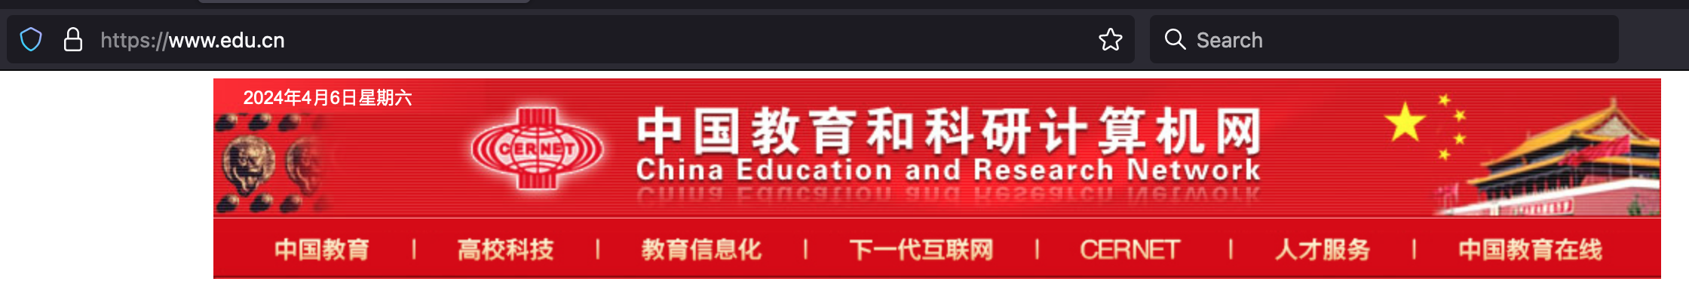
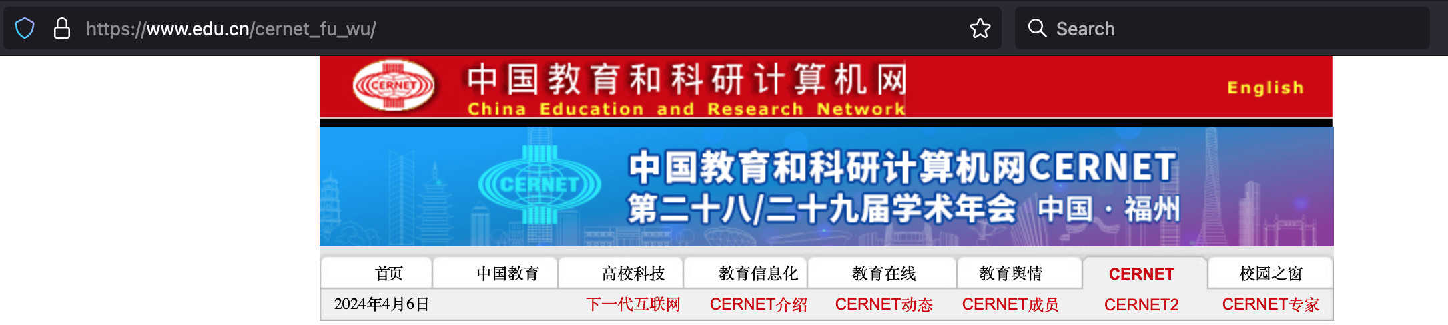
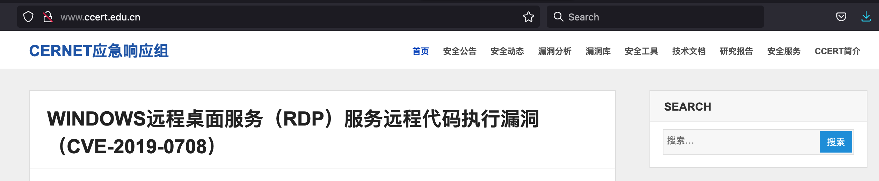
Public information

Slide 18
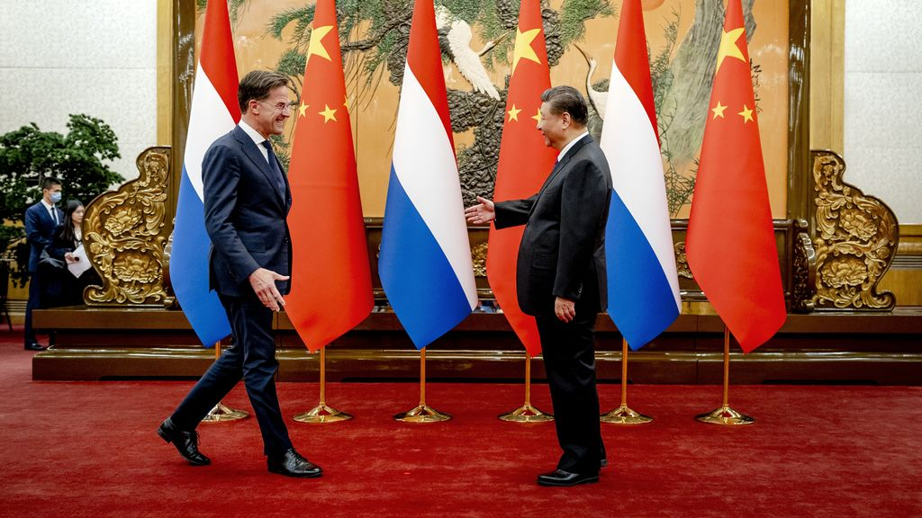
Next level?

Slide 19
Collaboration between different organisation levels
    Strategical
    Operational
    Tactical

Slide 20
Mind the gap
In cybersecurity often some disconnect between operational level/tech experts and boardroam (and layers in between)
If not in your NREN, you will probably see it in your constituency
Crisis(exercise) is often a trigger to bridge the gap (at least to some extend), and you can use this!
And work from organisation level to cross organisation coordination
The discussion on how the governance should work can take long (and often exceeds cybersecurity)
It is worth the effort!

Slide 21
An attempt to organise cross sector coordination at SURF
Strategic Coordination via Steering Committee (security & safety)
SURF
Security Team, SURFcert etc.
Branche organization
Branche organization
Branche organization
BR
BR
BR
BR
Board members
Board members
Board members
LP
LP
LP
IT directors universities
IT directors higher univs for applied sciences
IT directors vocational education
LP = linking pin cybersecurity
BR = executive board member representative
For cross sector crisis management we work on a similar structure

Slide 22
Collaboration between security services
    SURFfirewall
    SURF DNS
    SURFcert MISP

Slide 23
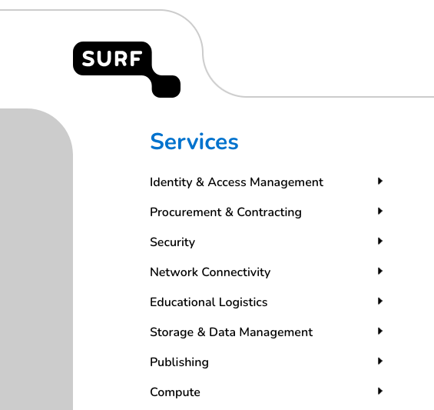
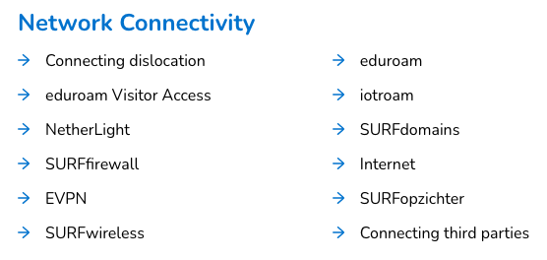
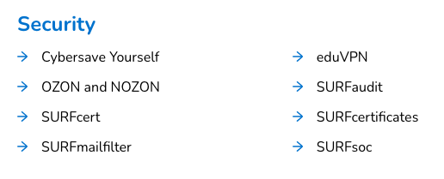
Our services

Slide 24

Ingredient declaration
Ingredients | 1/10/100 GE
Stable
redundant
Worldwide
Support
All-in
Security | Contains traces of security

Slide 25

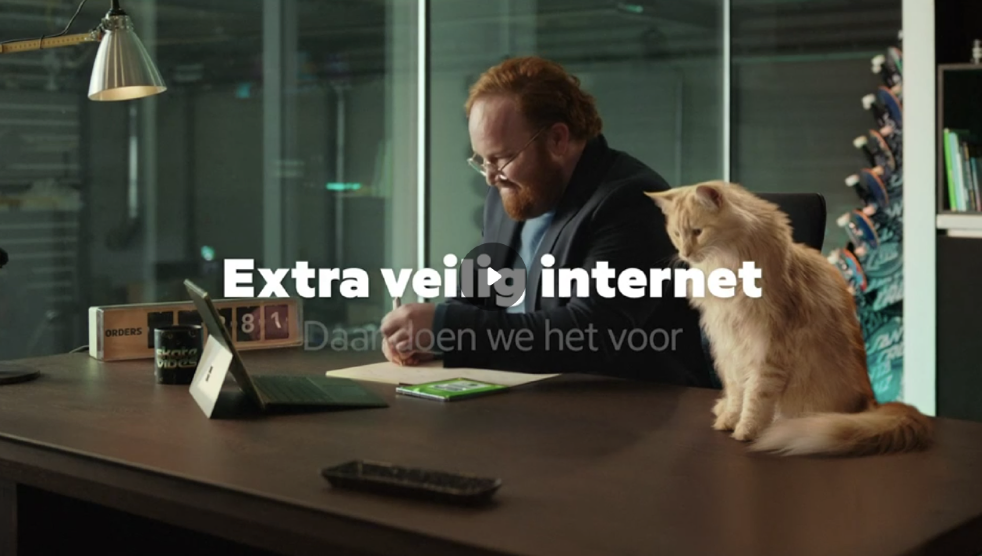
Keep it simple …

Slide 26
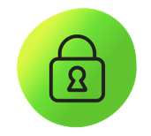


Components
 | Automatic protection | DDoS protection
 | DNS-filter | DNS-firewall
 | Webfilter | Hands-off SOC

Slide 27
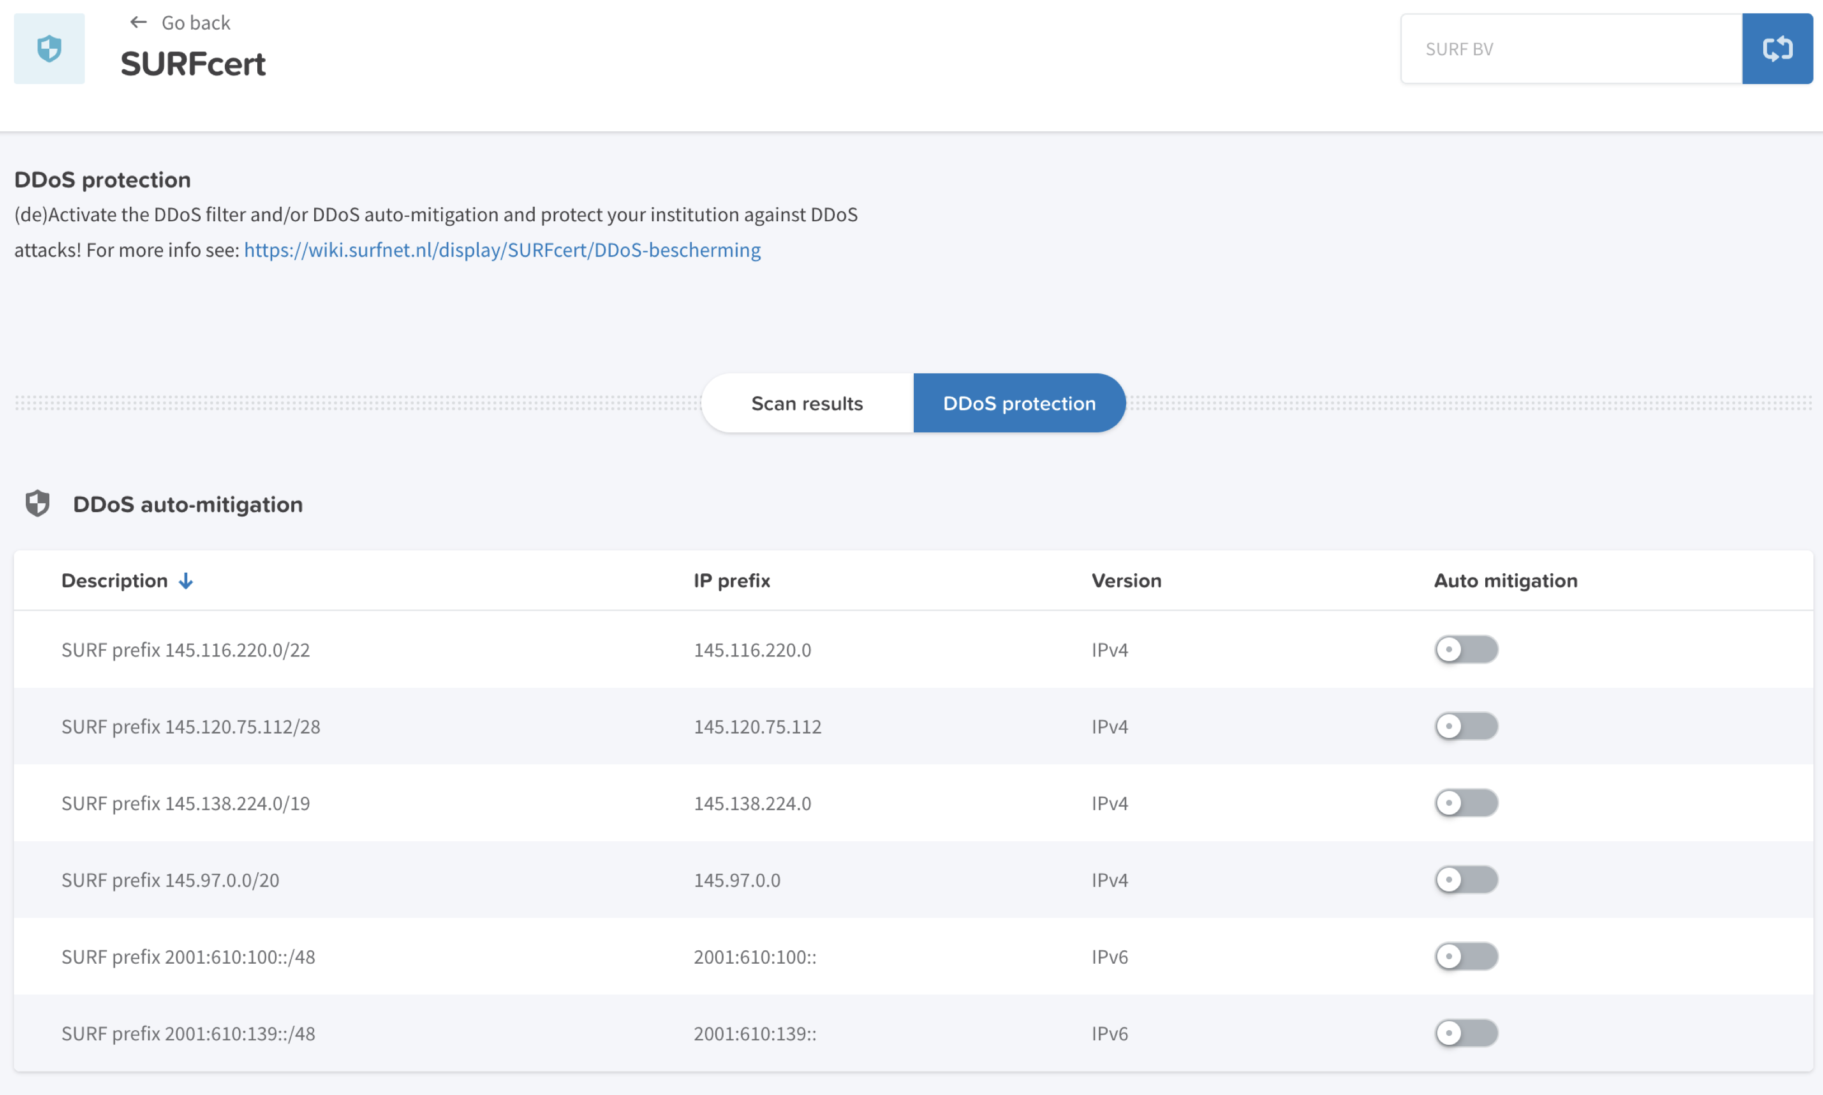
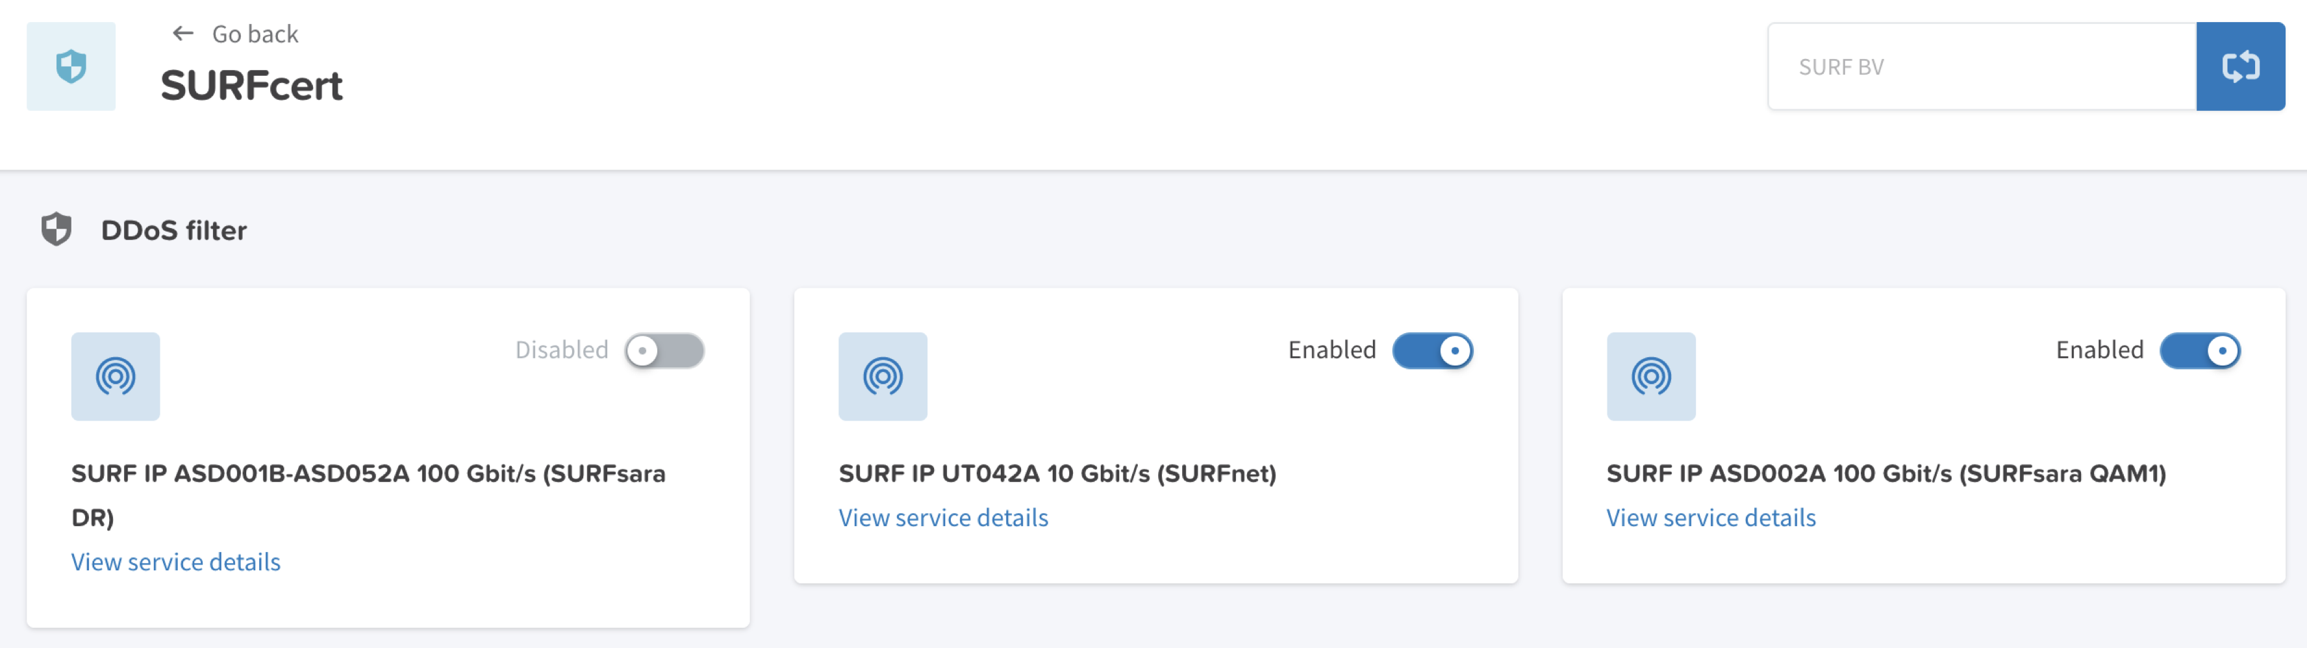
Automatic protection

Slide 28
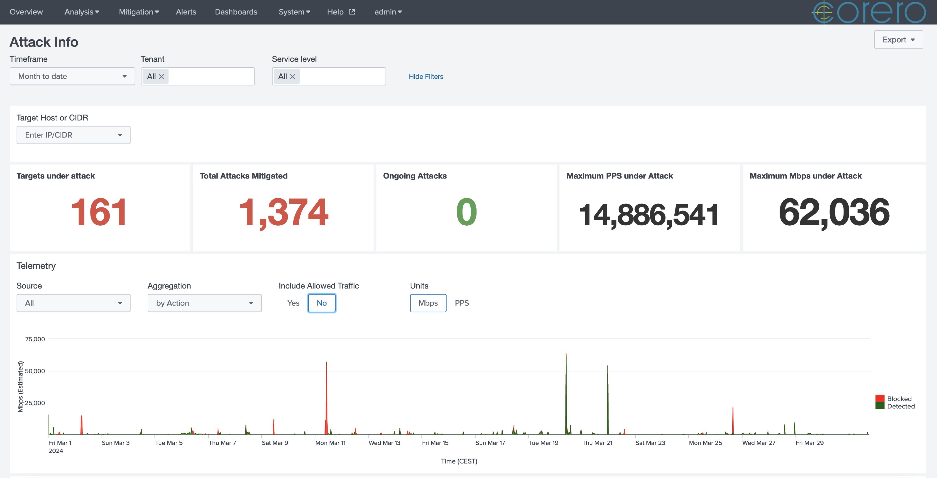
Sharing is caring (March, 2024)

Slide 29
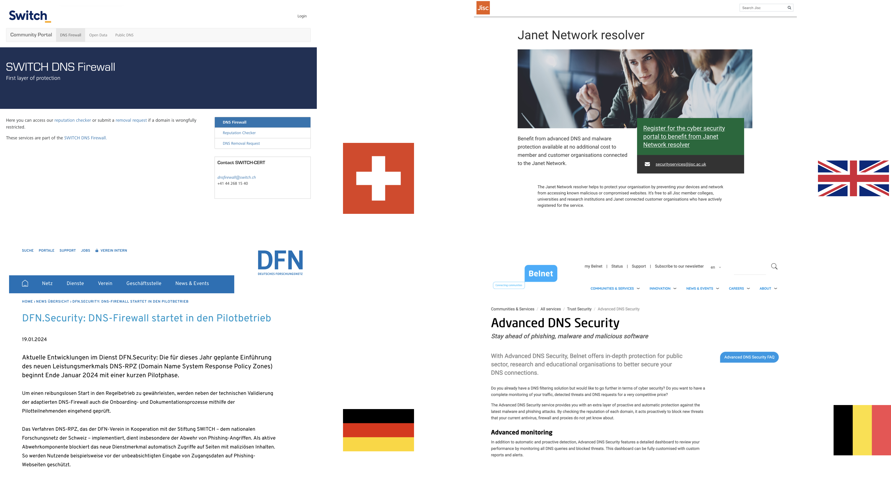
DNS firewall

Slide 30
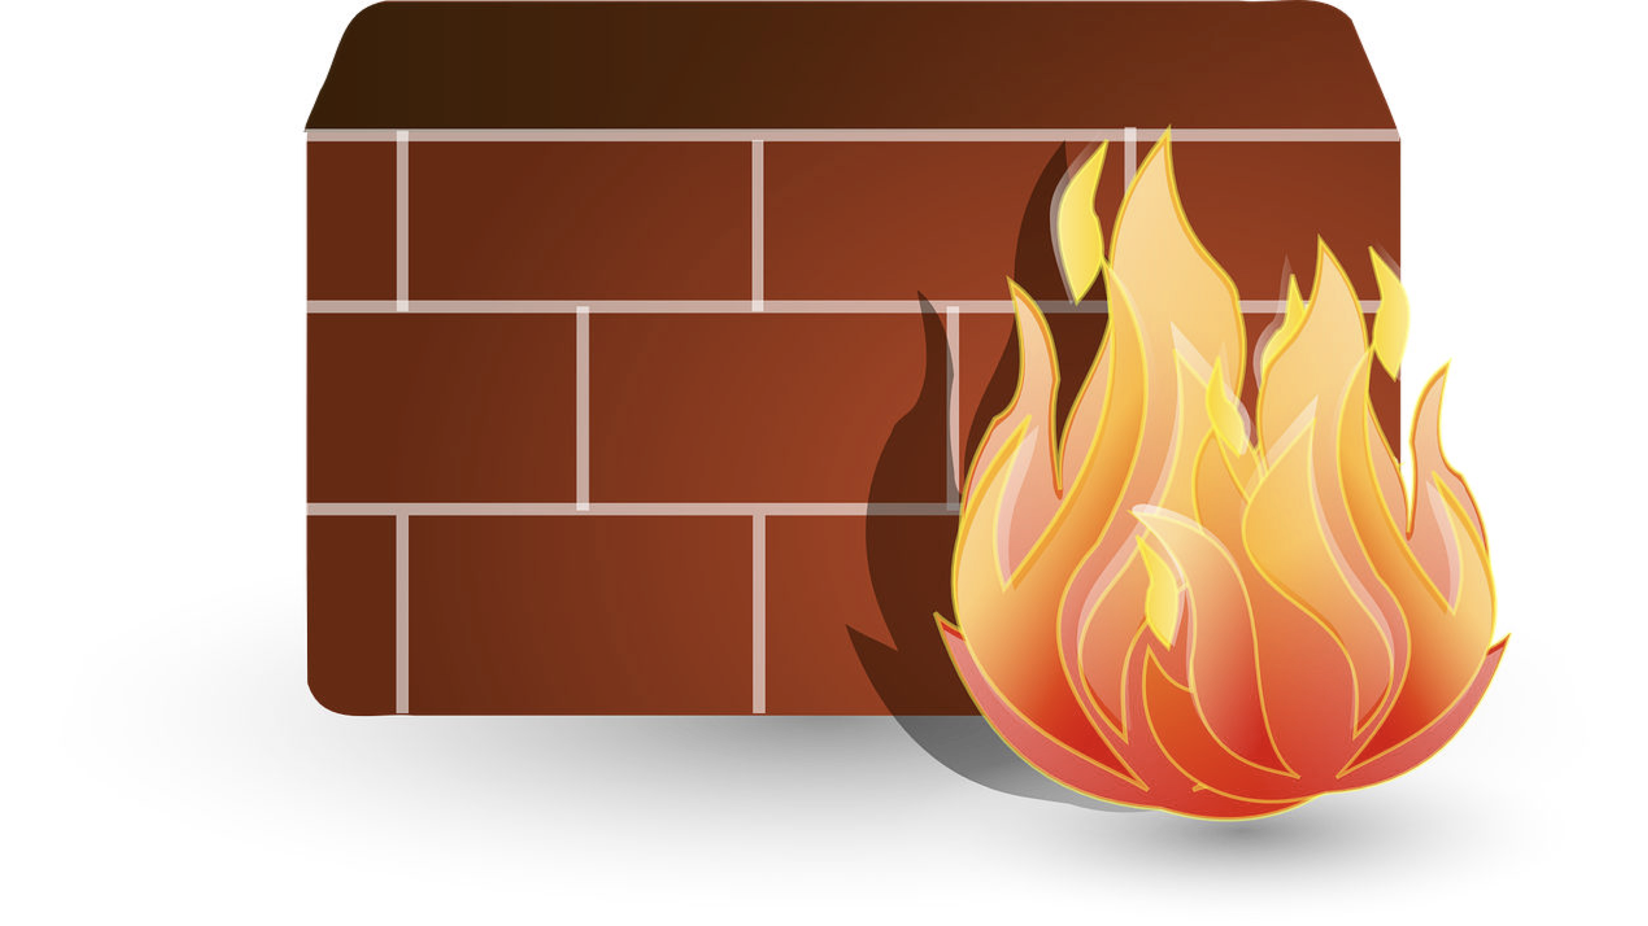
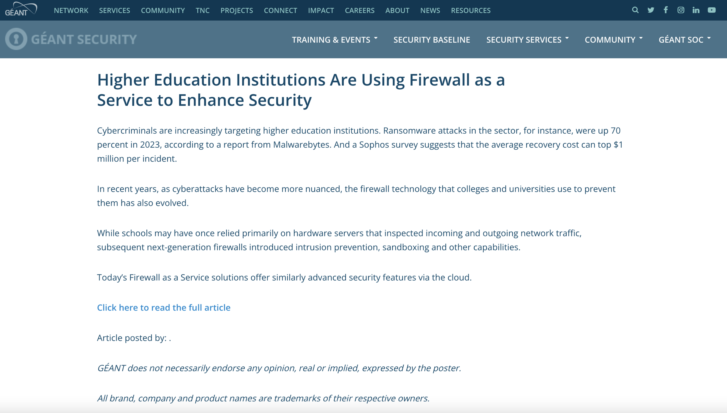

Firewall as a Service

Slide 31
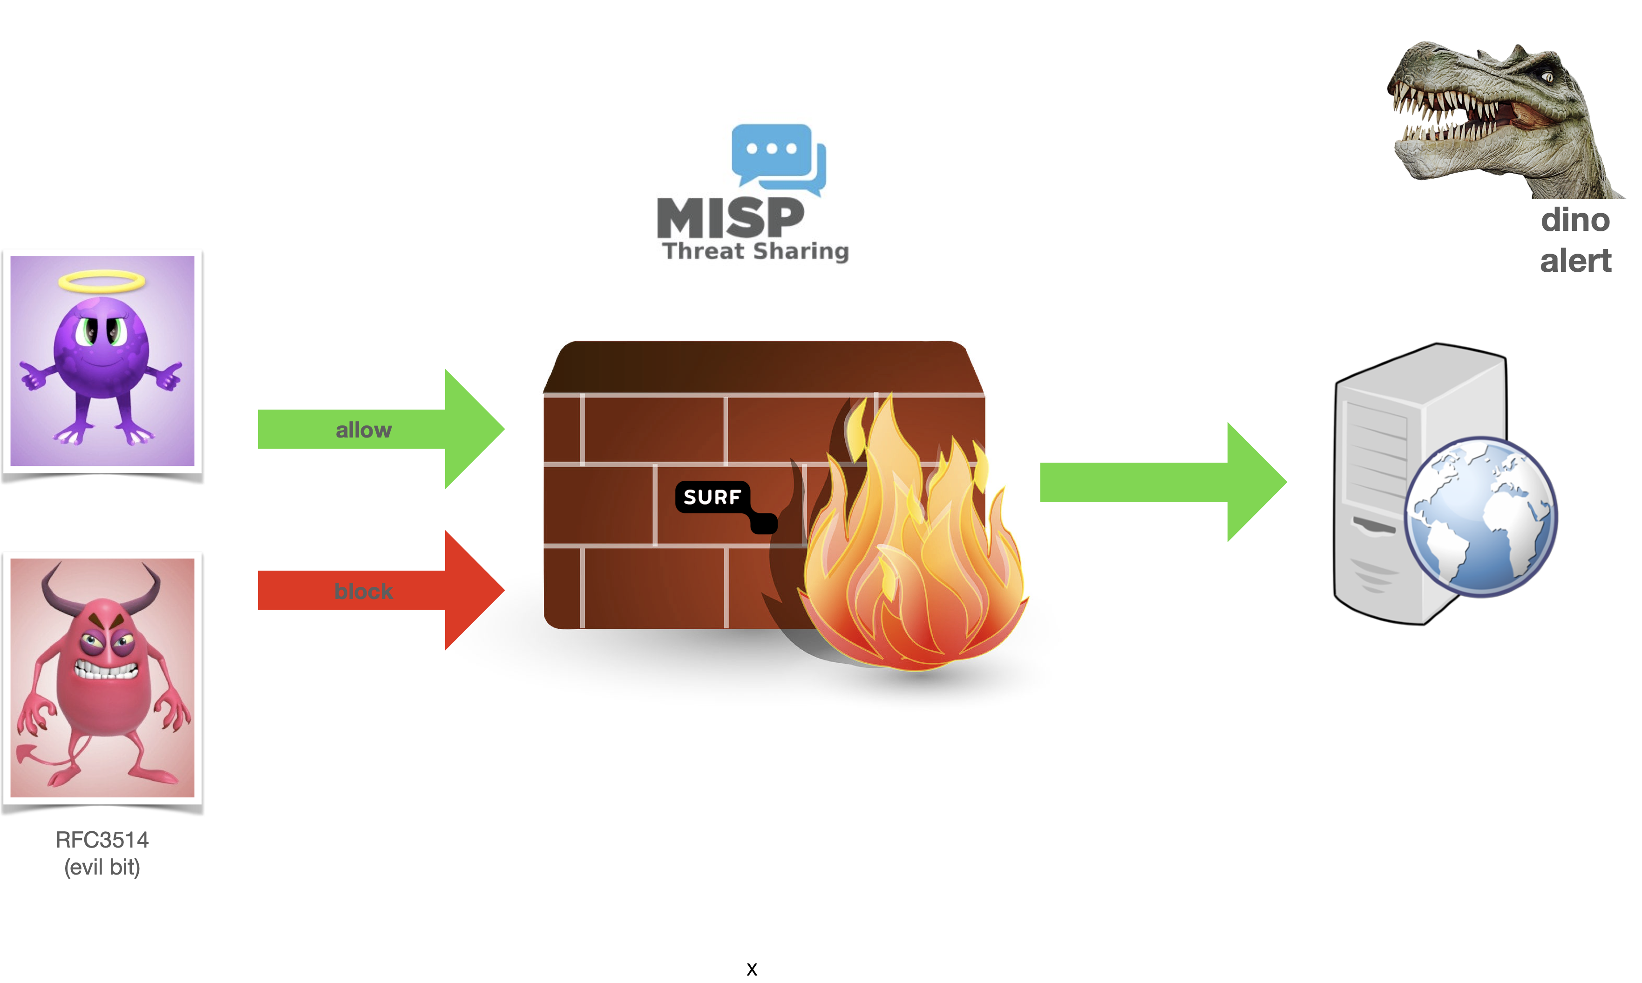
Offer additional protection

Slide 32
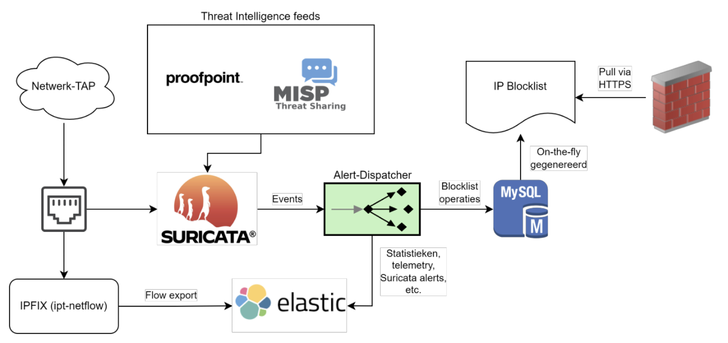
Idea: Hands-off SOC

Slide 33
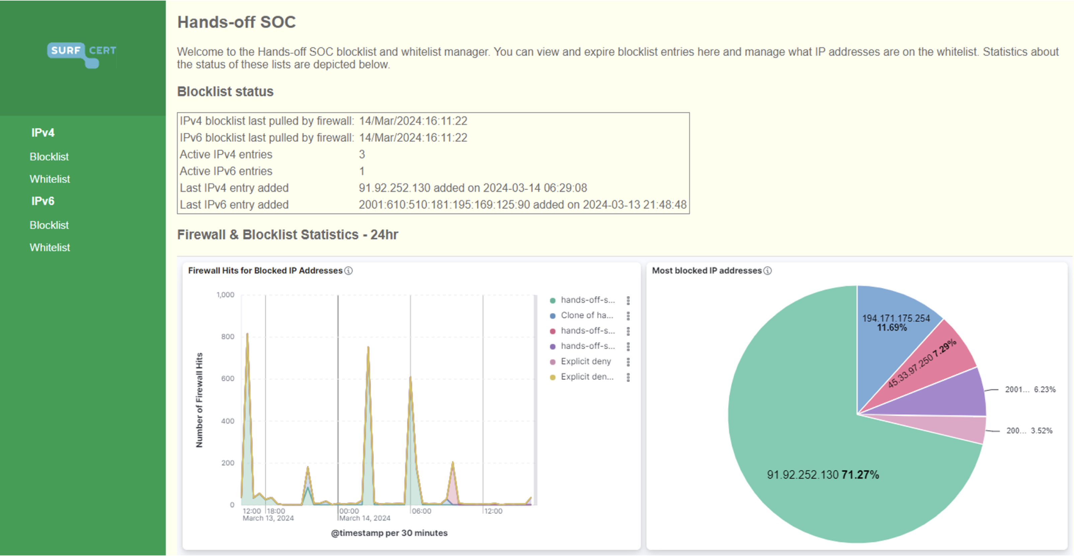
Pilot

Slide 34
Conclusions
    SURFfirewall
    SURF DNS
Collaboration on cybersecurity has a lot of angles and levels
You have to work on all of them to be successful, such as
  national and international collaboration between experts
  coordination in governance
  Integrated security services / secure services
Choose the right people for the job
  not everyone will be a tech expert
  not everyone likes organization politics
Bridge the gap
    Strategical
    Operational
    SURFcert MISP
    Tactical
    SURFcert
    GEANT
    SCIRT
Notes:
Did you know that you can use PowerPoint stock images? Go to Insert / Pictures.

Slide 35
Any questions?

