Slide 1
How We Knitted Our SOC
Brian Nisbet, Service Operations Manager
brian.nisbet@heanet.ie
11/04/2024

Slide 2
Photo by camilo jimenez on Unsplash
Notes:
All projects have an origin story!
Something, somewhere, happened! For HEAnet it was a client incidient
Irish Healthcare ransomware! Dinner table conversation across the country!

Slide 3
Photo by Jason Goodman on Unsplash
Notes:
We needed to do more and SOC & SIEM was at the top of all the wishlists
Previous contracts and financial concerns
Never waste a good crisis
Who doesn't love a good business case? So we wrote one!

Slide 4
Photo by Isaac Davis on Unsplash
Notes:
Much discovery in 2021 into 2022
Talked to NRENS (SURF! Jisc! GÉANT!)
Came back to build or buy, but build seemed like too much, getting the people, tools and licenses
Projects with dedicated PMs!
Engagement with professional firm to do feasibility study (we're still using some of their slides)
Feasibility study -> Business Case -> Securing Funding -> Dynamic Purchasing System -> Tender -> Procurement (Fox-IT!)
And we're done!

Slide 5
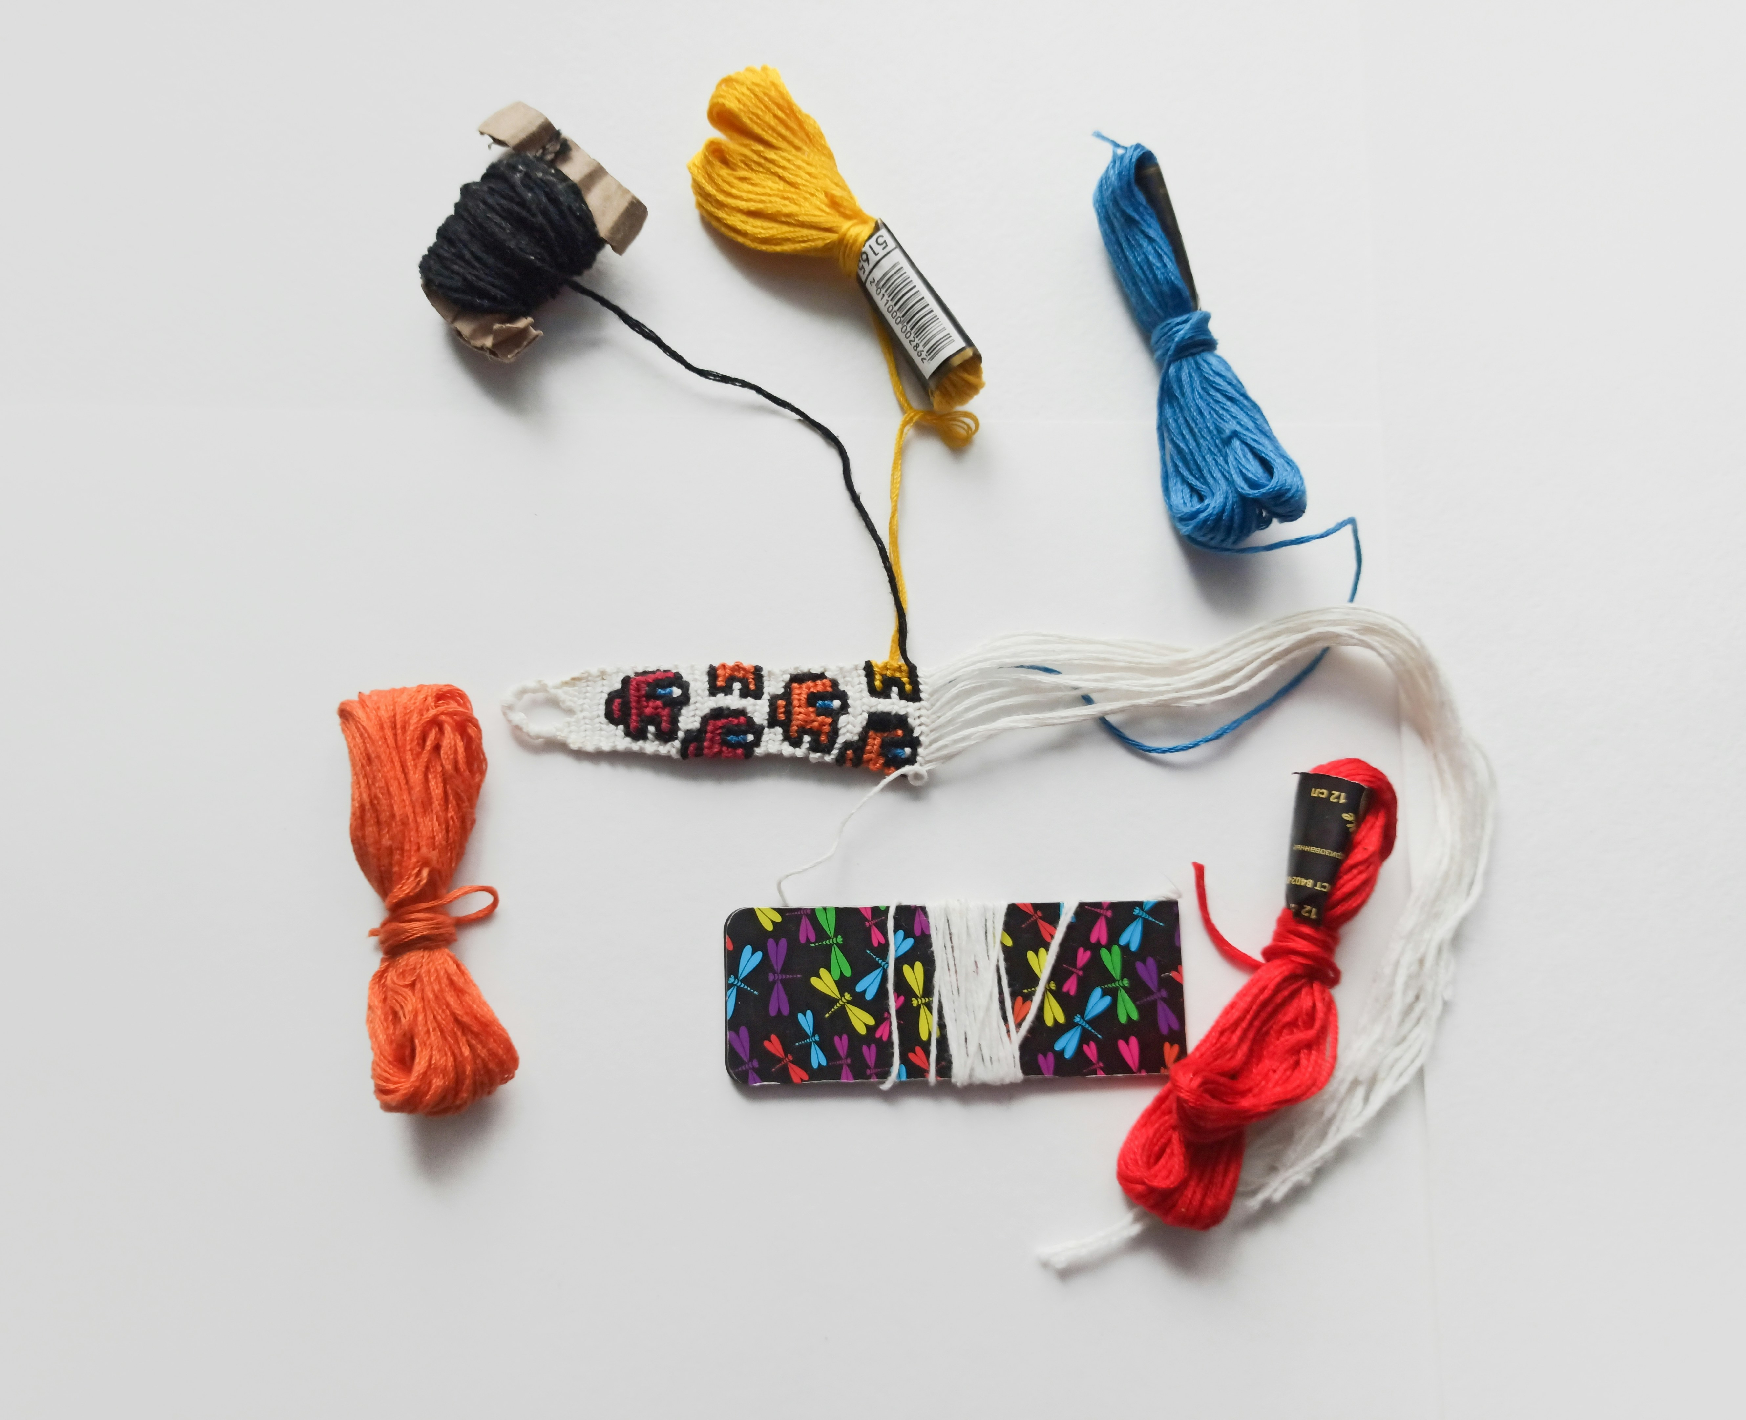
Photo by aisvri on Unsplash
Notes:
But really, that's not the most interesting part of the story!
To torture this joke, what we did was learn a lot, then make a pattern and choose some materials, and then persuaded people to pay experts to actually knit the whole thing.
So, what makes this "HEAnet's SOC"?

Slide 6
Photo by Joshua Hibbert on Unsplash
Notes:
Sectoral leadership
Sectoral centrality
Sending events from client devices and having them interpreted is the mechanical core of the service, but it misses so much
Pulling together lots of threads, financial, technical, administrative
We wanted to be able to join calls, being part of onboarding, answering technical questions, being a really active intermediary
Our end goal was to provide a service, but to be at the heart of it, to add to it

Slide 7
Photo by Vlad Hilitanu on Unsplash
Notes:
Late 2022 building a team at the same time as running the tender
Created the Security Operations Team with 2 members (initially!), focused on the SOC & SIEM service
Their job was to work with our clients and Fox-IT; to know what was going on; to advocate (internally & externally); to advise; to support and to build. The team was to be involved in every part of a client's onboarding journey, to learn from each one to be able to improve the next, to provide that continuous thread and to be at the centre.
Working with Fox-IT and our clients, additional IOCs, Netflow, service information, sharing
Full view of the Fox-IT portal and Splunk for all clients
If we see an IOC in one client, we can look to see if others have been affected, even if they aren't clients of the SOC & SIEM service!
Coordination with the Irish NCSC, with HEAnet's other teams, using our Netflow tools
Answering the question of what we can do when a client has an incident
We had always had security competence, but now we have dedicated people!

Slide 8
Photo by Laura Ohlman on Unsplash
Notes:
First client live in Q2 2023
What have we learned?
Hofstadter's Law: It always takes longer than you expect, even when you take into account Hofstadter's Law. Increased the estimated onboarding time from 12 -> 20 weeks
The significant amount of work on the client to deploy the solution - need to best prepare by providing technical instructions, allocation of project manager, and early engagement with third parties where there are dependencies
Engage 3rd party providers on project basis not just BAU on request
Ensure all required internal IT teams are brought in as early as possible so they are aware of the required work. Not brought in only when the project requires them ( no surprises )
Ensuring sponsorship from senior management - in order to get buy in from the different teams and different stakeholders within the organisation
Ensure internal discussion is had at high level as to how post project BAU alert response is to be managed. - 24/7 piece!
The variance in client speed of engagement - due to differences in capacity and capability - this means hard to predict timelines which poses challenges in managing the client onboarding pipeline and associated service costs (which kick in on go-live)
Importance in understanding where the service sits within the organisation’s security strategy (detection and response) and that it is not a silver bullet, we advocate for defence in depth approach etc.
The fact that other NRENs are amazing and helpful isn’t a new lesson, but it’s always good to call it out and to pay everything forward.

Slide 9
Photo by Nick Fewings on Unsplash
Notes:
Where do we go from here?
Millions of events are now being turned into reported and actionable cases in the mere hundreds, which is the hugest thing. And those events are looked at by dedicated SOC operatives and flagged with the appropriate severity level.
Aim is to have 25 onboarded or in the process of onboarding by the end of 2024. Looking at bringing the service to clients that don’t benefit from central funding.
Security Operations Team is now 6 people and next major project is setting up a formal CSIRT
We want to talk to other people! We want to learn and to be able to pass on the lessons we've learned, collaboration!

Slide 10
Thank you
brian.nisbet@heanet.ie

