Slide 1
Augmenting nfdump & nfsen with an analytical database creating a faster haystack
Remco Poortinga – van Wijnen (SURF)
remco.poortinga@surf.nl

Slide 2
Agenda
01
SURF network
02
nfdump/nfsen toolset & issue
04
processing setup
06
Other uses & examples
03
possible solutions
05
impressive numbers
07
conclusions

Slide 3
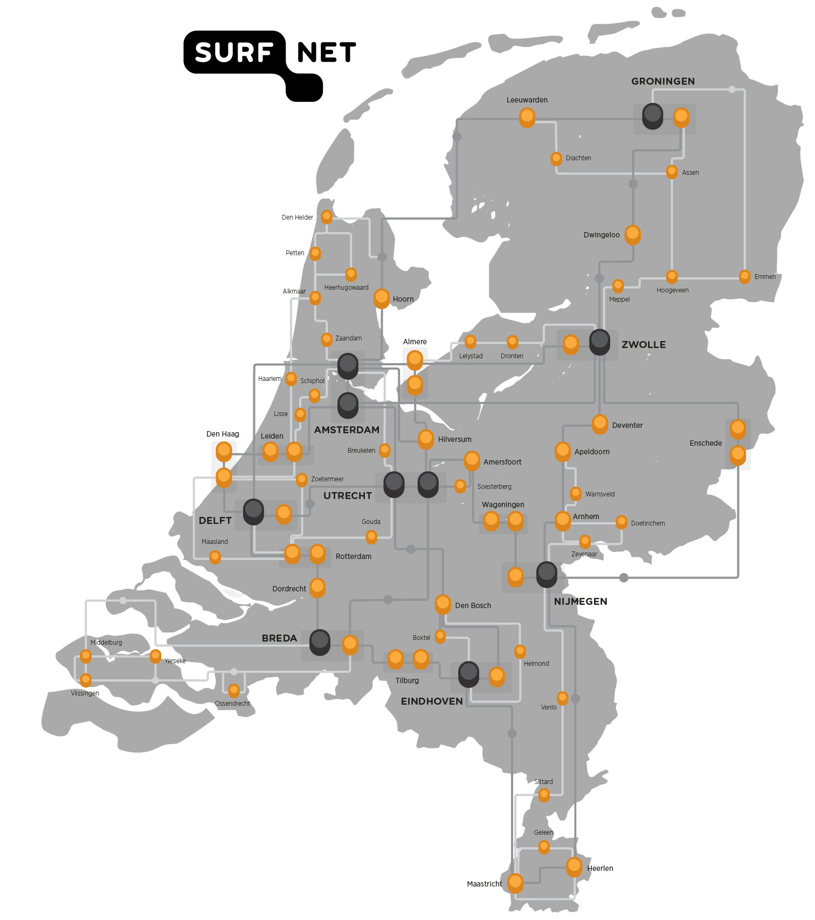
The SURF network
Points-of-Presence (PoP) in data centers of Universities, Applied Universities, Vocational Colleges, Research Institutes throughout the Netherlands
~ 12,000 km fibre cables
~ 460 routers
~ 1,5 million end users
Netflow 1/100 sampling
2..4 billion flows/day
> 80.000 flows/s peak
Mondays 12:00 – 12:05
3

Slide 4
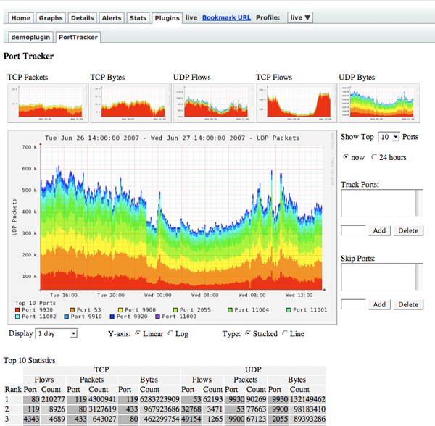
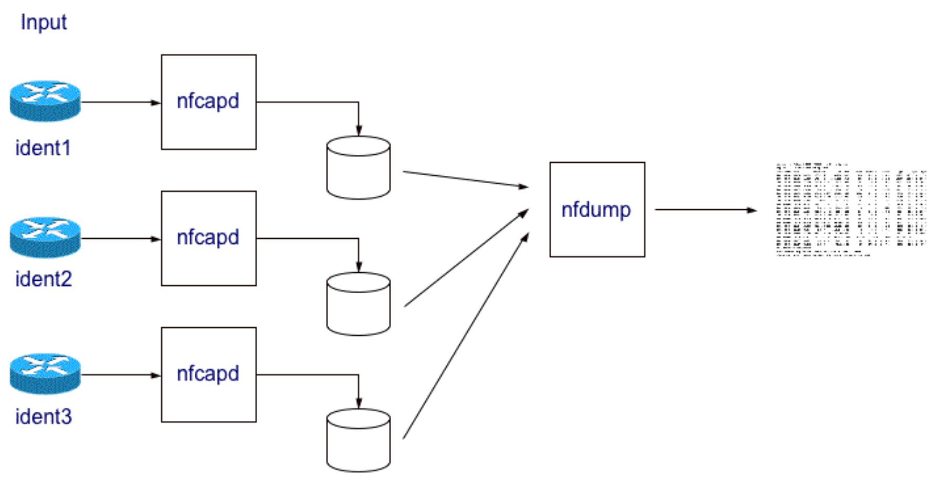
nfdump/nfsen toolset
Works really well for analysis
If you know where & (especially) when to look
Determining that can be really slow and cumbersome
4

Slide 5
Possible solutions
MySQL (2009)
Hadoop+spark (2018)
ClickHouse
Transactional database not developed for large data analytics. Much slower.
Faster for timeframes over 3.5 hours, slower for shorter ones. Complex/specialized.
Column oriented analytical database. Goldilocks ‘biggish data’ solution.
5

Slide 6
The processing setup
service
nfsen
nfdump2clickhouse⁽*⁾
clickhouse
directory
watches
processes
CSV
Parquet
CSV
Parquet
Clickhouse DB
CSV
Parquet
⁽*⁾ https://github.com/poorting/nfdump2clickhouse
6

Slide 7
Clickhouse flows table
flows | description | type
ts | Start time of the flow | DateTime
te | End time of the flow | DateTime
sa | Source IP address | String
da | Destination IP address | String
sp | Source port | UInt16
dp | Destination port | UInt16
pr | Protocol (e.g. ‘TCP’ or ‘UDP’) | String
flg | Flags (if pr is ‘TCP’) | String
ipkt | Number of packets in this flow | UInt64
ibyt | Number of bytes in this flow | UInt64
smk | Source mask | UInt8
dmk | Destination mask | UInt8
ra | Router (IP) Address | String
in | Input interface number | UInt16
out | Output interface number | UInt16
sas | Source AS number | UInt16
das | Destination AS number | UInt16
exid | Exported id | UInt16
flowsrc | Additional label for this source | String
nfdump2clickhouse
(service)
netflow
7

Slide 8
So how fast is this thing anyway?
timeframe | # of flows
5 minutes | 23 million
30 minutes | 136 million
1 hour | 268 million
3.5 hours | 997 million
7 hours | 1.16 billion
1 week | 23 billion
1 month | 95 billion
Comparing clickhouse to nfdump
Searches:
specific destination IP address
specific destination IP address + port
specific destination IP range + port excluding IP range from results
Searches executed on the same machine
24/48 core AMD EPYC 7443P Processor
128 GB of memory
2x7 TB of storage
8

Slide 9
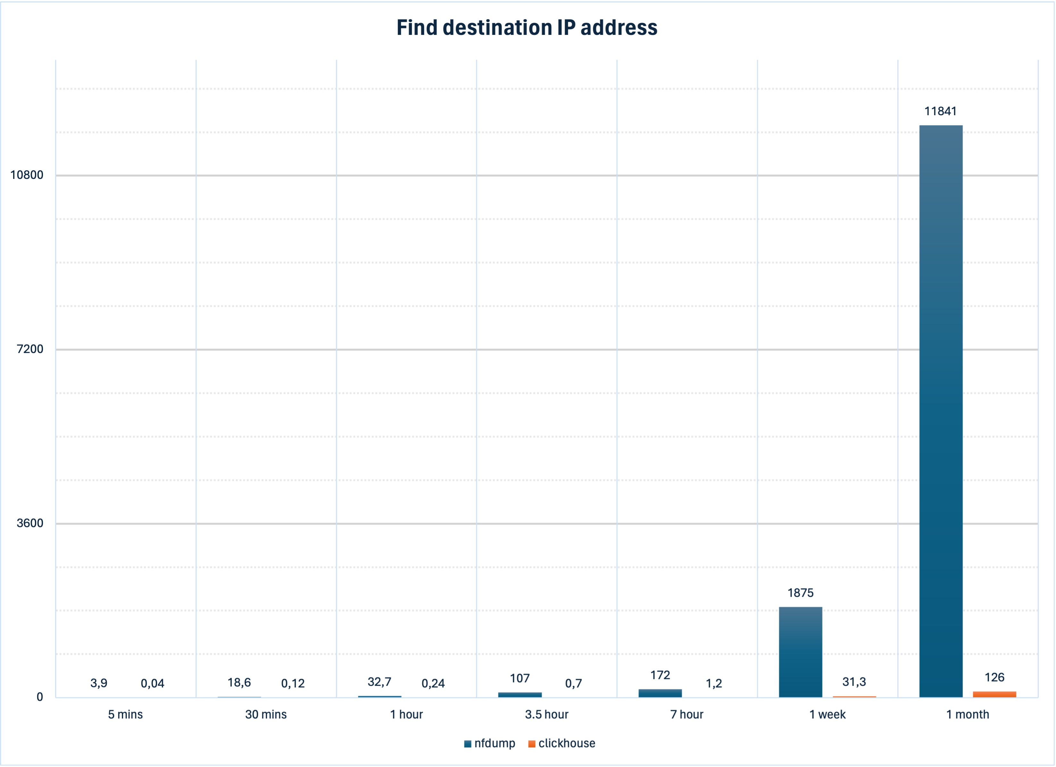
~ 3:15 hours
~ 30 minutes
9

Slide 10
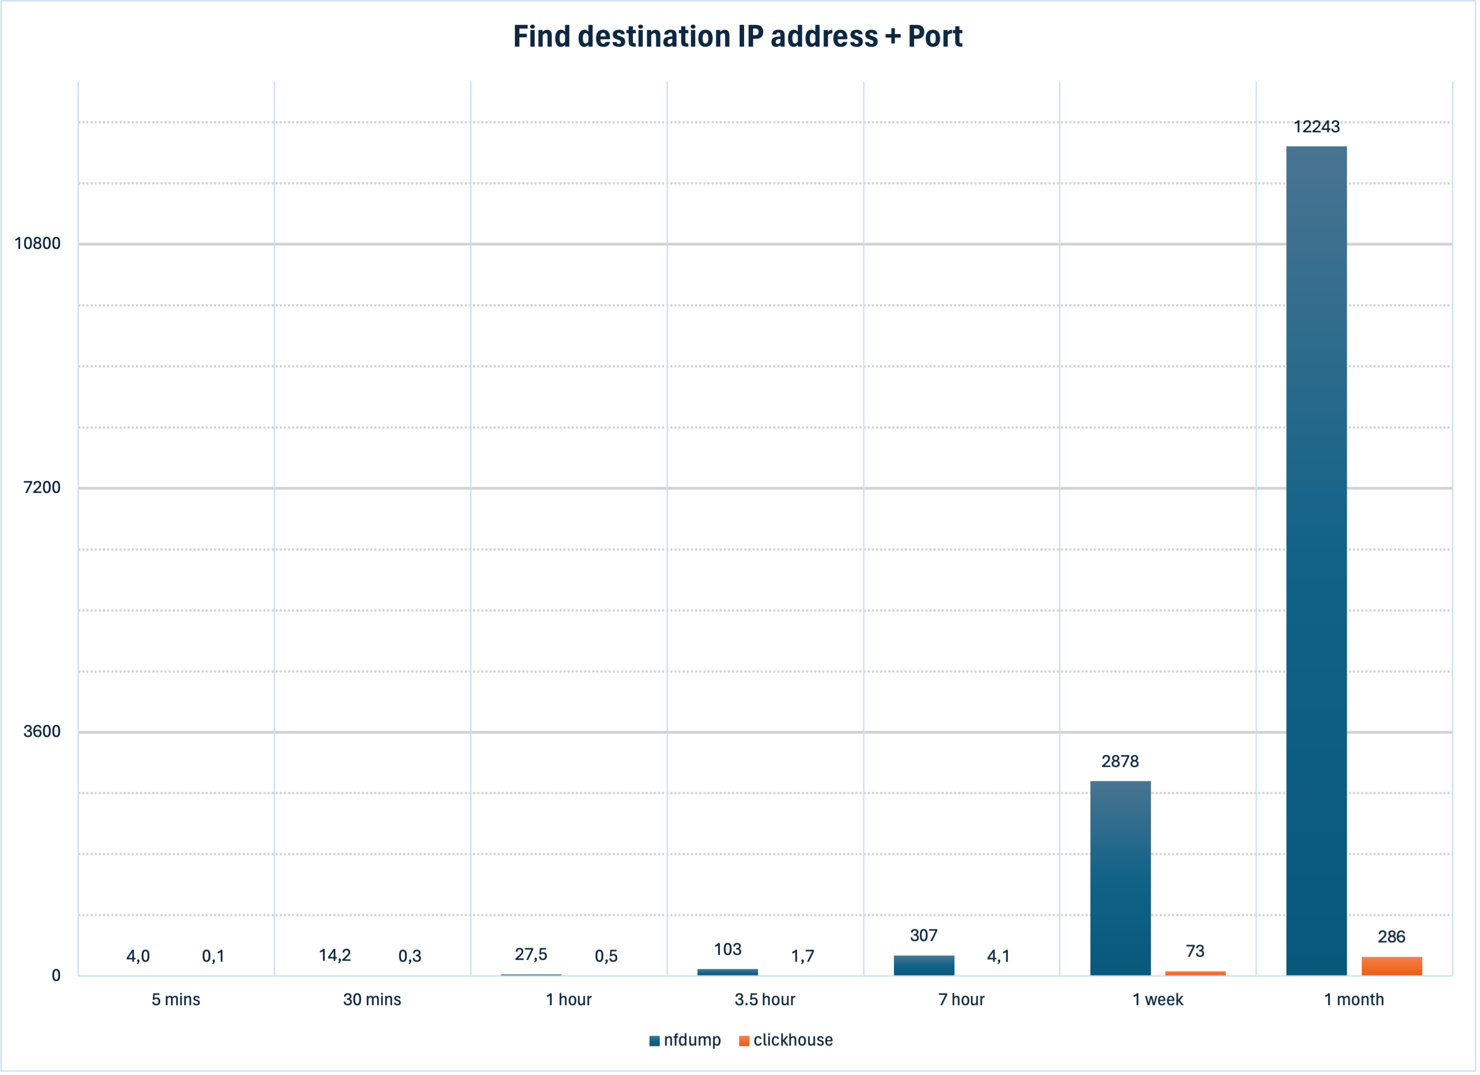
~ 3:24 hours
~ 48 minutes
10

Slide 11
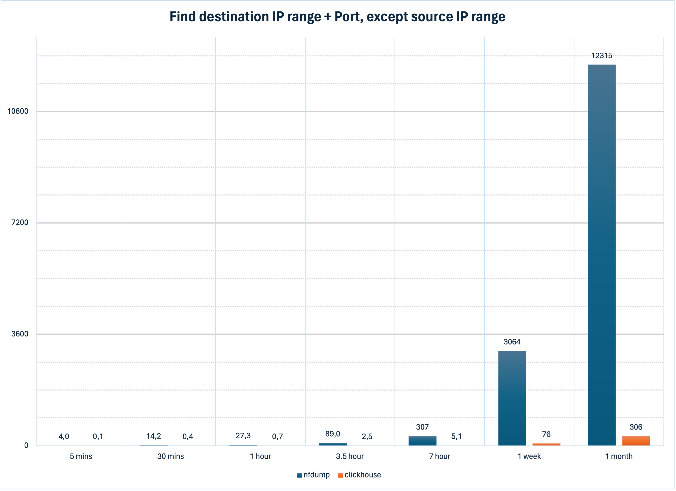
~ 3:25 hours
~ 51 minutes
11

Slide 12
But wait…
flows | description | type
ts | Start time of the flow | DateTime
te | End time of the flow | DateTime
sa | Source IP address | String
da | Destination IP address | String
sp | Source port | UInt16
dp | Destination port | UInt16
pr | Protocol (e.g. ‘TCP’ or ‘UDP’) | String
flg | Flags (if pr is ‘TCP’) | String
ipkt | Number of packets in this flow | UInt64
ibyt | Number of bytes in this flow | UInt64
smk | Source mask | UInt8
dmk | Destination mask | UInt8
ra | Router (IP) Address | String
in | Input interface number | UInt16
out | Output interface number | UInt16
sas | Source AS number | UInt16
das | Destination AS number | UInt16
exid | Exported id | UInt16
flowsrc | Additional label for this source | String
Finding IP addresses is all well and good,
but we deal with institutions
It would be nice to link an IP address to an institution directly
Just create a table with all prefixes of our network
Luckily there’s an API for that! ☺
nfdump2clickhouse
(service)
netflow
prefixes | description | type
prefix | Network prefix | String
customer_id | Customer id | String
abbreviation | Abbreviation of the org | String
name | Name of the organisation | String
network dashboard
prefix2clickhouse
(crontab, daily)
12

Slide 13
A real-life use case
Wageningen University & Research (WUR) noticed a high number of failed authentications
200.000 attempts in 24 hours
15 attempts per account, then on to the next
Appeared to be from a very old account list
None succeeded
Coming from an IP address in China
Shared this info with SCIRT
SURF Community of Incident Response Teams
Does this IP address show up in combination with other institutions?
13

Slide 15
But wait…
flows | description | type
ts | Start time of the flow | DateTime
te | End time of the flow | DateTime
sa | Source IP address | String
da | Destination IP address | String
sp | Source port | UInt16
dp | Destination port | UInt16
pr | Protocol (e.g. ‘TCP’ or ‘UDP’) | String
flg | Flags (if pr is ‘TCP’) | String
ipkt | Number of packets in this flow | UInt64
ibyt | Number of bytes in this flow | UInt64
smk | Source mask | UInt8
dmk | Destination mask | UInt8
ra | Router (IP) Address | String
in | Input interface number | UInt16
out | Output interface number | UInt16
sas | Source AS number | UInt16
das | Destination AS number | UInt16
exid | Exported id | UInt16
flowsrc | Additional label for this source | String
nfdump2clickhouse
(service)
If we can find IPs (+ports) quickly
Why not use this to find IoCs?
Just create a table with known IoCs (IP+port)
Luckily there’s an API for that! ☺
Search for IoCs by comparing flows with IoCs
Or use materialized views!
store results of a query in a table
updated automatically when underlying data changes
netflow
prefixes | description | type
prefix | Network prefix | String
customer_id | Customer id | String
abbreviation | Abbreviation of the org | String
name | Name of the organisation | String
network dashboard
prefix2clickhouse
(crontab, daily)
iocs | description | type
pub_ts | MISP publication time | DateTime
uuid | IoC attribute uuid | String
event_uuid | Event uuid | String
event_id | Event id in the source MISP | UInt32
threatlevel | Threat level | UInt8
ip | IP Address of IoC | String
port | Port of IoC | UInt16
info | Info on this IoC | String
misp2clickhouse
(crontab, hourly)
15

Slide 16
Clickhouse tables
flows | description | type
ts | Start time of the flow | DateTime
te | End time of the flow | DateTime
sa | Source IP address | String
da | Destination IP address | String
sp | Source port | UInt16
dp | Destination port | UInt16
pr | Protocol (e.g. ‘TCP’ or ‘UDP’) | String
flg | Flags (if pr is ‘TCP’) | String
ipkt | Number of packets in this flow | UInt64
ibyt | Number of bytes in this flow | UInt64
smk | Source mask | UInt8
dmk | Destination mask | UInt8
ra | Router (IP) Address | String
in | Input interface number | UInt16
out | Output interface number | UInt16
sas | Source AS number | UInt16
das | Destination AS number | UInt16
exid | Exported id | UInt16
flowsrc | Additional label for this source | String
ioc_hits
source_ip | Source IP address of sighting | String
destination_ip | IoC IP Address | String
dp | IoC port | UInt16
pkt | Number of packets | UInt64
byt | Number of bytes | UInt64
reverse | Forward (0) or reverse (1) | UInt8
event_uuid | MISP event uuid | String
id | MISP event id | UInt32
attr_uuid | IoC attribute uuid | String
ts | Start time of flow | DateTime
te | End time of flow | DateTime
info | Info on this IoC | String
nfdump2clickhouse
materialized view
ch_ioc_scan
(service)
(crontab, 5mins)
netflow
iocs | description | type
pub_ts | MISP publication time | DateTime
uuid | IoC attribute uuid | String
event_uuid | Event uuid | String
event_id | Event id in the source MISP | UInt32
threatlevel | Threat level | UInt8
ip | IP Address of IoC | String
port | Port of IoC | UInt16
info | Info on this IoC | String
materialized view
misp2clickhouse
ioc_stats
date | Date of this statistic | Date
event_uuid | MISP event uuid | String
id | MISP event id | UInt32
info | Info on the event | String
hits | # of hits seen on this date | UInt32
pkt | Total # of packets | UInt64
byt | Total # of bytes | UInt64
(crontab, hourly)
prefixes | description | type
prefix | Network prefix | String
customer_id | Customer id | String
abbreviation | Abbreviation of the org | String
name | Name of the organisation | String
network dashboard
prefix2clickhouse
(crontab, daily)
16

Slide 17
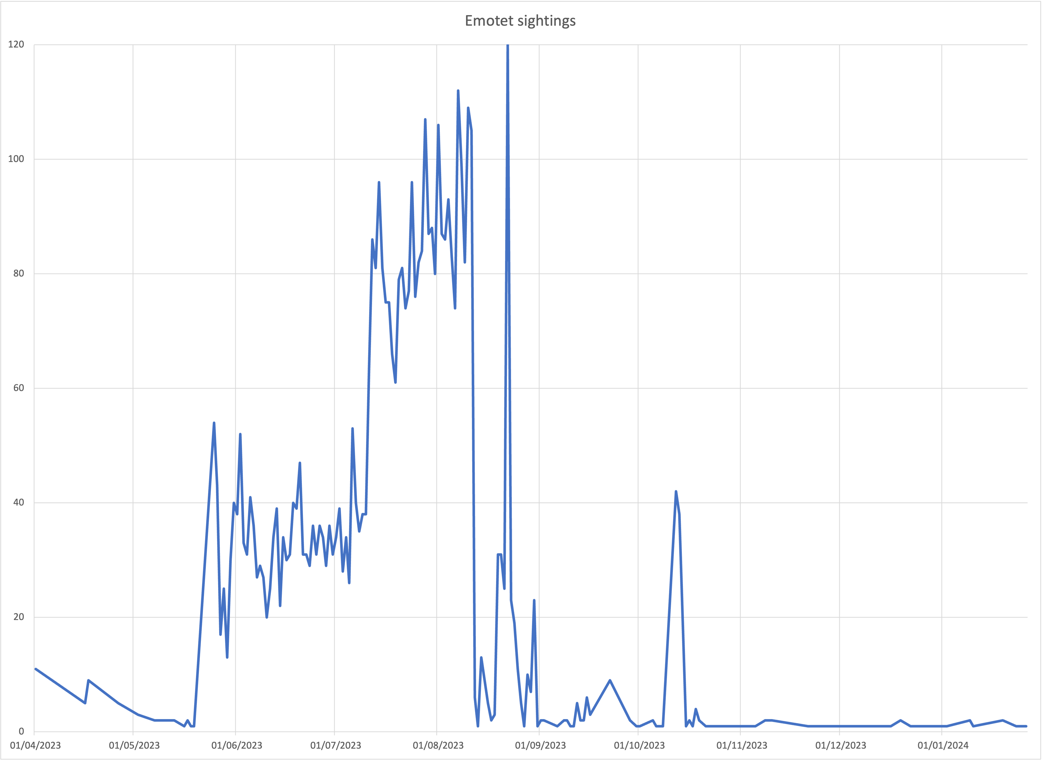
Column 2x + Image #2
Statistics
IoC hits of the same event aggregated by date
Such as Emotet sightings on the SURF network
Looks like a lot, but…
Allmost all are TOR exit nodes,
or machines that are scanning
This specific IoC is 3 years old…
17

Slide 18
Column 2x + Image #2
Lies, damned lies, and statistics
IoC hits of the same event aggregated by date
Such as Emotet sightings on the SURF network
Looks like a lot, but…
Allmost all are TOR exit nodes,
or machines that are scanning
This specific IoC is 3 years old…
18

Slide 19
Conclusions
Questions ?
Clickhouse solves main downside of nfsen/nfdump
Determining where & when to look, fast!
Speed enables interactive data analysis
Also useful for those ‘hmm… that’s odd?’ questions
Automated watches with materialized views
for (curated!) IoC feeds
other queries and statistics
If you have a new hammer, you keep discovering nails
Easy to explain and (fun to) use⁽*⁾
⁽*⁾ for the somewhat technically inclined person
19

Slide 20
Some earlier work
Bachelor thesis in 2009
Performance measurement of nfdump and MySQL
MySQL much slower than nfdump
Student assignment in 2018
‘big data’ approach seemed most promising
Faster queries for longer timeframe (> 3 hours)
Slower for shorter timeframes
lower limit on query execution ~ 3 minutes
complex setup, specialised knowledge
https://www.utwente.nl/en/eemcs/dacs/assignments/completed/bachelor/reports/2009-Hofstede.pdf https://rp.os3.nl/2017-2018/p83/report.pdf https://rp.os3.nl/2017-2018/p83/presentation.pdf
20

Slide 21
Column 2x + Image #2
2018 - now
analytical sqlite
Hype phase of Big Data behind us
Most big data … just isn’t
but still too big for ‘normal’ tools
Goldilock solutions for ‘biggish’ data
Without the need for clusters etc.
All working with Parquet (i/o CSV)
column-oriented file format
self-describing, binary & compressed
First tries with duckdb
Can analyze parquet directly (fast!)
1 parquet/5 mins = 60k files/month
More suited for data ‘at rest’
Switch to clickhouse
simply import parquet into ClickHouse
delete parquet file
Success!
analytical mysql/postgresql
21

