Slide 1

Crisis communication in the event of a cyber attack
Why “no comment” is not an option
Davina Luyten - Belnet
GÉANT Security Days
10 April 2024

Slide 2
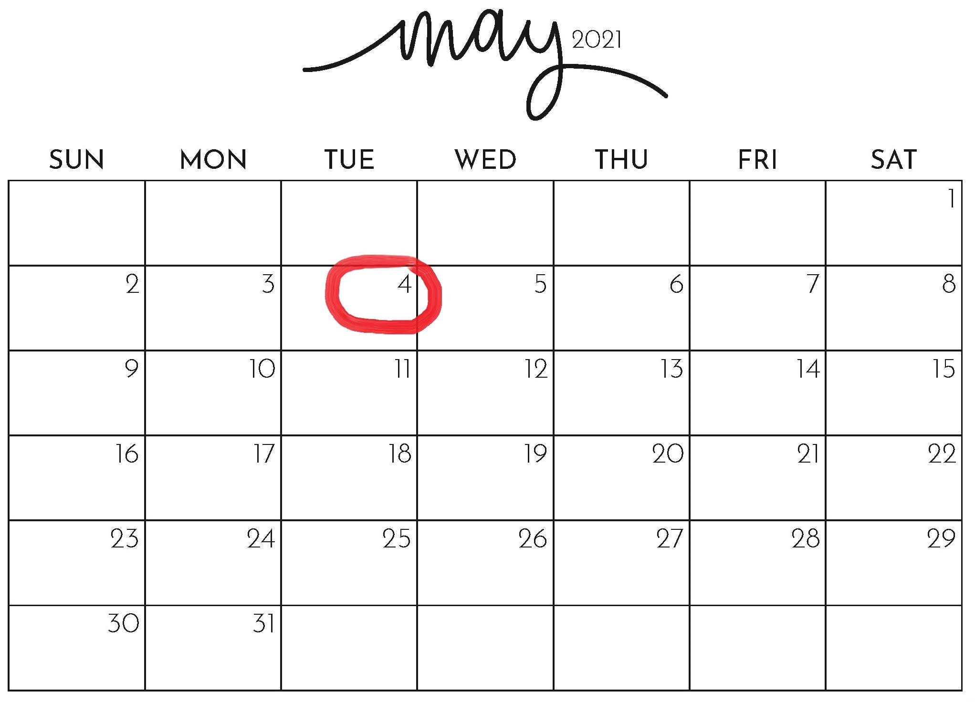

Slide 3
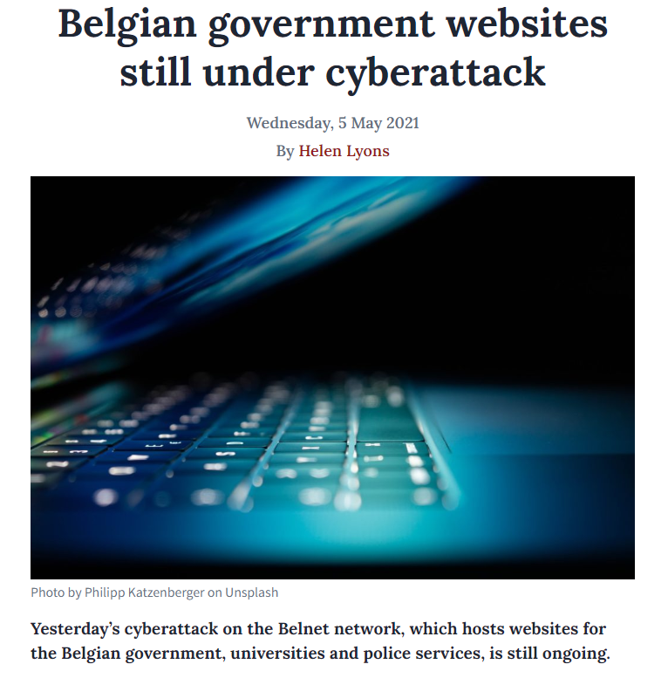
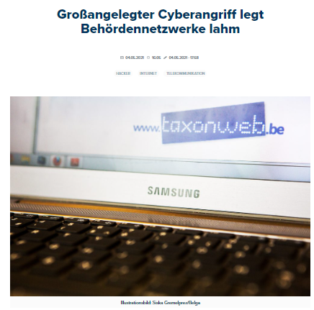
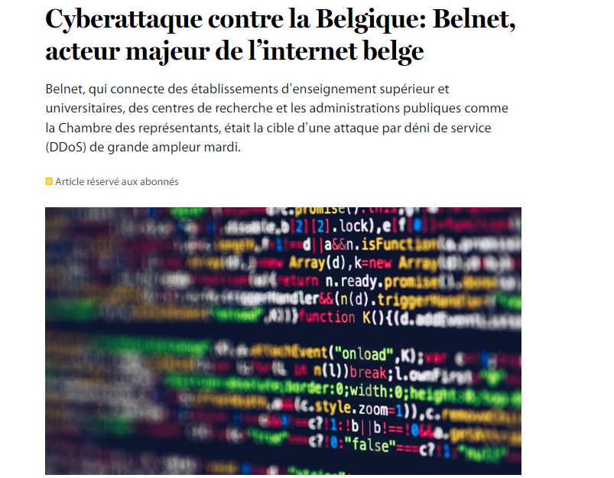
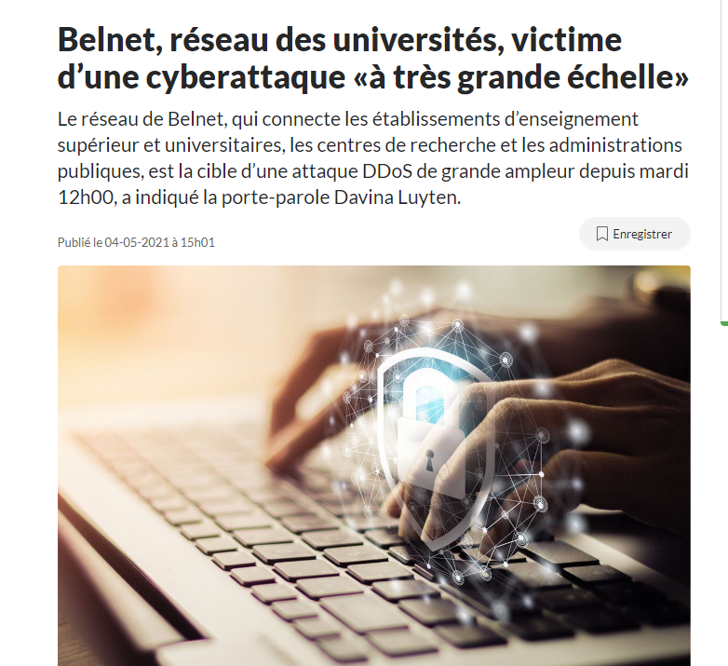

Slide 4
Not if but when

Slide 5

“Next to doing the right thing, the most important thing is to let people know you’re doing the right thing.”
John D Rockefeller

Slide 6


Slide 7
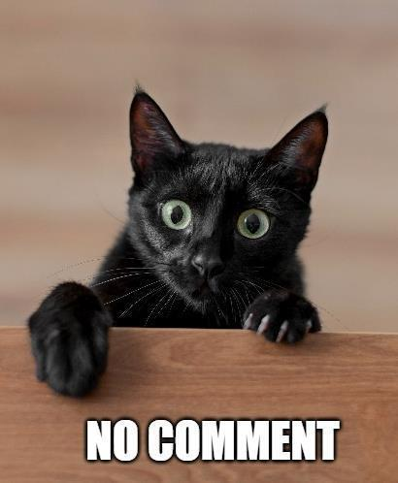
1/ Being silent or slow
Stealing thunder
Keep control of the information
No comment = guilty

Slide 8
Key elements
We know: we know what happened.
We do: we are working on a solution
We care: we take this seriously.
We'll be back: we say when we will release more info.

Slide 9
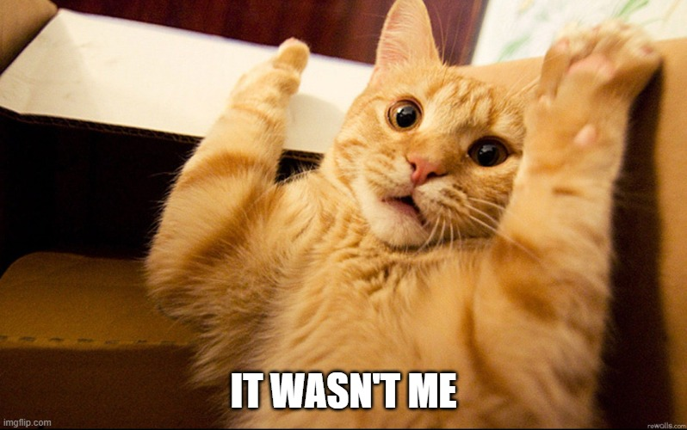
2/ Lie, speculate or deny responsability
Who’s behind the attack?
Could this crisis have been avoided?

Slide 10
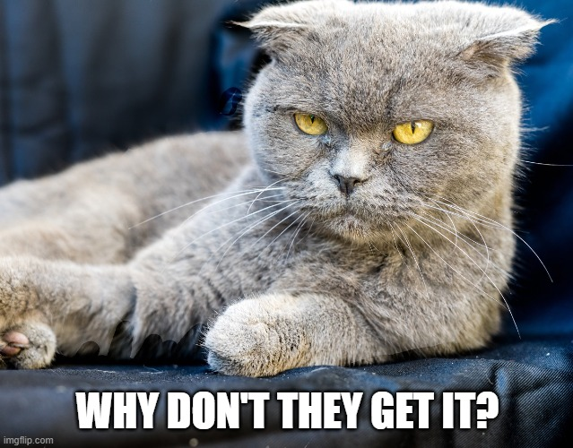
3/ Not speaking your audience’s language
Clear messages
Be consistent
What does the crisis mean for your stakeholders?

Slide 11

Crisis communication plan
Identify your stakeholders
Set up communication tools
Prepare key messages
Put together a team
Practise and test your plan

Slide 12


Slide 13
Thank you!
Davina.Luyten@belnet.be

