Slide 1
Side Meeting – Products and Services
5-minute Flash Talk
Jens-Christian Fischer, Switch
jens-christian.fischer@switch.ch

Slide 2

Switch CommunitySOC

Slide 3
Which Security Services & Products Do You Provide to Your Members?
Developed in-house
Switch-CERT
Community Service
”SOC Light” (MS Defender based)
Use Case Management
Continuous Testing of detection rules (Atomic Red Team)
Threat Hunting
Help in Operations at Customer sites
From GÉANT/Procured
SOC Sentinel (Operations outsourced to MSSP)

Slide 4
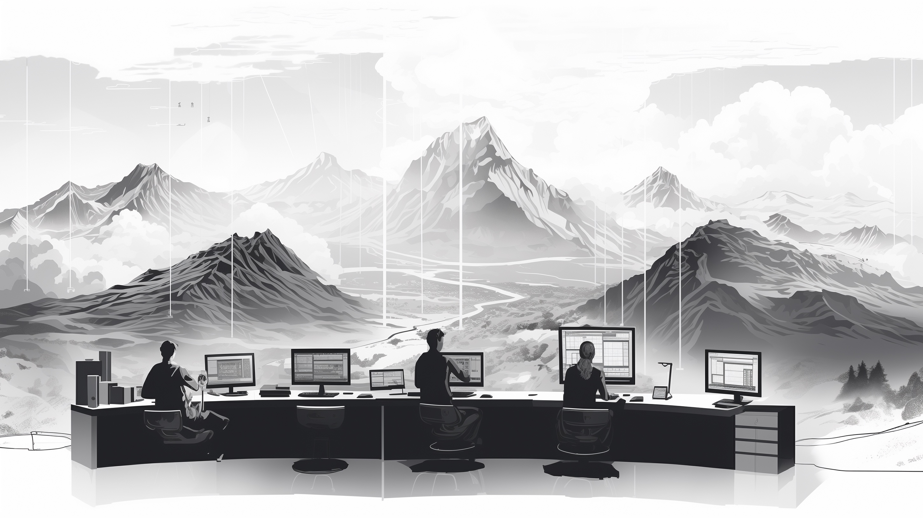
SOC Light

Slide 5
SOC Light
Designed for smaller institutions that use Microsoft Defender products
  Simple Onboarding and start within ½ day
  Regular check for critical incidents during office hours
  Analysis and Triage
  Incident Response (working with customers)
  Automated Threat Hunting
  Various Power BI dashboards for analysis of incidents
  Recommendations for improving Security posture
Good entry for small institutions – successful start and high interest from community

Slide 6
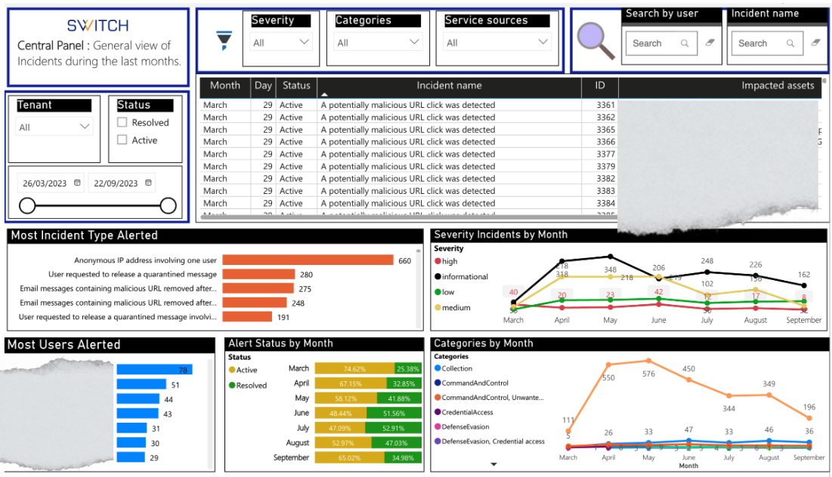
Example Dashboards
Central Panel – Trend Analysis

Slide 7
Which Services/Topics Will You Work on in the Coming Years?
Broader Range of SOC Operations
Vulnerability Management
Advanced Threat Hunting
Red Teaming “Attack as a Service”

Slide 8
Any questions?

