Slide 1
EGI - Authentication and Authorisation Infrastructures coordination in the ERA and beyond
Valeria Ardizzone
Solution Architect
(EGI Foundation)
22 June 2023
e-IRG
TLP: WHITE Public

Slide 2
European Research Area policy agenda
Overview of actions for the period 2022-2024
Deploy the core components and services of EOSC and federate existing data infrastructures in Europe, working towards the interoperability of research data
Deploy Open Science principles and identify Open Science best practices

Slide 3
2021-2023
2018-2021
EOSC Portal and Marketplace
Services Management System
Rules of Participation
Services in the Hub portfolio
Services in the EOSC Portfolio
Digital Innovation Hub
Business models
Interoperability Guidelines
Training courses
2017-2019
Science Demonstrators
Service Pilots
Interoperability Architecture
Governance Framework

Slide 4
EGI-ACE mission
Implement the Compute Platform of the EOSC and contribute to the EOSC Data Commons by delivering integrated computing, platforms, data spaces and tools as an integrated solution that is aligned with major European cloud federation projects and HPC initiatives.

Slide 5
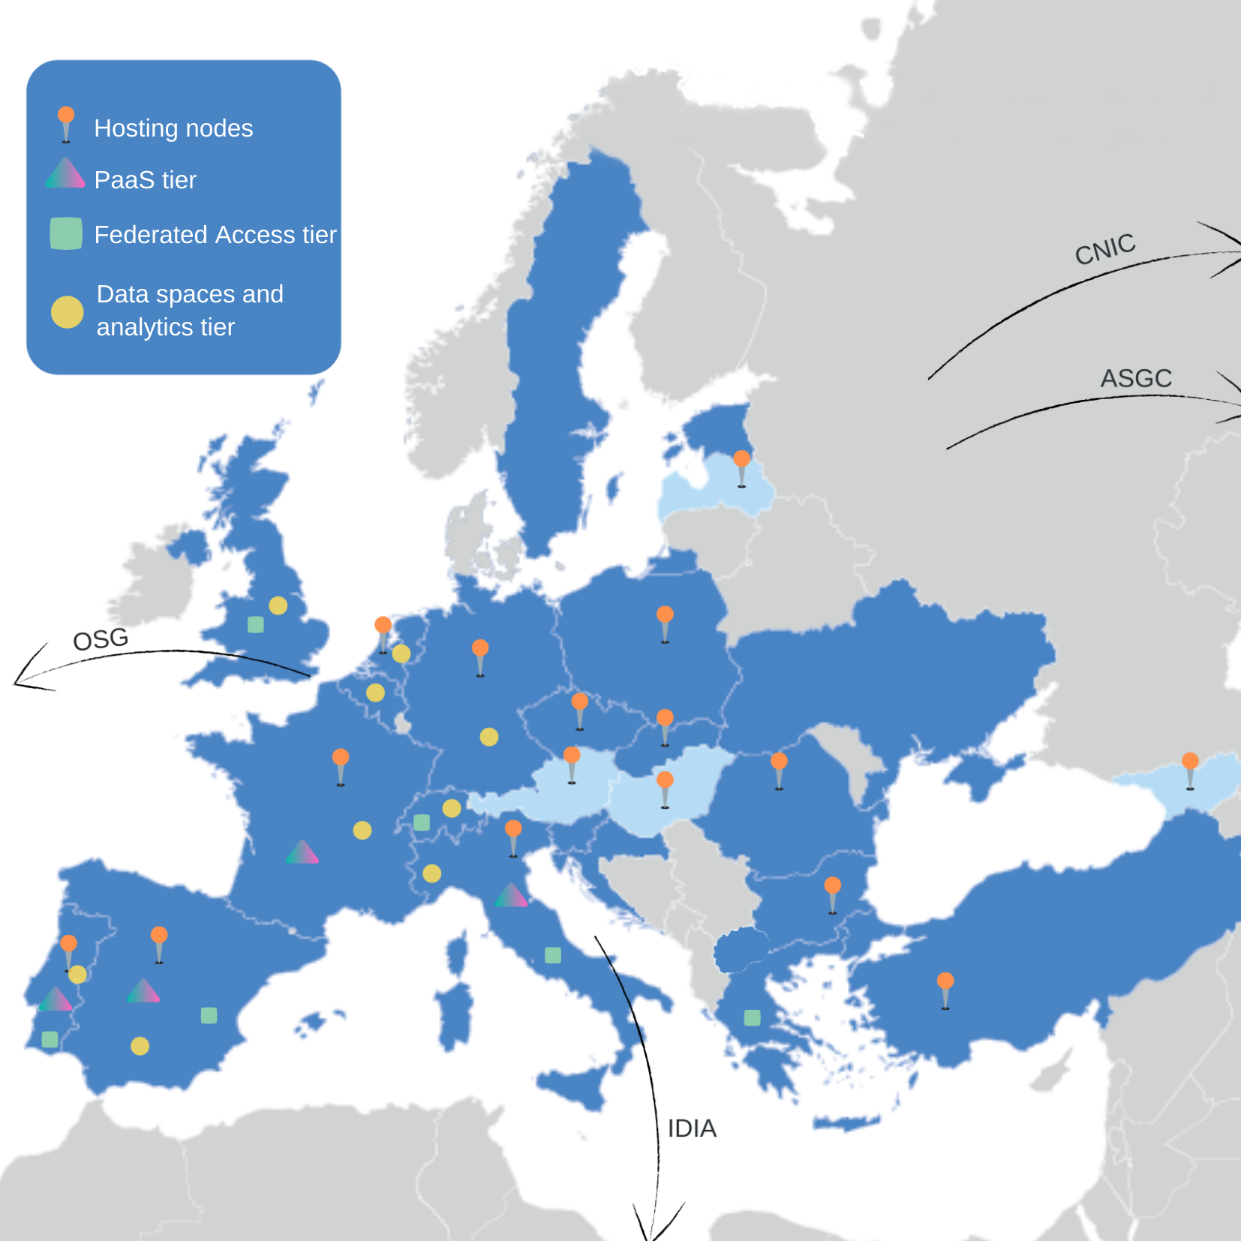
An EGI flagship project
Consortium:
33 Partners, 24 third parties
EGI council members + Research Infrastructures
Budget:
8 M EC + 4 M in-kind
Scope:
Service delivery (Virtual Access to 38 installations)
Co-development of ‘thematic services’
Broadening

Slide 6
Portfolio of user facing services in EOSC
Data Spaces
and Analytics
Data and thematic data analytics and processing tools
Thematic application services
Green Deal
Health
Fundamental Science
Humanities
Scientific
users
Platforms
generic added-value platform level services
Platform services
Interactive Computing
Automated Cluster deployment
Distributed AI training
Workload Management
Service Management = Tools + Processes + Policies
Federated
Access
Federation-wide management of data and computing
Federated Compute
Federated Identity
Federated Data
Expert
users
Federated
Resources
Compute and storage facilities
Infrastructure services
Research Clouds
Public Clouds
HTC
HPC

Slide 7
Portfolio of user facing services in EOSC
Data Spaces
and Analytics
Data and thematic data analytics and processing tools
17 + 36 = 53 thematic services
Green Deal
Health
Fundamental Science
Humanities
Scientific
users
Platforms
generic added-value platform level services
Interactive Computing
Automated Cluster deployment
Distributed AI training
Workload Management
Service Management =
Tools + Processes + Policies
Federated
Access
Federation-wide management of data and computing
Federated Compute
Federated Identity
Federated Data
Expert
users
Federated
Resources
Compute and storage facilities
Research Clouds
Public Clouds
HTC
HPC

Slide 8
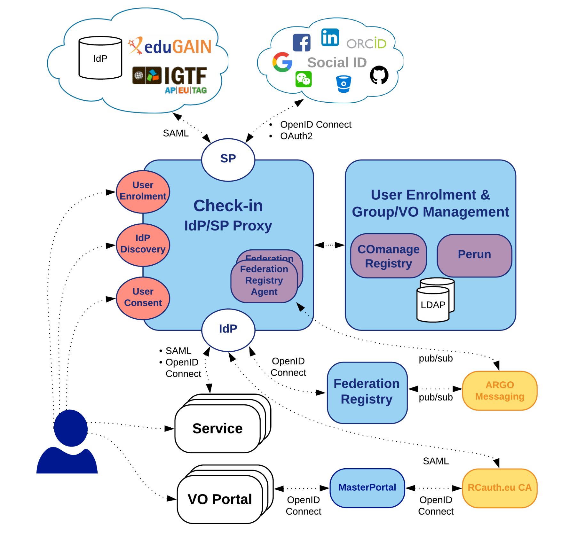
Check-in
Architecture components
Check-in IdP/SP Proxy
Acts as a Service Provider (SP) for external Identity Providers (IdPs)
Acts as an Identity Provider (IdP) for Service Providers (SPs)
Supports popular authentication and authorization standards like SAML 2.0, OpenID Connect 1.0, and OAuth 2.0
Central Discovery Service (WAYF) for users to select their preferred IdP
User Enrolment and Group/VO Management based on COmanage Registry and Perun
Web interface for VO enrollment and membership management
API for VO/group membership management
VO/group information querying through LDAP
MasterPortal
Acts as a caching intermediary service between end-services and RCauth Online CA
Provides proxy certificates for end-services like science gateways or VO Portals
Supports SSH key authentication for retrieving proxy certificates at the command line
Federation Registry
Web interface for managing EGI Check-in service connections based on OIDC or SAML
Covers service lifecycle from registration to deregistration
API
API

Slide 9
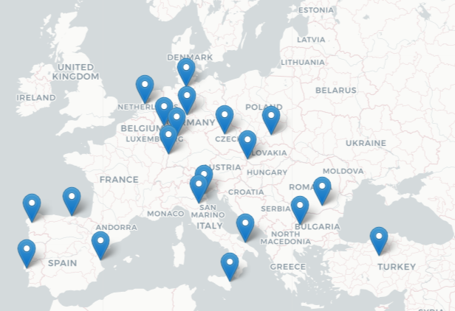
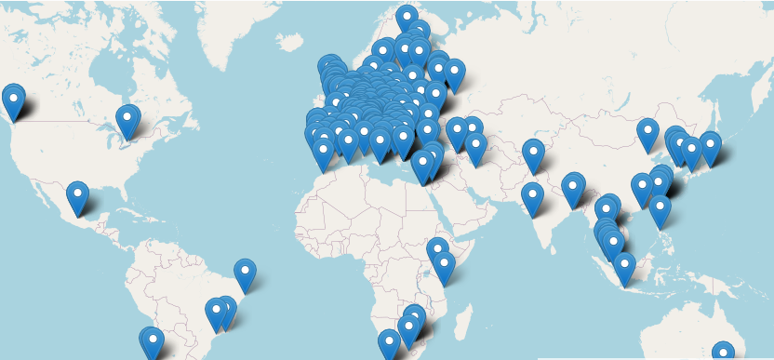
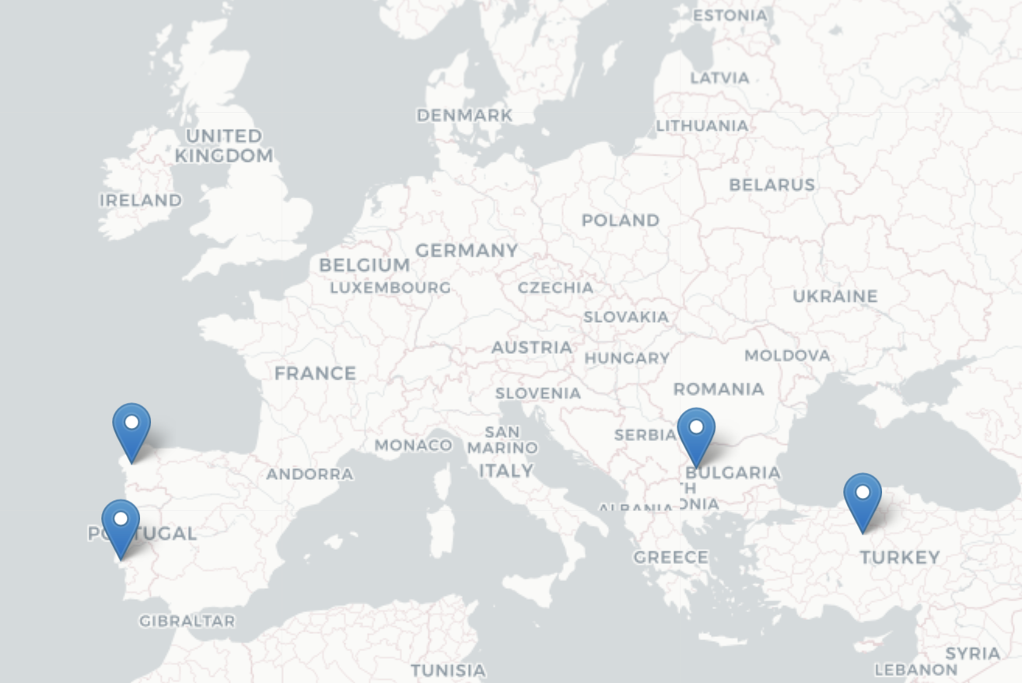
Resource infrastructure expansion
Distributed compute and storage facilities deliver CPUs, GPUs and Storage
29 Cloud providers: 15 funded with VA, 23 supporting EGI-ACE SLAs
200+ HTC providers: 1 funded with VA, 58 supporting EGI-ACE SLAs
4 pilot HPC centres, all supporting EGI-ACE
HPC (Pilot)
NEW
HPC

Slide 10
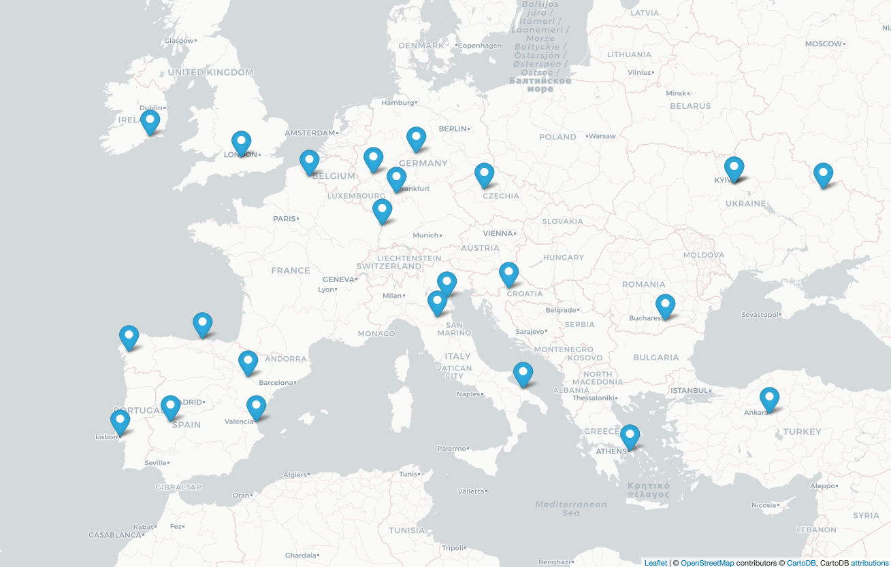
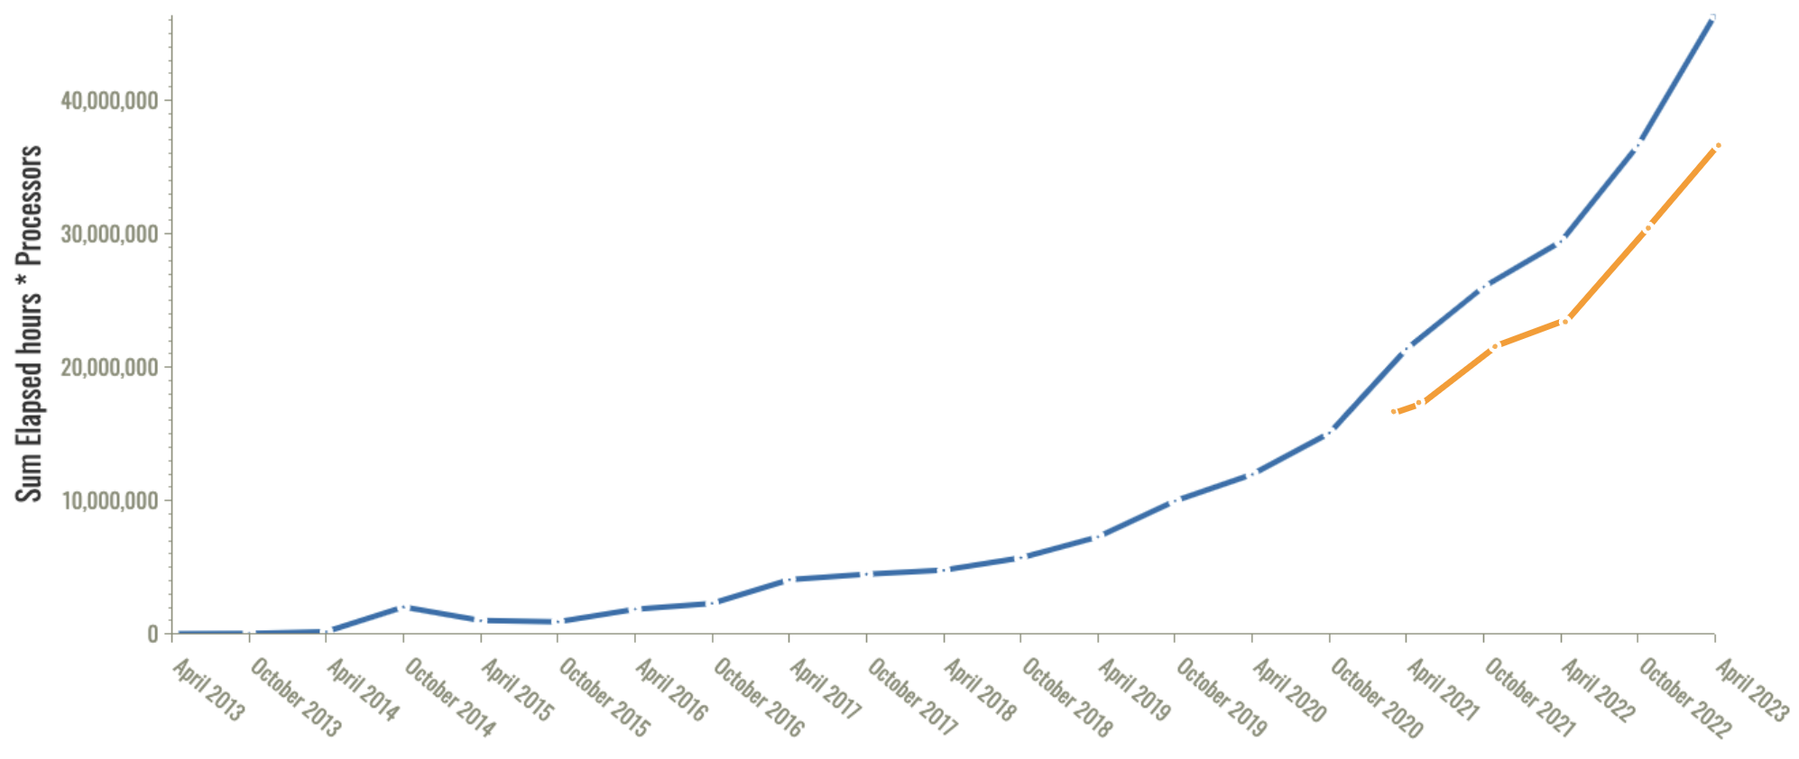
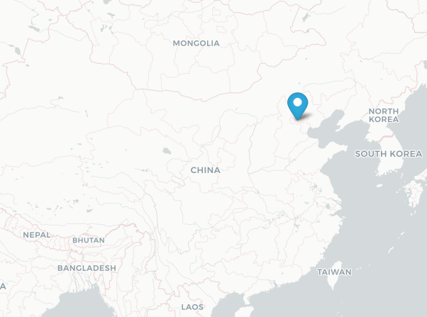
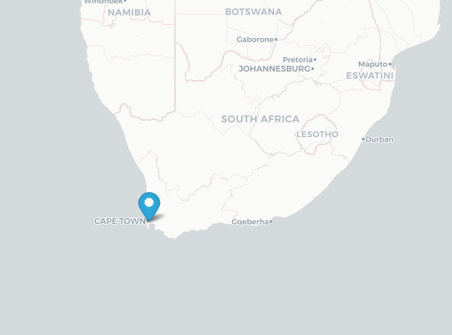
EGI Cloud uptake during EGI-ACE (CPU-hours)
102 Million CPU-hours delivered for EGI-ACE users
Virtual Access: 72 Mill CPUh
Local funds: 25 Mill CPUh
Pay-for-use: 5 Mill CPUh
+40% on top of VA
EGI-ACE users

Slide 11
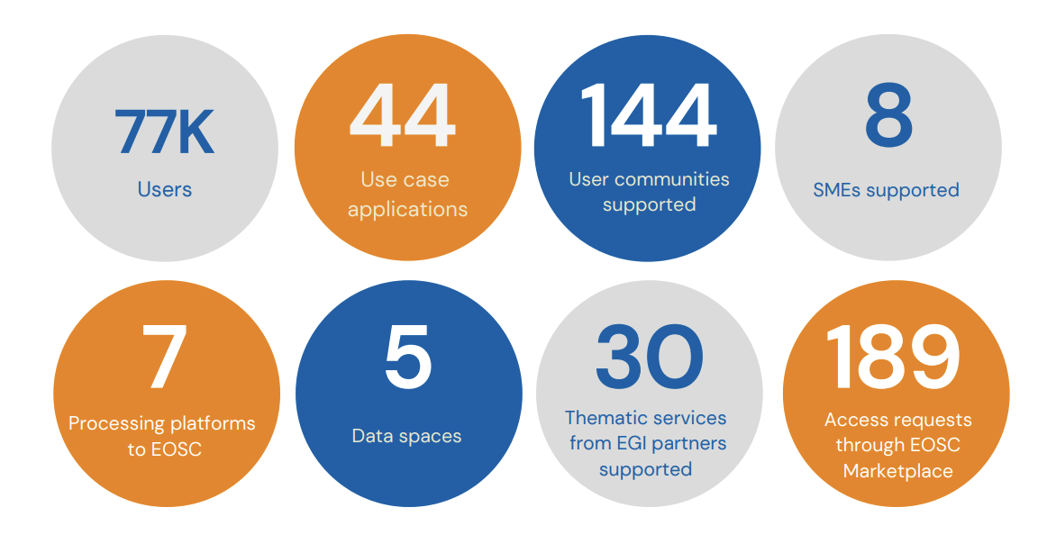
EGI-ACE impact

Slide 12
Collaborations
with non-European e-Infrastructures
with ESFRIs
with industry (EGI Digital Innovation Hub)
Notes:
Business Pilots supported:
Pundit
DigiFarm
Agilia
CloudSME
Cite
BioInvestAgro
OiPub
PreMaCOOL
Regreen
SOFIA
MRADSIM
EnergyDeel
B2Predict

Slide 13
EOSC Future project and the EOSC-A AAI Task Force
EOSC Future T7.3
focus on the implementation aspects of the EOSC AAI based on the HLR and the EOSC Authentication and Authorization Infrastructure (AAI) report published back in January by the AAI Task Force of the EOSC Executive Board Architecture WG.
EOSC-A AAI TF
focus on the requirements and the further evolution of the EOSC AAI.
Credits Task leader 7.3

Slide 14
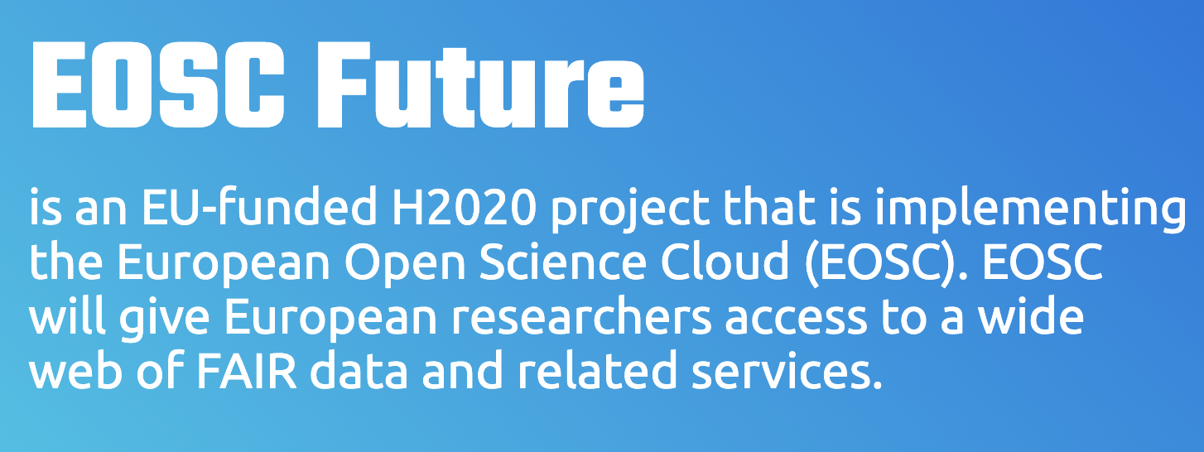
Project coordinator: ATHENA
Technical coordinators: EGI and GEANT
Two parallel areas of work
Area 1 is about the EOSC Core and its requirements from the EOSC AAI (the micro level).
Area 2 is about implementing the EOSC AAI at the macro level, and we will be working on the cross-infrastructure/domain aspects.
Credits Task leader 7.3

Slide 15
Area 1: EOSC Core
Credits Task leader 7.3

Slide 16
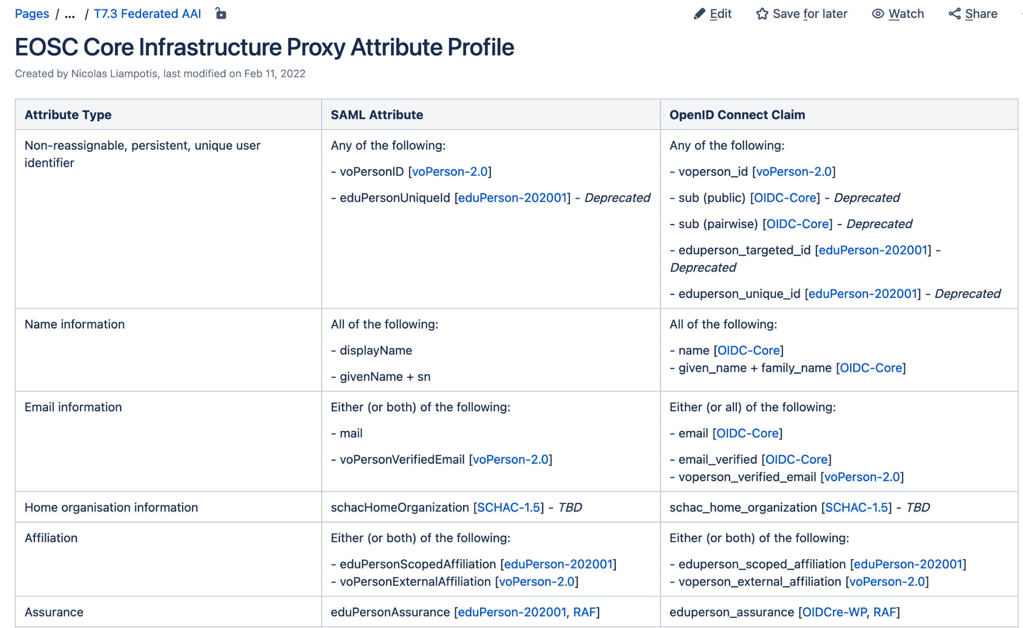
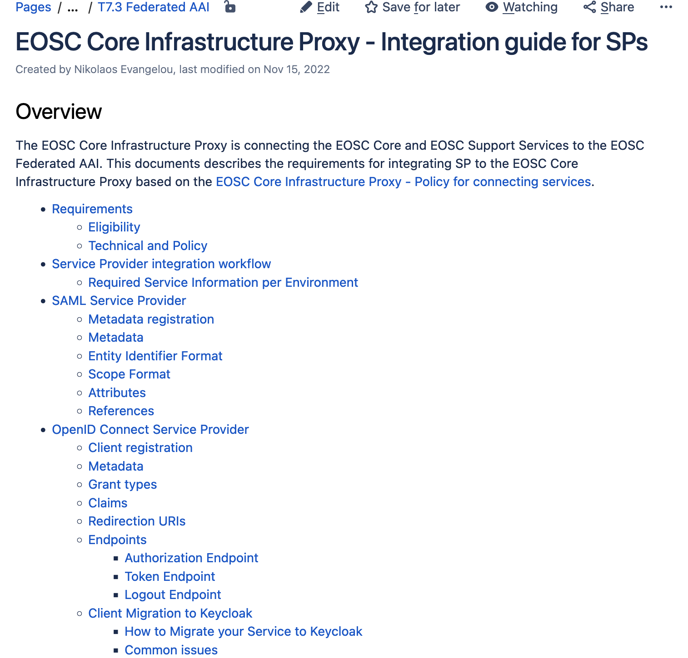
Area 1: EOSC Core
Credits Task leader 7.3

Slide 17
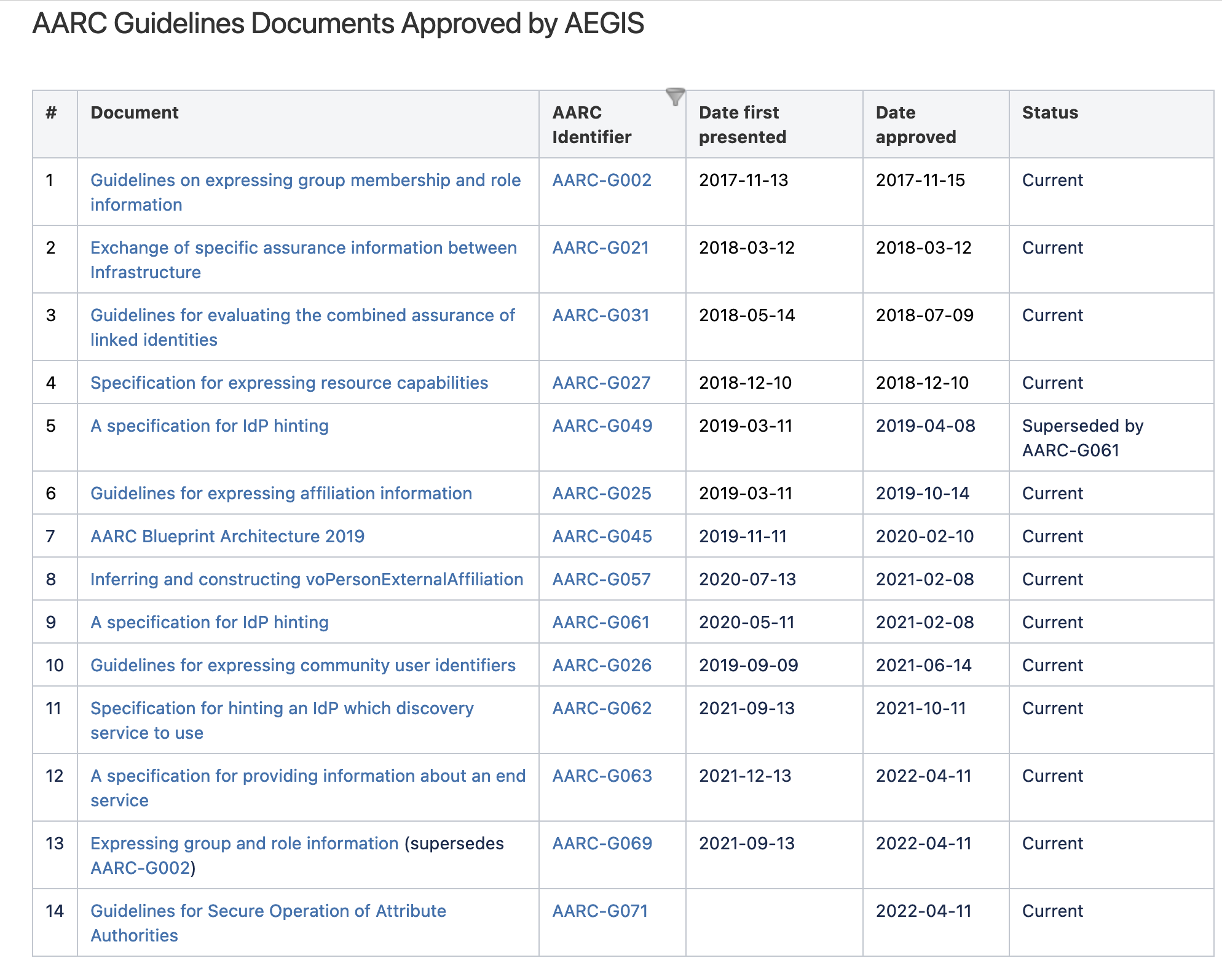
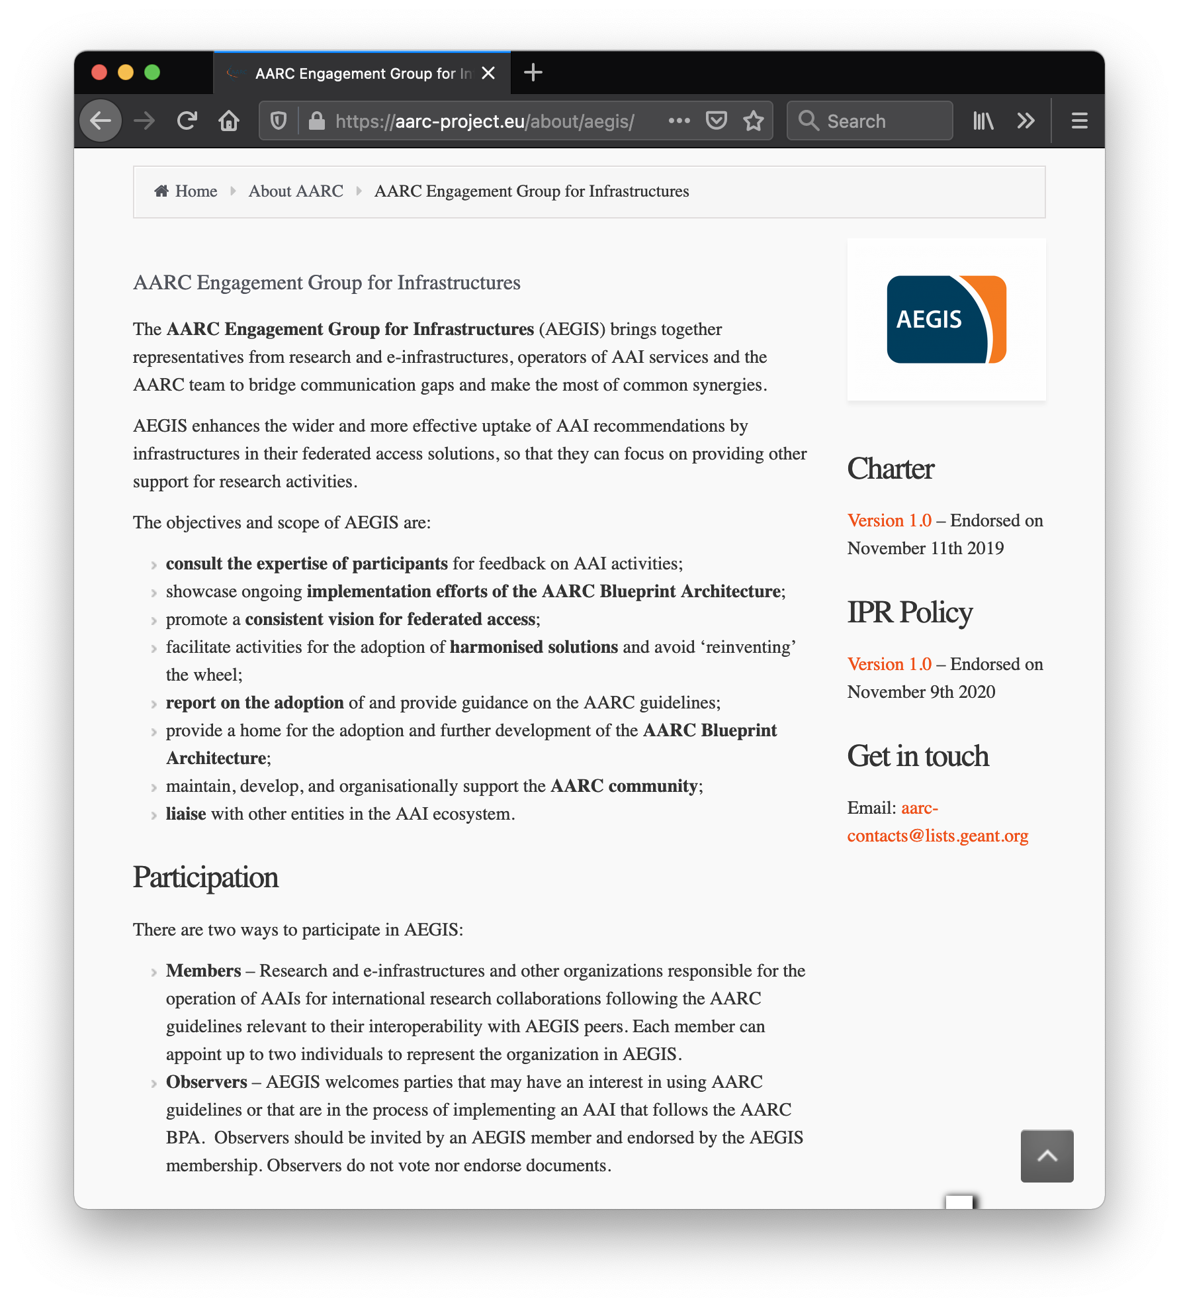
EOSC AAI Baseline Architecture
Based on the AARC Interoperability Guidelines
Credits Task leader 7.3

Slide 18
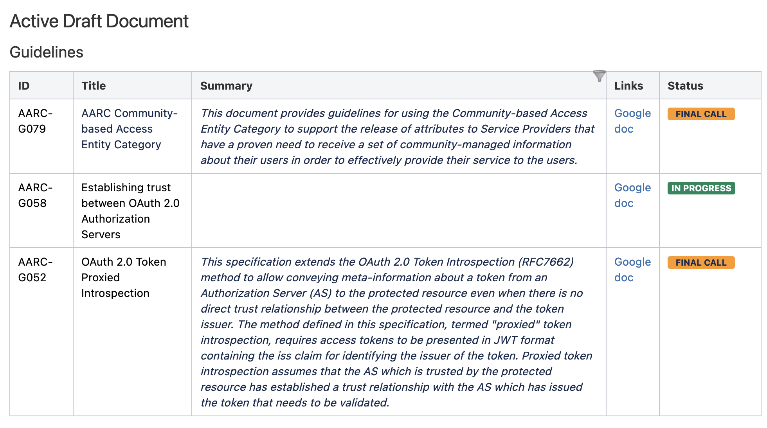
EOSC AAI Baseline Architecture (Contd.)
Based on the AARC Interoperability Guidelines
Credits Task leader 7.3

Slide 19
EOSC AAI Baseline Architecture (Contd.)
Based on the AARC Interoperability Guidelines
How can I participate?
For AAI Architects and Implementers
The work on the AARC BPA is done in the Architecture WG. Anyone can participate in the Architecture WG. Join the mailing list for more information: https://lists.geant.org/sympa/subscribe/appint
For organizations implementing the AARC BPA
AEGIS is the governing body for the AARC BPA. You can find more information at https://wiki.geant.org/display/AARC/AEGIS
Credits Task leader 7.3

Slide 20
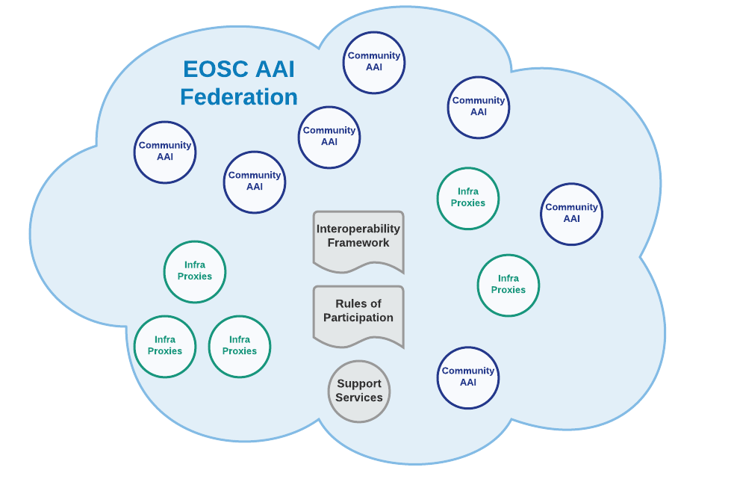
Area 2: The EOSC AAI Federation
Community AAIs and Infrastructure Proxies connect once with the EOSC AAI Federation (register metadata, URN namespaces, policies etc)
Technical interoperability conformance tested and monitored by the EOSC AAI FEderation.
GDPR and Security Policy conformance (Policy Notices, Acceptable Use Policy etc) assessed by the EOSC AAI Federation.
Community AAIs and Infrastructure Proxies discovery and establish trust with the rest of the Community AAIs and Infrastructure Proxies through the EOSC AAI Federation
Credits Task leader 7.3

Slide 21
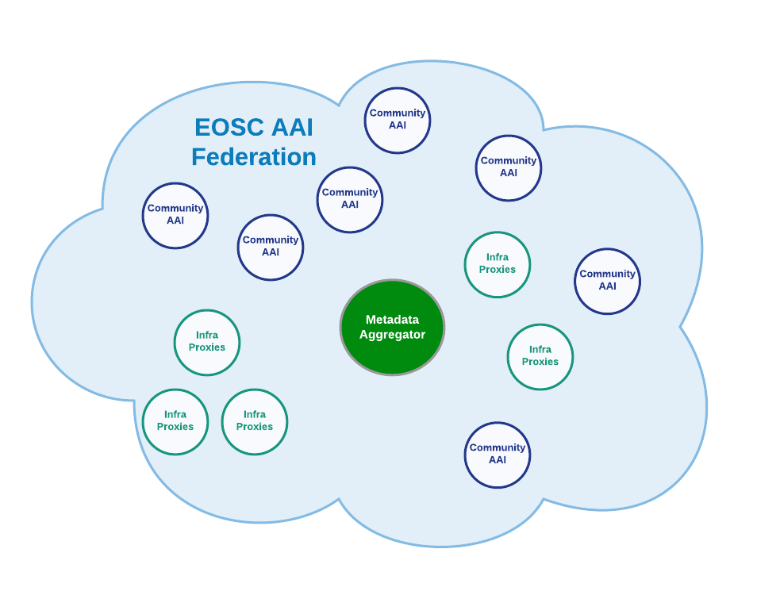
The EOSC AAI Federation
ESCAPE IAM (ESCAPE)
Lifesciences AAI (EOSC-Life)
UmbrellaID AAI (PaNOSC / ExPANDS)
CESSDA AAI (SSHOC)
EGI CheckIn
EUDAT B2ACCESS
GEANT SP Proxy
GEANT eduTEAMS
Infrastructure Proxy for EOSC Core Services
Credits Task leader 7.3

Slide 22
Contact us
contact@egi.eu
check-in@egi.eu
Let's talk. Or
meet in person
Get in touch with us

