Slide 1
Advancing the Portuguese Scientific Community with INCD and Google Cloud

Slide 2
National Distributed Computing Infrastructure
Services: scientific computing, data processing and other data oriented services
Target: scientific and academic community, infrastructures, R&I projects, SMEs
Promote: shared resources, advanced computing and data services for research
Interface: international digital infrastructures and initiatives (EGI, IBERGRID, WLCG, EOSC)
Notes:
INCD is a digital infrastructure that has as main objectives …

Slide 3
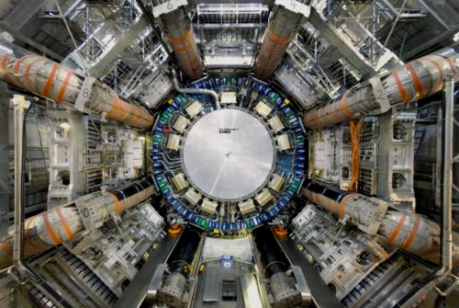
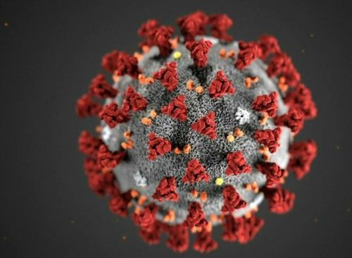
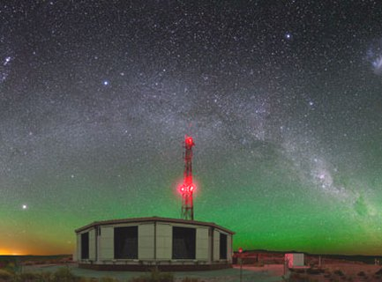
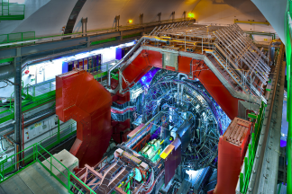
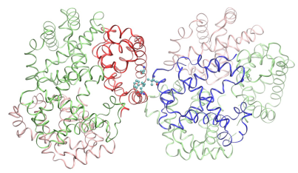
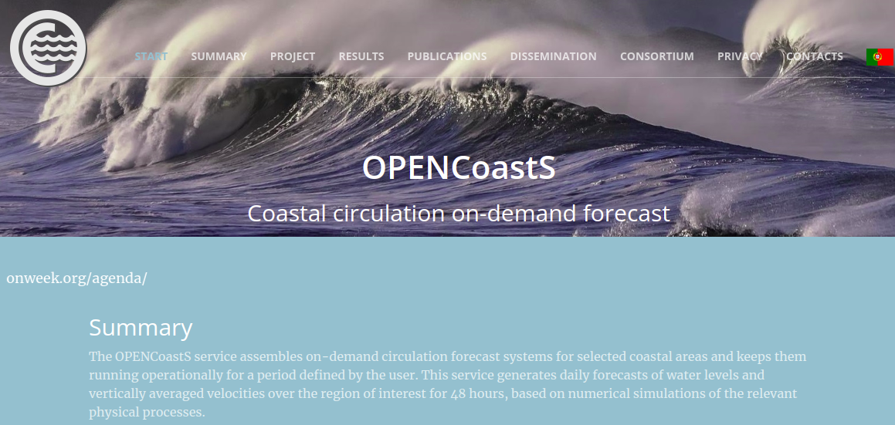
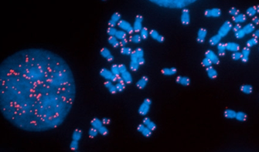
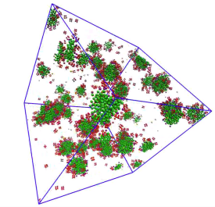
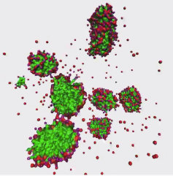
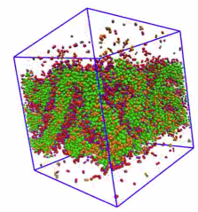
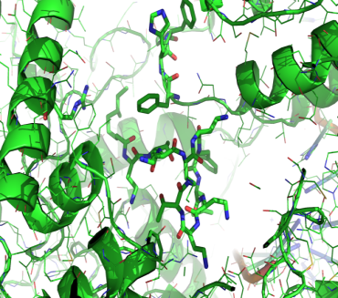
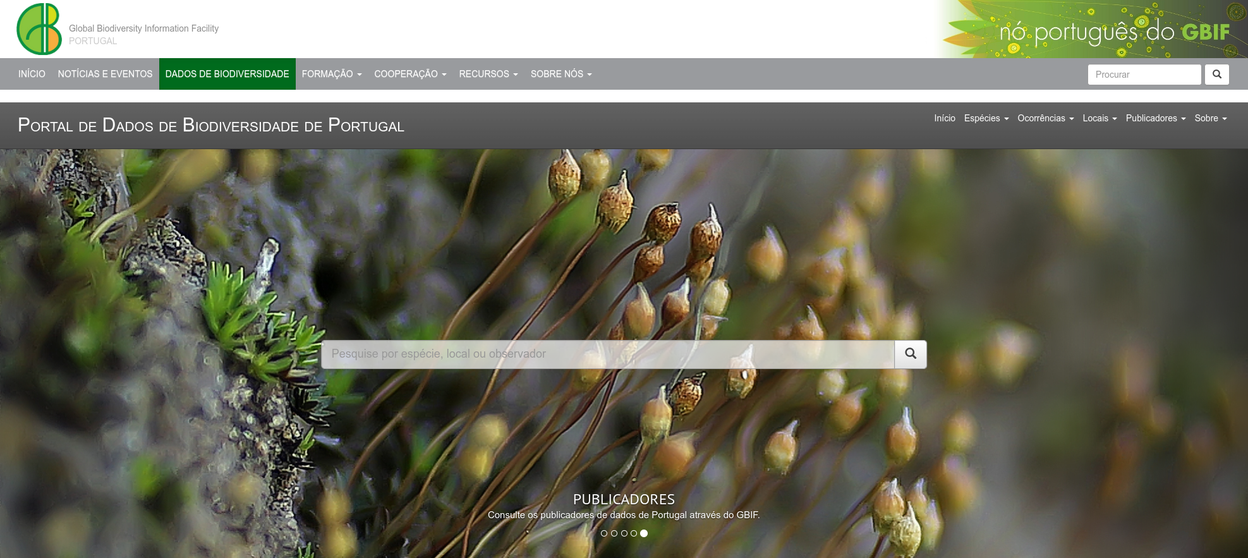
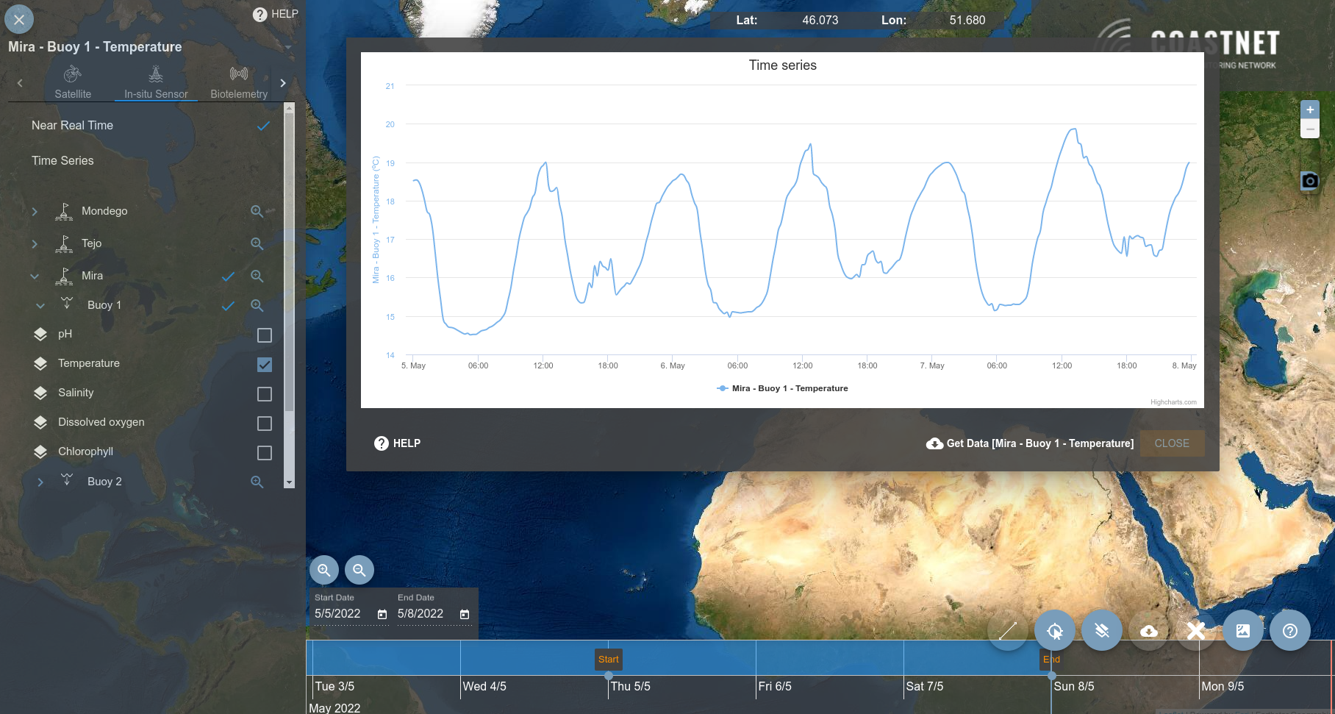
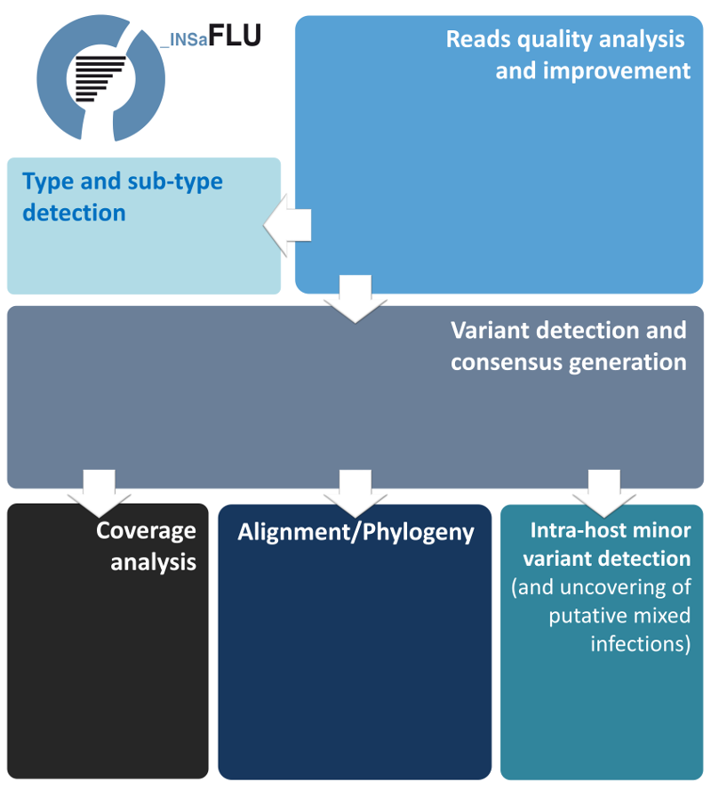
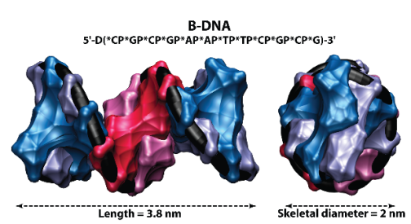
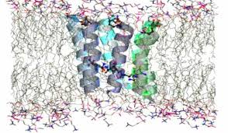
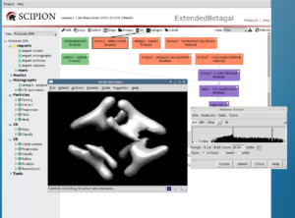
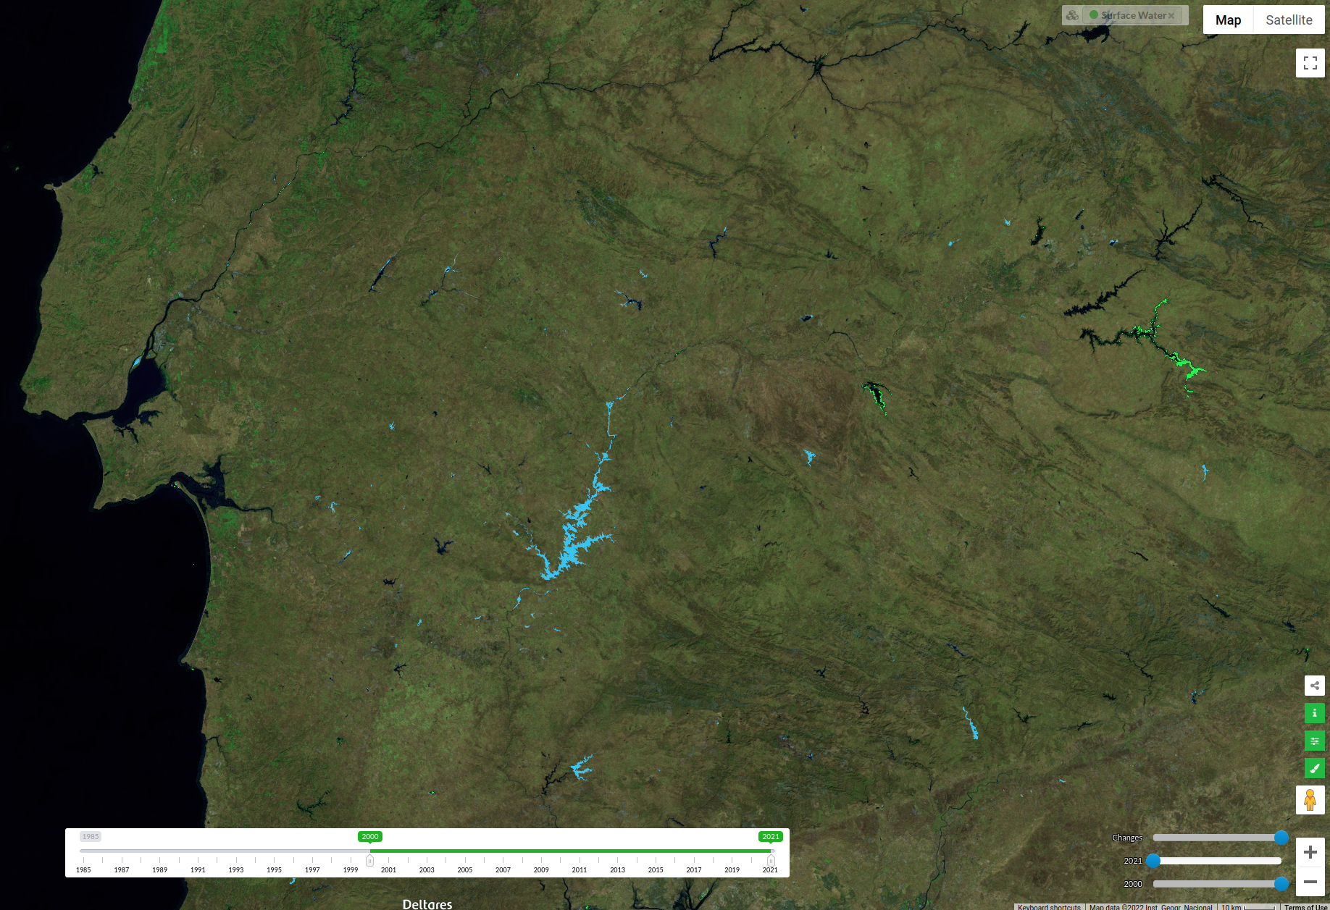
Users from 53
research units and entities in 2022
Biomolecular SIMulations Research Group (BioSIM) / UCIBIO
Business Research Unit (BRU) / ISCTE
Concepção e Desenvolvimento de Sistemas de Informação (CDSI) / ISCTE
Centro de Estudos de Doenças Crónicas (CEDOC) / UNL
Centro de Engenharia e Tecnologia Naval e Oceânica (CENTEC) / U.Lisboa
Centro de Ecologia Evolução e Alterações Ambientais (cE3c) / U.Lisboa
Centro de Ecologia Funcional (CEF) / U.C
Centro de Física do Porto (CFP)
Centro de Investigação em Biomedicina (CBMR) / UALG
Centro Interdisciplinar de Investigação Marinha e Ambiental (CIIMAR) / U.Porto
Fundação Champalimaud
Instituto de Biossistemas e Ciências Integrativas (BioISI) / U.Lisboa
Centro de Neurociências e Biologia Celular (CNBC) / U.Coimbra
Departamento de Informática / FCUL / U.Lisboa
Departamento de Informática / FCT-UNL
Departamento de Engenharia Civil / U.Aveiro
Departamento de Física / IST / U.Lisboa
Departamento de Física / FCUL / U.Lisboa
Departamento de Física / U.Minho
Departamento de Engenharia Informática / U.Coimbra
Departamento de Informática / U.Porto
Departamento de Química / U.Aveiro
Faculdade de Ciências Sociais e Humanas / UNL
Faculdade de Letras / U.Porto
Faculdade de Medicina / U.Lisboa
Fundação para a Ciência e a Tecnologia - Unidade FCCN (FCT-FCCN)
Nova School of Science and Technology (FCT/UNL)
Institute for Bioengineering and Biosciences (IBB) / U.Lisboa
Instituto de Biologia Experimental e Tecnológica (IBET/ITQB)
Instituto de Geografia e Ordenamento do Território (IGOT) / U.Lisboa
Instituto de Ciência e Inovação em Engenharia (INEGI)
Instituto de Engenharia de Sistemas e Computadores - Investigação e Desenvolvimento (INESC-ID)
Instituto Nacional de Saúde Doutor Ricardo Jorge (INSA)
Instituto de Ciências Sociais da Universidade de Lisboa (ICS) / U.Lisboa
Instituto de Saúde Ambiental (ISAMB) / U.Lisboa
Instituto Tecnologico e Nuclear (ITN) / U.Lisboa
Instituto de Plasmas e Fusão Nuclear (IPFN) / U.Lisboa
Instituto Superior de Agronomia (ISA)
Instituto Superior de Engenharia de Coimbra (ISEC)
Instituto Superior de Engenharia de Lisboa (ISEL)
Instituto Universitário de Ciências Psicológicas, Sociais e da Vida (ISPA)
Júnior Empresas do Instituto Superior Técnico (JUNITEC)
Computer Science and Engineering Research Centre (LASIGE) / U.Lisboa
Laboratório de Instrumentação e Física Experimental de Partículas (LIP)
Laboratório Nacional de Engenharia Civil (LNEC)
Nova School of Business and Economics (Nova SBE) / UNL
Rede de Química e Tecnologia (REQUIMTE) / UCIBIO
Sociedade Portuguesa de Botânica (SPBOTANICA)
Universidade Aberta (U.Aberta)
Applied Molecular Biosciences Unit / UCIBIO
Portuguese node of the Global Biodiversity Network (GBIF)
Portuguese Coastal Monitoring Network (CoastNET)
Portuguese Biological Data Network (BIODATA.PT)
ATLAS CERN LHC
Particle Physics
SARS-CoV-19
Life Sciences
AUGER
Astroparticle Physics
Cosmic Rays
CMS CERN LHC
Particle Physics
Sickle Cell Anemia
Life Sciences
Chromatin & Epigenetics, Clinical Pharmacology, Cancer Signaling, Computational Biology
Materials Science
Toxicology
SNO+
Astroparticle Physics
Neutrinos
GBIF
Portuguese biodiversity node
CoastNET
Coastal monitoring
Nanoscale confinement of DNA strands
INSAFLU
Life Sciences
WeNMR
structural biology
Computational Chemistry
Water monitoring
Earth Observation
BIOMED VO
Life Sciences/Genetics
INSTRUCT
Life Sciences
Protein formation
Protein folding

Slide 4
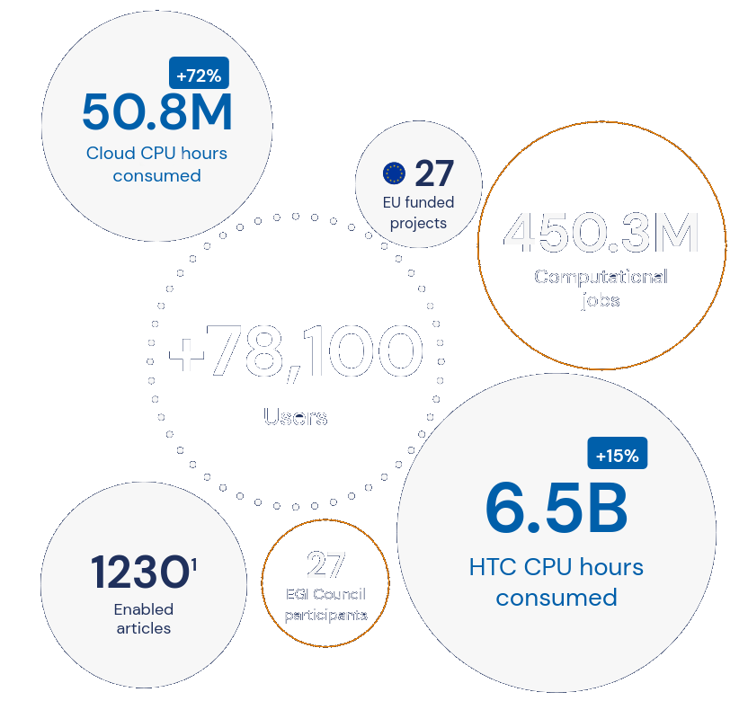
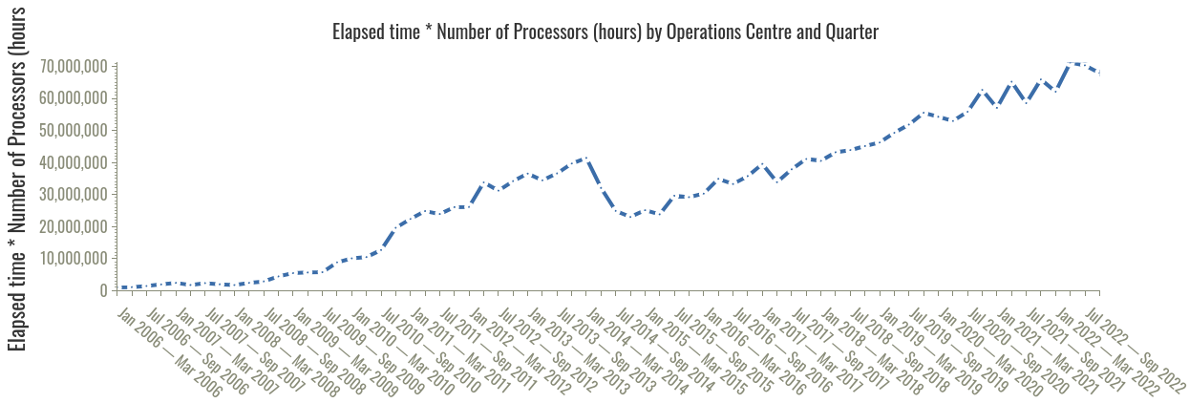
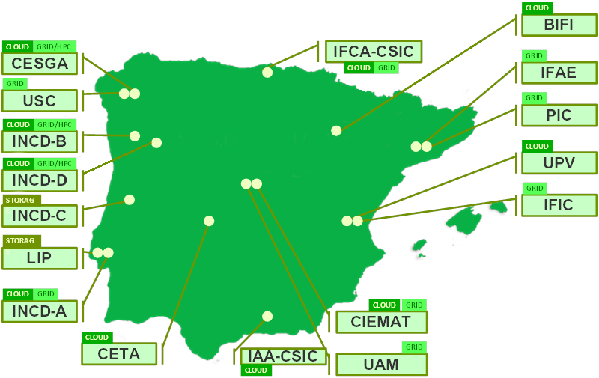
Federation in IBERGRID and EGI
INCD is the main Portuguese infrastructure in EGI and IBERGRID
IBERGRID - 311 million jobs since 2006 (INCD ~ 10%)
cloud+grid+data
IBERGRID - 1.1 million instantiated VMs since 2015
(INCD provided 25% of the elapsed time)

Slide 5
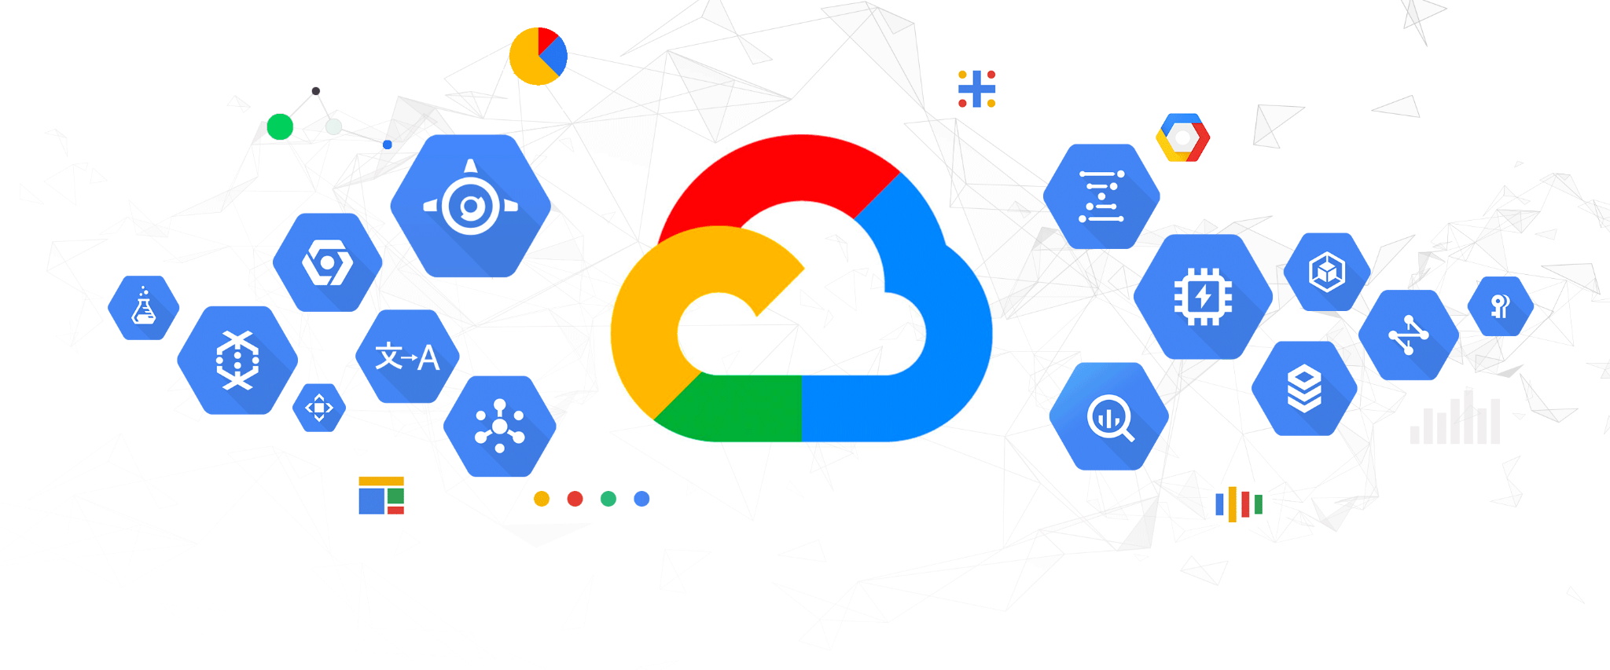
Call for European research e-infrastructures
for the
Distribution of commercial cloud services under OCRE

Slide 6
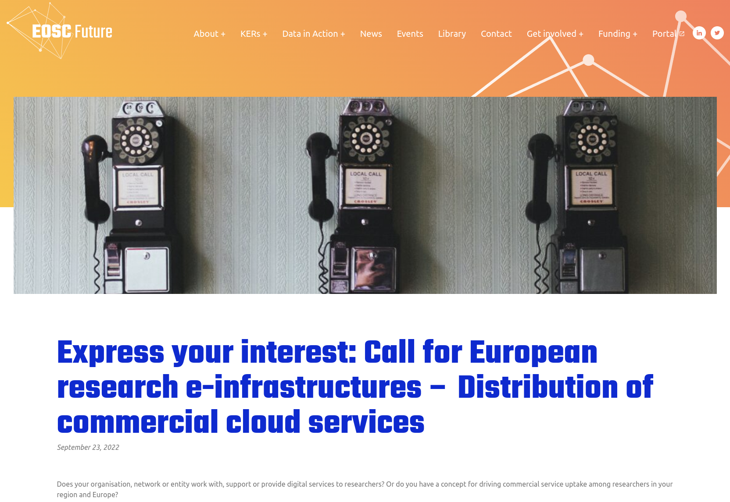
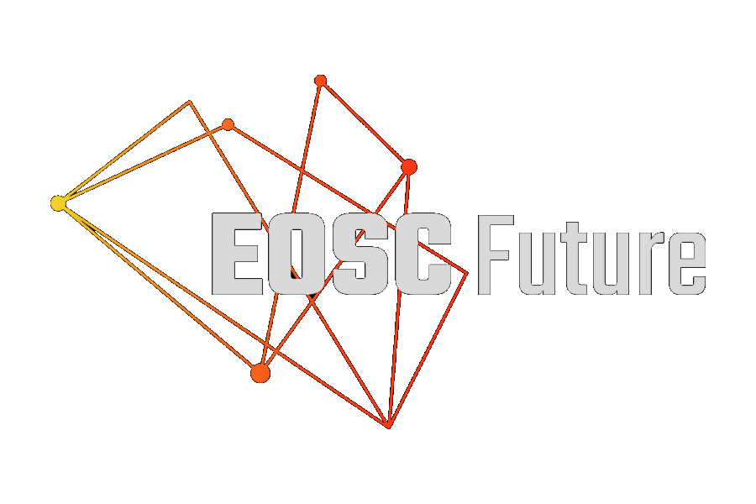
Advancing European research through Open Science

Slide 7
The EOSC-Future call for commercial cloud distribution
Digital service aggregators (e.g. non-profit entities, NRENs, RIs and e-Infrastructures, HPC centres, etc.)
+
OCRE cloud service providers in the same region collaborating on dynamic and creative proposals.
Proposals had to demonstrate a concrete approach to distributing state-of-the-art digital services (e.g. compute, storage, machine learning, analytics, AI) via the European Open Science Cloud.
Aiming at mechanisms to potentially drive strategy and relevance for many of the research infrastructures moving forward.
The award:
up to €400 000 (+ VAT) in pre-procured IaaS/PaaS/SaaS from the OCRE cloud provider
The call was part of a €4.8M adoption funding programme supported by the EU, through the EOSC Future project (the 1st call distributed €2M)
Was already in OCRE.
Could act as service aggregator !

Slide 8
EOSC - European Open Science Cloud
EOSC will give European researchers access to a wide web of FAIR data and related services.
INCD participation in EOSC related projects
EOSC-hub (2018-2021 unfunded via INCD partners)
EOSC-synergy (2019-2022)
EGI-ACE (2021-2023)
C-Scale (2021-2023)
iMagine (2022-2025 started last September)

Slide 9
Aggregator
INCD has the processes to manage requests from researchers to use cloud computing.
National calls for advanced computing projects
organised periodically with FCT
Direct submission of requests to INCD
permanently open
Requests via EGI and IBERGRID international federations
permanently open
Requests via EOSC marketplace
permanently open

Slide 10
The EOSC-Future call for commercial cloud distribution
GET MATCHED UP WITH A COMMERCIAL CLOUD PROVIDER!
To apply to this call get matched with a commercial cloud service provider in your region.
Specifically, from the list of OCRE framework contract holders.

Slide 11
Limitations to the adoption of commercial cloud
Researchers don’t have enough economic capacity to buy commercial cloud services:
reduced project funding;
reduced funding for purchase of services.
High cost of commercial cloud services:
compared to buying hardware;
particularly true for sustained use;
operational costs are often not seen.
Gaps in the continuous cash flow necessary to pay for the cloud services:
intervals between projects;
Intervals between payments.
Learning curve and support.
Hidden or unforeseen costs.
Fear of vendor lock-in.
However … :
hardware costs have increased due to semiconductor shortages;
time to delivery issues;
increase in energy costs;
organisations more aware and worried with the operational costs;
energy efficiency and carbon footprint;
lack of IT human resources;
public contracts bureaucracy;
purchases of hardware can be limited by the number of years of depreciation;
longer term cloud contracts, non-dedicated resources and spot instances can be attractive.

Slide 12
Public-cloud / Private-cloud partnership …
Additional Capacity and Capabilities
Peaks of usage
Specific services
Specific hardware
Resilience
Base Capacity and Capabilities
Safe harbour
Sustained usage
Low cost
User support
Research and academic community
Use INCD cloud
Burst into GCP
Avoid lock-in
Minimise costs

Slide 13
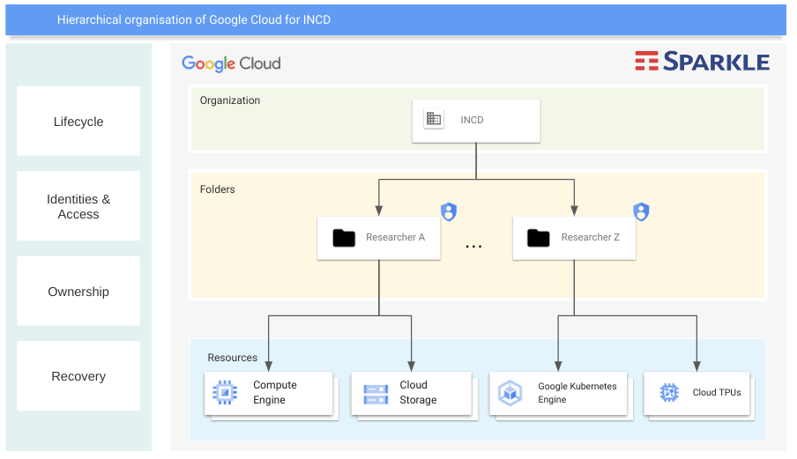

Slide 14
Added value for researchers
Can mix and match the usage of INCD and Google cloud services therefore taking advantage of the best of both providers to achieve higher elasticity, scalability, capacity, or to access services only available at Google.
Users can keep their base usage at INCD, and use Google Cloud to obtain capacity and capabilities that would otherwise not be available to them.
For critical applications higher resilience and robustness can be delivered by taking advantage of the robustness of the commercial cloud.
Google cloud can enable access to resources that are scarce at INCD and for which acquiring dedicated hardware would not be viable.
Researchers will be able to access resources through the same usual processes and mechanisms that they are already familiar.
By accessing the Google cloud via INCD, the researchers will be less subjected to vendor lock-in.
Researchers will still be able to benefit from the INCD services, support and helpdesk for assistance, training and consultancy.

Slide 15
Added value for INCD
INCD will be able to offer a solution for higher scalability and elasticity on top of what local INCD Cloud already provides.
INCD will be able to provide access to new services provided by the Google Cloud such as GPU, Vertex AI, TPUs and many others that INCD does not or cannot offer.
INCD will be able to free some of the capacity reserved for elasticity.
INCD will onboard more research projects.
INCD will be able to address new challenging and data-intensive projects.
INCD still retains the users and their base usage of the INCD cloud infrastructure.
INCD will be able to attract additional researchers interested in using the proposed usage model, particularly the ones that have applications with elasticity issues and/or can take advantage of value added services provided by the Google Cloud.

Slide 16
Added value for Google Cloud and Sparkle
Google Cloud and Sparkle will gain access to the INCD user base.
Google Cloud and Sparkle can more easily reach the research and academic community through INCD.
Google Cloud and Sparkle will benefit from the INCD access mechanisms, distribution capabilities, experience in EOSC and user support.
Google Cloud and Sparkle will receive the INCD cloud bursting loads.
Google Cloud and Sparkle will benefit from higher awareness about its services in the R&E community.
Google Cloud and Sparkle will benefit from a usage model that is more compelling for the research and academic community.

Slide 17
Approach
Training phase for INCD staff
Ongoing in partnership with Google
Understand the several options of use
Exploit lower cost solutions
Integration
Make things more transparent for the end users
Enable users to access Google cloud from the INCD services
Provide integration of INCD services with Google cloud
Pay for usage and exploit shared capacity
Execution of workloads in containers rather than VMs
Serverless execution e.g. function as a service
Asynchronous execution of requests e.g. tasks
First two use cases
Computing farm tasks workloads
Kubernetes elastic workloads

Slide 18
Implementation

Slide 19
Future model
The aggregation solution set-up for this project will remain operational after it finishes
enabling the INCD researchers to continue using the Google Cloud services by paying their usage costs.
This approach paves a way for a joint future
researchers will be able to use the INCD cloud services for their day-to-day needs as usual
and complement with Google Cloud for added capacity and capabilities
The proposed business model offers
a cost effective and compelling way to leverage both the INCD and Google Cloud services
a partnership that will be advantageous for all stakeholders.

Slide 20
https://www.incd.pt helpdesk@incd.pt
Thank you

Slide 21
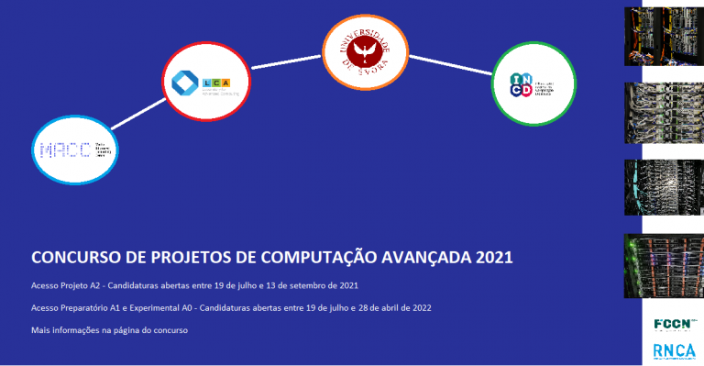
Advanced Computing Network - RNCA
RNCA aims to guarantee the conditions for the production of new knowledge and active participation in international R&D networks and programmes.
INCD is the cloud provider in RNCA.
Calls supported by the operational centers.
1st CPCA
2nd CPCA
Data science and AI in the public administration
Working towards the 3rd CPCA

Slide 22
EOSC-Synergy
Quality
Software
Quality Assurance
European Open Science Cloud (EOSC) project.
EOSC-Synergy (2019-2022) expanding national e-infrastructures and services in EOSC. Strong focus on quality, infrastructure, and thematic services.
Providing cloud services
Thematic services integration
Support training activities
Data repositories
Computing services integration
Software and services quality assurance
Software
Code in any format
Services
Quality Assurance
Services
Long running instances of code
FAIR data Principles Compliance
Data
Raw material
Produced and consumed via software
This project has received funding from the European Union’s Horizon 2020 research and innovation programme under grant agreement No 857647.

Slide 23
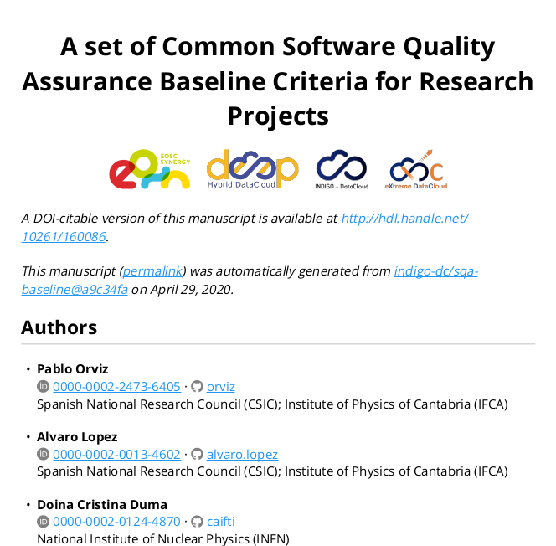
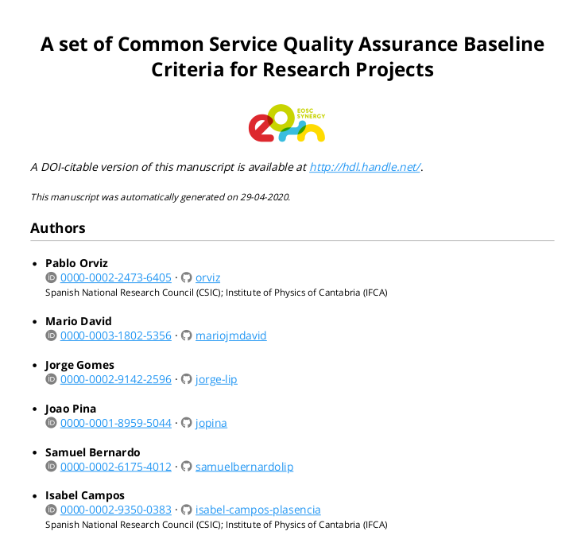
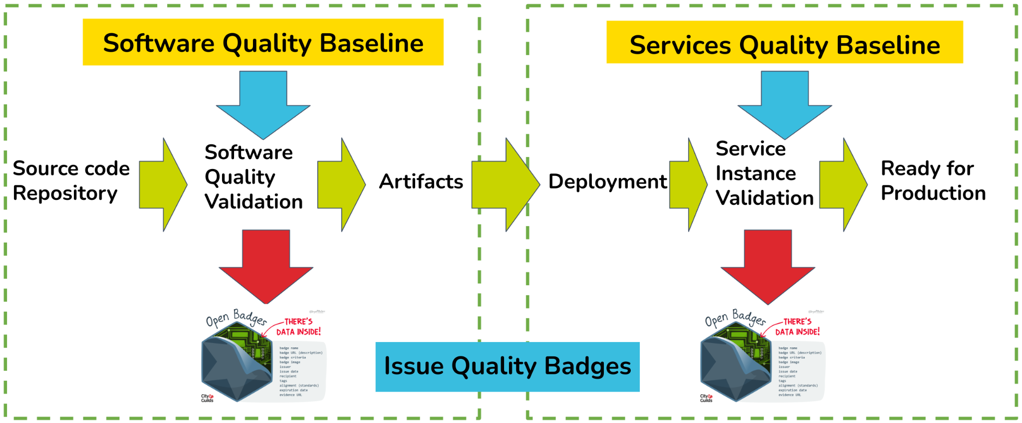
EOSC-Synergy - SQAaaS
https://sqaaas.eosc-synergy.eu/
Quality Badges
Software Classification
Quality Criteria | Quality Badges
 | Gold | Silver | Bronze
QC.Acc
QC.Lic
QC.Sty
QC.Met
QC.Uni
QC.Doc
QC.Sec
QC.Wor
QC.Ver
QC.Man
QC.Del
Quality Baselines
Good Practices
SQAaaS Platform
Accessibility
Licensing
Code style
Metadata
Unit tests
Documentation
Security
Workflows
Versioning
Code management
Delivery
IBERGRID partners
LIP
IFCA/CSIC
UPV

Slide 24
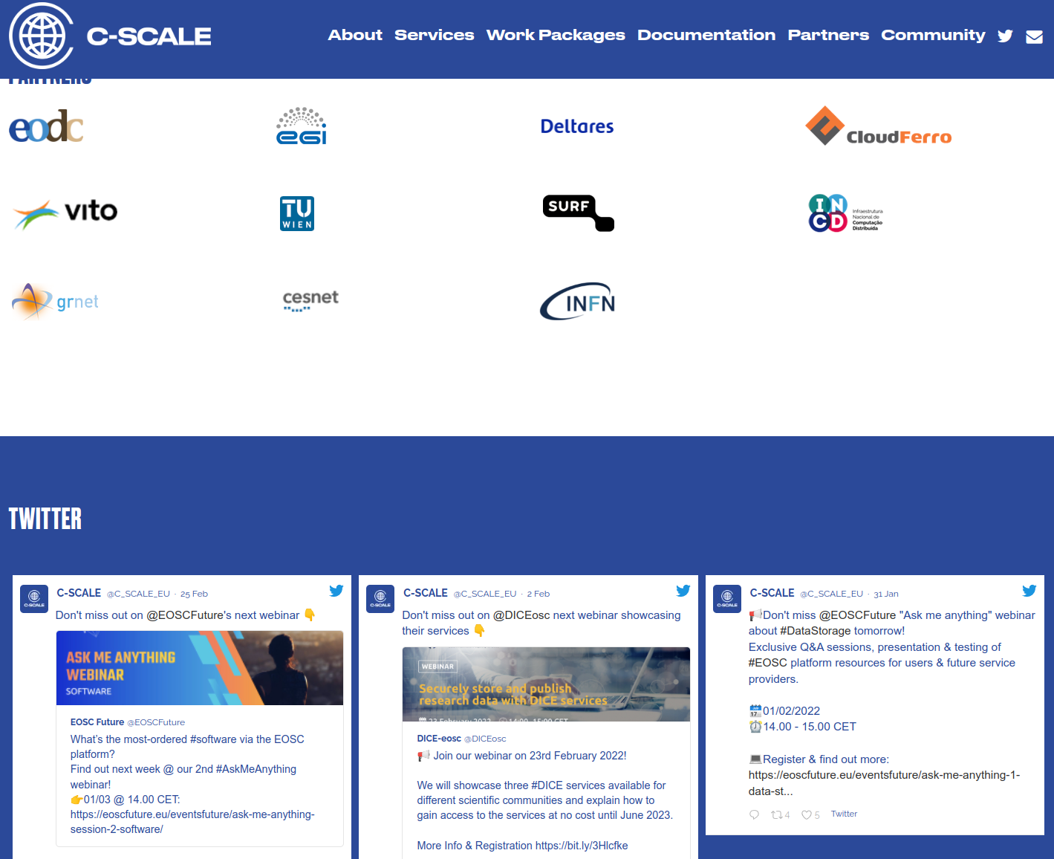
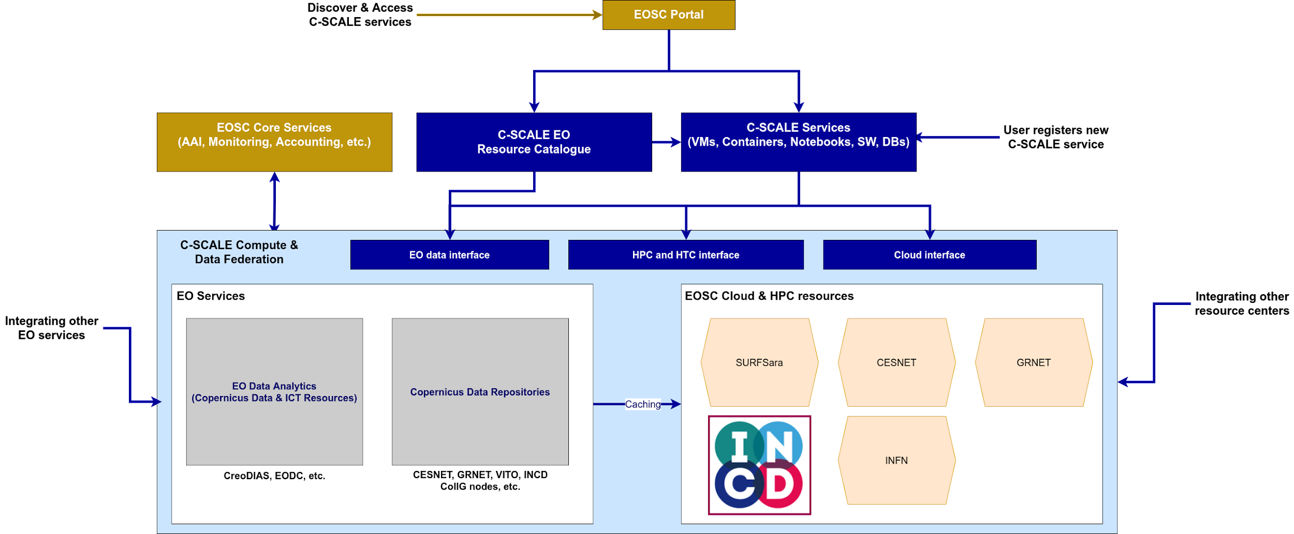
C-Scale: Copernicus - eoSC AnaLytics Engine
European Open Science Cloud (EOSC) project.
C-Scale (2021-2023) federate European Earth Observation infrastructure services such as Copernicus DIAS and others. Support Copernicus research and operations with large and easily accessible European computing environments.
INCD participation:
Providing cloud services.
Support to thematic services integration.
Data access and federation.
This project has received funding from the European Union’s Horizon 2020 research and innovation programme under grant agreement No 101017529.

