Slide 1
GÉANT Clouds Frameworks. Services Delivery
5th June 2023
Clouds Monday Session
Garvan McFeeley

Slide 2
Overview
What We Do
Consumption Figures

Slide 3
What we do
Operate Our Service Desk
Manage queries on the framework from providers
Eva’s team manages queries from NRENs
Reporting
Request, review and upload quarterly reports
Make country specific reports available for NRENs

Slide 4
What we do
Strategic Vendor Management
Manage interactions with key providers
WP IT/Automation
Manage O365 environment

Slide 5
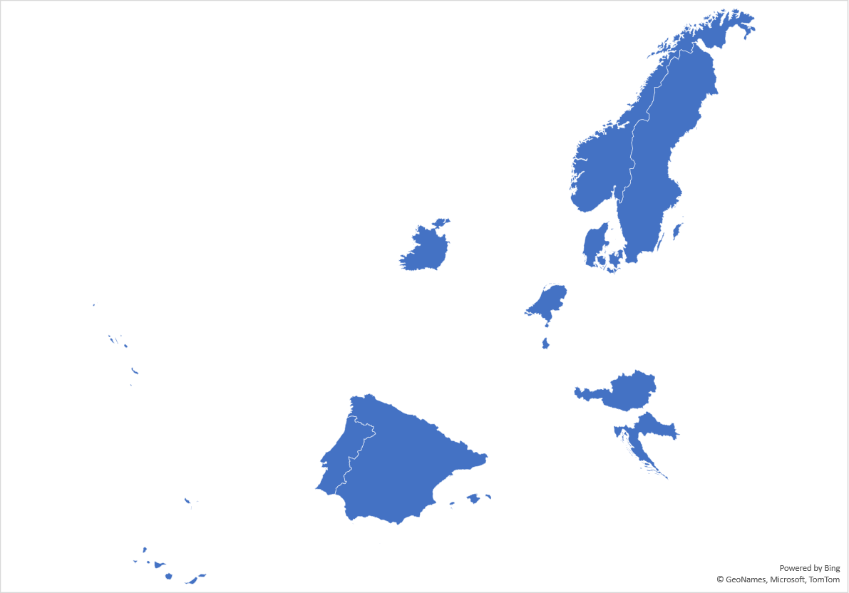
Countries using the frameworks - 2017

Slide 6
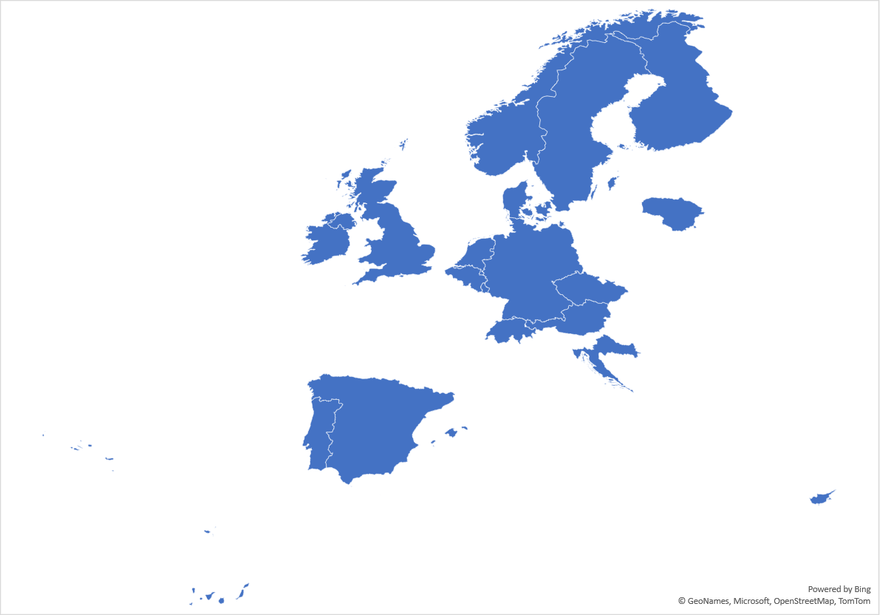
Countries using the frameworks - 2020

Slide 7
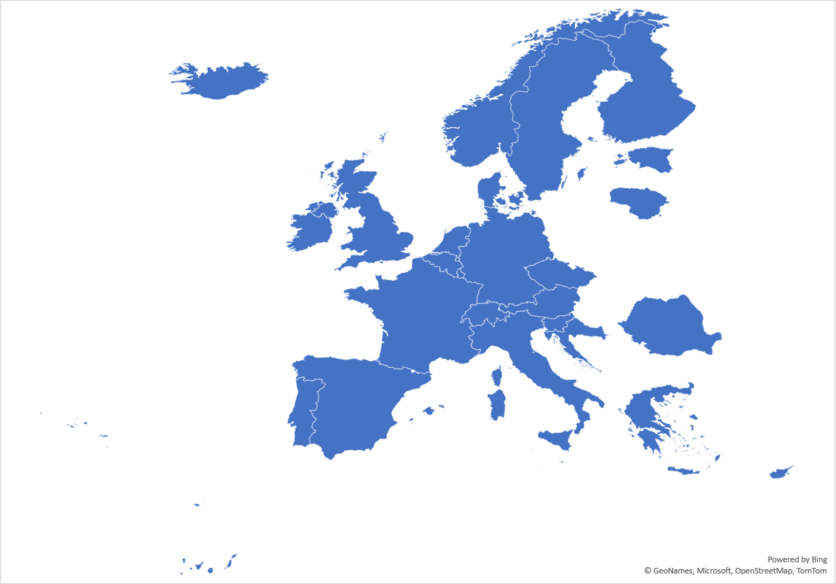
Countries using the frameworks - 2022

Slide 8
Countries using the frameworks - 2023

Slide 9
Countries using the frameworks

Slide 10
CONSUMPTION – per annum

Slide 11
CONSUMPTION – cumulative total

Slide 12
CONSUMPTION – Institutions

Slide 13
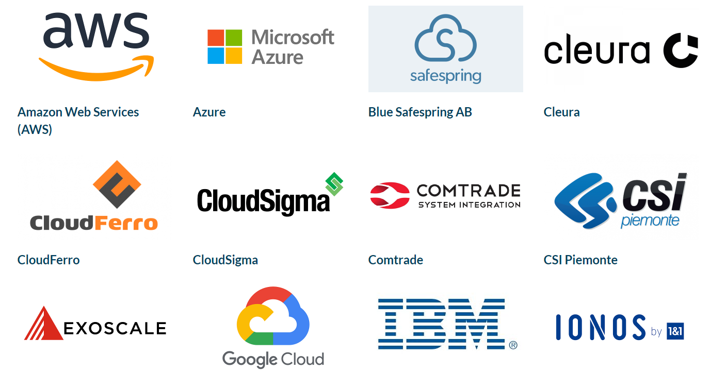
Platforms

Slide 14
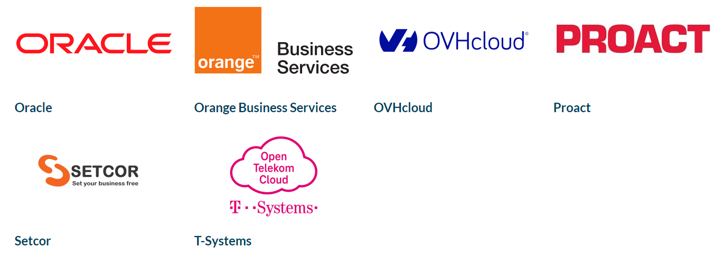
Platforms

Slide 15
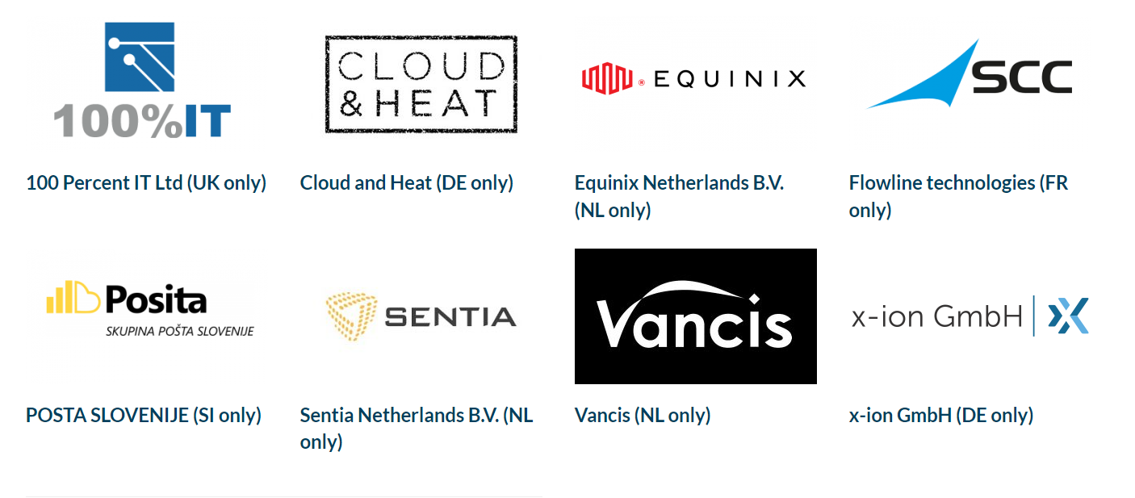
Platforms

Slide 16
Thank you
www.geant.org
© GÉANT Association
As part of the GÉANT 2020 Framework Partnership Agreement (FPA), the project receives funding from the European Union's Horizon 2020 research and innovation programme under Grant Agreement No. 856726 (GN4-3).

