Slide 1


context
GÉANT Cloud Services
Open Discussion on opportunities and barriers
Dave Heyns (GÉANT)
Monique Pellinkhof (GÉANT)
Tirana
Monday 5th June 2023

Slide 2



Discussion points
WHAT ARE CLOUD SERVICES?
WHO DO WE SERVE?
WHAT DO THEY NEED?
ALL ABOUT DATA
EOSC AND SIMPL
CASE STUDIES
USING THE OCRE FRAMEWORK
So much more than compute and storage
European (and beyond) R&E community
Bandwidth, security, cloud based services
The institutes and data autonomy
European Open Science Cloud and Data Spaces
GÉANT procured case studies
Contracts, contracts, contracts
Community ENABLEMENT
Next steps
💥
Notes:
This slide builds on click

Slide 3


Data Autonomy
What is it and why?
CONTROL Understanding of ALL data assets
SECURITY Protection – threat surveillance/response
PRIVACY Personal data (GDPR applies here)
ACCESS Identifying ownership and use
POTENTIAL SMART Campus/ Research/Administration
Business Intelligence
AI
Strategic
Advantage
Analytics
An Institute requires a carefully planned and implemented
DATA ARCHITECTURE in order to achieve Data Autonomy
Notes:
This slide builds on click

Slide 4


Data Architecture
Each and every data asset to be defined in terms of -
Description (meta-data)
Data/data elements must be described in a consistent way that allows an understanding of the relationships between data assets. ​
​Collection and curation
Data will be collected/produced in terms of workload (process support), but must be curated/modelled to reflect strategic relationships between data assets.
​Data policies and Access control
Data policies must describe how each data asset may be accessed and processed (and by whom).
​​Hosting
Data assets must be stored according to policy, be this on-premises; in the public cloud; in a community cloud. ​Data ownership and access policy does not vary across platforms.
Potential
Data modelling will help identify opportunities for the institutional harnessing of anonymised; collectivised behavioural data in support of academic/research excellence.
Notes:
This slide builds on click

Slide 5



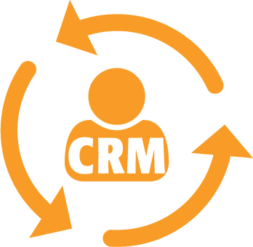















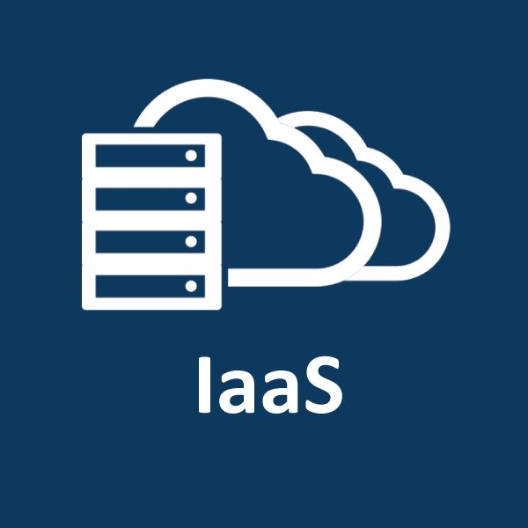
Data Assets - Curation and abstraction
HYBR ID
Typical Uni workloads -
On Prem
NREN
mobility LMS student
publish storage HPC
finance HR/HCM CRM
video conf. AAI network
PaaS
compliant
services support
academic
research
shared
Notes:
This slide builds on click

Slide 6







Data Assets – Hosting and processing
Academic workloads
Most enterprise software is slowly moving towards consumable SaaS.
It may be currently deployed in an on-premises D/C, or a private or community or public cloud (IaaS).
Consumable SaaS provides APIs for the Unis to extract and curate strategic structured data.
Legacy Business Intelligence solutions currently model data and provide strategic reporting.
SaaS is by nature GDPR compliant and secure (surveillance on commercial networks).
Research workloads
On premises hosting of HPC cluster (perhaps hybrid).
Trending towards on-demand consumable compute.
Research data storage in an on premises D/C, or private/community/public cloud (IaaS).
NREN (eg SURF Research Cloud) provision of hybrid cloud resources (IaaS/PaaS/SaaS).
PaaS providing bespoke research platforms (compute and storage) and containerisation.
Cloud hosting does not grant data access to commercial companies
Notes:
This slide builds on click

Slide 7


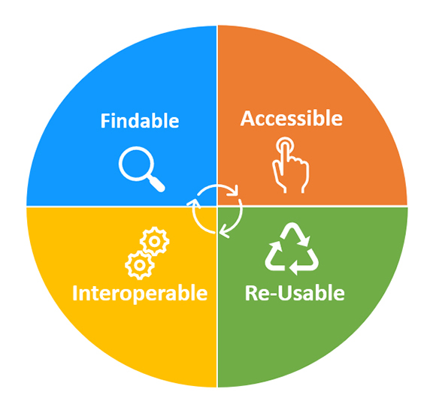

Data Sharing – Open Science and Data Spaces
Data Autonomy facilitates collaboration via institutional framework -
Data definition
Data must be described using standardised meta-data in order to be findable
Access policy
Is data Open; Restricted; Private. Restricted data accessed by request
Ownership
Data ownership must be identified and data may be licensed/copyrighted
Archival
Data must be archived according to the definition and rules considered above
Storage
Hybrid. Cold storage (meta-data online) cost effective and secure
European Data Spaces adopt the principles of
‘Data Visitation’ (ie. download unnecessary)
Notes:
This slide builds on click

Slide 8
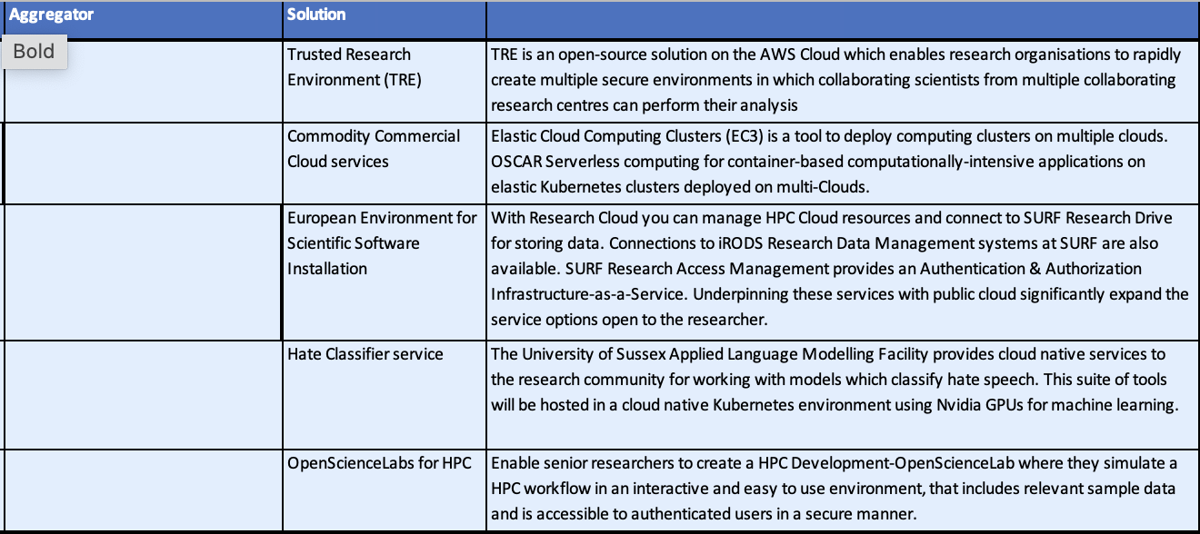







Some case studies
Commercial/COMMUNITY collaborations…
Portuguese National Distributed Computing Infrastructure
Final EOSC Future call now open ***
Notes:
This slide builds on click

Slide 9



Cloud Frameworks - Status
OCRE IaaS+ Framework (2020) replaced GÉANT IaaS framework (2016)
OCRE Framework -
Published on Tenders Electronic Daily (TED) on 15 April 2020.
IaaS+ tender fully compliant with all guiding principles of the EU tendering law procured under Dutch tendering law
LOT based – one supplier of each platform in each country (including hyperscale resellers **)
Competition between resellers per lot within the Framework
Market responded with 1100 bids across the 40 participating countries.
473 framework contracts have been awarded –
  37 platforms represented.
  Minimum 9 platforms per country
  Maximum 17 platforms per country
Notes:
This slide builds on click

Slide 10

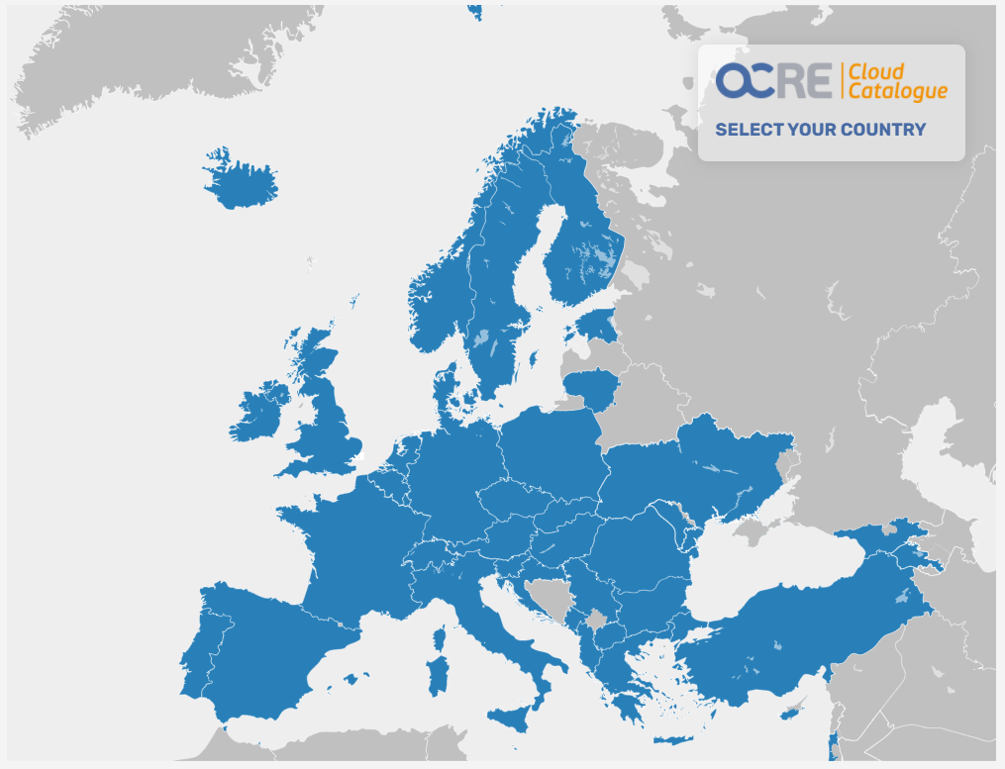
Cloud Frameworks – OCRE continued
A Framework that benefits the whole GÉANT Community
NO NEED TO TENDER SEPERATELY!!
Broad Catalogue of Cloud and Digital Services
Negotiation power and economy of scale
Good rates and tariffs
Favorable terms & conditions
Local (language) support
Part of a growing network of institutions and researchers using these frameworks
Access to sr. management at supplier, support and escalation available via GÉANT
Ongoing investment and feedback
GÉANT Cloud Services now registered on EOSC Future Marketplace
Notes:
This slide builds on click

Slide 11
Cloud Frameworks – OCRE continued
NREN's
Local laws
IaaS+
Irish law
Local laws
Users
GÉANT as CPB
Compliant. Contracts. Management. Reporting.
EU Procurement Directive compliant TENDERPROCEDURE
GÉANT mandated by the NREN’s as CPB
CPB = Central Purchasing Body
GÉANT Tendered as CPB -> Dutch public procurement legislation (for all involved)
Published on TED
GÉANT Contract Management Group:
Single point of contact
Pan European NREN representation/support
Monitoring results and consumption
Supplier engagement
Contract compliance
Contract management
Framework contract
EU Tender
Quarterly reports
Cloud Forum
Organising Trainings
Sharing experience and
knowledge exchange
Notes:
This slide builds on click

Slide 12
Framework procurements – experiences
Distribution of European adoption funding
Benefits of the cloud resources!!
Access to state of the art technology
Agility: scalability and flexibility
Speed of implementation
Cost: pay as you go
Big diveristy in compute
Faster results
Choice of instance to better fit
Great technical support
Challenges of the cloud!!
Improve data transfer
Integrate with excisting workflows
Extend use to researchers
Difficult to estimate cost in advanced
Security, data policy
Vendor lock in “Terraform”
Distribution of €12M in cloud services!!
22 countries represented
All science disciplines
120 research proposals
Use of SPV (Single Purpose Voucher)!!
GÉANT procures from FW contract holder
Institute signs call-off and consumes
Notes:
This slide builds on click

Slide 13
Framework procurements – experiences
Direct Award
Not economically feasible
Not available on other
Mini-desktop competition
Evaluate all Suppliers in Lot
Reuse GÉANT’s awarding criteria and scores
Mini-competition
Invite all resellers in Lot
Apply the award criteria
Licensing arrangements
Use price Online Cost Calculators
Score – award – stand still period
Distribution of European adoption funding
Benefits of the cloud resources!!
Three methods of signing Call Off Contracts under the Framework
While running a mini-competition Institutions responsible for scoring and awarding decision
Call of Contracts as result of a mini-competition or direct award between reseller and institute
Direct award possible on conditions
NREN facilitates relationships between supplier and local R&E community
Create demand
Minimum requirements & criteria
Choose procurement option
Direct, mini-desktop or competition
Award
Evaluate and Contract
Notes:
This slide builds on click

Slide 14
Cloud Frameworks – NEXT…..
Inventory -Strategize
Evaluate - Select
Award - Contract
Supply
Demand
Compliance
Best value on Commercial Cloud
Re-procurement of the 2024 IaaS+++ FW
NREN input…
NREN input…
NREN input…
NREN input…
PARTICIPATION!!!
💥
Jan.–Mar. 2023
Establish procurement task force
Mar.–Nov. 2023
Determine procurement strategy
Dec. 2023
ITT ready
Jan. 2024
Launch the procurement
Dec. 2024
OCRE II in place
Notes:
This slide builds on click

Slide 15





















GÉANT - Cloud enablement sessions
A Framework that benefits the whole GÉANT Community
Providing local support and aid at NRENs and Institutions on -
Adoption of Cloud Services within R&E community
Implemenation of the Framework within local laws
Legal advice and compliance
Bespoke negotiations
Calling of Contracts under the Framework
Creating use cases
Sharing best practices & lessons learned
Feedback and development of the Framework
REACH OUT!!! REACH OUT!!! REACH OUT!!!
Notes:
This slide builds on click

Slide 16
Thank you
Any questions?
david.heyns@geant.org
monique.pellinkhof@geant.org

