Slide 1
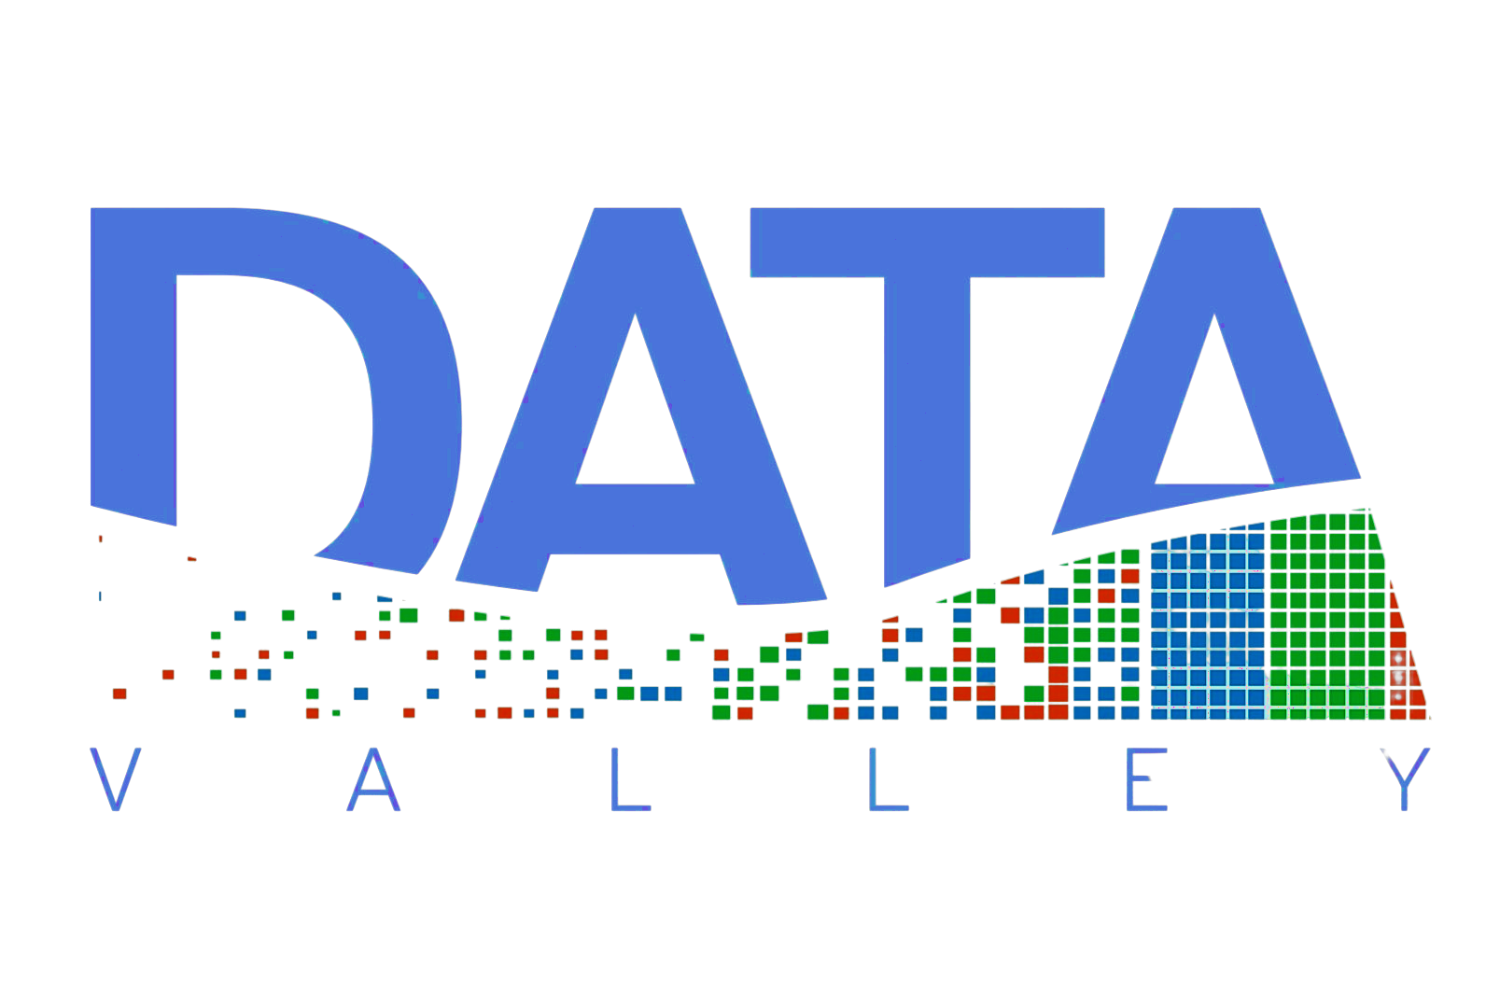

Slide 2
Data Valley is a company, think tank and community specialized in the development of data-driven business models, sharing models and data spaces, and AI applications.
www.datavalley.it

Slide 3












Team
The team consists of university researchers, start-up experts, lawyers specializing in data models and compliance, and artificial intelligence experts.
Carlo Rossi Chauvenet
Silvia Martinelli
Antonio Iannuzzi
Sara Gobbato
Laura Zoboli
Chiara Gallese
Francesca Filosa
Sebastiano Seccaneo
Daniele Panfilo
Pietro Giovanni Bizzaro
Andrea Filippo Ferraris

Slide 4














Data Valley takes an integrated approach that includes:
strategic research,
consulting,
policy advisory,
education and outreach.

Slide 5
Data Valley approach
Focus
Data Valley takes an integrated approach that includes:
strategic research,
consulting,
policy advisory,
education and outreach.
Data Strategy and Data Monetization;
Interactions and integration between Big Tech and small and medium enterprises;
Creation of Data Space and data sharing models;
AI Training and AI risk management.

Slide 6

Services
Algorithm & AI accountability
How to protect yourself with respect to decisions made by AI and algorithms? We help you evaluate the ethical and legal aspects related to the use of algorithms and AI.
Given the complexity of the technological world, we organize training events on the topic so that companies and entities can stay up to date.
Data Education
Data Mapping helps consolidate data by extracting it, transforming it and loading it onto a target system. It is the initial step in any data process. Companies can map and transform data to produce relevant insights and improve business efficiency.
Data Mapping

Slide 7
Services
We help SMEs implement a proper data strategy, define a program for data management and the best techniques for data monetization.
Business Modeling
Processing more data than necessary poses a risk. Data minimization refers to the practice of limiting the collection of personal information to that which is directly relevant and necessary to achieve a specific purpose.
Data minimization
Third party management and contract assessment
The tool for defining and managing relationships is the contract. To the papyri forgotten and renewed upon expiration without much care there are smart and technological alternatives.

Slide 8

Data Valley as policy Advisor
Data Valley organizes working tables with the participation of stakeholders from different sectors to share experiences, analyze regulations, and propose policies and protocols that facilitate data sharing and reuse in individual supply chains and for a specific target sector. From the identified pools of experts, Data valley encourages the establishment of new working teams to devise innovative projects.

Slide 9





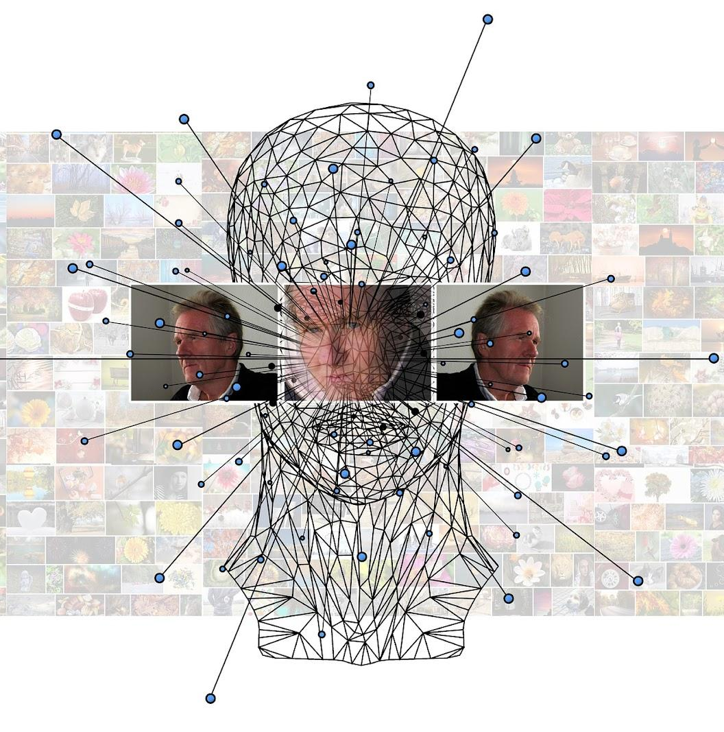

Working Tables
Goal: analyse the state of the art, define best practices and shared models
E-health
Agriculture
Tourism
Smart Cities & Urban Data
Algorithms
Data Sharing of e-health data
Smart Sustainability
Data Re-use & Tourism Platforms
Liability, responsibility, accountability

Slide 10

E-health working table
Data Valley organized a heterogeneous working table to delve into the dialogue between experts, hospitals, pharmaceutical companies, associations, and others in the field on the topic of leveraging data for research and for the development of new solutions and forms of interaction.
The issues we focused on:
- the sharing of data, personal and non-personal;
- anonymization and new techniques used, such as synthetic data;
- the forms for sharing (licenses, partnerships, consortia);
- the creation of new data-driven products and services in the health sector.

Slide 11
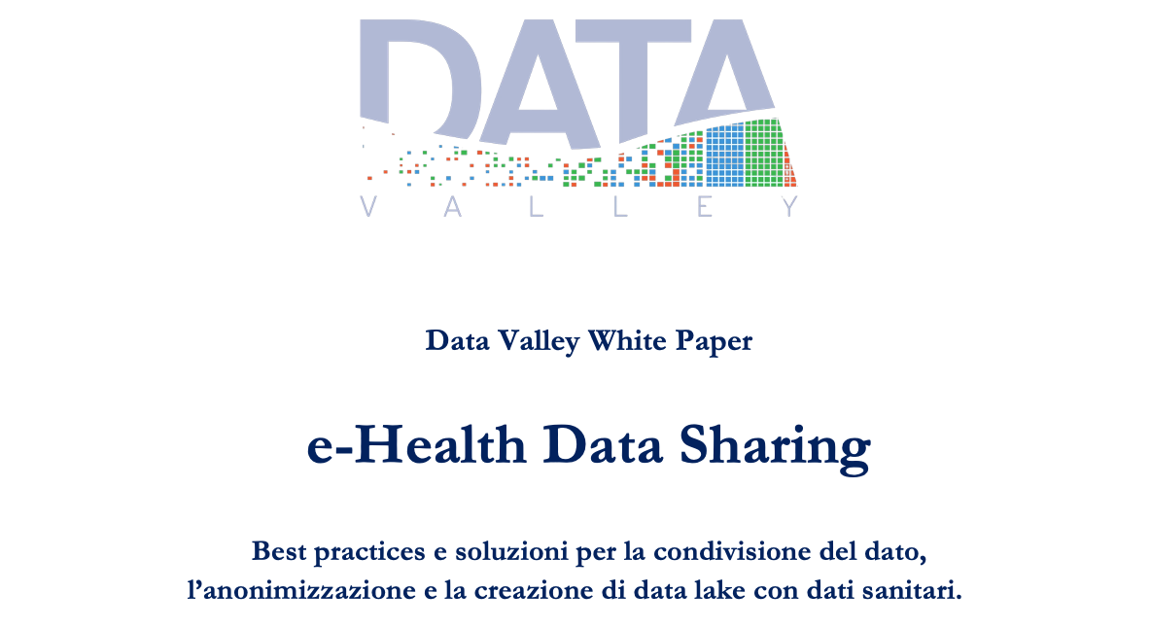
The White Paper on e-health data sharing
The regulatory framework and technical barriers can hinder the adoption of efficient technology solutions at the expense of patient care.
To address this need, Data Valley organized a heterogeneous working table to explore in dialogue between experts, hospital facilities, pharmaceutical companies, associations and other stakeholders the topic of leveraging data for research and for the development of new solutions and forms of interaction.

Slide 12


The needs: building a technology standard and legal framework for data sharing
The spread of digital health and data-driven technologies in the biomedical field has the potential to ensure better disease prevention, personalized therapies and more accurate diagnoses of patients.
However, creating an efficient system requires the adoption of:
a shared technology standard in order to overcome technological barriers that prevent true data sharing between different facilities;
a legal framework to protect citizens' personal data and, at the same time, ensure high quality of processed data.

Slide 13
Making the EU a role model for a society empowered by data.
The European data strategy aims to make the EU a leader in a data-driven society. Creating a single market for data will allow it to flow freely within the EU and across sectors for the benefit of businesses, researchers and public administrations.
People, businesses and organisations should be empowered to make better decisions based on insights from non-personal data, which should be available to all.
European Data Strategy

Slide 14

The EU will create a single market for data where:
data can flow within the EU and across sectors, for the benefit of all;
European rules, in particular privacy and data protection, as well as competition law, are fully respected;
the rules for access and use of data are fair, practical and clear.
A single market for data

Slide 15
The EU will become an attractive, secure and dynamic data economy by:
setting clear and fair rules on access and re-use of data;
investing in next generation tools and infrastructures to store and process data;
joining forces in European cloud capacity;
pooling European data in key sectors, with common and interoperable data spaces;
giving users rights, tools and skills to stay in full control of their data.
A single market for data

Slide 16
Common European standards and effective enforcement mechanisms should ensure that:
data can circulate within the EU and across sectors;
European norms and values, especially personal data protection, consumer protection legislation and competition law, are fully respected;
rules on data access and use are fair, practical and clear, and clear and reliable data governance mechanisms are established;
the approach to international data flows is open but assertive, based on European values.
Common European norms

Slide 17
Data Sharing
Business use of public sector information (data sharing between government and business - government-to-business, G2B).
Sharing and use of data held by individuals by other companies (data sharing between companies - business-to-business, B2B).
Use of privately held data by public authorities
Data sharing among public authorities.

Slide 18
The goal is, therefore, to improve the conditions and mechanisms for data sharing in the internal market by creating a harmonized framework for data exchange, both for access and reuse.
Specifically, the new regulation will establish a common legal framework by intervening:
On public sector data sharing,
On intermediary services for sharing data between enterprises and stakeholders provided for remuneration; and
on "data altruism," or the collection and processing of data made available for altruistic purposes by individuals and legal entities.
Data Governance Act

Slide 19
The goal is to ensure the fair allocation of the value of data among economic actors and to promote access to and use of data.
Facilitate access to and the use of data by consumers and businesses, while preserving incentives to invest in ways of generating value through data.
Provide for the use by public sector bodies and Union institutions, agencies or bodies of data held by enterprises in certain situations where there is an exceptional data need.
Facilitate switching between cloud and edge services.
Put in place safeguards against unlawful data transfer without notification by cloud service providers.
Provide for the development of interoperability standards for data to be reused between sectors.
Data Act

Slide 20

Purpose
The white paper aims to help define the regulatory and technical framework that represents the new level playing field in which health sector actors are increasingly called upon to operate.
The white paper produced by the working table describes the legal and technical state of the art and perspectives in the collection, access, preservation, use and reuse of health data.
The publication of the white paper "E-health Data Sharing" marks the conclusion of the first phase of a journey and the starting point for building a multi-stakeholder discussion, involving institutions, academia and the private sector.

Slide 21
Issues
Three obstacles:
Sensitive data - the use of personal data requires the application of all the principles, cautions and procedures provided by our legal system for the processing of personal data;
Data protection and governance - the sharing of data among different entities requires agreements, partnerships or the construction of new legal structures to manage the governance of the data and to regulate all potential issues that may arise from the sharing itself;
Standardization - the use of scalable and compliant data processing technology and software integration, for real-time communication between systems, for data quality, as well as for reaching the end customer itself, accessing the desired interface or product.

Slide 22
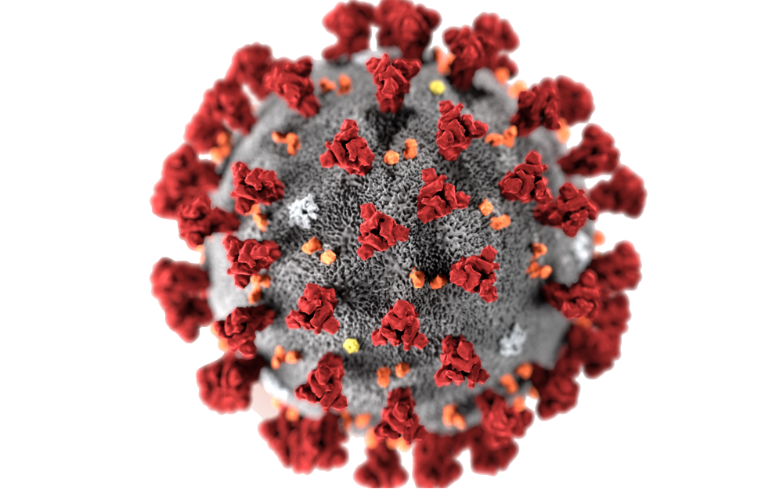
The Covid lesson
The Covid-19 pandemic has prompted a global trend of digital transition in healthcare.
The current emergency situation has demonstrated how international collaborations and global sharing of health data have been essential tools for health research, yet legal obstacles prevent data sharing for research purposes in normal situations, with potentially harmful effects on citizens and patients.

Slide 23

European Health Data Space
The EU4Health program will fund the creation of a European health data space to promote better exchange and access to different types of health data, not only to support health care delivery, but also for health research and health policy making.
The European Health Data Space will revolve around three pillars:
a strong data governance system and a framework of rules for data exchange;
data quality;
creation of a framework to enable interoperability.

Slide 24
Dato personale, dato anonimo e dato pseudonimo
Dato personale: (ex art. 4 GDPR) qualsiasi informazione riguardante una persona fisica identificata o identificabile. (...) identificabile è la persona fisica che può essere identificata, direttamente o indirettamente, con riferimento a un identificativo come il nome (...) a uno o più elementi caratteristici della sua identità fisica, genetica(...).
Dato anonimo: (ex considerando 26 GDPR) informazioni anonime, vale a dire informazioni che non si riferiscono a una persona fisica identificata o identificabile o a dati personali resi sufficientemente anonimi da impedire o da non consentire più l'identificazione dell'interessato.
Pseudoanonimizzazione: mezzo per ridurre i rischi per gli interessati “nascondendo” l'identità degli individui in un dataset, ad esempio, sostituendo uno o più identificatori personali con i cd. pseudonimi. Stante possibilità de re-identificare, dati pseudoanonimi ancora sottoposti a GDPR.

Slide 25
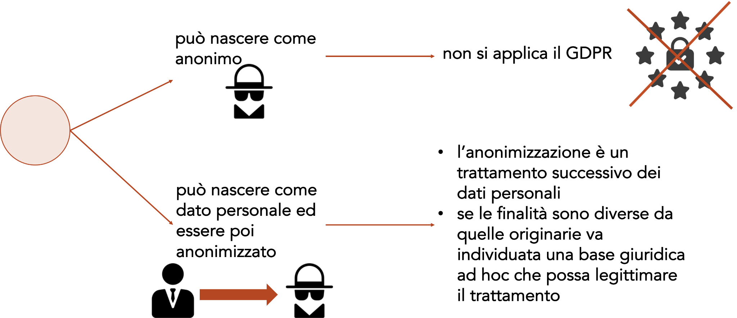
Dato personale, dato anonimo e dato pseudonimo nel GDPR
Dato

Slide 26
Personal data, anonymous data and pseudonymous data in the GDPR
Recital 26: The Regulation applies to anonymous information (information that does not relate to an identified or identifiable natural person or to personal data rendered sufficiently anonymous that identification is prevented or no longer possible).
Two readings:
Absolutist (WP29), so-called 0-risk test
Two additional criteria (in addition to the de-identification test).
(i) linkability of information about the individual in different datasets; and,
(ii) inference, i.e., the ability to infer, with significant probability , the value of an attribute from the values of a set of other attributes
Relativist:
considers only the efforts required to identify an individual, without delving into the realm of mere theoretical possibilities.
That is, a test of the reasonable likelihood that particular data, can be (re)linked to the natural person to whom they originally related. If answer yes qualified as personal data, vice versa no.

Slide 27



Health data
Health data are considered sensitive according to GDPR
personal data revealing racial or ethnic origin, political opinions, religious or philosophical beliefs, or trade union membership, as well as dealing with genetic data, biometric data intended to uniquely identify a natural person, data relating to a person's health or sex life or sexual orientation.
(ex art 9)
&
Health status data concern the physical or mental condition of the individual whether past, present, or future.
(ex recital 35)

Slide 28

Health Data
The GDPR seeks to reconcile the protection of the individual, (sensitive information) with the need for relevant activities such as scientific research to take place.
Recital 159 suggests latu sensu interpretation of the term research, making it include privately funded research as well as studies carried out in the public interest in the field of public health.
In line with Art 179 TFEU, whereby researchers, scientific knowledge and technologies should be able to circulate freely.

Slide 29
Health data
With respect to the processing of health-related data for scientific research purposes, it is necessary to distinguish between two different uses that can be made of these data.
Primary use: when such data are collected directly for scientific study purposes.
Secondary use: when the health-related data that are used research purposes were originally collected for other purposes (e.g. to the case of retrospective observational studies).

Slide 30
Health data, observational studies, and data reuse
The observational method: developed for epidemiological research, defined this as the study of the distribution and determinants of health-related situations or events in a specific population, and the application of this study to the control of health problems.
Observational studies can be
prospective and retrospective
Both exposure and outcomes of interest have not yet occurred, so data are collected prospectively and directly for the specific purposes of the study.
Both exposure and outcomes of interest already occurred. The data are collected retrospectively-as they are recorded in different datasets-and thus involve further processing of data initially collected for other purposes ("secondary use").

Slide 31

Sharing health data
Health and welfare systems need profound reforms and innovative solutions to become accessible and effective in providing care to European citizens.
Data sharing is an essential step in achieving these goals: however, data are often available in formats that do not guarantee interoperability and are often managed differently both across member states and within national health systems.

Slide 32

Sharing health data
This vision has been described and incorporated within the EU4Health Program for 2021-2027, aimed at digital transformation of health services, promotion of interoperability. The EU4Health program represents the European Union's response to the deployment of Covid-19.
The program will also fund actions related to the creation of the European Health Data Space, among others.

Slide 33
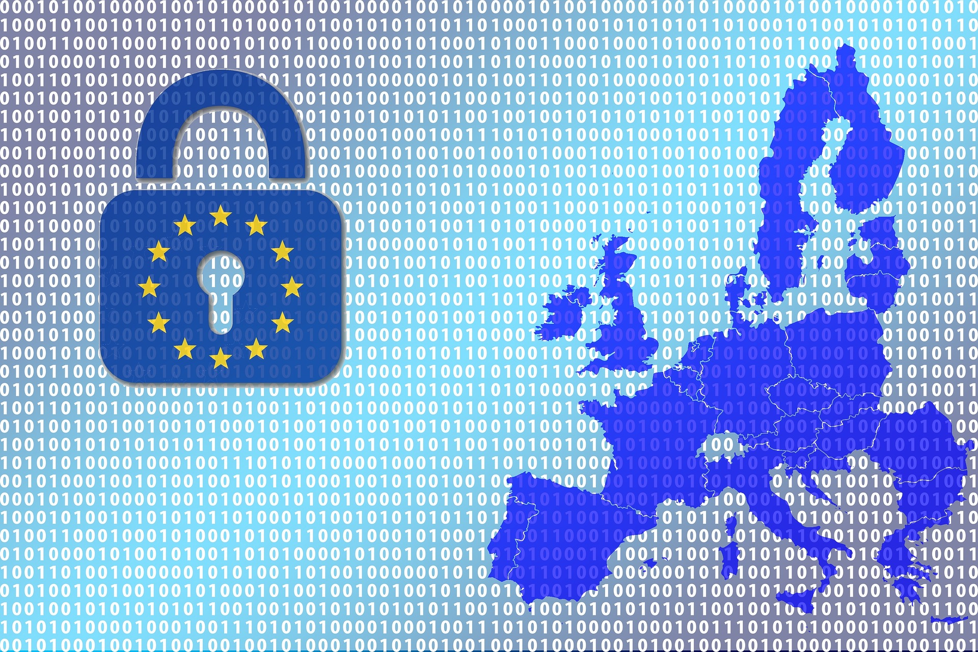
The European Health Data Space (‘EHDS’)
The European strategy for data proposed the establishment of domain-specific common European data spaces. The European Health Data Space (‘EHDS’) is the first proposal of such domain-specific common European data spaces and will be an integral part of building a European Health Union.

Slide 34
Sharing Health data
Addressing challenges to electronic health data access and sharing:
EHDS will create a common space where natural persons can easily control their electronic health data. It will also make it possible for researchers, innovators and policy makers to use this electronic health data in a trusted and secure way that preserves privacy;
Sharing health data will promote a single digital health market, covering health services and products, including telemedicine, telemonitoring, and mobile health;
Sharing health data will enhance the development, deployment, and application of reliable digital health products and services, including those incorporating artificial intelligence in the health sector;
Sharing health data will establish an appropriate legal and governance framework to cover access to and exchange of health data for health care delivery, research, policy-making, and regulatory activities.

Slide 35

Primary use of Health Data
European Health Data Space (‘EHDS’) will improve access to and control by natural persons over their personal electronic health data in the context of healthcare (primary use of electronic health data).
Single market for digital health products and services (tele-health and m-health)

Slide 36

Primary use of Health Data: challenges
Electronic health data:
Availability of health data in digital format;
Technical and semantic interoperability;
Tools and infostructures.
Digital health:
Reimbursement;
Interoperability;
Certification;
Data protection and accountability

Slide 37

Primary use of Health Data: challenges
Electronic health record exchange format;
Cross borders infostructure for health-data exchange: MyHealth@EU platform is now implemented in only 10 Member States and it is currently supporting only two services (electronic prescription and patient summary)

Slide 38
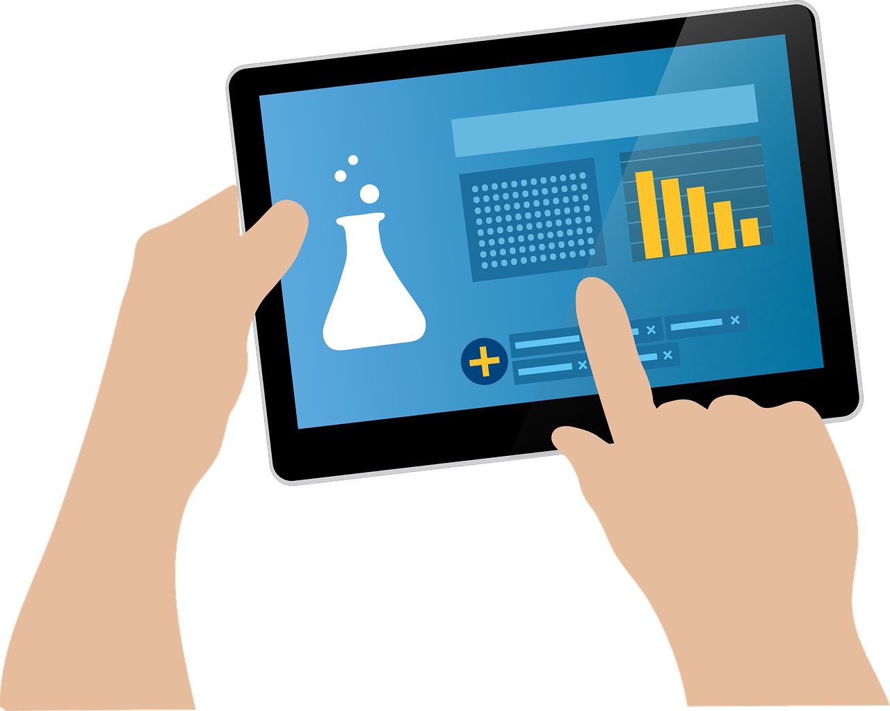
Secondary use of Health Data
European Health Data Space will also support health research, innovation, policy-making, regulatory purposes and personalised medicine purposes.

Slide 39

Secondary use of Health Data
This Regulation provides the legal basis in accordance with Articles 9(2) (g), (h), (i) and (j) of Regulation (EU) 2016/679 for the secondary use of health data, establishing the safeguards for processing, in terms of lawful purposes, trusted governance for providing access to health data (through health data access bodies) and processing in a secure environment, as well as modalities for data processing, set out in the data permit (Recital 37)

Slide 40
Secondary use of Health Data
Considering the administrative burden for health data access bodies to inform the natural persons whose data are used in data projects within a secure processing environment, the exceptions provided for in Article 14(5) of Regulation (EU) 2016/679 should apply. Therefore, health data access bodies should provide general information concerning the conditions for the secondary use of their health data containing the information items listed in Article 14(1) and, where necessary to ensure fair and transparent processing, Article 14(2) of Regulation (EU) 2016/679, e.g. information on the purpose and the data categories processed. Exceptions from this rule should be made when the results of the research could assist in the treatment of the natural person concerned. In this case, the data user should inform the health data access body, which should inform the data subject or his health professional (Recital 44)

Slide 41
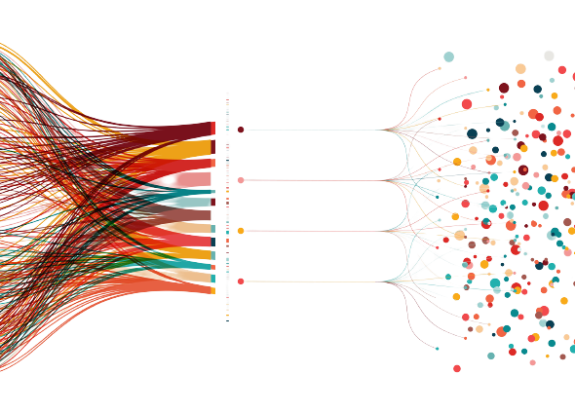
How?
From personal data to non personal data

Slide 42
Recital 26, GDPR, pseudonymous data
‘[...] processing of personal data in such a manner that the personal data can no longer be attributed to a specific data subject without the use of additional information, provided that such additional information is kept separately and is subject to technical and organisational measures [...]’
(Art. 4(5) GDPR)

Slide 43

“[...] the processing of personal data in such a manner that the personal data can no longer be attributed to a specific data subject without the use of additional information, provided that such additional information is kept separately and is subject to technical and organisational measures to ensure that the personal data are not attributed to an identified or identifiable natural person [...]”
(Art. 4(5) GDPR)
Pseudonymised data

Slide 44
Pseudonymization
Different anonymization techniques:
Hashing functions
Hashing functions and salt
Hash encryption with stored key
Encryption with a secret key
Symmetric
Asymmetric
Tokenization
Pseudonymization
Pseudonymization aims to replace the identifying attributes of a piece of data with other values that do not allow for subject identification. It is often a reversible process.

Slide 45
Recital 26, GDPR, anonymous data
‘[...] The principles of data protection should therefore not apply to anonymous information, namely information which does not relate to an identified or identifiable natural person or to personal data rendered anonymous’
(Recital 26, GDPR)

Slide 46

Health data and privacy
Access to and reuse of health data are often hindered by the fact that the personal information contained within this data, if improperly disclosed, could cause a serious breach of the right to privacy.
Technically, there are several approaches to protecting the privacy of individuals ranging from standard anonymization and pseudo-anonymization solutions to modern data synthesization.
This requires that the person in charge of managing the health information asset meet the highest standards aimed at protecting the privacy of individuals.

Slide 47
Anonymization
Different anonymization techniques:
Randomization
Addition of noise;
Permutation;
Differential privacy.
Generalization\Aggregation
K-anonymity
L-diversity/T-vicinity
Anonymization
is that process of data obfuscation that irreversibly involves the total removal of the identifying element.

Slide 48

Synthetization
The data generated are highly representative of the input statistical distribution, such that when used for descriptive statistical analysis they exhibit results that are statistically comparable to those obtainable with real data.
Synthetization
completely new paradigm for personal data management. modern data synthesizing solutions based on generative machine learning models represent a completely new paradigm for personal data management.
The identification of real subjects or the possibility of membership attacks (MIAs), in the absence of access to the parameters of the generating model or the actual dataset is unlikely and much more complex when compared to the case of MIAs on discriminative models.

Slide 49
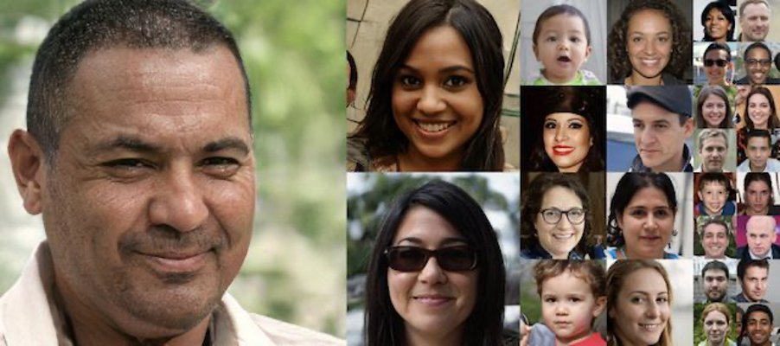
Synthetic Data
Synthetic data are data created through generative machine learning models.

Slide 50

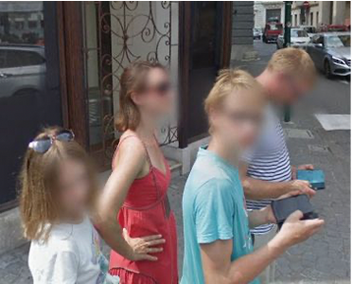
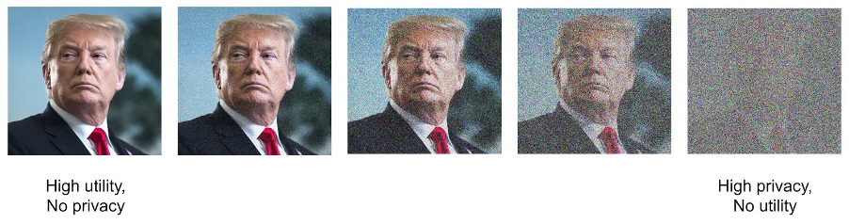
Synthetic data
Sometimes anonymization techniques open risks of re-identification.
Anonymizing data using traditional methods often implies a loss of data quality and usefulness

Slide 51
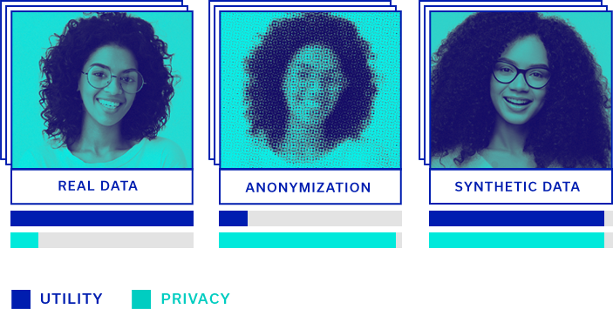

Slide 52
What are Synthetic Data?
Synthetic data are information generated by taking an original data source (dataset) and create new, artificial data, with similar statistical properties, from them.
Keeping the statistical properties means that anyone analysing the synthetic data should be able to draw the same statistical conclusions from the analysis of synthetic data or of the “original” ones.

Slide 53



GDPR does apply
Personal
can be anonymized, however, if the purposes are different from the original ones, it is necessary to identify an ad hoc legal basis that can legitimize the processing.
Data
Anonymous
GDPR does not apply
product originating from real data: synthetic information has almost-identical statistical inference but it’s not referable to data subject. GDPR shall not be considered applicable
Synthetic
Notes:
Dato anonimo è dato personale.

Slide 54

Synthesization is a processing activity …
Synthesization, like anonymization, is the result of processing personal data for the purpose of irreversibly preventing the identification of the data subject.
The process of generating synthetic data configures a processing of personal data under Article 4 GDPR.

Slide 55
Purpose of the processing …
Processing activities that allow the synthesization constitute a further processing of personal data, which had already been collected for a specific purpose.
The further processing of data should not be incompatible with the original purpose of their collection.
To verify this, the further activity must be subject to the so-called "compatibility test" (Opinion 03/2013 WP29).

Slide 56


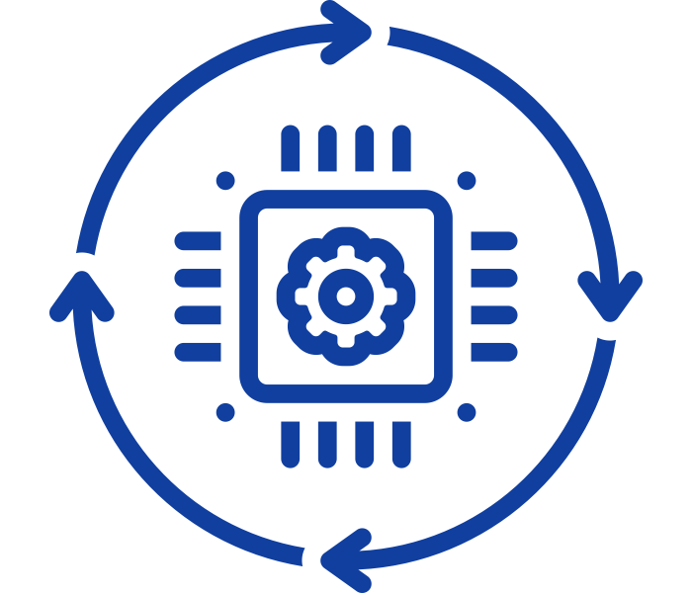
Starting from a real dataset
you train an artificial intelligence system instructed to detect statistical correlations in the original dataset
A new data set is generated that maintains the same statistical distribution as the original

Slide 57

Aindo
Aindo srl has developed a technology based generative machine learning models for producing synthetic data in a health care context.
The artificial patient, generated by means of AI models, has the statistical characteristics of the real one, maintaining usefulness during analysis but preventing re-identification of real subjects or sharing of personal information.
This technology facilitates medical research and development projects by speeding up data access time and enabling sharing of the statistical asset without compromising patient privacy.

Slide 58
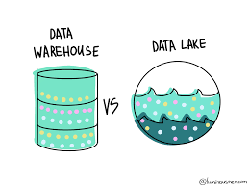
Data lake
Repository of structured and filtered data, already processed for a specific purpose
Huge raw data set whose purpose is not yet defined
Notes:
Aspetti in cui il Data Lake si differenzia dal Data Warehouse:
Raccolta dei dati. A differenza del Data Warehouse, il Data Lake non necessita di una strutturazione ex ante del dato. Anzi, trova proprio nella capacità di accogliere dati strutturati, semi-strutturati e destrutturati il suo punto di forza.
Elaborazione dei dati. Nel Data Warehouse viene definita a priori la struttura del database, i dati vengono scritti nella struttura predefinita e poi letti nel formato desiderato (Schema-on-write). Nel Data Lake, invece, sono acquisiti nel formato nativo e ogni elemento riceve un identificatore e un insieme di metadati a corredo (Schema-on-read).
Agilità e flessibilità. Essendo un repository altamente strutturato, cambiare la struttura di un Data Warehouse può risultare molto dispendioso in termini di tempo. Un Data Lake, all’opposto, consente di configurare e riconfigurare facilmente modelli, query e app live e di procedere al Data Analytics in modo più flessibile.

Slide 59

Contatti:
info@datavalley.it
silvia.martinelli@datavalley.it
paola.aurucci@unito.it

