Slide 1
ScienceMesh: A Federated Open Research Infrastructure
Guido Aben (AARNet), slides by Pedro Ferreira (CERN)
SIG-CISS, TNC22, 13/06/2022

Slide 3
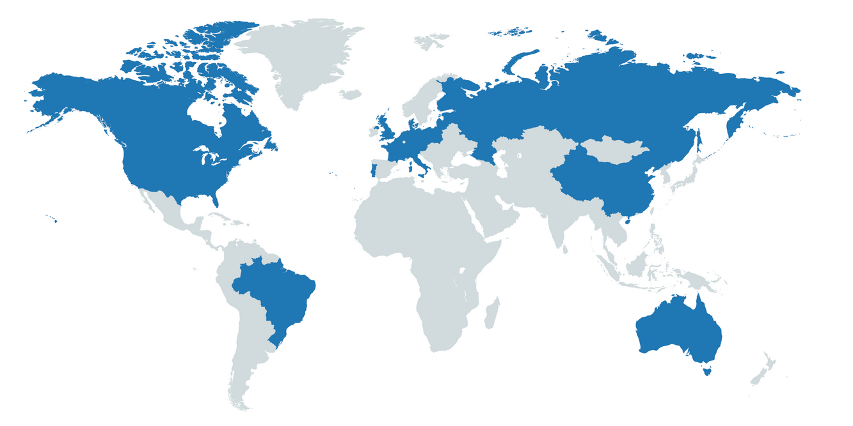
CS3 Community
Several EFSS nodes providing valuable services to the community
Mostly Sync and Share, but not limited to that
User environments, higher level applications (e.g. editors, data analysis…)
CS3 Site Reports:
~16 PB of data
> 20 nodes
> 400.000 users
> 3.5 billion files/directories

Slide 4
What is ScienceMesh?
Decentralized Mesh of EFSS nodes
Based on Open Standards and Open Source Software
Federated research space for Europe
Promote Open Science, Collaborative Research and support Full Research Lifecycle
Interoperability Platform to develop and connect new applications
Close collaboration with EFSS industry and other commercial partners

Slide 5
Partners

Slide 6
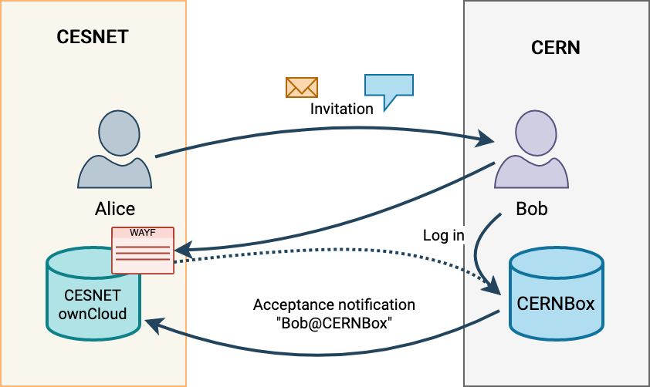
Simplest Case

Slide 7
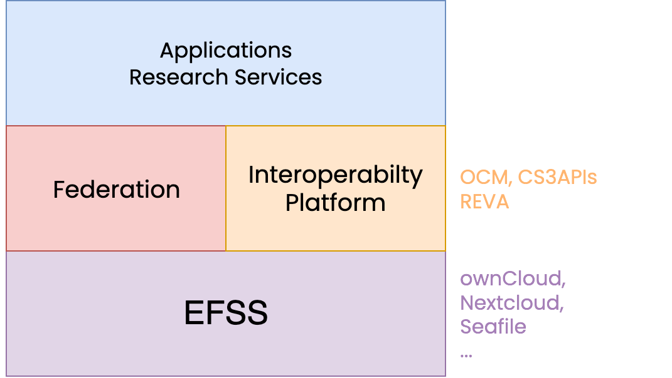
New domain-specific applications developed
in the community
Lightweight add-on
Easy to deploy and install new functionality
Build upon existing infrastructure and long-term efforts
Connect to already deployed and commercially supported products

Slide 8
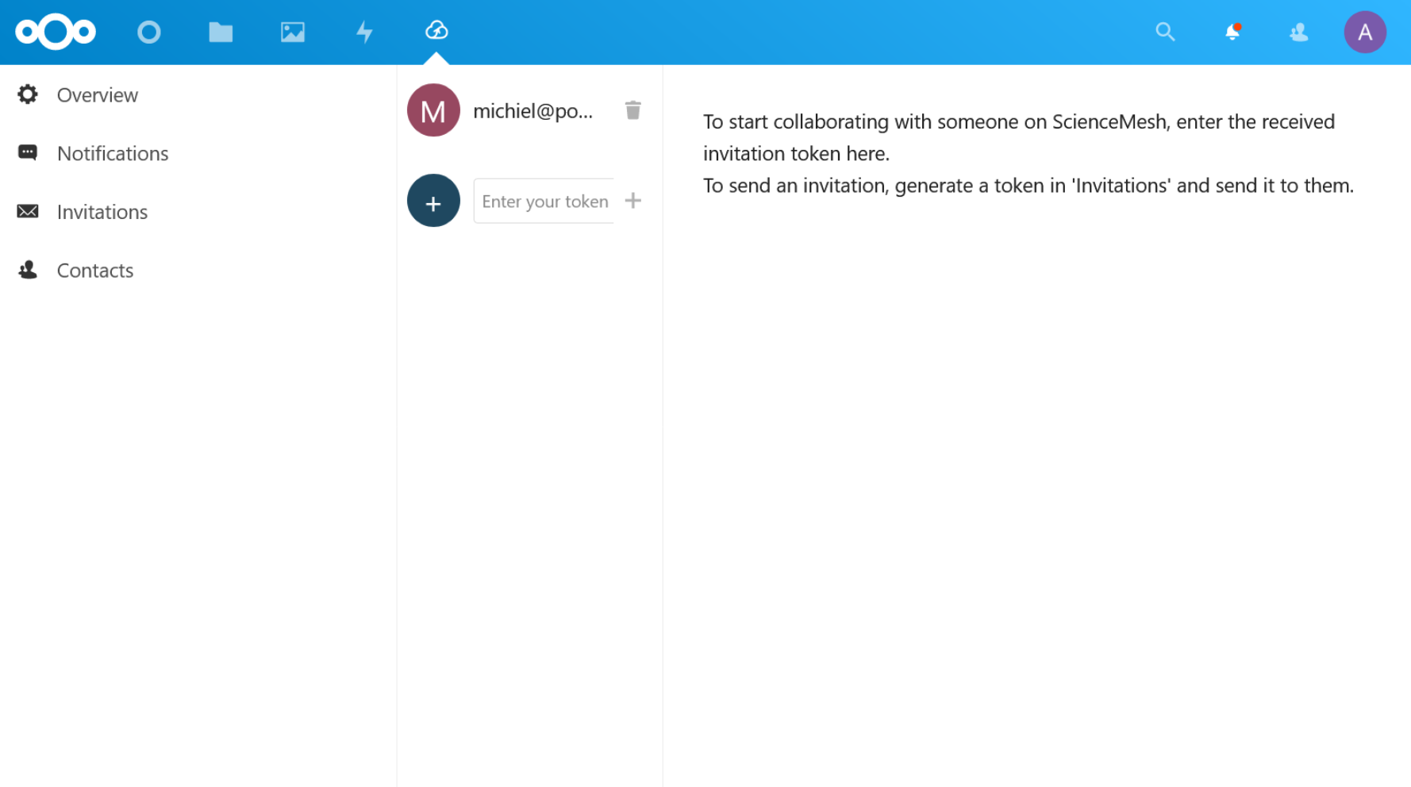
Platform Support
Nextcloud
alpha stage;
UI and backend;
ownCloud
OCIS - using REVA, still UI work to do;
version 10 - backport (April 2022);
Seafile
under discussion

Slide 9
Invitation Workflow for new sites and users

Slide 10
Increase service value for users...

Slide 11
Data Science Environment

Slide 12
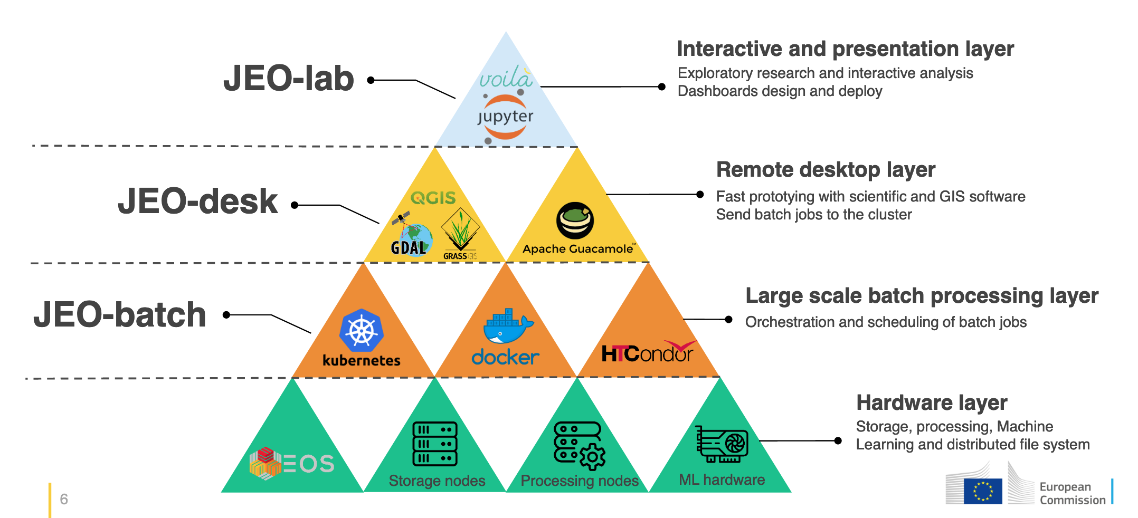
Integrating Storage, Compute, Software, ...
Big Data Platform at JRC
Copernicus Earth Observation
Geo Visualization and Data Exploration
Interactive Dashboards
D. De Marchi, CS3 2021 https://indico.cern.ch/event/970232/contributions/4158372
SWAN Service at CERN
High Energy Physics
Interactive Data Analysis
LHC Machine Learning
Accelerator Logging
….
D.Castro, CS3 2020 https://indico.cern.ch/event/854707/contributions/3680522

Slide 13
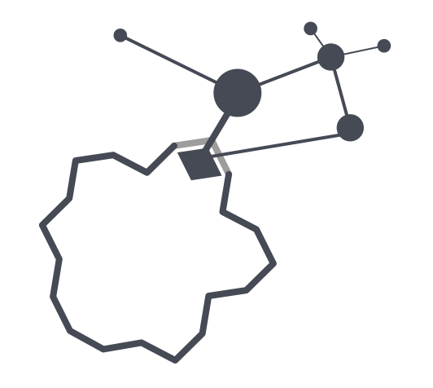
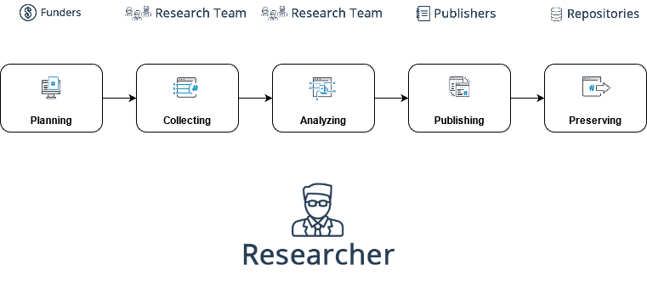
Open Data Workflow
Integrated workflow, from creation to publishing
Create, collaborate, annotate and publish
Based on battle-tested tools

Slide 14
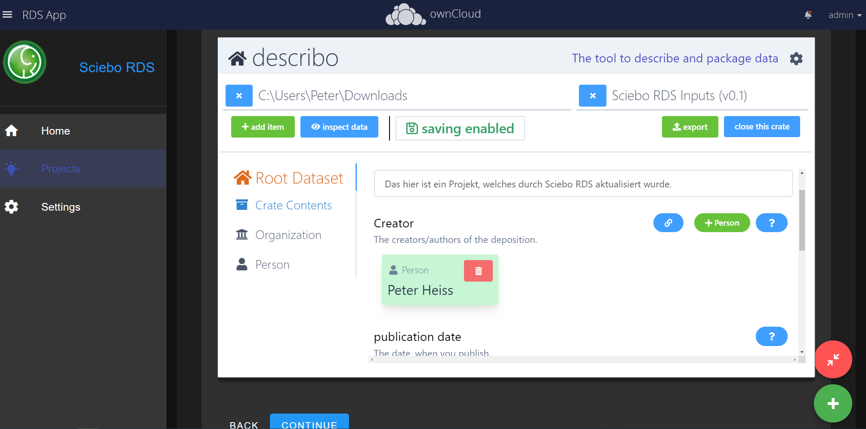
Open Data Workflow
Proof of Concept successful
Working on bringing it to test users

Slide 15
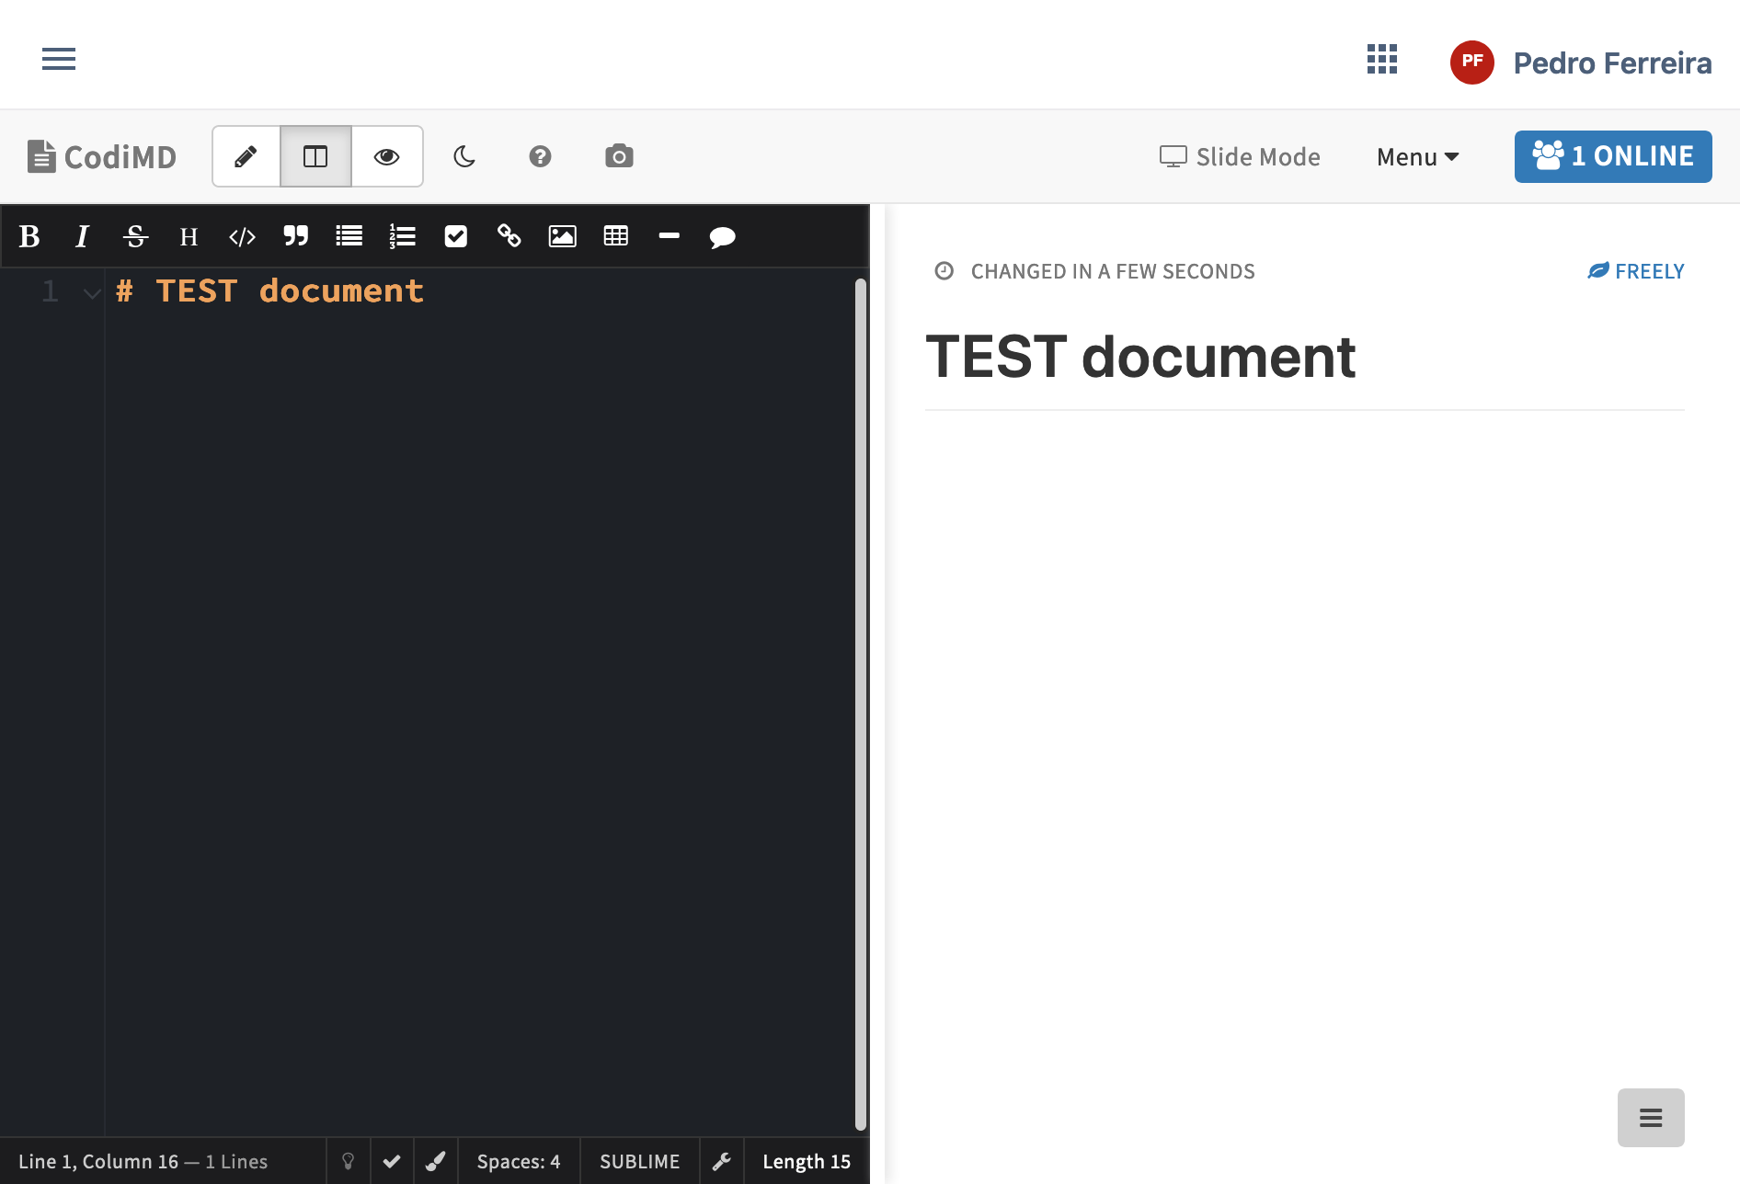
Markdown Editor
Open-source product (CodiMD)
Collaborative editing within teams
EFSS-centric storage of notes

Slide 16
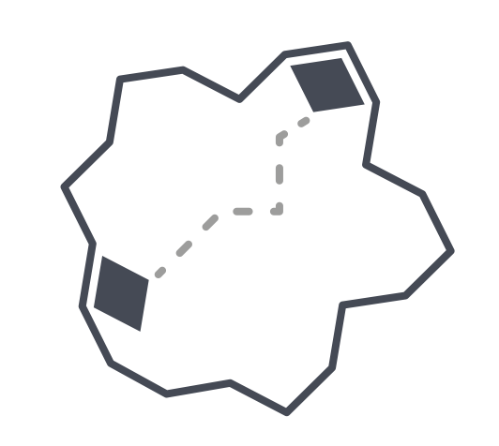
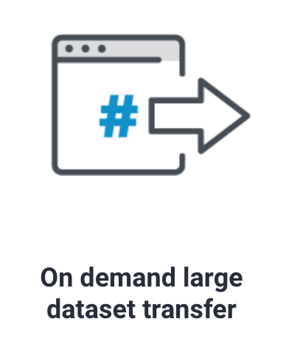
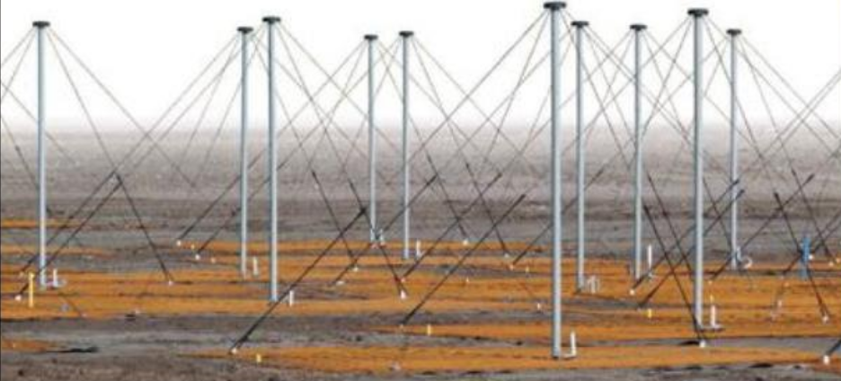
Dataset transfer between research groups
Data Transfers
Data stored at SURF and FZJ.
Initially processing (64x reduction).
Data shipped to Kraków​
for creating science quality images​

Slide 17
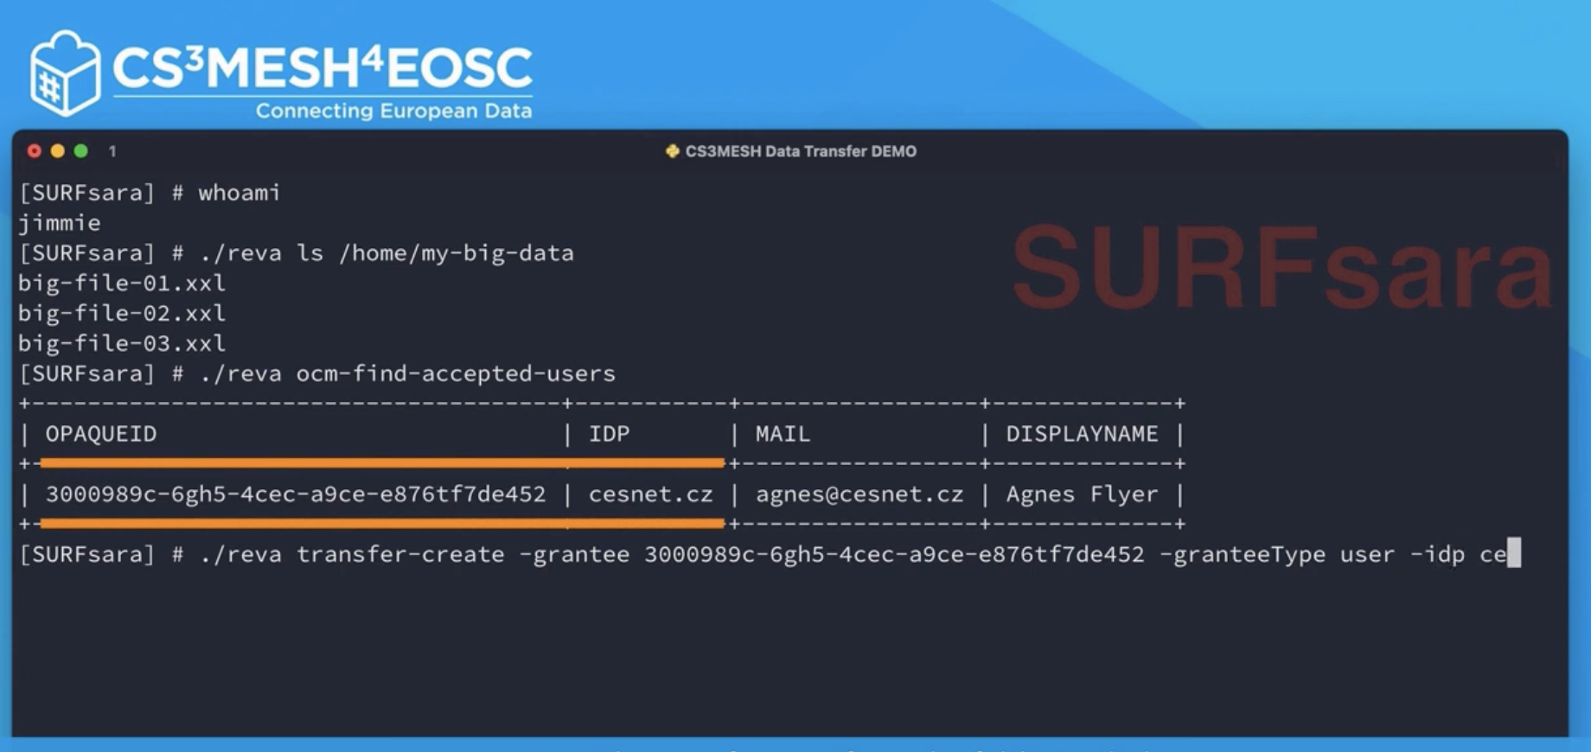
Data Transfers
Proof of Concept successful
Rclone use case
Direct contribution to Rclone
Working on user interface

Slide 18
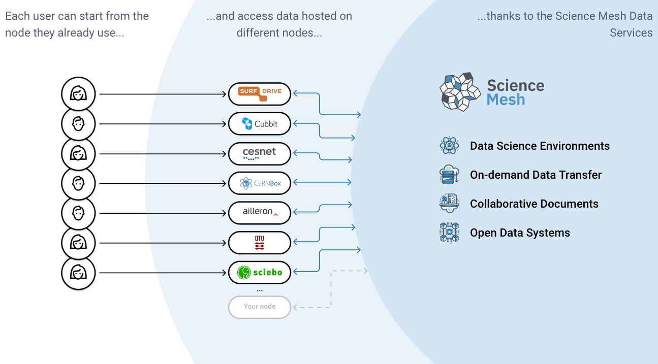
What now?
Bringing applications to user groups
Some identification work done, more to be done
Onboarding of first “early adopters”
ScienceMesh as a federated data + application layer for EOSC

Slide 19
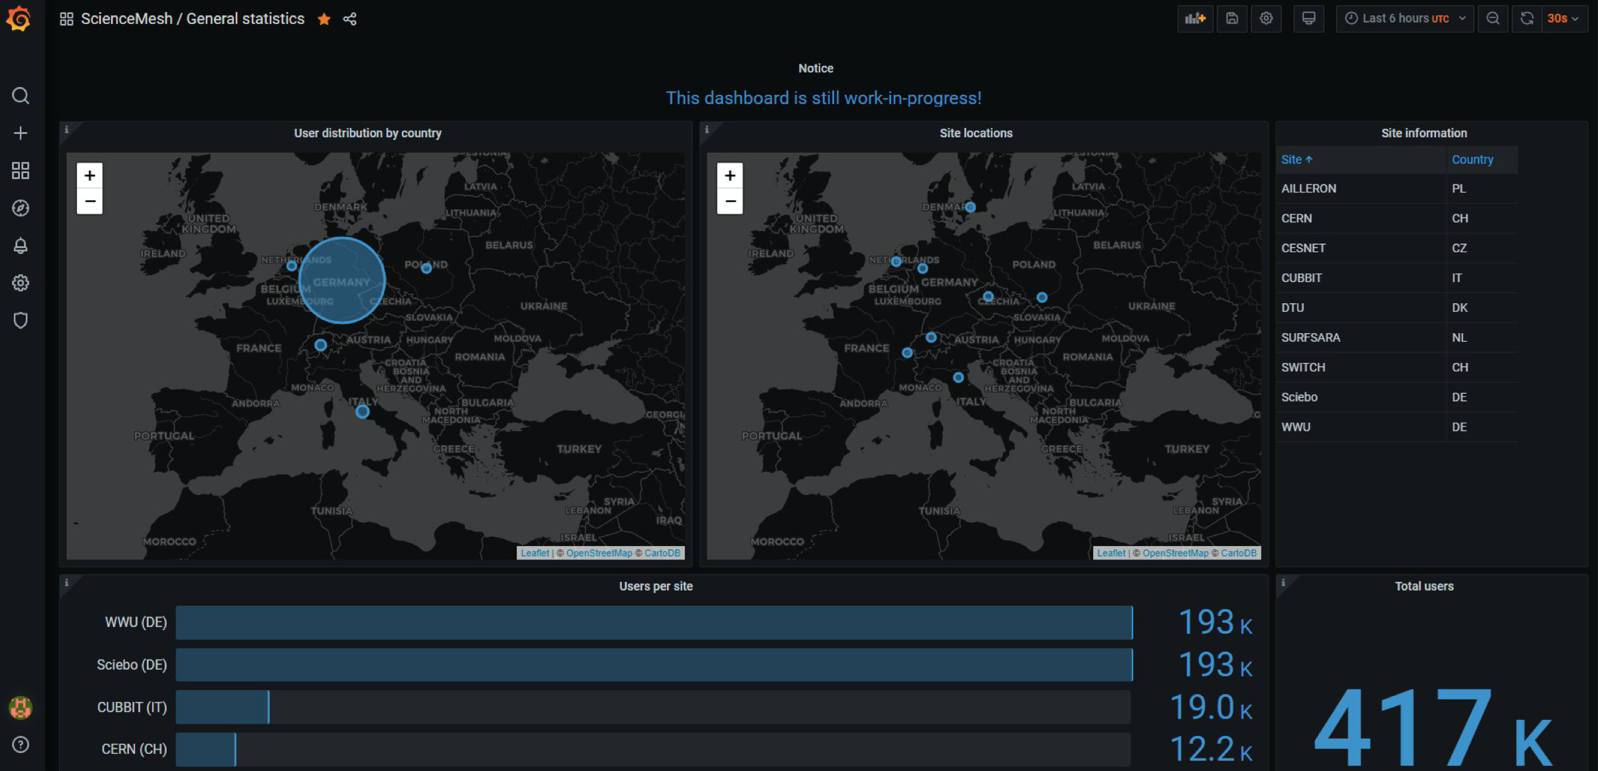
ScienceMesh Dashboard (beta)

Slide 20
Summary
Open, practical, bottom-up approach
working closely with user communities we take existing best practices, services and technologies, improve them and open up for other scientific communities
Leverage open-source community effort
Build and extend existing services and infrastructures
Expected outcome of Science Mesh
Enable frictionless collaboration on research objects for users
Increase the value of each individual service node for providers

Slide 21
Future
Vendor integration - more news this summer
Production Applications – end of the year
Integration with RIs
ELIXIR – TESK workflows from EFSS
Data migration for ENVRI-FAIR
Let’s talk!

Slide 22
https://sciencemesh.io
https://gitter.im/sciencemesh/community
https://github.com/sciencemesh

Slide 24
Acknowledgements
Icons:
“Connection” by Eucalyp from the Noun Project
“Connection” by Doub.co from the Noun Project
“Platform” by Eucalyp from the Noun Project
All logos are property of the respective institutions/projects
Remaining content licensed under CC-BY-SA 4.0

