Slide 1
Huawei Redefining Data Center Centric Cloud
Luca D’Ambrosio – Enterprise Executive Business Manage
Notes:
Hello, everyone. After listening to the previous speeches, you may now have a general understanding of Huawei OceanStor Pacific's capabilities. Now, I will explain its technical innovations in more detail.

Slide 2







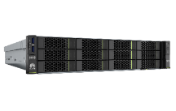
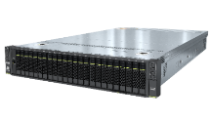

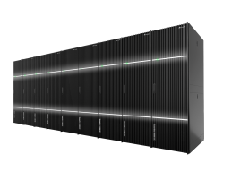
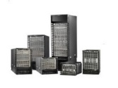
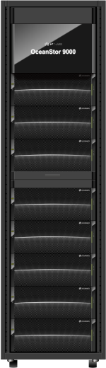
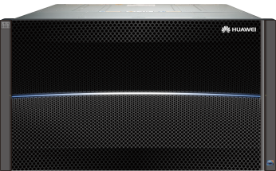
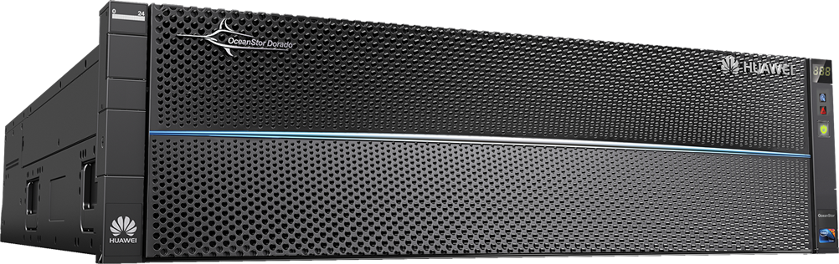
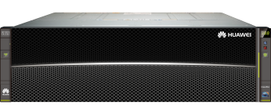

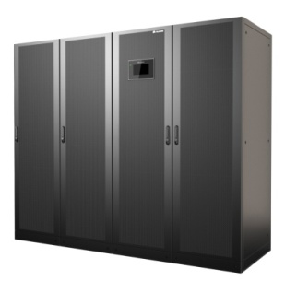
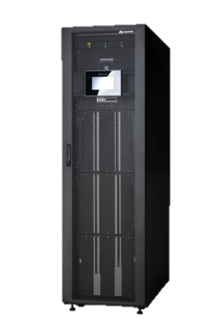

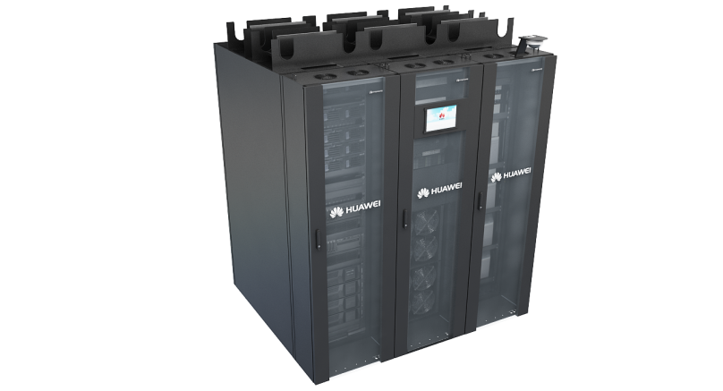
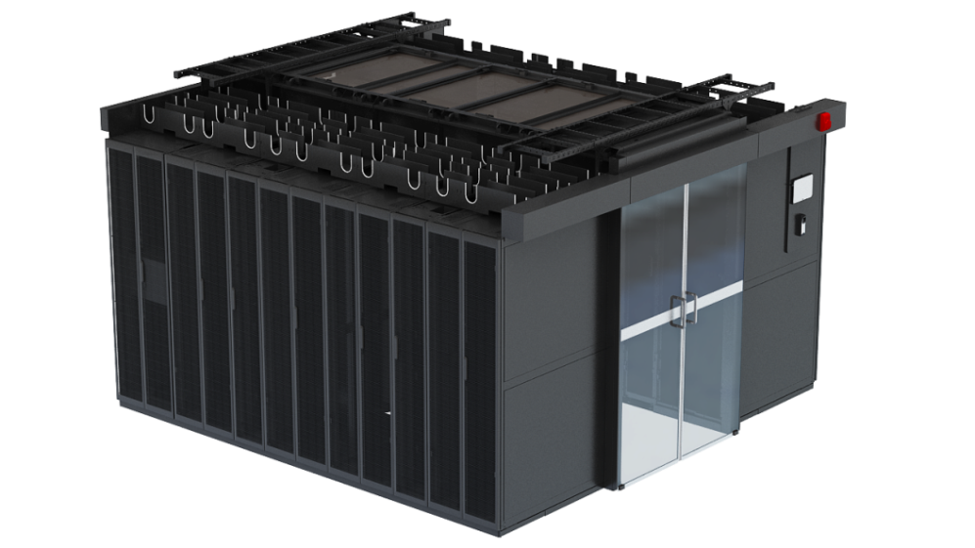
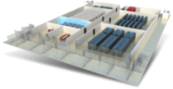
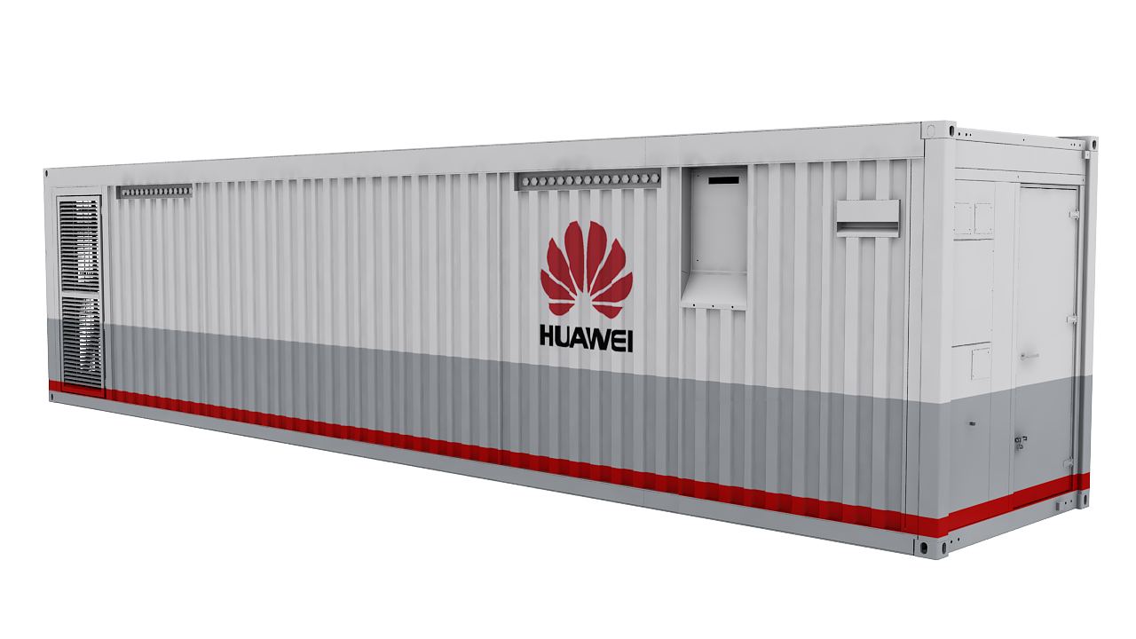
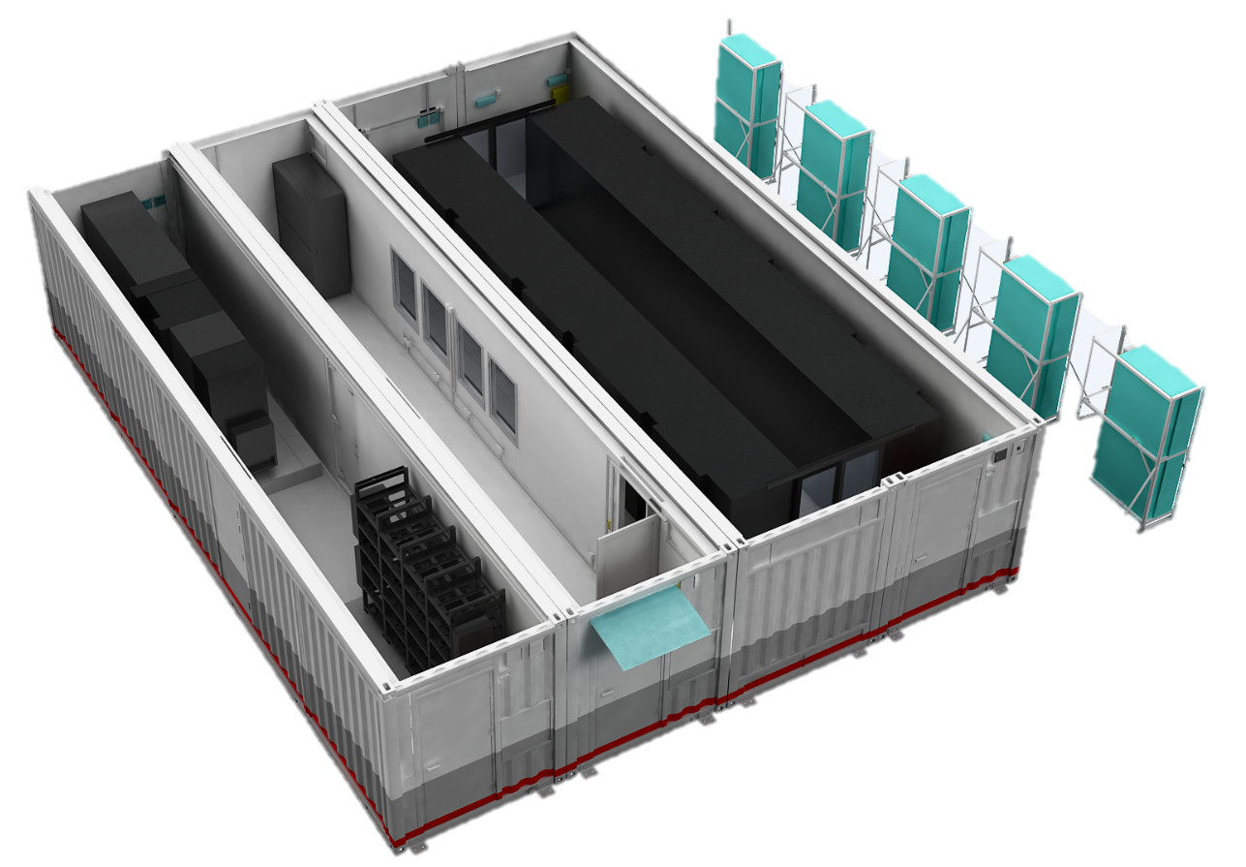

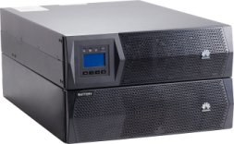

Huawei Full-Stack Cloud Data Center Solution
…
…
…
…
…
Industry Oriented
Solution
Public Security
Carrier
Government
Finance
Manufacture
Transportation
Video
Enabling Platform
Huawei 1+4
Cloud
Full Stack
Cloud Software
MEC
Data Lake
Edge Cloud
Gateway
IoT
3rd Party
Public Cloud
Cloud Infra
Automated Driving
HUAWEI CLOUD Stack
Computing
Storage
Network
Enterprise Level
Hardware
TaiShan
FusionCube
CE12800 Series
CE6800/CE5800 Series
18000
9000
6800
Dorado
5600/5800
DC
Energy
iBattery
UPS5000
UPS2000
Micro DC
Outdoor Large Modular DC
NetCol8000-A/C
PDU
Small DC
Mid-Small DC
Large DC
Outdoor Small Modular DC
Notes:
Huawei's industry-wide, full-stack IT infrastructure uses innovative technologies such as cloud and AI-based chips, algorithms, and architecture to help enterprises solve several key challenges from the global perspective: 1. Solve IT system computing power, data, Algorithms, applications and system complexity are constantly improving; 2. Solving the problem of IT as a production system, reliable and stable operation; 3. Solving the problem of IT cost reduction and efficiency increase; 4. Solving the process of enterprise renewal and digital intelligence Smooth evolutionary problem
华为面向行业的全栈智慧IT基础设施，采用基于云和AI的芯片、算法、架构等创新技术，从企业全局的维度，帮助企业解决几大关键难题：1、解决IT系统算力、数据、算法、应用与系统复杂度不断提升的难题；2、解决IT作为生产系统，可靠与稳定运营的难题；3、解决IT降本增效的难题；4、解决企业更新换代与数字化智能化进程中平滑演进的难题

Slide 3

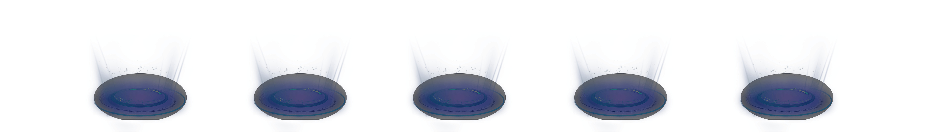




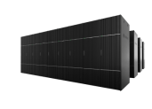
Full Stack and Industry Oriented Hybrid Cloud with Comprehensive Services
HUAWEI CLOUD Stack
Service
Innovation
Industry enablement
platform
3rd party public cloud
HUAWEI CLOUD
Data Intelligence
Data Lake
...
Collect > Store > Compute > Manage > Use
Resource
Convergence
Container
Bare Metal
VM
Cloud edge
Intra-cloud
Inter-cloud
Industry's only Full Stack cloud solution
Most private cloud IaaS cloud services
40+ services (IaaS + DaaS + PaaS)
Notes:
总结一下就是，6.3是业界唯一的全栈私有云解决方案，同时是私有云IaaS云服务最多的解决方案，达到28种（总共9类42个云服务），涵盖IaaS到DaaS到PaaS三层的能力。
企业在转型过程当中，需要新型的合作伙伴，能够既把互联网公司带来的敏捷快速的理念，融合在一起，同时能够满足传统的IT厂家，能够提供的2B的规模能力，规模交付能力和业务咨询能力，以及对垂直领域的理解能力，同时需要连接线上线下，通过混合云的布局，为企业未来的创新转型提供支持，这是我们一个愿景。

Slide 4

Unified IT Resource Management and Seamless Cloud Evolution
HUAWEI CLOUD
HUAWEI CLOUD Stack
HUAWEI CLOUD Stack
Traditional IT
Virtualization
Cloud resource pool
Public cloud
Server
FusionCompute
HUAWEI CLOUD
FusionSphere
VMware
Storage
AWS
Hyper-V
Third-party OpenStack
Network
PowerVM
Azure

Slide 5











Seamless Hybrid Cloud on Top of a Federated Cloud Architecture
Full service access
Unified and refined control
HUAWEI CLOUD
200+ services
...
200+ services
HUAWEI CLOUD
Department VDC
User group
EI service
PaaS
Blockchain
IoT
40+ services
HUAWEI CLOUD Stack
Service
catalog
Service
provider
Identity
Authentication
HUAWEI CLOUD
O&M
Enterprise project
Quota management
Service management
Unified authentication for use of all public and private cloud services
Multi-cloud rights- and domain-based refined management
IAM
Mapping online and offline tenants
Cloud
federation
Seamless ecosystem sharing
One-click image synchronization
Identity
authentication
provider
Identity
Authentication
Local
O&M
VDC
HUAWEI CLOUD
*Third party Cloud providers
Federated authentication
Image
HUAWEI CLOUD Stack
HUAWEI CLOUD Stack
Universal software
Industry software
Cutting-edge applications
Development APIs
Sharing the HUAWEI CLOUD ecosystem with 3500+ applications
Rapid service deployment across clouds

Slide 6



Huawei All-Flash as a data center foundation
Core Banking
ERP
HIS
HPC
CCTV
Big Data
Backup
Archive
All-IP Data Center Network
Cloud intelligence
Full-Lifecycle Intelligent O&M
Automatic execution
Analysis & decision-making
FC switch
IP switch
Device intelligence
Intelligent and
automatic
Manual/Passive
Tier 0
Tier 1
Tier 2
Intelligent lossless switch
Disaster recovery (DR)
Production
Backup
Archive
All-Scenario Flash
All-Scenario Data Protection
DR business
(DB/VM/File Sharing)
Traditional business
(DB/VM/File Sharing)
Emerging business
(HPDA/HPC)
Mechanicalera
Flash era
Active-passive/Active-active/3DC
Low-level DR
All-scenario protection
Backup
OceanProtect
Archive
OceanStor Dorado All-flash storage
OceanStor Dorado All-flash storage
OceanStor Pacific
OceanProtect
Backup storage
OceanStor Pacific Object storage
Notes:
< Not a reference architecture, nor specific on why Huawei Flash >
All-Scenario Flash
Primary storage acceleration
Backup acceleration
HPDA acceleration
All-Scenario Data Protection
Full DR of hot data
Quick backup and restore of warm data
Warm archiving of cold data
All-IP Data Center Network
All IP for unified data center network
NoF+ to unlock all-flash potential
Full-Lifecycle Intelligent O&M
3-layer intelligence for full-lifecycle data management
Automatic planning, deployment, O&M, and optimization

Slide 7
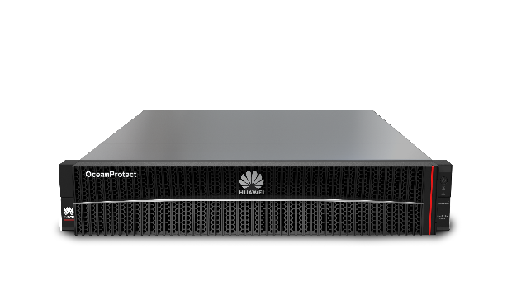
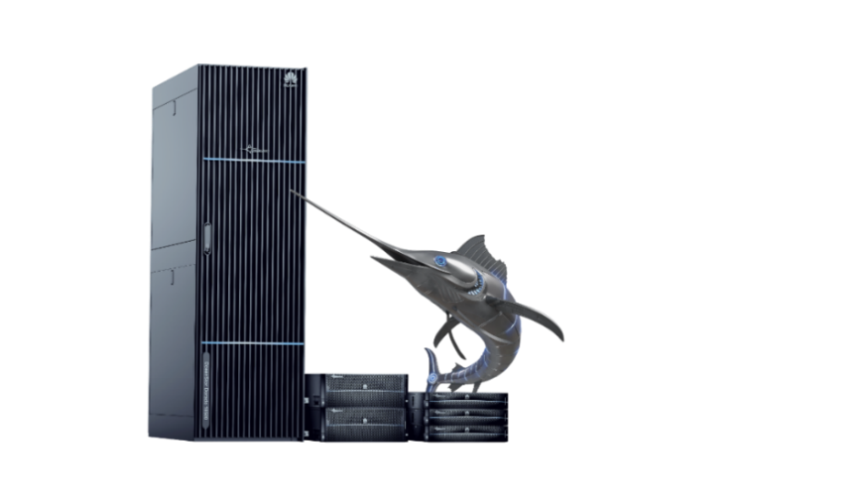
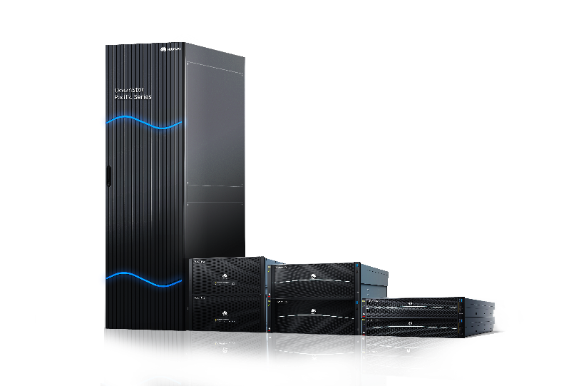
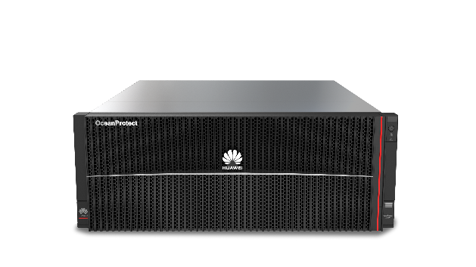
All-flash Acceleration for Mission Critical Applications
All-flash Acceleration for All Scenarios
Government
Core tax admin
Customs clearance mgmt
Finance
Core banking system
Channel access system
Energy
Oil & Gas exploration
Operations mgmt
Transaction
Dev. and testing
Analytics
High-performance file sharing
DR and backup
HPC/HPDA
1
Primary storage acceleration
2
Backup acceleration
3
HPDA acceleration
50%
Access latency
3x
Backup speed
60%
IOPS
Latency
0.1 ms
0.05 ms
Backup speed
40+ TB/h
155 TB/h
IOPS per U
250k
400k
Vendor E
Huawei
Vendor E
Huawei
Vendor D
Huawei
Industry-leading NoF+ solution
Industry's only native all-flash backup storage
Highest performance density HPDA storage

Slide 8
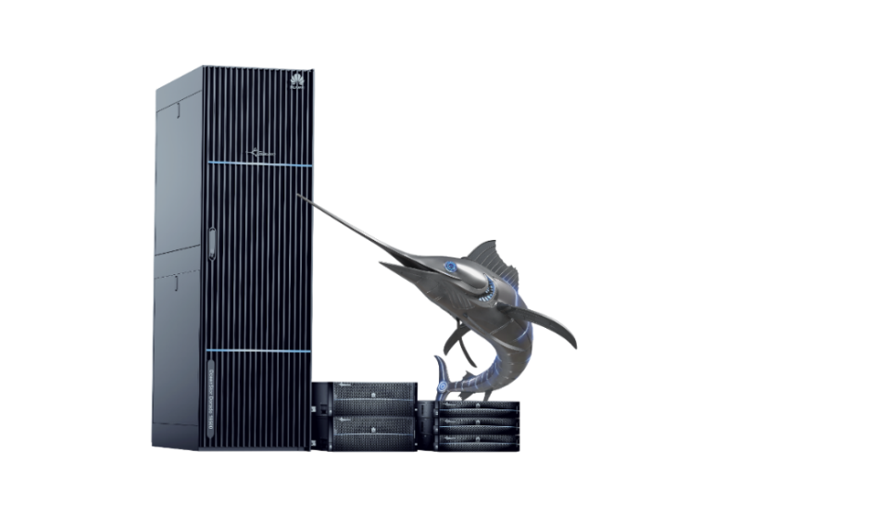
OceanStor Dorado All-flash Storage:
Industry's only active-active SAN & NAS solution
Performance
Reliability
Security
30% higher NAS performance than industry benchmark
Industry-only active-active
SAN&NAS solution
Four layers of Anti-Ransomware protection
Database
Block and Detection
380K OPS
VM
File Sharing
Local security snapshot
OceanStor Dorado
All-flash Storage
18000/6000/5000 series
300K OPS
120K OPS
SAN & NAS
Local backup
HyperMetro
Gateway-free active-active
HUAWEI
Vendor N
Vendor E
Site A
Site B
AirGap
Notes:
< sort of – needs tweaking >
Ever Fast
NAS：30% higher performance than industry benchmark（30% higher in small files and small blocks ）
SAN：21M IOPS
Ever Solid
Tolerates failure of 7 out of 8 controllers
Active-active solution
Ever Secure
Data security, protocol security
System security, management security

Slide 9
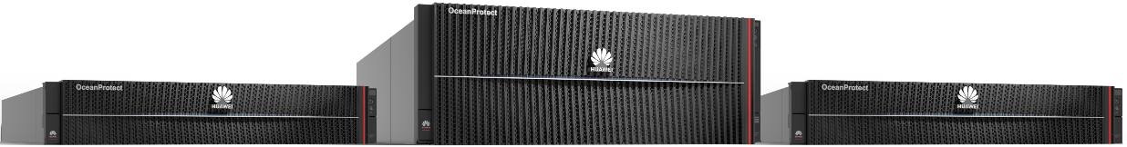

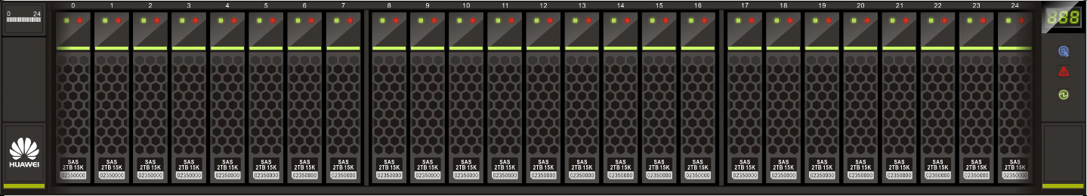
OceanProtect Backup Storage: Flash Accelerated Backup
OceanProtect X9000
OceanProtect X8000
OceanProtect X6000
Fast backup and restore
Efficient data reduction
High reliability
Backup bandwidth (TB/hr)
Restore bandwidth (TB/hr)
155
172
Before reduction
After reduction
Active-Active
Controller
Controller
3x
5x
Up to 72:1
DRR
RAID TP
Vendor E
OceanProtect
Vendor E
OceanProtect
Just 20 seconds to restore 1 TB of data
Data reduction ratio: 20% higher than
the industry benchmark
Second-level failover for non-disruptive backup
Notes:
< has other weaknesses – need more than bandwidth >
OceanProtect X8000
Max. backup bandwidth: 55 TB/hr
Max. restore bandwidth: 57.6 TB/hr
OceanProtect X9000
Max. backup bandwidth: 155 TB/hr
Max. restore bandwidth: 172.8 TB/hr
OceanProtect X6000
Max. backup bandwidth: 19.3 TB/hr
Max. restore bandwidth: 22.9 TB/hr
Fast backup and restore:
End-to-end acceleration, industry-leading DTOE, I/O optimization, and back-end SSD network optimization
Efficient data reduction
Multi-layer inline variable-length deduplication, Feature-Based Compression and Byte-Level Compaction
High reliability
Dual-Controller AA Architecture and RAID-TP Technology

Slide 10
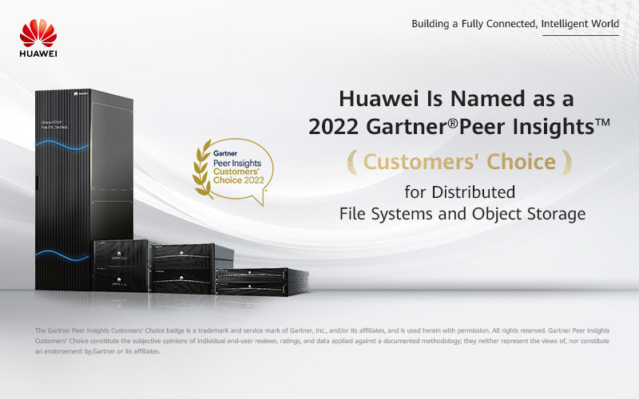
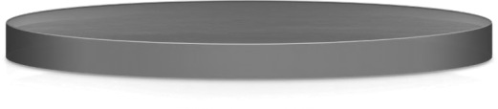

OceanStor Pacific:
Multi-workload, Highest Performance Density for HPDA
OceanStor Pacific
Seamless multi-protocol interworking
Hybrid-workloads oriented
High-density design
Model training
Simulation
400,000 IOPS/U
24-slot/U
NFS/CIFS
S3
HDFS
20-slot/U
250,000 IOPS/U
High IOPS
High bandwidth
62,500 IOPS/U
9-slot/U
OceanStor Pacific
Next-Gen Parallel File System
DPC
All-flash nodes from vendor E
All-flash nodes from vendor N
HUAWEI
Storage
server
Vendor E
HUAWEI
Zero data coping helps customers improve data analysis efficiency
A single storage supports both high bandwidth (32 GB/s/U) and IOPS (400k IOPS/U) workloads
400K IOPS/U & 24-slot/U high-density, intelligent tiering of hot and cold data
Notes:
< needs clarification >

Slide 11
Huawei's Four-Layer Protection Solution Protects Your Business Against Ransomware
Storage Air-Gap Zone
Production zone
Backup Air-Gap Zone
Layer 1
The production storage detects and intercepts ransomware in a timely manner to assist prompt handling.
Detection
Production hosts
Layer 2
Detection
Detection (backup software capability)
Secure snapshots on production storage are used to recover services in seconds.
Backup
Anti-tampering
Anti-tampering
SAN/NAS
Anti-tampering
Anti-tampering
Layer 3
Local backup is used to recover services in hours.
Air gap
Air gap
OceanProtect
OceanProtect
Layer 4
OceanStor Dorado
Encrypted
Tunnel*
OceanStor Dorado
OceanProtect X
Encrypted
Tunnel*
OceanProtect X
Secure data in the Air-Gap zone is used for fast service recovery.
Items with * will coming in a future release
Notes:
< how is this uniquely Huawei? >
Production zone
OceanStor Dorado feature：
Storage encryption
Secure snapshot
Antivirus scanning
Ransomware detection*
OceanProtect X feature：
Storage encryption
Secure snapshot*
WORM*
Storage Air-Gap Zone
OceanStor Dorado feature：
Storage encryption
Secure snapshot
Ransomware detection*
Backup Air-Gap Zone
Storage encryption
Secure snapshot*

Slide 12
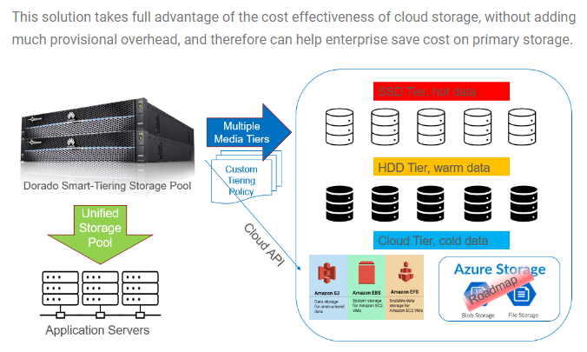
AWS OBS and Huawei OceanStor Dorado CloudTier Solution
Tested by Axians
https://axians.cloud-services.paris/2022/06/07/aws-obs-and-huawei-oceanstor-dorado-cloudtier-solution/

Slide 13
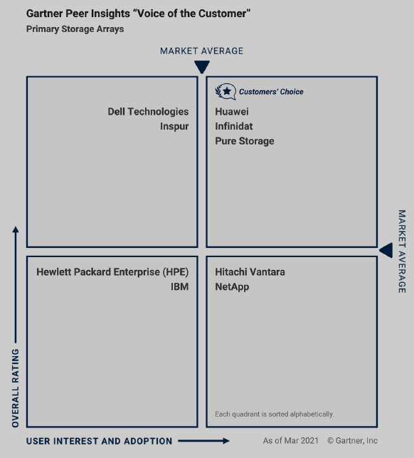
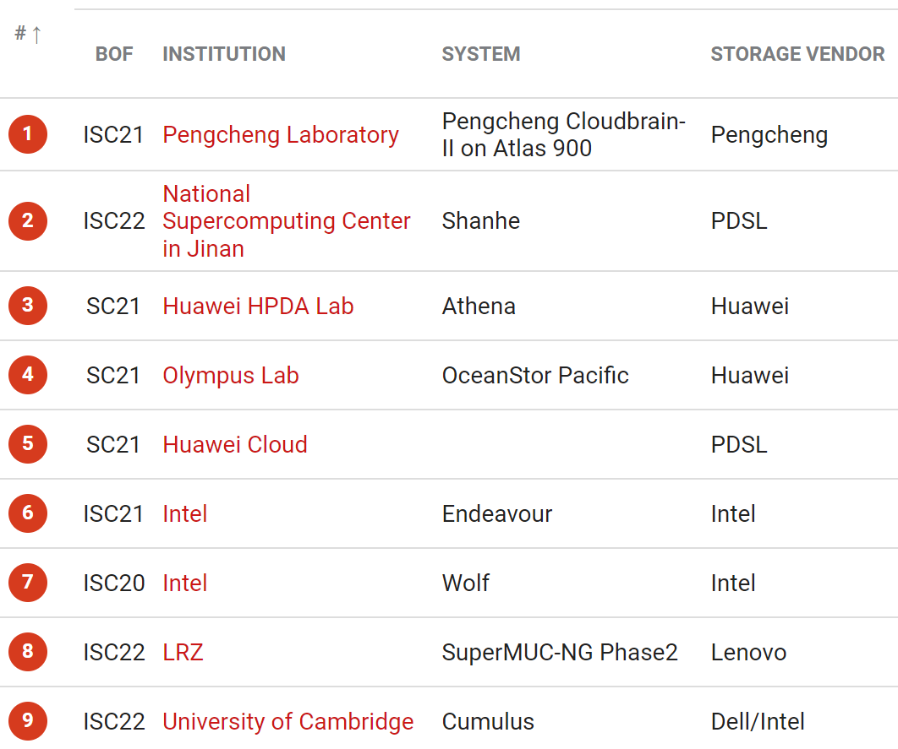

Huawei All-Flash Storage Tops Gartner Customers' Choice, and Distributed Storage ranked 3rd in IO500 List
Enterprise storage
Mass data storage
Gartner Customers' Choice NO.1
NO.1 on SPC-1 rankings
Top 3 position on the IO500 list
21,000,000 IOPS
10,001,522
2,401,171
2,004,941
Tested by SPC, a third-party non-profit corporation
https://spcresults.org/benchmarks/results/top10/performance/spc1/3
Notes:
< price performance? >
The last one, let’s see the 3rd report of Huawei storage. At the left slide part, there are two reports of Enterprise storage. One is the gartner new report, Huawei storage get the number 1 of Gartner Customers‘ Choice. Another is the SPC-1 rankings, Huawei storage is 4 positions in the top 10. The last report is the IO500，Huawei get the Top 4 positions on the list.

Slide 14
luca.dambrosio@Huawei.com

