Slide 1
WISE SCI v2 ‘how-to’ guide
Ian Neilson, UKRI-STFC Modified from WISE presentation 21 April 2022

Slide 2
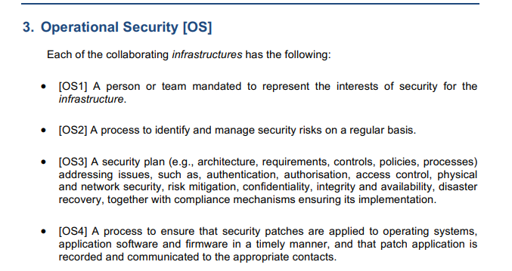
A Trust Framework for Security Collaboration among Infrastructures
https://wise-community.org/wp-content/uploads/2017/05/WISE-SCI-V2.0.pdf
29 Assertions across 5 Categories.
How to assess the level of compliance?

Slide 3
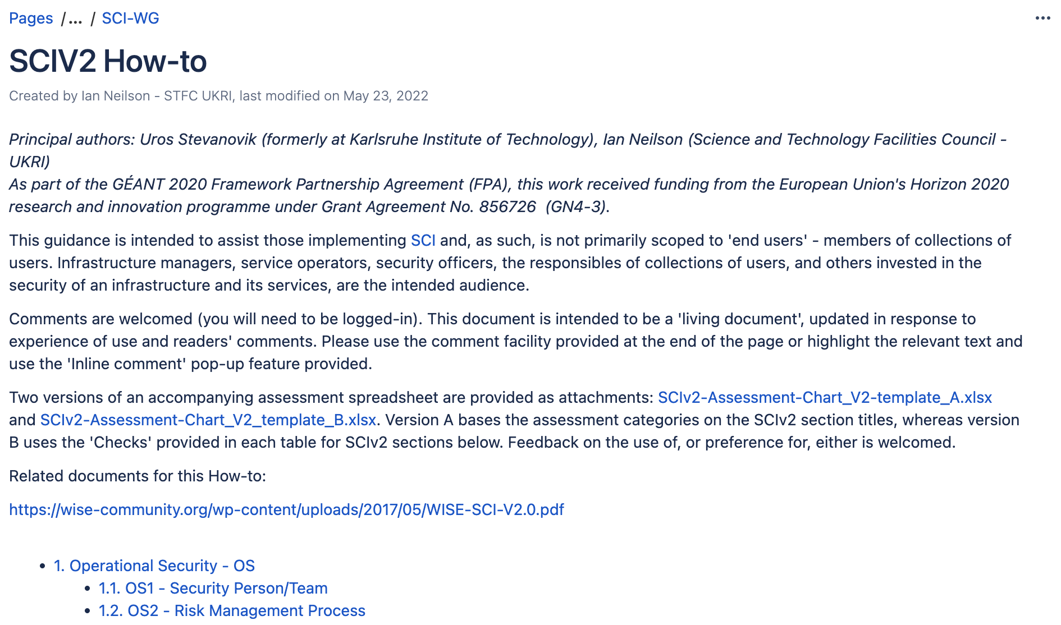
WISE words ….
All information now in one place: on the WISE Wiki -
https://wiki.geant.org/display/WISE/SCIV2+How-to

Slide 4
SCIv2 Assessment Chart (A)
https://wiki.geant.org/download/attachments/440303650/SCIv2-Assessment-Chart_V2-template_A.xlsx?api=v2

Slide 5
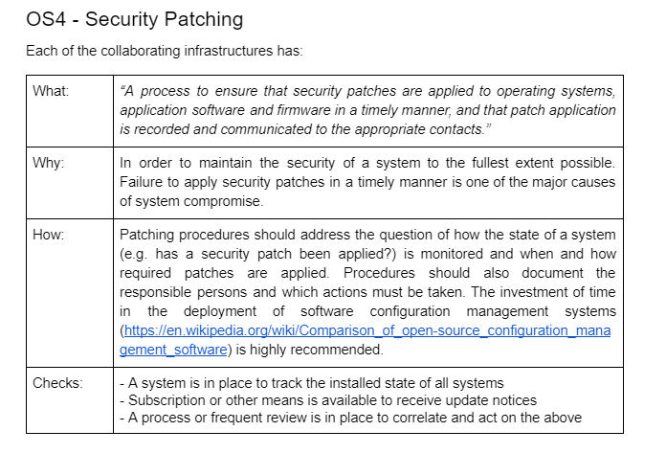
SCI v2 How-To
To provide guidance on interpreting the SCIv2 text
https://wiki.geant.org/display/WISE/SCIV2+How-to

Slide 6
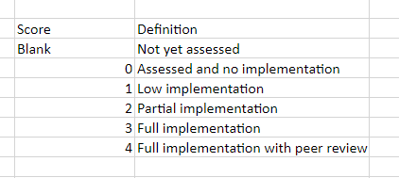
SCIv2 Assessment Chart (B)
https://wiki.geant.org/download/attachments/440303650/SCIv2-Assessment-Chart_V2_template_B.xlsx?api=v2

Slide 7
SCI v2 Assessment options
Need feedback for experience from use
A
B

Slide 8
Thank you

