Slide 1
WISE Community Meeting David Kelsey (STFC-RAL, UK Research and Innovation) Security Day at TNC22, Trieste, 17June 2022
Wise Information Security for collaborating e-Infrastructures
In collaboration with and co-supported by EU H2020 GN4-3, EOSC Future & EGI-ACE
https://wise-community.org

Slide 2
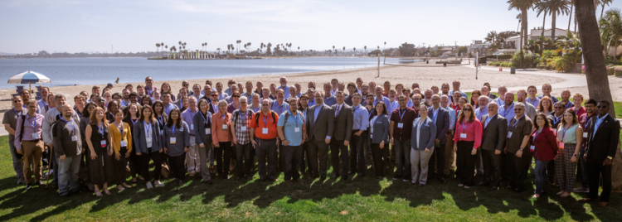
WISE Community – recent history
Last met in person at the NSF Cybersecurity Summit 2019
Community members come from e-Infrastructures across the world
Governed by a steering committee
Two per year virtual meetings in 2020 and in 2021
Meetings in 2022
21 April (virtual)
Autumn/Fall 2022 (Where?)
NSF Cybersecurity Summit Oct 2019 (San Diego CA) - not just the WISE people!

Slide 3
WISE Mission
The WISE community enhances best practice in information security for IT infrastructures for research.
How do we operate to fulfil the WISE mission?
WISE fosters a collaborative community of security experts and builds trust between IT infrastructures, i.e. all the various types of distributed computing, data, and network infrastructures in use today for the benefit of research, including cyberinfrastructures, e-infrastructures and research infrastructures.
Through membership of working groups and attendance at workshops these experts participate in the joint development of policy frameworks, guidelines, and templates.

Slide 4
WISE Working Groups
Active Working Groups - 3 topics included in this meeting
Security Communications Challenge Coordination Working Group (SCCC-WG) – joint with SIG-ISM
Incident Response & Threat Intelligence Working Group (IRTI-WG)
Risk Assessment WISE (RAW-WG) – joint with SIG-ISM
Trust and policy issues related to the Security for Collaborating Infrastructures trust framework (SCI-WG)
Not yet started (was proposed at recent WISE meetings)
Best Practices for handling Software Vulnerabilities

Slide 5
https://indico.geant.org/event/1/contributions/23/attachments/23/119/20220615-EnCo_Kremers_Short.TNC22-final.pptx. (TNC22 Wed 15 June 2022) (FIM4R.org)
We are restarting activities
An ”open” activity – please join us!
Consult member Research Communities
Identify use cases and requirements for Assurance
Feedback from appropriate events in North America, Asia & Europe
Aiming for a FIM4R V3 paper in time for TNC23

Slide 6
Backup slides

Slide 7
WISE and Trusted CI have agreed a joint statement of collaboration
“Trusted CI and WISE share a common goal to support the research mission through the development of appropriate cybersecurity practices. Through close collaboration, the groups will ensure that cybersecurity frameworks, templates, and policies for our international infrastructures for research will grow increasingly aligned and interoperable.”

