Slide 1
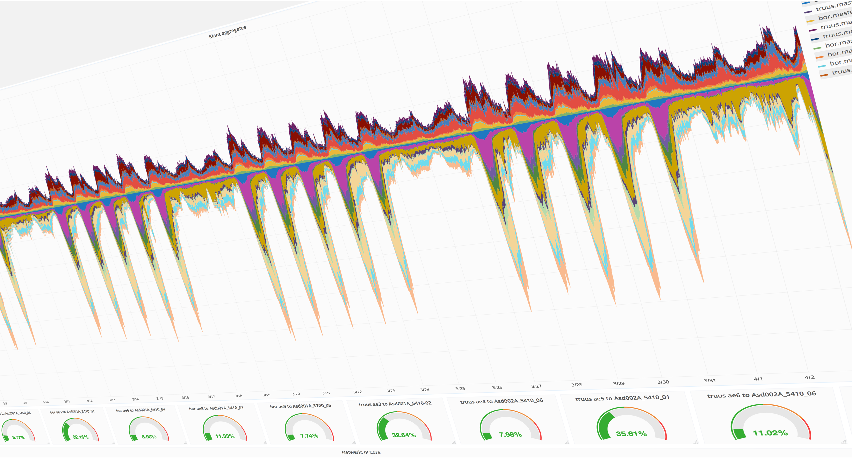
Streaming Telemetry at scale
Lessons learned and lessons to learn

Slide 2

Max: An introduction
Works for SURF, the Dutch NREN
Technical product manager
‘Obsessed’ with measuring usage ;-)

Slide 3
Agenda
SURF metrics
Current measurement setup
Why streaming
Our experiences with streaming telemetry at scale
  Native JTI
  Openconfig Telemetry (Work in Progress)
Work to be done as a replacement technology

Slide 4
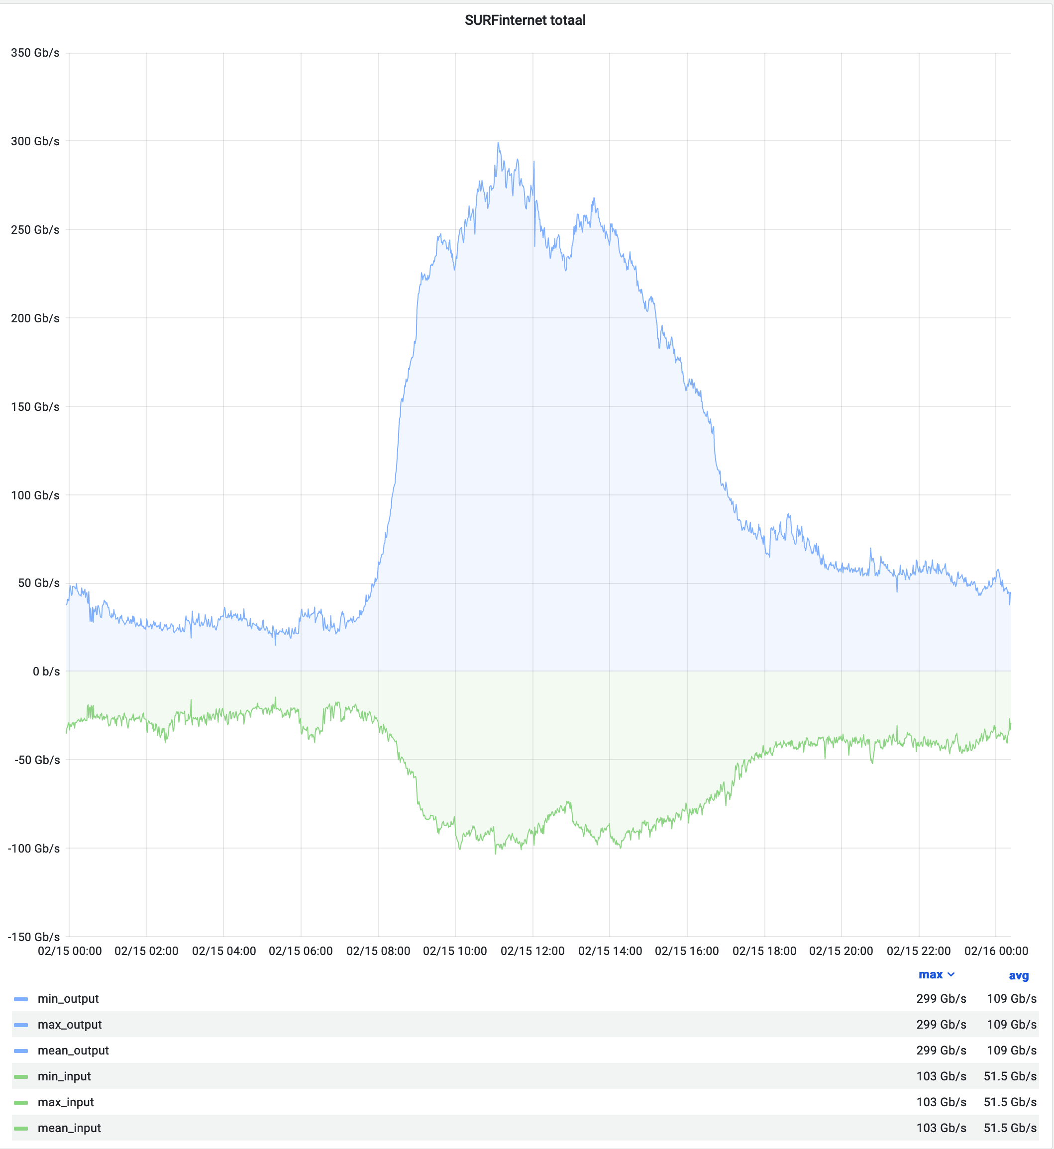
The SURF Network: An introduction
Current version (SURFnet8) started rollout in 2019
Last customer service migrated December 2020
Fully automated & orchestrated from router to CMDB
Currently 433 devices
Juniper
IP peaks at almost 300Gb/sec
Layer2 circuits peaks at 340Gb/sec

Slide 5
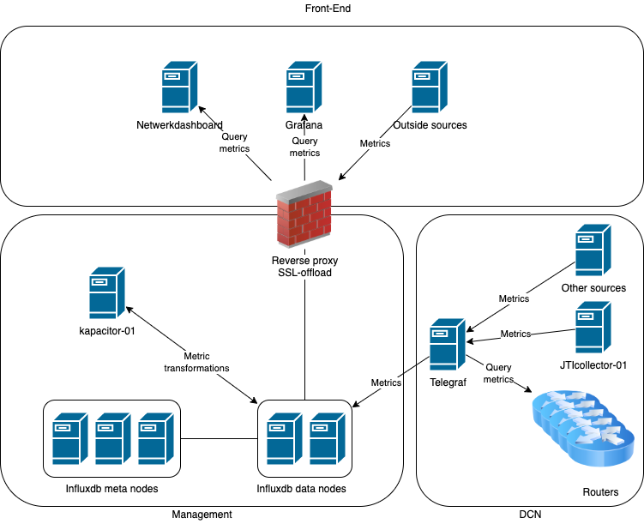

Measurement Infra
All Metrics stored in InfluxDB Enterprise
SNMP collected by Telegraf
Kapacitor for metric transformations
Telegraf extracts metadata and stores in tags
  Subscription ID
  Instance ID (Primary, Secondary)
  Service Type (EVPN, Customer IP, External IP)
All data is directly queried by all these tags
Fully automated
100% correct

Slide 6
Our experiments with Streaming Telemetry

Slide 7
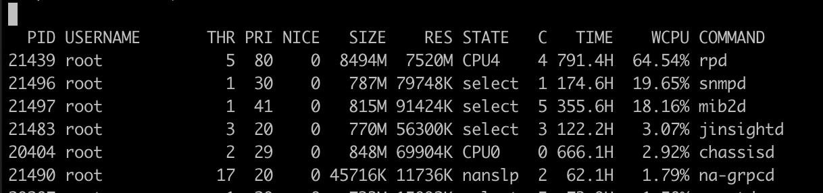
Why streaming?
SNMP
  polling is inefficient
  SNMP especially is inefficient
  Creates significant load on each NE
  resolution is low (@SURF 1 poll/minute)
Streaming
  Focus on metrics
  Highly structured data
  Pushing metrics is efficient for the NE
  High resolution of metrics (Juniper upto per second maybe higher?)
  Not just traffic (unlike sFlow)

Slide 8
Our first ‘attempt’: native JTI
Easy to deploy just a few config lines
UDP stream towards an IP/Port
No extra load on devices
Fluentd
  Accepts data
  Transform to InfluxDB stream and forwards
InfluxDB
  Stores metrics

Slide 9
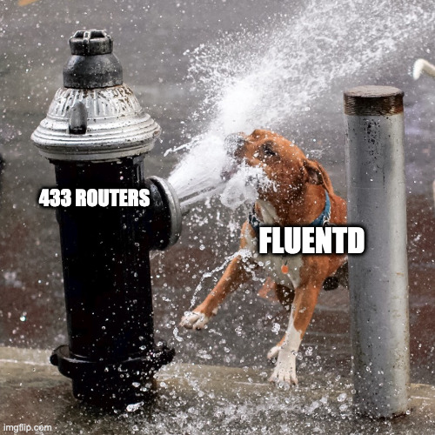
Scaling up native JTI
400+ NE’s emitting JTI per second
FluentD = Ruby and Single threaded
So, we ended up using 16 FluentD instances with UDP load balancer
I never got FluentD to be realy stable
Plugin project seems abandoned
I did not test logstash
Telegraf: Native JTI plugin never ended up in the main project

Slide 10
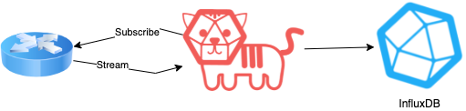
Our second ‘attempt’: Openconfig JTI
We waited until upgrade to Junos >= 19.1 to avoid install packages on every router
We could use Telegraf
  It’s plugin driven
  Openconfig-jti plugin is maintained better
  Telegraf is written in Go
OpenConfig more future proof, less proprietary
More sensors
Custom sensors with Netconf proxy functionality

Slide 11

Telegraf openconfig_JTI at scale
Telegraf is multithreaded (if configured correctly)
Flushing metrics to InfluxDB becomes the bottleneck
Still in the process of tuning and scaling up
This is all with a 1 measurement/sec
The jury is still out on how easy it is to scale with Telegraf

Slide 12
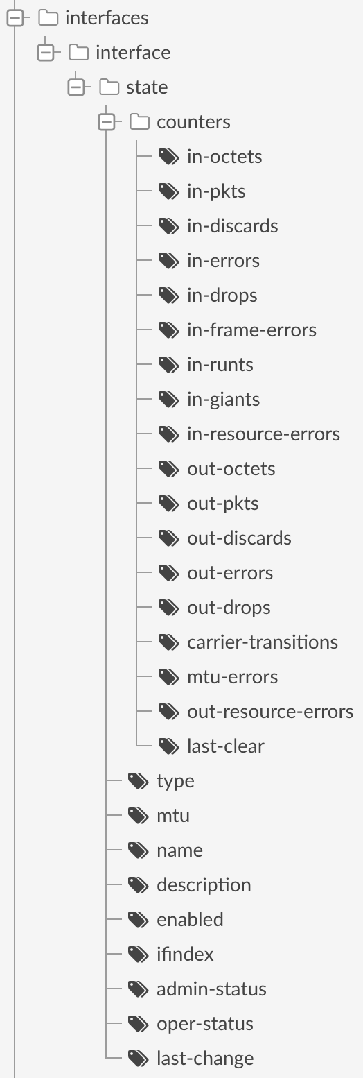
But why no production yet?
We are heavily dependent on what’s in the description of an interface
  We use that to relate to a customer service
Junos emits telemetry as an hierarchical structure
BUT!! every level in that hierarchy is emitted as a separate line of metrics to the collector
This makes it impossible (in InfluxDB) to query packet counters by description

Slide 13
Next up
Telegraf has a thing called ‘aggregator plugins’
  We need an aggregator plugin that can merge on a subset of tags. IE
    Timestamp
    Device
    Interface name

Slide 14
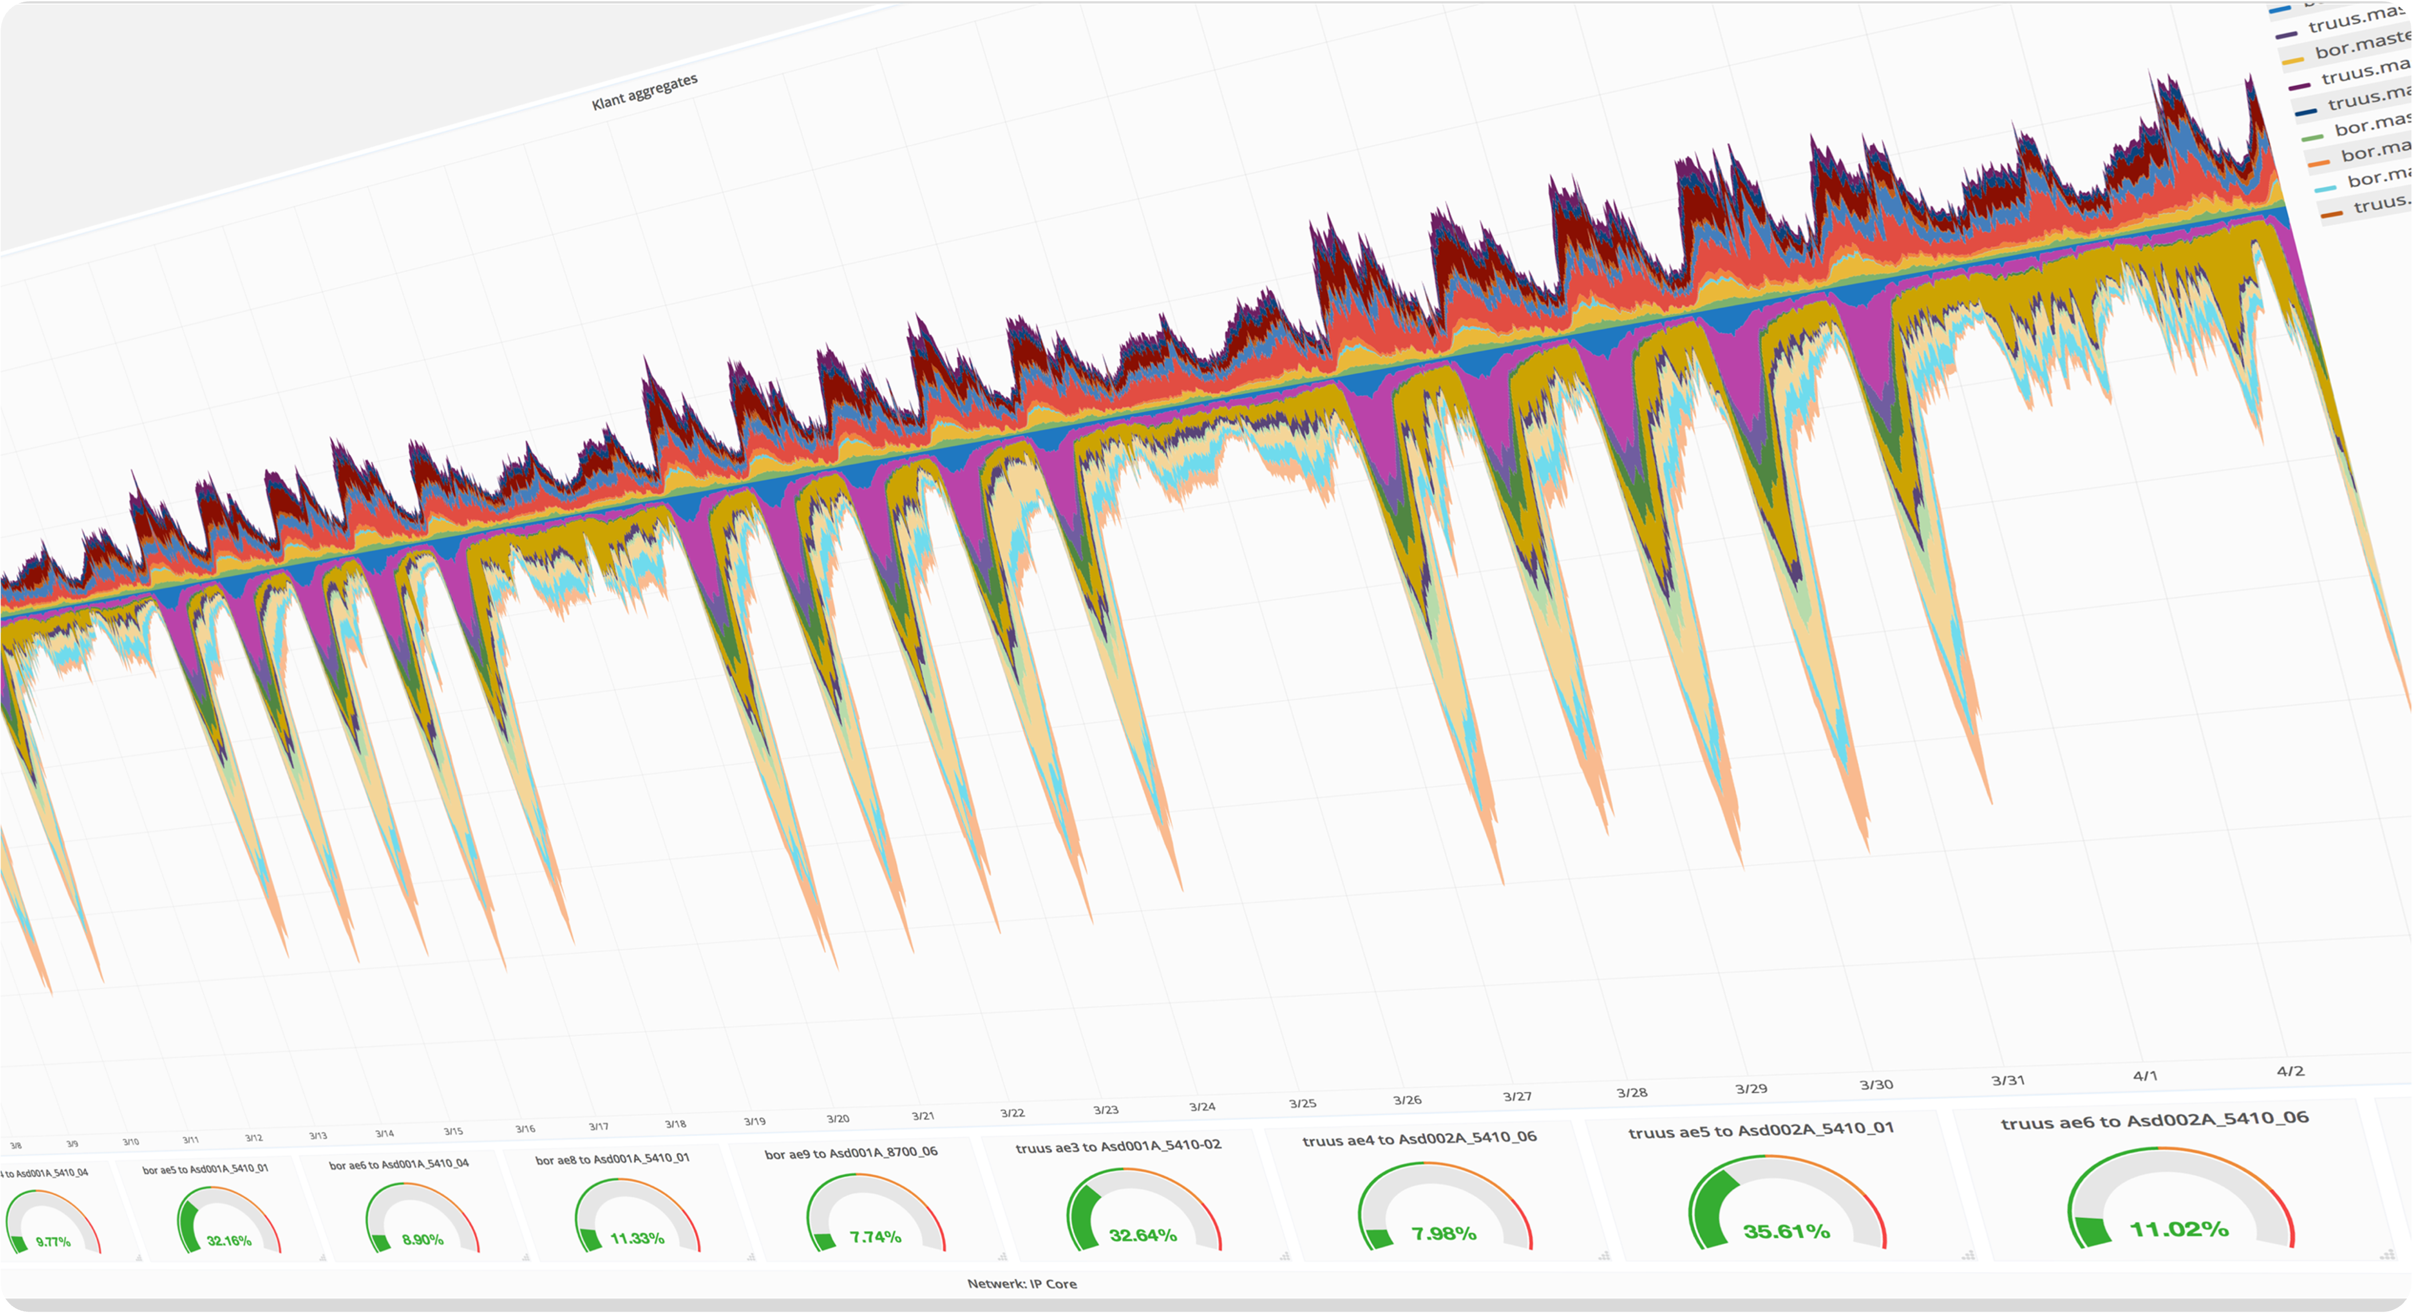
Close but no sigar
Max Mudde
E-mail: max.mudde@surf.nl
www.surf.nl
Social media: https://www.linkedin.com/in/maxmudde/
Driving innovation together

Slide 15
Driving innovation together

