Slide 1
NetSage: Flexible Monitoring Framework for Multiple Applications
Doug Southworth, Indiana University (dojosout@iu.edu)
GÉANT 2nd Performance Management Workshop
March 08, 2022

Slide 2
Quick overview of NetSage
NetSage advanced measurement services for R&E data traffic
Better understanding of current traffic patterns across instrumented circuits
Better understanding of large flow sources/sinks
Performance information for data transfers
Collaboration between Indiana University, LBNL, and University of Hawaii Manoa
Originally funded by the NSF for IRNC circuits, NetSage is now deployed in a variety of configurations across the globe

Slide 3
Built around answering questions
Answers questions asked by network engineers, network owners, and end-users
Human-readable summaries and patterns
Big picture overview helps highlight trends and events that can make in-depth analysis of local data more fruitful

Slide 4
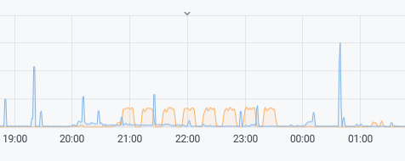
Built around answering questions
Interesting pattern. What is it?
Why so slow?
Singapore to Taiwan via LA?

Slide 5
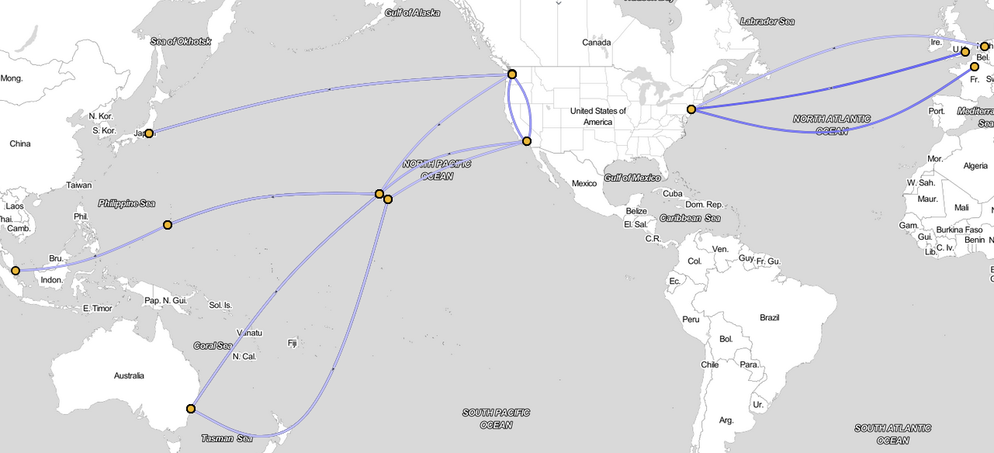
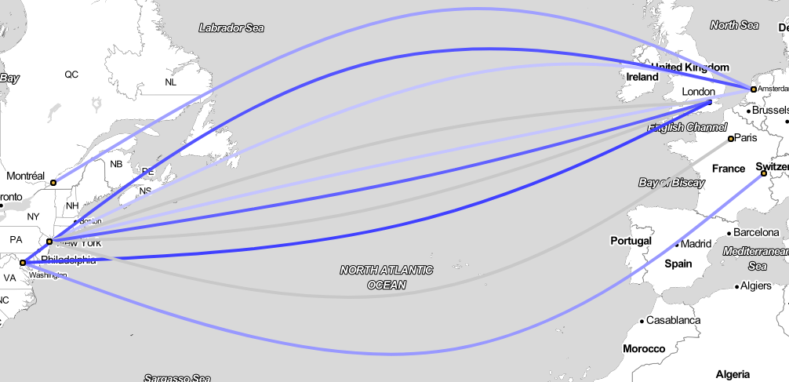
NetSage International:
sflow:
SingAREN
GEANT (NY-Paris)
TransPAC (Seattle-Tokyo, Guam-Singapore)
NEA3R (NY-London, NY-Amsterdam)
Hawaii-Guam, Hawaii-LA
PIREN and PNWGP
SNMP
Mostly the same as above, plus ANA links
Notes:
Future sources from KAUST and CAE

Slide 6
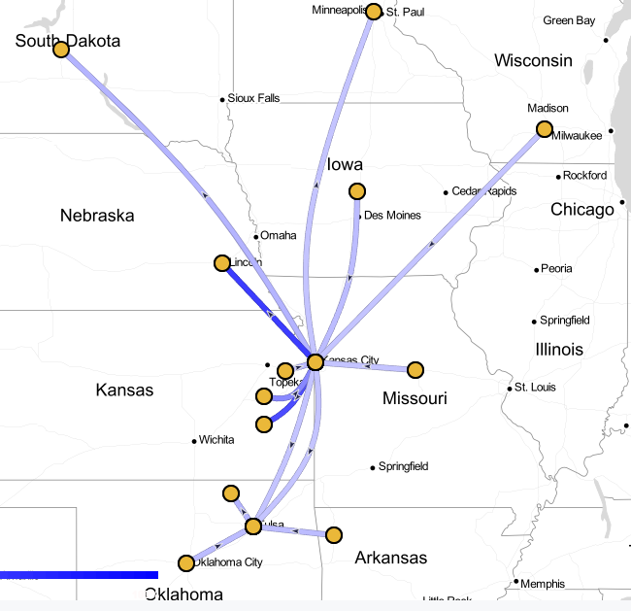
NetSage Regional:
FRGP
GPN
iLight
PennREN
PACWAVE
SoX
Sun Corridor
TACC
LEARN - almost ready!

Slide 7
How can I get data into NetSage?
Send flow/SNMP data directly to NetSage
GlobalNOC handles data ingest
Records stored securely by OmniSOC
Run your own ingest pipeline
Full Docker deployment of ingest pipeline on-site in about one hour
Regardless of method, NetSage never has access to the full IP address and remains privacy compliant!

Slide 8
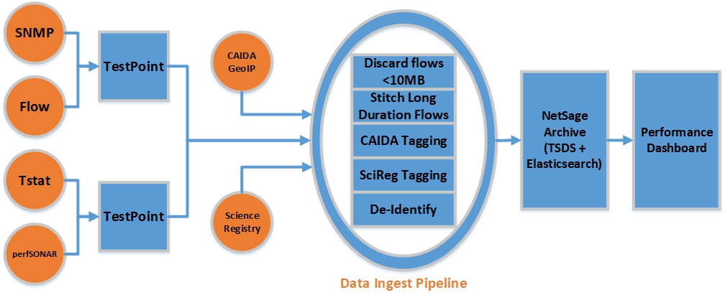
NetSage Ingest
Notes:
Currently using NFDUMP, although developing our own tool is not out of the question

Slide 9
NetSage Privacy
NetSage is committed to privacy, and preemptively addressing any security or data sharing concerns
No PII collected
Remove the last octet from IP address
Only keep data on flows over 10M for circuits
1M for archives
Fully GDPR Compliant
Data Privacy Policy
http://www.netsage.global/home/netsage-privacy-policy
Data Flow Data Retention (De-Identification) Policy
https://tinyurl.com/netsage-deid

Slide 10
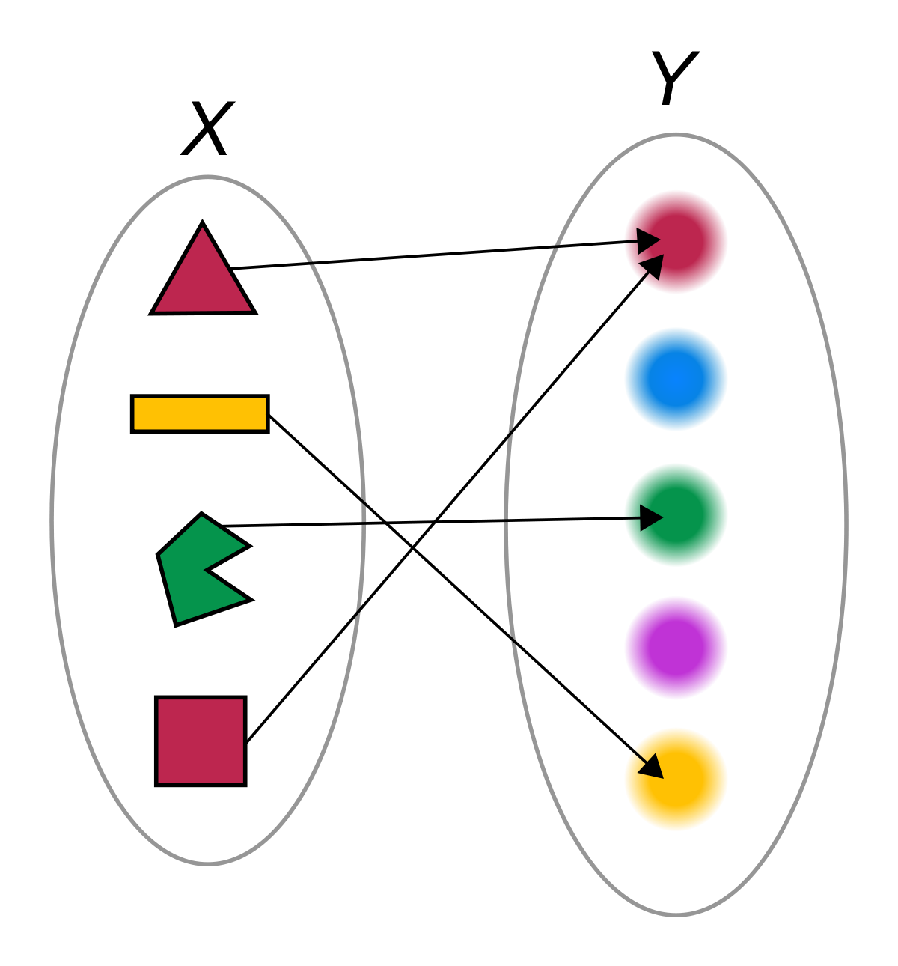
Global Science Registry
Maps flows to specific resources
DTN
Instrument
Compute
Contributions come from resource owners
Currently matched by IP, however packet marking is in the roadmap for development

Slide 11
Packet Marking?
IPv6 packet marking initiative to positively identify the science domain or project of a particular flow
Uses a series of bits in the IPv6 header
Not compatible with IPv4 (no room!)
Has some technical hurdles to overcome, mainly regarding different equipment manufacturers and how they handle packets/header inspection

Slide 12
An IPv4 marking option
UDP “firefly” packets
Same source/dest address as associated flow
Specific destination port (10514)
Contain a syslog facility header and JSON formatted flow information
Are sent at the beginning and end of a flow, and optionally in regular intervals of 60 seconds max

Slide 13
Pinpointing flows while retaining privacy
Packet marking allows us to match flows in a very specific manner while still not having a record of the IP address
Useful in a number of scenarios where multiple science domains or projects are represented by the same IP
LHC test vs production traffic
Data Mobility Exhibition
Data Mover Challenge

Slide 14
I thought we were talking about NetSage
What’s next?
NetSage for Campus
NetSage for Supercomputing Facilities
NetSage for LHC
NetSage inspired projects, such as ESnet’s Stardust

Slide 15
The campus use case
Granular understanding of East-West data movement
What/where/when of data movement between campus resources by researchers
Identify performance issues and trends that are traditionally tough to spot
Better understanding of North-South data movement
Are large transfers being made from capable DTNs or WiFi connected laptops?
Is traffic flowing as designed?

Slide 16
But I already have campus network data
Traditional network tools are fine for viewing raw data, but -
Hard to see performance trends of specific resources
Human-readable patterns rarely stand out
Traditional network tools are only accessible by campus CI personnel
NetSage gives stakeholders eyes on their data
Access to data helps make the case for future funding
Notes:
Single data sources rarely paint the entire picture, and comparing data from different sources rarely yields useful insights

Slide 17
What needs to happen?
NetSage framework is built around answering questions that scale well to the campus use case
Science Registry becomes the source of truth
If a campus doesn’t already have a solid IP-to-resource mapping, this could take time
De-identification is no longer necessary (and in fact is not desired)

Slide 18
NetSage development roadmap
What’s next?
NetSage for Campus
NetSage for Supercomputing Facilities
NetSage for LHC
NetSage inspired projects, such as ESnet’s Stardust

Slide 19
Tracing the shape of a cloud
Better R&E connectivity has led to easier access to traditionally walled-off resources
Small institutions that cannot afford to maintain HPC resources on their own now have the option of using shared HPC infrastructure
But what does data movement look like in this scenario? What does the end user expect?

Slide 20
The supercomputing use case
An XSEDE follow-on proposal
Understanding who submitted a job and how many compute/storage resources were utilized is relatively easy
Understanding the end-to-end transfer of user data related to a specific project or job is harder
Multiple geographically diverse participants working on the same project is even more challenging

Slide 21
What needs to happen?
This one is a little more complicated as mapping flows to jobs isn’t terribly straightforward
Fortunately, we have great partners in this space such as TACC, PSC, SDSC, etc who are willing to take the time to figure out a solution
First step is to use in-house record keeping (like TACC Stats) and correlate those with log files from Globus

Slide 22
NetSage development roadmap
What’s next?
NetSage for Campus
NetSage for Supercomputing Facilities
NetSage for LHC
NetSage inspired projects, such as ESnet’s Stardust

Slide 23
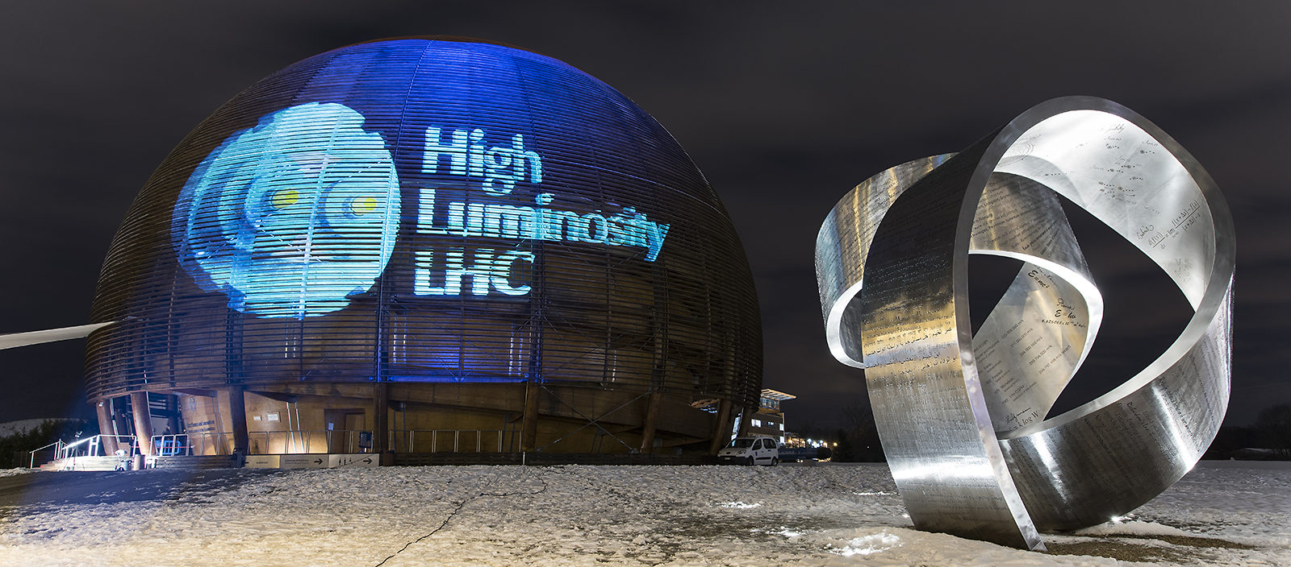
The LHC use case
Upcoming data challenges between all LHC sites in preparation for High Luminosity
Each site collects their own data
There is no single, common tool for visualization
Increasing volumes of test data over the next several years to see where network pinch points are located
HL will consume more bandwidth than the current ANA combined can provide

Slide 24
The LHC use case
The main challenge isn’t collecting data, it’s viewing it in a meaningful way
One tool can’t possibly answer every question that arises
One tool can, however, give a broad enough view to understand trends, recognize patterns, and spot anomalies
This is where local data analysis begins

Slide 25
What needs to happen?
Community involvement to get data from endpoints
Dashboard development to answer questions of specific interest to the LHC community
Packet marking will be essential
Resources used for several different projects
The ability to separate test traffic from production will be important in the analysis phase

Slide 26
NetSage development roadmap
What’s next?
NetSage for Campus
NetSage for Supercomputing Facilities
NetSage for LHC
NetSage inspired projects, such as ESnet’s Stardust

Slide 27
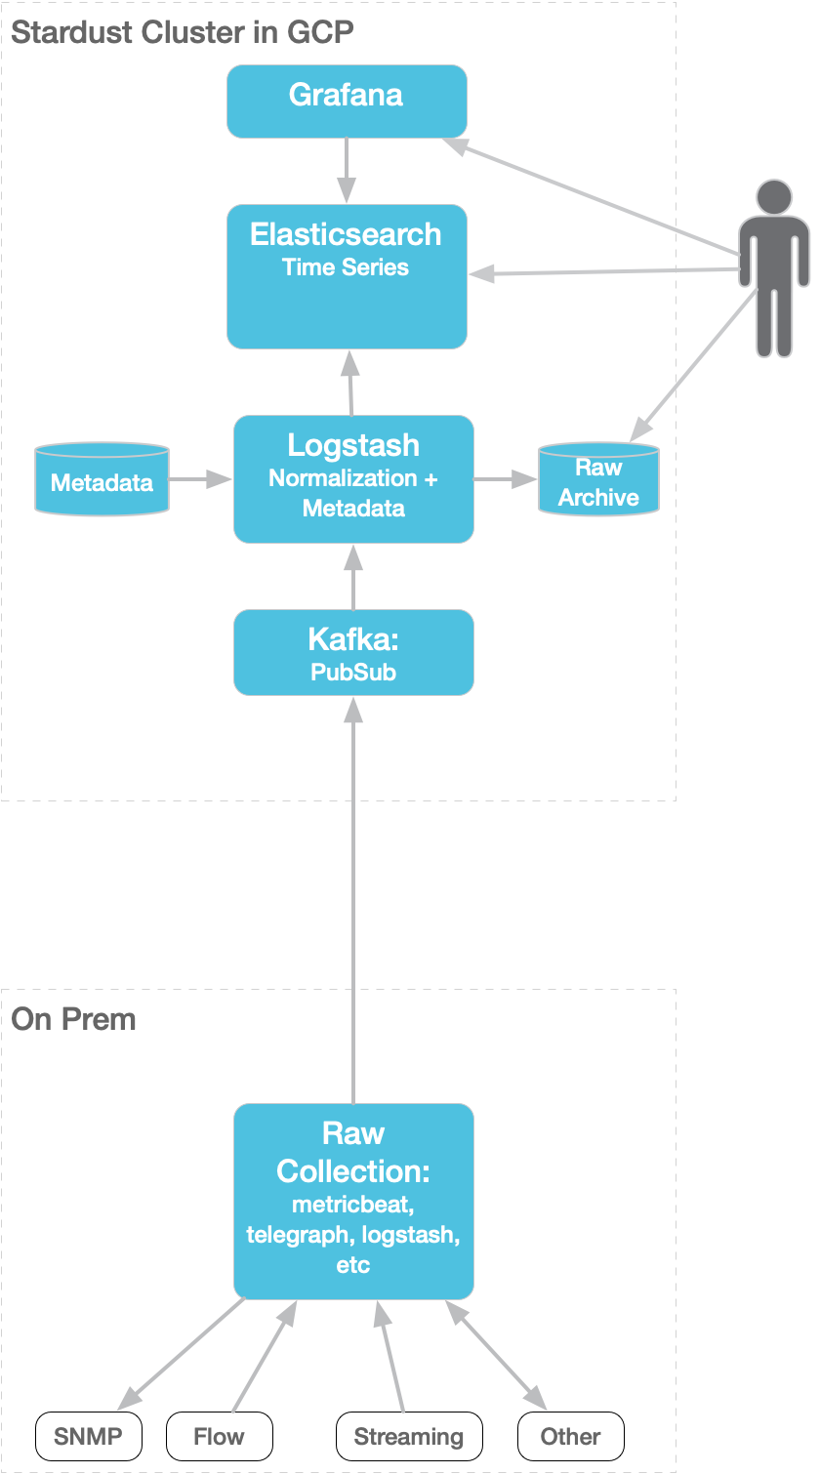
Network Measurement and Analysis for ESnet
Extensible / Open Architecture
NSF NetSAGE project derived approach
Telegraf
Pmacct
Kafka
Logstash
Elasticsearch
Grafana
Multiple access methods
Dashboards, Indexed APIs and “Raw”
Grafana based predefined and user definable dashboards
Elasticsearch based query API
Kafka pre and post ingest topics
Multi Datasource
Low and High cardinality Time Series
Network Flow and BGP
High Touch
SNMP
Optical Perf
perfSONAR
Flexible aggregation
Variable time and metadata dimensions
Examples:
Aggregate flows by Src and Dst AS matrix
Retain 5 min granularity for 2 years
Retain daily granularity for 10 years
Aggregate interface data by ckt and router adj
Retain 1 min granularity for 2 years
Retain 1 hr granularity for 10 years
Notes:
NetSage provides a powerful and flexible arch for adapting different use cases ESnet had an immediate need to replace legacy flow system. After comparing a number of options decided on a netsage-derived approach Additional use cases such as peering analysis required integration of BGP data Adapting to other data sources, will replace Netbeam at end of quarter Proven highly flexible for “telling different stories”, such as tailored dashboards for ESnet portion of LHC data challenge More at talk next week

Slide 28
Other crazy ideas?
NetSage for VLBI?
NetSage for SCinet??
NetSage for your house???
Or not. You...probably don’t want to know every flow in and out of your house.
The point is, anywhere you want to ask questions about network data, NetSage has an application and is flexible enough to adapt.

Slide 29
Existing NetSage Examples
https://netsage.global
International circuits
Regional R&E networks
Datacenter archives
Look and feel is similar, but Dashboards are added/removed depending on use case

Slide 30
Questions? Comments?
Doug Southworth - NetSage troublemaker (and occasional developer)
dojosout@iu.edu

