Slide 2
The briefing
Test the new Bella link: 100G link from Portugal to Fortaleza (Brazil)
Isolate routing issues
Tune perfSONAR hosts
Find how MTU, congestion window, an other tuning can affect the transfers.
Pace transfers to zero retransmissions
Could we drive a consistent 80 Gbps TCP throughput through the link?
The host used in the tests:
SURF perfSONAR host: ps2.netherlight.net
Fortaleza perfSONAR host: nfor.rnp.br

Slide 3
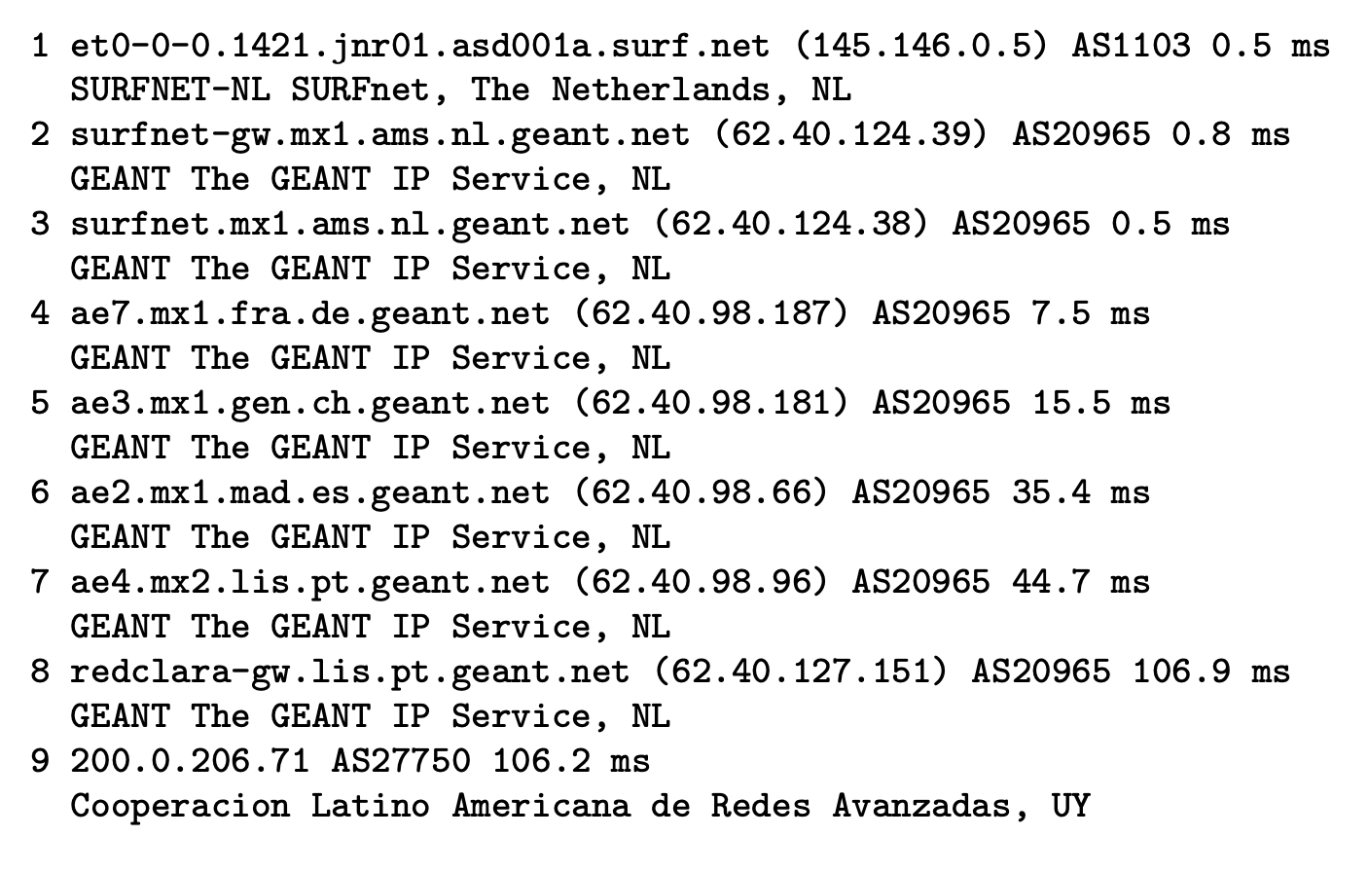
The path

Slide 4
Impact of MTU 9000
SURF and the hosts in the RNP all have MTU equal to 9000.
ICMPv6 is correctly configured and PMTUD was never an issue. SURF is IPv4 only.
The question: can increasing the MTU from 1500 to 9000 improve a host’s performance?
Simulated the limitation on MTU using pscheduler option –mss=1500
Disclaimer: I run a WLCG site using MTU at 1500. It works fine if you have a twenty plus storage system.
Important notice: all plots shown come from the SURF streaming telemetry system.

Slide 5
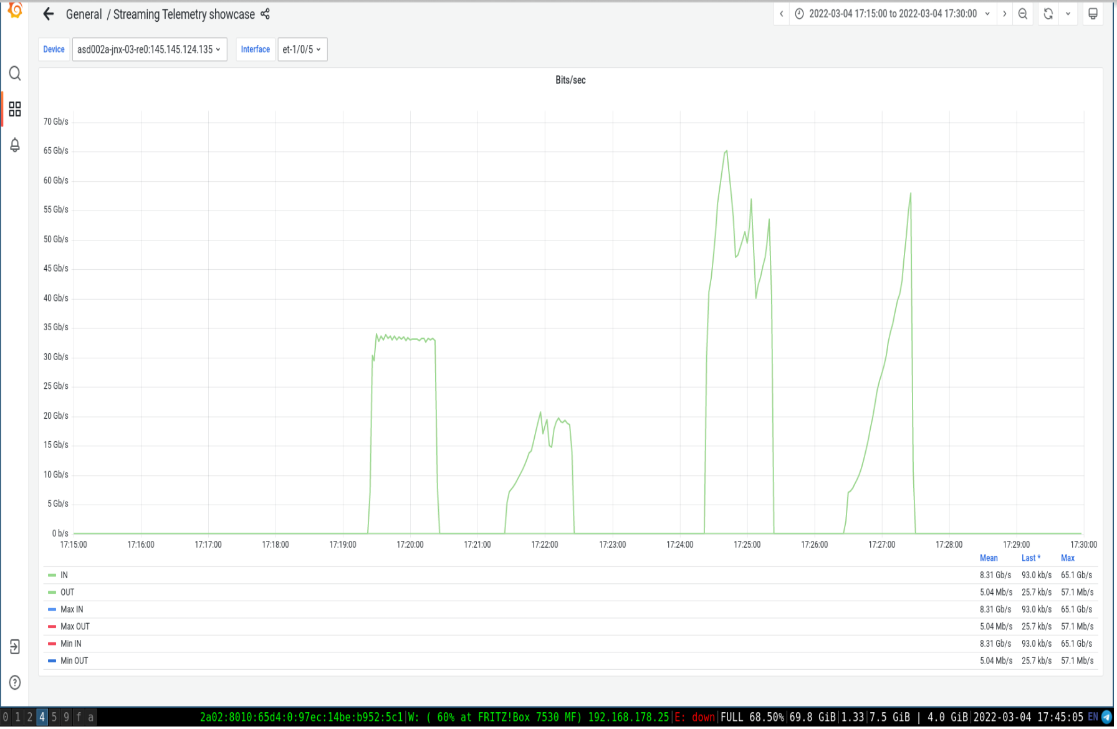
MTU: iperf3 and iperf2: SURF to Fortaleza
iperf3: two left columns: 9000 and 1500
iperf2: two right: 9000 and 1500 (iperf2 problems with mss setting?)

Slide 6
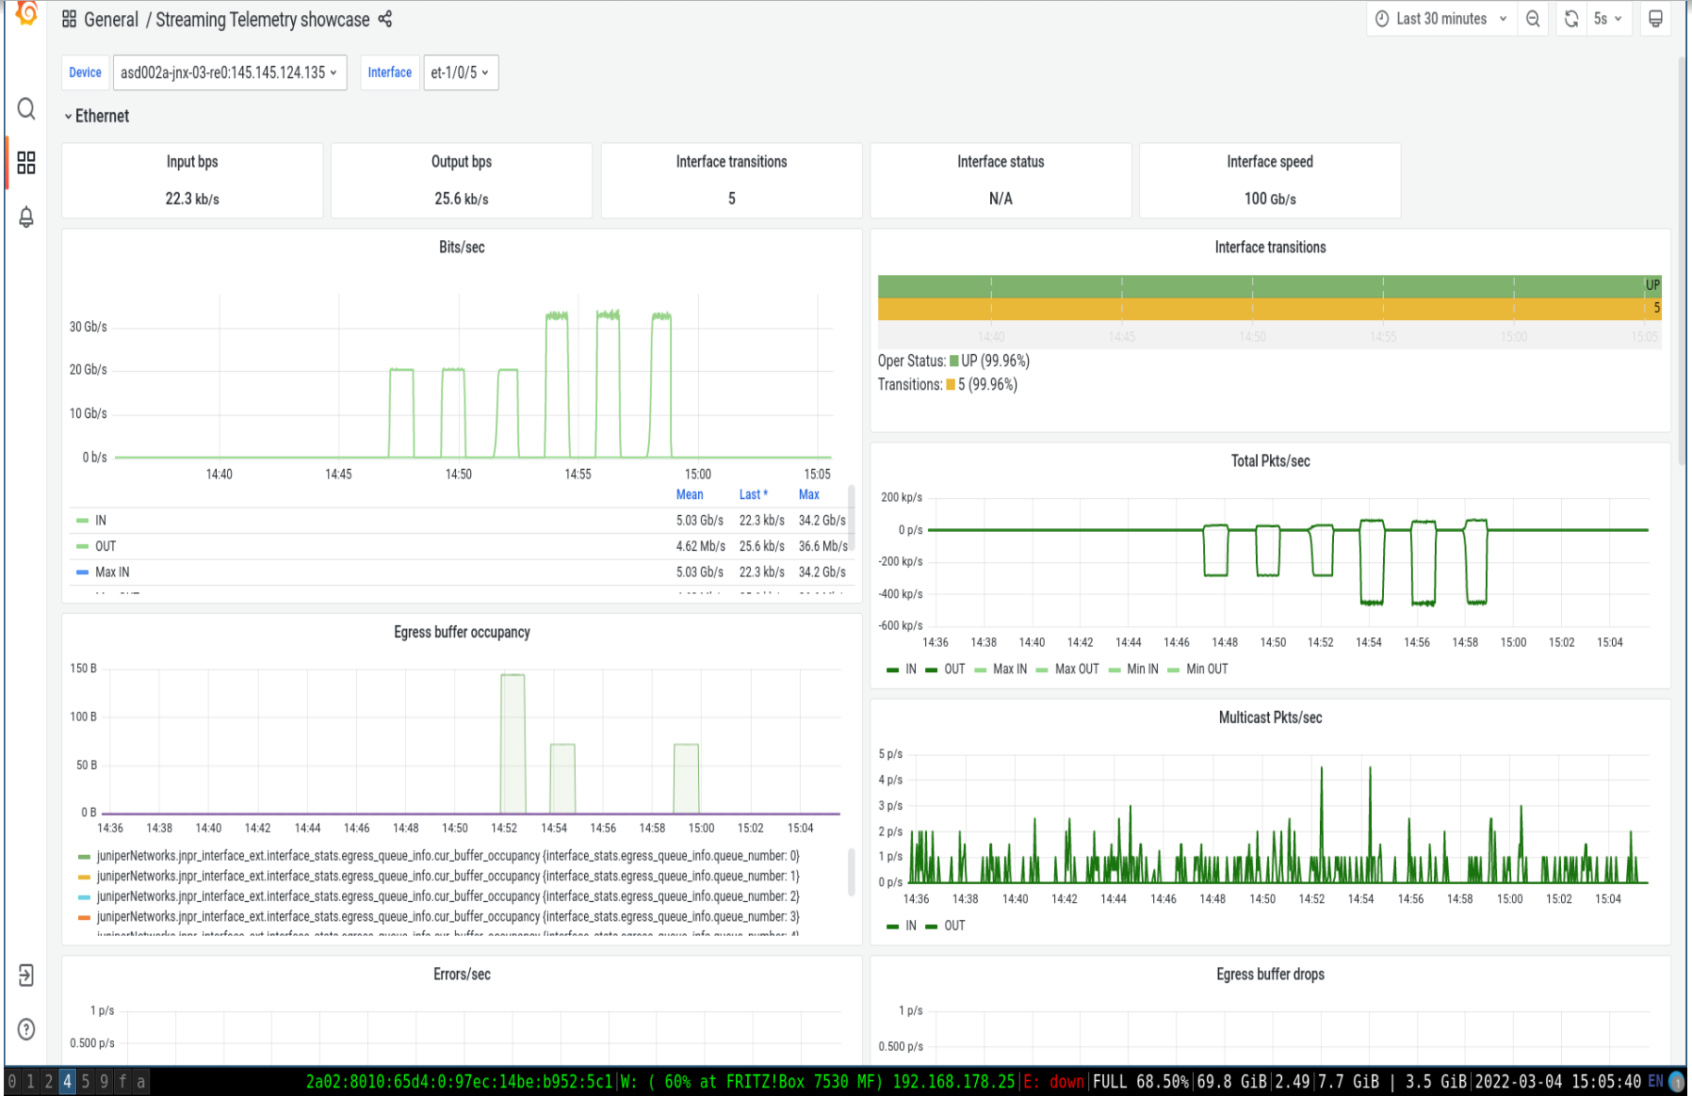
Effect of the Congestion Window Algorithm (CWA)
CWA: reno, htcp, cubic
iperf3 (first 3 curves) and iperf2
4 streams and 64M socket length

Slide 7
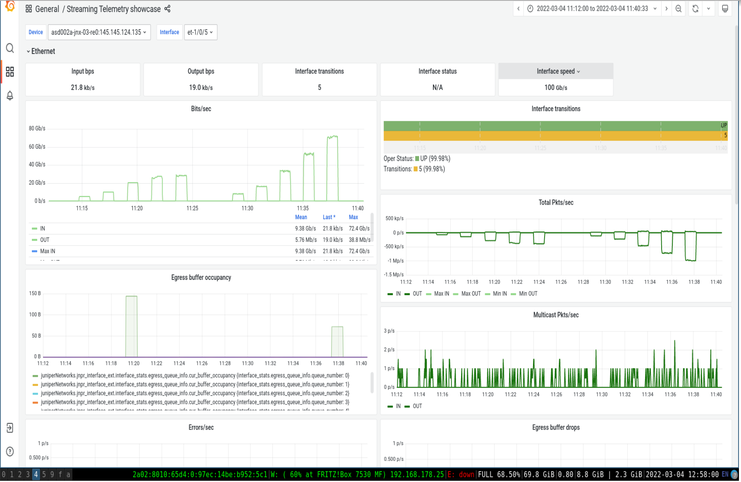
Parallel Streams
number of streams: 1, 2, 4, 6 8
iperf3 (first 5 curves) and iperf2
htcp and socket at 64Mb.

Slide 8
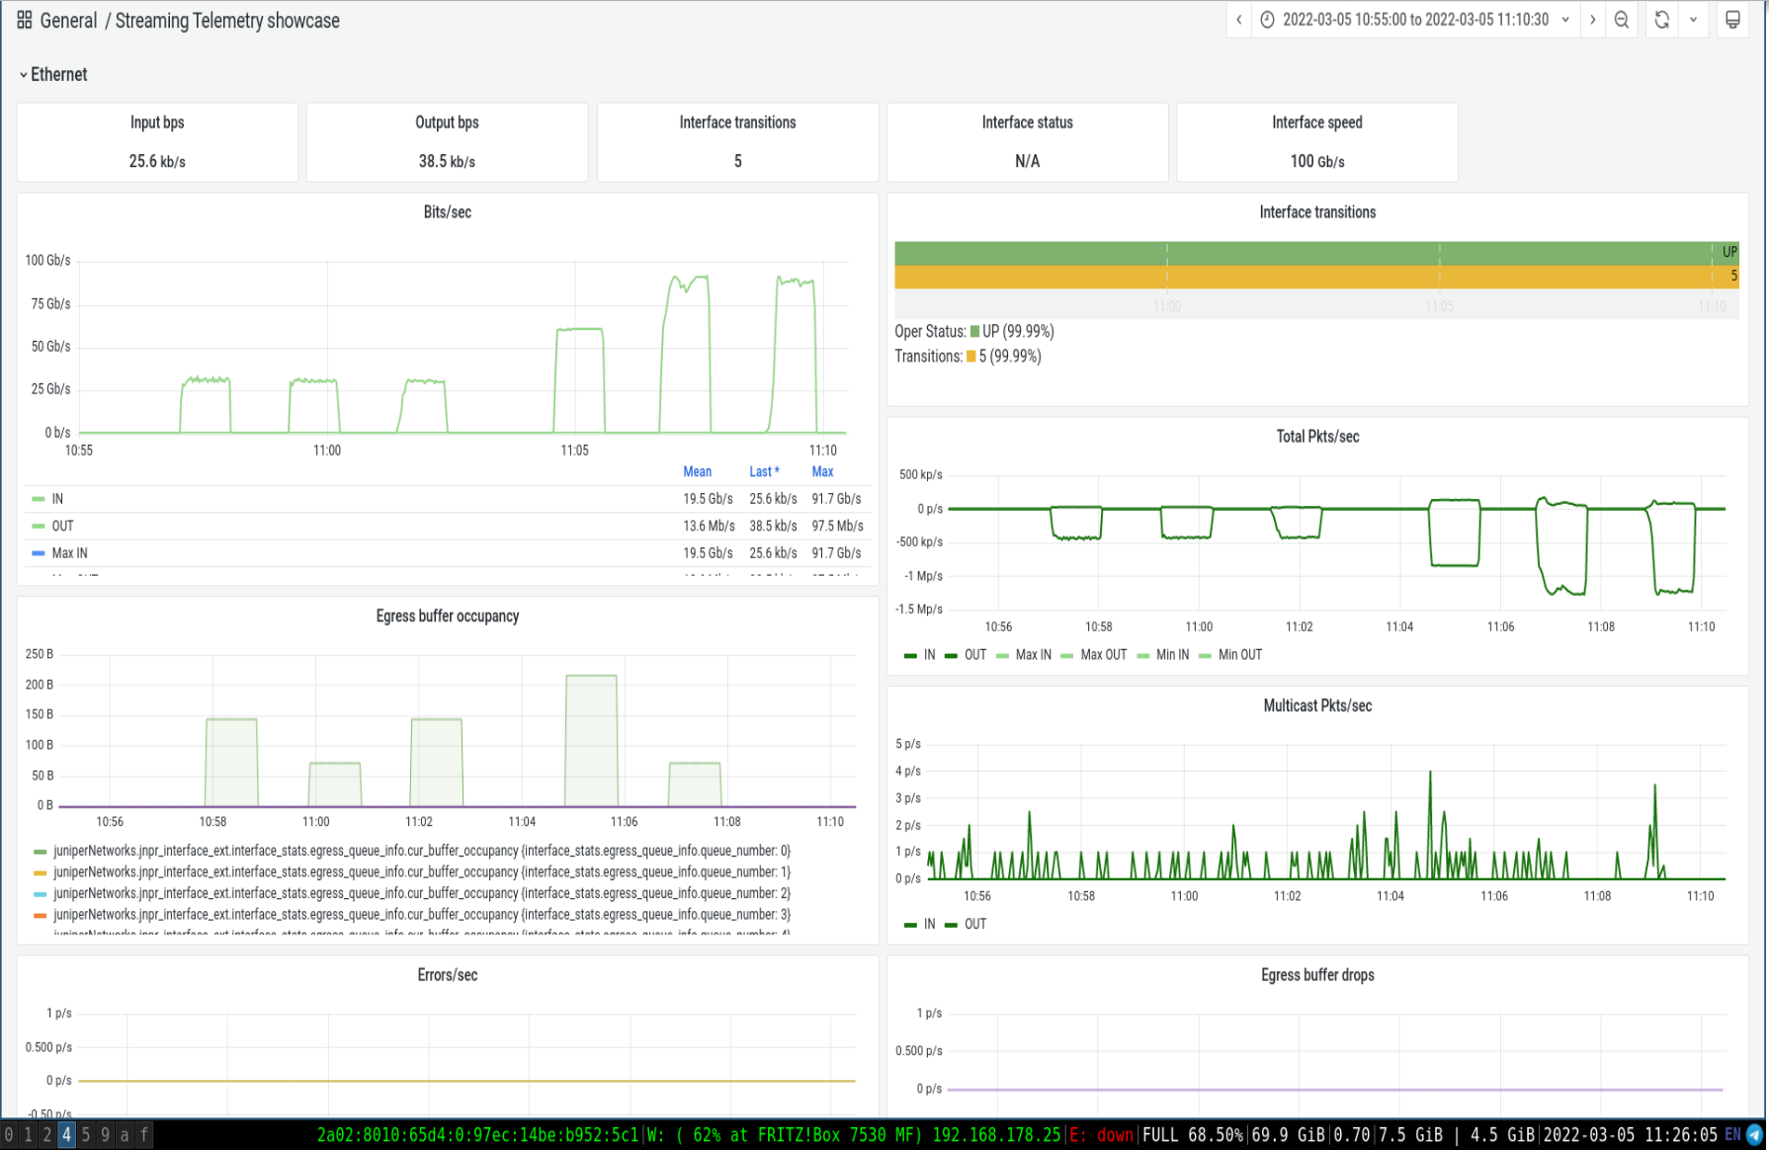
Six Parallel Streams, but…
number of streams: 6
CWA: reno, htcp, cubic
iperf3 (first 3 curves) and iperf2
socket at 128Mb

Slide 9
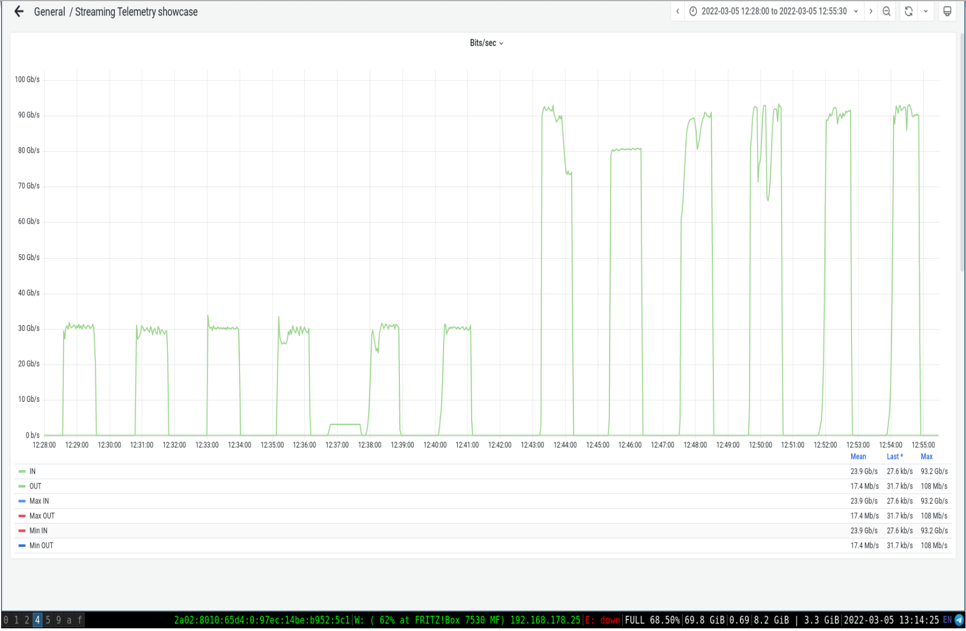
Six Parallel Streams, but…
number of streams: 6, 8
CWA: reno, htcp, cubic
iperf3 (first 3 curves) and iperf2
socket at 128Mb

Slide 10
The issues
Routing from to RNP was flipping between Bella link and USA
Corrected by Max Mudde and GÉANT colleagues in December
BGP issues affecting transfers to São Paulo and Salvador
Corrected by RNP in January
Present state
Transfers to Fortaleza on 2 streams with zero retransmits any time.
pscheduler tests using iperf3 deliver consistent 30 Gbps
Asymmetry to be investigated: transfer from SURF to Fortaleza show much less retransmits than the other way round.

Slide 11
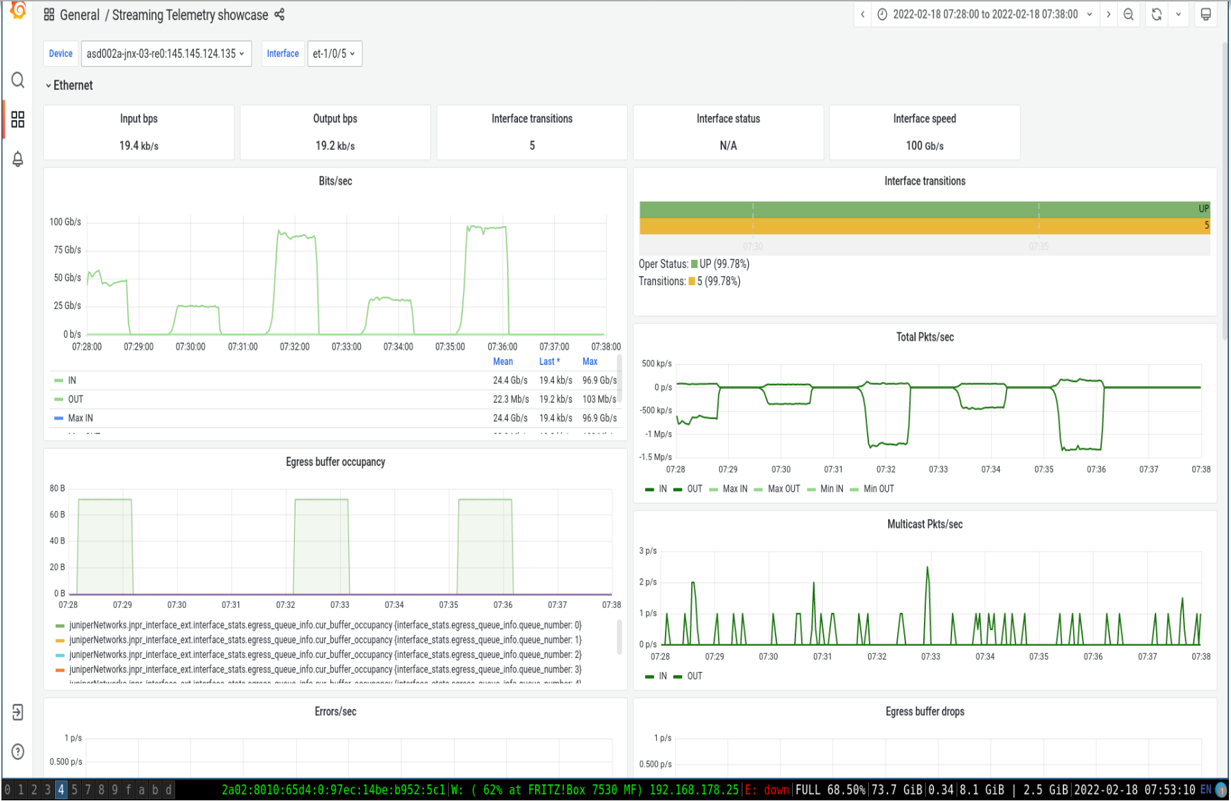
SURF to Fortaleza: 96 Gbps on SURF telemetry system
iperf2 (07:36): cubic 6 streams (no gain with 8) and 256M socket
htcp (07:32) slightly lower

Slide 12
Team involved
RNP: Marcus Schwartz, Jeferson Souza
SURF: Max Mudde
Jisc Netperf: David Richardson, Tim Chown, Duncan Rand

Slide 13
To come: Report covering experiments with RNP, USA, Europe

